Slide 1
VLDB 2020
Query Performance Prediction for Concurrent Queries using Graph Embedding
Xuanhe Zhou, Ji Sun, Guoliang Li, Jianhua Feng Department of Computer Science, Tsinghua University, Beijing, China

Slide 2
Introduction
Query performance prediction
transaction scheduling, parameter tuning, and progress monitoring
Traditional prediction methods
for single queries
cannot effectively predict the performance for concurrent queries
Performance prediction for concurrent queries
BAL (SIGMOD 2011)
captures logical I/O metrics
neglects many resource-related features
cannot effectively predict the performance
DL (PVLDB 2019)
uses neural units to learn from query plans
does not consider many potential relations between concurrent queries

Slide 3
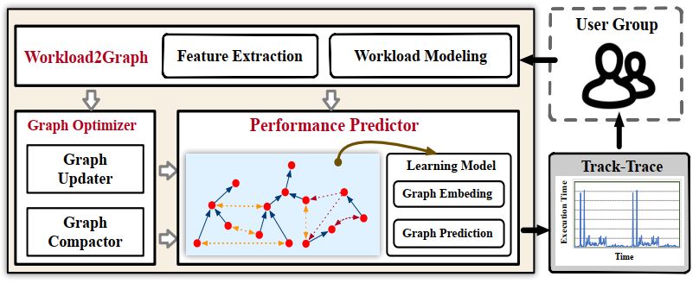
System Overview
Gpredictor
provides real-time query performance prediction for concurrent and dynamic workloads

Slide 4
Graph Model
Vertices
Physical operators in the query plans
Edges
There is an edge between two operators if they satisfy one of the following relationships:
parent-child relationship in the same query plan
data-sharing: they access the same data, i.e., visiting the same table or index
data-conflict: they have read-write/write-write access conflicts
resource-competition: they compete the resource at the same time, e.g., competing memory, CPU, I/O bandwidth

Slide 5
Graph Model
Vertice Modeling
Each vertex contains key features of the corresponding operator.
Estimated Cost
use the cost values provided by the database optimizer to estimate the actual execution cost
Operator Type
including aggregation, hash join, sequential scan
encode operation types into one-hot

Slide 6
Graph Model
Vertice Modeling
Predicates
the filter/join conditions in an operator
predicates affect the cost of operator execution
predicates can capture the similarity of data access
encode each condition in the predicate into a one-hot vector and then concatenate these vectors in a depth-first order
Sample Bitmap
sample some tuples for each table
provide an approximation of the query cost
010
OR
id > 225
AND
001
011 001 11100001
id < 50
Name <> ‘Fan’
010 001 110010
101 010 11110011
id > 225 or id < 50 and name <> ‘Fan’
010 011 001 11100001 001 010 001 110010 101 010 11110011

Slide 7
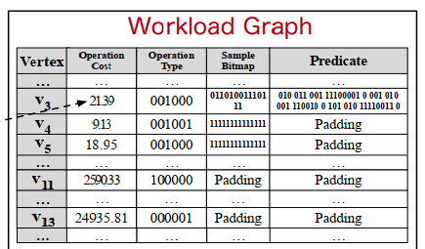
Graph Model
Vertice Modeling

Slide 8
Graph Model
Edge Modeling
The execution of concurrent queries has the following features:
There are data dependencies between operators in the same query plan.
Data in the shared buffer is available for multiple queries, bringing in data sharing and conflicts.
Resources allocation is affected by database configurations (e.g., Work_Mem, Max_Connections).
Four types of correlations to add edges:
parent-child relationship in the same query plan
data-sharing: they access the same data, i.e., visiting the same table or index
data-conflict: they have read-write/write-write access conflicts
resource-competition: they compete the resource at the same time, e.g., competing memory, CPU, I/O bandwidth

Slide 9
Graph Model
Edge Modeling
Parent-Child Relationship
The start time of a parent vertex depends on the finish time of its children.
The resource usage of a parent vertex depends on the result size passed from its children.
Data Sharing
Index Sharing
on the same table aka_name, both Hash Scan (id > 90) and Hash (id=100) can use the index index_id of aka_name
Table Sharing
If one query operator loads the table (or a part) into memory, other query operators can utilize the cached data.
Intermediate Results Sharing
The vertex with the same sub-tree in the query plan will share the same intermediate results.

Slide 10
Graph Model
Edge Modeling
Data Conflict
The conflict data may be locked and this will affect the concurrency.
If two operators manipulate the same data and at least one of them is a write operator, there could be data-conflict relationship between them.
Resource Competition
For analytical queries, memory size is usually the bottleneck.
For transactional tasks
The concurrency level is limited by the maximal connection threshold.
I/O bandwidth can be the bottleneck.
Mainly consider memory, CPU, and I/O bandwidth competitions.

Slide 11
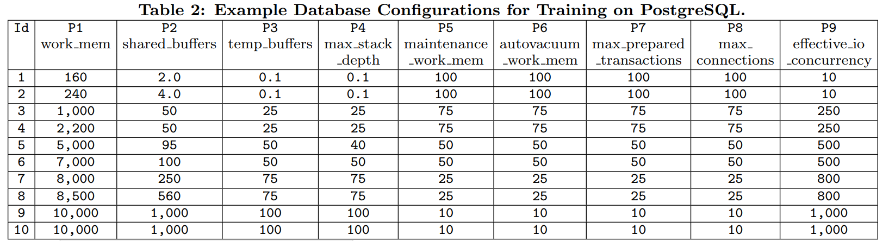
Graph Model
Notes:
Work_mem:设置在写入临时磁盘文件之前查询操作(例如排序或哈希表)可使用的最大内存容量。
Shared_buffer:设置数据库服务器将使用的共享内存缓冲区量。
Temp_buffer:为每个数据库会话设置用于临时缓冲区的最大内存.
Max_stack_depth:指定服务器的执行堆栈的最大安全深度。
Maintenance_work_mem:指定在维护性操作（例如VACUUM、CREATE INDEX和ALTER TABLE ADD FOREIGN KEY）中使用的 最大的内存量。
Autovacuum_work_mem:指定每个自动清理工作者进程能使用的最大内存量。
Max_prepared_transactions:设置可以同时处于prepared状态的事务的最大数目
Max_connections:决定数据库的最大并发连接数。
Efective_io_concurrency:可以同时被执行的并发磁盘 I/O 操作的数量.

Slide 12
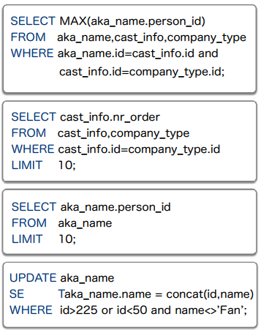
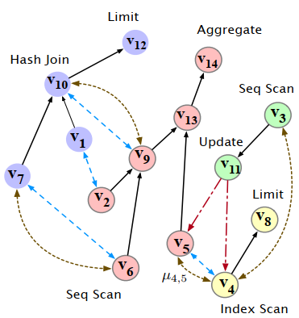
Graph Model

Slide 13
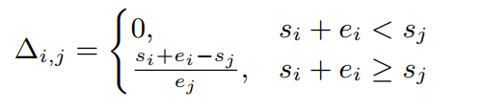
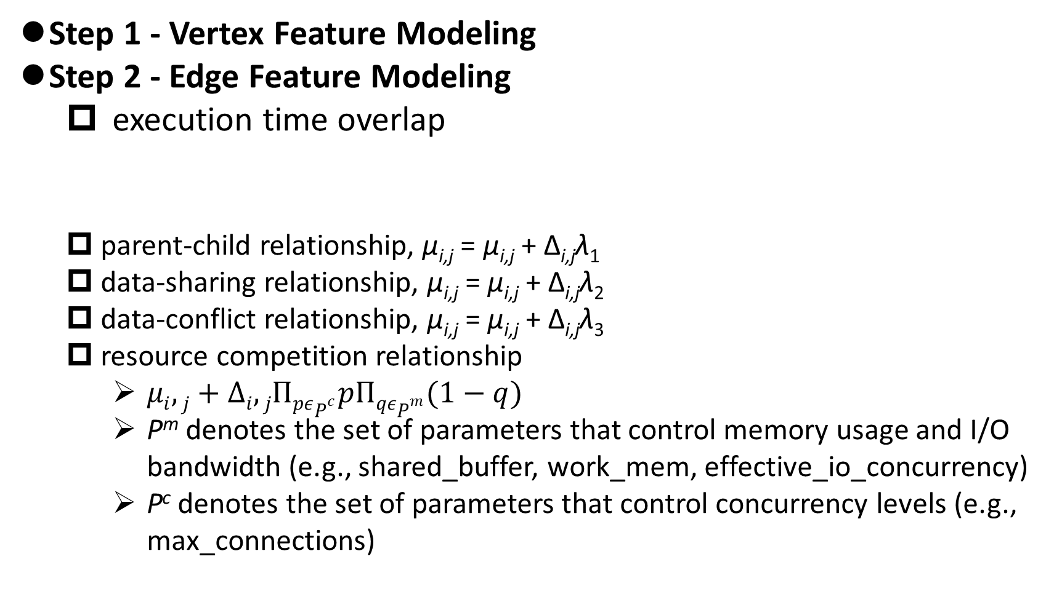
Graph Construction
Step 1 - Vertex Feature Modeling
Step 2 - Edge Feature Modeling
execution time overlap
parent-child relationship, µ_{i,j} = µ_{i,j} + ∆_{i,j}λ₁
data-sharing relationship, µ_{i,j} = µ_{i,j} + ∆_{i,j}λ₂
data-conflict relationship, µ_{i,j} = µ_{i,j} + ∆_{i,j}λ₃
resource competition relationship
$μi,j+∆i,jΠpεP^{c}pΠqεP^{m}(1−q)$
P^{m} denotes the set of parameters that control memory usage and I/O bandwidth (e.g., shared_buffer, work_mem, effective_io_concurrency)
P^{c} denotes the set of parameters that control concurrency levels (e.g., max_connections)

Slide 14
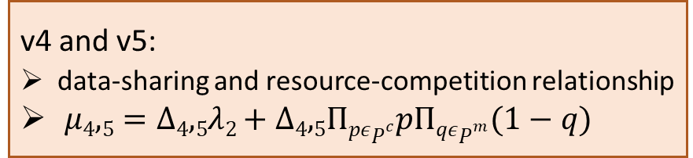
Graph Construction
For example
v4 and v5:
data-sharing and resource-competition relationship
$μ4,5=Δ4,5λ2+Δ4,5ΠpεP^{c}pΠqεP^{m}(1−q)$
Notes:
例子

Slide 15
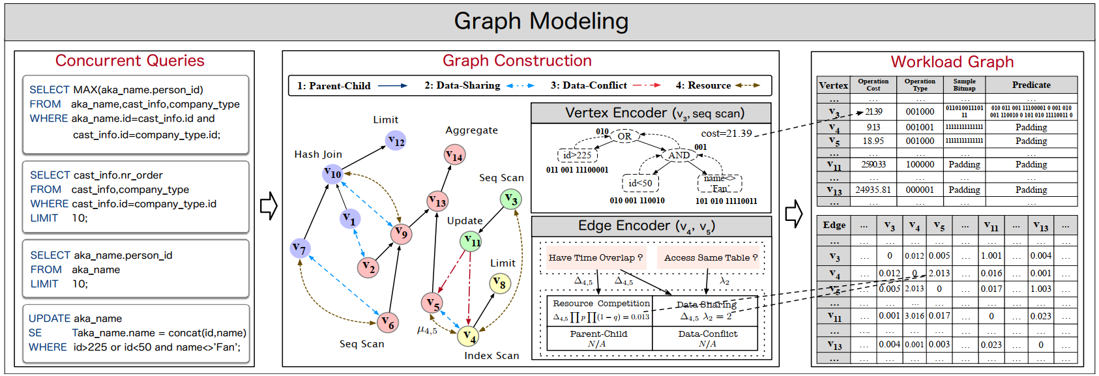
Graph Model

Slide 16
Performance Prediction
Challenges
The performance-related features are sparsely scattered in the graph.
Traditional graph traversal algorithms either directly encode the graph or choose random paths, and may not extract useful features.
The prediction is of high dimension and traditional regression methods are time consuming.
In high concurrency scenarios, a graph may have thousands of vertices.
Graph Embedding
图嵌入是一种将图数据（通常为高维稠密的矩阵）映射为低微稠密向量的过程，能够很好地解决图数据难以高效输入机器学习算法的问题。

Slide 17
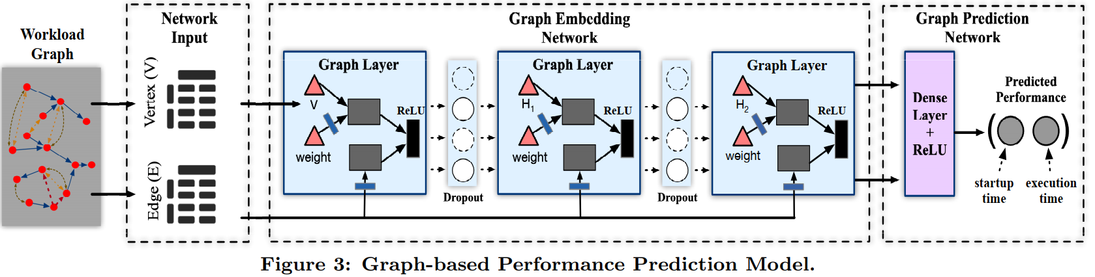
Performance Prediction
Graph Embedding Network
embed each vertex into a vertex vector that captures both the vertex features and edge features
Graph Prediction Network
predict the performance based on the embedding vector
three-layer: input/hidden/output
(st_{i}, et_{i})

Slide 18
Model Training
Training Data
a set of tuples <Q, p^{m}, p^{c}, P>
for example
JOB dataset: 20,187 SQL queries
mix them into 1000 queries with concurrency from 10 to 100, split into training, validating, testing sets by 8:1:1
Train the prediction model by updating the layer weights with the loss values.
After the performance converges or arriving the maximum training iterations, we test the performance on validation set.
After running out of training samples or the performance is steady, we test the prediction model on the testing set.

Slide 19




Model Training
Loss Function
Label 80% vertices with real performance.
To reflect the prediction accuracy, calculate the loss on labeled vertices using the Mean Squared Error (MSE):
To smooth the prediction results across different vertices, calculate the loss on unlabeled vertices as a Laplacian regularization term:
Overall loss function

Slide 20
Graph Update
Φ: store operators with the earliest end time
Case 1: add a new query
Add operators in the query as new vertices on the graph.
For each vertex, find correlated vertices from the graph and add edges to these vertices.
Run the graph embedding and graph prediction algorithms to predict the performance.
Update Φ by adding the operators with the earliest finish time, which is predicted by the performance model.
Case 2: remove some finished operators
When Φ = φ, remove the finished operators and the corresponding edges from the graph.
Run the embedding and prediction algorithms to predict the performance.
Add the operators with the earliest finish time to Φ.

Slide 21
Graph Compaction
We only need the overall performance of queries, depending on the longest path in the query tree from a leaf to the root.
Compact several vertices into a compound vertex.
The execution time of any two vertices has overlap.
Any two vertices have no parent-child/data-sharing/data-conflict relationships.
Graph Compaction Problem
Given a graph G(V, E), we aim to generate a graph G’(V’, E’) with the minimum vertex size.
Any vertex in v ∈ V must be in a compound vertex v’ ∈ V’ .
For any edge (v, u) ∈ E, there exists an edge (v’, u’) ∈ E’ where v and u are in compound vertices v’ and u’ respectively.
NP-hard

Slide 22
Graph Compaction
Compaction Algorithm
Step 1: Grouping Vertices with Time Overlap.
Sort the vertices based on their start time.
Scan the vertices in order.
Take the first vertex as a group which has a time span (start time, end time).
Visit the second vertex.
If the second vertex has time overlap with the first vertex, we group them together and update the time span; otherwise we take the second vertex as a new group.
Step 2: Splitting Groups into Compound Vertices.
Enumerate the vertices.
Take the first vertex as a compound vertex.
For the second vertex, if it has an edge with the first vertex; we take it as the second compound vertex; otherwise, we compact it into the first compound vertex.

Slide 23
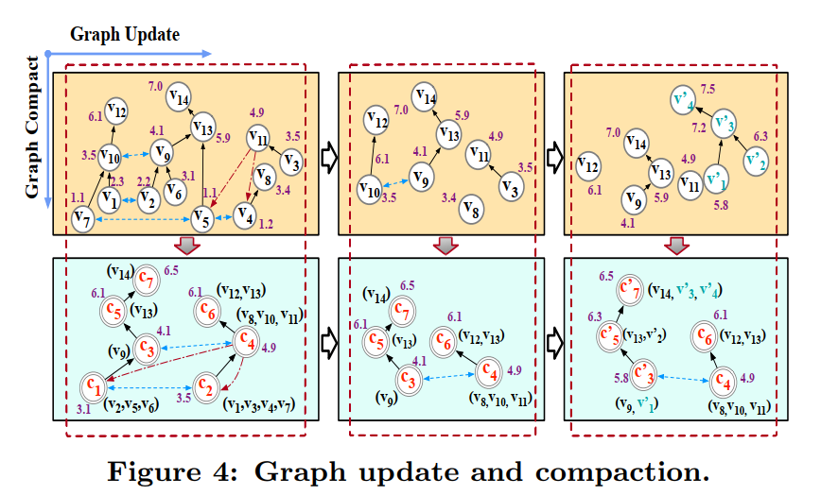
Graph Compaction

Slide 24
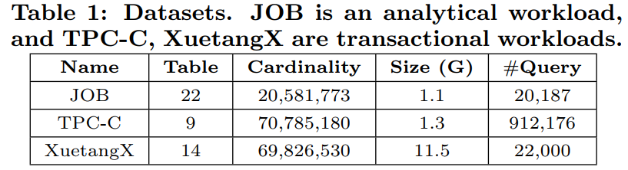
Experiments
Experiment Setting
Server: 128GB RAM, 5TB disk, 4.00GHz CPU
Database: PostgreSQL v11.1
Datasets

Slide 25
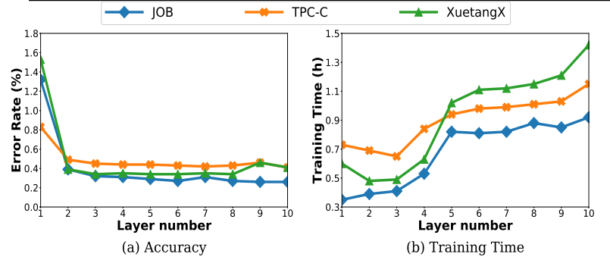
Experiments
Evaluation on Embedding Layers

Slide 26
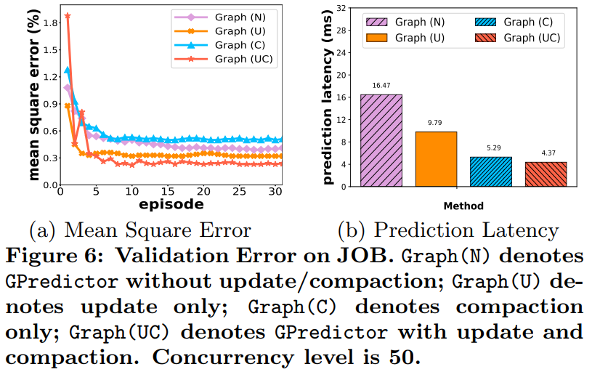
Experiments
Evaluation on Graph Update and Compaction

Slide 27
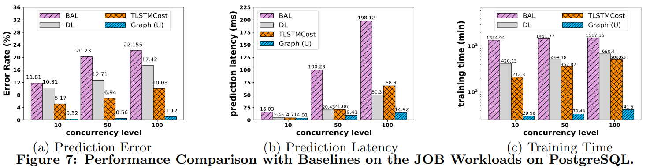
Experiments
Performance Comparison

Slide 28
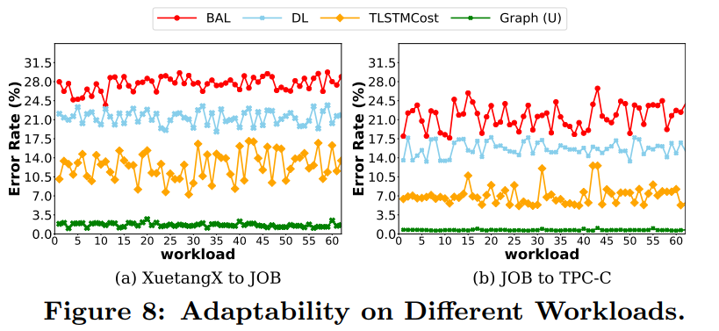
Experiments
Evaluation on Adaptability
Use the well-trained model on the training set of XuetangX to predict the test set of JOB.
Use the well-trained model on the training set of JOB to predict the test set of TPC-C.

Slide 29
Thank You!

