Slide 1
Spanner: Google’s Globally-Distributed Database
James C. Corbett, Jeffrey Dean, Michael Epstein, Andrew Fikes, Christopher Frost, JJ Furman, Sanjay Ghemawat, Andrey Gubarev, Christopher Heiser, Peter Hochschild, Wilson Hsieh, Sebastian Kanthak, Eugene Kogan, Hongyi Li, Alexander Lloyd, Sergey Melnik, David Mwaura, David Nagle, Sean Quinlan, Rajesh Rao, Lindsay Rolig, Yasushi Saito, Michal Szymaniak, Christopher Taylor, Ruth Wang, Dale Woodford
Google, Inc.

Slide 2


Part 1
Introduction
目录
System Implementation
Part 2
Contents
Part 3
TrueTime
Part 4
Concurrency Control
Part 5
Evaluation

Slide 3
Spanner
Distributed database
Scalable
Multi-version
Globally-distributed
Synchronously-replicated
Support externally-consistent distributed transactions
Support
Non-blocking reads in the past
Lock-free read-only transactions
Atomic schema changes

Slide 4
Spanner
Semi-relational data model
Schematized tables
SQL query language
General-purpose transactions (ACID)
Data is versioned

Slide 5
Spanner’s Features
The replication configurations for data can be dynamically controlled at a fine grain by applications.
It provides externally consistent reads and writes, and globally-consistent reads across the database at a timestamp.
New TrueTime API exposes clock uncertainty

Slide 6
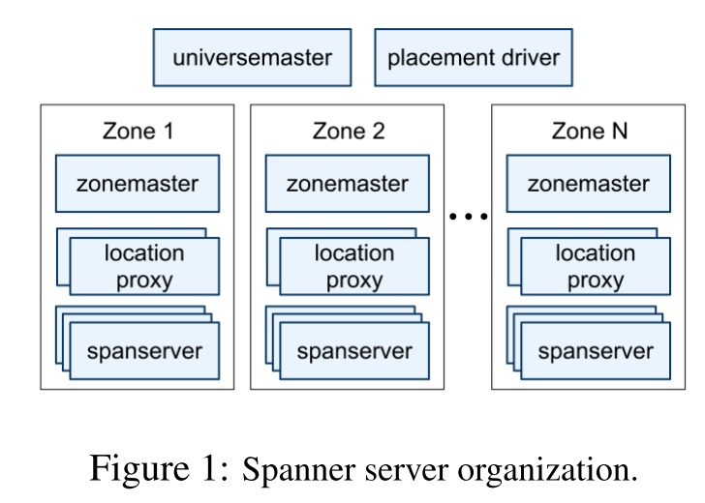
Spanner Organization
Universe: A Spanner deployment
Universe master: zones’ status information
Placement driver: automated movement of data across zones
Zones: the unit of administrative deployment
Zonemaster：assigns data to spanservers
Spanservers：serve data to clients
Location proxies
Notes:
Console 交互式debugging

Slide 7
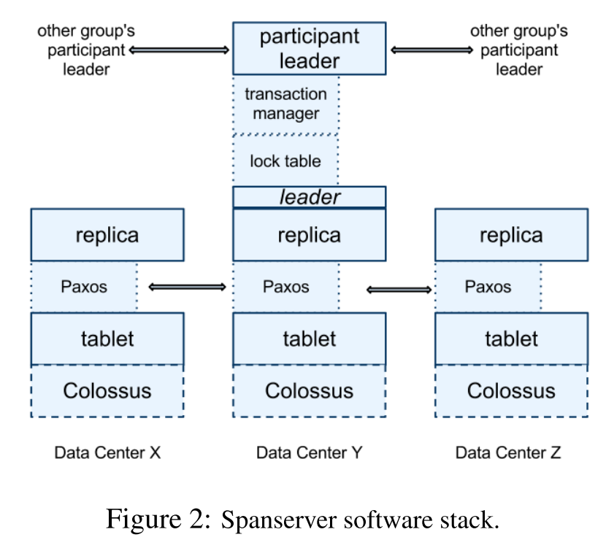
Spanserver Software Stack
Introduction
System Implementation
TrueTime
Concurrency Control
Evaluation
Tablet
(key:string, timestamp:int64) → string
Colossus
Lock table
Transaction manager
Support distributed transactions
Notes:
Tablet状态和wal存在colossus中

Slide 8
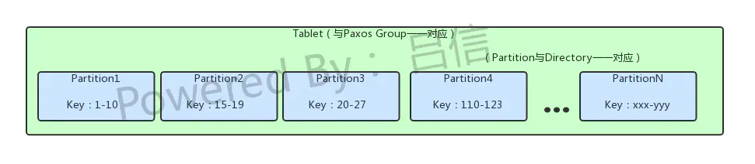
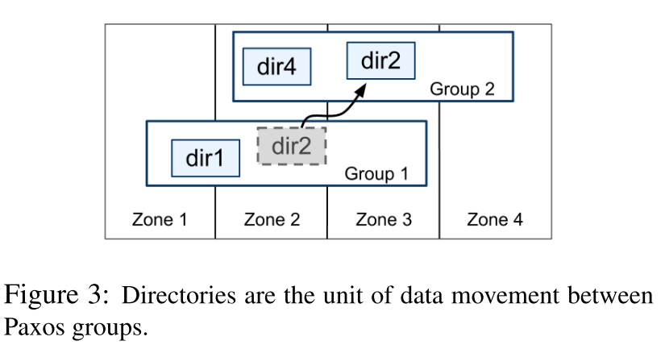
Directories and Placement
Directory: which is used to manage replication and locality，the unit of data movement
Put directories that are frequently accessed together into the same group
Move a directory into a group that is closer to its accessors
Fragments: Spanner will shard a directory into multiple fragments if it grows too large
Notes:
a Spanner tablet is a container

Slide 9
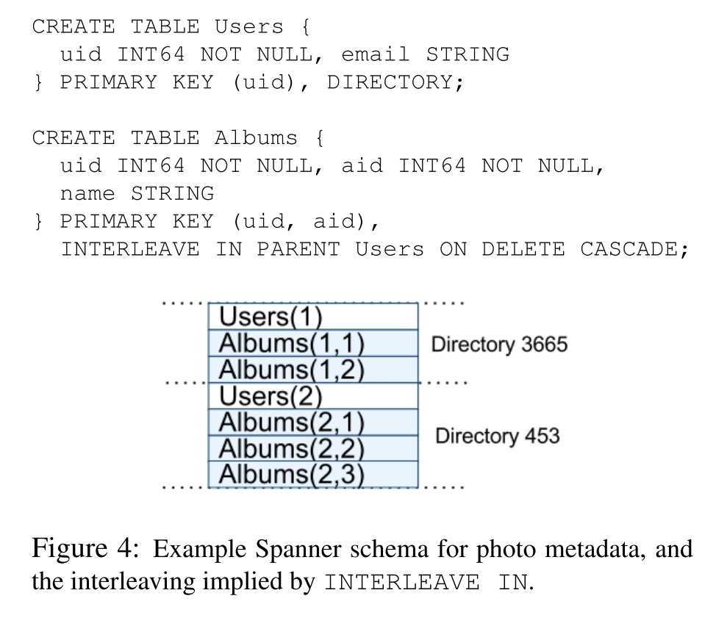
Data Model
Support schematized semi-relational tables
(key:string, timestamp:int64) → string
Support a SQL- like query language
Hierarchies of tables
INTERLEAVE IN
Notes:
Spanner的表是层次化的，最底层的表是目录表，其他表创建的时候，可以用INTERLEAVE IN PARENT来表示层次关系
通过交错表，spanner才知道各个表之间的局部关系

Slide 10
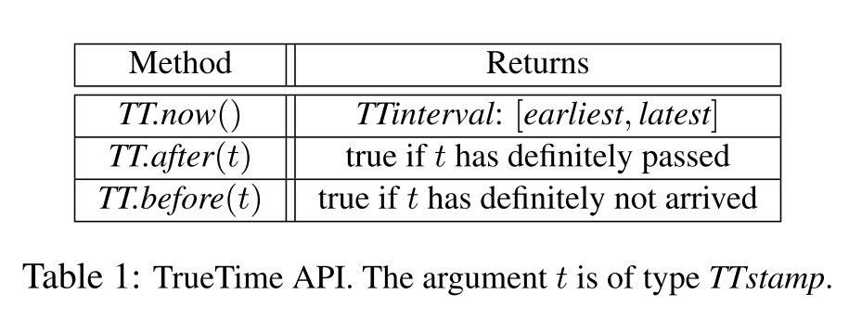
TrueTime Concept
“Global wall-clock time” with bounded uncertainty
TT.now() -> now ± ε
TT.after(t) -> TT.now().earliest > t.now().latest
TT.before(t) -> TT.before().latest < t.now().earliest
TT.now()
time
earliest
latest
2*ε
Notes:
后台进程收集投票的间隔为30秒，当前的时钟频率的漂移比率为200微秒/秒，所以每轮投票间隔内，其时间不确定性的值就会在0到6ms之间来回波动。剩下的1毫秒主要是由于各个time master服务器之间的通讯延时产生的。

Slide 11
TrueTime Architecture
antenna and receiver failures
local radio interference
correlated failures
GPS timemaster
GPS timemaster
GPS timemaster
GPS timemaster
Atomic-clock timemaster
drift
GPS timemaster
Client
Datacenter 1
Datacenter 2
…
Datacenter n
time-master uncertainty
communication delay to the time masters
Compute reference [earliest, latest] = now ± ε
Notes:
Bad hosts are evicted
Timemasters check themselves against other timemasters
Clients check themselves against timemasters
时延
每个数据中心有一组time master机器，每个机器有一个timeslave进程
Client是再time slave daemon，和一部分timemaster进行交互；为了减少延迟，daemon会访问一部分本地time master；以防本地time master挂掉，会访问remote的time matser来备份；大多数访问GPS,但也会有原子钟来备份。

Slide 12
Timestamp Management
Paxos
Leader long-lived, 10s
Abdicate by releasing its slaves from their lease votes, TT.after(smax)
RW Transactions
For a given transaction, Spanner assigns it the timestamp that Paxos assigns to the Paxos write that represents the transaction commit.
External- consistency invariant:
If the start of a transaction T2 occurs after the commit of a transaction T1, then the commit timestamp of T2 must be greater than the commit timestamp of T1
Notes:
先讲如何paxos上时间戳分配的要求和如何分配时间戳给只读事务和读写事务，之后详细讲只读事务和读写事务再truetime这种新的技术下的执行
Smax是该leader的最大租期
Define the start and commit events for a transaction Ti by estart
i and ecommit i ; and the commit timestamp of a transaction Ti by si.

Slide 13


Timestamp Management
Serving Reads at a Timestamp
Every replica tracks a value called safe time t_safe which is the maximum timestamp at which a replica is up-to-date.
Former: the timestamp of the highest-applied Paxos write
Later :
∞ at a replica if there are zero prepared (but not committed) transactions
During 2PC
Assigning Timestamps to RO Transactions
Assign a timestamp s_read
Execute the transaction’s reads as snapshot reads at s_read
Notes:
A replica can satisfy a read at a timestamp t if t <= t_safe.
tTM safe may prevent tsafe from advancing. 都是single prepared事务，那么值集不增长了
t Paxos safe cannot advance in the absence of Paxos writes. May cause reads to block infinitely

Slide 14
Timestamps and TrueTime
RW Transactions
Acquired locks
Release locks
T
Pick s = TT.now().latest
s
Wait until TT.now().earliest > s
Commit wait
average ε
average ε
Notes:
读写事务
直到TT.now().earliest都大于s，说明所有的paxos group都好了
S的pick的话是取tt.now().latest，取最大的哪个

Slide 15
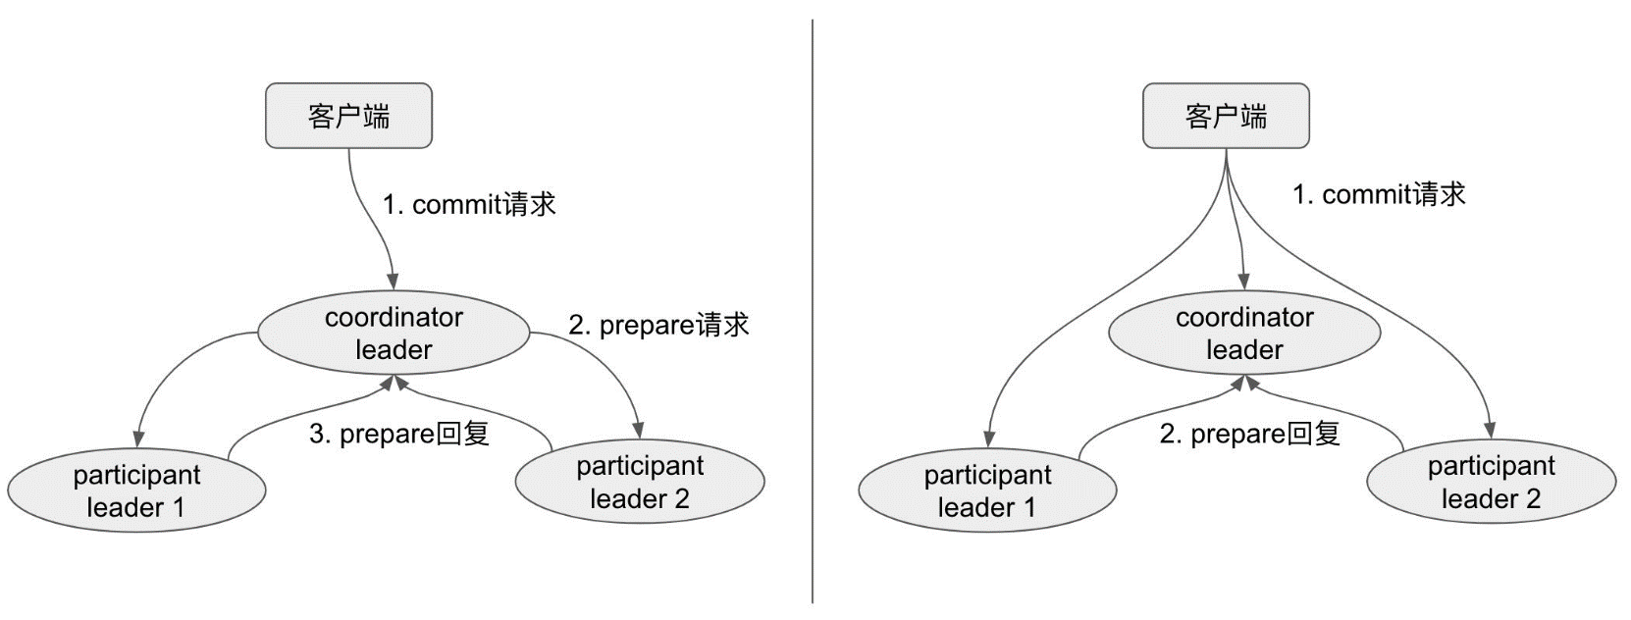
Read-Write Transactions
Start logging
Done logging
Acquired locks
Release locks
T_{C}
Committed
Notify participants of s
Acquired locks
Release locks
T_{P1}
Acquired locks
Release locks
T_{P2}
Prepared
Send s
Compute s for each
Commit wait done
Compute overall s
Commit Wait and 2-Phase Commit
Notes:
读写事务会把read给leader来获取读锁；当一个client完成一个事务的所有的读和缓存好所有的写之后开始两阶段提交【由client进行两阶段提交】（各个数据库在这个由谁进行2PC方面有所差异）
S是提交时间

Slide 16
Read-Only Transactions
Assigning a timestamp requires a negotiation phase between all of the Paxos groups that are involved in the reads.
Scope expression for every read-only transaction, which is an expression that summarizes the keys that will be read by the entire transaction.
Single Paxos group
Leader distribute timestamp s_read = LastTS() （the timestamp of the last committed write at a Paxos group）
Multiple Paxos groups
Do a round of communication with all of the groups’ leaders to negotiate sread based on LastTS()
S_read = TT.now().latest
Notes:
Commit wait causes commits to happen some time after the commit timestamp. I LastTS() causes reads to wait for commit wait
(which may wait for safe time to advance)

Slide 17
Schema-Change Transactions
Non-blocking variant of a standard transaction
Assigned a timestamp in the future[t], which is registered in the prepare phase
Reads and writes, which implicitly depend on the schema, synchronize with any registered schema-change timestamp at time t
now
t

Slide 18
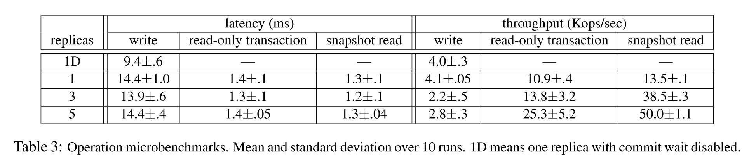
Microbenchmarks
Environment:
Spanserver = replica
Each spanserver ran on scheduling units of 4GB RAM and 4 cores (AMD Barcelona 2200MHz)
50 Paxos groups with 2500 directories
Operations were standalone reads and writes of 4KB
For the latency experiments, clients issued sufficiently few operations so as to avoid queuing at the servers.
For the throughput experiments, clients issued sufficiently many operations so as to saturate the servers’ CPUs.
Notes:
从复制，事务和可用性来评测spanner的性能

Slide 19
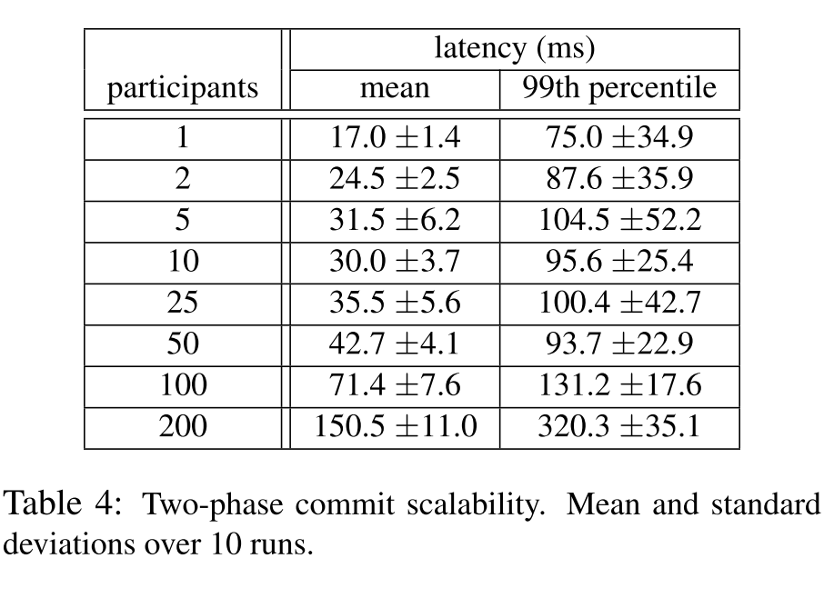
Microbenchmarks
Environment
3 zones, each with 25 spanservers
Two-phase commit

Slide 20
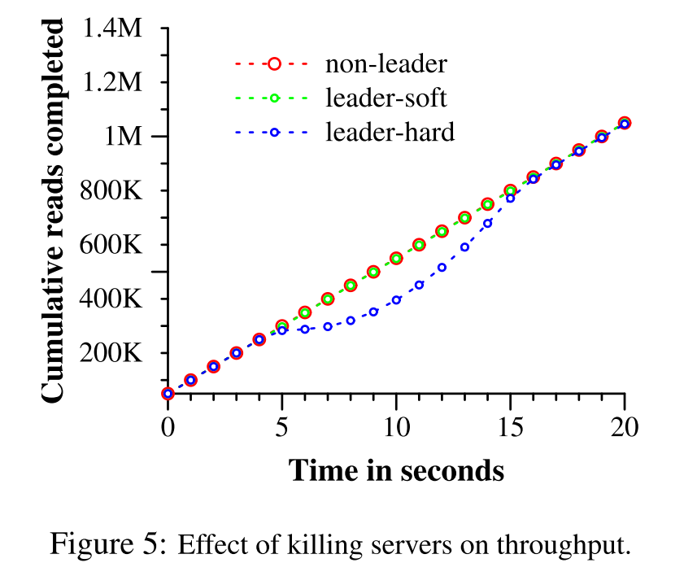
Availabilty
It shows the results of three experiments on throughput in the presence of datacenter failure
Environment:
5 zones Zi, each of which had 25 spanservers.
The test database was sharded into 1250 Paxos groups, and 100 test clients constantly issued non-snapshot reads at an aggregrate rate of 50K reads/second.
Non-leader: kills Z2
Leader-hard: kills Z1
Leader-soft: kills Z1, but it gives notifications to all of the servers that they should handoff leadership first

Slide 21
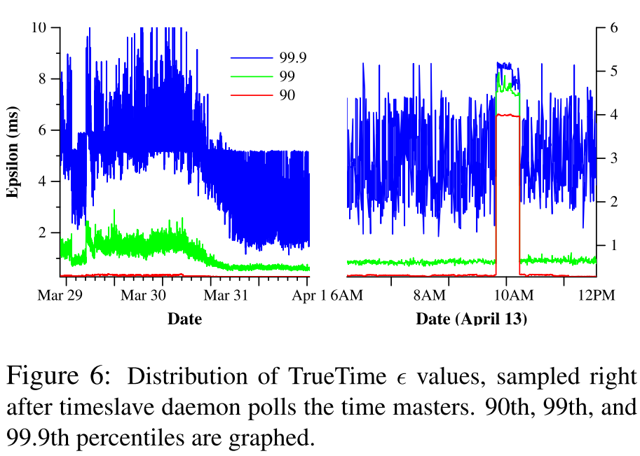
TrueTime
TrueTime data taken at several thousand spanserver machines across datacenters up to 2200 km apart.
Notes:
Two questions must be answered with respect to True- Time: is ? truly a bound on clock uncertainty, and how bad does ? get?
Figure 6 presents TrueTime data taken at several thousand spanserver machines across datacenters up to 2200 km apart.

Slide 22
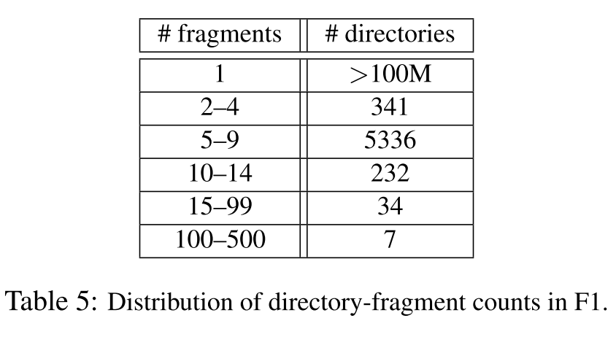
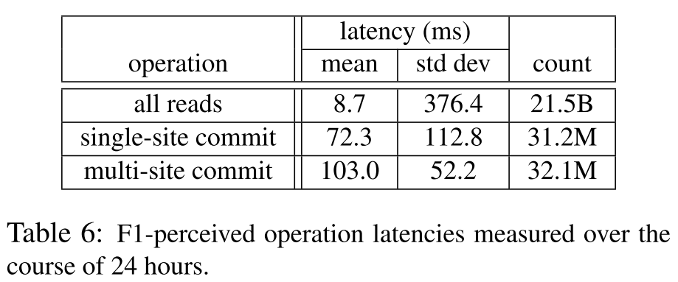
F1
The vast majority of directories (and therefore customers) consist of only 1 fragment, which means that reads and writes to those customers’ data are guaranteed to occur on only a single server.
The large standard deviation in write latencies is caused by a pretty fat tail due to lock conflicts.
Notes:
Table 5 illustrates the distribution of the number of fragments per directory in F1. Each directory typically corresponds to a customer in the application stack above F1. The

Slide 23


谢谢

