Slide 1

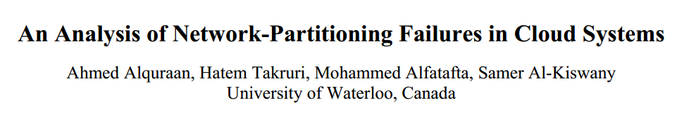


Slide 2
REASONS
Network-partitioning fault tolerance pervades the design of all system layers.
In production networks, network-partitioning faults occur as frequently as once a week and take from tens of minutes to hours to repair.
How these faults still lead to system failures.

Slide 3
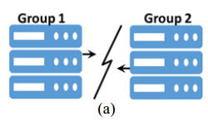
BACKGROUND
Types of Network Partitions
Complete network partitioning:
dividing the network into two disconnected parts

Slide 4
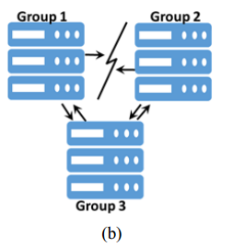
BACKGROUND
Types of Network Partitions Solution
Partial network partitioning:

Slide 5
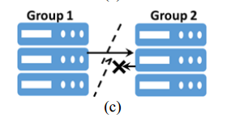
BACKGROUND
Types of Network Partitions Solution
Simplex network partitioning:
permits traffic to flow in one direction, but not in the other.

Slide 6
BACKGROUND
Theoretical Limit
Strong consistency promises that a read operation will return the most recent successfully written value.
Providing strong consistency reduces system availability and requires complex consistency protocols.

Slide 7
BACKGROUND
Theoretical Limit
Eventually consistent systems implement unproven protocols.
Systems that implement proven, strongly consistent often tweak these protocols in unproven ways.

Slide 8
BACKGROUND
Testing with Network Partitioning
Mocking: can be used to imitate communication problems.
Jepsen: does not readily support unit testing or all types of network partitioning.
NEAT: has a simple API for deploying systems, specifying clients’ workloads, creating and healing partitions, and crashing nodes.

Slide 9
METHODOLOGY
136 real-world failures in 25 popular distributed systems.

Slide 10
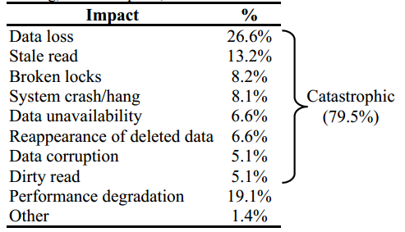
FINDINGS
Failure Impact
Finding 1. A large percentage (80%) of the studied failures have a catastrophic impact, with data loss being the most common (27%).

Slide 11
FINDINGS
Failure Impact
Finding 2. The majority (90%) of the failures are silent, whereas the rest produce warnings that are unatonable.

Slide 12
FINDINGS
Failure Impact
Finding 3. Twenty one percent of the failures lead to permanent damage to the system. This damage persists even after the network partition heals.
If a new node is unable to reach the other nodes in RabbitMQ , the node will assume that the rest of the cluster has failed and will form a new independent cluster. These clusters will remain separated, even after the network partition heals.

Slide 13
FINDINGS
Failure Impact
Network-partitioning faults occur as frequently as once a week and take from tens of minutes to hours to repair.
These systems are designed for deployments in which component failure is the norm.
VoltDB employ “split-brain protection,” a technique that continuously monitors the network and pauses nodes in the minority partition if a network partition is detected.

Slide 14
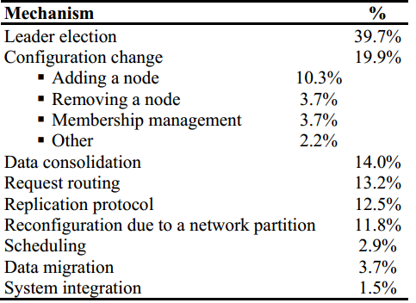
FINDINGS
Vulnerability of System Mechanisms
Finding 4. Leader election, configuration change, request routing, and data consolidation are the most vulnerable mechanisms to network partitioning.

Slide 15
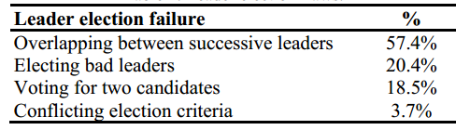
FINDINGS
Vulnerability of System Mechanisms
Leader election: the simultaneous presence of two leaders (57.4%).
In MongoDB, VoltDB, and RethinkDB, if a network partition isolates a leader, the isolated leader will not be able to update the data, but it will still respond to read requests from its local copy, leading to stale and dirty reads.

Slide 16
FINDINGS
Vulnerability of System Mechanisms
Leader election: elect a bad leader (20.4%).
The node with the longest log wins (e.g., VoltDB).
The node that has the latest operation timestamp wins (e.g., MongoDB).
The node with the lowest id wins (e.g., Elasticsearch).

Slide 17
FINDINGS
Vulnerability of System Mechanisms
Data consolidation: lead to data loss in both eventually and strongly consistent systems.
the write with the latest timestamp wins.
The log with the most entries wins.

Slide 18
FINDINGS
Vulnerability of System Mechanisms
Data consolidation: a case in ZooKeeper
storage synchronization for a large amount of data;
in-memory log synchronization for a small amount of data.

Slide 19
FINDINGS
Vulnerability of System Mechanisms
Request routing: routing requests or responses between clients and the specific nodes that can serve the request.
Fail to return a response.

Slide 20
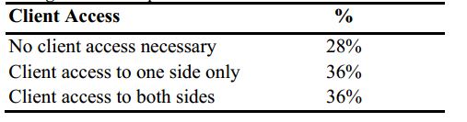
FINDINGS
Network Faults Analysis
Finding 5: The majority (64%) of the failures either do not require any client access or require client access to only one side of the network partition.

Slide 21
FINDINGS
Network Faults Analysis
In HBase, region servers process client requests and store them in a log in HDFS.
A partial partition separates a region server from the HMaster but not from HDFS.
HMaster assign the region logs to other servers.

Slide 22
FINDINGS
Partial Network-Partitioning Failures
The majority of partial network partitioning failures are due to design flaws.
Tolerating partial network partitions is complicated:
these faults lead to inconsistent views of a system state.

Slide 23
FINDINGS
Partial Network-Partitioning Failures
×
AppMaster
×
Resource Manager
Cluster Nodes

Slide 24
FINDINGS
Partial Network-Partitioning Failures
×
Replica A
(primary)
Replica B
×
Arbiter

Slide 25
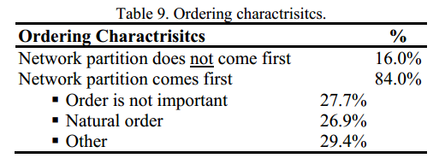
FAILURE COMPLEXITY
Manifestation Sequence Analysis
Finding 7: A majority (83%) of the failures triggered by a network partition require an additional three or fewer input events to manifest.
Finding 8: All of the failures that involve multiple events only manifest if the events happen in a specific order.

Slide 26
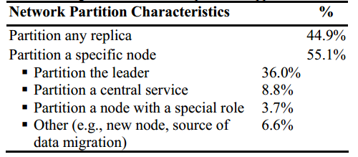
FAILURE COMPLEXITY
Manifestation Sequence Analysis
Finding 9: The majority (88%) of the failures manifest by isolating a single node, with 45% of the failures manifest by isolating any replica.

Slide 27
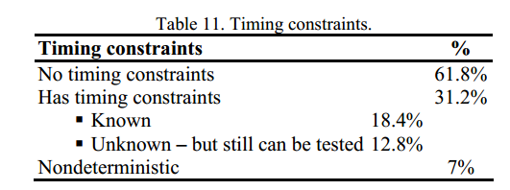
FAILURE COMPLEXITY
Timing Constraints
Finding 10: The majority (80%) of the failures are either deterministic or have known timing constraints.

Slide 28
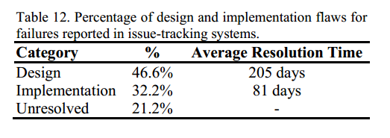
FAILURE COMPLEXITY
Resolution Analysis
Finding 11: The resolution of 47% of the failures required redesigning a system mechanism.
If it involves significant changes to the affected mechanism logic, design, or protocol.

Slide 29
DISCUSSION
All failures can be reproduced on a cluster of five nodes, with the majority (83%) of the failures being reproducible with three nodes only.
The majority of the failures (93%) can be reproduced through tests by using a fault injection framework.

Slide 30
NEAT
Network-partitioning fault injection;
Supports the three types of partitions;
Has a simple API for creating and healing partitions;

Slide 31
NEAT
API
ISystem interface: provides methods to install, start, obtain the status of, and shut down the target system.
Client class: provides wrappers around the client API (e.g., put or get calls).
Test workload and verification code.

Slide 32
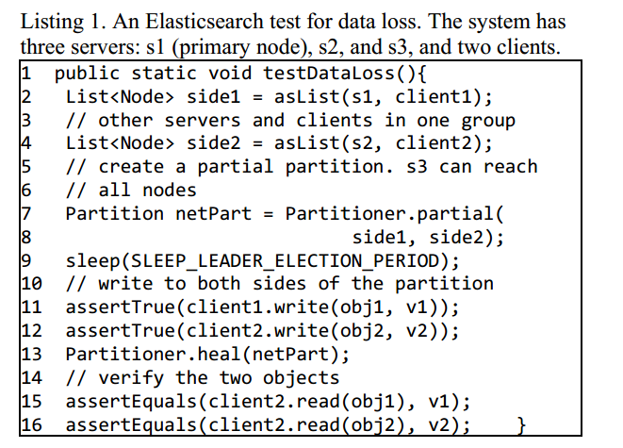
NEAT
API

Slide 33
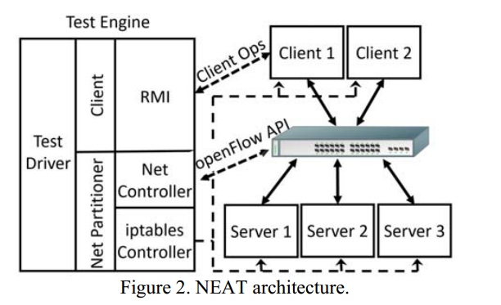
NEAT
NEAT Design
server nodes: run the target system;
client nodes: issue client requests;
test engine: runs the test workload

Slide 34
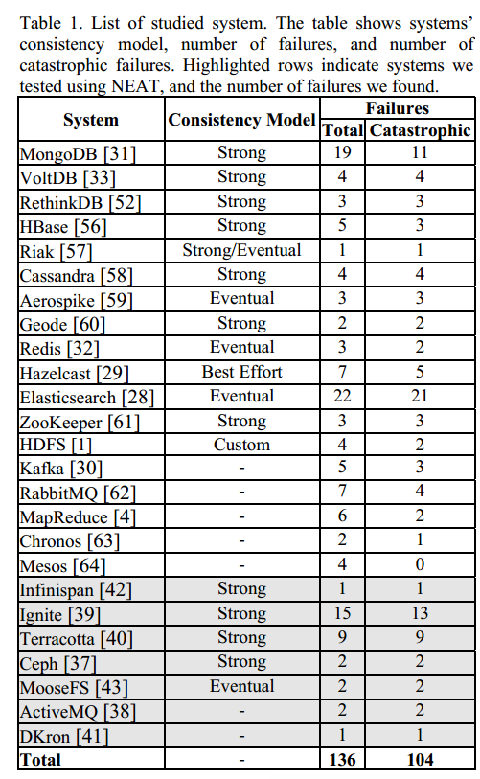
NEAT
NEAT Design

Slide 35
ADVANTAGE
First in-depth study of the manifestation sequence of network partitioning failures.
Detail the manifestation sequences, study the impact of different types of network-partitioning faults, study client access requirements, characterize network faults, or analyze timing constraints.

Slide 36
CONCLUSION
Production systems experience silent catastrophic failures due to a frequently occurring infrastructure fault.
Indicator for node failure, which is unreachability, is dangerous.

