Slide 1



Slide 2
INTRODUCTION
BACKGROUND
The key idea behind LSMs is buffered log structuring, which exploits the high sequential write bandwidth of traditional disks.
Modern NVMe SSDs no longer suffer the same significant random write drawback as traditional disks.
QUESTION
How should a persistent key-value store’s design change for NVMe SSDs where random writes are comparable to sequential writes in performance?

Slide 3
INTRODUCTION
TARGET
larger-than-memory workloads that are:
read-heavy;
skewed write-heavy.
ANSWER
an update-in-place design for NVMe SSDs that has the read benefits of a classical update-in-place design while also mitigating its traditional write drawbacks.

Slide 4
CONTRIBUTION
analyze the key performance challenges of an update-in-place design on NVMe SSDs
implement these key ideas, including page grouping, insert forecasting and record caching, into TreeLine.

Slide 5
DESIGN
Key Idea
Record Caching
Workload Skew Does Not Care About Your Layout.
Page Grouping
Small Pages, Large Pages: Why Not Both?
Small page is good for space amplification and I/O reduction, but hurts range scan.
Insert Forecasting
Data pages must contain empty space to absorb some inserts, but empty space creates amplification during I/O.

Slide 6
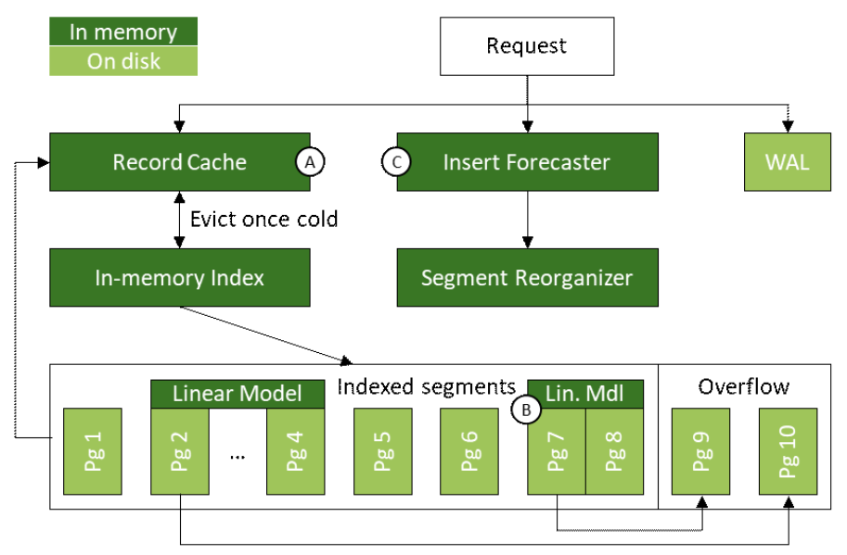
DESIGN
Design
Searching in TreeLine:
Record cache ->
In-memory index->
Overflow page
Lookups
Data Modifications
Range Scans
Supported Operations

Slide 7
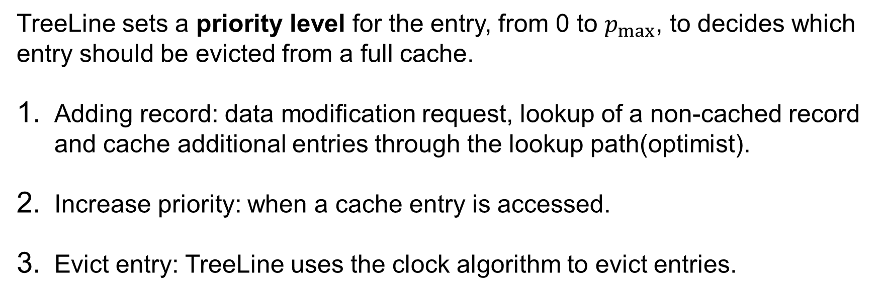
DESIGN
Record Cache
TreeLine sets a priority level for the entry, from 0 to $p_{max}$, to decides which entry should be evicted from a full cache.
Adding record: data modification request, lookup of a non-cached record and cache additional entries through the lookup path(optimist).
Increase priority: when a cache entry is accessed.
Evict entry: TreeLine uses the clock algorithm to evict entries.

Slide 8
DESIGN
Pages
page
a sorted array of slots
records in insertion order
Segments
Segments
page
page
page
page
page
overflow page
overflow page
logically contiguously on disk

Slide 9
DESIGN
In-Memory Index
In-memory index maps the lexicographically smallest key of each data segment to the appropriate (physical) segment identifier.
A compact linear model is stored in the in-memory index to select the correct data page within the segment without additional index nodes.

Slide 10
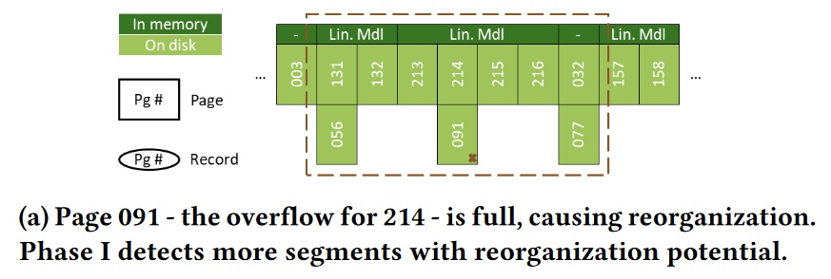
DESIGN
Reorganization 1

Slide 11
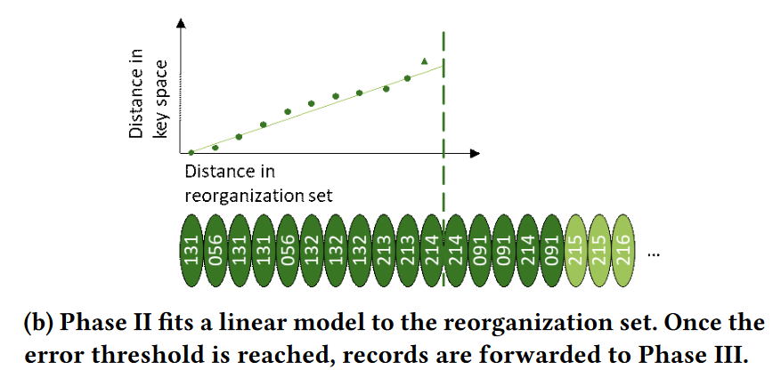
DESIGN
Reorganization 2
TreeLine considers records in key order and tries to place them into as-large-as-possible(depend on linear model error) segments.

Slide 12
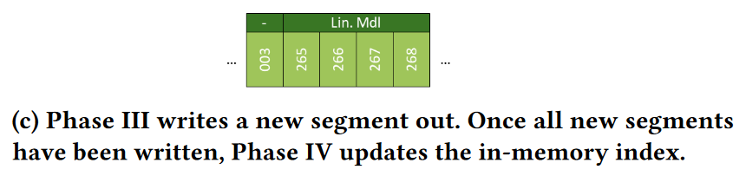
DESIGN
Reorganization 3
Reorganization 4
TreeLine concludes the reorganization process by updating the in-memory index.

Slide 13
DESIGN
Insert Forecasting
Epoch-base forecast: divide the workload into epochs, and update predict module every epoch.
Statistics: capture the distribution of inserts by equi-depth histogram.
Generate: sum the counters of intersecting partitions with linear interpolation to forecast inserts for a segment.
Utilize: estimate pages needed by the number of keys and insert forecast while reorganization segment.
Notes:
Interpolation 内插法

Slide 14
DESIGN
Crash Consistency and Recover
Touch single SSD page: SSD guarantees atomic writes.
Overflow page allocation: The lower bound of overflow page is corresponding to correct base page.
Reorganization: An undo-like WAL is added while starting reorganization.

Slide 15
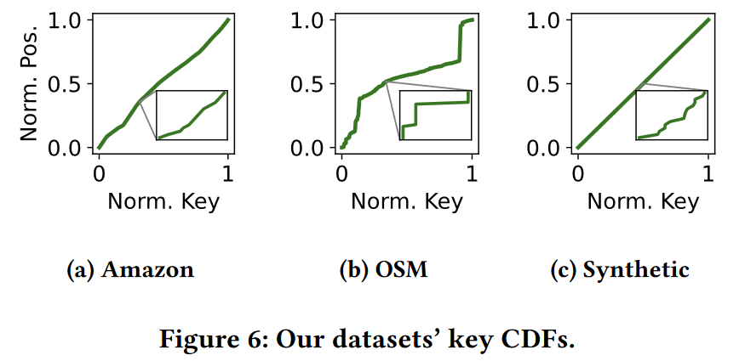
EVALUATION
Setup
20C128G+1TB NVMe SSD
Compare with RocksDB(v6.14.6) and LeanStore(commit d3d8314)
Workload
YCSB (own cpp implementation) with 3 datasets:
uniformly distributed keys (20 million)
Amazon reviews dataset (33 million)
Open Street Maps dataset (23 million)
Notes:
Rocks-db lsm
Leanstore update in place

Slide 16
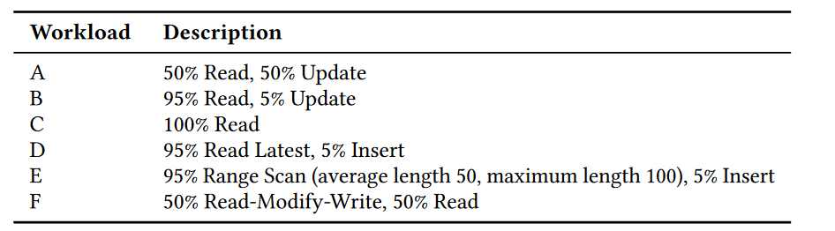
EVALUATION
Workload Cont.

Slide 17
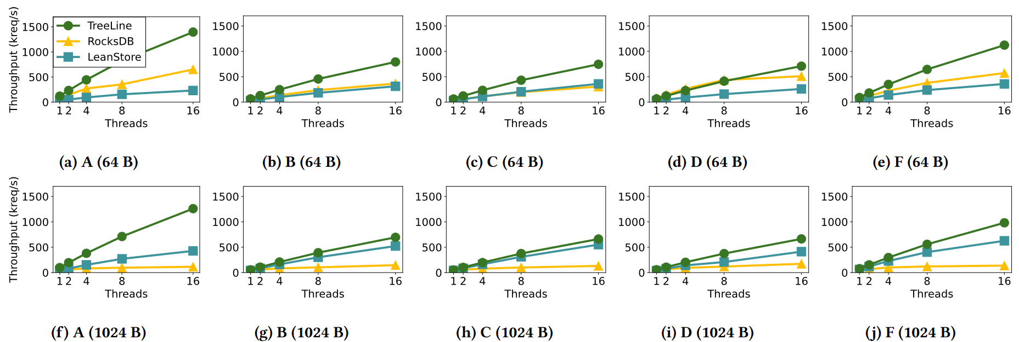
EVALUATION
End-to-End Performance(skew point)
TreeLine outperforms RocksDB and LeanStore on skewed update-heavy workloads because it
leverages its record cache to reduce write amplification
provide efficient reads.
Physical data access(record length is 64B)
DB | Write(GB) | Read(GB)
TreeLine | 3.09 | 12
RocksDB | 4.27 | 27
LeanStore | 23.1 | 42.2
Notes:
A: 50%read 50% update
LeanStore writes signicantly more than TreeLine and RocksDB because it uses a page cache which causes more hit miss.

Slide 18
EVALUATION
End-to-End Performance(skew point)
When TreeLine outperforms RocksDB on read-heavy workloads, it is because it performs fewer physical reads.
TreeLine surpasses LeanStore on the 64 B read-heavy workloads because of record caching.
Notes:
B: 95%read 5%update
C: 100%read

Slide 19
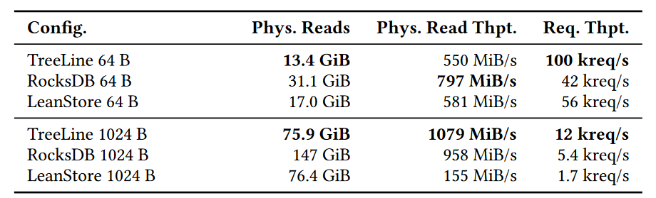
EVALUATION
End-to-End Performance(scan-heavy)
TreeLine’s speedup over RocksDB on the scan-heavy workloads comes from reading less data from disk, because of its update-in-place design.
Notes:
E 95% range scan(avg 50) 5%insert
Key skew limits LeanStore’s buffer pool’s effectiveness when records are small relative to the page

Slide 20
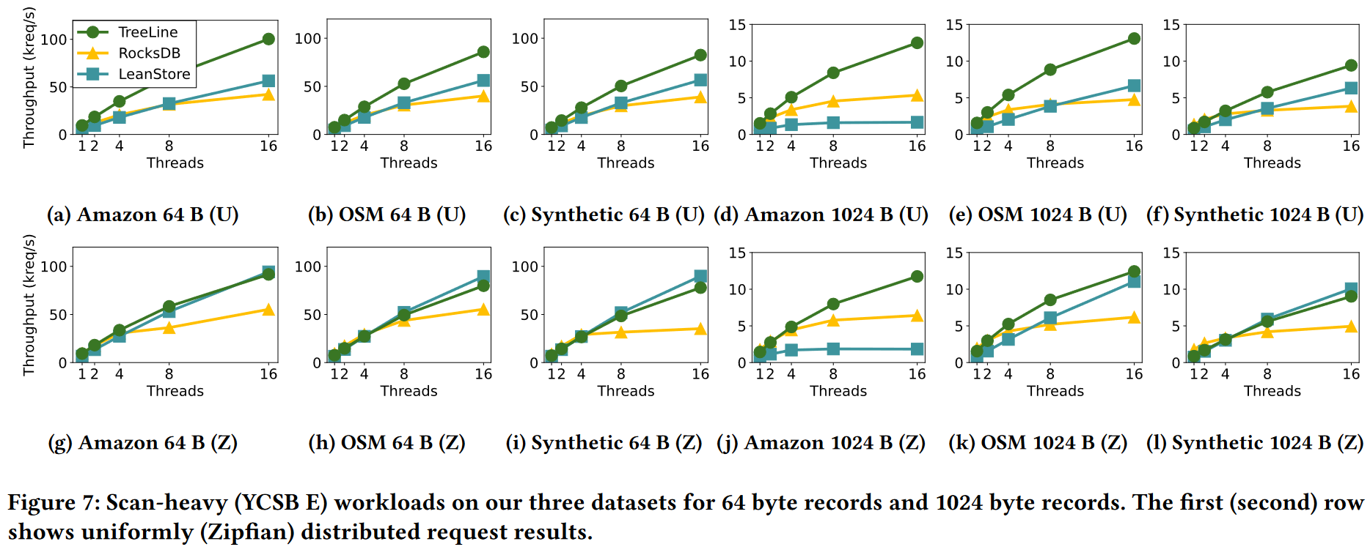
EVALUATION
End-to-End Performance(scan-heavy)
TreeLine’s scan performance is not significantly affected by request skew.

Slide 21
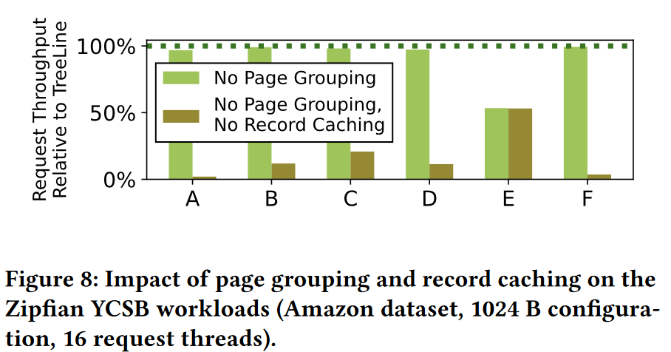
EVALUATION
TreeLine Factor Analysis
Record caching helps reduce read and write amplification in the read/update workload. (3.11x)
Page grouping does not negatively affect the point workloads.
Page grouping accelerates scans by enabling longer physically contiguous reads.

Slide 22
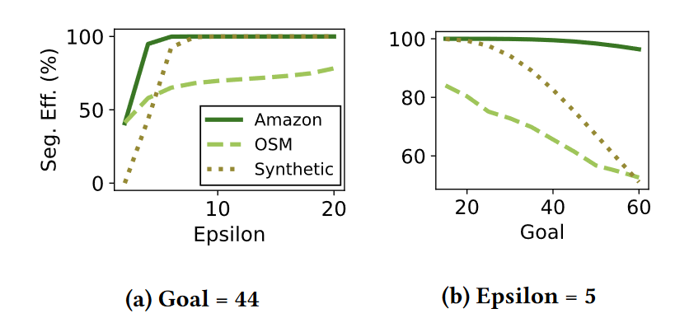
EVALUATION
Page Grouping Effectiveness
Increasing epsilon improves segment efficiency.
Increasing goal(record/page) decreases segment efficiency.
The dataset affects segment efficiency.

Slide 23
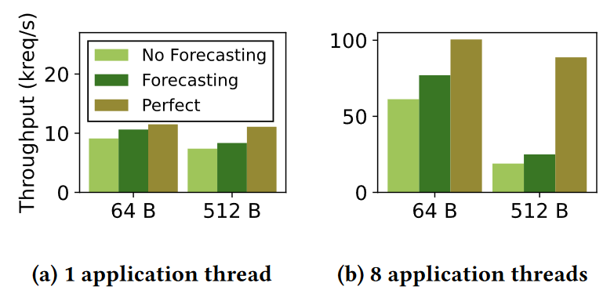
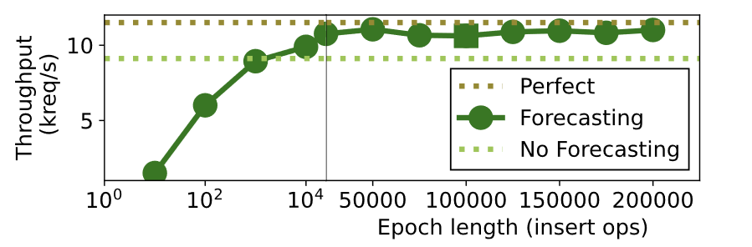
EVALUATION
Insert Forecasting
Insert forecasting can estimate and leave appropriate free space at a finer granularity.
Very short epochs cannot justify their overhead.

Slide 24
DISCUSSION
To forecast inserts, we could use a timeseries forecasting module for more sophisticated insert distributions.
Even with perfect forecasting, TreeLine currently cannot compete with RocksDB on pure write workloads, while RocksDB can simply write out its memtable without a prior read.

