Slide 1
WoW:
A Window-to-Window Incremental Index for Range-Filtering Approximate Nearest Neighbor Search
Ziqi Wang, Jingzhe Zhang, Wei Hu* | Nanjing University, China
Proc. ACM Manag. Data, Vol. 3, No. 6 (SIGMOD 2025)
Notes:
WoW：一种用于 范围过滤近似最近邻搜索 的窗口到窗口增量索引

Slide 2
Background — The Era of Vector Databases
Nearest neighbor search is widely used
Essential for RAG (Retrieval-Augmented Generation)
Image Search
NNS
Approximate nearest neighbor search
Three categories:
hashing-based (LSH)
partition-based (KD-Tree)
graph-based algorithms (HNSW)
ANNS
Range-filtering ANNS
searching for similar commodities by an image and a price range
a query comes with “What symptoms are common for people with hypertension aged from 50 to 60?”
RFANNS

Slide 3
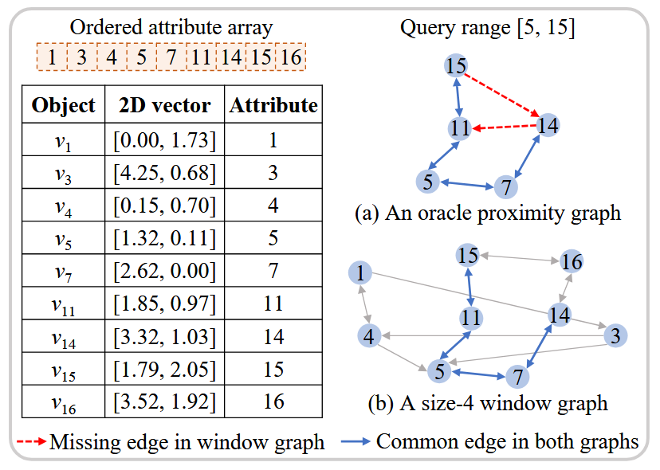
RFANNS
Three methods to address the RFANNS problem
Pre-filtering
Post-filtering
Dedicated RFANNS indices
• Filter in-range data from the dataset first.
• Perform a linear scan on the filtered results.
• Extremely inefficient due to the absence of index support.
• Build a standard ANNS index on the entire dataset.
• Exclude out-of-range vectors after the initial search.
• May require multiple search iterations to retrieve sufficient (k) results.
• Construct specialized indices that visit only in-range vectors.
• Simulate the connectivity of an Oracle Proximity Graph.
• graph-based RFANNS indices are superior in query efficiency.
• Superior performance, yet still hindered by two major challenges.
Two key challenges
Challenge 1: Can RFANNS indices be built incrementally?
Challenge 2: Can RFANNS indices handle varying query correlations and selectivity?
Notes:
先/后/搜索中 过滤
“理想邻近图”（Oracle Proximity Graph）

Slide 4
RFANNS
Challenge 1: Incremental Support
Dedicated graph-based RFANNS indices are slower to build compared with hashing/partition-based ones.
Longer indexing time and larger size than a vanilla graph built on the vector set. (for Simulate OPG)
Most RFANNS indices are either static or only provide limited incremental support.
Challenge 2: Multi-Range Adaptability
No or negative correlation between the query vector neighborhood and the filtering subset.
Queries of high selectivity are also challenging as most of nearest neighbors are out of range.
Many RFANNS indices fail to obtain the optimal balance between query speed and accuracy for all levels.
iRangeGraph is a static index and lacks support for insertion.
DIGRA encounters severe accuracy loss after frequent insertions.

Slide 5
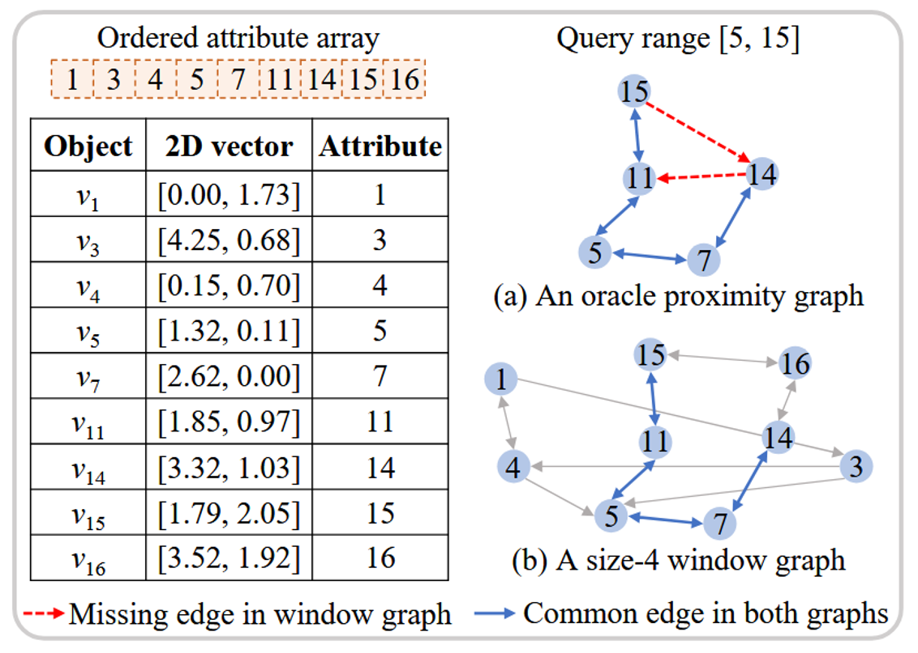
Core Design: Hierarchical Window Graphs
Window-Based Connectivity:
Models attribute similarity as an Attribute Window.
Vertices connect only to in-window nearest neighbors, balancing vector and attribute similarity.
Why Hierarchy?
A single window graph cannot generalize to all query ranges.
Small Window Graphs act as complements to recover missing connections in narrow ranges.
Notes:
基于窗口的连接性：
将属性相似性建模为属性窗口。
节点仅与窗口内的向量最近邻建立连接，平衡了向量与属性的双重相似性。
为什么需要分层？
单一窗口图无法推广到所有查询范围。
小窗口图作为补充，用于找回在窄范围查询中缺失的关键连接。

Slide 6
Main Contributions
Fully Incremental Construction:
Supports building from an empty index without data presorting.
Insertion complexity: O (log² n) highly parallelizable.
Optimal Query Efficiency:
First to reduce filter tests and distance computations simultaneously.
Query complexity: O (log n′) , equivalent to an Oracle RNG.
State-of-the-Art Performance:
Indexing: 4.9x faster and 0.5x smaller than the most efficient baseline (DIGRA).
Querying: 4x faster than the best incremental index (HSIG) and 1.5x faster than the best static index in high-selectivity workloads.
Notes:
全增量构建：
支持从空索引开始实时构建，无需任何数据预排序。
插入复杂度为
$$O\left({\log{}}^{2}n\right)$$
，且具有高度的可并行性。
最优查询效率：
首个同时减少“属性过滤测试”和“向量距离计算”的方案。
查询复杂度为
$$O\left(\log{n^{′}}\right)$$
，等同于在理想 RNG 图上的搜索效率。
卓越的性能表现：
索引构建： 比最快基准 (DIGRA) 快 4.9 倍，体积缩小 50%。
查询性能： 比最佳增量索引 (HSIG) 快 4 倍；在高选择率场景下，比最佳静态索引快 1.5 倍。

Slide 7
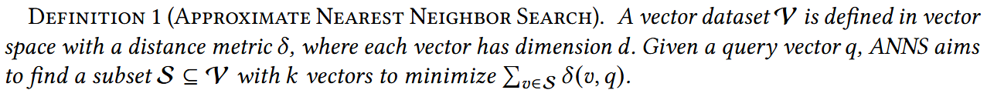

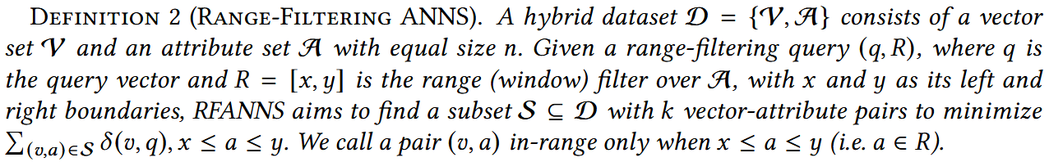
Problem Formulation
ANNS
The search accuracy can be defined by the fraction of the exact nearest neighbors:
RFANNS
Query Selectivity

Slide 8
Related Work: ANNS & Filtering Strategies
Three Categories of ANNS Indices
Hashing-based: Maps similar vectors to buckets via static or learnable hash functions.
Partition-based: Groups similar vectors into clusters/cell.
Graph-based: Represents similarity via proximity edges, aiming to approximate the Relative Neighborhood Graph (RNG). HNSW is the state-of-the-art for performance and speed.
Graph Construction Strategies
Refinement-based: (e.g., NSG, NSSG) Optimizes a pre-built graph for better search quality; typically static.
Increment-based: (e.g., NSW, HNSW) Builds the graph by inserting nodes one by one; offers greater flexibility.
The Gap: Incremental support for filtered search remains an unaddressed challenge.
Evolution of Filtering ANNS
Filter Types: Label, Range (this paper's focus), and Generic Predicates.
From Baselines to Dedicated Indices:
Pre/Post-filtering: Inherent defects (inefficiency and low recall).
Dedicated Indices: Specifically designed to only visit vectors satisfying the predicate, avoiding wasteful computations.
Notes:
1. ANNS 索引的三大类别
基于哈希： 通过静态或学习型哈希函数将相似向量映射到哈希桶。
基于分区： 将相似向量分入同一个聚类中（如 IVF, PQ）。
基于图： 通过边表示向量相似性，旨在逼近 RNG（相对邻域图）。
核心算法： HNSW 是目前高性能和快速索引的主流方案。
2. 图构建策略分类
优化式 (Refinement-based)： (如 NSG, NSSG) 优化预建图以提升查询质量；通常为静态。
增量式 (Increment-based)： (如 NSW, HNSW) 通过逐个插入节点构建；灵活性更高。
现状： 针对“带过滤”搜索的增量支持仍是一个尚未解决的挑战。
3. 过滤 ANNS 的演进
过滤器类型： 标签过滤、范围过滤（本文重点）、通用谓词过滤。
从基准方法转向专用索引：
预/后过滤： 存在固有缺陷（效率低、召回率不稳定）。
专用索引： 专门设计为仅访问满足过滤条件的向量，避免无效计算。

Slide 9
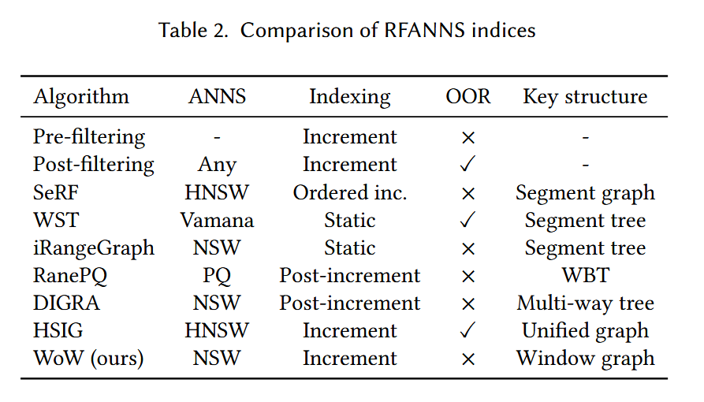
Related Work Comparison
ANNS: indicates the ANNS algorithm that an index is based on.
Indexing: compares how to construct the indices: static, post-incremental, ordered incremental, or unordered incremental.
OOR: marks whether the distance of out-of-range vectors needs be calculated.
Key structure: lists the structure employed to arrange vectors and attribute values.
WoW is the only index to support fully incremental construction (cf. Challenge 1) without OOR-vector visit (cf. Challenge 2).
Notes:
ANNS 表示所基于的 ANNS 算法。
(2) 索引比较如何构造索引:静态、后增量、有序增量或无序增量。
(3)OOR 标记是否需要 计算超出范围的向量的距离。
(4)键结构列出了用于排列向量和属性值的结构

Slide 10
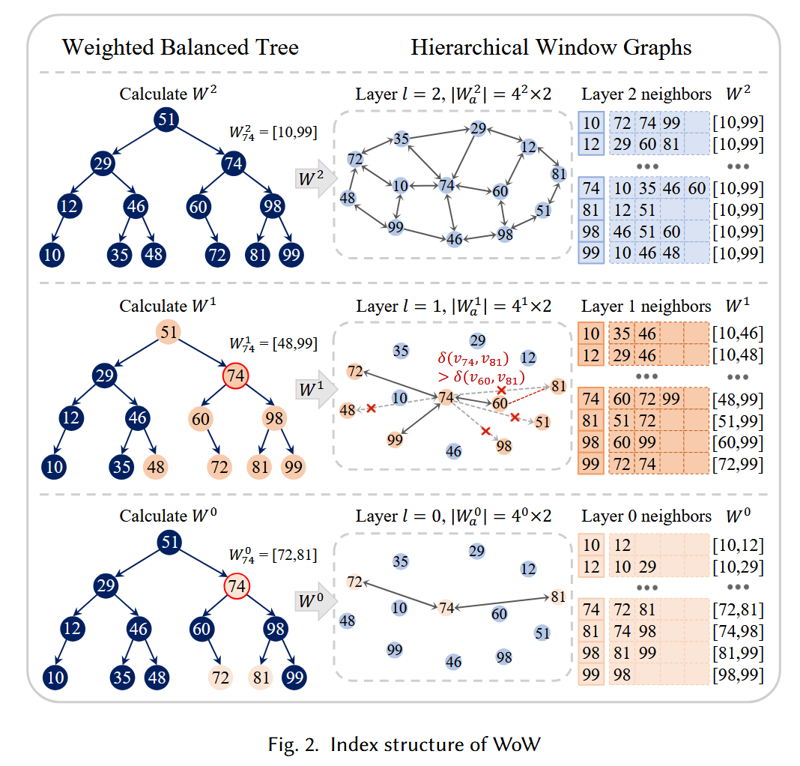
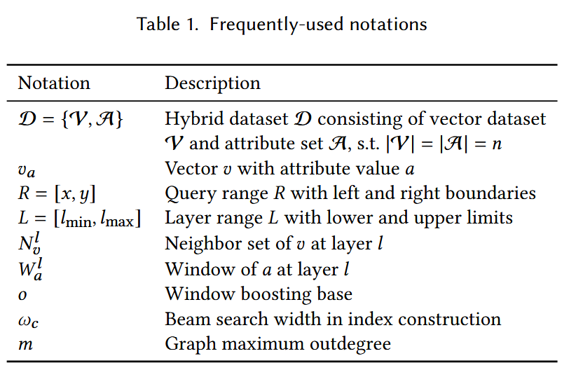
Definitions & Structure
WBT and Hierarchical Window Graphs
m=4 o=4

Slide 11
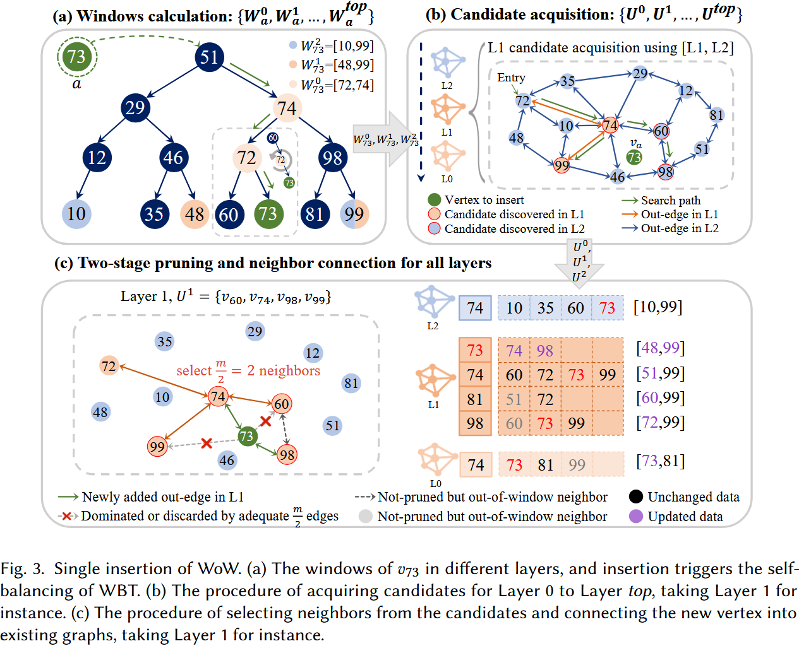
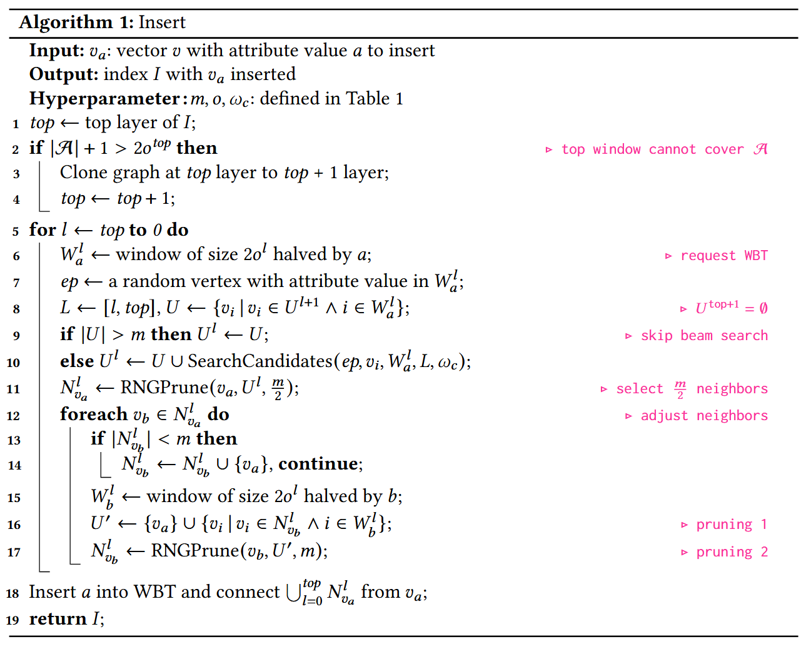
Top-down Insertion

Slide 12
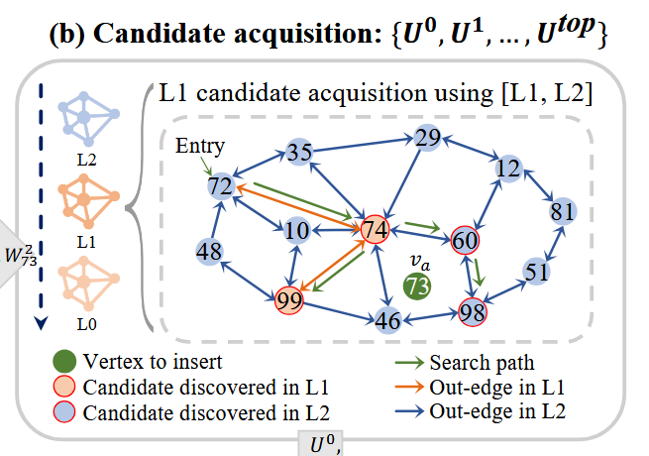
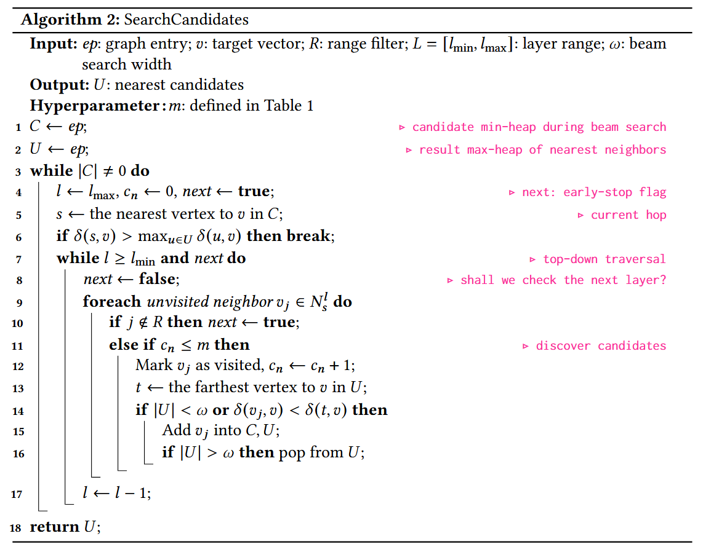
Multi-layer Candidate Acquisition
Multi-layer Traversal
Selectivity Filtering
Early-stop Strategy

Slide 13
Multi-layer Candidate Acquisition
layer range L = [1, 2], range filter R = [48, 99], target vector v₇₃, and beam search width ω = 4. The random entry ep is set to v₇₂
HOP1- v₇₂ The neighbors of v₇₂ in Layer 2 are v₁₀, v₃₅.(out of R) The algorithm then checks Layer 1 and appends the only in-range neighbor v₇₄ into the candidate list.
HOP2- v₇₄ At the 2-hop v₇₄, it finds an in-range neighbor v₆₀ in Layer 2 and v₉₉ in Layer 1.
HOP3- v₆₀ Since v₆₀ is closer to va, it is picked as the 3-hop whose neighbor v₉₈ in Layer 1 is added into C, U at this hop.
The last hop is v₉₉ and there are no more candidates in C because other vertices are far away from v_{a}. The search converges and the algorithm returns v₆₀, v₇₄, v₉₈, v₉₉

Slide 14
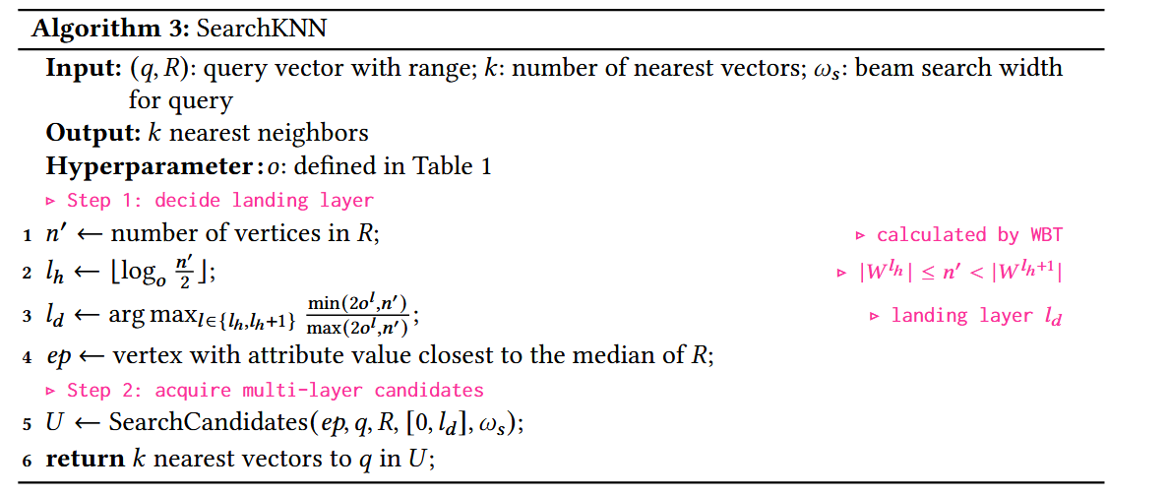
Selectivity-Aware Range Search
Decide landing layer
The Balance: Minimizes filter checks while maintaining high-quality candidates.
Acquire multi-layer candidates
Call Algorithm 2 with beam width ω_{s} to retrieve top-k results.

Slide 15
Influence of Hyperparameters
Standard Graph Parameters
Max Outdegree m: Controls graph density.
Trade-off: Higher m improves connectivity but increases distance computations per hop.
Beam Search Width ω_{c}: Controls candidate quality during indexing.
Trade-off: Higher ω_{c} leads to more diversified connections but increases indexing time.
WoW-Specific Parameter: Window Boosting Base o
Layer Control: Determines the total number of layers and affects indexing speed.
o directly impacts the fraction of in-range neighbors on the landing layer.
More in-range neighbors in the landing layer would benefit query with faster navigation speed

Slide 16
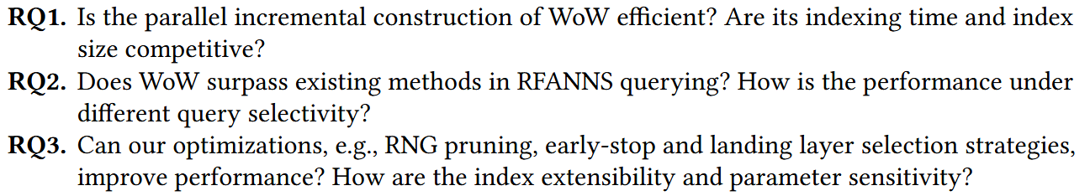
Experiments
Three research questions
Environment

Slide 17
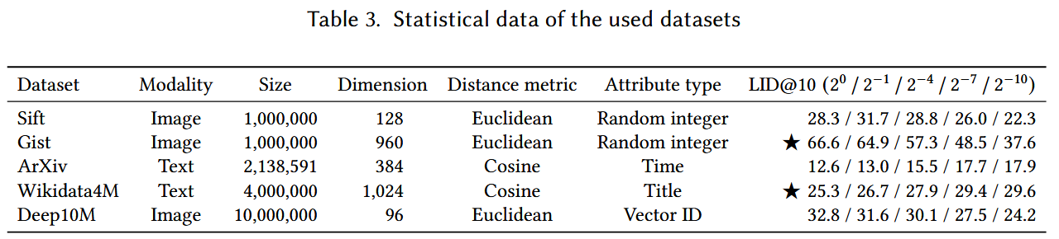
Experiments
Datasets
Workload
We refer to ranges with fractions in [2⁻¹⁰, 2⁻⁹] as exhibiting extreme selectivity, [2⁻⁸, 2⁻⁶] as high selectivity, [2⁻⁵, 2⁻³] as moderate selectivity, and [2⁻², 2⁰] as low selectivity.
We further assemble a mixed range workload comprising query ranges with equal number of fractions in [2⁻¹⁰, 2⁰].
In our experiments, each query workload contains 1,000 range-filtering queries.
We estimate the hardness of a query workload by Local Intrinsic Dimensionality (LID)
Notes:
LID 全称是局部本征维度。在向量搜索领域，它被用来衡量一个查询点周围数据的“拥挤程度”或“检索难度”。
直观理解： 即使两个数据集原始维度都是 100，但如果数据集 A 的点都挤在一起（像一团乱麻），而数据集 B 的点分布很均匀，那么搜索 A 就要比搜索 B 难得多。
数值意义： LID 值越大，意味着该数据集越难搜，召回率越难提升。
这些数值代表了不同的查询选择率（Selectivity），

Slide 18
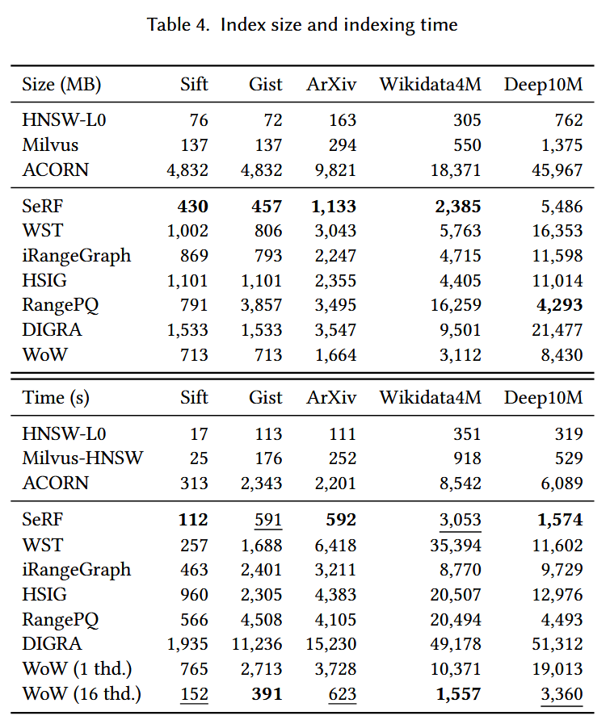
RQ1: Index Construction Efficiency
Overall Performance
Dedicated vs. Generic: ACORN has the largest size (10x+ others) due to its dense graph without pruning. Milvus-HNSW is fast but lacks specialized range-filtering optimizations.
Easy Datasets (Sift, ArXiv, Deep10M): SeRF is the fastest and smallest, but its performance relies on ordered insertion and suffers from unstable recall (to be shown in RQ2).
Hard Datasets (Gist, Wikidata4M): WoW outperforms all competitors. It handles high-dimensional and dense neighborhoods more effectively than RangePQ or DIGRA.
Notes:
它们是标准的向量索引（Vanilla HNSW），在构建时完全不考虑任何过滤条件。 后过滤
ACORN这是一个通用的谓词过滤索引（Generic Predicate Filter）。它被设计用来处理各种复杂的过滤条件

Slide 19
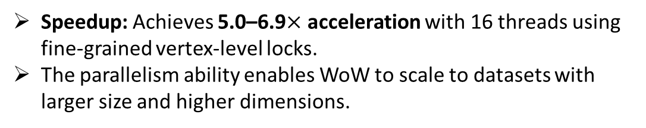
RQ1: Index Construction Efficiency
Acceleration Rationale
Complexity: WoW's worst-case complexity is on par with others' average case.
Graph Quality: Unlike SeRF (lossy compression), WoW maintains high-quality connections equivalent to an "Oracle Graph," allowing faster candidate acquisition during indexing.
Index Size Characteristics
Linear Growth: Size grows linearly with vector count and layer number
Multi-thread Acceleration
Speedup: Achieves 5.0–6.9$×$ acceleration with 16 threads using fine-grained vertex-level locks.
The parallelism ability enables WoW to scale to datasets with larger size and higher dimensions.
Notes:
它们是标准的向量索引（Vanilla HNSW），在构建时完全不考虑任何过滤条件。 后过滤
ACORN这是一个通用的谓词过滤索引（Generic Predicate Filter）。它被设计用来处理各种复杂的过滤条件

Slide 20
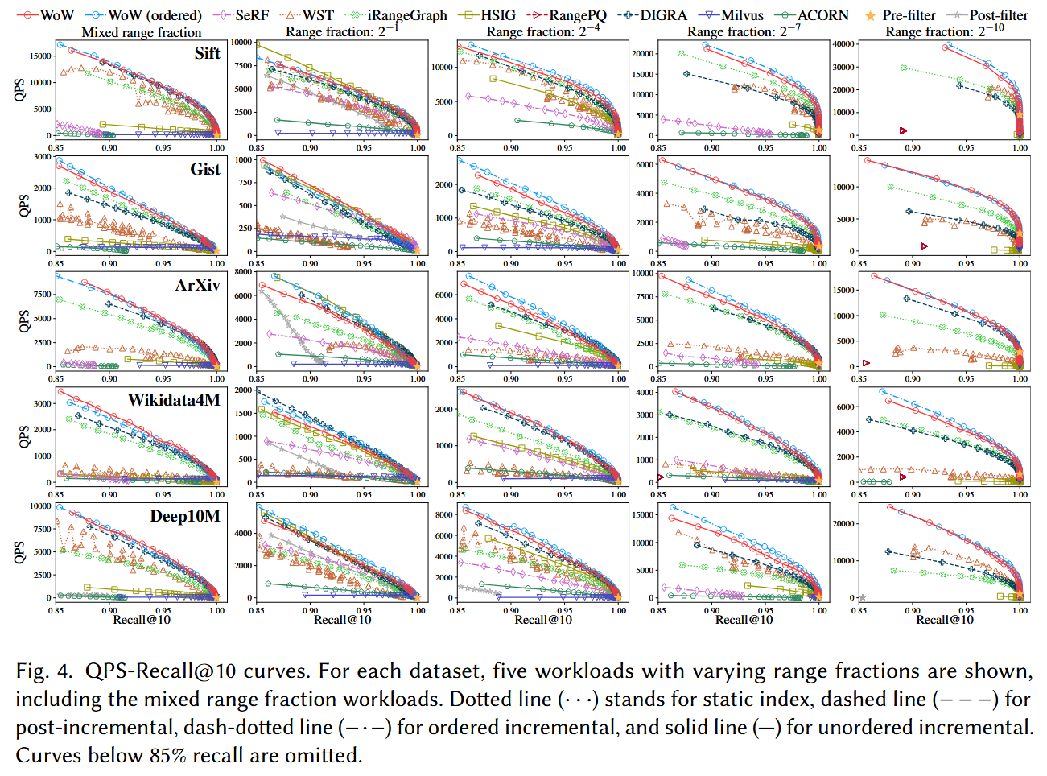
RQ2: RFANNS Query Performance

Slide 21
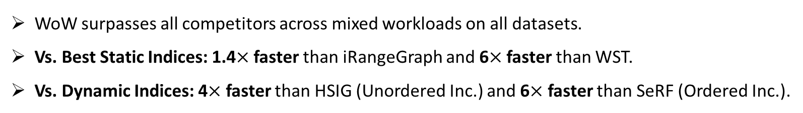
RQ2: RFANNS Query Performance
Overall Dominance
WoW surpasses all competitors across mixed workloads on all datasets.
Vs. Best Static Indices: 1.4$×$ faster than iRangeGraph and 6$×$ faster than WST.
Vs. Dynamic Indices: 4$×$ faster than HSIG (Unordered Inc.) and 6$×$ faster than SeRF (Ordered Inc.).
Dynamic vs. Static Performance
WoW matches or even beats the best statically-built indices (like iRangeGraph/DIGRA).
Key Achievement: WoW successfully maintains high-quality neighbor relations even after frequent incremental insertions.
Ordered vs. Unordered WoW
WoW (ordered) is slightly better because fixed window boundaries during ordered insertion lead to fewer pruning-induced neighbor losses.

Slide 22
RQ2: RFANNS Query Performance
Superiority in High Selectivity
WoW remains stable while others degrade.
Why WoW Wins: Benefits from the Early-stop strategy (Alg. 2) and Selectivity-aware layer selection (Alg. 3).
Analysis on Hard Datasets (Gist, Wikidata4M)
In dense datasets, WoW’s high-quality RNG structure provides superior navigation.
Why Competitors Fail?
DIGRA/RangePQ: Suffer from a "Performance Cliff" after insertions (e.g., Recall drops from 99% to 27%) due to broken graph interconnections.
SeRF: Fails to reach 85% recall due to lossy compression and falling into local optima.
ACORN: Performance drops at high selectivity as beam search ends prematurely.
iRangeGraph: High per-hop tree-traversal overhead on large-scale datasets (Deep10M).

Slide 23
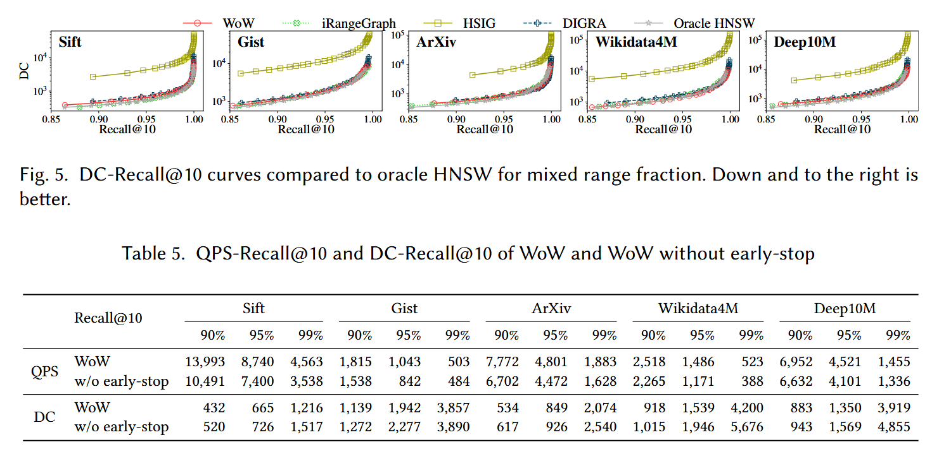
RQ3: Detailed Analysis
WoW’s DC-Recall curves coincide closely with the Oracle HNSW (the theoretical lower bound).
Notes:
DC 距离计算次数

Slide 24
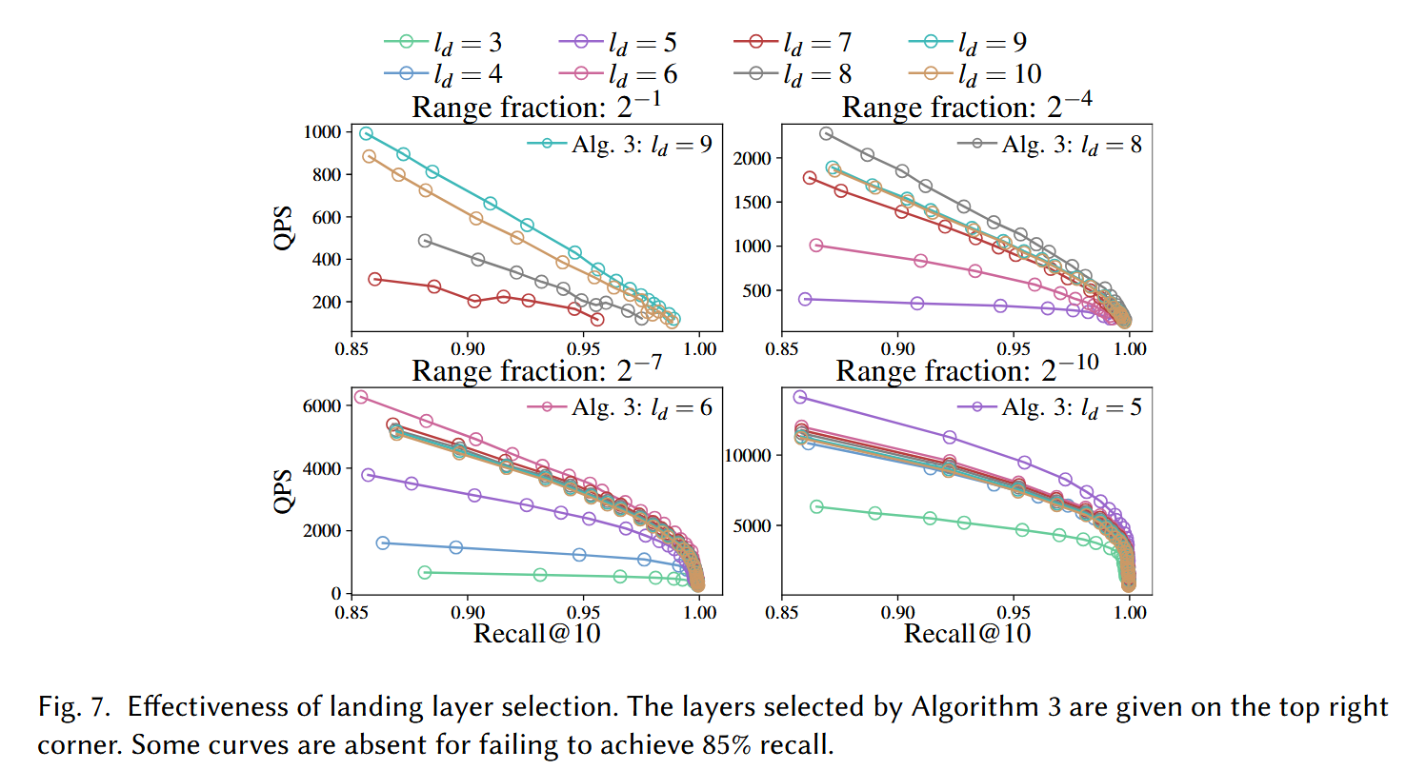
RQ3: Detailed Analysis

Slide 25
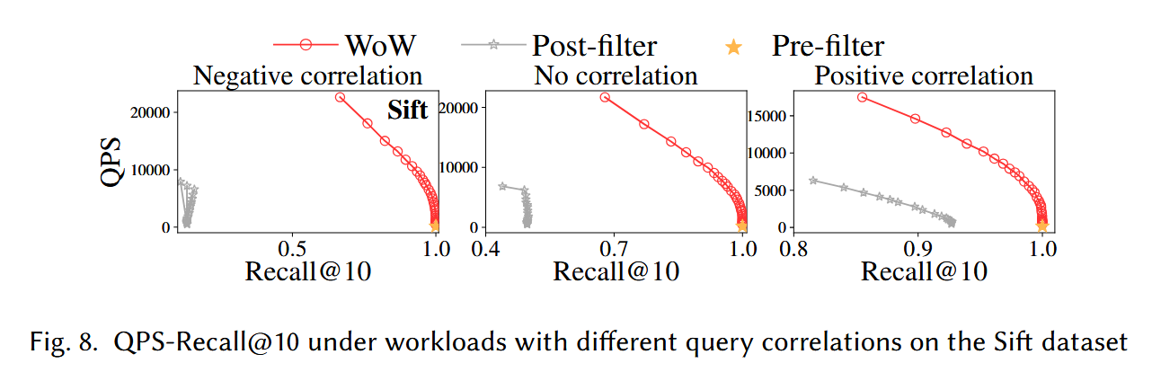
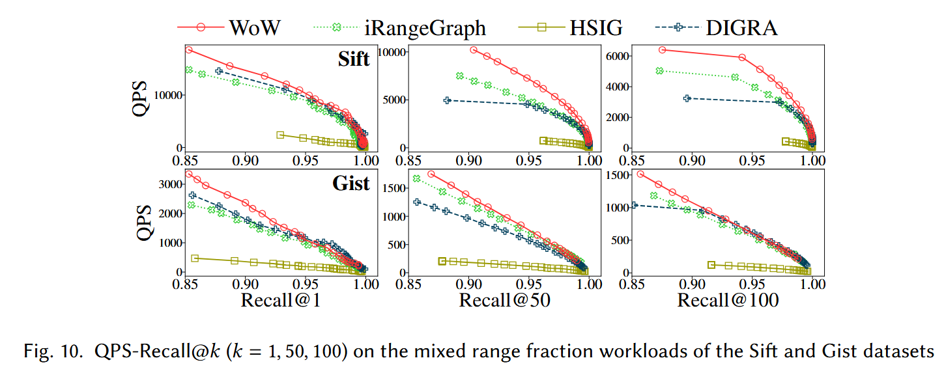
RQ3: Detailed Analysis

Slide 26
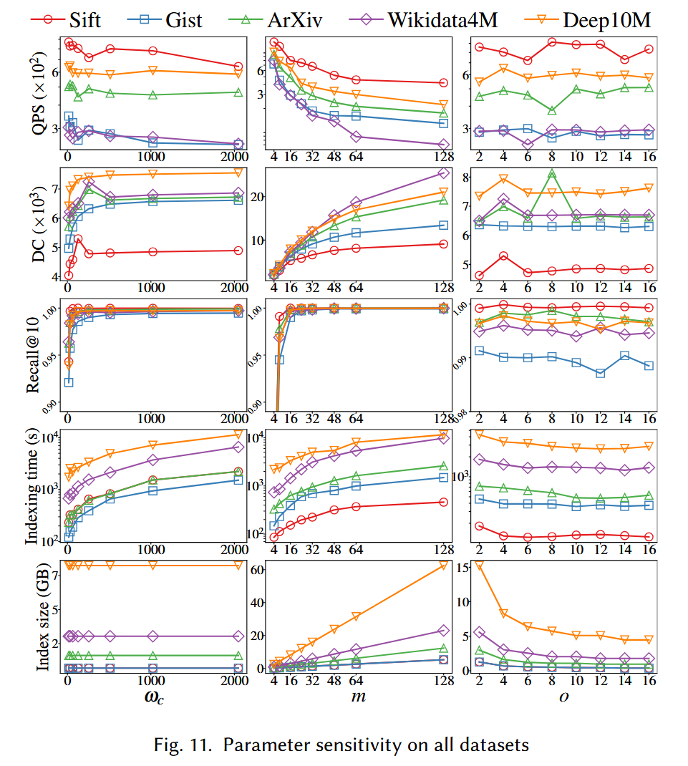
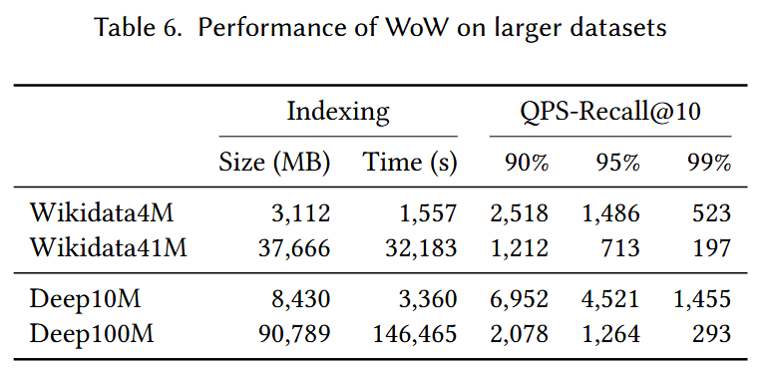
RQ3: Detailed Analysis

Slide 27
Conclusion
In this paper, we propose a dedicated RFANNS index WoW.
The index addresses two main challenges about incremental construction and efficiency for varying range-filtering query correlations and selectivity.

