Slide 1
An Experimental Evaluation of Hybrid Querying on Vectors
Jiaxu Zhu, Jiayu Yuan, Kaiwen Yang, Xiaobao Chen, Shihuan Yu, Hongchang Lv, Yan Li*, Bolong Zheng*
Huazhong University of Science and Technology · Wuhan University of Technology
PVLDB 2025, Vol. 19, No. 2 · doi:10.14778/3773749.3773757
Notes:
大家好，今天分享的论文是《An Experimental Evaluation of Hybrid Querying on Vectors》，发表于PVLDB 2025。作者来自华中科技大学和武汉理工大学。这篇论文首次对混合查询——即向量检索结合属性/范围过滤——进行了全面系统的实验评估。

Slide 2
Background
Nearest neighbor (NN) search serves as a fundamental algorithm in vector retrieval, with widespread applications in recommendation systems and image retrieval.
To address the exponential growth of data volume and increasing dimensionality, studies turn to Approximate NN (ANN) search, which improves efficiency by constructing effective indexing structures, albeit at the cost of reduced accuracy.
As application scenarios grow increasingly complex, simple ANN search can no longer satisfy all practical needs. Hybrid querying techniques emerge, integrating vector retrieval with conditional filtering for refined retrieval.
· AF-ANN: vector similarity + attribute constraints (e.g., specific brand, color)
· RF-ANN: vector similarity + range conditions (e.g., price between $100 and $200)
Notes:
先回顾背景。最近邻搜索是向量检索的基础，广泛用于推荐系统和图像检索。随着数据量和维度的指数增长，传统NN面临维数灾难，研究者转而采用ANN——通过构建索引结构以精度换取效率。然而应用场景日益复杂，单纯向量相似度搜索已不够：用户搜商品时可能还要按品牌、颜色、价格区间筛选。这就催生了混合查询——AF-ANN是把向量相似度和离散属性约束结合；RF-ANN是把向量相似度和连续范围条件结合。图1展示了电商场景的示例。

Slide 3
Motivation & Research Gap
In practical applications, hybrid query algorithm performance is influenced not only by unstructured data but also closely relates to structured data. For AF algorithms, factors such as the number of attributes, attribute distribution, and attribute selectivity significantly impact performance. For RF algorithms, the width of the query range and the characteristics of different datasets play an important role.
Although existing studies conduct benchmark evaluations of ANN methods, a systematic experimental study specifically targeting hybrid query algorithms is still lacking. BigANN 2023 presents the following notable limitations:
1. Covers a limited number of algorithms, failing to include mainstream methods.
2. Uses only a single dataset, focusing solely on single/dual-attribute queries, without considering the impact of attribute selectivity on query performance.
3. Only compares query speed and recall, but does not consider key metrics such as time and space overhead, and lacks in-depth analysis of performance reasons.
To fill this gap, this paper conducts the first comprehensive experimental evaluation of hybrid query algorithms, systematically analyzing their index construction costs and query efficiency across diverse scenarios, and rigorously assessing the robustness of each algorithm under different experimental settings.
Notes:
论文动机：混合查询性能不仅受向量数据影响，还与结构化数据密切相关。AF中属性数量、分布和选择率是关键因素；RF中查询范围宽度和数据集特征很重要。虽然已有ANN基准评估，但专门针对混合查询的系统研究还是空白。BigANN 2023有三个不足：算法覆盖面窄、只用单一数据集且忽略了属性选择率的影响、只比较速度和召回率但没考虑时间空间开销，缺少对性能原因的深入分析。本文填补了这一空白，进行了首次全面的实验评估。

Slide 4
Contributions
(1) Systematic Classification and Overview.
Systematically classify 6 representative AF algorithms and survey 5 RF algorithms along multiple dimensions. Survey one vector library and 3 vector databases.
(2) Strengthening Datasets and Experimental Settings for Fair Evaluation.
Enrich commonly used datasets by generating attribute values tailored to real-world scenarios. Design comprehensive settings reflecting diverse application requirements.
(3) Evaluation of Attribute Filtering Algorithms.
Scale: Evaluated 10 methods (6 algorithms, 1 library, 3 databases) on 11 real-world datasets.
Analysis: Assessed attribute counts and selectivity to reveal robustness and adaptability.
Metrics: Measured 5 core dimensions: build time, index size, peak memory, QPS, and accuracy.
(4) Evaluation of Range Filtering Algorithms.
Benchmarking: Tested RF algorithms on 6 datasets with varying query range settings.
Performance: Analyzed index efficiency, storage overhead, and query speed.
Factor Analysis: Explored underlying factors that fundamentally impact range filtering performance.
(5) Recommendations and Challenges.
Provide algorithm selection recommendations for common application scenarios and highlight key challenges in the field of hybrid query.
Notes:
论文五大贡献：一、系统分类——从多个维度对6种AF和5种RF算法进行分类，并概述1个向量库和3个向量数据库。二、强化数据集与实验设置——为数据集生成属性值，设计覆盖多种场景的综合实验方案。三、AF评估——在11个数据集上使用5个核心指标进行系统评估。四、RF评估——在6个数据集上对不同查询范围进行基准测试。五、建议与挑战——提供了面向不同场景的算法选择指南，指出了领域关键挑战。

Slide 5
Problem Definition
Definition 2.1 — Nearest Neighbor (NN) Search
Let D = {v₁, ..., vₙ} be a dataset of n d-dimensional vectors. Given a query Q = (qᵥ, k), the NN search aims to return a set R ⊆ D with |R| = k, such that for any x ∈ R and y ∈ D\R, dist(qᵥ, x) ≤ dist(qᵥ, y). Euclidean distance is adopted in this paper.
Definition 2.2 — AF-NN Search (Attribute Filtering)
Each vector vᵢ is associated with an attribute set sᵢ. Given Q = (qᵥ, qₛ, k), return a set R ⊆ Dₛ with |R| = k, where Dₛ = {vᵢ | (vᵢ, sᵢ) ∈ D ∧ qₛ ⊆ sᵢ}, such that the vectors in R are the k closest to qᵥ among all vectors satisfying the attribute constraints.
Definition 2.3 — RF-NN Search (Range Filtering)
Each vector vᵢ is associated with an attribute value aᵢ. Given Q = (qᵥ, [a_min, a_max], k), return a set R ⊆ Dₐ with |R| = k, where Dₐ = {vᵢ | a_min ≤ aᵢ ≤ a_max}, such that the vectors in R are the k closest to qᵥ among all vectors whose attribute value falls within the query range.
→ Most existing studies focus on approximate solutions (AF-ANN and RF-ANN), evaluated by Recall@k = |R ∩ R̂| / k.
Notes:
这里给出三个形式化定义。NN搜索：给定n个d维向量的数据集D和查询Q=(qv,k)，返回距离qv最近的k个向量。AF-NN搜索：每个向量关联一个属性集，查询包含向量和属性约束，返回满足属性条件的最近k个向量。RF-NN搜索：每个向量关联一个属性值，查询包含数值范围，返回属性落在范围内的最近k个向量。本文采用欧氏距离。由于精确解面临维数灾难，现有研究主要关注近似方案——AF-ANN和RF-ANN，用Recall@k评估准确度。

Slide 6
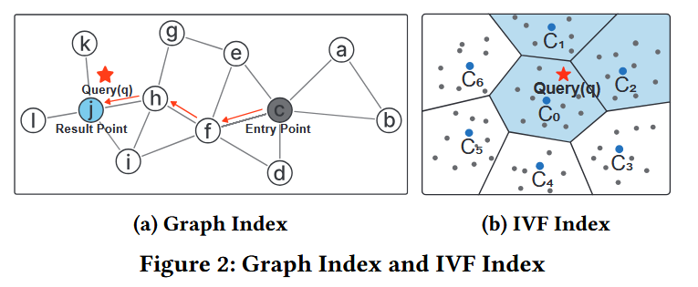
Index Organization for Hybrid Queries
Graph-Based Index
Inverted File Index(IVF)-Based Index
Connects each data point with its nearest neighbors. During querying, algorithms start from an initial point and use a greedy strategy to progressively move towards closer neighbors until convergence.
Hybrid query support:
AF: attach attribute metadata to nodes or edges, thereby skipping parts that do not satisfy query conditions during traversal.
RF: store valid attribute intervals on edges; traversal proceeds only along edges that satisfy range constraints.
Divides data into multiple clusters through a clustering algorithm (e.g., K-Means), with each cluster represented by a center. During querying, algorithms search only a few clusters closest to the query point, reducing computational load.
Hybrid query support:
Pre-filtering: exclude vectors that do not satisfy attribute constraints before distance computation.
Hierarchical partitioning by attributes can form finer-grained sub-clusters to enhance filtering efficiency
Notes:
混合查询中两种主流索引结构。图索引：每个点与最近邻相连，查询时从入口点贪心遍历、逐步跳向更近邻居。AF方向在节点或边上附加属性元数据，遍历时跳过不满足条件的部分。RF方向在边上存储有效数值区间，只沿满足范围约束的边遍历。IVF索引：通过K-Means将数据划分为多个簇，只搜索最近的几个簇。AF方向用预过滤——在距离计算前排除不符合属性约束的向量。RF方向可通过层次划分在簇内按属性值进一步划分细粒度子簇。两种结构各有优势——图索引查询效率高但构建成本大，IVF索引构建快、内存小。

Slide 7
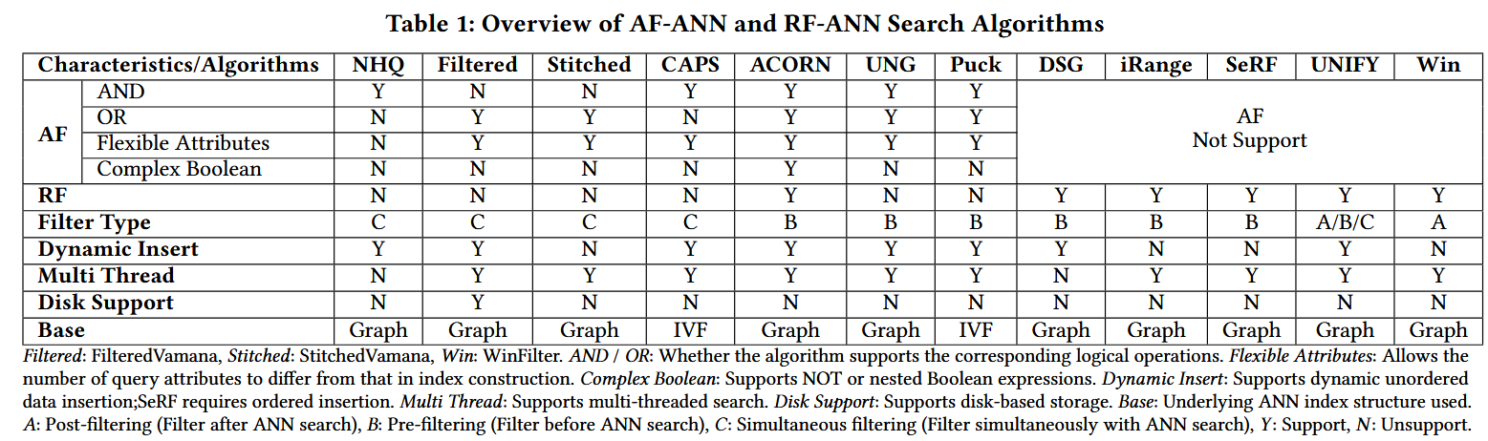
Algorithm Classification Overview
Table 1 provides a comparative overview of 6 attribute filtering and 5 range filtering algorithms.
Notes:
表1是对11种算法在10个维度上的分类对比。关键维度包括AND/OR支持、灵活属性、复杂布尔、RF支持、过滤类型、动态插入、多线程、磁盘支持和基础索引类型。一个重要的发现是：大多算法只支持AND或OR之一，不能兼顾；仅ACORN支持复杂布尔表达式（包括NOT和嵌套组合）。这个表格对后面理解各算法的优缺点非常重要。

Slide 8
Attribute Filtering Algorithms (I): Graph-Based
NHQ [Wang et al.] — First Simultaneous Filtering Approach
Constructs an index based on a nearest neighbor graph and introduces a fusion distance that jointly captures vector similarity and attribute similarity. Leveraging this fusion distance, NHQ unifies vector similarity and attribute matching into a single comprehensive similarity measure and builds the graph accordingly. During the query process, NHQ efficiently prunes irrelevant edges via this composite index, enabling fast retrieval of results that satisfy both vector similarity and attribute constraints.
Filtered-DiskANN [Gollapudi et al.] — Simultaneous Filtering on Vamana
Built upon the Vamana graph-based ANN index. Incorporates attribute information directly into the graph during index construction, ensuring the index reflects both vector similarity and attribute constraints. Proposes two indexes:
FilteredVamana: incrementally builds the graph by inserting data points and dynamically adding edges, allowing adaptive expansion.
StitchedVamana: adopts a batch construction strategy — constructing separate Vamana subgraphs for each attribute, followed by merging and edge pruning.
Notes:
先看AF算法中的图方法。NHQ是第一个实现同时过滤的方法——传统做法是将属性过滤和ANN搜索分开执行，NHQ引入融合距离，把向量相似度和属性匹配度合并成统一的相似性度量，依此构建图，查询时通过综合索引修剪不相关边。Filtered-DiskANN基于Vamana图索引，在构建时将属性信息合并到图中。两个变体：FilteredVamana动态插入、自适应扩展；StitchedVamana批量构建——先按属性建子图再缝合剪枝。从表1可以看到，这两个方法分别支持AND和OR，各有侧重。

Slide 9
Attribute Filtering Algorithms (II): Graph-Based
ACORN [Patel et al.] — Predicate-Agnostic on HNSW
Adopts a predicate-agnostic indexing framework based on HNSW, building a denser hierarchical graph through neighborhood expansion and edge pruning. During search, it filters out nodes violating constraints, maintaining a valid nearest neighbor graph.
ACORN-γ: expands neighbor lists during construction, trading memory for higher performance.
ACORN-1: extends neighbor lists via second-hop neighbors during search, reducing index size with minor performance loss.
UNG [Cai et al.] — Unified Framework with Label Navigating Graph
A unified framework integrating various graph-based ANN indexes to support hybrid queries.
Groups the dataset by attribute sets, ensuring that vectors in each group share identical attributes. Within each group, builds graph-based ANN indexes (e.g., Vamana, HNSW). Constructs a Label Navigating Graph (LNG) encoding inclusion relationships among attribute sets. Connects groups via cross-group edges to enable efficient cross-group search.
Notes:
ACORN采用与谓词无关的框架，基于HNSW构建更稠密的分层图，搜索时过滤违规节点。ACORN-γ构建时扩展邻居列表，以内存换性能。ACORN-1搜索时通过二跳邻居扩展，索引更小且性能损失轻微。ACORN是表1中唯一支持复杂布尔的算法。UNG是一个统一框架，按属性集分组、每组内独立构建ANN索引，通过标签导航图LNG编码属性集的包含关系，用跨组边连接实现高效跨组搜索。

Slide 10
Attribute Filtering Algorithms (III): IVF-Based
CAPS [Gupta et al.] — Attribute Frequency Tree (AFT)
Introduces a hierarchical sub-partitioning algorithm inspired by Huffman trees, termed the Attribute Frequency Tree (AFT), to overcome the coarse granularity of traditional IVF-based methods.
Adopts a two-level partitioning strategy:
the first level clusters vectors based on similarity using K-Means or learning-based methods; within each cluster, AFT partitions data further based on attribute frequencies, enabling finer-grained indexing and improving query efficiency.
Puck [Baidu] — Two-Level Quantization with Pre-Filtering
Utilizes two-level quantization for indexing.
Maintains an attribute set for each cluster to track vector attributes. During the query process, employs pre-filtering to exclude clusters without required attributes, thereby reducing the search space.
Notes:
IVF方向的两种AF算法。CAPS针对传统IVF粒度太粗的问题，引入受霍夫曼树启发的属性频率树AFT。第一级按向量相似度聚类，第二级在每个簇内按属性频率进一步划分，实现更细粒度索引。Puck利用两级量化，为每个簇维护属性集，查询时预过滤排除不含所需属性的簇，缩小搜索空间。这两种IVF方法构建快、索引小，非常适用于大规模场景。

Slide 11
Range Filtering Algorithms (I)
SeRF [Zuo et al.] — Validity-Range-Aware Graph Compression
Building a separate neighbor graph (e.g., HNSW) for each attribute range could ensure efficient querying but incurs an O(n²) cost in constructing and storing n graphs. Since many edges are shared across these graphs, SeRF introduces a validity-range-aware design where each edge records the interval in which it is valid. This compresses n graphs into a single unified graph, maintaining search effectiveness while significantly reducing memory and index construction overhead.
WinFilter [Engels et al.] — β-Window Search Tree (β-WST)
Proposes a structural partitioning framework.
After the dataset is sorted by attribute value, it is partitioned into multiple intervals and organized into a tree structure. Each node in the tree corresponds to an attribute range and maintains a local ANN index (e.g., Vamana).
For a range filtering query, WinFilter only searches within nodes overlapping the query range and merges partial results. With a tree height of O(log n), each query accesses at most O(log n) sub-indexes, resulting in significant speedups.
Notes:
范围过滤算法。SeRF的核心思想：为每个属性范围单独建图有O(n²)的成本，但很多边在多个图之间是共享的。于是SeRF只保留一个图，在每条边上记录其有效的数值区间——压缩n个图为一个统一图，大幅降低内存和构建开销。WinFilter提出了β窗口搜索树：数据集按属性排序后划分到多个区间，组织成树。每个节点对应一个属性范围并维护本地ANN索引。查询时只搜索重叠节点并合并结果。树高O(log n)，每次查询最多访问O(log n)个子索引。实验表明WinFilter是RF中性能最强的。

Slide 12
Range Filtering Algorithms (II)
iRange [Xu et al.] — Interval-Based Local Graph Merging
Partitions the dataset into intervals based on attribute values and independently constructs a local graph for each interval, storing only edge information. During the query process, the relevant local graphs overlapping with the query range are merged into a temporary search graph, and a pruning strategy is applied to enable efficient search.
DSG [Peng et al.] — First Dynamic RF-ANN Framework
Introduces the first dynamic RF-ANN framework supporting data insertion with unordered attributes while maintaining efficient range filtering. DSG relies on two data structures: a rectangle tree that partitions query space into rectangular regions, each corresponding to a group of queries sharing nearest neighbors; and a dynamic segment graph where each edge is annotated with its valid attribute range.
UNIFY [Liang et al.] — Segmented Inclusive Graph (SIG)
Partitions the dataset into segments by attribute and constructs an independent neighbor graph for each segment, then integrates them into a unified global graph. Its hierarchical variant HSIG incorporates the multilayer design of HNSW, skip lists, and edge bitmaps for efficient range localization. Supports 3 filtering strategies — pre-filtering, post-filtering, and simultaneous filtering — enabling robust and flexible performance.
Notes:
iRange按属性值分区，每个区间独立构建只存边信息的局部图。查询时把重叠的局部图合并为临时搜索图，用剪枝策略实现高效检索。小范围查询表现很好，但查询范围变大后性能会退化。DSG是首个动态RF-ANN框架——支持无序数据插入。依赖两种结构：矩形树将查询空间划分为矩形区域，动态线段图在边上标注有效属性范围。UNIFY引入了分段包含图SIG，按属性划分后构建段图再集成。分层变体HSIG融合了HNSW多层设计、跳表和边位图。支持预过滤、后过滤和同时过滤三种策略——是RF中最通用的方案。

Slide 13
Vector Libraries & Databases
The following systems are not explicitly designed for hybrid query, but support both attribute filtering and range filtering.
Faiss [Johnson et al.]
An efficient similarity search library. Supports hybrid search by using an ID selector to filter data before performing ANN search. The HQI batch optimization strategy groups queries with the same filter conditions, running the filter once and using efficient matrix operations to compute vector similarity in batches.
PASE [Yang et al.]
A vector index plugin for PostgreSQL using a post-filtering strategy. Since the candidate set size is fixed, it may fail to return enough top-k results. Its on-demand loading and caching strategies frequently trigger disk I/O and page scheduling, which seriously affect efficiency. Supports only data with dimensionality less than 512.
VBASE [Zhang et al.]
A vector plugin for PostgreSQL. Unlike PASE, it applies filters during the HNSW index traversal, discarding unmatched nodes on the fly. This strategy ensures that enough valid results are returned.
Milvus [Wang et al.]
A vector database designed for large-scale similarity search. In hybrid queries, adopts a pre-filtering strategy, similar to the ID selector mechanism used in Faiss.
Notes:
除了专门的混合查询算法，论文还评估了四个通用系统。Faiss用ID选择器预过滤，HQI批量优化——将相同过滤条件的查询分组、批量计算向量相似度。PASE是PG插件，采用后过滤——候选集大小固定，可能无法返回足够结果，且按需加载频繁触发磁盘IO，仅支持维度小于512的数据。VBASE也是PG插件，但在HNSW遍历期间就实时过滤不匹配节点，确保返回足够有效结果。Milvus是专门的大规模向量数据库，采用预过滤和内置查询优化器，可根据选择率动态决定先搜向量还是先滤属性，还有缓存感知优化。总的来说，这些通用系统灵活性强，但纯查询性能不如专门算法；其中PASE表现最差。

Slide 14
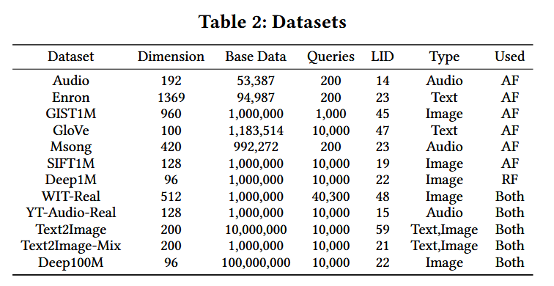
Experimental Setup
12 Real-World Datasets (Table 2)
Diverse Scales: 12 datasets (Audio/Text/Image) ranging from 1M to 100M (Deep100M).
Search Hardness: Quantified by LID (Local Intrinsic Dimensionality); higher LID = more complex search.
Attribute Types:
Generated: Precise control over distribution (first 7 sets).
Real-world: WIT-Real (CLIP-encoded) and YT-Audio-Real (YouTube8M).
Key Challenges: Text2Image for OOD (Out-of-Distribution) and Deep100M for scalability testing.
5 Core Metrics & Environment
(1) Recall@k (2) QPS (3) Index Construction Time (4) Index Size (5) Peak Memory Usage
Server: AMD EPYC 7K62 (2.6GHz) 256GB RAM | 100M-scale: 2×AMD 7Y43 1TB RAM
Index construction: 32 threads (64 for Deep100M). Query execution: single thread.
Parameters: recommended settings from original papers when available.
Notes:
实验使用12个真实数据集。前7个是标准数据集，作者生成了属性值以便精确控制属性数量和分布。WIT-Real和YT-Audio-Real使用真实属性。Text2Image是跨模态数据集——用文本查图像，专门测试OOD泛化能力。Deep100M含1亿条数据，测试极端扩展性。LID是局部本征维度，值越高数据集越复杂。5个核心评估指标：Recall@k衡量准确性、QPS衡量搜索效率、索引构建时间衡量时间成本、索引大小衡量存储开销、峰值内存衡量内存成本。普通测试用AMD EPYC 256GB内存，亿级测试用双路AMD 1TB内存。构建用32线程，查询用单线程。参数优先使用原论文推荐值。

Slide 15
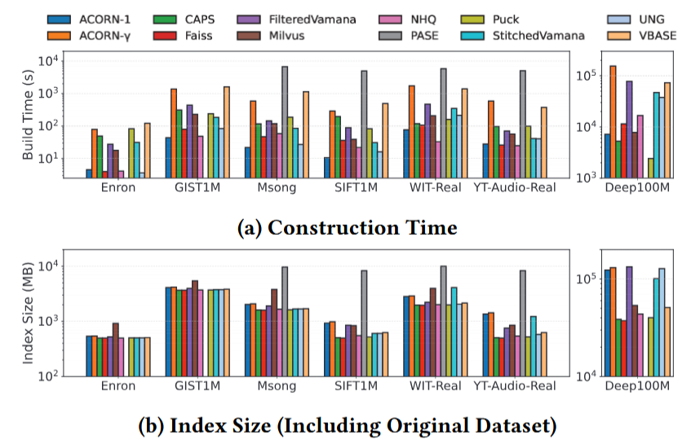
AF: Time & Space Overhead
Index Construction Time.
Among single-threaded algorithms, PASE has the longest build time due to its on-demand loading and caching strategies, which frequently trigger disk I/O. VBASE uses full-memory builds and is therefore comparatively faster. Among multi-threaded algorithms, ACORN-γ is the slowest because it needs to expand the neighbor list and evaluate a large number of candidates. On Deep100M, algorithms based on Vamana (FilteredDiskANN, StitchedVamana and UNG) exhibit significantly increased construction time due to the two-pass graph construction and optimization strategy(greedy search + robust pruning). In contrast, the construction time of IVF-based algorithms grows much more slowly — their shard-based design and high parallel efficiency make them more scalable in large-scale scenarios.
Notes:
AF时空开销（图3）。构建时间：PASE单线程最慢——按需加载频繁触发磁盘IO。ACORN-γ多线程最慢——需要大量邻居扩展和候选评估。Vamana系列在大规模上显著变慢——两阶段构建方式在大数据量下计算开销爆炸；IVF方法基于分片设计，可扩展性最强。索引大小：PASE最大——依赖大量元数据；大规模下基于图的方法急剧增加；基于IVF的方法结构更紧凑。峰值内存：三个例外——NHQ构建时生成大量候选邻居导致构建内存极高但最终索引紧凑；CAPS查询时动态维护大候选集导致搜索内存高；PASE按需加载使得构建内存甚至低于最终索引大小。

Slide 16
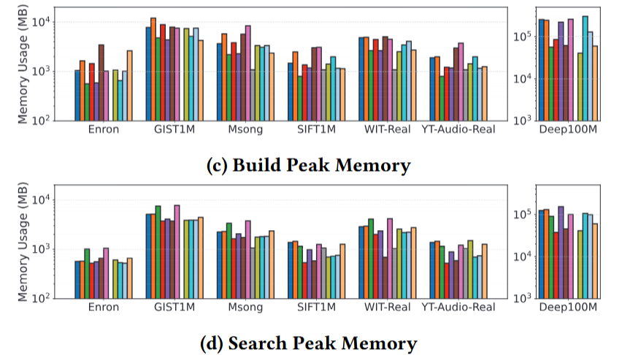
AF: Time & Space Overhead
Index Size.
PASE exhibits significantly larger index sizes across all datasets, mainly due to its reliance on a large amount of metadata. On large-scale datasets, graph-based algorithms such as ACORN, FilteredDiskANN, and UNG tend to exhibit a sharp increase in index size. Overall, IVF-based methods tend to produce more compact indexes.
Peak Memory.
NHQ generates a large number of candidate neighbors during construction, leading to high peak memory usage despite a relatively compact index. During querying, CAPS maintains a large candidate set dynamically, which significantly increases its search peak memory consumption. PASE adopts an on-demand loading strategy, resulting in build peak memory usage even lower than the final index size.
Notes:
AF时空开销（图3）。构建时间：PASE单线程最慢——按需加载频繁触发磁盘IO。ACORN-γ多线程最慢——需要大量邻居扩展和候选评估。Vamana系列在大规模上显著变慢——两阶段构建方式在大数据量下计算开销爆炸；IVF方法基于分片设计，可扩展性最强。索引大小：PASE最大——依赖大量元数据；大规模下基于图的方法急剧增加；基于IVF的方法结构更紧凑。峰值内存：三个例外——NHQ构建时生成大量候选邻居导致构建内存极高但最终索引紧凑；CAPS查询时动态维护大候选集导致搜索内存高；PASE按需加载使得构建内存甚至低于最终索引大小。

Slide 17
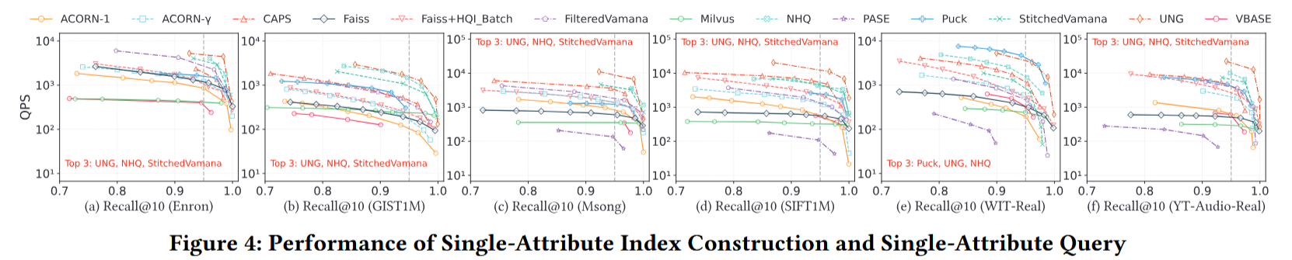
AF: Single-Attribute Performance
Scenario: Index constructed using a single attribute, filtering applied on the same attribute.
As shown in Figure 4, as recall approaches 1, search often requires traversing larger candidate sets or deeper graph paths, leading to a sharp QPS drop for most methods. Despite this, UNG consistently maintains high QPS due to its LNG structure, which eliminates unnecessary online filtering of irrelevant attributes and searches only within the subgraph formed by points satisfying the filtering conditions.
NHQ and StitchedVamana also perform well and show stable performance across all datasets. StitchedVamana outperforms FilteredVamana because post-merge pruning allows nodes to accumulate a richer candidate set, while FilteredVamana's early pruning may eliminate useful candidates prematurely. Puck and CAPS also perform relatively well by further reducing the search space on IVF indexes using attribute partitioning.
Among all methods, vector database systems (PASE, VBASE, Milvus) show the worst performance — these systems incur communication latency from network I/O and experience high query processing overhead. Faiss+HQI_Batch outperforms original Faiss, indicating that batch querying via HQI can effectively enhance query performance.
Notes:
单属性场景（图4）。UNG表现最优——LNG结构消除了在线过滤无关属性的开销，只在满足过滤条件的子图中搜索。NHQ和StitchedVamana稳定——联合过滤和搜索策略在高召回率下有效。StitchedVamana优于FilteredVamana——缝合后剪枝保留了更丰富的候选集，而早期剪枝可能过早剔除有用候选。Puck和CAPS通过属性分区进一步缩小搜索空间。向量数据库系统最差——网络IO和查询解析开销大。Faiss加HQI批量优化后性能显著提升。注意灰色虚线是0.95召回率的基准线。

Slide 18
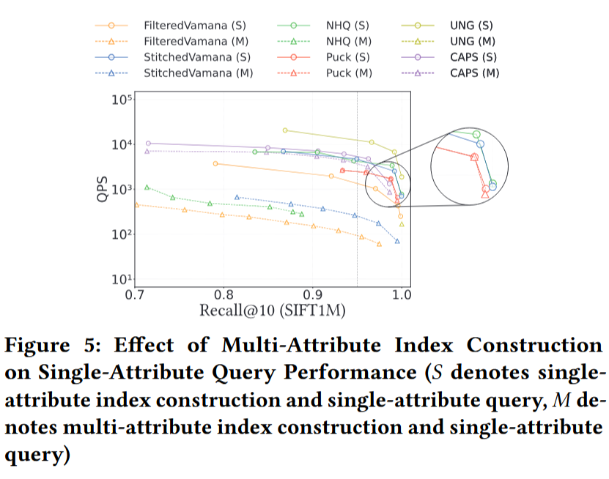
AF: Multi-Attribute Build + Single-Attribute Query
Scenario: Index constructed using 8 attributes, filtering applied on only 1 attribute.
As shown in Figure 5, Puck demonstrates nearly no performance degradation. CAPS shows a slight performance decline due to increased query overhead from excessive attribute-based grouping.
In contrast, StitchedVamana, FilteredVamana, NHQ, and UNG drop significantly. The reasons are:
(1) FilteredVamana increases the complexity introduced by retaining attribute information during index construction. (2) StitchedVamana complexity increases because data points duplicate across multiple subgraphs. (3) The fusion distance of NHQ exhibits sensitivity to the number of attributes, which degrades its effectiveness. (4) UNG has poor performance because a large number of entry points need to be traversed; it is difficult for a graph with multiple entries to have good connectivity, degenerating into a situation closer to inverted retrieval.
IVF-based methods (Puck and CAPS) significantly outperform graph-based methods. The reason is that they filter out irrelevant results during the retrieval process rather than searching for more candidates.
Notes:
多属性构建+单属性查询场景（图5）。Puck几乎无性能下降，CAPS仅轻微下降。而图方法性能大幅下降：FilteredVamana属性元数据太多导致复杂度增加；StitchedVamana数据点在多个子图中重复；NHQ的融合距离对属性数量极度敏感；UNG入口点太多导致图连通性变差，退化为接近倒排检索。核心结论：在这个场景下IVF方法完胜图方法——因为IVF只是在检索过程中过滤掉不相关结果，而图方法因属性增多导致整个索引结构臃肿复杂。

Slide 19
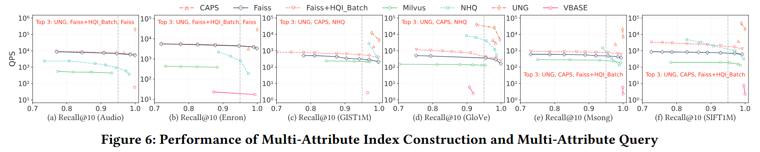
AF: Multi-Attribute Build + Multi-Attribute Query
Scenario: Index constructed using 3 uniformly distributed attributes, filtering applied on all 3 attributes simultaneously. Only algorithms supporting multi-attribute queries are evaluated.
As shown in Figure 6, UNG still maintains the best performance across all datasets. CAPS becomes the second-best algorithm, but its performance on small datasets is relatively poor because CAPS performs multi-level partitioning based on attributes on top of the IVF index, which introduces additional overhead. While this overhead negatively impacts performance on small datasets, on larger datasets the overhead is amortized, and the advantages of attribute-aware partitioning become evident.
NHQ performs moderately overall but poorly on small datasets. Its reliance on fusion distance computations makes it highly sensitive to the number of attributes. For IVF-based methods not specifically optimized for hybrid queries (Faiss and Milvus), their QPS shows a similar and relatively stable trend as recall varies.
Notes:
多属性构建+多属性查询场景（图6）。UNG依然最强。CAPS第二——小数据集表现一般因为多层分区增加了额外开销，但在大数据集上开销被摊平，属性感知分区的优势开始显现。NHQ整体中等但在小数据集上较差——融合距离对属性数量太敏感。Faiss和Milvus趋势相对稳定。

Slide 20
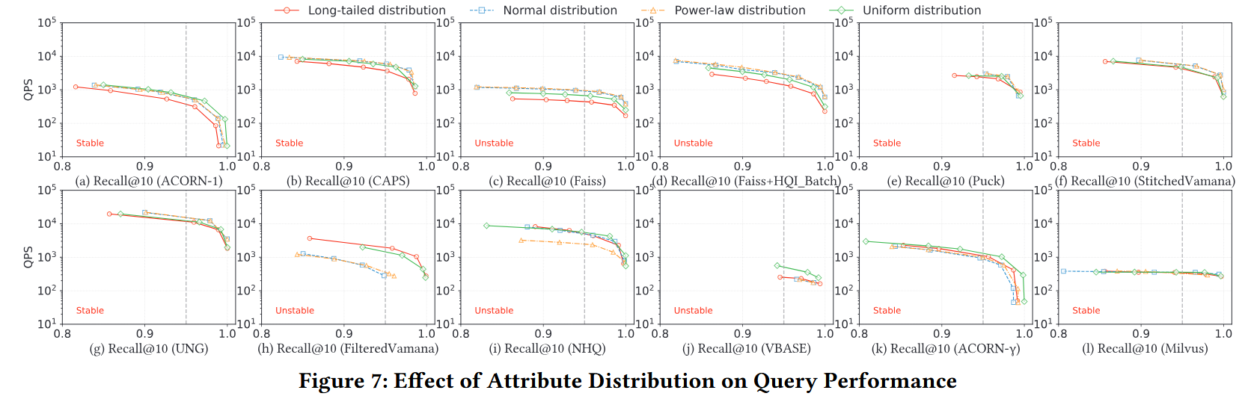
AF Robustness: Attribute Distribution
Experiment: Four distributions (long-tail, normal, power-law, uniform) on SIFT1M. The proximity of the curves in Figure 7 reflects algorithm sensitivity — when curves converge closely, the algorithm maintains stable performance when attribute distributions change. PASE is excluded due to poor past performance.
Algorithms highly sensitive to attribute distribution:
Graph-based methods like FilteredVamana and NHQ are prone to degraded connectivity or distorted structures under power-law distributions, where label frequencies are highly imbalanced. VBASE, employing a post-filtering strategy, shows efficiency that directly correlates with attribute selectivity. Faiss may need to traverse more clusters when relevant data points are unevenly distributed across clusters due to attribute skew.
Notes:
AF鲁棒性——属性分布的影响（图7）。在SIFT1M上测试了四种分布。敏感算法：FilteredVamana和NHQ在幂律分布下图连通性受损；VBASE的后过滤效率与选择率直接相关——过滤越严格浪费的计算越多；Faiss属性偏斜时需要遍历更多簇。鲁棒算法：Milvus内置查询优化器根据选择率动态选择策略；UNG用逻辑图将属性和向量索引分离；CAPS用属性频率树自适应幂律模式；ACORN-γ上层导航图基本不受属性变化影响。

Slide 21
AF Robustness: Attribute Distribution
Experiment: Four distributions (long-tail, normal, power-law, uniform) on SIFT1M. The proximity of the curves in Figure 7 reflects algorithm sensitivity — when curves converge closely, the algorithm maintains stable performance when attribute distributions change.
Algorithms with low sensitivity to attribute distribution:
Milvus leverages a built-in query optimizer that dynamically determines whether to filter by attributes or search vectors first based on selectivity. UNG uses a logical graph to separate attribute and vector indexing into distinct stages. CAPS employs an attribute frequency tree to adapt to power-law patterns. For ACORN-γ, the upper-layer hierarchical navigation graphs remain largely unaffected by attribute distribution changes.
Notes:
AF鲁棒性——属性分布的影响（图7）。在SIFT1M上测试了四种分布。敏感算法：FilteredVamana和NHQ在幂律分布下图连通性受损；VBASE的后过滤效率与选择率直接相关——过滤越严格浪费的计算越多；Faiss属性偏斜时需要遍历更多簇。鲁棒算法：Milvus内置查询优化器根据选择率动态选择策略；UNG用逻辑图将属性和向量索引分离；CAPS用属性频率树自适应幂律模式；ACORN-γ上层导航图基本不受属性变化影响。

Slide 22
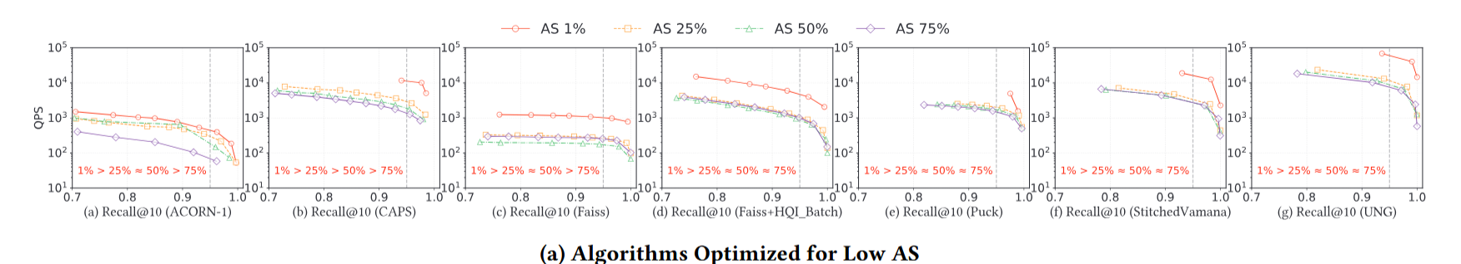
AF Robustness: Attribute Selectivity
AS = proportion of data points sharing a given attribute value. Tested: 1%, 25%, 50%, 75% on SIFT1M. Based on the query performance trends, algorithms are categorized into three groups.
Group 1 — Algorithms optimized for low AS (Figure 8a):
ACORN-1, Faiss, Puck, and UNG all use pre-filtering strategies which significantly reduce the number of candidate points under low AS, thereby lowering the cost of distance computations. CAPS efficiently skips irrelevant sub-partitions. StitchedVamana optimizes local adjacency using independent subgraphs, enabling fast localization at low AS.
Notes:
AF鲁棒性——属性选择率的影响（图8）。选择率AS表示满足条件的点占比，1%是极度严格、75%是宽松。分三组。低AS优化组：ACORN-1、Faiss、Puck、UNG采用预过滤策略，在低AS时显著压缩搜索空间、降低计算成本。CAPS能有效跳过不相关子分区。StitchedVamana利用独立子图优化局部邻接。高AS优化组：低AS下FilteredVamana动态剪枝难以平衡向量距离和属性相关性；NHQ难以高效定位相关区域；PASE最差——固定候选集在低AS时几乎不包含有效结果，召回率降至0.2以下。不敏感组：Milvus系统开销主导了性能；ACORN-γ通过高γ参数确保属性剪枝后仍有稳定的平均节点度数。结论：如果过滤条件苛刻应选择有强力预过滤机制的算法。

Slide 23
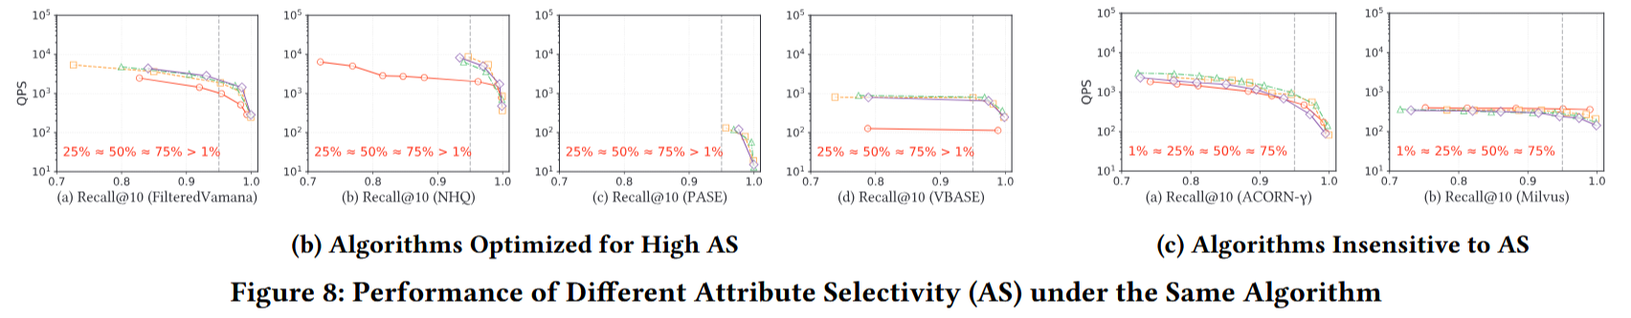
AF Robustness: Attribute Selectivity
AS = proportion of data points sharing a given attribute value. Tested: 1%, 25%, 50%, 75% on SIFT1M. Based on the query performance trends, algorithms are categorized into three groups.
Group 2 — Algorithms optimized for high AS (Figure 8b):
At low AS, FilteredVamana's dynamic pruning strategy makes it difficult to balance vector distance and attribute relevance, resulting in overly restricted search paths. NHQ struggles to locate relevant regions efficiently. PASE performs poorly at extremely low AS (1%), with recall dropping below 0.2. VBASE, relying on post-filtering, increases computational overhead at low AS.
Group 3 — Algorithms insensitive to AS (Figure 8c):
Milvus is mainly limited by system-level communication overhead so its query performance remains largely unaffected by AS variations. ACORN-γ maintains stable performance by using a higher index construction parameter γ, which ensures a relatively stable average node degree even after attribute pruning.
Notes:
AF鲁棒性——属性选择率的影响（图8）。选择性AS表示满足条件的点占比，1%是极度严格、75%是宽松。分三组。低AS优化组：ACORN-1、Faiss、Puck、UNG采用预过滤策略，在低AS时显著压缩搜索空间、降低计算成本。CAPS能有效跳过不相关子分区。StitchedVamana利用独立子图优化局部邻接。高AS优化组：低AS下FilteredVamana动态剪枝难以平衡向量距离和属性相关性；NHQ难以高效定位相关区域；PASE最差——固定候选集在低AS时几乎不包含有效结果，召回率降至0.2以下。不敏感组：Milvus系统开销主导了性能；ACORN-γ通过高γ参数确保属性剪枝后仍有稳定的平均节点度数。结论：如果过滤条件苛刻应选择有强力预过滤机制的算法。

Slide 24
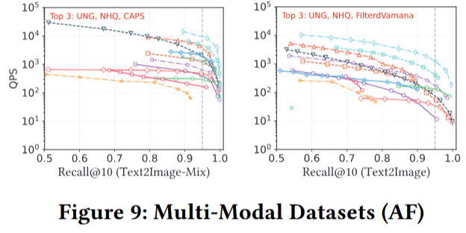
AF Robustness: Multi-Modal Queries
Text2Image-Mix (lower difficulty):
The base dataset comprises 0.5 million image embeddings and 0.5 million text embeddings. As shown in Figure 9, UNG and NHQ consistently perform best, followed by CAPS. Although the dataset contains two modalities, due to the significant differences between them, they are actually two separate regions in the vector space. The performance is similar to that of the single-modal dataset (Figure 4).
Text2Image original (OOD, high difficulty):
The base dataset contains 1 million image embeddings, with 10,000 text embeddings as the query set. The query set and the base dataset belong to two completely different modalities. Queries are far from the dataset points, and the ground truths are more dispersed. To find the ground truths, algorithms typically need to examine more points, which leads to degraded performance across all evaluated algorithms.
Notes:
AF鲁棒性——多模态查询（图9）。Text2Image-Mix包含图像和文本两种模态，但由于它们在向量空间中处于分离区域，查询本质上等同于分别在两个同模态数据集上搜索，性能与单模态相似。但Text2Image原始版则完全不同——查询集是文本、底库是图像，完全跨模态。查询点距离数据点非常遥远，真实最近邻分布极其分散，算法必须检查更多节点才能找齐结果，导致所有算法性能下降。这说明目前算法在跨模态OOD场景下面临严重挑战。

Slide 25
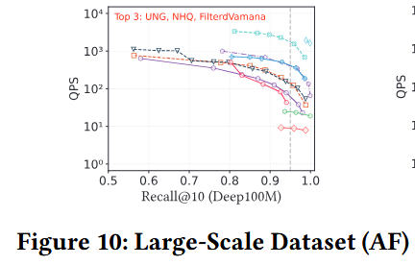
AF Robustness: Large-Scale Dataset (Deep100M)
Deep100M: 100 million data points — tests extreme scalability of AF algorithms.
As shown in Figure 10, UNG and NHQ still exhibit excellent query performance on the Deep100M dataset, demonstrating good adaptability to large-scale datasets. However, this also comes with significant memory overhead.
The clustering-based algorithm Faiss+HQI_Batch shows moderate performance but has very low memory overhead, which also has certain practical significance for resource-constrained industrial deployment.
The paper does not present results for StitchedVamana and CAPS at this scale.
StitchedVamana sets the search entry point to 0 by default, which makes it prone to getting stuck in local optima when the entry is far from the target region. CAPS cannot properly run large-scale dataset experiments because its code implementation does not account for such scenarios.
Notes:
AF鲁棒性——大规模数据集（图10）。Deep100M包含1亿条数据。UNG和NHQ依然表现出卓越的查询性能——证明它们对海量数据有很好的适配性，但代价是惊人的内存开销。聚类算法Faiss+HQI_Batch展示中等的查询性能和极低的内存占用——在工业界资源受限的实际部署中是极具参考价值的平衡方案。StitchedVamana没有数据——因为它默认搜索入口点为0，在亿级空间中入口离目标太远极易陷入局部最优。CAPS同样无法运行——其原始代码实现未考虑大规模场景。

Slide 26
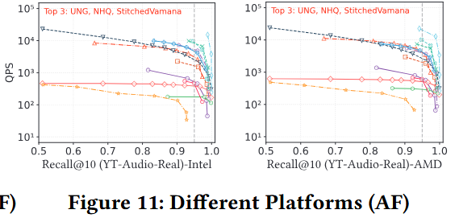
AF Robustness: Different Hardware Environments
To investigate the impact of different server configurations, the authors conduct experiments on two servers using the YT-Audio-Real dataset (Figure 11). Server A: AMD EPYC 7K62 @ 2.6GHz, 256GB RAM, 192MiB L3 cache. Server B: Dual Intel Xeon Gold 6330 @ 2.0GHz, 128GB RAM, 84MiB L3 cache.
Key finding: The relative ranking of the algorithms under the two servers essentially remains unchanged,
indicating that the performance of these methods is not significantly affected by differences in CPU configurations. This validates that performance differences are determined by the underlying algorithmic logic, not by specific hardware optimizations.
Due to the lower CPU frequency, reduced RAM capacity, and smaller L3 cache on the Intel platform, all methods demonstrate slightly lower absolute QPS values.
Notes:
AF鲁棒性——不同硬件环境（图11）。论文在AMD和Intel两种完全不同架构的服务器上做了对比实验。重要发现：算法之间的优劣排名几乎没有变化——这证明了性能差异是由算法底层逻辑决定的，而非特定硬件优化。在Intel平台上所有算法的绝对QPS略有下降，这归因于更低的CPU主频、更小的RAM和更小的L3缓存。结论：混合查询算法性能对硬件配置不敏感，但在高频大缓存硬件上有更好的绝对速度。

Slide 27
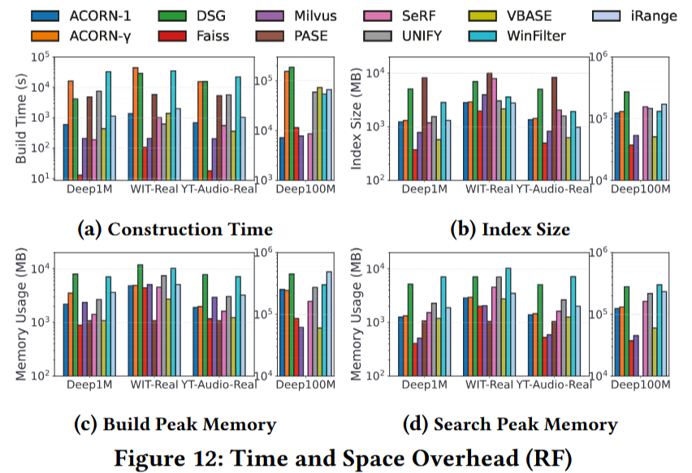
RF: Time & Space Overhead
Index Construction (Figure 12a).
Faiss and Milvus, based on the IVF architecture, require less time because this indexing structure enables fast construction through subset sampling and centroid computation. Milvus performs particularly well on large-scale datasets due to its cache-aware optimizations. ACORN-1 and SeRF also achieve short construction time. ACORN-γ, DSG, and WinFilter exhibit relatively long construction time — WinFilter incurs high cost as it builds a separate nearest neighbor graph for each tree node, leading to redundant computations.
Index Size (Figure 12b).
Faiss has the smallest index size — IVF only adds centroid data and partition information to the vector dataset. PASE requires the most storage. DSG also results in a large index size on massive datasets as it stores additional metadata for each edge.
Peak Memory (Figure 12c-d).
WinFilter presents an exception: although the final index size remains relatively small, the peak memory usage increases significantly during both construction (parallel building of local indices for each tree node) and search (parallel loading of multiple local indices for different tree nodes).
Notes:
RF时空开销（图12）。构建时间：Faiss和Milvus最快——IVF只需子集采样和质心计算；Milvus在大规模下缓存感知优化出色。ACORN-γ、DSG和WinFilter较慢——WinFilter为每个树节点构建独立的ANN索引导致大量冗余计算。索引大小：Faiss最紧凑——IVF仅在原始向量数据上增加极少质心和分区信息。PASE最臃肿。DSG在大规模下为每条边存储额外元数据导致体积激增。峰值内存：WinFilter例外——最终索引不算大，但因为并行构建和并行加载各节点的本地索引，峰值内存极高。范围比例定义为2^{-i}。

Slide 28
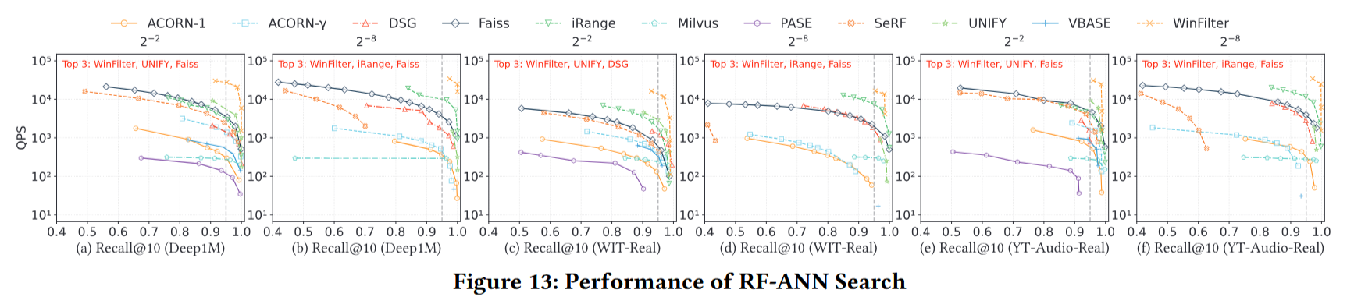
RF: Performance Evaluation
Evaluated under four query range settings: 2⁻², 2⁻⁴, 2⁻⁶, and 2⁻⁸. Figure 13 reports results for the largest (2⁻²) and smallest (2⁻⁸) range ratios.
Algorithms that performed well:
WinFilter maintains optimal performance by building an index for each tree node, performing ANN search on the relevant nodes, and post-filtering the results, ensuring high recall and QPS. iRange dynamically constructs a search graph during querying — this method has low overhead and performs well in small-range queries, but its performance degrades as the query range increases. UNIFY utilizes a skip list for localization followed by a linear scan for small ranges. Faiss, aided by its efficient ID selector for filtering, calculates distances for only a small subset of points in small-range scenarios; consequently, it can outperform algorithms specifically designed for range searches in these cases.
Notes:
RF性能评估（图13）。WinFilter全场最佳——为每个树节点建索引，在相关节点上执行ANN搜索后做后过滤，在高召回率和高QPS之间达到最佳平衡。iRange擅长小范围查询——动态构建搜索图开销低，但范围扩大后性能退化。UNIFY在小范围场景用跳表定位加线性扫描。Faiss是一个意料之外的表现者——借助高效ID选择器预过滤，在小范围下只计算极少数符合条件数据点的距离，甚至能超过某些专门设计的范围搜索算法。表现差的算法：SeRF小范围召回率严重下滑——必须扫描大量与当前查询无关的边项，容易陷入局部最优。ACORN不是专为RF设计的——通用预过滤在应对区间逻辑时力不从心。PASE最差——小范围下召回率低于0.1。

Slide 29
RF: Performance Evaluation
Evaluated under four query range settings: 2⁻², 2⁻⁴, 2⁻⁶, and 2⁻⁸. Figure 13 reports results for the largest (2⁻²) and smallest (2⁻⁸) range ratios.
Algorithms that performed poorly:
SeRF demonstrates relatively weak overall performance, with a pronounced drop in recall under small-range query scenarios — its multi-filtering mechanism requires scanning a large number of edge entries that are irrelevant to the current query range. ACORN does not design an index specifically for range queries, adopting instead a generic pre-filtering strategy. PASE performs particularly poorly in small-range queries, with recall rate lower than 0.1, mainly due to its post-filtering strategy on a fixed candidate set.
Notes:
RF性能评估（图13）。WinFilter全场最佳——为每个树节点建索引，在相关节点上执行ANN搜索后做后过滤，在高召回率和高QPS之间达到最佳平衡。iRange擅长小范围查询——动态构建搜索图开销低，但范围扩大后性能退化。UNIFY在小范围场景用跳表定位加线性扫描。Faiss是一个意料之外的表现者——借助高效ID选择器预过滤，在小范围下只计算极少数符合条件数据点的距离，甚至能超过某些专门设计的范围搜索算法。表现差的算法：SeRF小范围召回率严重下滑——必须扫描大量与当前查询无关的边项，容易陷入局部最优。ACORN不是专为RF设计的——通用预过滤在应对区间逻辑时力不从心。PASE最差——小范围下召回率低于0.1。

Slide 30
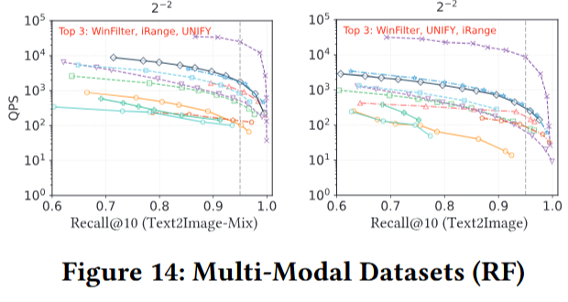
RF Robustness: Multi-Modal Queries
Text2Image-Mix:
The performance of range filtering queries on this dataset is similar to the single-modality query performance (Figure 13). Even though the base contains two modalities, since they are spatially independent in the vector space, the range filtering logic is not additionally disturbed.
Text2Image original (OOD dataset):
All evaluated algorithms exhibit a significant performance degradation. This is because most range query algorithms (e.g., WinFilter, iRange) are graph-based, and such algorithms require more iterations to find true neighbors in out-of-distribution scenarios where query points (text vectors) are distant from base points (image vectors). The cross-modal semantic gap causes noticeable efficiency loss for current range filtering algorithms.
Notes:
RF鲁棒性——多模态查询（图14）。Text2Image-Mix性能与单模态相似——两种模态在向量空间中处于分离区域。Text2Image OOD场景：所有算法均出现显著退化——因为大多数RF算法基于图结构，而在OOD场景下查询点与底库点距离遥远，图算法需要更多迭代跳转才能锁定真实最近邻。跨模态语义鸿沟对现有范围过滤算法的效率损耗非常明显。

Slide 31
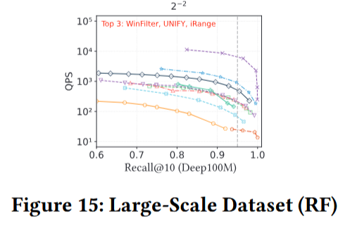
RF Robustness: Large-Scale Dataset (Deep100M)
As shown in Figure 15, the top 3 ranked algorithms (WinFilter, UNIFY, and iRange) remain unchanged on the Deep100M dataset, proving their excellent search efficiency at scale. However, this high performance is achieved at the cost of extremely high memory consumption to maintain complex range-filtering structures (see Figure 12d).
In contrast, VBASE and Faiss demonstrate moderate query performance while consuming significantly less memory. For memory-budget-constrained industrial large-scale deployments, VBASE or Faiss represent more practical and balanced alternatives.
Notes:
RF鲁棒性——大规模数据集（图15）。在Deep100M上前三名排名不变——WinFilter、UNIFY、iRange证明了卓越的大规模搜索效率。但代价是极高的内存消耗——维护复杂范围树或局部图吃掉了大量RAM。相比之下VBASE和Faiss展示中等性能但内存消耗显著更低——对内存预算有限的工业部署是更务实的平衡方案。

Slide 32
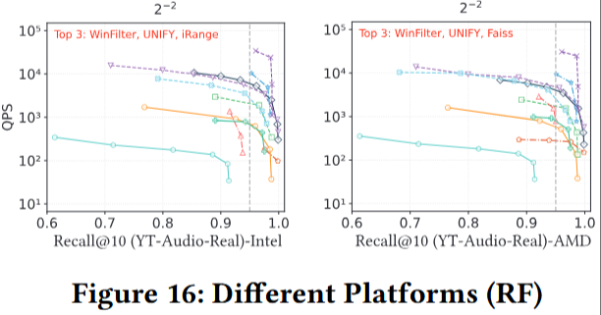
RF Robustness: Different Hardware Environments
Consistent with Section 4.2.3, the authors conduct range filtering experiments on the YT-Audio-Real dataset using two server configurations, with results presented in Figure 16.
Although the third- and fourth-ranked algorithms may swap positions slightly (their performance is very close), the overall ranking order remains stable across platforms. Different server configurations mainly affect the absolute speed of individual algorithms, with minimal impact on their relative performance ranking. This finding is consistent with the AF hardware robustness results, further validating that hybrid query algorithm performance is determined by algorithmic logic, not by specific hardware optimizations.
Notes:
RF鲁棒性——不同硬件环境（图16）。与AF硬件评估一致，排名保持稳定。虽然第三和第四名可能在不同平台上发生微调（两者性能本身非常接近），但总体排名顺序不变。不同服务器配置主要影响绝对速度，对相对排名影响很小。这再次验证了混合查询算法的性能取决于算法底层逻辑。

Slide 33
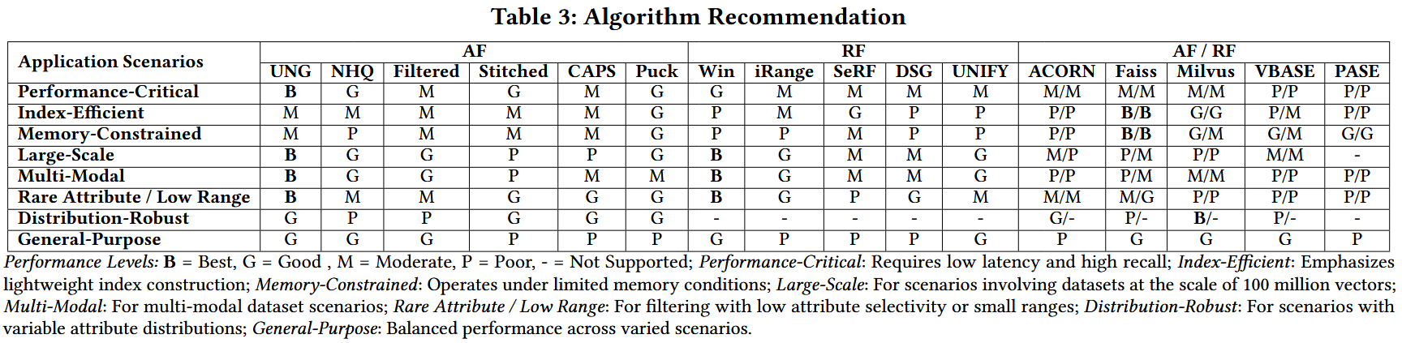
Discussion: Algorithm Recommendations
Based on the performance of algorithms across various experimental settings, the authors evaluate their strengths and weaknesses in different application scenarios, as shown in Table 3. Performance levels: B = Best, G = Good, M = Moderate, P = Poor, - = Not Supported.
Notes:
表3是论文的核心总结——在8种应用场景下各算法的评级。性能关键型需要低延迟高召回率：UNG、NHQ、Filtered-DiskANN最优。索引高效型侧重轻量构建：Faiss最佳。内存受限：Faiss和Milvus领先。大规模亿级场景：UNG和WinFilter表现出色、Puck性价比最高。多模态：UNG、NHQ、WinFilter最优。稀有属性或小范围过滤：UNG和WinFilter最强。分布鲁棒：Milvus最好——其内置查询优化器能动态选择策略。通用场景：Faiss、Milvus、VBASE平衡且灵活。PASE在所有维度都表现最差——其按需加载策略完全不适合对性能有要求的场景。

Slide 34
Recommendations: Attribute Filtering
Performance-critical (low latency, high recall): UNG, NHQ, Filtered-DiskANN. Caveat: UNG and NHQ suffer performance degradation when the attribute count differs between indexing and querying; NHQ's performance is also sensitive to attribute distribution.
Large-scale + memory-constrained: FilteredVamana supports disk-based indexing and dynamic insertion, making it suitable for extremely large-scale datasets even in memory-constrained environments. Cost: disk-based construction significantly increases indexing time.
Cost-performance for 100M-scale: Puck offers fast index construction and low memory consumption, making it the most cost-effective choice for 100-million-scale scenarios.
Compact + low-selectivity optimized: CAPS features low index space overhead, flexible support for varying numbers of attributes, and is optimized for low-selectivity attribute scenarios. Overall performance is relatively moderate.
General-purpose: Faiss, Milvus, VBASE offer versatile pre-/post-filtering strategies with broad applicability but moderate search performance. PASE performs less well across various aspects — its on-demand loading strategy is unsuitable for performance-demanding scenarios. ACORN demonstrates average overall performance.
Notes:
AF算法推荐总结。性能优先选UNG、NHQ、Filtered-DiskANN——但要注意UNG和NHQ对索引属性数和查询属性数的一致性要求很高，不匹配时性能骤降；NHQ还对属性分布敏感。超大规模且内存受限选FilteredVamana——支持磁盘索引和动态插入，代价是磁盘构建很慢。亿级数据性价比最高选Puck——构建快、内存消耗极低。节省空间和处理极端过滤选CAPS——索引体积小、专为低选择性优化。通用系统选Faiss、Milvus或VBASE——灵活但性能中等。PASE各方面最差。

Slide 35
Recommendations: Range Filtering
Best search performance: WinFilter achieves the best search performance but requires high time and memory resources during construction. For large-scale datasets (e.g., 100 million points), parameter tuning — particularly of tree height — is needed to prevent excessive index growth. When QPS and recall requirements are not strict, its basic variant Vamana-WST offers a more efficient alternative with significantly lower indexing overhead.
Lightweight choice: iRange has relatively low time and space costs for index construction. However, its search performance declines significantly with increasing query range. Despite offering threading parameters for indexing, it does not effectively utilize multi-core parallelism in practical scenarios.
Dynamic insertion: DSG supports unordered dynamic insertions and range queries, but its index construction is limited to single-threaded execution, resulting in long build times and poor practical applicability.
Most general-purpose: UNIFY adopts multiple filtering strategies tailored to different query range sizes, avoiding the limitations of a single strategy in specific scenarios. It requires only one index to support all queries, allows dynamic insertions, and features low time and space overhead during construction — making it the most general-purpose solution among range filtering algorithms.
Notes:
RF算法推荐总结。性能天花板选WinFilter——搜索速度最快，但索引构建耗时极长、内存资源消耗极大。大规模下需要调优树高，否则索引体积会失控。如果速度要求不那么极致，基础版Vamana-WST构建成本更低、性价比更高。轻量级选手iRange——构建快占地小，但搜索大范围时性能差，且无法充分利用多核。动态插入专家DSG——支持无序动态插入，但只能单线程构建导致入库时间太长。全能型选手UNIFY——一个索引走天下，能根据查询范围大小自动切换过滤策略，支持动态插入，时空开销都很低，是目前最通用的RF方案。大规模性价比选VBASE和Faiss——性能中等但内存显著更低。

Slide 36
Challenges: Attribute Filtering (I)
GPU Acceleration
The index construction phase of graph-based algorithms is computationally intensive. Therefore, exploring GPU-based acceleration for graph construction and vector computation during indexing is a promising direction that can significantly improve the performance of graph-based methods.
Limited Boolean Logic Support
In multi-attribute scenarios, some algorithms support only Boolean OR logic (e.g., Filtered-DiskANN), while others support only Boolean AND logic (e.g., NHQ, CAPS). Although algorithms such as ACORN, UNG, and Puck support both AND and OR logic, they still struggle to handle complex Boolean expressions that involve nested combinations of conjunctions and disjunctions. In contrast, while databases and the vector search library Faiss support more expressive Boolean logic, their performance is often suboptimal in queries involving only basic attribute filtering. Therefore, designing algorithms that can support complex filtering expressions while maintaining high query efficiency remains a key challenge.
Notes:
AF面临的挑战。第一，GPU加速——图算法索引构建计算量巨大，探索基于GPU的图构建和向量计算加速是极具前景的方向。第二，布尔逻辑支持不全——很多算法偏科，有的只支持OR如Filtered-DiskANN，有的只支持AND如NHQ和CAPS。即使同时支持AND/OR的ACORN、UNG、Puck，在处理嵌套逻辑时依然吃力。而传统数据库和Faiss虽支持复杂逻辑但纯查询效率又太低。设计能兼顾复杂表达式和极致效率的算法是核心挑战。

Slide 37
Challenges: Attribute Filtering (II)
IVF-Based Methods — A Very Promising Research Direction
Notably, the paper finds that IVF-based methods are easily extendable to support joint query scenarios of attribute filtering and range filtering, and are compatible with arbitrary combinations of Boolean logic. Experiments also indicate that IVF-based methods (CAPS, Puck) achieve performance comparable to graph algorithms, while having the lowest time and space overhead, making them highly suitable for large-scale data processing. Therefore, IVF-based hybrid query methods represent a very promising research direction that deserves more attention from the community.
Distribution Decoupling
The distribution and selectivity of attributes significantly impact the performance of attribute filtering methods. Therefore, when designing algorithms, efforts should be made to minimize the coupling with specific attribute value distributions, in order to enhance the robustness and generalization ability of the algorithms under varying data conditions.
Notes:
第三，IVF方法的潜力被严重低估——实验证明基于IVF的方法极易扩展以同时支持属性和范围过滤，且能完美兼容各种布尔逻辑。CAPS和Puck性能已接近图算法，同时拥有最低的时间空间开销，非常适合大规模数据处理。这是一个非常重要的研究方向。第四，解耦分布依赖——现有算法性能高度依赖属性分布，未来算法设计应尽量减少与特定分布的耦合，增强在多变数据环境下的通用性。

Slide 38
Challenges: Range Filtering
Pre-sorting Requirement & Multi-Attribute Limitation
Except for DSG and UNIFY, most range filtering algorithms require the dataset to be pre-sorted before building the index, which reduces flexibility. Moreover, existing range filtering algorithms do not support range queries with more than 3 attributes. Designing algorithms that support an arbitrary number of range-filterable attributes remains an open research challenge.
Adaptive Strategy Design
Experiments show that different algorithms exhibit varying strengths under different query ranges. No single algorithm excels at all query ranges. Therefore, designing general range query algorithms that can adapt to diverse query conditions holds significant research value. UNIFY demonstrates strong generality by dynamically selecting execution strategies based on the query range — building on this idea is a promising direction.
High-Recall Performance Gap
Many range filtering algorithms perform worse than Faiss at high recall (0.95), showing that current algorithm designs still need improvement. Future studies on range filtering algorithms should include Faiss as a baseline.
Notes:
RF面临的挑战。预排序与多属性瓶颈：除DSG和UNIFY外，大多数RF算法要求数据在建索引前预排序，灵活性差。现有算法几乎不支持超过3个属性的范围过滤——设计能支持任意数量属性的算法仍是开放性难题。自适应能力缺失：没有算法能通杀所有查询范围。设计像UNIFY那样根据范围大小动态选择执行策略的自适应算法具有极高研究价值。高召回率差距：在0.95高召回率下，许多专门设计的算法表现不如基础Faiss——未来研究必须将Faiss作为基准线来衡量。

Slide 39
Challenges: Cross-Cutting Directions
Unified AF + RF Framework
Range filtering and attribute filtering are both forms of hybrid queries. However, aside from vector databases and ACORN, few existing algorithms support both modalities simultaneously. Designing unified frameworks that simultaneously support both attribute and range filtering is an important research frontier.
Out-of-Distribution (OOD) Adaptability
Existing algorithms suffer from significant performance degradation on out-of-distribution datasets such as Text2Image, where query points and base points belong to completely different modalities. The cross-modal semantic gap causes noticeable efficiency loss for current algorithms. Exploring how to improve these algorithms to better adapt to more complex and divergent query conditions is a worthwhile direction for further research.
Notes:
两个跨领域挑战。第一，AF与RF的大一统：目前除了向量数据库和ACORN，很少有算法能同时处理属性过滤和范围过滤。设计统一支持两种模态的高效框架是当前的研究前沿。第二，OOD适应性：现有算法在处理Text2Image这类跨模态OOD数据集时性能大幅崩塌。如何优化算法以适应更复杂更发散的查询条件，是未来研究的重中之重。

Slide 40
Conclusion
This paper systematically evaluates hybrid query methods across multiple algorithms, vector databases, and libraries. The authors enrich dataset attributes, design diverse experimental scenarios, and analyze overall performance across 5 core metrics.
Future Work:
Improving the flexibility and efficiency of filtering algorithms, and developing unified frameworks that integrate both attribute and range filtering.
Notes:
总结。本文首次对混合查询进行了全面系统的实验评估。主要发现：AF方面——UNG、NHQ、Filtered-DiskANN查询速度最强，IVF方法在可扩展性和成本方面更具优势。RF方面——WinFilter综合最佳，但许多专门设计的算法在高召回率(0.95)下表现不如基础Faiss，说明当前设计仍有显著改进空间。核心不足：属性过滤缺乏灵活的布尔逻辑支持；范围过滤在多属性条件下表现疲软；很少有方法能同时支持AF和RF。未来方向：提升过滤算法的灵活性与效率，开发整合属性过滤和范围过滤的统一化算法框架。代码和数据已在GitHub开源。以上就是我对这篇论文的分享，欢迎提问和讨论。

