Slide 1

Make Your Database System Dream of Electric Sheep: Towards Self-Driving Operation
Andrew Pavlo, Matthew Butrovich, Lin Ma,
Prashanth Menon, Wan Shen Lim, Dana Van Aken, William Zhang
Carnegie Mellon University
pavlo@cs.cmu.edu

Slide 2

Part #1
Part #2
Part #3
Background NoisePage
Design Principles

Slide 3
Background

Slide 4

BACKGROUND
A BRIEF HISTORY
1990-2000s
Self-Tuning
1970-1990s
Self-Adaptive Databases
2010s
Cloud Databases
Databases

Slide 5

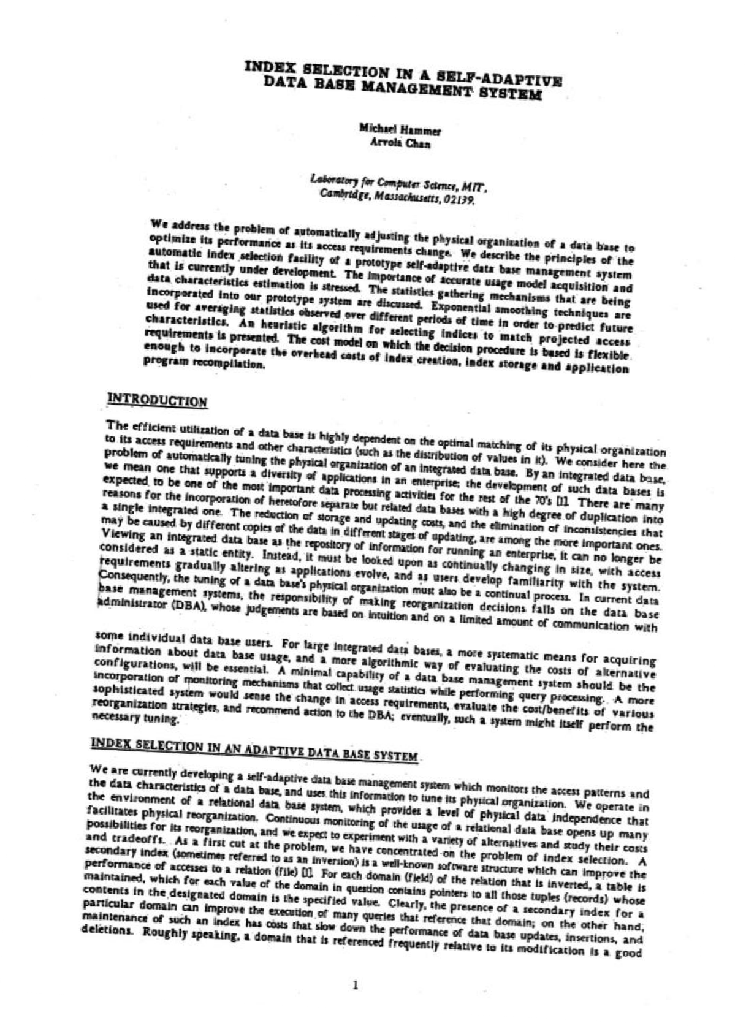


AUTONOMOUS DBMSs
SELF-ADAPTIVE DATABASES
SELECT * FROM A JOIN B
ON A.ID = B.ID
WHERE A.VAL > 123
AND B.NAME LIKE 'XY%'
1970-1990s
Self-Adaptive Databases
Admin
A.ID A.VAL B.ID B.NAME
Tuning Algorithm
+100
+200 +50
Notes:
以索引构建为例，用户最终决定何时apply，这对human的要求很高，需要知道application的流程

Slide 6

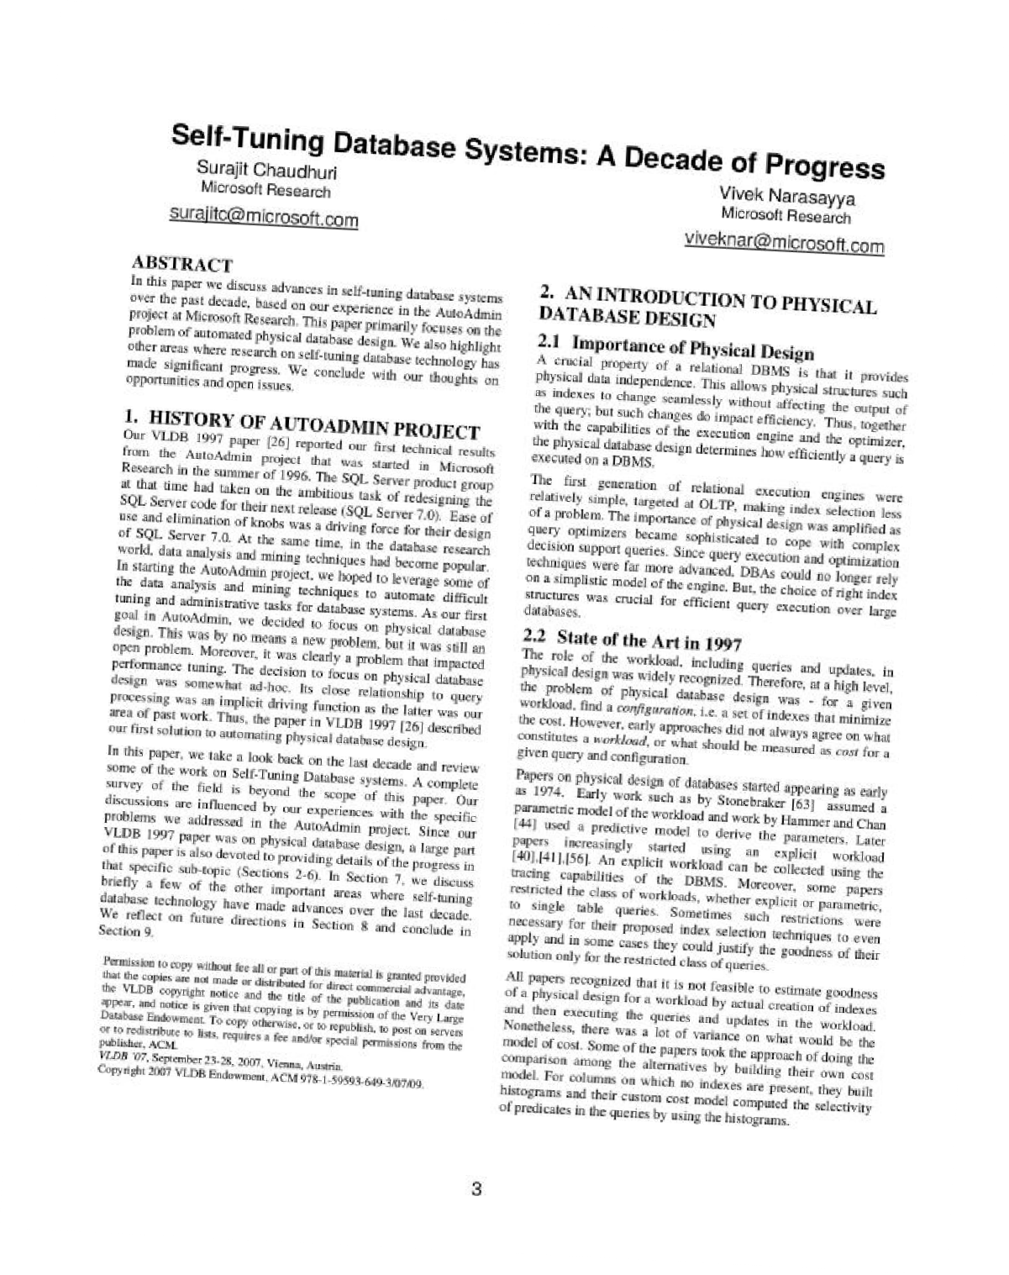
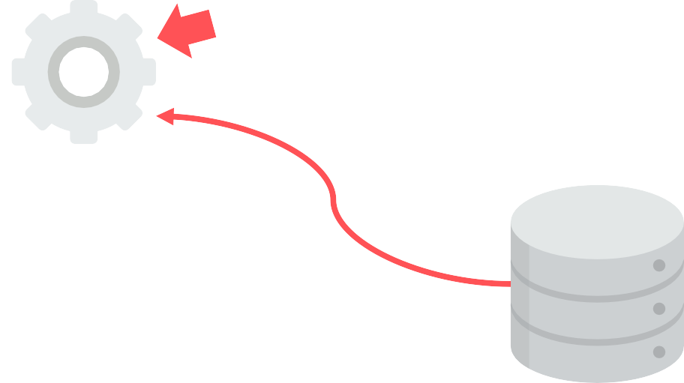
AUTONOMOUS DBMSs SELF-TUNING DATABASES
SELECT * FROM A JOIN B
ON A.ID = B.ID
WHERE A.VAL > 123
AND B.NAME LIKE 'XY%'
1990-2000s
Self-Tuning
Admin
A.ID A.VAL B.ID B.NAME
Tuning Algorithm
Optimizer Cost Model
AutoAdmin
Databases
Notes:
Microsoft不一样的地方是重用了query optimizer，这十分合理，因为索引构建就是要选择query optimizer会走的列来构建

Slide 7





AUTONOMOUS DBMSs SELF-TUNING DATABASES
1990-2000s
Self-Tuning Databases
600
Number of
Knobs
541
400
291
200
0
2000 2004 2008 2012 2016
→Knob Configuration

Slide 8
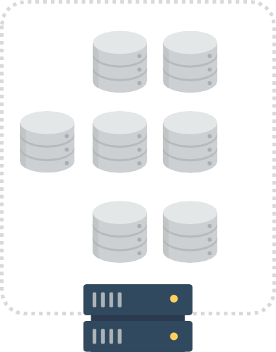
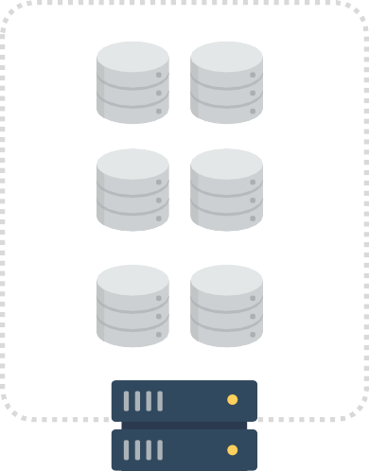
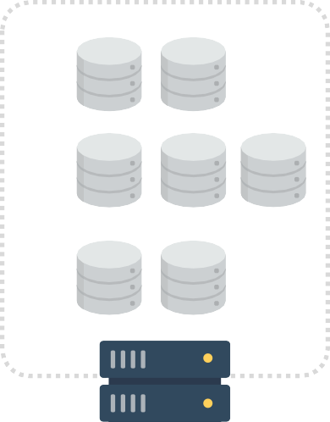
AUTONOMOUS DBMSs
CLOUD MANAGED DATABASES
→Initial Placement
→Tenant Migration
2010s
Cloud Databases

Slide 9
W hy is this previous work insufficient ?

Slide 10


Background
PROBLEMS
Problem #1 Human Judgements
Problem #2 Reactionary Measures
Problem #3 Single Problem

Slide 11

Background
Desirable DBMSs
predicts an application’s needs
automatically chooses actions
objective function
constraints
Notes:
目标函数包括performance metrics (e.g., throughput, latency, availability)或者deployment costs (e.g., hardware, cloud resources))

Slide 12
BACKGROUND
Levels of Autonomy
Level0: manual
Level1: recommend improved configurations
Level2: mixed initiative for making decisions
Level3: local autonomy, no higher-level coordination
Level4: semi-autonomy, user only provides high-level direction
Level5: completely independent
Notes:
Level1下用户需要选择which when to apply，还要监控DBMS的行为
Level2下达到阈值会触发修改或者提醒user
Level3下自动进行内存分配、索引构建
Level4下可以协调子系统，但需要用户主动scaling以适应未来负载

Slide 13
NoisePage

Slide 14
NoisePage
Perception System
Workload Forecast
Mobility Model
Behavior Model
Self-Driving Cars
NoisePage
Decision-Making
Action Planning

Slide 15
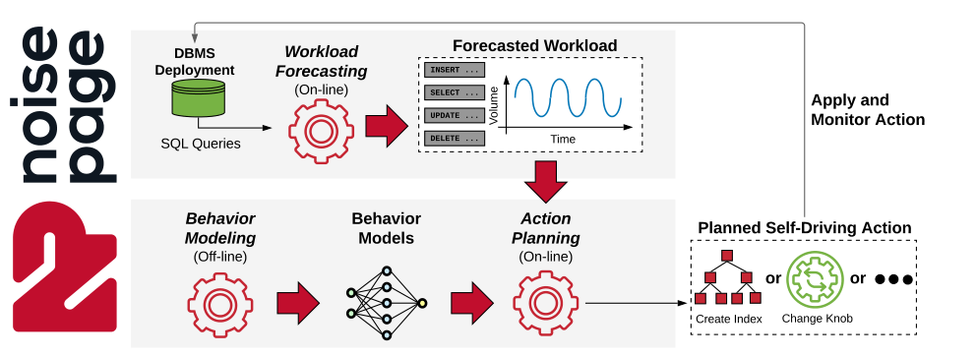
NoisePage
Notes:
Behavior model用来estimate cost

Slide 16
NoisePage
Workload Forecast
When NoisePage receives the workload from the clients, it stores the workload’s query arrival rates and parameter samples in aggregated intervals (e.g., per minute) in internal tables.
It periodically sends this data to its training components process to build the forecast models. These models predict the future arrival rates for each query in the aggregated intervals over different horizons (e.g., one hour, one day, one week).
NoisePage uses query templatization, arrival-rate-pattern clustering, and an ensemble of time-series forecasting to train models efficiently

Slide 17
NoisePage
Behavior Modeling
May require a high-dimensional model, which may require a large amount of training data
NoisePage decomposes the DBMS’s into small and independent operating units (OUs) that it then models separately
Each OU model represents some internal task in the system (e.g., scanning a table, building an index)

Slide 18
NoisePage
Action Planning
A self-driving DBMS needs to decide when to apply which actions
(1) account for both the current and future workloads to address problems before they occur
(2) satisfy all system constraints (e.g., maximum memory consumption)
(3) provide explanations for the past and future planned actions
RHC (receding horizon control) & MCTS (Monte Carlo tree search)

Slide 19
Design Principles

Slide 20

AUTONMOUS DBMS Design Principles
Environment
Observations
Configuration Knobs
Action Engineering

Slide 21
Environment Observations
Workload History
A self-driving DBMS records the workload history of the transactions and queries that it executes.
Each entry in the history contains the logical operation invoked (e.g., SQL) along with its execution context. This context includes client meta-data, query plan hints, and configuration knobs.
The system also tracks each query’s completion status, such as its execution time and whether its parent transaction aborts.

Slide 22
Environment Observations
Workload History
BUT !
Such a strategy will consume a sizable amount of storage space for large applications !
Sampling
Aggregation
Notes:
Sampling在transaction级别进行采样，transaction中每个query都被记录
Aggregation对query的主干进行提取，相同主干的query一起存储；Microsoft搜索冗余的query来达到压缩的目的

Slide 23
Environment Observations
Runtime Metrics
Train model to estimate the cost/benefit of actions
observe system's behavior and diagnose problems
Two categories of metrics:
accumulating metrics
aggregation metrics
Notes:
the number of pages read from disk
record the average number of events over a time window

Slide 24
Environment Observations
Meta-Data Tag
Each metric should record what sub-system it is collects data from in a structured meta-data tag.
They should match action tags that modify those sub-systems.
Two benefits:
Remove the need for the DBMS to train separate models to identify which metrics are affected by which actions.
produce human-understandable explanations.

Slide 25
Environment Observations
Hardware Capabilities
Including hardware profiles with a DBMS’s metrics enables the ML components to reuse training data across deployments
Need to distinguish whether unexpected changes in performance are due to its actions or because the hardware is different. (especially important in cloud environment)
Notes:
之前部署过那么下一次类似的application就会部署更快,知道怎么调优，直接分给这个应用（数据库）最合适的硬件资源，否则得从头开始调

Slide 26


CONFIGURATION KNOBS UNTUNABLE KNOBS
Anything that requires a human value judgement should be marked as off-limits to autonomous components.
File Paths
Network Addresses
Durability / Isolation Levels

Slide 27
CONFIGURATION KNOBS HOW TO CHANGE
The autonomous components need hints about how to change a knob
Min/max ranges.
Separate knobs to enable/disable a feature.
Non-uniform deltas.
1 KB 1 MB
1 GB 1 TB
+10 KB +10 MB +10 GB

Slide 28
CONFIGURATION KNOBS Dependencies
This knob is marked as untunable and then the system only examines the dependent knobs if the first knob is enabled.
This reduces the number of actions that the DBMS has to consider
No special Knob values

Slide 29

CONFIGURATION KNOBS
SUB-COMPONENTS
If the DBMS has sub-components that are tunable, then it must expose separate metrics for those components.
Bad Example:
Notes:
table, index, buffer pool

Slide 30

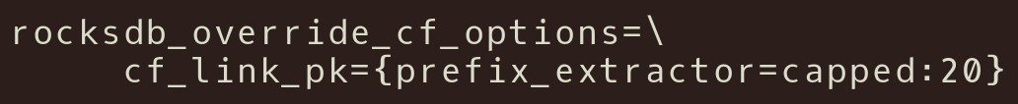

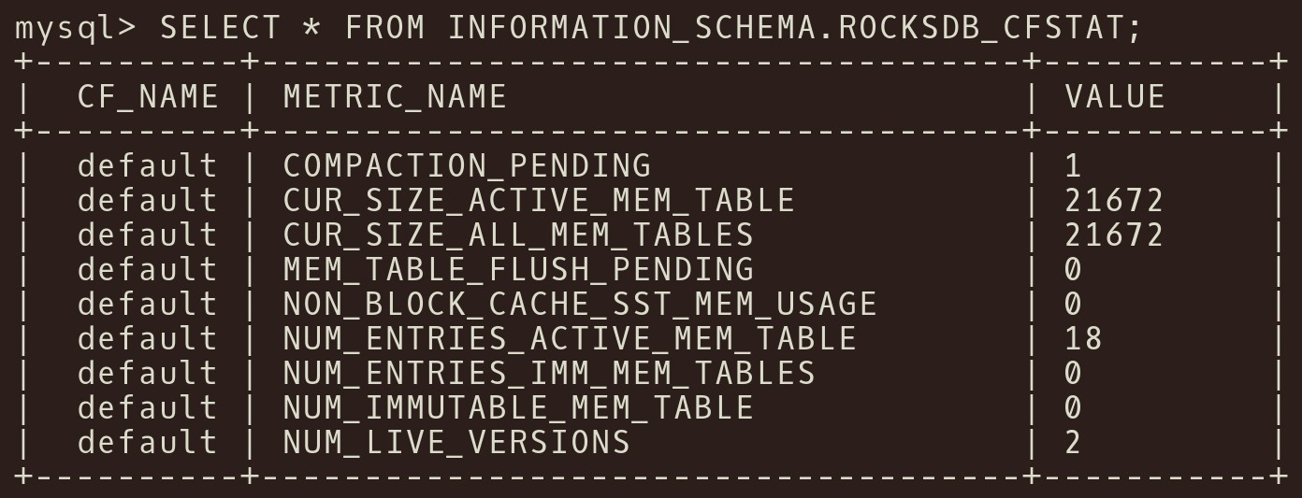
CONFIGURATION KNOBS
SUB-COMPONENTS
RocksDB Column Family Knobs
Column Family Metrics
Missing: Reads Writes

Slide 31

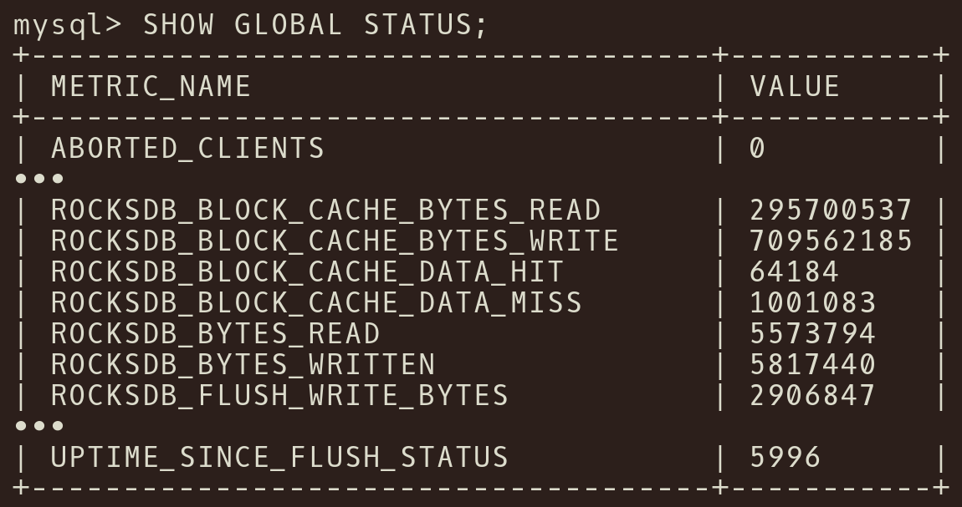
CONFIGURATION KNOBS
SUB-COMPONENTS
RocksDB Column Family Knobs
Global Metrics
Aggregated Metrics

Slide 32
ACTION ENGINEERING NO SHUTDOWN
No action should ever require the DBMS to restart in order for it to take affect.
If the DBMS is unable to deploy actions without downtime, then it must include the expected downtime in their cost estimates
Notes:
重启时间由操作决定，例如log的扩容缩容

Slide 33
ACTION ENGINEERING NOTIFICATIONS
Provide a notification callback to indicate when an action starts and when it completes.
Notes:
否则无法判断性能下降的原因

Slide 34
ACTION ENGINEERING Deployment History
Maintain the history of each action deployment
This provide a log to help planning algorithm reason about how the system reach current state

Slide 35
ACTION ENGINEERING Aborted Actions
Discard data collected during rejected and failed actions

Slide 36

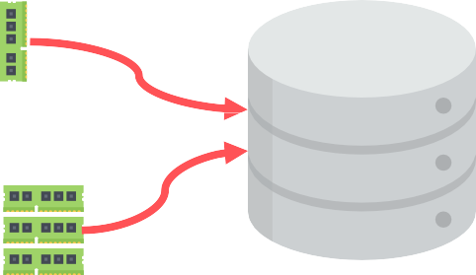



ACTION ENGINEERING RESOURCE USAGE
Support executing the same action with different resource usage levels.

Slide 37

END
@andy_pavlo

