Slide 1

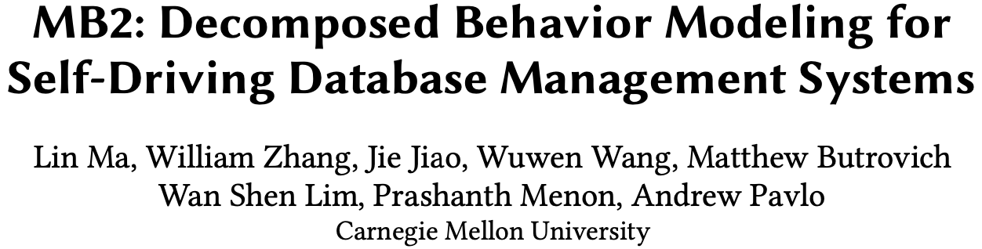
SIGMOD ’21

Slide 2

Self-Driving Database
A DBMS that can configure, tune, and optimize all system aspects without human intervention.
Will support physical design, data placement, SQL tuning, knob configuration, provisioning
Why possible?
More Data (for DBMSs)
Better Hardware
Advanced in AI/ML

Slide 3
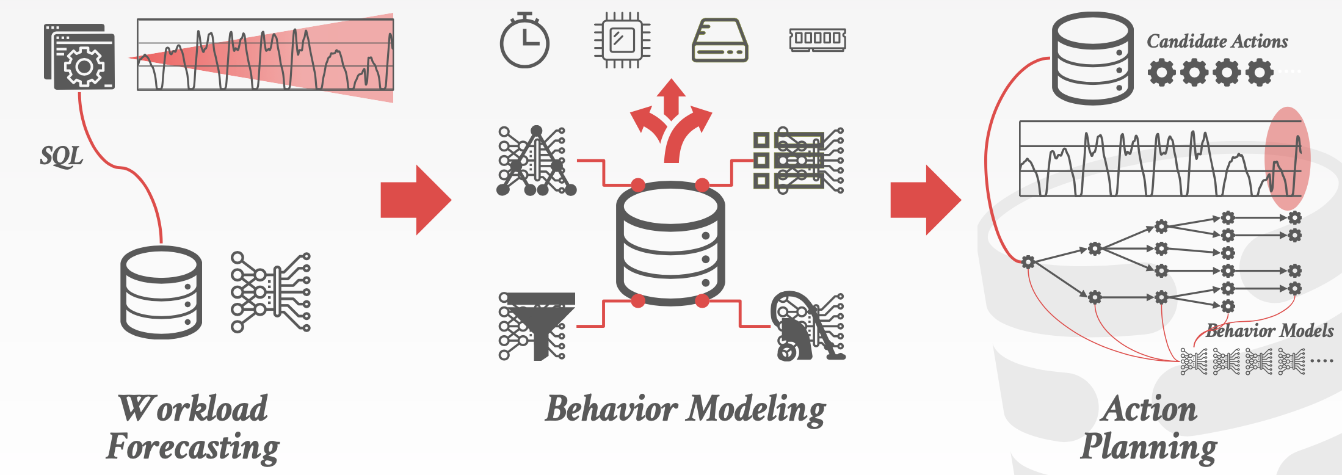
Self-Driving Components
Notes:
Andy pavlo自主优化主要分为三个模块：预测未来的负载是什么样的、选择优化措施、以及措施的最佳组合

Slide 4
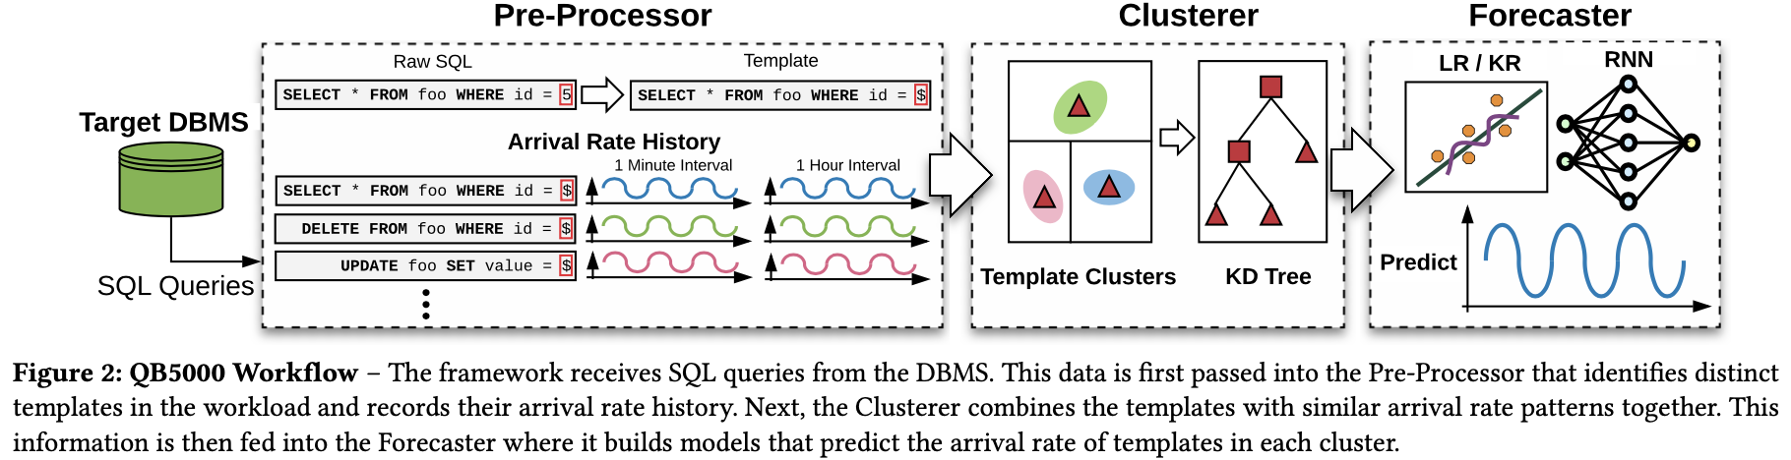
Workload Forecasting
QB5000 (SIGMOD’18)

Slide 5
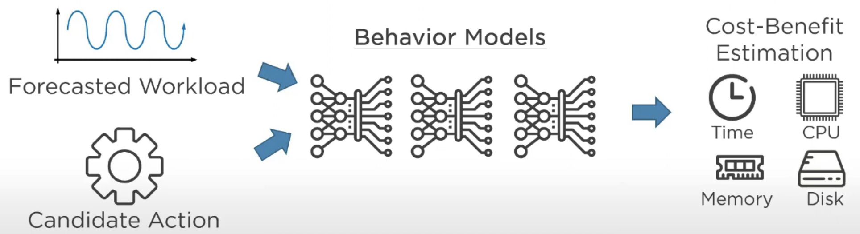
Behavior Modeling
Generate behavior models that predict the cost and benefit for self-driving actions.

Slide 6
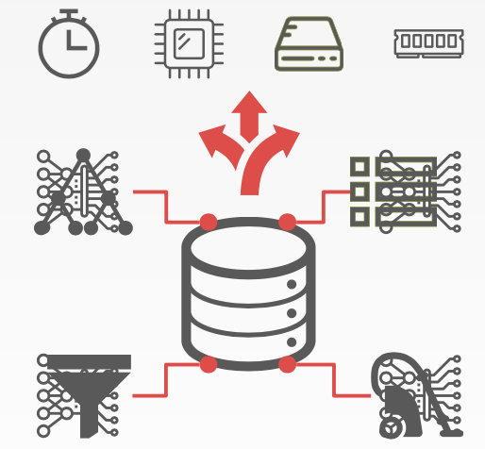
Challenges
1
High Dimensionality
2
Concurrent Operations
3
Data Collection and Training
4
Generalizability
5
Explainability

Slide 7
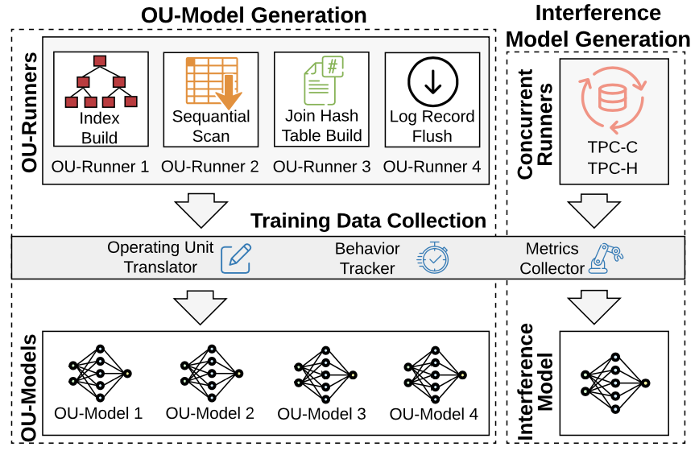
MB2 System Architecture
MB2 trains OU-models for each OU with the data generated by OU-runners and builds interference models for concurrent OUs based on system resource utilization.
Notes:
从查询和行动计划中提取OU，然后生成它们相应的输入特征

Slide 8
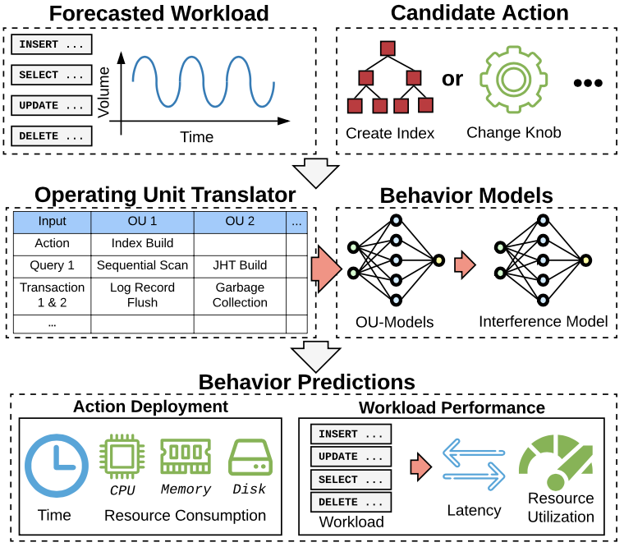
MB2 Inference Procedure
MB2 records the OUs for all input tasks, and uses the OU-models and interference models to predict the DBMS’s behavior.

Slide 9
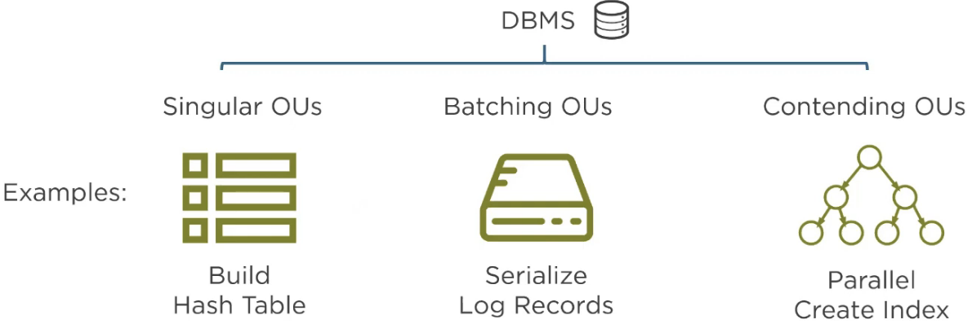
OU-MODELS
The main idea is to decompose the DBMS into independent operating units (OUs). An OU represents a step that the DBMS performs to complete a specific task.
Category

Slide 10
Input Features
Singular OUs
(1) rows of input tuples, (2) columns of input tuples, (3) average input tuple size, (4) estimated key cardinality , (5) payload size , (6) number of loops, (7) execution mode flag
Batch OUs
(1) the total number of bytes, (2) the total number of log buffers, (3) the log flush interval
Contending OUs
(1) number of tuples, (2) number of keys, (3) size of keys, (4) estimated cardinality of the keys, and (5) the number of parallel threads

Slide 11
Output Labels
A vector of commonly available hardware metrics
Elapsed time
CPU
CPU time
CPU cycles
CPU instructions
CPU cache references
Disk
Disk block reads
Disk block writes (for logging)
Memory
Memory consumption

Slide 12
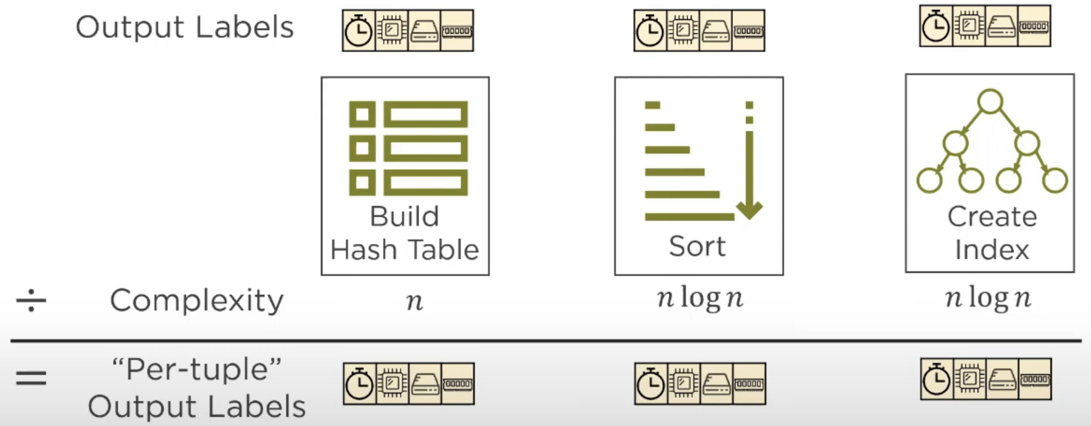

Output Label Normalization
MB2 normalizes OU-models’ output labels by tuple counts to improve their accuracy and efficiency

Slide 13
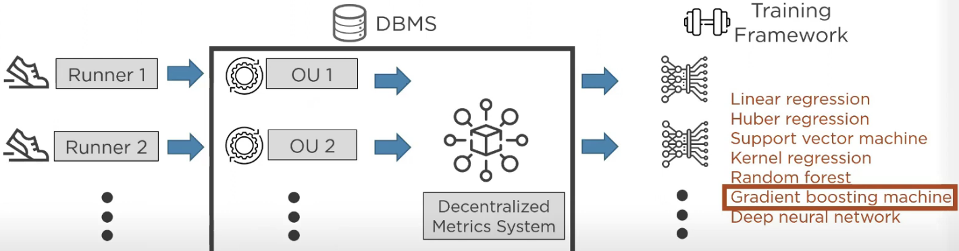
Model Training
MB2 trains multiple models per OU and then automatically selects the one with the best accuracy for each OU

Slide 14
Interference Models
Use resource metrics from the OU-model outputs to approximate the interference
Input Features
Summary Statistics of the OU-model outputs for concurrent OUs in a forecasting interval (e.g. sum, mean, variance)
Output Labels
Adjustment ratios between the actual metrics and
the OU-model’s prediction

Slide 15
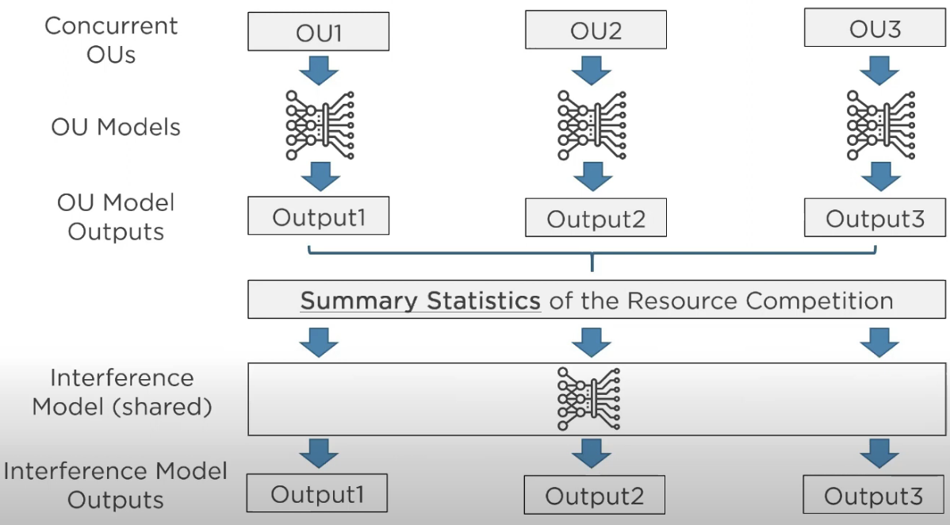
Interference Procedure

Slide 16
EXPERIMENTAL EVALUATION

Slide 17
Preparation
DBMS
NoisePage (https://github.com/cmu-db/noisepage)
Workload Generator
OLTP-Bench
Evaluation Metrics
For OLAP: |𝐴𝑐𝑡𝑢𝑎𝑙 − 𝑃𝑟𝑒𝑑𝑖𝑐𝑡| / 𝐴𝑐𝑡𝑢𝑎𝑙
For OLTP: |𝐴𝑐𝑡𝑢𝑎𝑙 − 𝑃𝑟𝑒𝑑𝑖𝑐𝑡|

Slide 18
OU-Model Generalization
Evaluate the OU-models’ ability to predict query runtime and generalize across workloads
Both OLAP and OLTP workloads
MB2 always uses the same OU models generated offline
Baseline: QPPNet (VLDB’19)
Train on one workload, evaluate on others (without data generation mechanism)

Slide 19
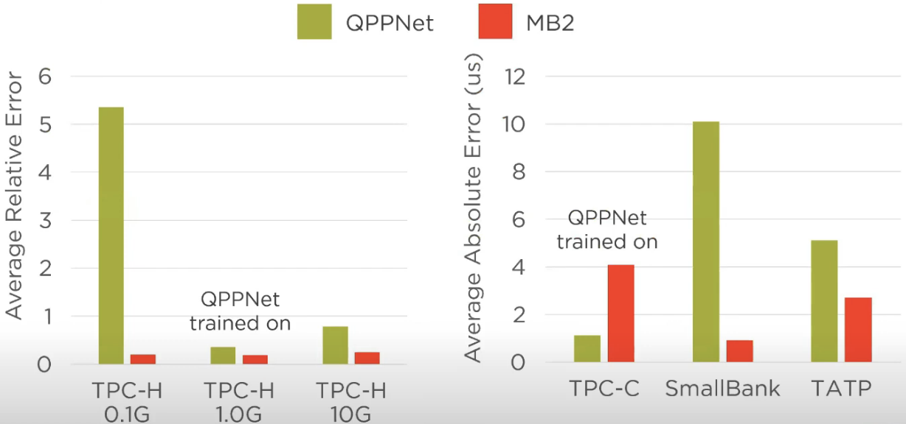
Query Latency Prediction Results

Slide 20
End-to-End Self-Driving Estimation
Simulate a daily transactional-analytical workload cycle
Alternate between TPC-C and TPC-H with 10 concurrent threads
Assume accurate workload forecasting prediction
An Oracle planner changes a knob for TPC-H and builds and index for TPC-C
TPC-C
20 warehouses and adjust the number of customers per district to 50,000
Remove a secondary index on the CUSTOMER table for the (C_W_ID, C_D_ID, C_LAST) columns
TPC-H
1 GB dataset size
Sub-optimal knob configuration

Slide 21
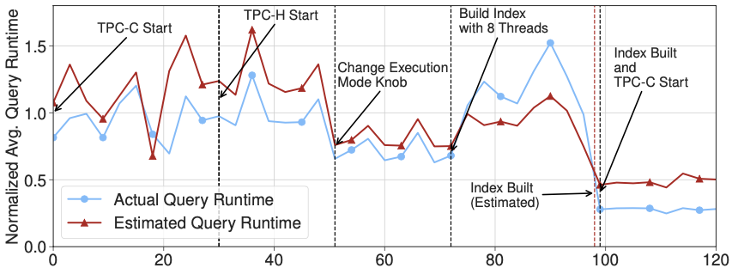
Knob Changing and Index Creation

