Slide 1

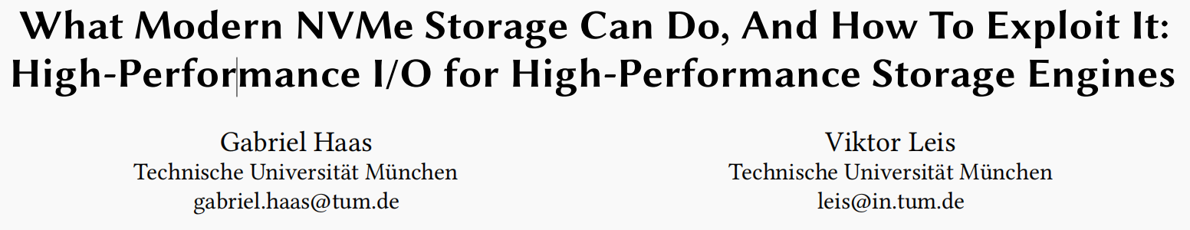

Slide 2
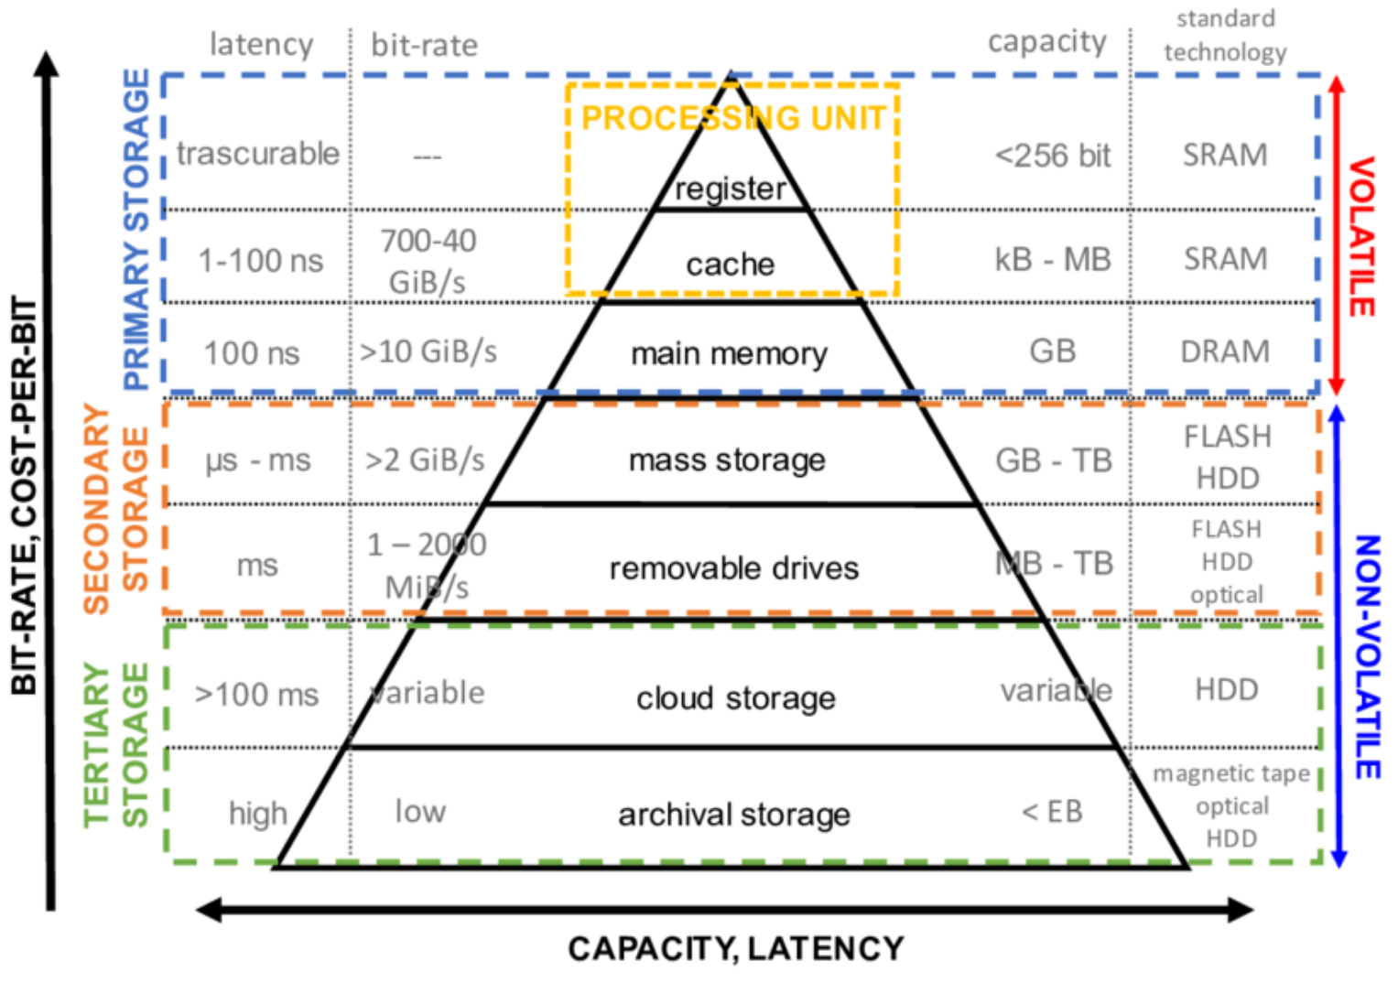
INTRODUCTION
BACKGROUND
Flash performance:
Magnetic Disks < SATA SSDs < NVMe SSDs
Servers with PCIe 5.0 are already available and corresponding SSDs with 12 GB/s per device.
Flash capacity:
Enterprise-grade SSDs cost less than $200 per TB, which is about 10-50 times cheaper than DRAM.

Slide 3
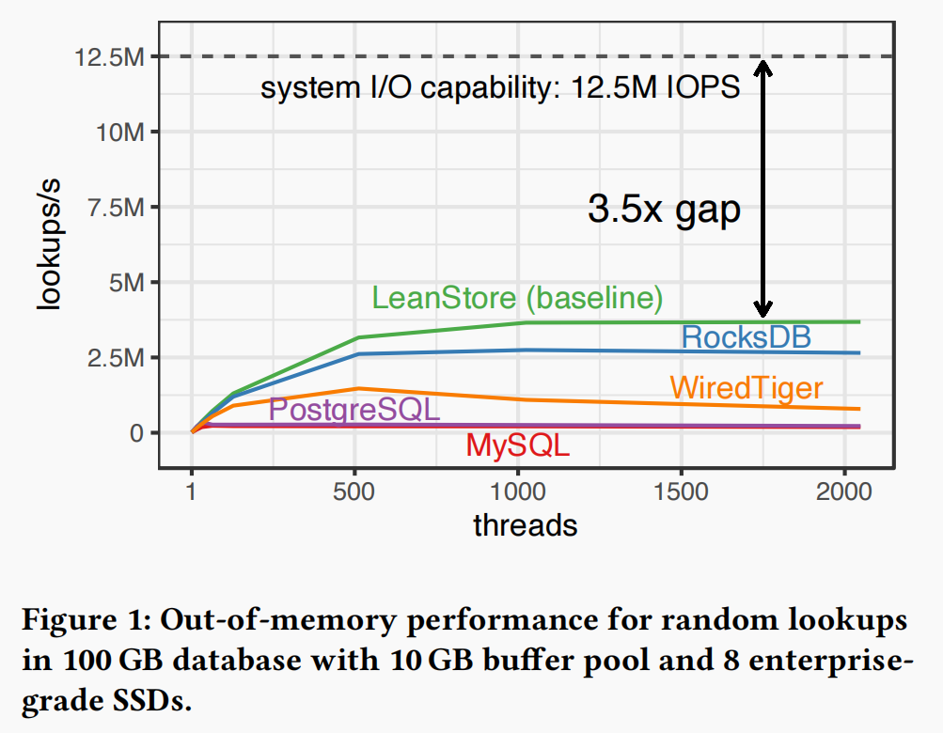
INTRODUCTION
BACKGROUND
Performance gap of existing systems:
Measure the performance of 5 systems for a simple random read benchmark on a 64-core AMD server with 8 Samsung PM1733 SSDs. (Maximum to 1.5M × 8 random 4KB reads per second).

Slide 4
WHAT MODERN NVME STORAGE CAN DO
Present the result of a series of micro-benchmarks that provide us with the necessary background on how to fully exploit modern storage.

Slide 5
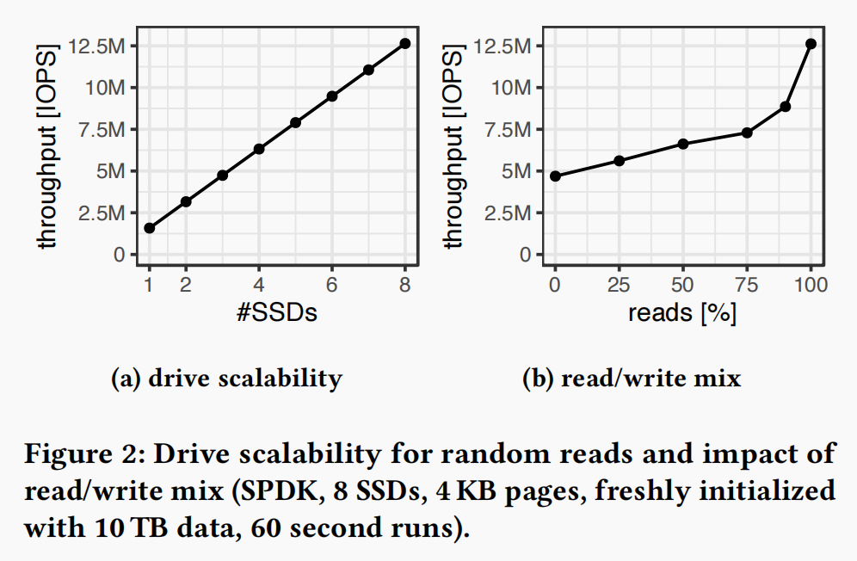
Drive scalability
8 × 3.8 TB Samsung PM1733 SSDs: 1.5 M I/O operations per second (IOPS) for random 4 KB reads

Slide 6
The Case for 4 KB Pages
Page size tradeoffs
Many database systems use larger pages sizes such as 8 KB (PostgreSQL, SQL Server, Shore-MT), 16 KB (MySQL, LeanStore), or even 32 KB (WiredTiger) as their default.
(Strong) Less cache management overhead and high performance for in-memory workloads.
(Weak) I/O amplification on out-of-memory workloads.

Slide 7
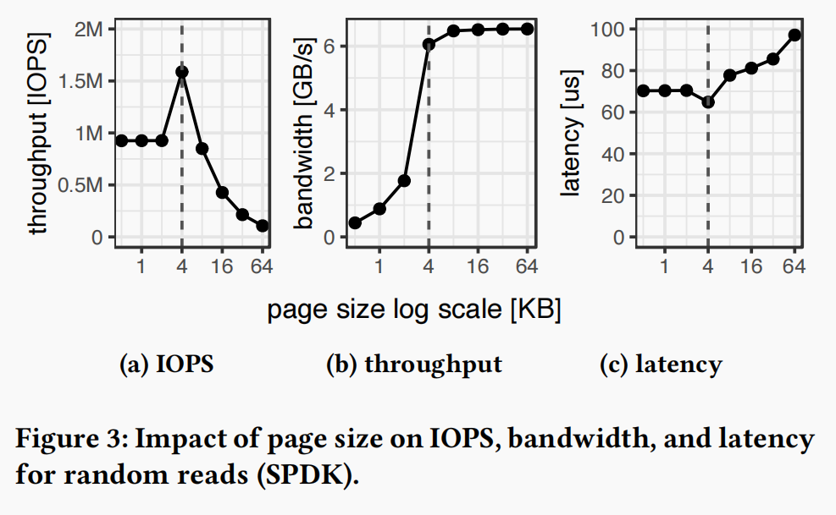
The Case for 4 KB Pages
Better go small (but not too small)
It is possible to achieve almost the full bandwidth (6 GB/s) with 4 KB pages and random reads.
A smaller page size actually results in less write amplification, while worse IOPS and latency on our SSDs.

Slide 8
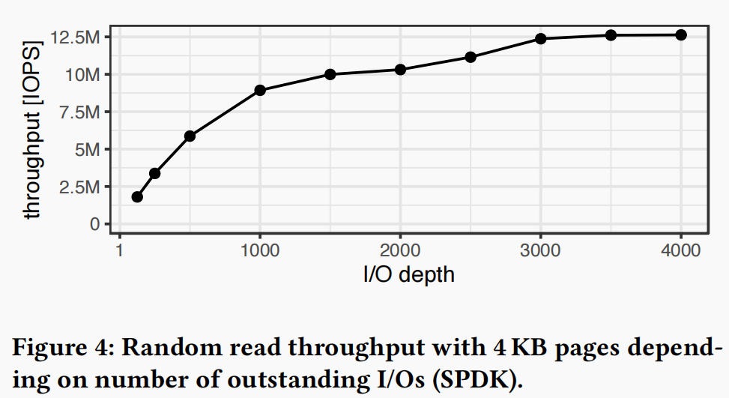
SSD Parallelism
SSDs are highly parallel devices, with multiple channels connecting to independent flash dies.
Flash random read latency is on the order of 100 microseconds. Synchronous accesses would result in a meager 10k IOPS (or 40 MB/s).
IO-depth, i.e., the number of simultaneously outstanding I/O requests on all 8 SSDs.

Slide 9
I/O Interfaces
Common procedure:
Interfaces take the I/O requests and place them into the NVMe submission queues.
The host system uses the requests to communicate with SSDs.
SSDs write completion events to the completion queue and, if interrupts are used, notify the host.
Differences: How requests are submitted and how completed operations are reaped.

Slide 10
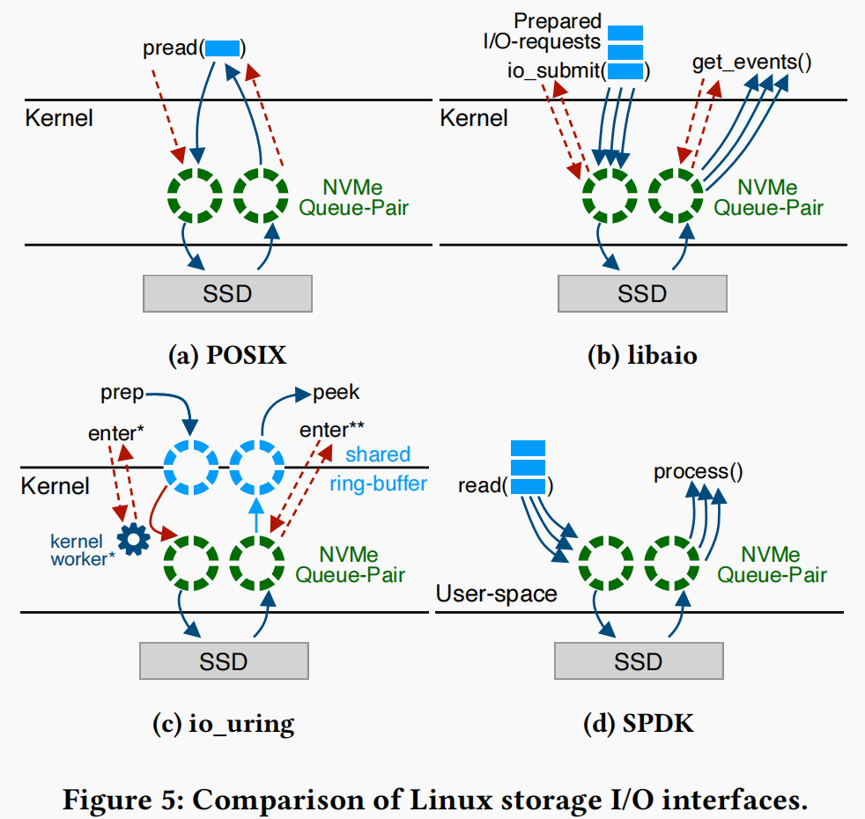
I/O Interfaces
Blocking POSIX interface
libaio: traditional asynchronous interface
io_uring: modern asynchronous interface
User-space I/O with SPDK (Intel’s Storage Performance Development Kit (SPDK))

Slide 11
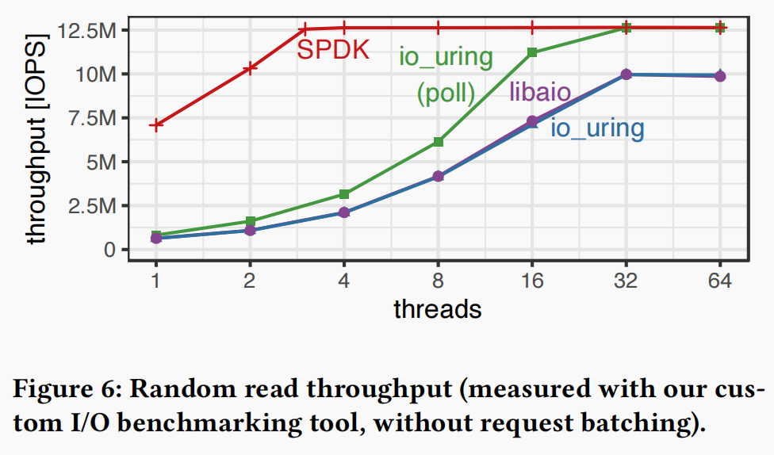
A Tight CPU Budget
CPU impact of I/O libraries
Our experiments show that, unless we use SPDK (which is not always a practical choice), around half of the available CPU cores are consumed by the OS just for submitting and reaping I/O requests.

Slide 12
AN I/O-OPTIMIZED STORAGE ENGINE DESIGN
Describe a storage engine design that can exploit the full potential of modern storage devices.

Slide 13
DBMS-Managed Multitasking
The problem with high oversubscription
Most database systems run thousands of queries in independent threads causes extreme oversubscription and poor performance due to context switching overhead.
Lightweight tasks
Lightweight cooperative threads managed by the database system in user-space allow the system to be fully in control of scheduling without kernel interference.
A task switch costs only around ~20 CPU cycles, instead of several thousands for a kernel context switch.

Slide 14
Background Work Through System Tasks
The burden of background threads
Once the system runs out of free pages because the page replacement algorithm is too slow, the system will stall.
The downside of background threads is that it is hard to know how many of them are needed, in particular when workloads change.
Background work as tasks
Remove the necessity to have background threads, and page eviction can instead be run directly on worker threads. Worker threads do not stall waiting for free pages.

Slide 15
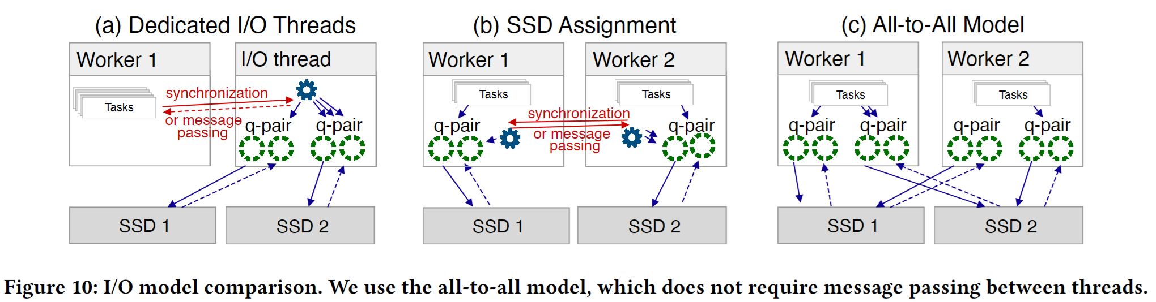
Managing I/O
Dedicated I/O Threads
SSD Assignment
(Strong) Simplify request batching, need fewer polling calls, result in reduction in context switching and improve cache locality.
(Weak Dedicated I/O Threads) Adjusting the number of I/O threads is difficult and highly dependent on the workload.
(Weak SSD Assignment) Require message passing between the threads, involving some kind of synchronization.

Slide 16
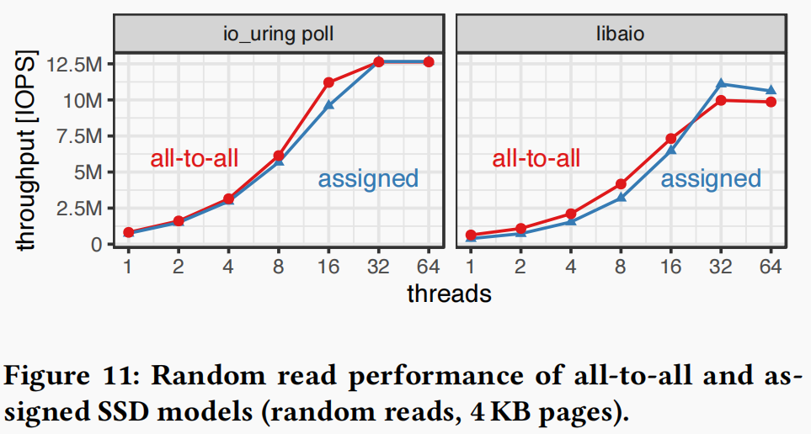
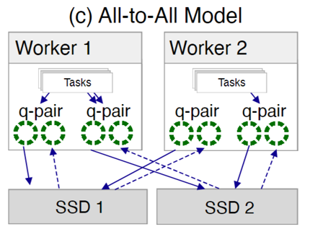
Managing I/O
All-to-All Model

Slide 17
CPU Optimizations and Scalability
CPU can be a bottleneck: Once the system becomes capable of scheduling millions of IOPS, the CPU often becomes the performance bottleneck.
Global lock for I/O operations.
Page eviction index.

Slide 18
Experimental Setup
AMD EPYC 7713 Milan CPU with 64 cores / 128 threads, which has 128 PCIe 4.0 lanes
The system has 512 GB of DRAM and 8 × Samsung PM1733 SSDs with 3.84 TB each.
Disable logging and select the least available isolation level to focus on I/O handling.
Workloads: Random read-only and TPC-C.

Slide 19
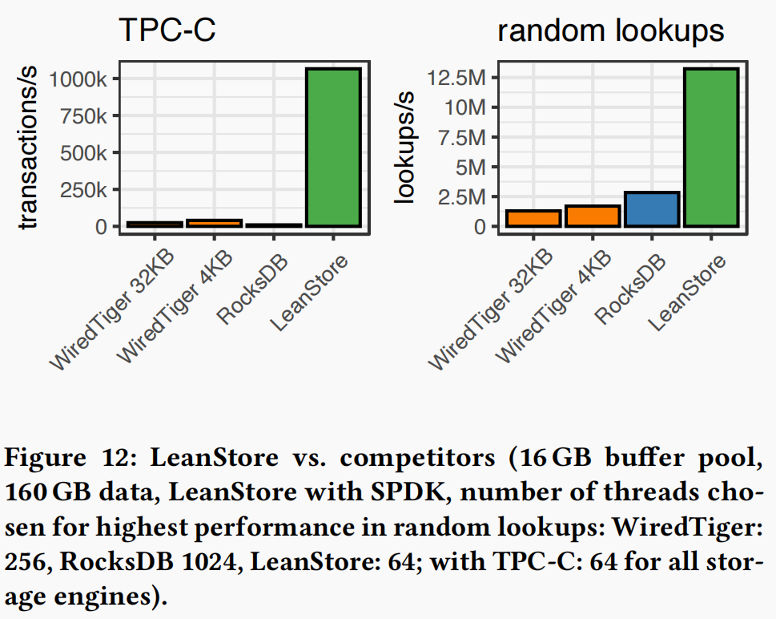
System Comparison

Slide 20
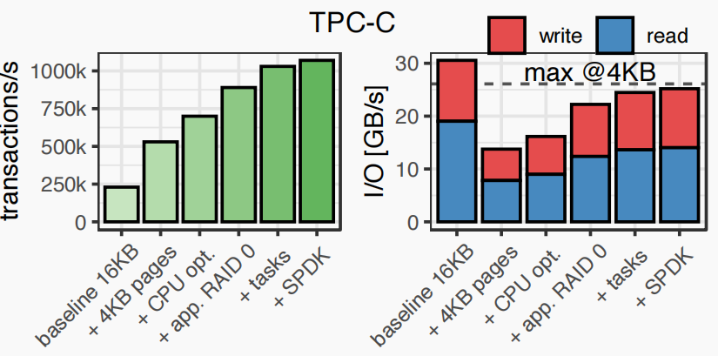
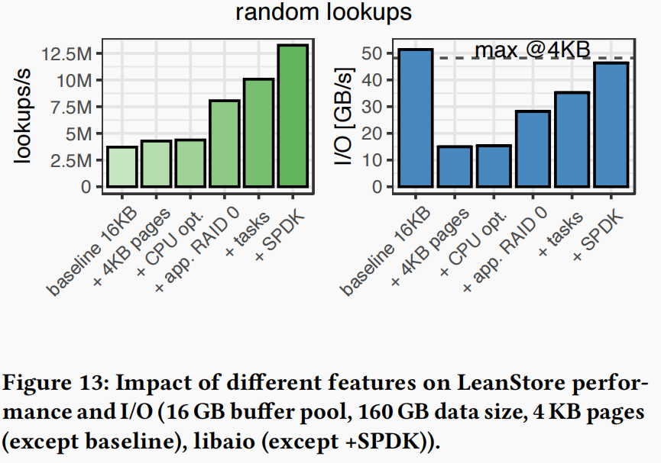
Incremental Performance Improvements

Slide 21
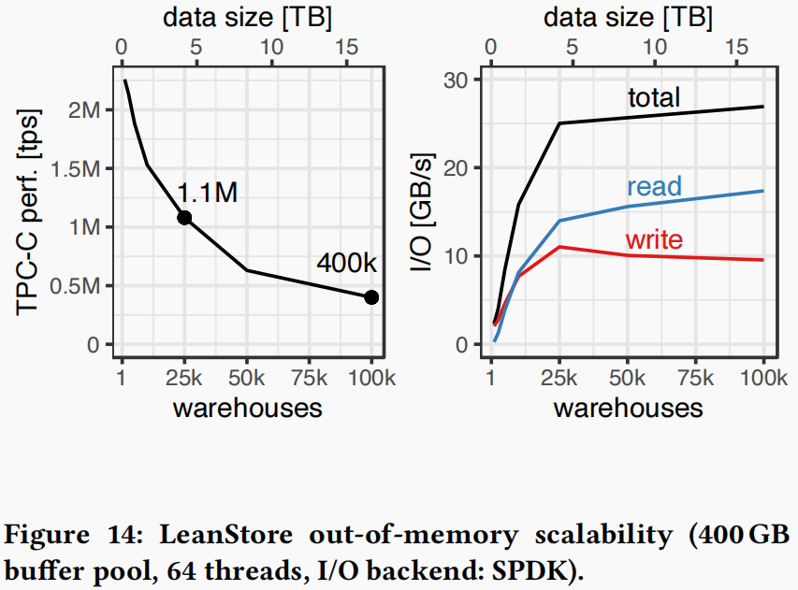
Out-Of-Memory Scalability

Slide 22
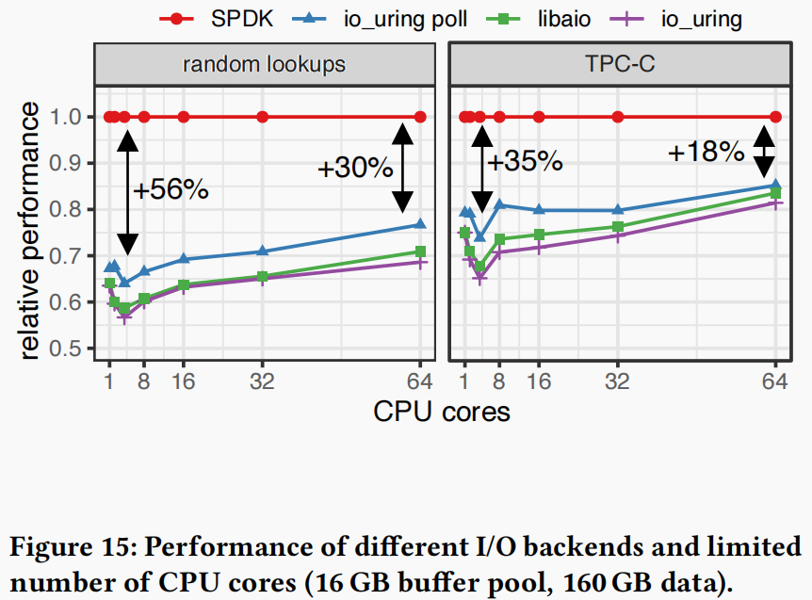
I/O Interfaces

Slide 23
CONCLUSIONS
Good performance can be achieved with all asynchronous I/O interfaces. Kernel-bypassing is not essential to achieve full bandwidth even with small pages. However, it is more efficient in CPU usage.
To manage the high parallelism required for large NVMe SSD arrays, the database system must employ a low overhead mechanism to quickly jump between user queries. To solve that we employed cooperative multitasking using lightweight user-space threads.

