Slide 1

SIGMOD 2026

Slide 2
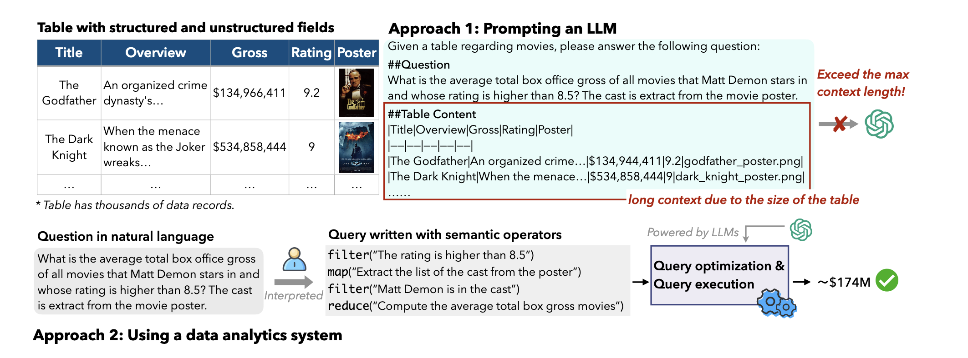
Background
Directly prompting an LLM （long context ）
Using a semantic analytical processing system

Slide 3
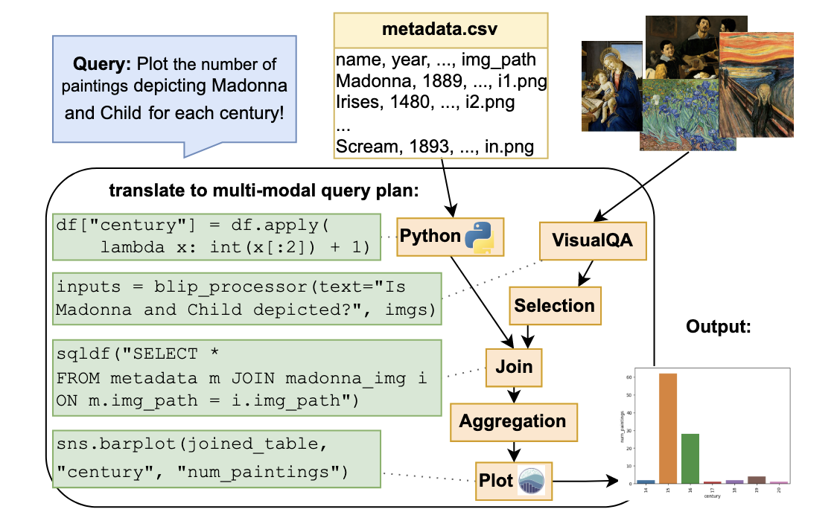
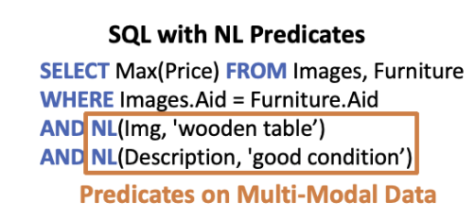
Related Work
Integrate AI-powered operators into existing SQL engines
ThalamusDB
CAESURA
They exhibit low compatibility with the query optimizers in existing systems.

Slide 4
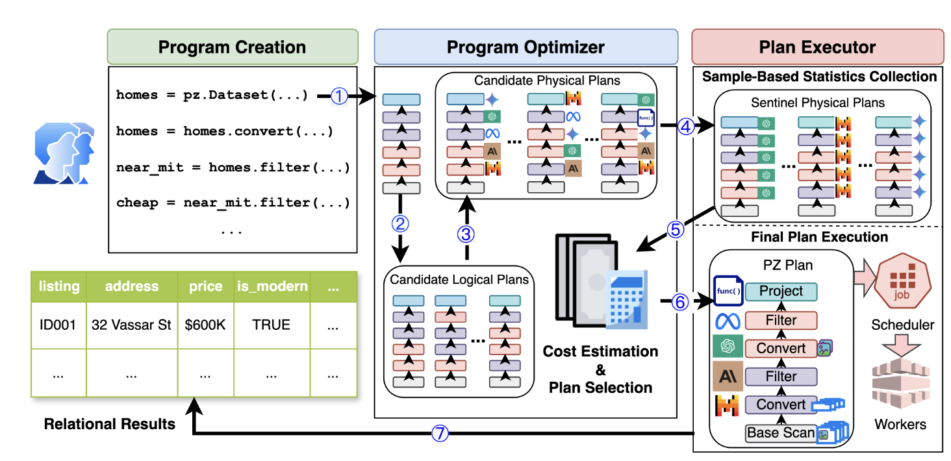
Related Work
Ground-up, purpose-built semantic analytical systems
Lotus: limited to single operator or fixed tasks, lacking cross-operator logical plan optimization
Palimpzest: relies on traditional relational rules ; its sampling-based cost and quality evaluations rely on static averages, making them coarse-grained.
Nirvana

Slide 5
Contribution
Logical plan optimizer：uses a random walk search framework and an LLM-as-a-judge plan evaluator for logical plan exploration and exploitation.
Physical plan optimizer ： model selection algorithm based on the novel concept of an improvement score, selects the most cost-effective LLM backend per operator in a logical plan, minimizing inference costs while preserving result quality.

Slide 6
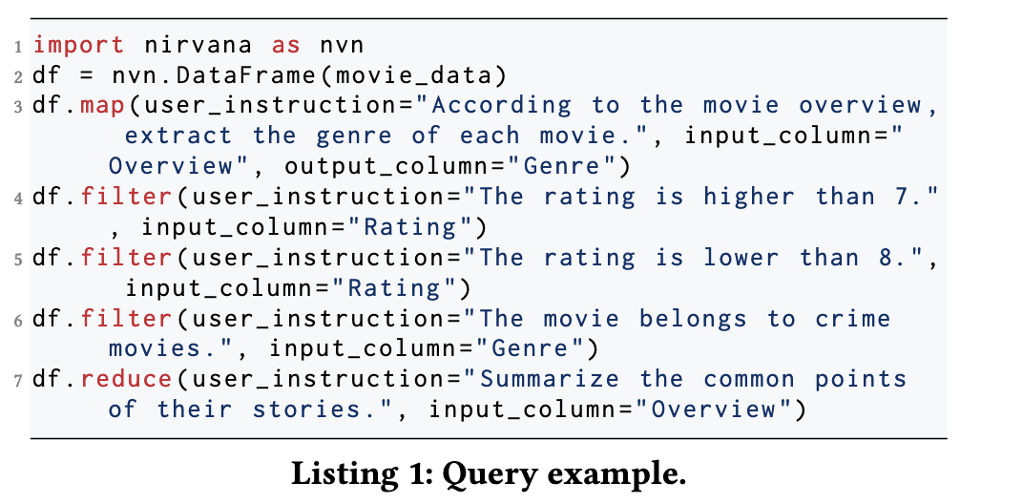
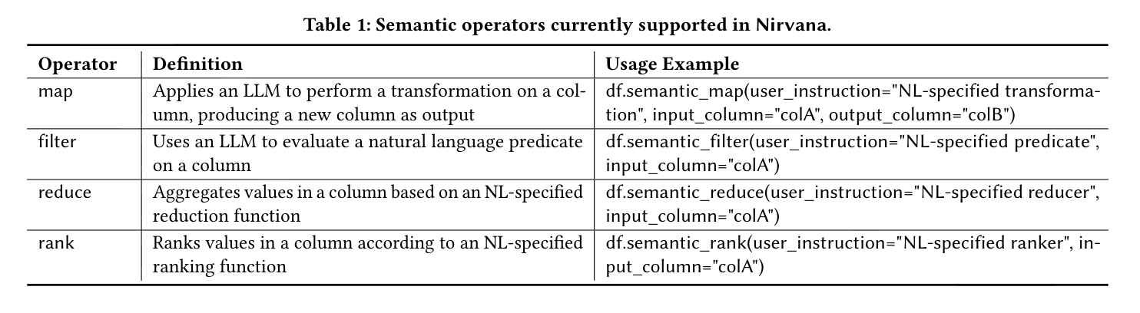
System Overview
Operators

Slide 7
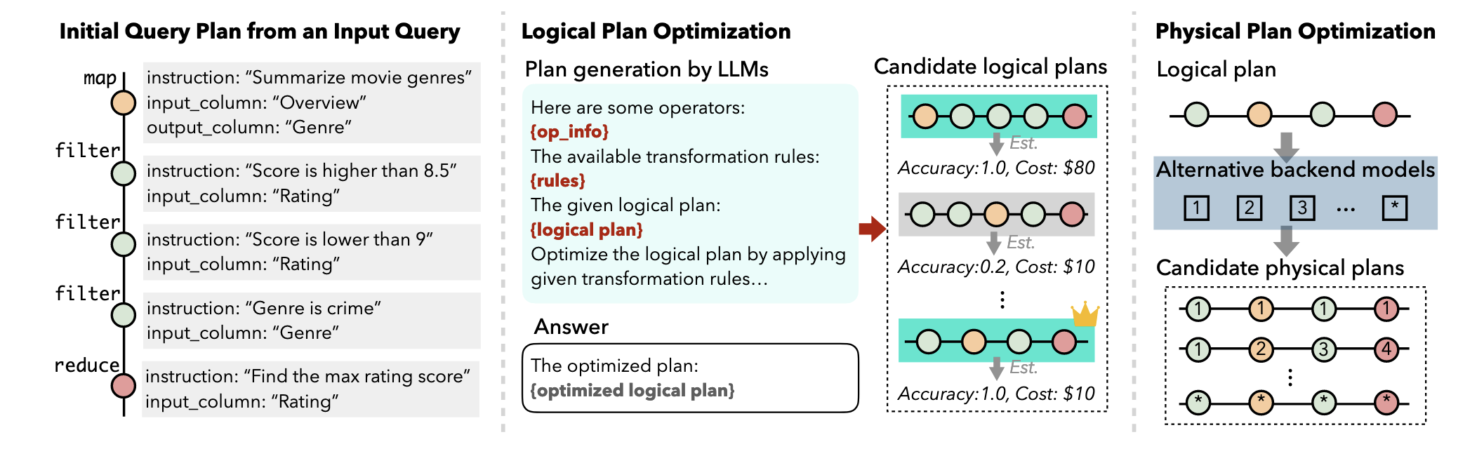
System Overview
Query Optimization

Slide 8
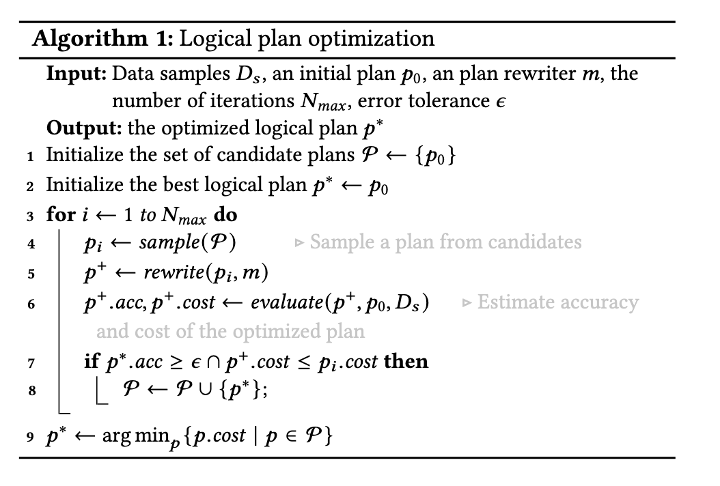

Logical Plan Optimizer
Initialization
Sample
Rewrite
Evaluate

Slide 9
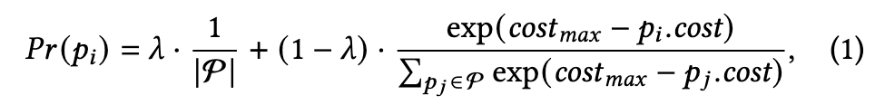
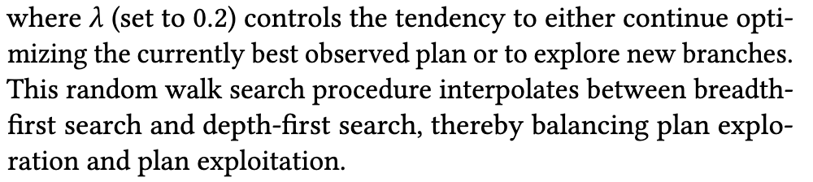
Logical Plan Optimizer
Sample – random walk approach
uniform distribution
cost-based weighted probability distribution

Slide 10
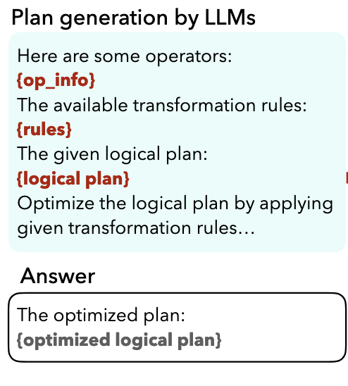
Logical Plan Optimizer
Plan rewrite
Filter pushdown: moves a filter operator that does not rely on results of preceding operators to an earlier stage in the plan.
Operator fusion: merges multiple operators on the same field into one operator. To maintain semantic equivalence, the predicate (or user instruction) will be rewritten for the new operator.
Non-LLM replacement: replaces an operator’s NL instruction with an equivalent compute function.

Slide 11
Logical Plan Optimizer
Plan evaluation
Verifying Execution consistency: use LLM-as-a-judge as an equivalence verifier. prompt an LLM to rate the similarity between the two plan outputs (input plan and the rewritten plan) on a scale from 0 to 10 based on the their semantic consistency.
Evaluate the plan’s cost: tracks the number of processed data items and prompt lengths per operator. The total cost is computed as the sum of all operator costs. assign a selectivity parameter to each operator to monitor changes in the number of data points to be processed throughout the plan.

Slide 12
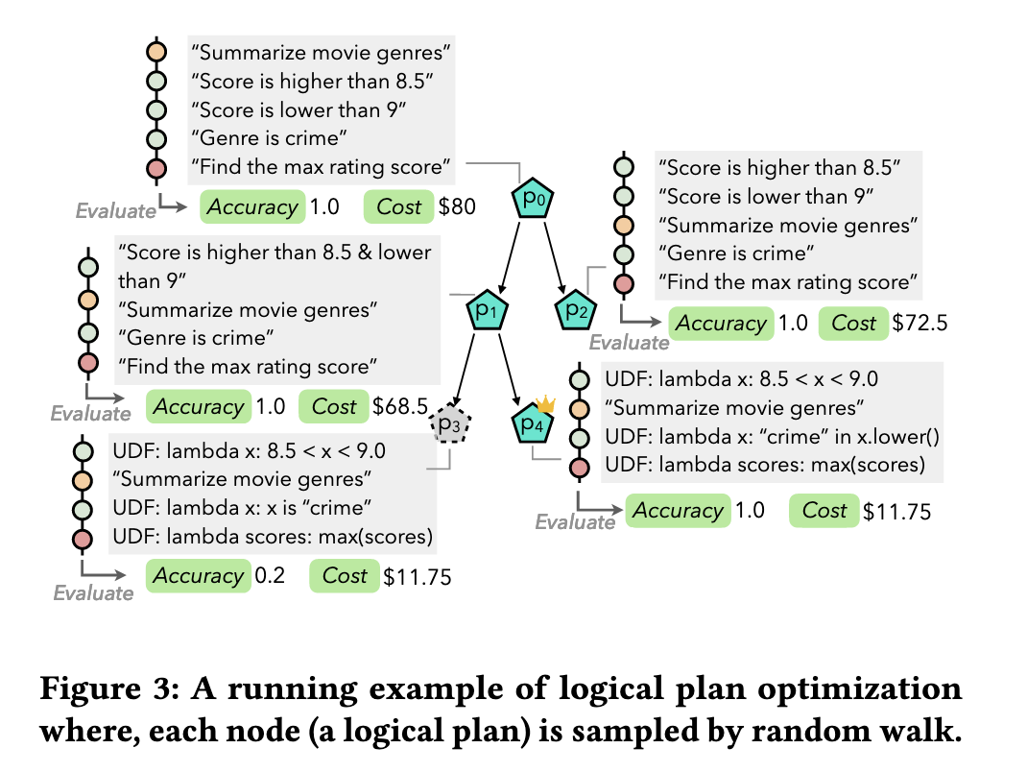
Logical Plan Optimizer
Filter pushdown
Operator fusion
Non-LLM replacement

Slide 13
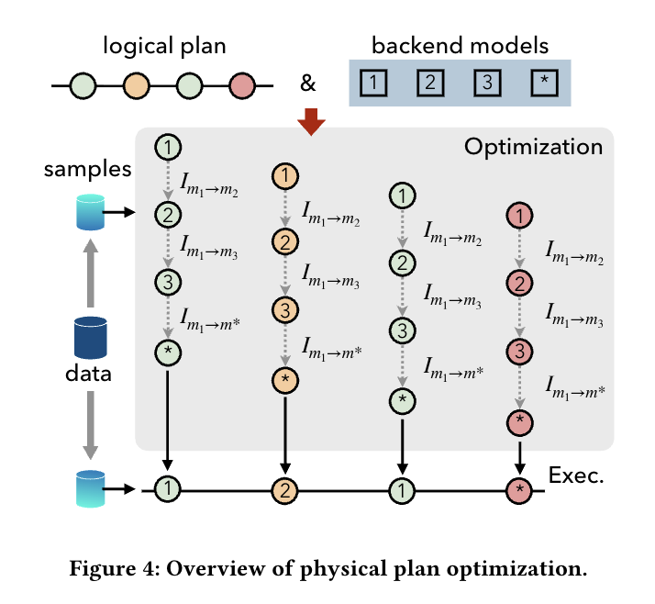
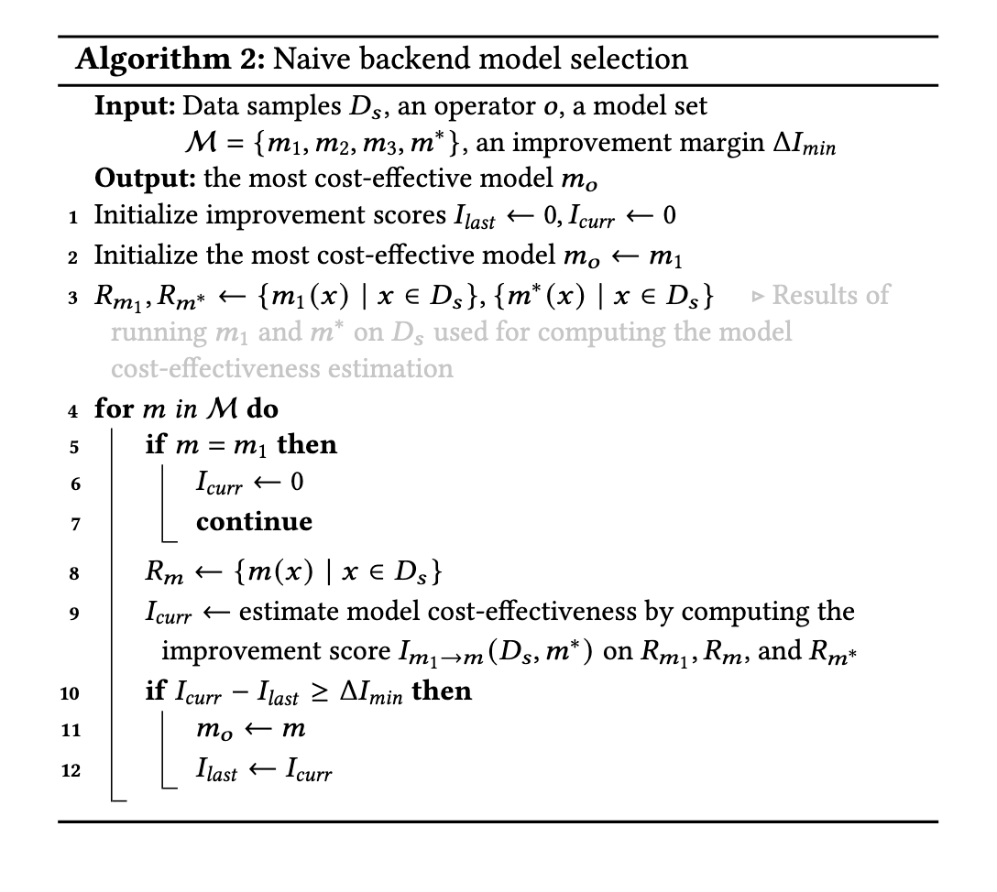
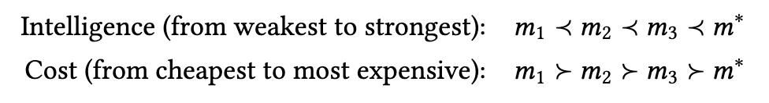
Physical Plan Optimizer

Slide 14
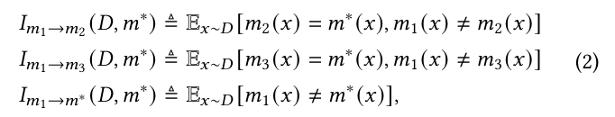
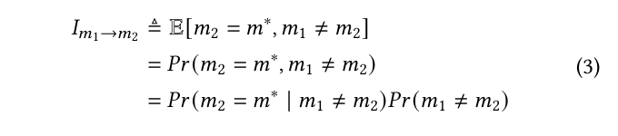
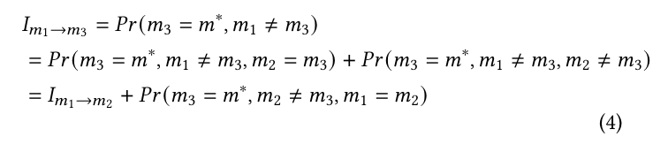

Physical Plan Optimizer
Improvement Score Computation
Define the improvement score ${\text{I}}_{{\text{m}}_{\text{1}}\text{ →}\text{m}}$ as the performance improvement gained from switching from the backend model 𝑚1 to a stronger model 𝑚.
To reduces the number of 𝑚∗ invocations
Evaluation pushdown
Computation reuse

Slide 15
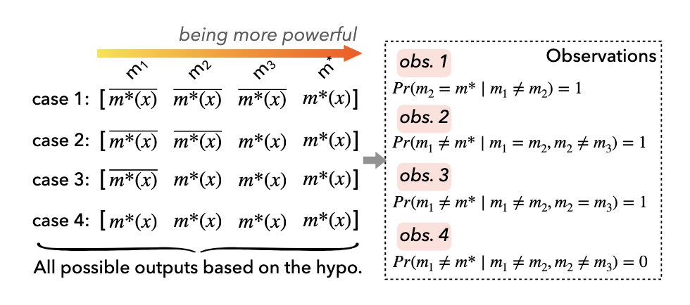
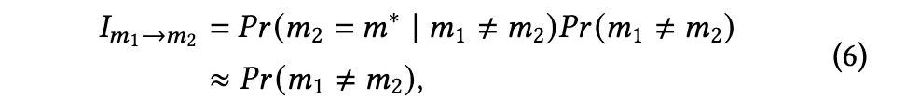
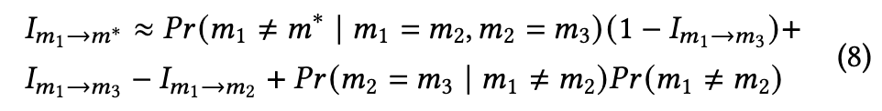
Physical Plan Optimizer
Improvement Score Approximation

Slide 16
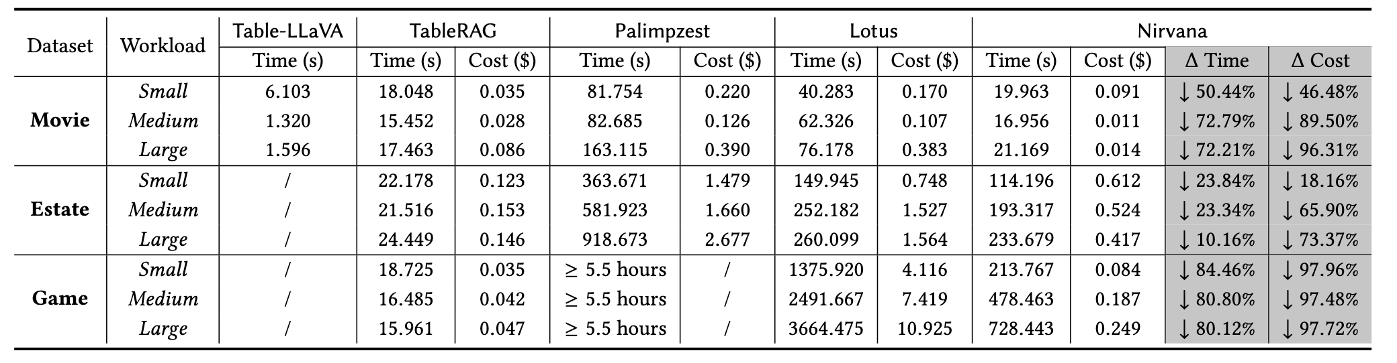
Experimental Evaluation

Slide 17
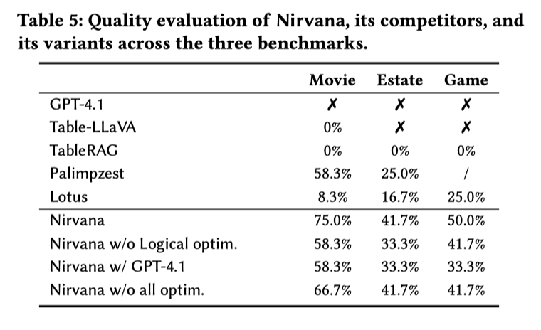
Experimental Evaluation

Slide 18
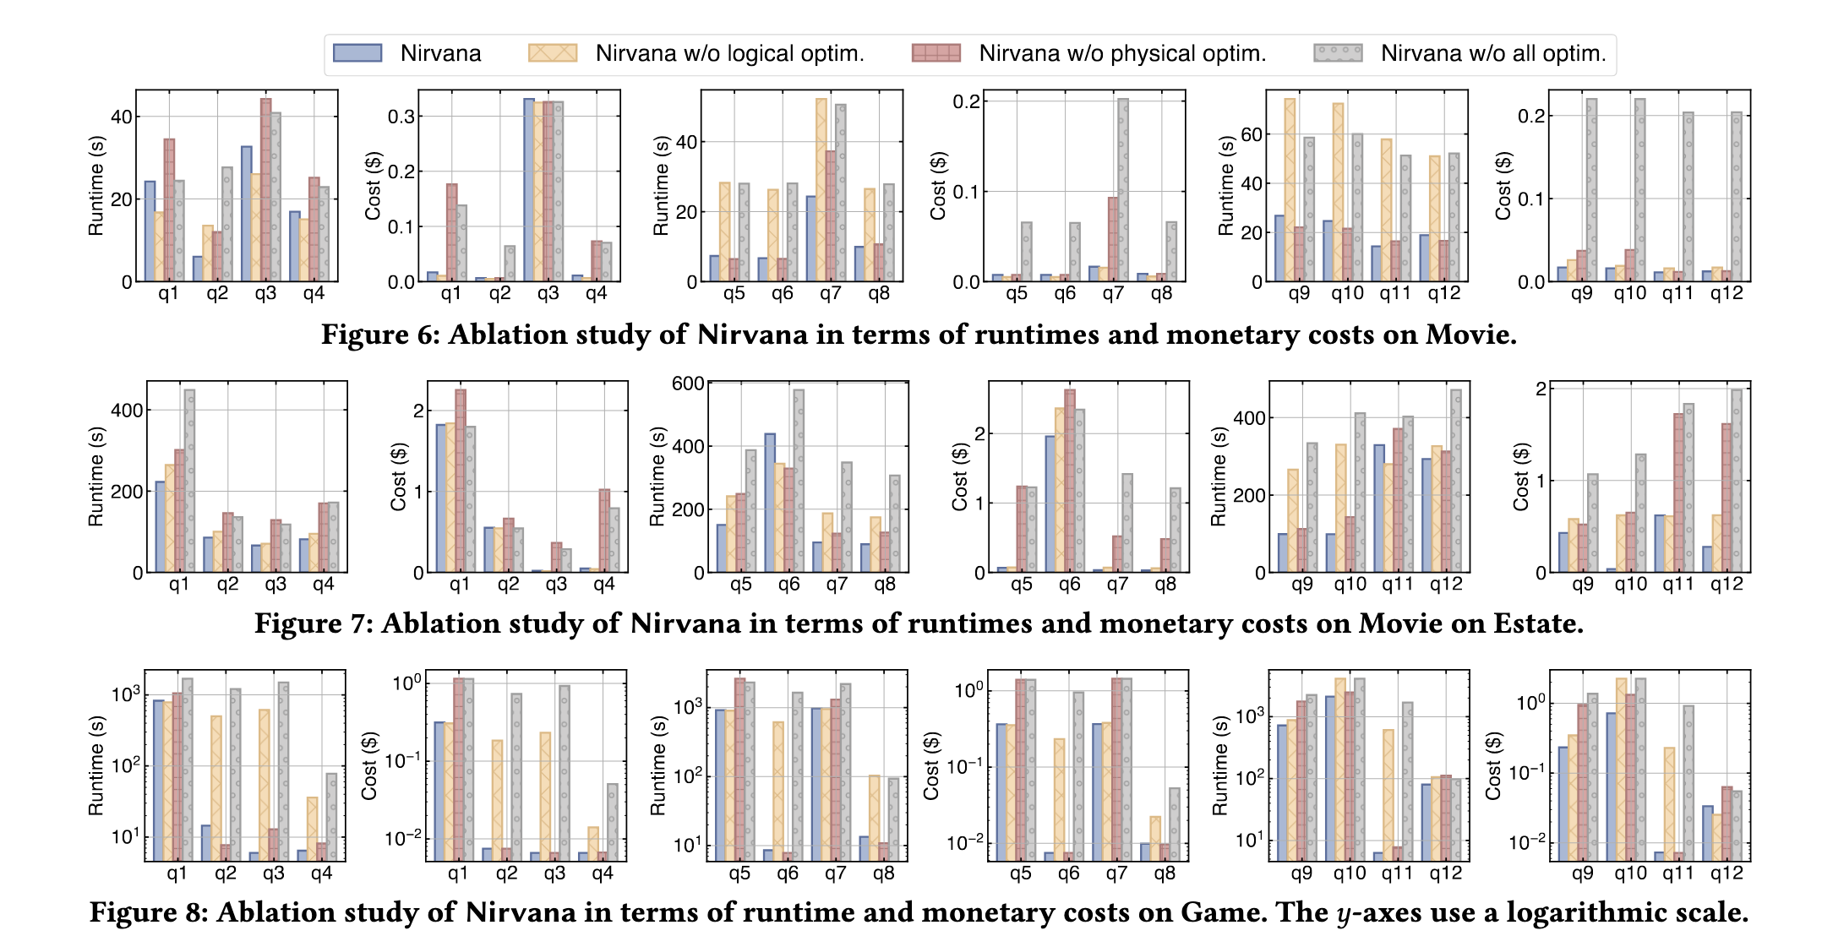
Experimental Evaluation

Slide 19
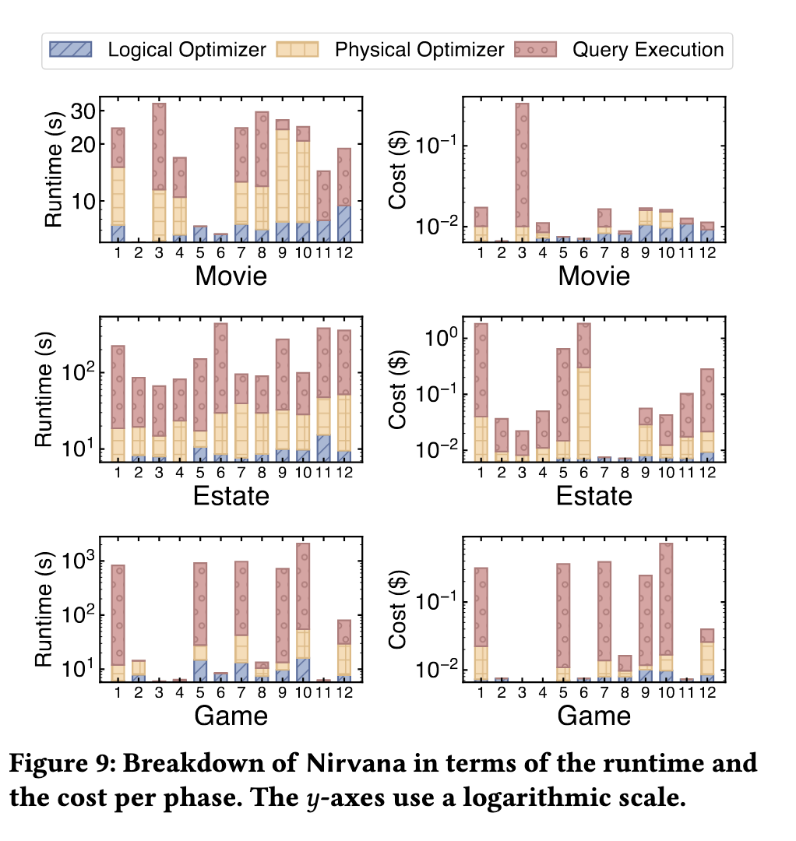
Experimental Evaluation
The proportions of optimization time relative to total query evaluation time are 50.7%, 6.7%, and 42.7% for the Movie, Estate, and Game benchmarks, respectively.

Slide 20
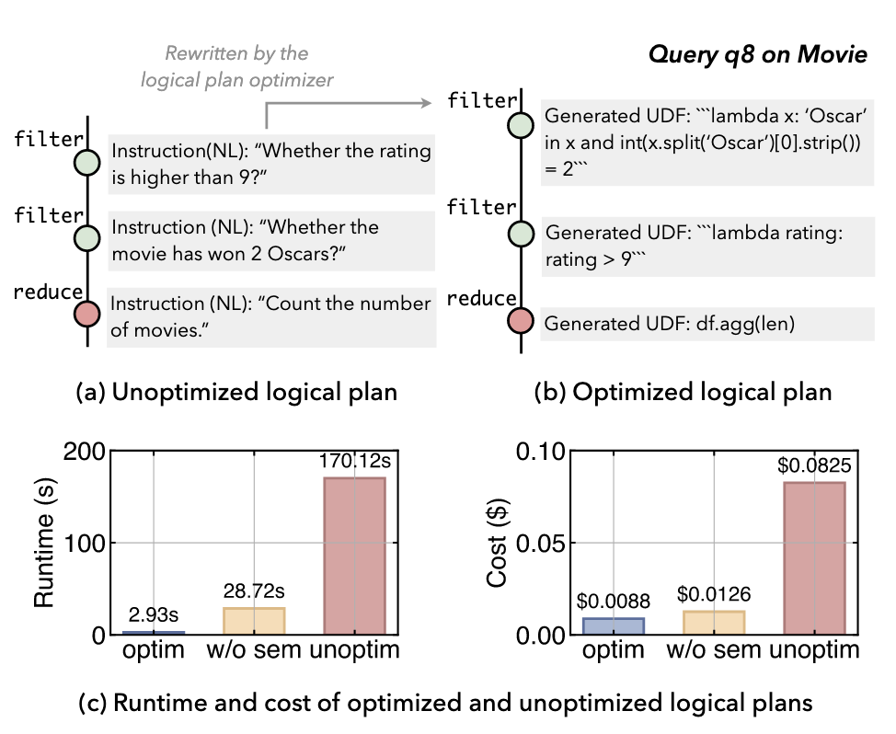
Experimental Evaluation
Successful cases

Slide 21
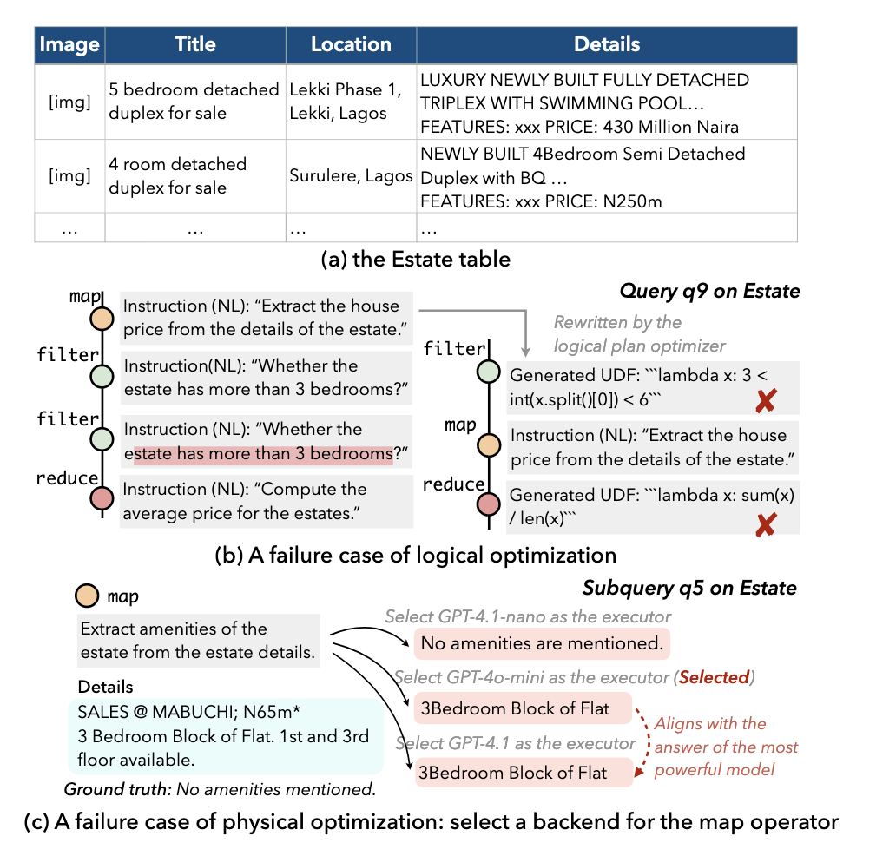
Experimental Evaluation
Failure cases

