Slide 1



Slide 2
INTRODUCTION
Background
Serializable isolation level (SER) is regarded as the gold standard for transaction processing due to its ability to prevent all forms of anomalies. SER is essential in mission-critical applications.
However, it incurs expensive coordination overhead by configuring the RDBMS to SER.

Slide 3
INTRODUCTION
Background
Many studies have explored achieving SER by modifying applications while configuring the RDBMS to a low isolation level.
Some RDBMSs cannot strictly guarantee SER and do not support the in-RDBMS modification.
RDBMSs typically offer better performance at lower isolation levels.

Slide 4
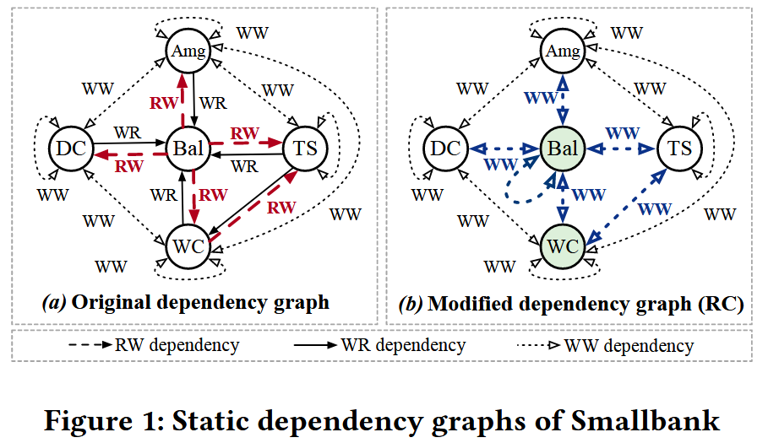
INTRODUCTION
Background
Achieving SER under low isolation levels follows three steps:
Build a static dependency graph by analyzing the transaction templates.
Configure the RDBMS to a low isolation level and identify dangerous structures, e.g., RW edge under RC isolation level.
Eliminate dangerous structures by modifying application logic.
Notes:
For example, under RC, a single RW dependency constitutes the dangerous structure. 所谓的dangerous structure就是构成异常所需要的边。

Slide 5
INTRODUCTION
Background
Existing studies exhibit two major shortcomings.
The static modification of query patterns is inefficient. These studies alter static SQL statements at the application level, converting certain read operations into write operations. This may result in unnecessary transaction conflicts.
These studies fail to address the trade-off between the performance gains of lower isolation levels and the overhead needed to maintain SER, making it difficult to choose the optimal isolation level.
Notes:
For example, under RC, a single RW dependency constitutes the dangerous structure. 所谓的dangerous structure就是构成异常所需要的边。

Slide 6
INTRODUCTION
Challenge
Designing an approach that elevates various isolation levels to SER without introducing additional writes is a complex task.
Determining the optimal isolation level requires accurately modeling the trade-offs between the performance benefits and serializability overhead associated with lower isolation levels, which is particularly challenging in dynamic workloads.
As workloads evolve, the optimal isolation level may need to adapt over time, making it essential to design an efficient and reliable mechanism for transitioning between isolation levels.

Slide 7
INTRODUCTION
Contribution
Efficient middle-tier concurrency control algorithm ensuring SER for each low isolation level.
Self-adaptive isolation level selection mechanism.
Cross-isolation validation mechanism that enables efficient transitions and serializable scheduling.

Slide 8
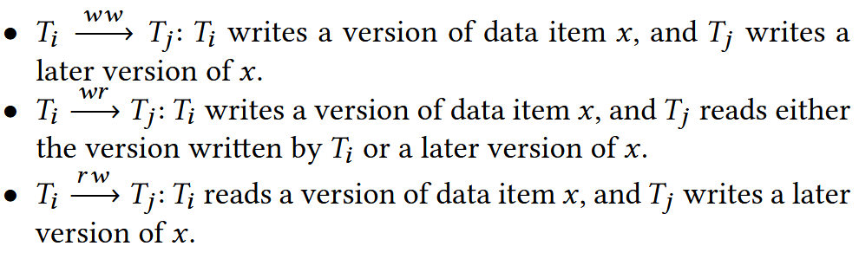
PRELIMINARIES
Dangerous Structures
The dependencies between two concurrent transactions, Ti and Tj , operating on the same item x, are classified as follows.

Slide 9
PRELIMINARIES
Dangerous Structures
Under SI, two consecutive RW dependencies are considered as an SI dangerous structure.
Under RC, an RW dependency is considered as an RC dangerous structure.
When it comes to transaction templates, the dependencies between two transaction templates exist if transactions access the same data in sequence.
Then, we extend the definition of dangerous structure to the static dangerous structure similarly.

Slide 10
PRELIMINARIES
Vulnerable Dependency
A vulnerable dependency is the dependency forming dangerous structures in the given isolation level.
For any vulnerable dependency from transaction Ti to Tj, if Ti commits before Tj, then the scheduling achieves SER.
Notes:
这是因为按依赖顺序提交的话，事务可以被视为串行执行，也就没有异常了。

Slide 11
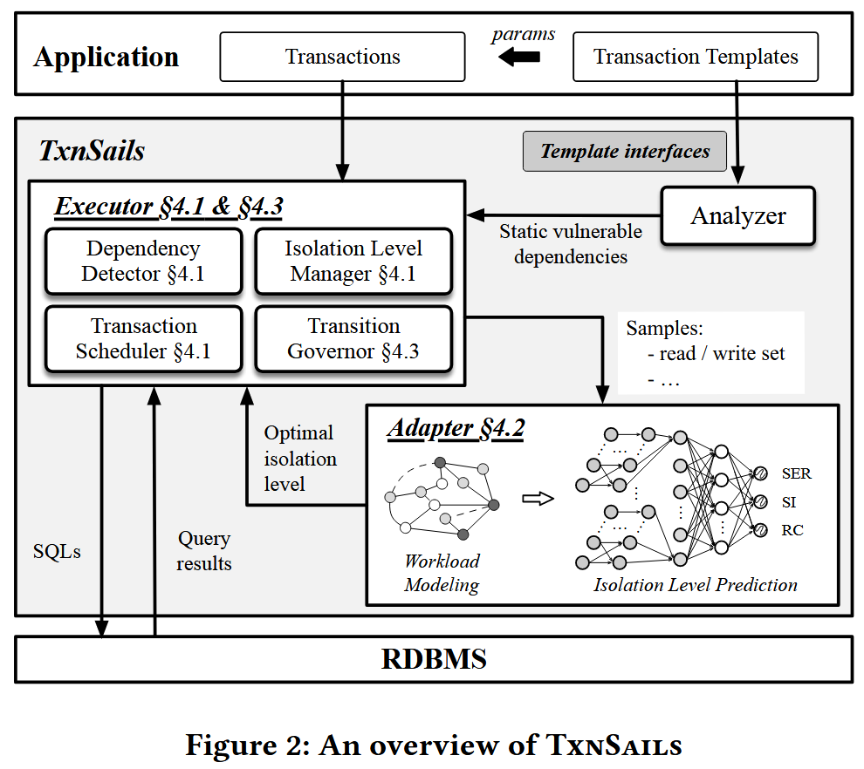
OVERVIEW
Analyzer builds the static dependency graph for the transaction templates and identifies all the static vulnerable dependencies for each low isolation level.
Executor ensures SER when transactions operate either at a single low isolation level or during the isolation level transition.
Adapter models the trade-off between performance benefits and serializability overhead under lower isolation levels.

Slide 12
DESIGN
Middle-tier Concurrency Control
Transaction lifecycle.
In the execution phase, TxnSails establishes a database connection with a specific isolation level, which is not adjusted until the transaction is committed or aborted.
In the validation phase, TxnSails acquires validation locks for data items stored in the buffer. Then, it detects the dependencies among them and aims to schedule the commit order consistent with the identified dependency order.

Slide 13
DESIGN
Middle-tier Concurrency Control
Validation phase.
TxnSails performs two key tasks in the validation phase: (1) detecting vulnerable dependencies; (2) scheduling the commit order consistent with the dependency order.
We utilize a version column, which is incremented after every write operation. We trace the dependency orders by comparing the versions of data items.

Slide 14
DESIGN
Middle-tier Concurrency Control
Validation phase.
Ti checks each data item in its write set to detect the RW dependencies from Ti ’s concurrent transactions (e.g., Tj ) to Ti. We achieve this via the validation locks, so that Ti would be blocked if someone reads the same data and put a shared lock on it.
Ti checks each data item in its read set to detect the RW dependencies from Ti to Ti ’s concurrent transactions. Then we abort Ti if it reads a stable version, while the latest versions are cached in TxnSails.

Slide 15
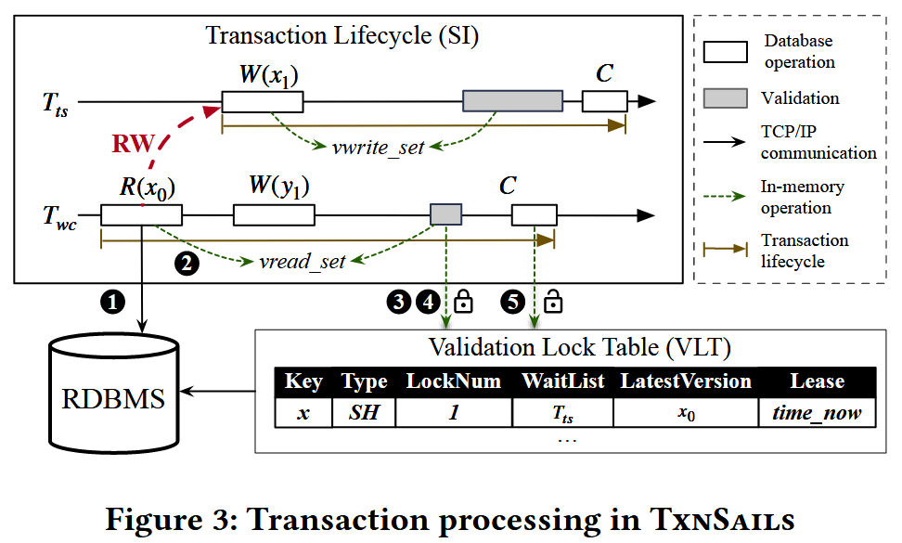
DESIGN
Middle-tier Concurrency Control
Validation phase.

Slide 16
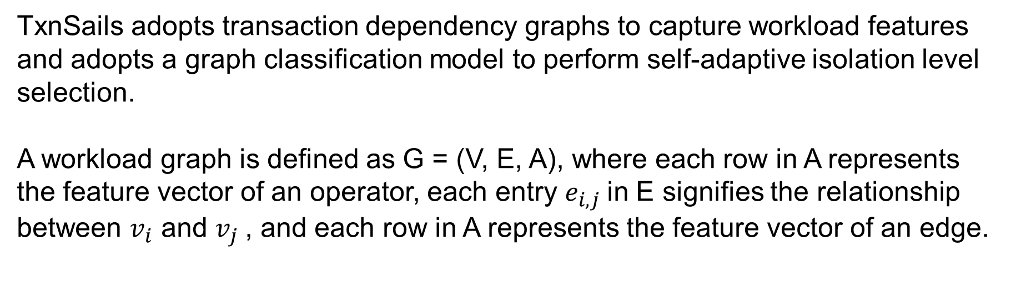
DESIGN
Self-adaptive Isolation Level Selection
TxnSails adopts transaction dependency graphs to capture workload features and adopts a graph classification model to perform self-adaptive isolation level selection.
A workload graph is defined as G = (V, E, A), where each row in A represents the feature vector of an operator, each entry $e_{i,j}$in E signifies the relationship between $v_{i}$ and $v_{j}$, and each row in A represents the feature vector of an edge.

Slide 17
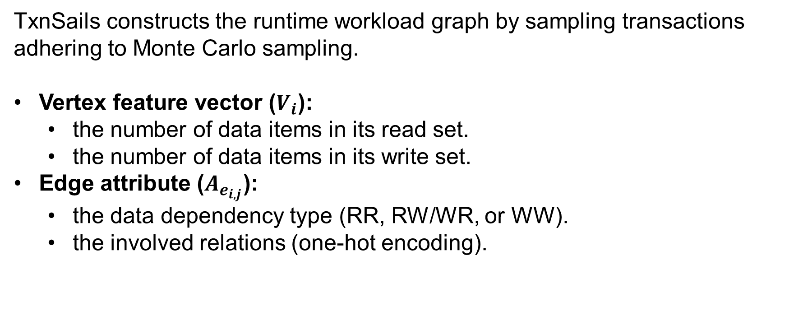
DESIGN
Self-adaptive Isolation Level Selection
TxnSails constructs the runtime workload graph by sampling transactions adhering to Monte Carlo sampling.
Vertex feature vector ($V_{i}$):
the number of data items in its read set.
the number of data items in its write set.
Edge attribute ($A_{e_{i,j}}$):
the data dependency type (RR, RW/WR, or WW).
the involved relations (one-hot encoding).

Slide 18
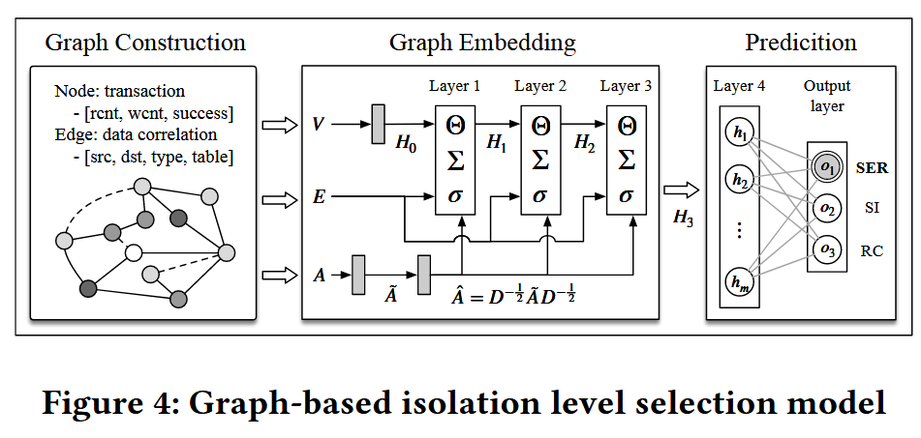
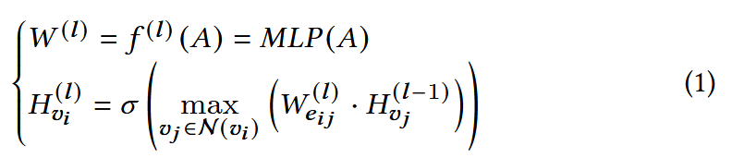
DESIGN
Self-adaptive Isolation Level Selection
Our graph model comprises two parts. First, we use a Graph Embedding Network to learn and aggregate both vertex and edge features.
Second, we use a Graph Classification Network that learns the mapping from the embedded matrix H to perform the end-to-end graph classification.
The optimal isolation level is labeled based on throughput.

Slide 19
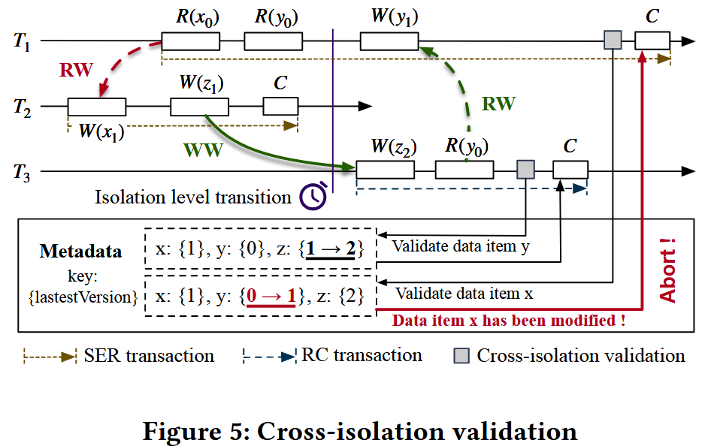
DESIGN
Cross-isolation Validation
If the predicted optimal isolation level changes, TxnSails will adapt from the previous isolation level $I_{old}$ to the optimal isolation level $I_{new}$.

Slide 20
DESIGN
Cross-isolation Validation
When the system transitions isolation level, the middle tier blocks new transactions from entering the validation phase until all transactions that have entered the validation phase before the transition commit or abort.
The transaction that has completed the execution phase enters the cross-isolation validation phase, which request validation locks according to the stricter locking method of both the former and later isolation level.
Then, the transaction checks the stricter vulnerable dependency and eliminates it.

Slide 21
EVALUATIONS
Setup & Baselines.
Default DBMS: PostgreSQL 15.2 (RC, SI, SER).
Benchmark: SmallBank, YCSB-T, and TPC-C.
Baselines:
Native concurrency control mechanisms: SER(SSI) and SI.
Promotion: This strategy converts read operations into write operations by promoting SELECT statements with non-modifying UPDATE statements.
Conflict materialization(ELM): This approach employs an external lock manager (ELM) and introduces additional write operations on the ELM to ensure serializable scheduling.
Similar method: TxnSails-Rule and TxnSails-Bayesian, which use pre-defined rules and 4-dimensional feature vector to detect optimal IL.

Slide 22
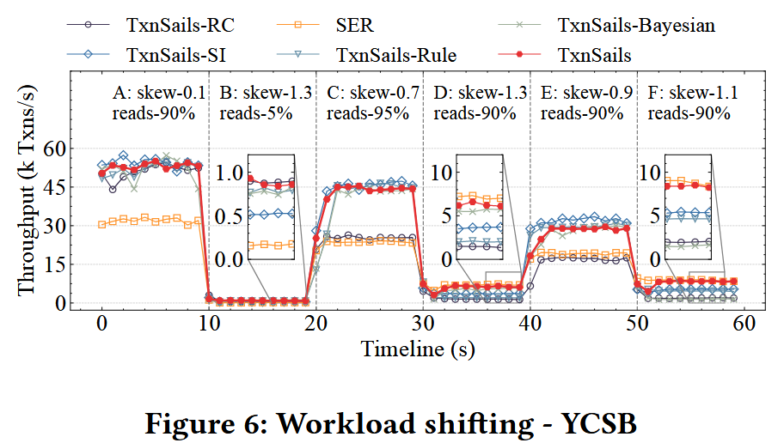
EVALUATIONS
Ablation Study: Self-adaptive isolation level selection.
TxnSails successfully adapts to the optimal isolation level.
The performance of TxnSails is slinghtly lower than because: (1) TxnSails requires selecting version; (2) TxnSails needs to sample transactions to predict the optimal isolation level.

Slide 23
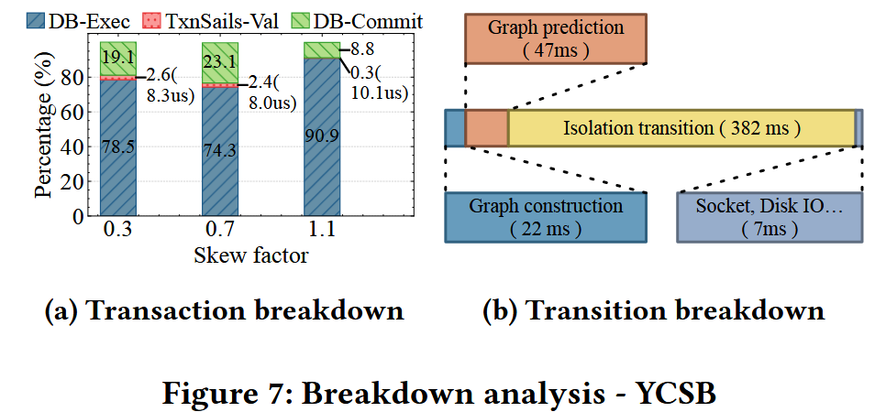
EVALUATIONS
Ablation Study: Validation analysis.
The middle-tier concurrency control does not significantly affect normal execution. Meanwhile, the IL transition takes a little time.

Slide 24
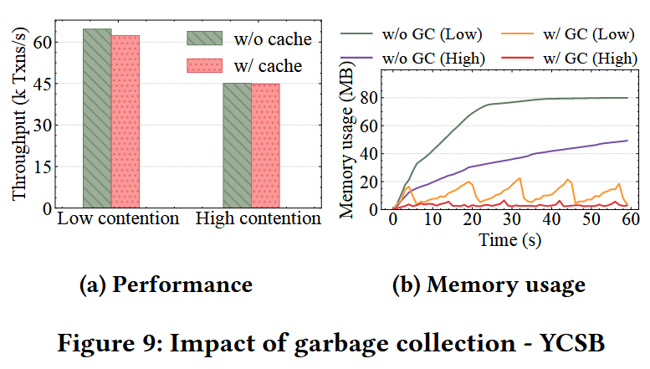
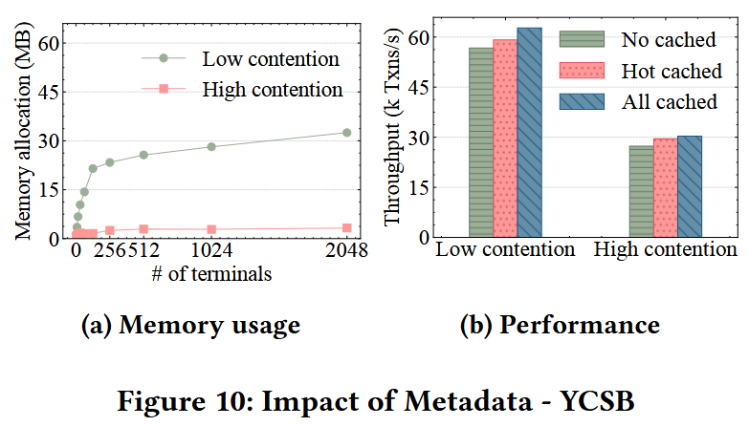
EVALUATIONS
Ablation Study: Validation analysis.
TxnSails efficiently caches frequently accessed tuples, especially when contention is high.

Slide 25
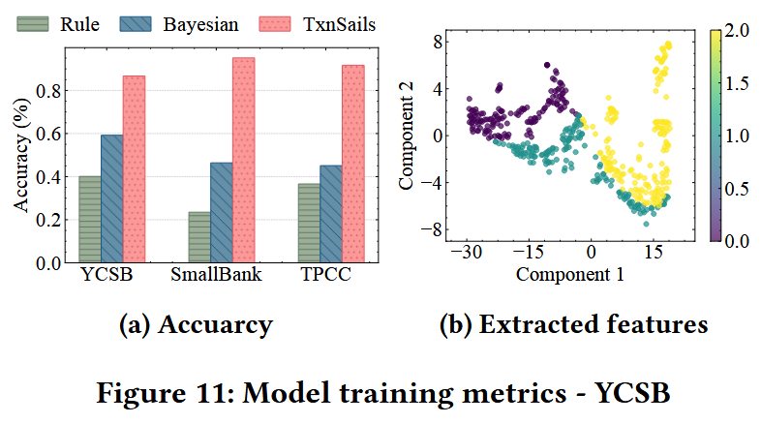
EVALUATIONS
Ablation Study: Graph model.
The neural network method consistently achieves the highest accuracy across all benchmarks.
Most workloads are accurately distinguished, with few errors primarily occurring at the boundaries between isolation levels.

Slide 26
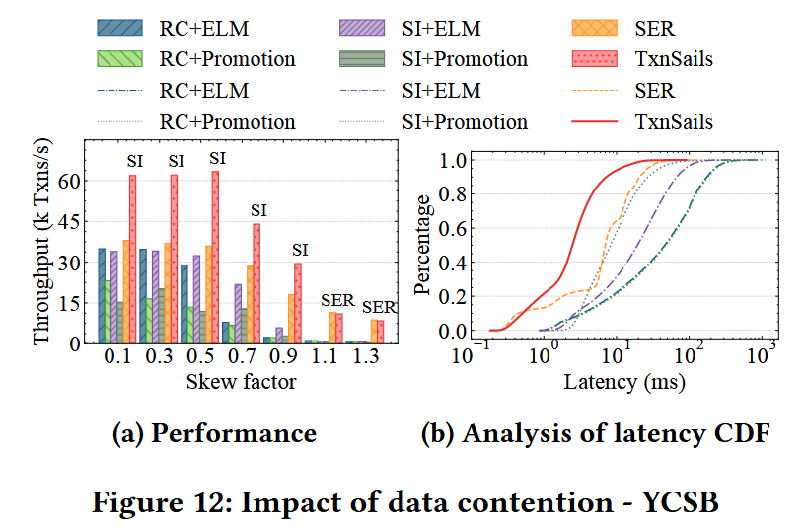
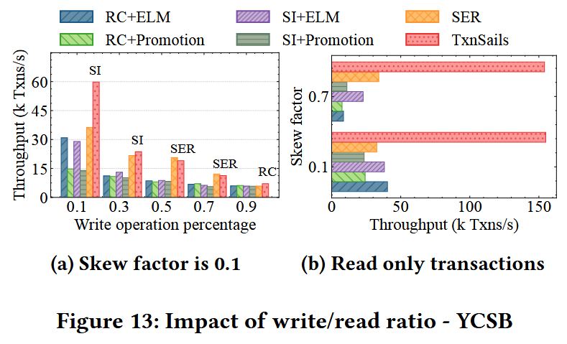
EVALUATIONS
Comparison to State-of-the-art Solutions.
In low-skew scenarios, SI outperforms RC; in high-skew scenarios with fewer writes, SER is the most effective; and in high-skew scenarios with intensive writes, RC is more suitable.

