Slide 1
ResTune: Resource Oriented Tuning Boosted by Meta-Learningfor Cloud Databases
Xinyi Zhang*
Hong Wu*, Zhuo Chang, Shuowei Jin, Jian Tan, Feifei Li, Tieying Zhang, Bin Cui
SIGMOD ’21
1

Slide 2
Research Motivation
Tuning configuration knobs of modern database management systems (DBMS) is critical for system performance.
In a cloud environment, manually tuning possibly tens to hundreds of controlling knobs do not guarantee the performance across various workloads and instances.
Controlling the resource utilization is a necessity from the cloud provider’s perspective:
To maintain a low cost.
To prevent unpredictable system hangs and resource contentions.

Slide 3
Challenge
To reduce resource utilization while still guaranteeing the Service Level Agreement (SLA), e.g., without violating the throughput and latency requirements.
To reduce the tuning time:
Tuning systems replay the workload repeatedly to learn the model iteratively, and the replay time dominates the tuning process:
For real workloads, the replay time for each iteration takes at least 5 minutes to adapt to different types of transactions.
The state-of-the-art systems (OtterTune, CDBTune) take hundreds to thousands of iterations to find an ideal configuration.

Slide 4
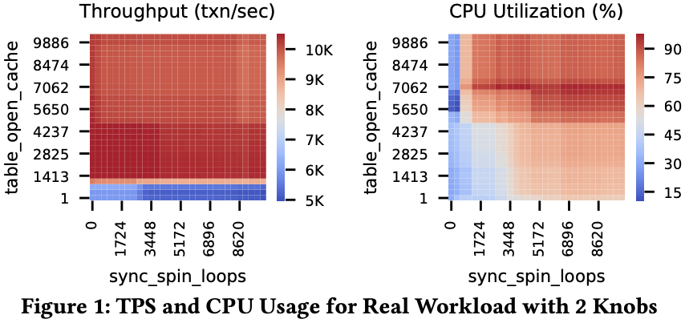
Observation
The throughput of real workloads is often bounded by the request rate determined by the clients.
Throughput is not the bottleneck in most cases.
A wide range of configurations has different CPU usages but the same throughput.

Slide 5
Limitation of Existing Methods
#1
Not Optimizing Resource Usage
#2
Time Consuming
#3
High Training overhead
#4
Weak Adaptability
All Methods
Search Based
(e.g. BestConfig)
Reinforcement Learning Based
(e.g. CDBTune)
Bayesian Optimization Based
(e.g. Ottertune)

Slide 6
Overview of ResTune
ResTune is a tool provided by the cloud providers:
Aims to find the configurations to minimize the resource usage without sacrificing the throughput and latency.
Also aims to boost the tuning process with different past tuning tasks from different instance types and different workloads.
How does ResTune overcome challenges?
ResTune optimizes the resource utilization for a given workload by imposing constraints on the performance requirements.
ResTune leverages the tuning experience from the history tasks and transfers the accumulated knowledge to accelerate the tuning process of the new tasks.

Slide 7
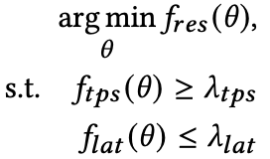

Resource Oriented Tuning Problem
Consider a database with a continuous configuration space:
$$Θ=Θ_{1}×Θ_{2}×…×Θ_{m} \left(Θ_{i}∈\left[0,1\right]\right),$$
For a given workload, we want to find the configuration $θ^{∗}∈Θ$ that minimizes resource usage and satisfies the SLA requirements:

Slide 8

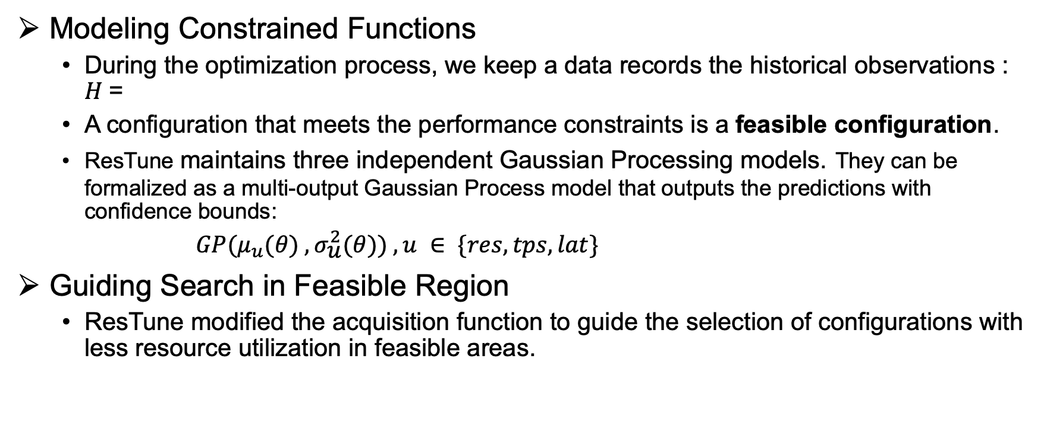
Solving Constrained Optimization
Modeling Constrained Functions
During the optimization process, we keep a data records the historical observations : 𝐻 =
A configuration that meets the performance constraints is a feasible configuration.
ResTune maintains three independent Gaussian Processing models. They can be formalized as a multi-output Gaussian Process model that outputs the predictions with confidence bounds:
$GP(μ_{u}(θ) , {\text{σ}}_{\text{u}}^{2}(θ)) ,u ∈ \{res,tps,lat\}$
Guiding Search in Feasible Region
ResTune modified the acquisition function to guide the selection of configurations with less resource utilization in feasible areas.

Slide 9

Solving Constrained Optimization
Guiding Search in Feasible Region
Assume $f_{res}\left(θ_{best}\right)=min{f_{res},}$ The expected form of the improvement function of a candidate point 𝜃:
$$α_{EI}(θ)=E[max⁡(0,f_{res}\left(θ_{best}\right)−f_{res}\left(θ\right)]$$
To solve the constrained optimization problem, the new acquisition function:
${ α}_{CEI}=α_{EI}× Prob(feasibility)$

Slide 10
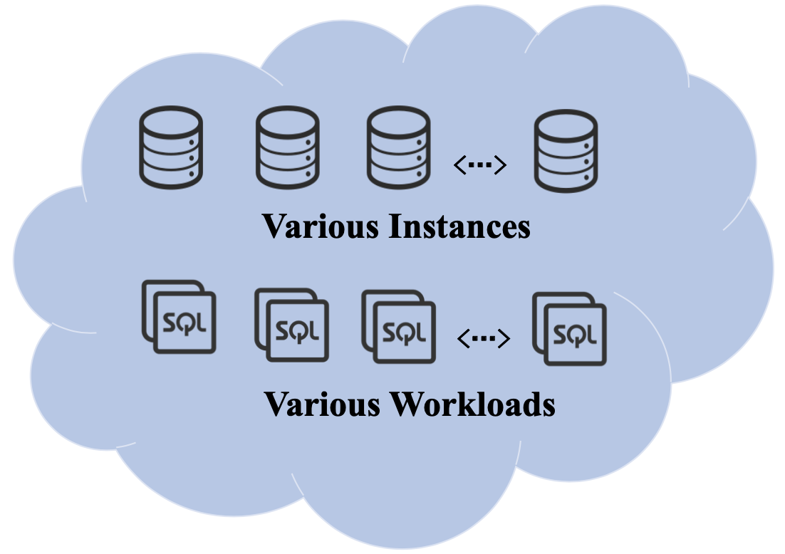
BOOSTING TUNING PROCESS
The same workloads running on different hardware share information for tuning knobs.
Even for different workloads, the relationship between hidden features can lead to knowledge sharing.

Slide 11
Boosting Tuning Process: Meta-Learning
Learn across tasks like humans do.
Why? Not enough training data but require less trial-and-error.
Task 1
Task 2
Task 3
Learning
Meta- Learning
Learning
Meta- Learning
Learning
Meta- Learning
Learning episodes
Models
Models
Models
Performance
Performance
Performance

Slide 12
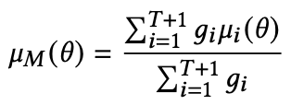
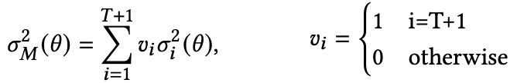
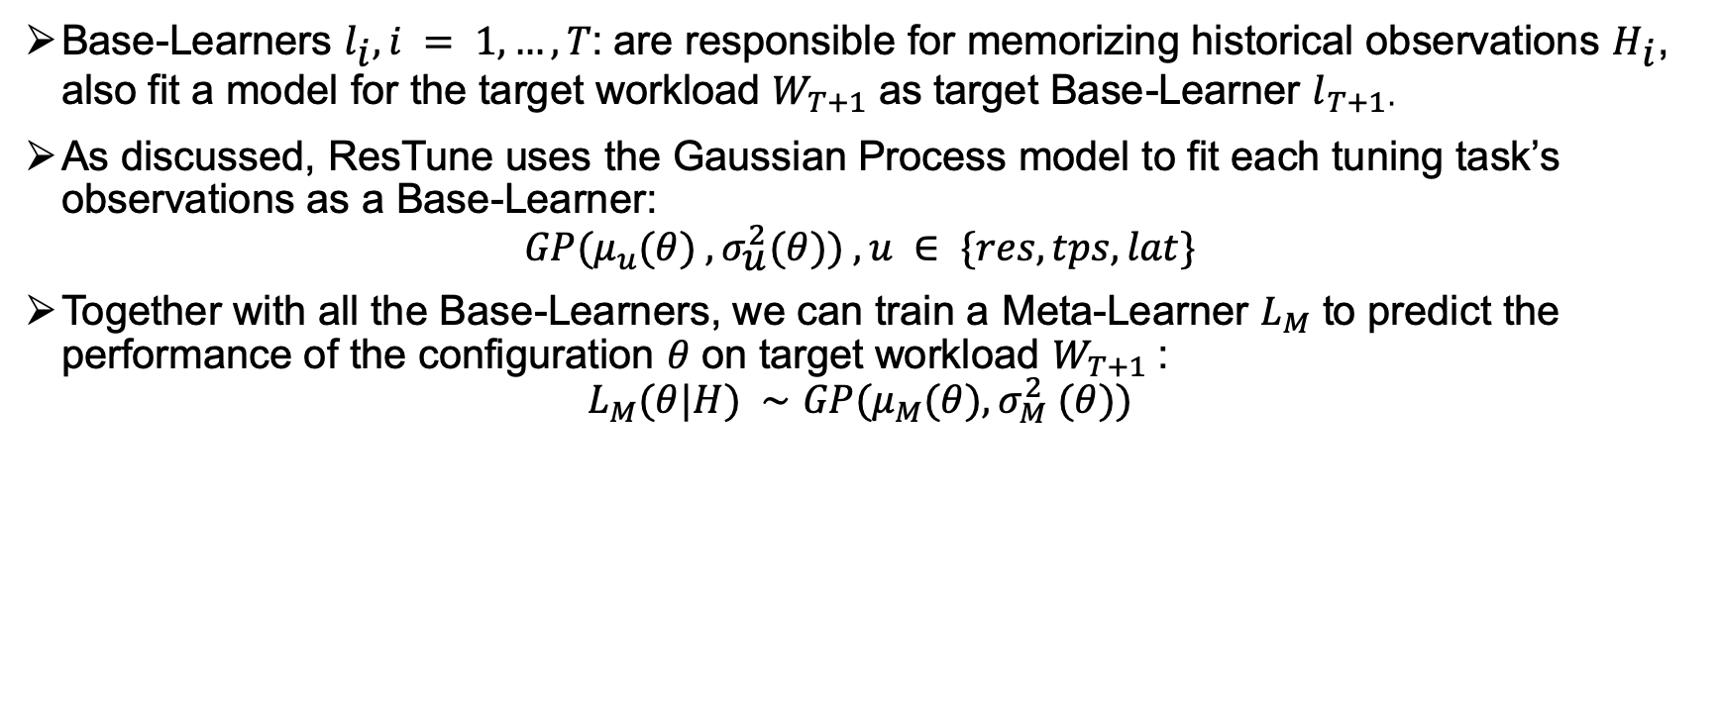
Knowledge Extraction
Base-Learners $l_{\text{i}}, i = 1,…,T$: are responsible for memorizing historical observations ${\text{H}}_{\text{i}}$, also fit a model for the target workload $W_{T+1}$ as target Base-Learner $l_{T+1}$.
As discussed, ResTune uses the Gaussian Process model to fit each tuning task’s observations as a Base-Learner:
$$GP(μ_{u}(θ) , {\text{σ}}_{\text{u}}^{2}(θ)) ,u ∈ \{res,tps,lat\}$$
Together with all the Base-Learners, we can train a Meta-Learner $L_{M}$ to predict the performance of the configuration 𝜃 on target workload $W_{T+1}$:
$$L_{M}(θ|H) ∼GP(μ_{M}(θ), σ_{M}^{2} (θ))$$

Slide 13
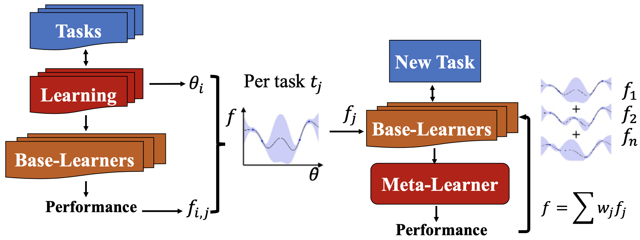
Knowledge Extraction
The prior knowledge is extracted from historical tuning tasks by ensemble.

Slide 14
How to determine the weights?
Learning from Meta-Feature
Learning from Model Predictions
Static
Good initialization
Dynamic
Avoid over-fitting

Slide 15




Learning from Meta-Feature
Meta-features: estimated resource cost of the workload.
ResTune learns the meta-feature by workload characterization.
A Workload characterization pipeline
Predicted Probability
Distribution
Keywords
Feature Vector
Workload j
TF-IDF
Random Forest Model
Meta-Feature
Label:
resource cost level

Slide 16
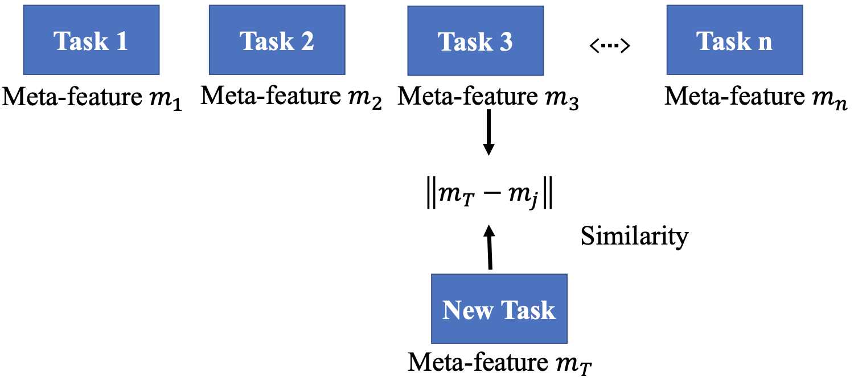
Learning from Meta-Feature
The static weight is calculated by the distance between meta-features.

Slide 17
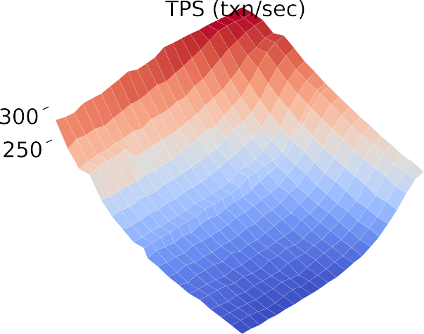
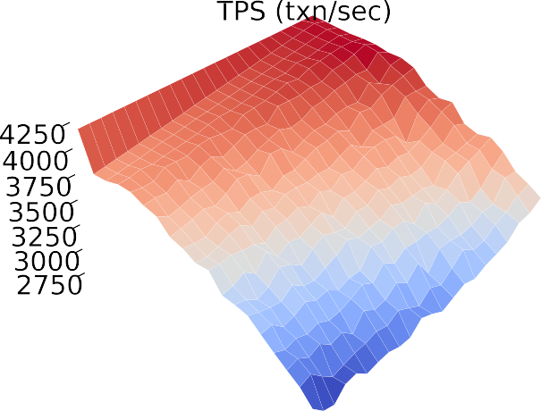
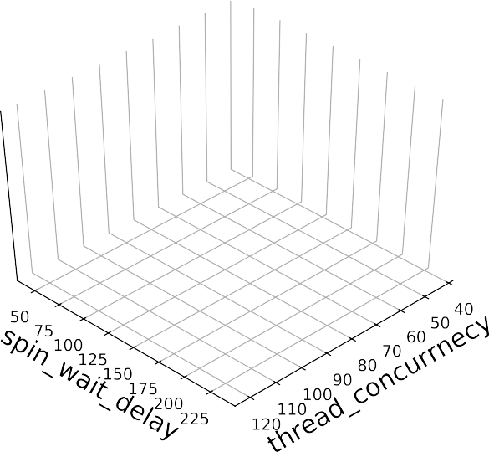
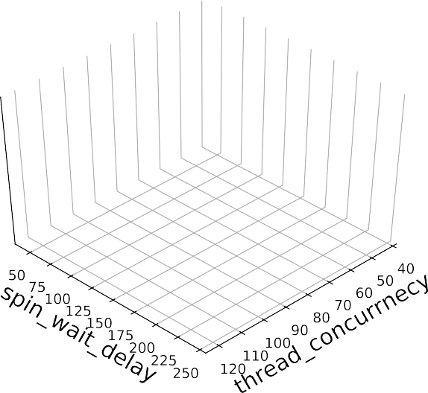
Learning form Model Predictions
Base-Learners’ generalizability: how accuracy base-learner can predict the performance of the target task.
Challenge: The performances can differ in scale significantly among various hardware environments in the cloud.
Instance A
Instance B

Slide 18
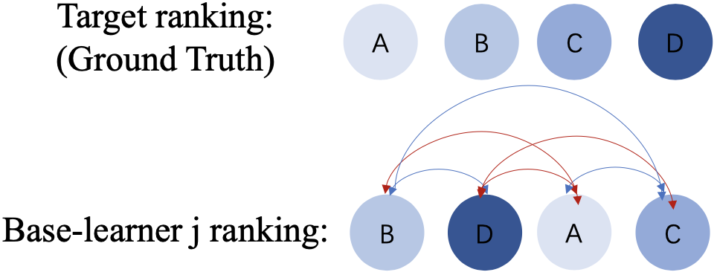
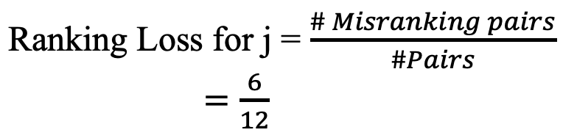
Learning form Model Predictions
Key observation: the actual values of the predictions do not matter, since we only need to identify the location of the optimum.
The fundamental similarity of tasks in an optimization problem means that the tasks have surfaces with similar trends in the configuration space.
ResTune calculate the ranking loss of base-learners against target observations.

Slide 19
Adaptive weight schema
Static Weight Assignment:
Meta-features gives a coarse-grained abstraction about task properties.
Suggesting knobs that are promising according to similar historical tasks.
Dynamic Weight Assignment:
Ranking of model predictions measures the similarity of tasks in the optimization problem.
Avoiding over-fitting by shrinking historical base learners' weight.

Slide 20
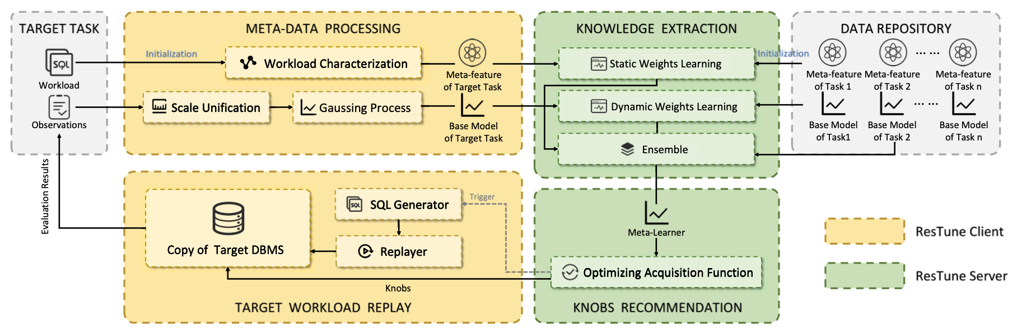
Overall Architecture of ResTune

Slide 21
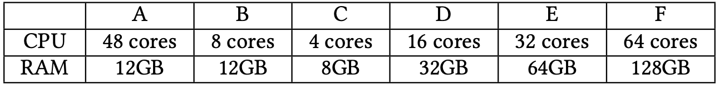
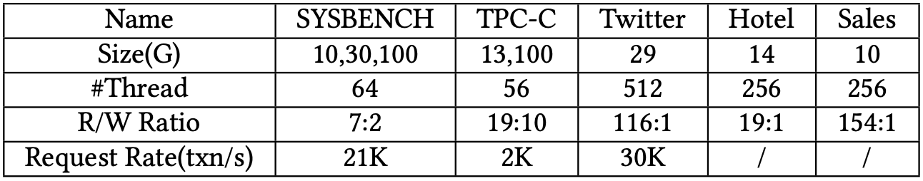
Experimental Study
DBMS: version 5.7 of MySQL RDS
Hardware instances:
Workloads:
Benchmark workloads: SYSBENCH,TPC-C, Twitter
Real world workloads: Hotel, Sales

Slide 22
Experimental Study
Baselines:
Default: The default knobs provided by experienced DBA;
iTuned: Change its objective to minimize the resource utilization;
OtterTune-w-Con: Replace OtterTune’s acquisition function to the designed CEI to guide search in feasible region;
CDBTune-w-Con: Modify its reward function to encourage the agent to minimize resource usage and satisfy the SLA;
ResTune-w/o-ML: ResTune without Meta-Learning;
ResTune: ResTune uses the meta-learner to boost the tuning.

Slide 23
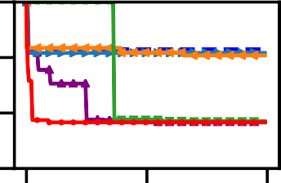
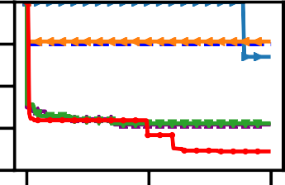
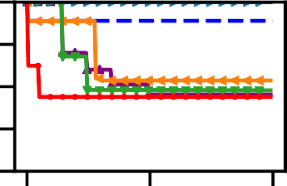
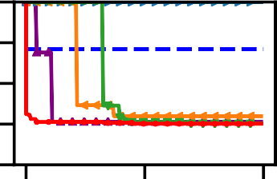
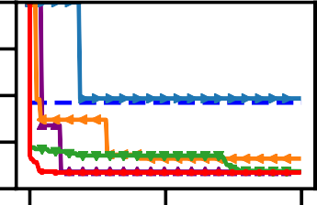
Efficiency Comparison
Performances of various workload on Instance A
Result:
ResTune can reduce the default CPU usage by 50.1% on average and guarantee the SLA.
Within one hour, ResTune can already find good configurations, while the other methods can not.

Slide 24
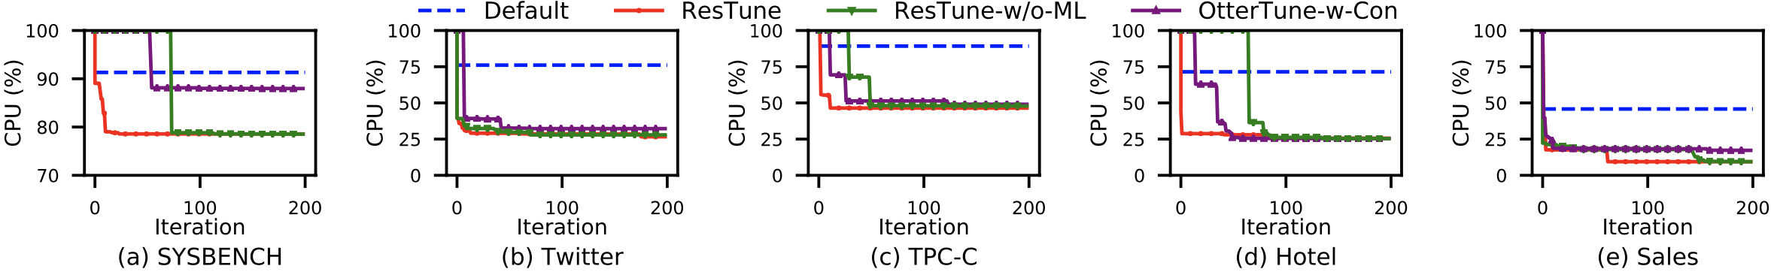
Evaluation on Adaptability
Workload Adaption
Holding out the target workload’s data from the data repository
Performance Adapting t o Different Workloads

Slide 25
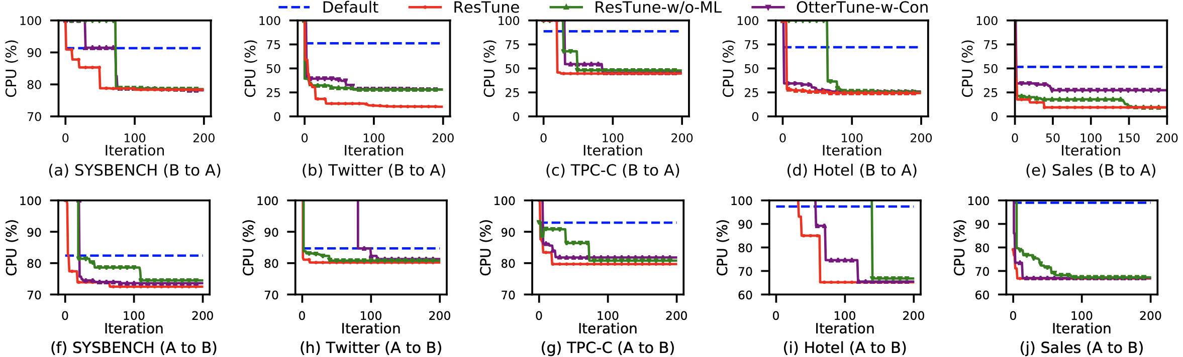
Evaluation on Adaptability
Hardware Adaption
B to A
A to B
Performance Adapting t o Different Hardware Environments

Slide 26
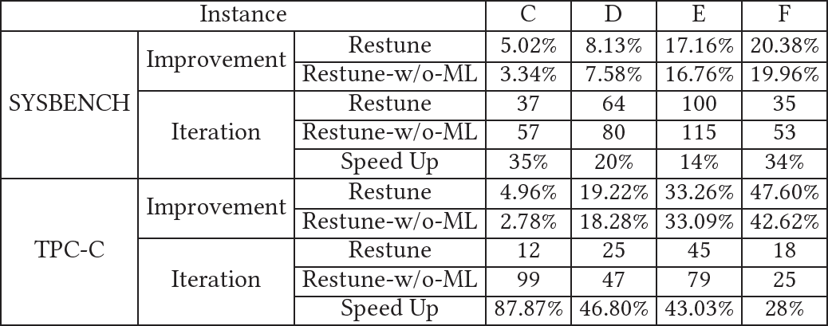
Evaluation on Adaptability
Hardware Adaption
AB to C, D, E and F respectively

Slide 27
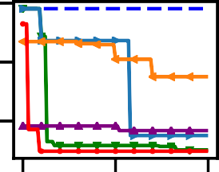
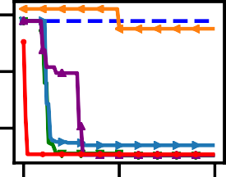

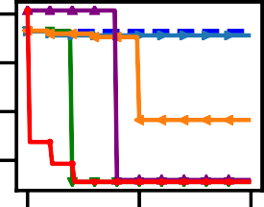

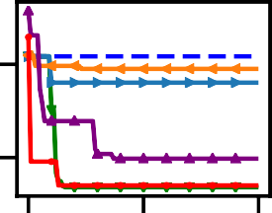

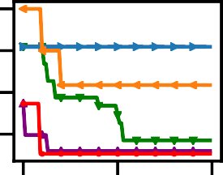

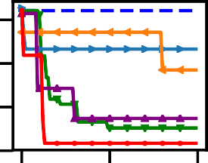







Tuning other types of Resources
Other types of resources
I/O (BPS and IOPS)
Memory
Performance Tuning Other Types of Resources
Result:
ResTune reduces 87% of I/O, and 39% of memory on average.

