Slide 1

TXSQL: Lock Optimizations Towards High Contented Workloads（SIGMOD’25）
胡梓锐
2025.12.22

Slide 2
Introduction
Lock Contention in Real-World OLTP System
  In Tencent Cloud’s OLTP scenarios, database workloads are mostly underloaded during normal operation. However, systems frequently experience short bursts of traffic spikes, e.g.,
    best-selling products in e-commerce;
    large-scale promotional events.
  These bursts lead to highly contended workloads, where:
    access concentrates on one or a few data items;
    hotspot records emerge naturally.
Lock Manager: A Core Component of Concurrency Control
  The lock manager is a central module in pessimistic concurrency control protocols.
  It regulates concurrent access to database resources during transaction execution.
T1
T2
T3
T4
T5
T6
T1
T2
T3
T4
T5
T6
T1
T2
T3
T4
T5
T6
(a) Low-Contention
(b) High Contention
(c) Hotpot

Slide 3
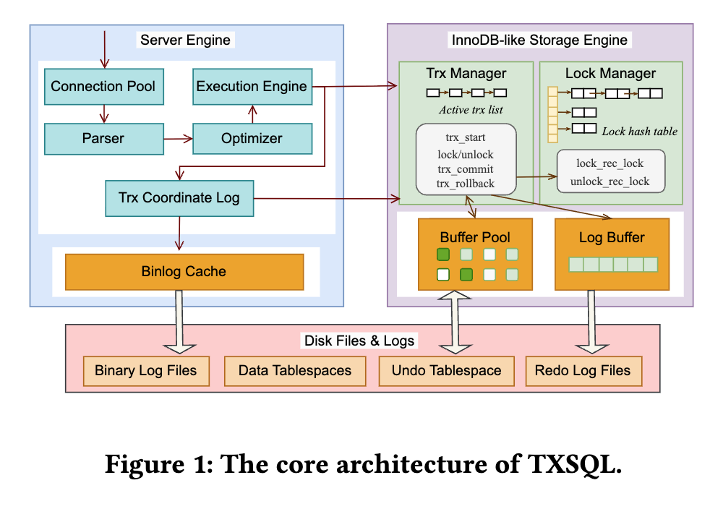
Typical Applications at Tencent
WeChat Red Envelope
  A monthly active user base exceeding 1.3 billion.
  On traditional Chinese New Year’s Eve, we successfully handled a peak of Transaction per Second (TPS) up to 14 million red envelope.
Tencent Financial Technology (FiT)
  Its primary application is WeChat Pay, which facilitates an average of over one billion payment transactions daily.
  During holidays or special events, such as Double Eleven Day, transaction volumes on WeChat Pay typically experience a significant surge.

Slide 4
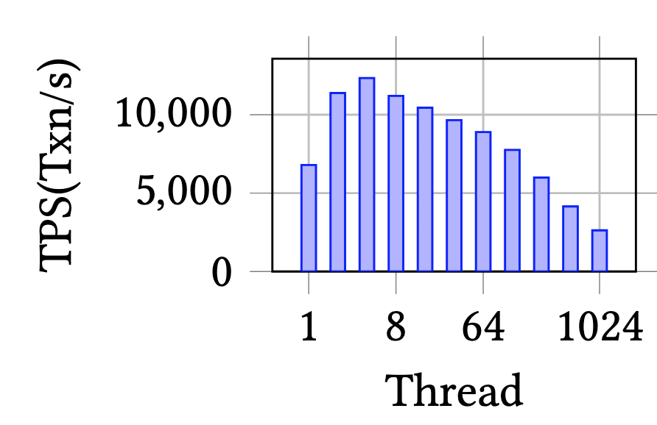
Motivation
Locking under High Contention
  High-contention workloads are common in OLTP systems. In such workloads:
    updates to the same record are logically serial
    but enforced via heavyweight lock management
  Although these workload transactions are typically short, the system’s efforts to maintain transaction isolation result in numerous lock requests and contention, which negatively impacts performance
More clients, lower TPS

Slide 5
Motivation
Implications under Hotspot Access
  When multiple transactions repeatedly update the same record:
    Each transaction: 1) requests the same lock, 2) enters the lock wait queue, 3) waits for its predecessor to release the lock.
    As concurrency increases: 1) lock wait queues grow, 2) lock allocation and deallocation become frequent, 3) deadlock detection is triggered more often.
    Performance issue: 1) long lock wait queues, 2) frequent lock allocation/deallocation, 3) expensive deadlock detection

Slide 6
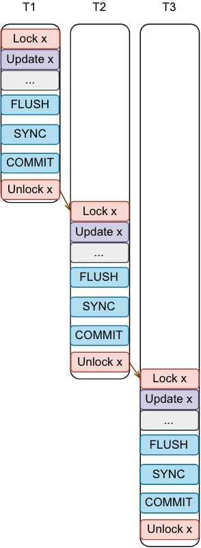
How InnoDB works
Long lock waiting
time limits
parallelism
Clients
InnoDB
Lock_System
record1
record2
reorcd3

Slide 7
Observations
In highly contended hotspot scenarios:
  Transactions are effectively executed in serial order, yet the system incurs full locking overhead for each transaction.
We observe that:
  The cost of enforcing serialization via locks far exceeds the cost of executing serialized updates themselves.
  Therefore: Can we execute inherently serial hotspot updates without repeatedly invoking the lock manager?

Slide 8
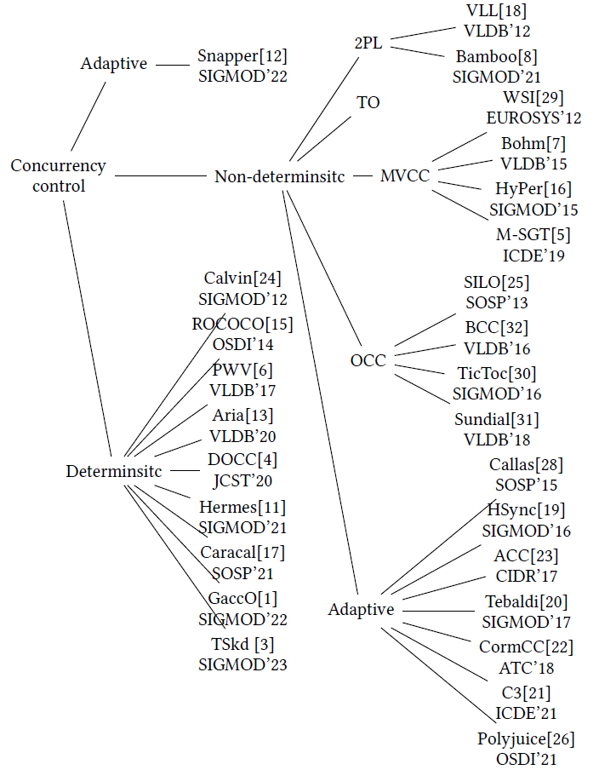
Existing Work
锁竞争减缓
这类方法在高冲突工作负载中表现出一定的有效性，但是现有的锁方案无法克服在热点访问期间锁的集中获取和争用导致吞吐性能低下的挑战。
确定性调度
这类算法因为新协议或融合协议的复杂验证设计，在实现和证明可串行化面临事务正确性验证难的问题

Slide 9
General Lock Optimization (O1)
Lightweight Locking (Reduce the unnecessary lock objects: lazy materialization)
  Problem：
    Traditional InnoDB eagerly creates row locks → many unnecessary lock objects, even without conflicts
  Idea：Check conflicts first, create locks only if needed
  How：
    Use a lock-free wait map (record_id → waiting trx [trx_id_1, trx_id_2, ...])
    No conflict → no lock object
    Conflict → materialize lock on demand
Copy-Free Active Transaction List
  Problem:
    MVCC needs active transaction list→ locking or copying causes overhead
  Idea：Visibility = timestamp comparison
  How：
    Add transaction deletion timestamp (del_ts)
    Check visibility using snapshot + del_ts
    No access to active transaction list

Slide 10
Initial Hotspot Lock Mechanism within TXSQL(O2)
Queue Locking for Hotspot Access:
  Problem：
    Hotspot updates cause heavy lock manager contention
    Lock wait queues grow rapidly as concurrency increases
    Deadlock detection is frequently triggered and expensive
  Idea：Serialize hotspot updates before entering the lock manager
    Avoid lock manager contention
    Avoid expensive deadlock detection
  How：
    Automatically detect hotspot rows at runtime
    Maintain a hotspot hash table
      row_id → waiting transaction queue
    Queue-before-lock execution
      Transactions accessing hotspot rows are queued
      Dequeued transactions acquire locks and proceed in order
    Timeout mechanism instead of direct deadlock detection

Slide 11
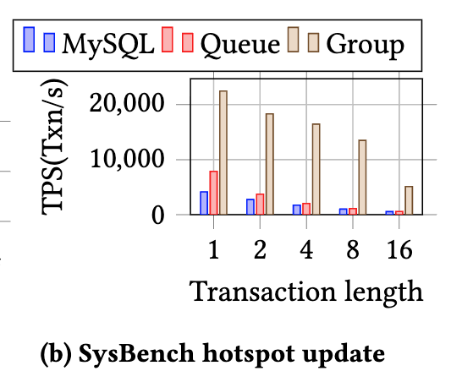
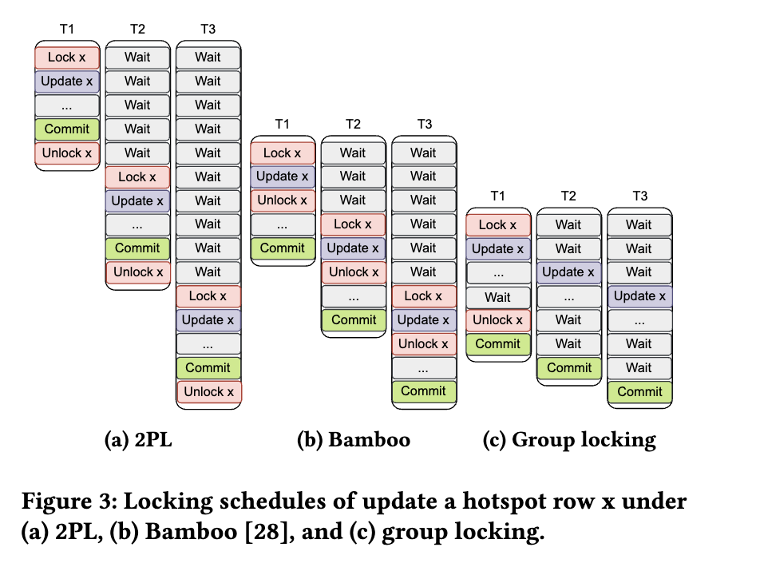
Group Locking for Hotspot Access (Key Design)
Group Locking:
  Problem：
    Queue locking effectiveness degrades under long transaction length (e.g., HA synchronization between primary & secondary replicas);
    Hotspot updates remain serialized but pay lock costs repeatedly.
  Idea：Group multiple hotspot updates and lock only once per group
    Execute conflicting hotspot updates sequentially without locks
    Pay lock/unlock cost once per group, not per transaction
  How：
    Form a hotspot update group
      Transactions updating the same hotspot row are grouped
    Group-level locking
      Acquire lock once before group execution
      Release lock once after group completes
    In-group execution without locks
      Transactions execute sequentially inside the group
      No lock release or wake-up between transactions

Slide 12
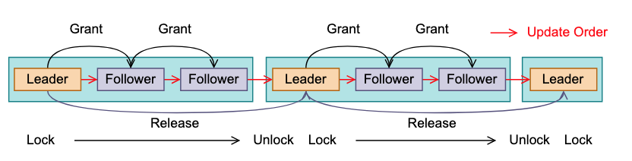
Implementation
Hot item detection: (inspired by using FIFO)
    The number of waiting transactions on a row lock record
      #Waiting transactions > threshold (e.g., 32 (rule of thumb))
    Once identified, the hotspot is added to a hotspot hash table
      hot_row_hash: row_id → hotspot metadata
      Not 2PL protocal, go to hotspot queue
  Group Locking
    The leader is responsible for acquiring and releasing locks
    The follower can operate a tuple without holding the lock
    New group is generated after the previous leader committed
Clients
InnoDB
Detecthot spots
Hot item queues
Group Locking
record1
record3

Slide 13
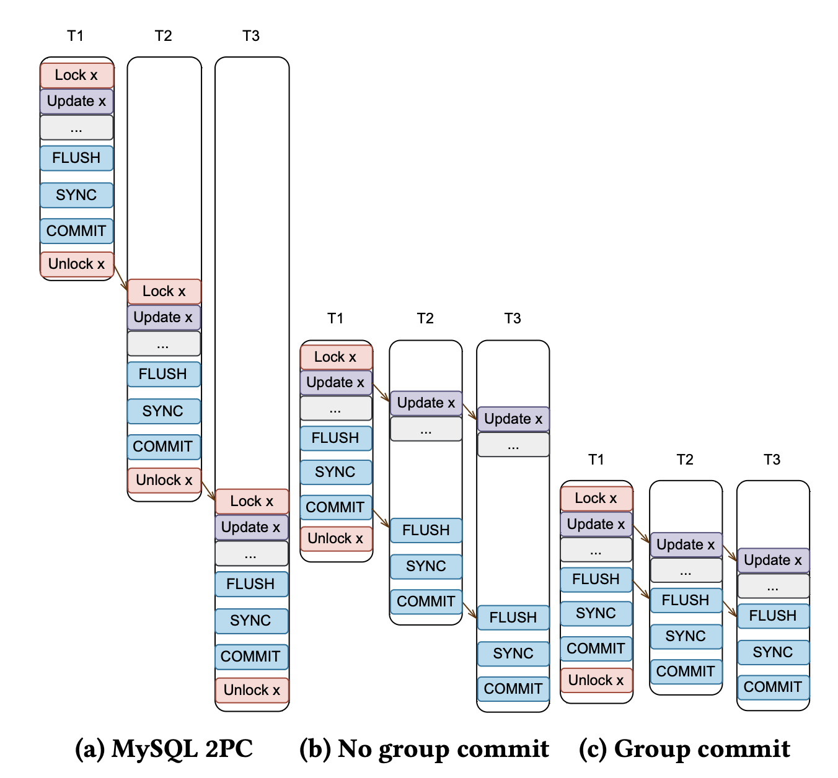
Group Commit
Problem
  Group locking decouples update and commit
  Multiple transactions reach the commit phase concurrently
  Without coordination:
    Commit order may differ from update order
    Commit phase (Flush / Sync / Commit) becomes a bottleneck
Idea
  Enforce commit order while batching commit operations
How
  Commit-phase group commit
    Followers join the same Flush / Sync steps in the leader’s IO process
    Commit completes in update order
    When the leader of a commit phase group releases the lock, a group commit can occur

Slide 14
Performance Evaluation
The workloads
  Sysbench
  TPC-C
  FiT simulates the transaction operations of the Financial Transaction system in Tencent.
Experiment setup
  Intel(R) Xeon(R) Gold 6133 CPU @2.50GHz, featuring 80 cores
  753 GB of DRAM, and a 15 TB SSD
Compare methods
Methods | Description
MySQL | The base database MySQL v8.0.30
TXSQL | The group locking together with general lock optimizations in TXSQL
Aria | Deterministic protocol representative which combines OCC and deterministic protocol without pre-knowing read-write sets
Bamboo | SOTA solution that violates 2PL to boost performance

Slide 15
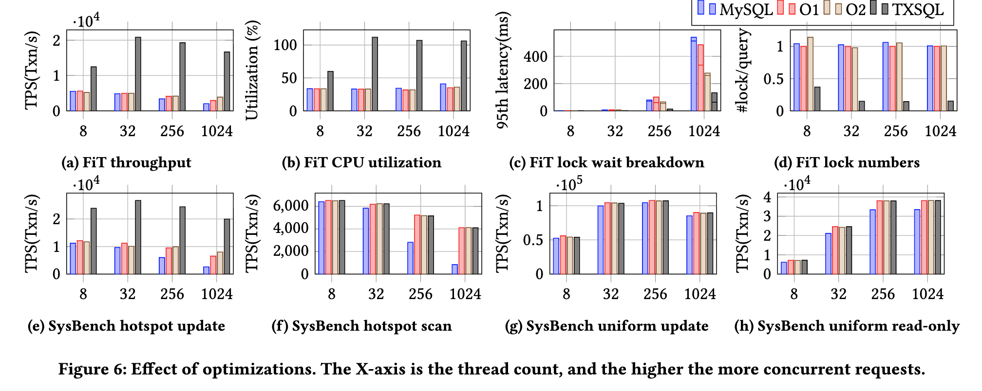
Ablation Study

Slide 16
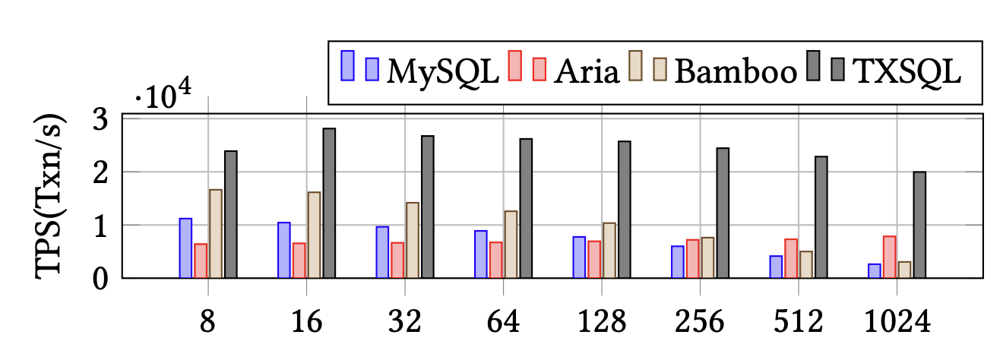
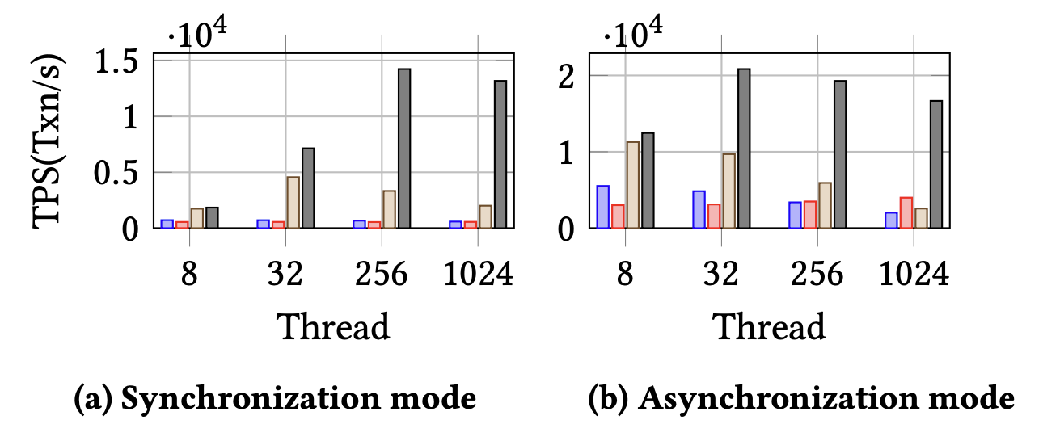
Scalability (Comparison to SOTA)
TXSQL achieved a performance improvement of up to 7x
Bamboo demonstrated superior performance under low concurrency, its performance improvement under high concurrency was less effective
Aria, utilizing a deterministic algorithm, maintained stable TPS as the number of threads increased
Effect of scalability by Sysbench hotspot update
Effect of synchronization by FiT

Slide 17
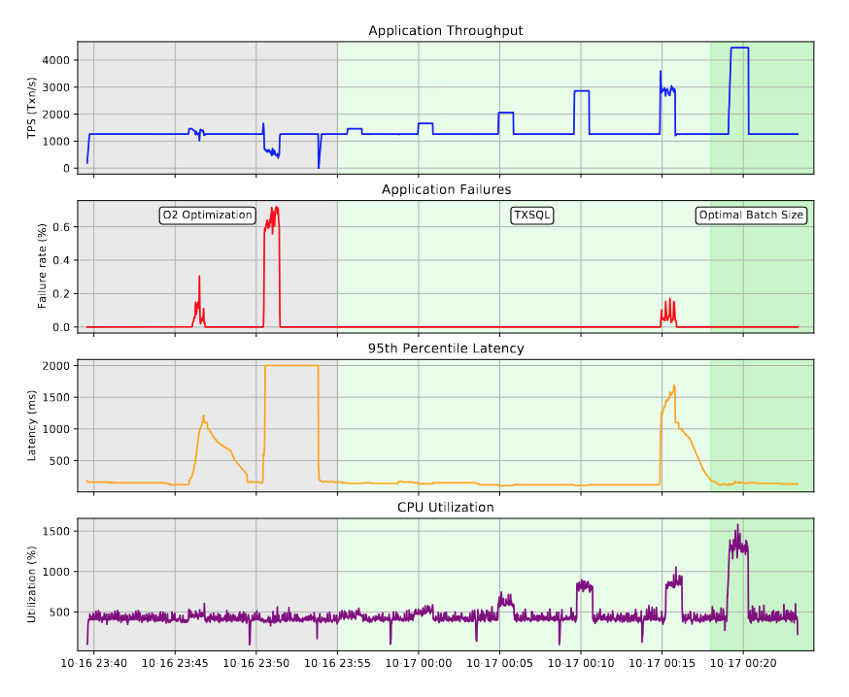
Real-world applications
Without group locking enabled, system latency skyrockets with violent jitter once hotspot update workloads coming
Group locking activation stabilizes TPS
even under increasing target rates
Beyond threshold TPS: Jitter and spikes persist
TXSQL can process higher throughput by tuning the group batch size

Slide 18
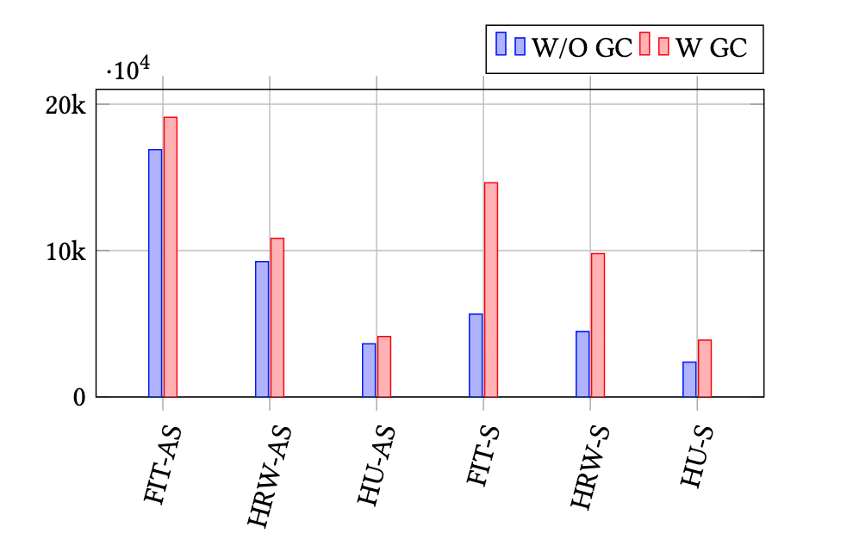
Effect of Group Commit
Workload | Replication
Simulated workload of the Financial Transaction system in Tencent(FIT) | Semisynchronous Replication(-S)
SysBench hotspot read/write(HRW) workload (RW=0.5,TL=16) | Asynchronous Replication(-AS)
SysBench hotspot update(HU) workload (RW=0,TL=16)
Without group commit, performance lags significantly
—particularly under semisynchronous replication.

Slide 19
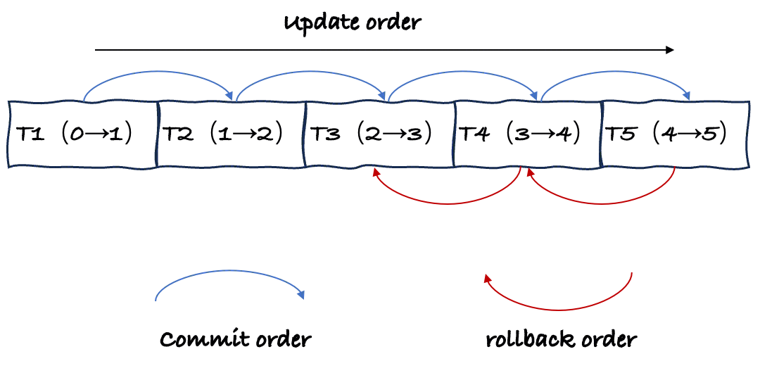
How to ensure correctness?
Commit order
    Commit order must be the same with the update order on hot spots
  Rollback order
    Rollbacks must execute in the reverse order of updates

Slide 20
How to ensure correctness?
Granting a follower and releasing a leader may be performed in the same time (determine a sequence)
Commit order
    Follower operates on a tuple without holding the corresponding lock
    Follower sees “uncommitted” data
    Commit order must be the same with the update order on hot spots
  Rollback order
    Rollbacks must execute in the reverse order of updates

