Slide 1
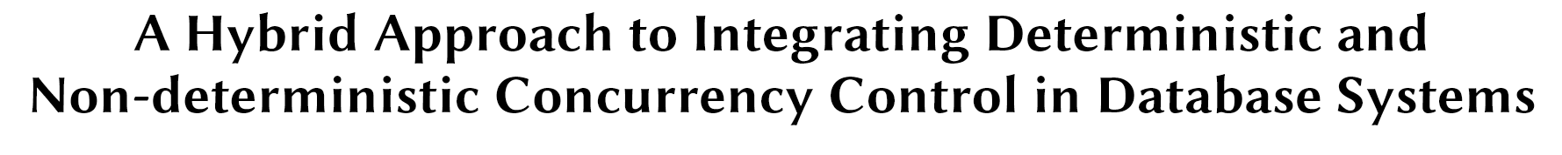
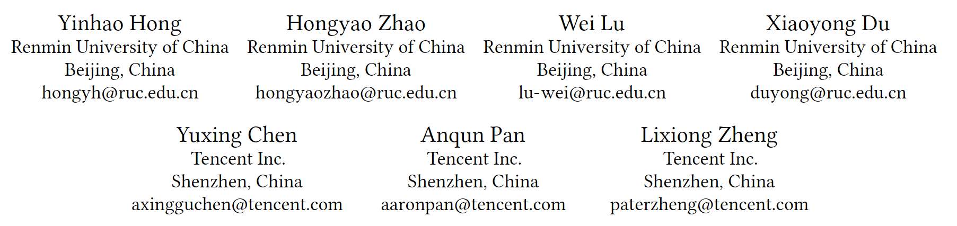
VLDB 2025

Slide 2
Background
Two Categories of Concurrency Control Algorithms
Deterministic Algorithms
Transactions execute in predetermined order with reproducible results
Examples: Calvin, Aria, BCDB
Approach: Batch processing + deterministic scheduling
Strengths: Excel in high-contention workloads; No 2PC for distributed transactions
Non-deterministic Algorithms
Transaction execution order determined at runtime
Examples: OCC, 2PL, MVCC, Timestamp Ordering
Approach: Individual scheduling + conflict detection
Key Difference: When the transaction execution order is determined

Slide 3
Background
Existing Hybrid Approaches
Current hybrid methods mainly combine non-deterministic algorithms:
MVOCC, MV2PL, MVTO (algorithm fusion)
Only deterministic + non-deterministic hybrid: Snapper
Uses Calvin for pre-declared transactions, 2PL for others
Limitations:
Coarse-grained validation leads to high abort rates
Does not fully leverage algorithm strengths → leads to limited performance gains
Gap: Need effective integration of deterministic and non-deterministic algorithms

Slide 4
Challenges & Contribution
Challenge 1: Ensuring Serializability
Different algorithms may produce conflicting schedules across nodes
Challenge 2: Correct Failure Recovery
Separate logging mechanisms lose transaction commit ordering
HDCC Contributions:
Novel mechanisms to ensure serializability (lock-sharing + global validation)
Two-log-interleaving mechanism for correct failure recovery
Rule-based assignment strategy for optimal algorithm selection
Up to 3.1× performance improvement over Snapper (undeclared transaction scenarios)

Slide 5
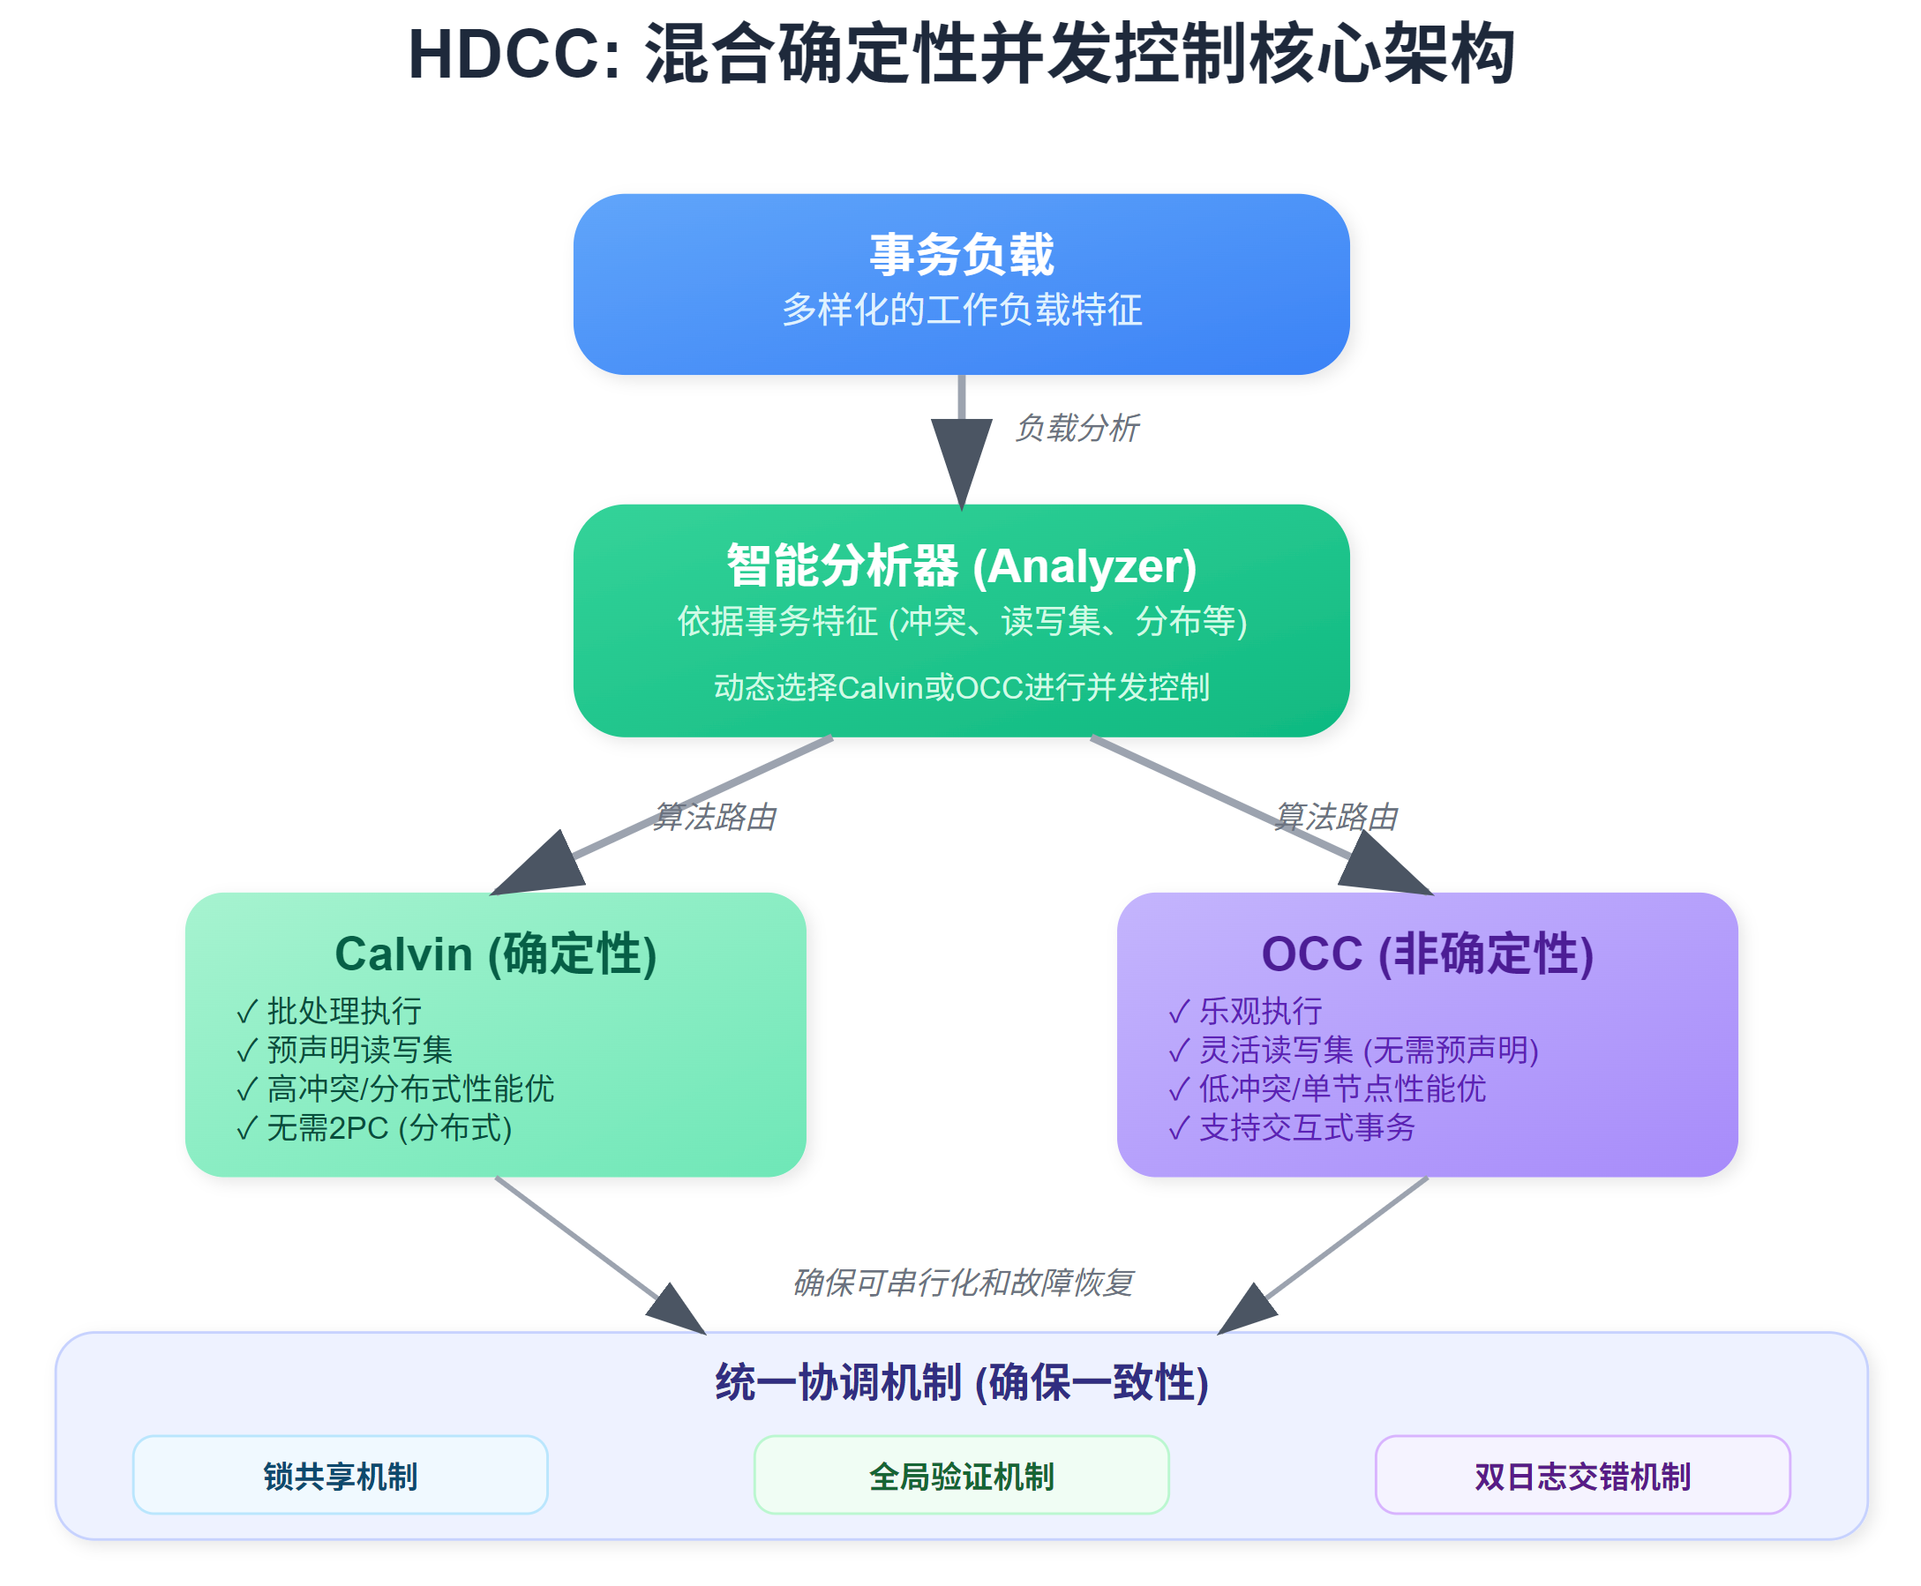
HDCC Core Architecture Overview
HDCC Core Idea: Adaptive algorithm selection based on workload characteristics
Routing transactions to suitable algorithms:
Distributed + high-contention transactions → Calvin path
Single-node + low-contention transactions → OCC path
Unified Coordination Mechanism:
Lock-sharing mechanism
Global validation mechanism
Two-log-interleaving mechanism

Slide 6
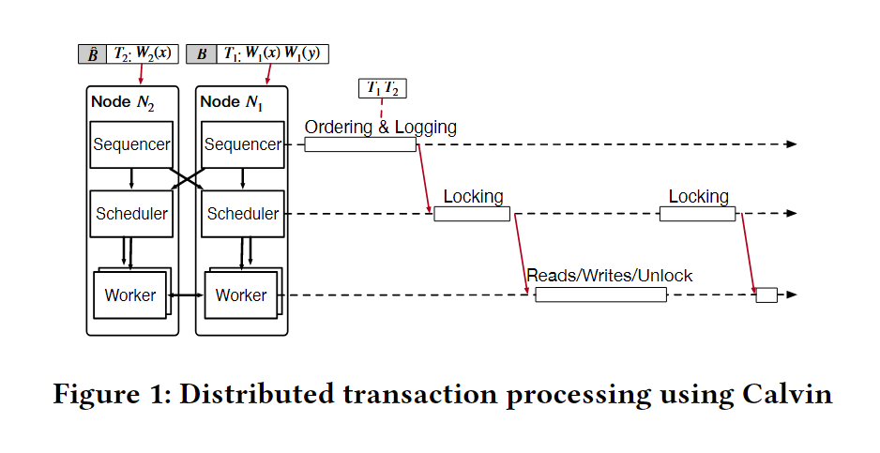
Calvin Algorithm
Core Philosophy:
Deterministic: Pre-defined global transaction order.
Batch Processing: Transactions grouped for ordered execution.
Pre-declared R/W Sets: Enables upfront planning & locking.
No 2PC (Distributed): Global order ensures atomicity.
Key Components
Sequencer:
Orders & Batches Txs (Global TID).
Logs batches.
Distributes sub-Txs.
Scheduler:
Acquires all locks for sub-Txs (Strict TID order).
To Worker only when all locks held.
Worker:
Executes locked sub-Txs (Reads/Writes).
Releases locks on completion.
Notes:
预声明读写集： T1: R(A), W(A), W(B) T2: R(A), R(C) 时间线： t1: Sequencer收集T1,T2 → 分配TID → T1(id=1), T2(id=2) t2: 批处理并写入日志 → Batch{T1, T2} t3: 分解并分发子事务到各节点 t4: Scheduler按TID顺序获取锁 → 先T1后T2 t5: Worker执行 → T1: A=A-100, B=B+100; T2: read A,C t6: 释放锁并提交

Slide 7
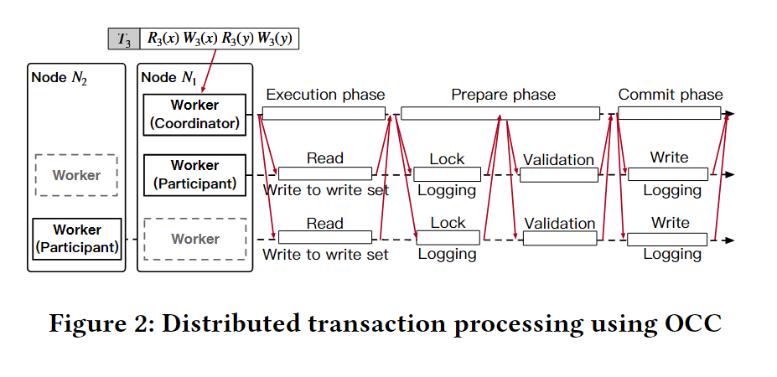
OCC Algorithm
Core Philosophy:
Optimistic Execution: Execute first, then validate (assumes low conflict).
No Locks During Execution: Operates on private copies.
Conflict Detection: At validation phase.
Three Key Phases:
Execution Phase:
Read to private read-set.
Buffer writes to private write-set.
No direct DB modification.
Prepare Phase (Crucial for Correctness):
Acquire Locks (for write-set).
Log Changes (redo logs).
Validate Read-Set (check for conflicts).
Commit Phase (If validation passes):
Log commit, Apply writes, Release locks.
Abort if validation/locking fails.
Notes:
执行时间线： t1: T3, T4 并行开始执行阶段 T3: read X(=50) → writeSet{X=49} T4: read X(=50) → readSet{X=50} t2: T3进入prepare阶段 - 获取X的排他锁 ✓ - 验证读集 ✓ (X未被修改) - 写入redo日志 t3: T3提交 → X=49, 释放锁 t4: T4进入prepare阶段 - 验证读集 ✗ (X已被T3修改: 50→49) - T4中止并重试

Slide 8
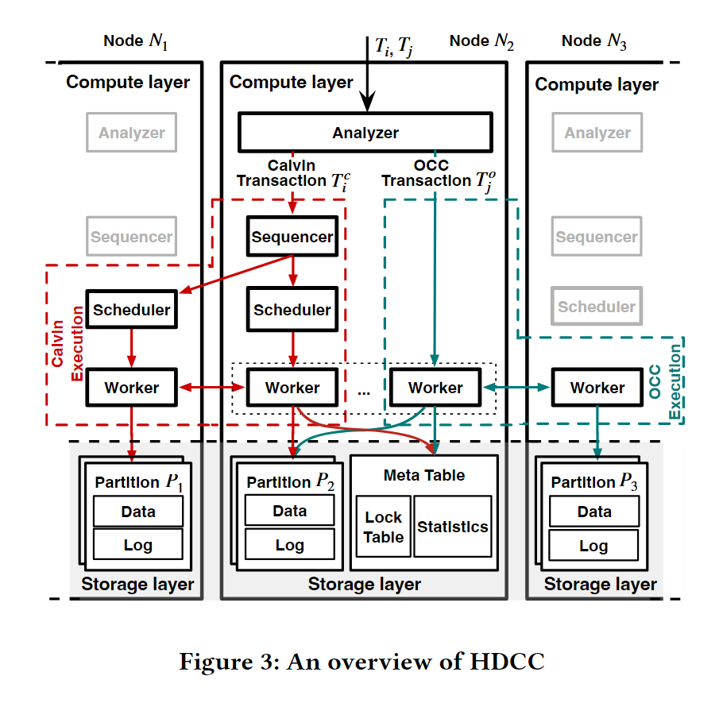
HDCC Core Component Overview
Analyzer: Routes Txs (Rule-based)
Selects Calvin or OCC path.
Assigns global TIDs.
Calvin Path (Ordered, Pre-locked):
Sequencer → Scheduler → Worker
(Batches, Logs, Acquires Locks, Executes)
OCC Path (Optimistic, Validate-on-Commit):
Worker (3-Phase Protocol)
(Acts as Coordinator/Participant)
Coordination via Shared Meta Table:
Contains Lock Table & Stats.
(Foundation for Lock-Sharing & Local Serializability)

Slide 9
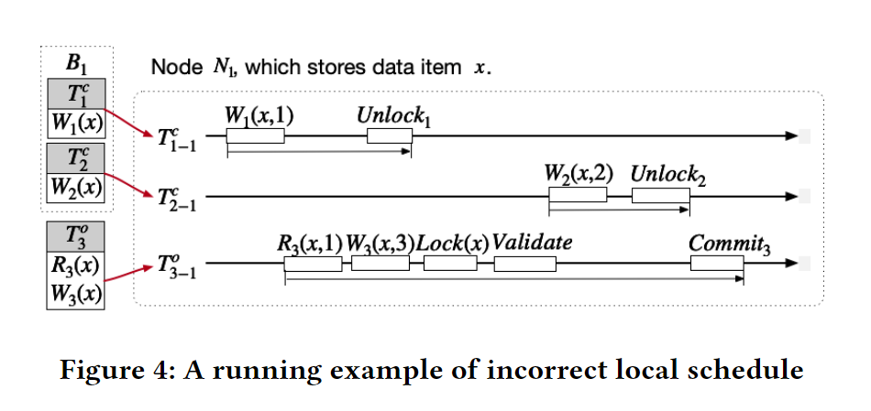
Challenge: Local Inconsistency
Example from Node N₁:
T^c_{1-1}: W₁(x,1) - Calvin transaction
T^c_{2-1}: W₂(x,2) - Calvin transaction
T^o_{3-1}: R₃(x)W₃(x,3) - OCC transaction
Problematic Execution Sequence:
T^c_{1-1} writes x=1, commits
T^o_{3-1} reads x=1, prepares to write x=3
T^o_{3-1} acquires lock, validation passes, decides to commit
T^c_{2-1} writes x=2, commits (No conflict detection!)
T^o_{3-1} commits, final x=3
Result: Non-serializable Schedule!
Lost Update: T₂'s write is overwritten

Slide 10
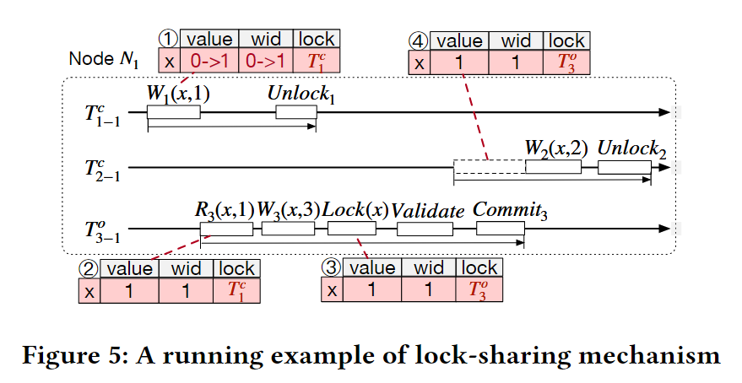
Solution: The lock-sharing mechanism
Core Idea: Unify data item metadata (lock, wid) for Calvin & OCC
Key Shared Metadata:
lock (Shared Lock State):
Unified EX/SH lock per item.
Calvin: Pre-acquires locks (scheduling).
OCC: Acquires write-set locks (prepare phase).
wid (Write ID):
Stores TID of last Calvin write.
OCC: Read wid → Validate to detect Calvin's committed writes.
Benefits:
OCC "sees" effects of committed Calvin Txs (via wid).
Shared locks coordinate concurrent access (especially writes).
Notes:
lock和wid的配合 lock：解决写写冲突（互斥访问） wid：解决读写冲突（检测读取后的修改）

Slide 11
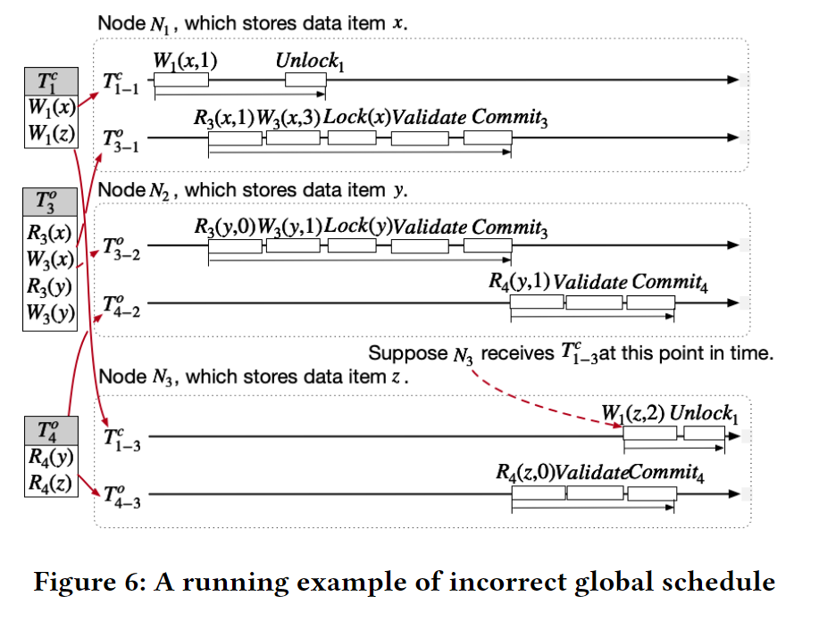
Challenge: Global Dependency Cycles
Example: Multi-node Transaction Conflict
Scenario:
T₁ᶜ: W₁(x) on N₁, W₁(z) on N₃
T₃ᵒ: W₃(x) on N₁, W₃(y) on N₂
T₄ᵒ: R₄(y) on N₂, R₄(z) on N₃
Problematic Dependencies:
Node N₁: T₁ᶜ writes x before T₃ᵒ => T₁ → T₃
Node N₂: T₃ᵒ writes y before T₄ᵒ reads =>T₃ → T₄
Node N₃: T₄ᵒ reads z before T₁ᶜ writes =>T₄ → T₁
Result: Dependency Cycle!
T₁ → T₃ → T₄ → T₁ (Non-serializable!)
Problem:
Lock-sharing ensures local serializability but cannot prevent global cycles across nodes.

Slide 12
Solution: The global validation mechanism
Problem:
Lock-sharing ensures local serializability but cannot prevent global dependency cycle
Core Idea:
OCC transactions collect dependency information on Calvin transactions to prevent global cycles.
Key Metadata Extensions:
cid: Current maximal Calvin TID on each data item
cid': Propagated gMaxCid from committed OCC transactions
gMaxCid: Maximum Calvin TID that current OCC transaction depends on
Working Principle:
Calvin transactions update cid when reading/writing items (if their ID > current cid)
OCC collects cid/cid' during locking round → computes gMaxCid
Global validation: Check if all Calvin transactions with ID ≤ gMaxCid have committed on all nodes accessed by OCC
If any Calvin transaction hasn't committed → Abort OCC to prevent cycle formation

Slide 13
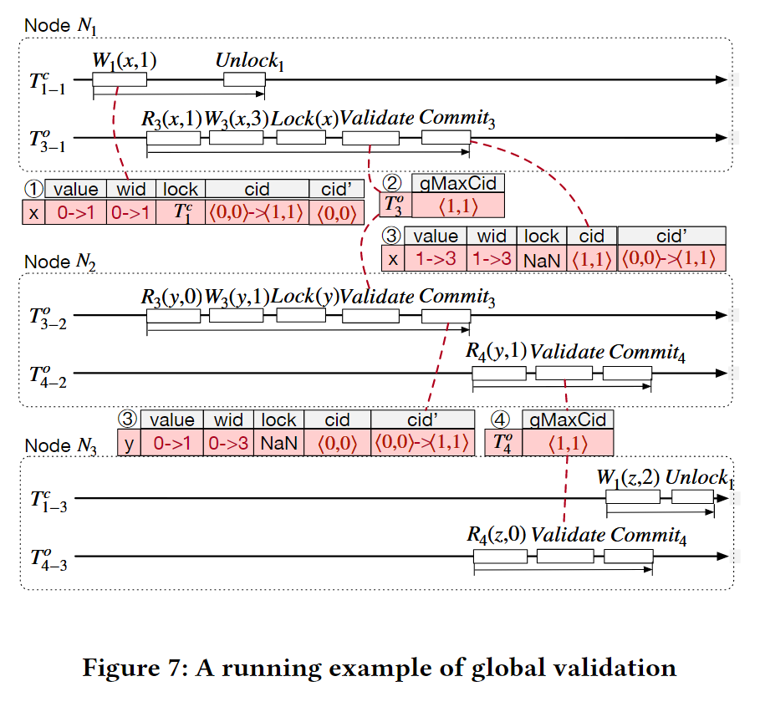
Solution: The global validation mechanism
Setup: T₁→T₃→T₄→T₁ cycle threatens serializability
Step-by-step Cycle Prevention: ① T₁ writes x: Updates x.cid = ⟨1,1⟩ on N₁ ② T₃ prepare phase:
Collects: x.cid=⟨1,1⟩, y.cid=⟨0,0⟩
Computes: gMaxCid = ⟨1,1⟩
Validates: Calvin⟨1,1⟩ committed on N₁,N₂? → YES ✅
③ T₃ commits: Propagates cid' = ⟨1,1⟩ to x,y
④ T₄ prepare phase:
Collects: y.cid'=⟨1,1⟩, z.cid=⟨0,0⟩
Computes: gMaxCid = ⟨1,1⟩
Critical Check: Calvin⟨1,1⟩ committed on N₂,N₃?
N₃ says NO → T₄ ABORTS ❌
Result: Cycle T₁→T₃→T₄→T₁ broken, serializability preserved!

Slide 14
Challenge: Determine the redo order
The Interleaving Order Problem:
Both Calvin and OCC maintain separate commit logs
Independent ID sequences → Cannot determine relative commit order
Example Recovery Dilemma:
After Crash:
Calvin Log: [T₁ᶜ inputs], [T₅ᶜ inputs]
OCC Log: [T₃ᵒ commit], [T₄ᵒ commit]
Question: What was the actual commit order?
Option A: T₁ᶜ → T₃ᵒ → T₄ᵒ → T₅ᶜ
Option B: T₃ᵒ → T₁ᶜ → T₅ᶜ → T₄ᵒ
Option C: T₄ᵒ → T₁ᶜ → T₃ᵒ → T₅ᶜ
Why Order Matters:
Dependencies between Calvin and OCC must be preserved
Wrong order → Dependency violations → Inconsistent recovery

Slide 15
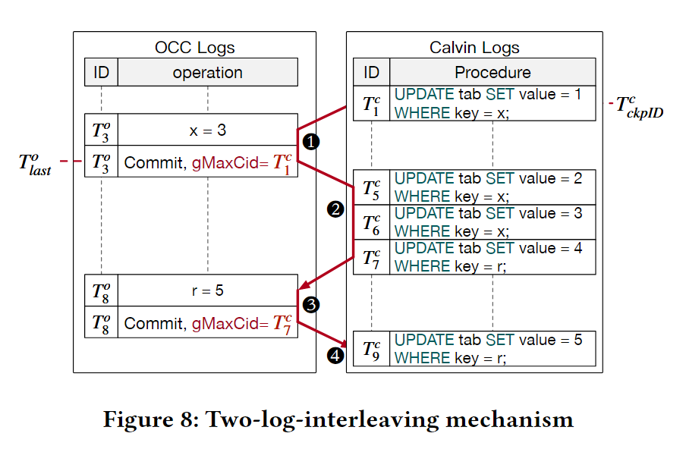
Solution: Two-log-interleaving mechanism
Key Insight: Interleaved replay guided by OCC dependency information
Enhanced Logging:
OCC commit records include gMaxCid (dependency watermark)
Calvin logs remain standard input-based
Example Timeline
OCC Log: [T₃(gMaxCid=1)], [T₈(gMaxCid=7)]
Recovery:
1. Replay Calvin [1] → Apply T₃
2. Replay Calvin [5, 6, 7] → Apply T₈
3. Replay remaining Calvin [9→end]
Notes:
在HDCC中，不需要undo操作，因为只有已提交事务的数据才会刷写到磁盘；未提交事务的数据永远不会刷写。

Slide 16
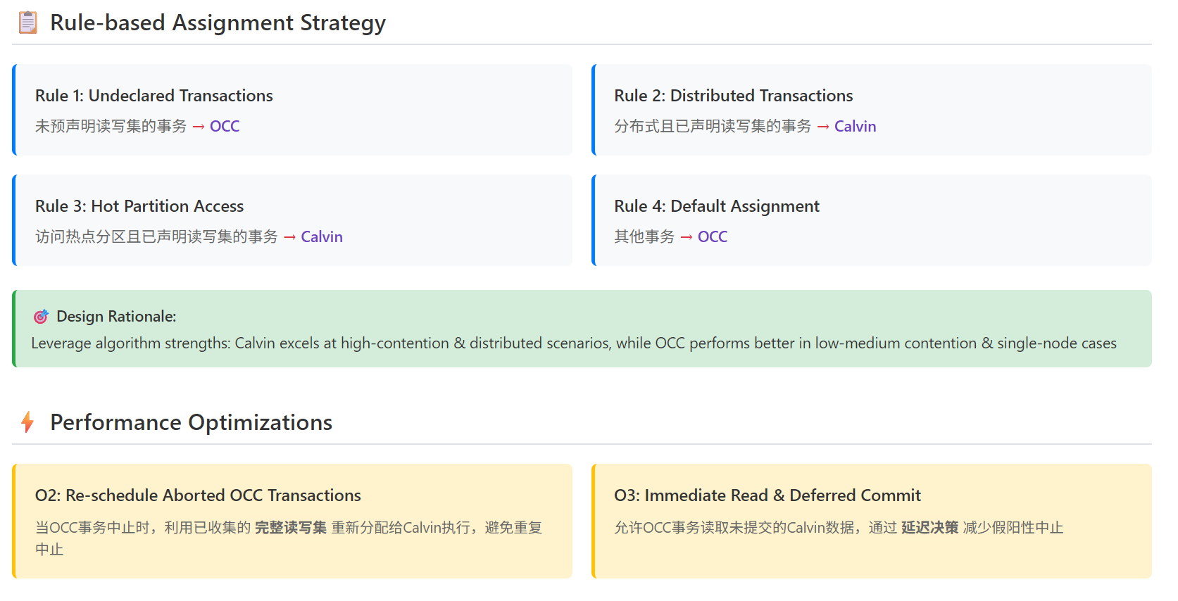
Optimizations
Notes:
# O3要解决的具体问题： OCC事务在验证阶段发现： "这个数据项被Calvin事务锁定了"

Slide 17
Experimental Setup
Category | Detail
Main Testbed | 2 Servers: 18-core Intel Xeon Gold 5220 (2.20 GHz), 156 GB RAM/server; 1 Gbps network (0.12 ms latency)
Scalability Testbed | 12 Tencent Cloud Servers (S5.6XLARGE48): 24 vCPU, 48 GB RAM/node; Network latency 0.1-0.5 ms
YCSB | 8M records/node, 10 ops/Tx; Zipfian (skew=0.9), 20% Writes; Default 20% Distributed Tx Rate
TPC-C | 32 warehouses/node; NewOrder (10% dist.) & Payment (15% dist.) Txs
Threading | Per node: 16 Workers, 1 Sequencer, 1 Scheduler, 1 Analyzer (+ communication threads)
Evaluation | Throughput (TPS), Abort Rate, Latency (50th & 90th percentile)

Slide 18
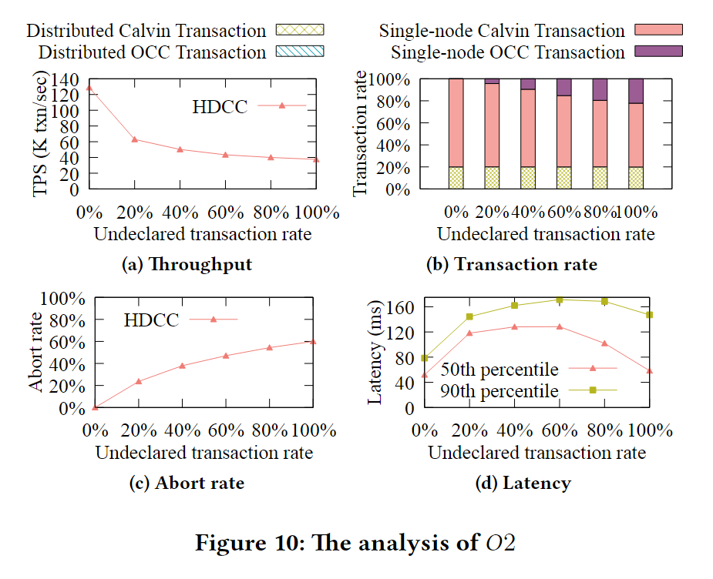
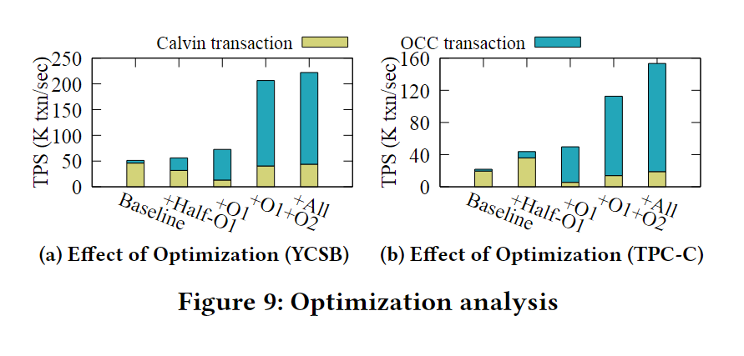
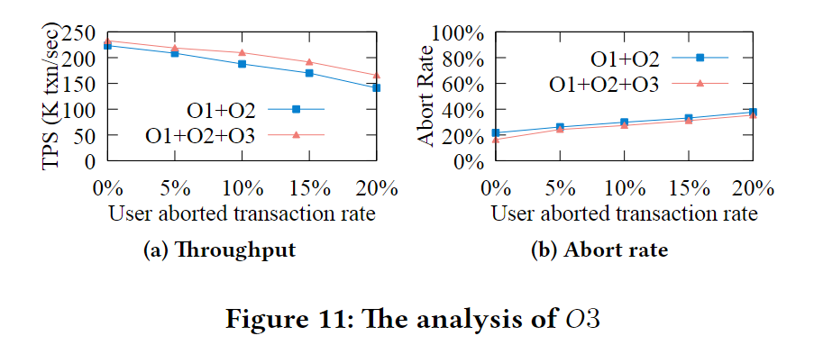
Optimization Analysis
Baseline:
Simple assignment (pre-declared R/W sets only).
Half-O1 (Partial Rules):
Adds hot partition awareness (Rule 1 + Rule 3).
O1 (Full Rules):
Comprehensive rule-based assignment (Rules 1-4).
O1+O2 (Rules + Re-scheduling):
Adds smart re-scheduling of aborted OCC transactions (Core Optimization).
All (O1+O2+O3 - Full HDCC):
Adds immediate read & deferred commit mechanism.
Notes:
Figure9
基线设置：未声明事务率设为10%（YCSB和TPC-C）
优化层次：渐进式添加优化措施 Figure10
实验场景
高冲突环境：偏斜因子 = 1.3
变量：未声明事务率从0%到100% 实验设计 实验目的 测试O3优化在Calvin事务可能中止场景下的表现 关键变量 X轴：User aborted transaction rate（用户中止事务率）0% - 20% 对比：O1+O2 vs O1+O2+O3

Slide 19
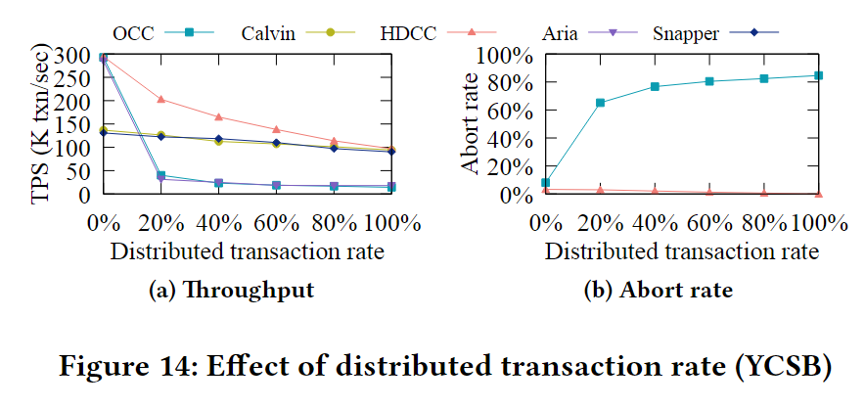
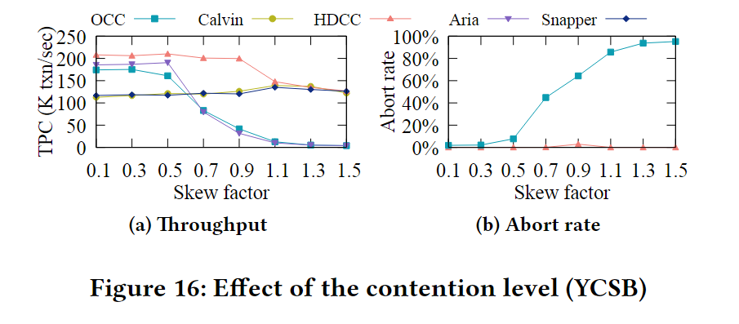
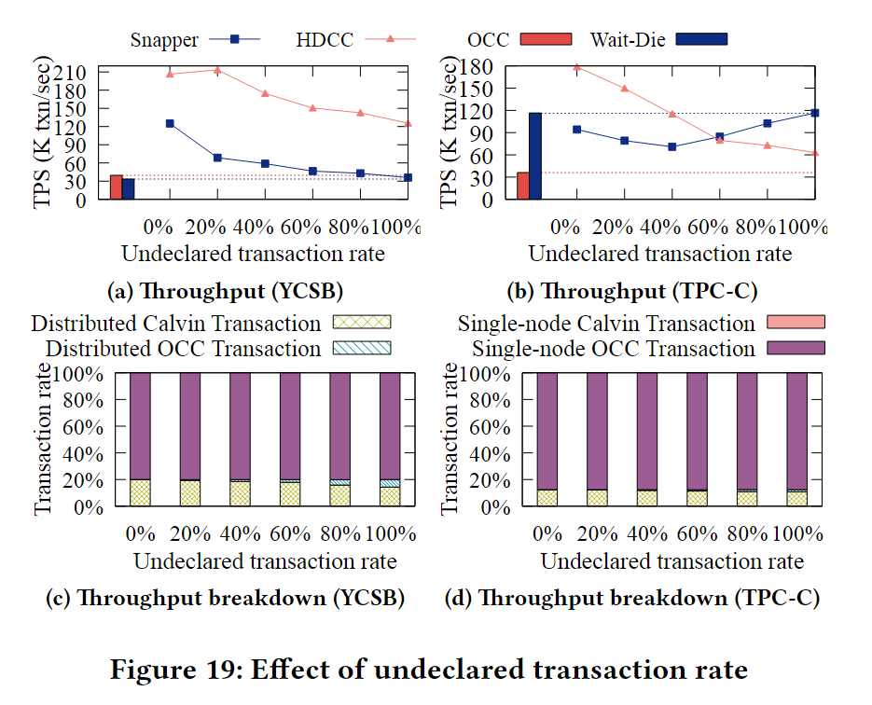
Performance Comparison

Slide 20
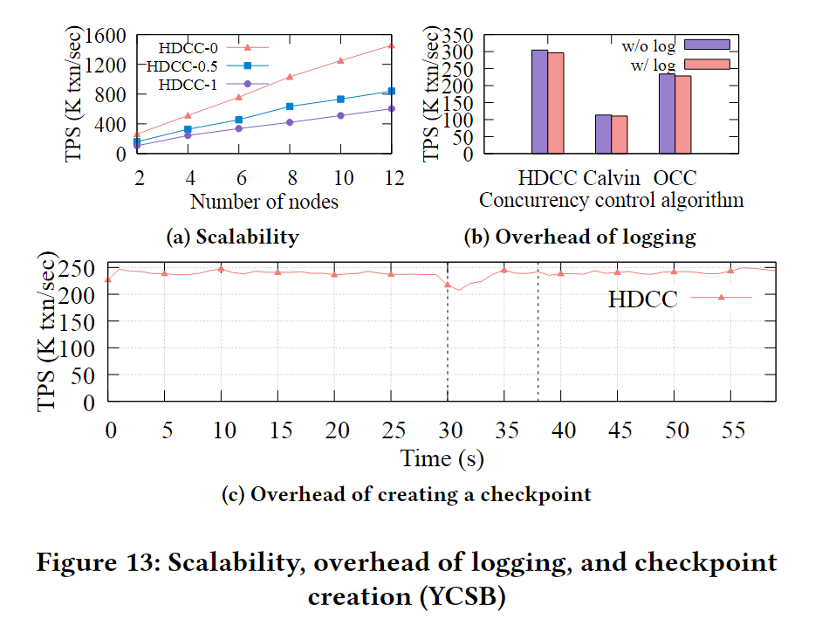
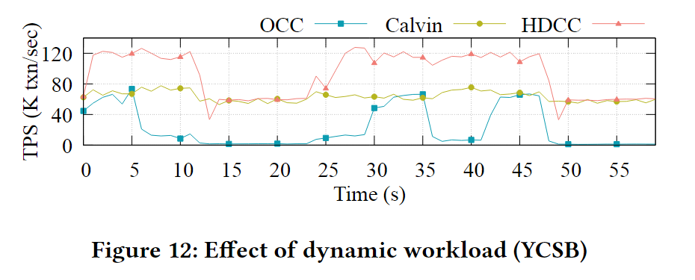
Dynamic workload & Scalability
Notes:
实验设计
时长：60秒实验
切换频率：每6秒切换一次工作负载配置
参数变化：
写读比例：从{0.1, 0.5, 0.9}中随机选择
偏斜因子：从{0.3, 0.9, 1.5}中随机选择 结果分析（Figure 12）
切换时点：7秒、13秒、25秒等时刻发生配置切换
响应速度：HDCC能够快速响应工作负载变化
性能表现：
在每次切换后，HDCC的吞吐量快速调整
始终保持与最优单一算法相当或更好的性能
证明了规则基分配机制的有效性 可扩展性测试（Figure 13a） 测试配置
节点范围：2-12节点
三种配置：
HDCC-0：0%未声明事务率
HDCC-0.5：50%未声明事务率
HDCC-1：100%未声明事务率 扩展性结果
HDCC-0：2-12节点提升5.57倍
HDCC-0.5：提升5.3倍
HDCC-1：提升5.72倍
结论：所有配置都展现了优秀的线性扩展性 日志开销评估（Figure 13b） 对比算法
OCC、Calvin、HDCC三者的有/无日志性能对比 开销分析
OCC：日志开销2.4%
Calvin：日志开销2.7%
HDCC：日志开销2.7%
结论：HDCC的日志机制开销minimal且可接受 检查点创建开销（Figure 13c） 测试场景
在30-38秒间创建检查点（黑色虚线标记）
观察对系统吞吐量的影响 结果分析
最低吞吐量：检查点期间仅比平均值低10%
原因分析：
检查点过程是异步的，不会阻塞正常事务处理
性能下降主要由CPU和磁盘资源竞争造成
结论：检查点创建对系统性能影响很小

