Slide 1
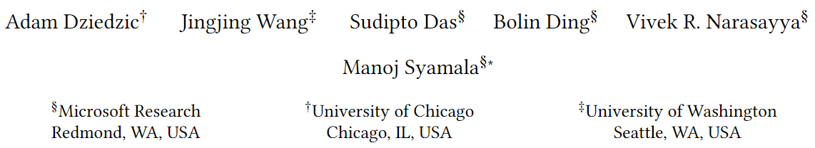
Columnstore and B+ tree – Are Hybrid Physical Designs Important?

Slide 2
Background
Background:
The benefits of B+ tree for OLTP workloads and columnstore for OLAP workloads are well-understood
Focus:
The importance of hybrid physical designs, consisting of both columnstore and B+ tree indexes on the same database and potentially the same table, is not well-studied
Result:
We extend the Database Engine Tuning Advisor(DTA) for Microsoft SQL Server to recommend a suitable combination of B+ tree and columnstore indexes for a given workload
Source:
With hybrid plans, the optimizer's search space is much larger, especically when both row and column store are available. To our knowledge, existing solutions have not yet well explored these aspects and leave them as their future work (as admitted in [59])
A survey on hybrid transactional and analytical processing

Slide 3
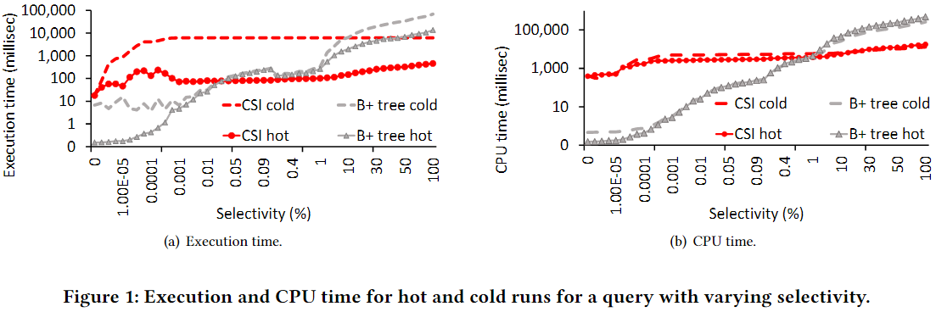
Preliminary Experiment
Impact of data skipping:
SQL Server stores simple aggregates (min and max) for each column in each segment which allows data skipping (or segment elimination) if the segment is guaranteed to not contain data relevant to the query
First experiment studies the trade-off between range scans of B+ tree and full scan of columnstore

Slide 4
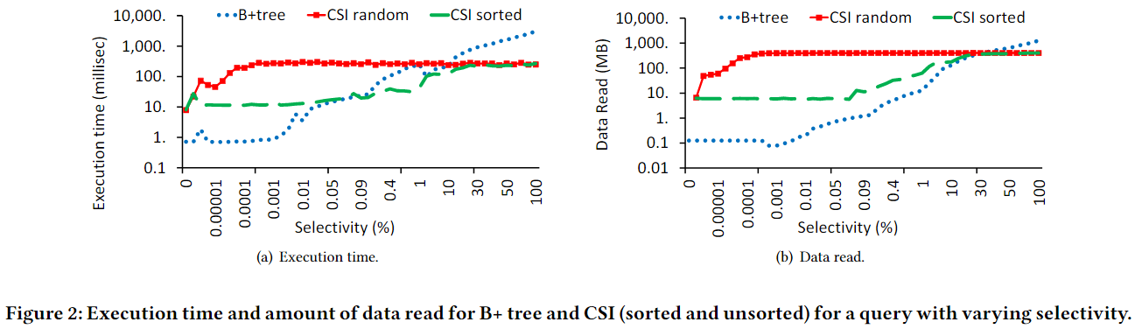
Preliminary Experiment
Impact of data skipping:
Second experiment studies how columnstores compare with B+ tree if they can skip data more aggressively

Slide 5
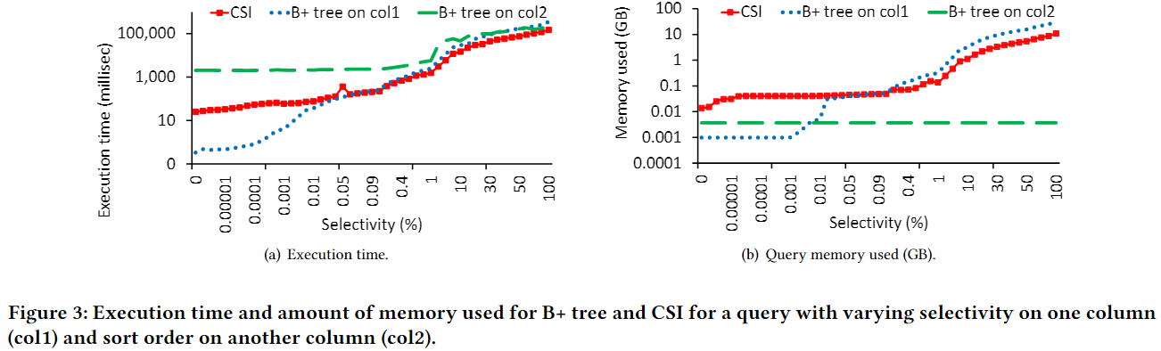
Preliminary Experiment
Impact of sort order:
SELECT col1, col2 FROM table WHERE col1 <{1} ORDER BY col2
When accessing large amounts of data, the sort order of B+ tree does not provide benefits above CSI, especially when sufficient memory is available to sort the data in-memory during query execution

Slide 6
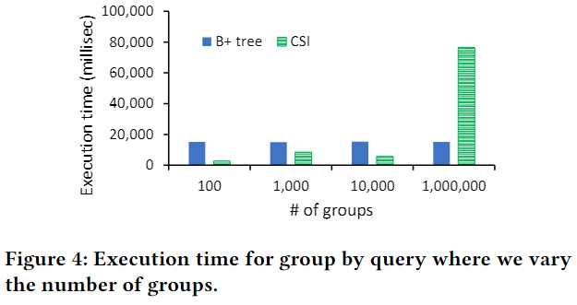
Preliminary Experiment
Impact of sort order:
SELECT col1, sum(col2) FROM table GROUP BY col1
CSI significantly outperforms B+ tree due to two reasons:
Efficient scan and vectorized execution
Compression achieved by CSI for cases where the number of distinct values of col1 is small, resulting in CSI accessing much less data compared to B+ tree which cannot benefit from such compression

Slide 7
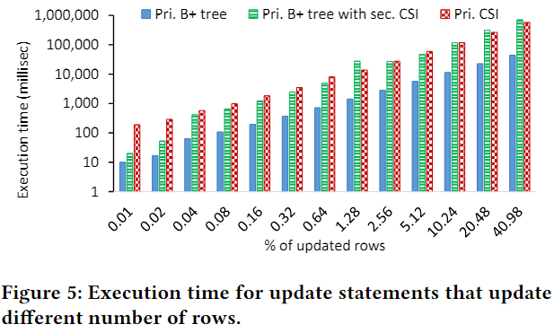
Preliminary Experiment
Impact of updates:
As the percentage of the updated rows increases, the performance for the secondary CSI deteriorates in comparison to the primary B+ tree and is similar to the performance of the primary CSI

Slide 8
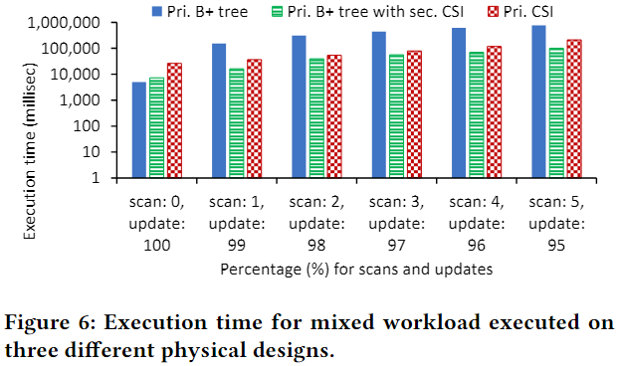
Preliminary Experiment
Impact of mixed workload:
Hybrid physical design has the best performance, since secondary CSI strikes a right balance between increased overhead of small updates vs. improved efficiency for large scans when compared to a B+ tree-only design

Slide 9
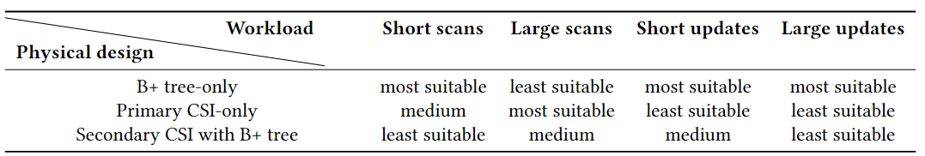
Preliminary Experiment’s Key Findings

Slide 10
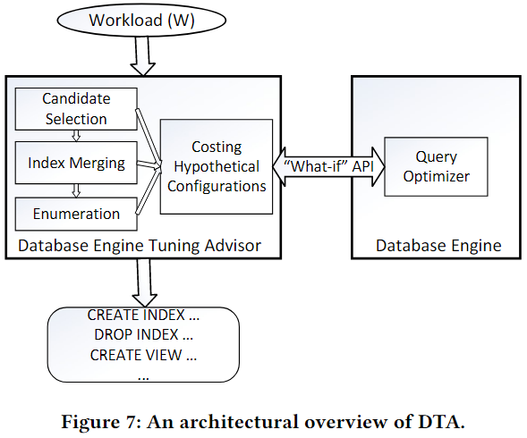
Recommending Hybrid Designs
This API returns the estimated query plan (and its cost) the optimizer will use if that configuration were to be materialized
Database Engine Tuning Advisor(DTA) can recommend B+ tree indexes (primary and/or secondary), materialized views, and partitioning in one holistic search and costing framework. We extended DTA to analyze the combined space of B+ tree and columnstore indexes

Slide 11
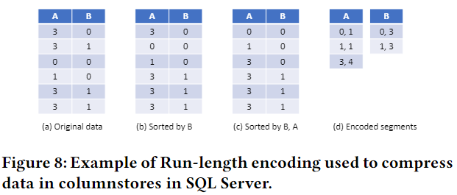
Columnstore Size Estimation
In order to cost a query using the "what-if" API for a configuration consisting of a columnstore index, we need to provide the size of each column in that index
Two main challenges in columnstore size estimation:
For scalability of DTA for large tables, we cannot afford to scan and execute the encoding algorithms on the entire data
Using the block-level sampling technique described in Chaudhuri et al
When SQL Server builds a columnstore index, it applies a combination of encoding techniques to compress data
Black-box approach: First build a columnstore index on the sample and then for each column, scale up the size of the column in the index by the inverse of the sampling ratio
Modeling Runs using Distinct Value Estimation: Adapting the GEE estimator

Slide 12
Impact on Query Optimizer and Execution
The optimizer's search space is much larger, thus requiring heuristics to prune the search space to keep optimization times within reasonable bounds
Considering B+ tree indexes and columnstores when optimizing a given query implies the optimizer needs to estimate the costs in different execution modes
Columnstores have very different locking characteristics compared to B+ tree indexes, which impact query execution as well

Slide 13
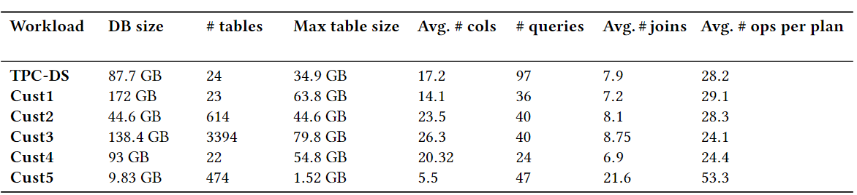
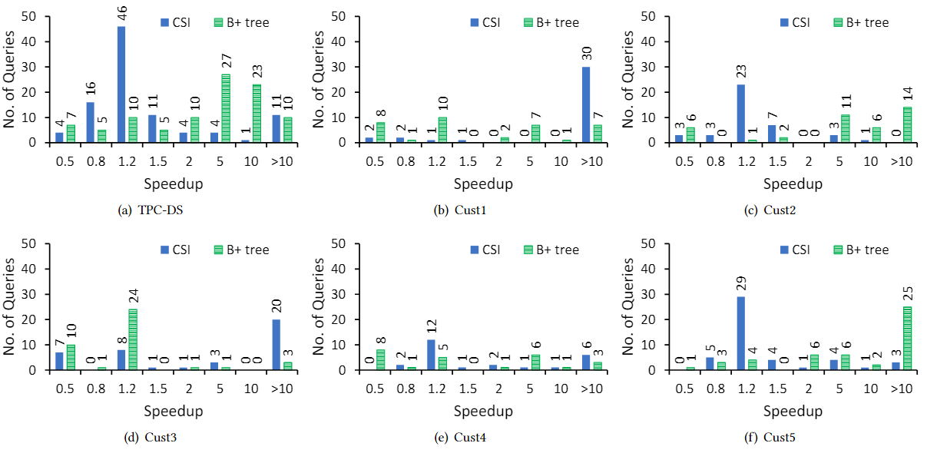
Experiment
Distribution of speedup factor (for CPU time) achieved by a hybrid physical design compared to columnstore-only (CSI) and B+ tree-only designs

