Slide 1
Loss of function annotation (LOF) Splice sites
Pablo Cingolani
Mathieu Blanchette
Rob Sladek

Slide 2
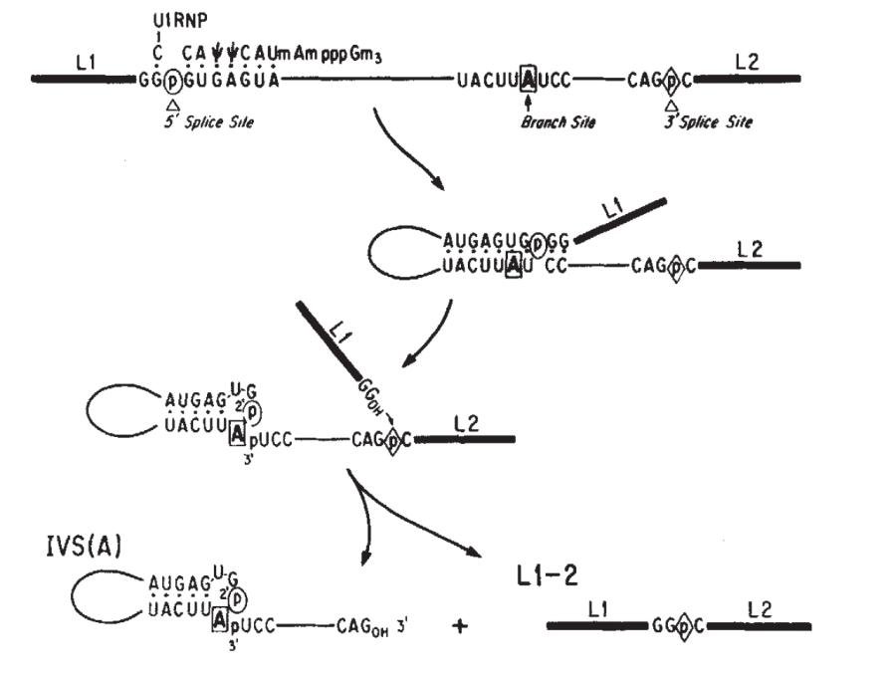
Splicing
Exon Splice Branch Splice Exon
donor point acceptor

Slide 3
Donor & acceptor sites
“Essential splice sites” is only two bases in the intronic part (usually donor “GT”, acceptor “AG”)
There is conservation beyond those two bases.
There is conservation in the exonic part.
There is no “gold standard” to predict branch point.
Exon
Exon

Slide 4
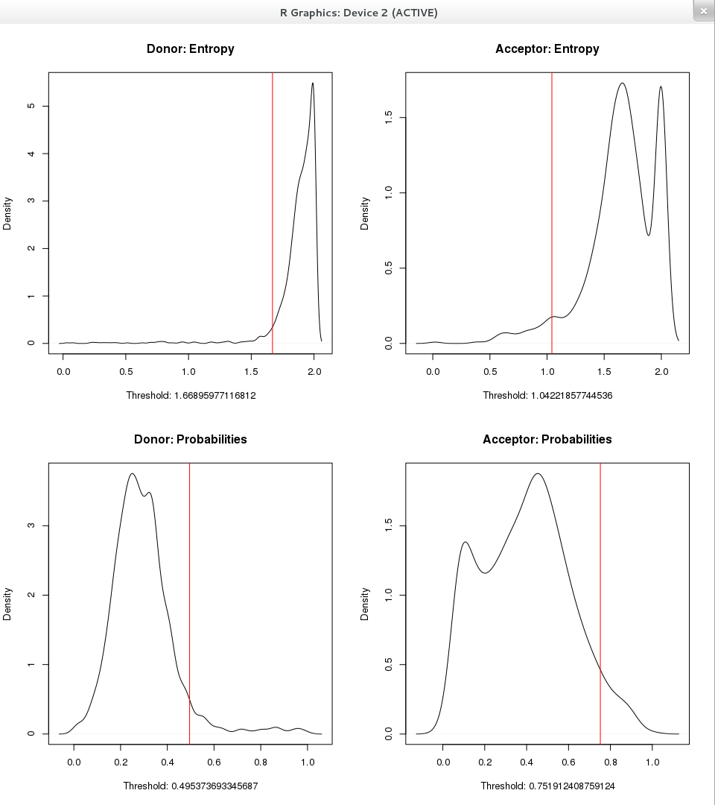
Analysis
Step 1
Goal: Find conserved donor & acceptor pairs
Create quaternary trees counting occurrences of donor (or acceptor) sites.
Find low entropy nodes in the trees (defined as bottom 0.05 quantile)
For those nodes, find child nodes have high probability (i.e. top 0.95 quantile).
Select those child nodes and create new quaternary trees only for those sites.
Repeat the process selecting paired acceptor (or donor).
Create a list of “significant donor-acceptor pairs”

Slide 5
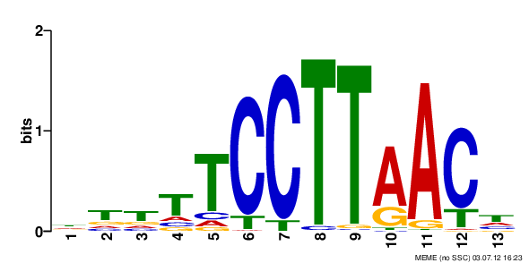
Analysis
Step 2
Goal: Find Branch points
For all “significant donor-acceptor pairs”:
Create sets of sequences 50 bases before the acceptor.
Run motif finding using EM algorithm.
Find overexpressed motifs
Found U12 motif: Confirmation that the analysis was OK.

Slide 6
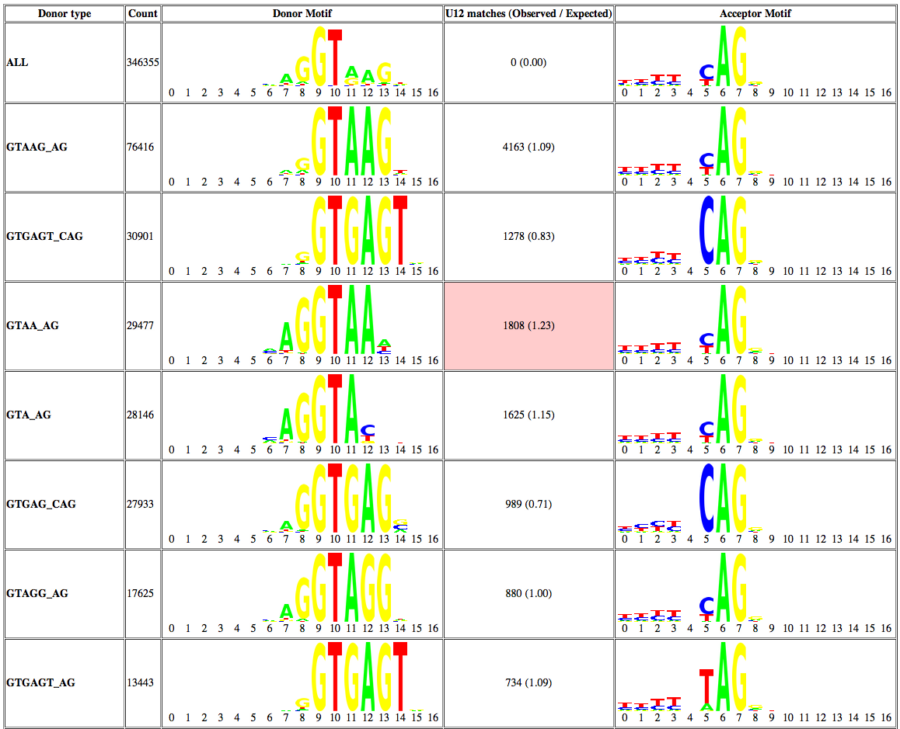
Results
i-) Some donor-acceptor pairs have higher degree of conservation in the donor and exon.

Slide 7
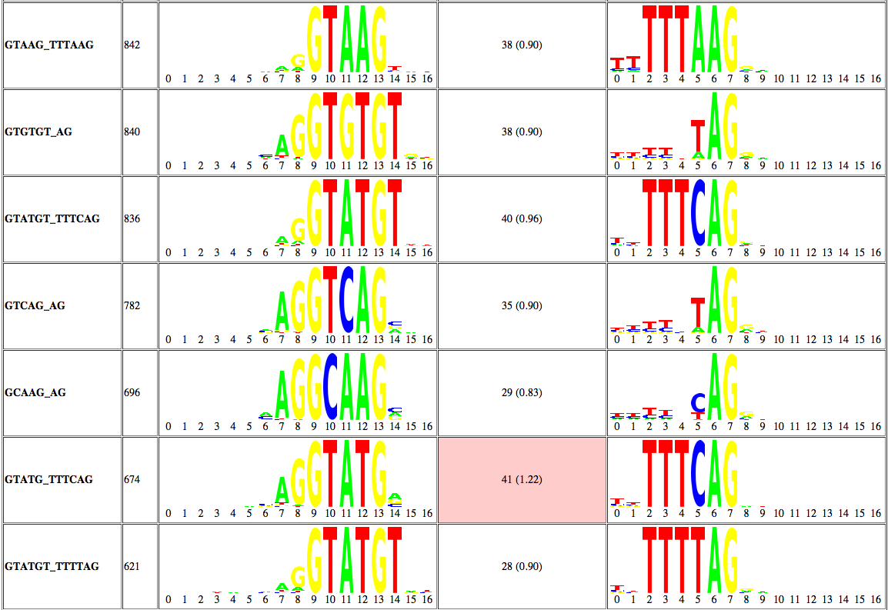
Results
i-) Some donor-acceptor pairs have higher degree of conservation in acceptor.

Slide 8
Results
i-) Branch point associated with donor-acceptor pairs: Over 100 times the expected values (red square).

Slide 9
Proposed changes: LOF
Extend splice site donor & acceptor definitions to include highly conserved sequences (i.e. low entropy).
Extend sites to exons whenever conservation is significant.
Add U12 branch points predictions, but only in donor-acceptor subsets where enrichment is significant.
Use PWMs scores (or similar scores) to “predict” LOF annotation of those sites.

