Slide 1
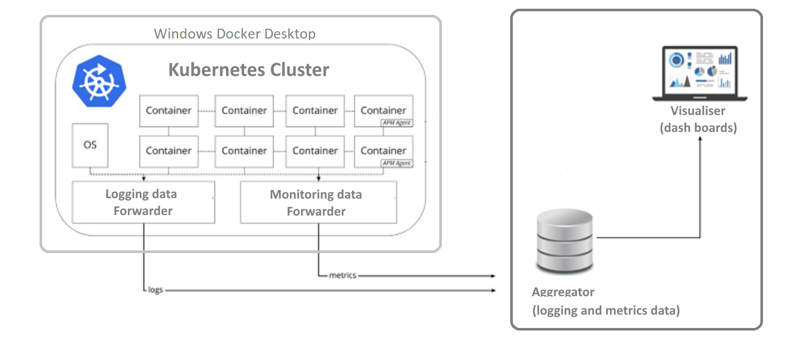
Logging Dashboards (ELK, Splunk, AWS, etc…)
FIS Laptop
FluentBIT
FluentBIT
https://kubernetes.io/docs/reference/kubectl/docker-cli-to-kubectl/

