Slide 1
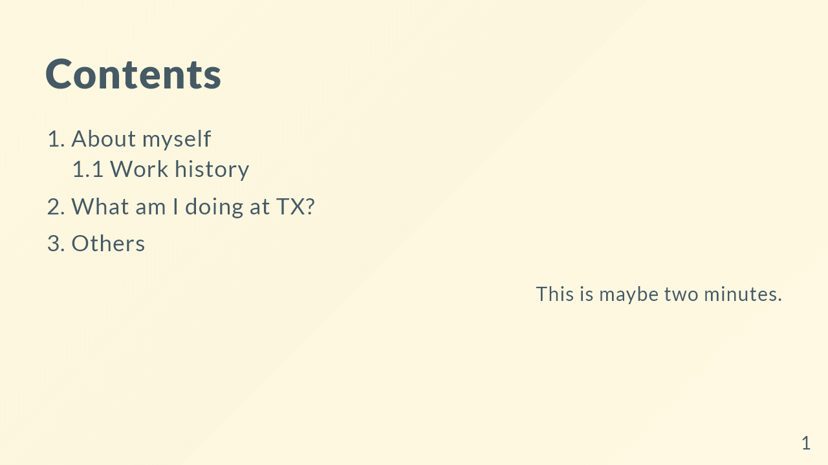
Notes:
$size: 16:9 page_number: true

Slide 2
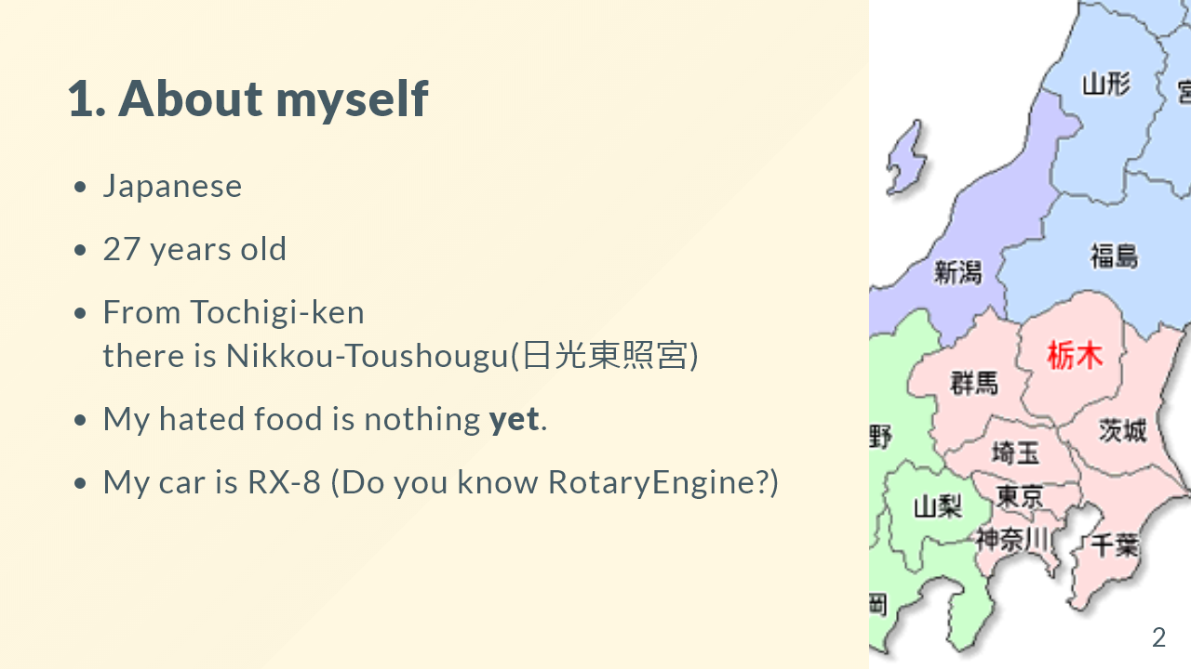

Slide 3


Slide 4


Slide 5


Slide 6
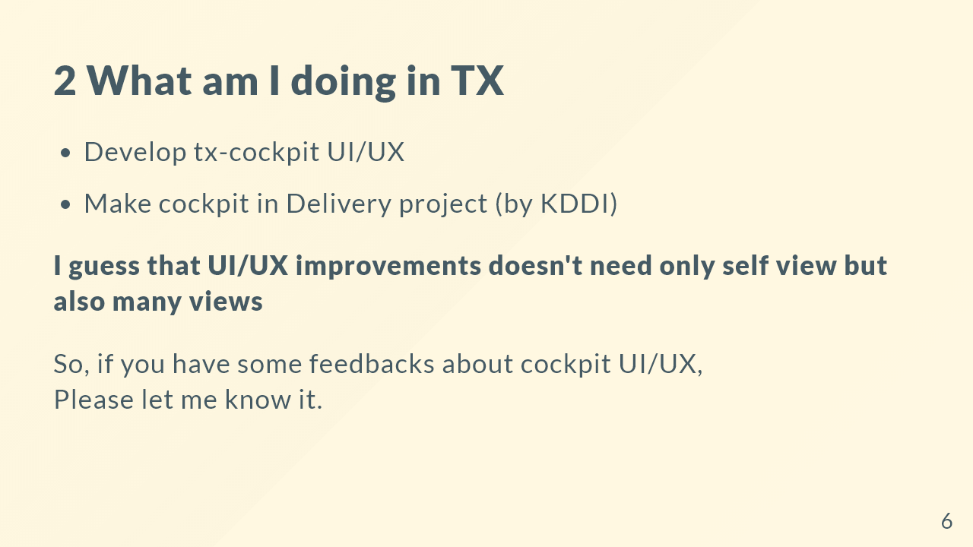

Slide 7


Slide 8
