Slide 1
Database Management Systems Online Doctor Visit Appointment
By
Ch. Sri Chandana(2110030020)
D. Neha(2110030032)
B. Akshita(2110030056)
V. Charishma(2110030457)
Under the guidance of
Mrs. P. Sree Lakshmi

Slide 2
Problem statement and domain
Problem statement: The management of records and doctor appointment would become difficult for the hospital in general. Adjusting the schedules for appointment would become difficult. Communication between the doctor and patient would sometimes become difficult.
Aim: The aim of this project is to develop a online doctor visit web application. This research project is aimed at computerizing all the records about patients, Hospital and doctors. The concept of report production has been computerized hence, no more delay in report generation to the hospital, patient and doctor.
Objectives:
To create web based Online Doctor Appointment management system.
To manage all patient related information.
To provide emergency information in critical situation.

Slide 3
Existing solutions/ Naïve solutions
There are many existing online doctor appointment applications already developed. Some of them are:
Apollo 24*7, Lybrate, Doctor on Demand, Am well, MD Live, My Health
The disadvantages of these applications are :
Sometimes it is possible that the patient may not be able to communicate their problems clearly online and the patient may need direct consultation of the doctor rather than online.
It might be inconvenient for old or illiterate people as they may not know how to use the application properly.
Any activity conducted online will have hacker related security issues. Maintenance of privacy could be a problem in telemedicine.

Slide 4
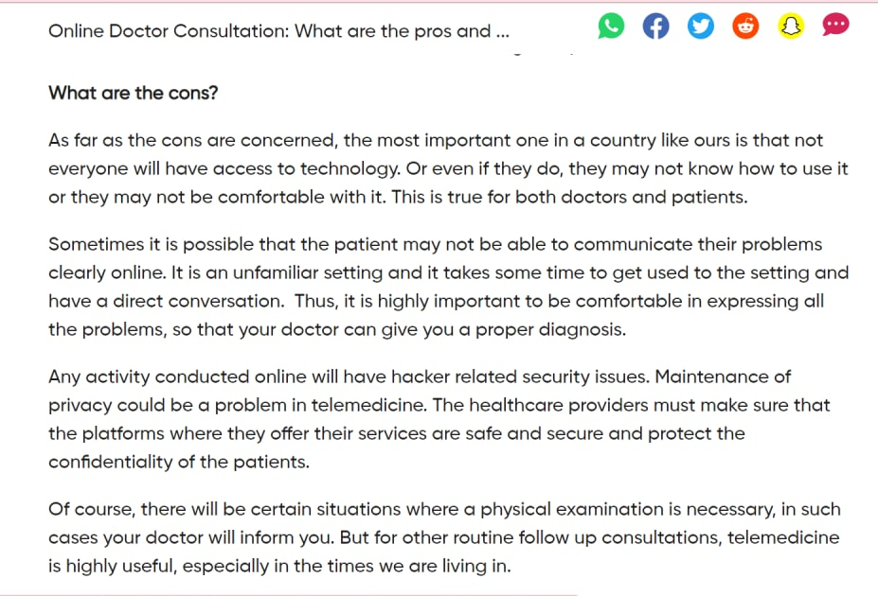
Existing solutions/ Naïve solutions
https://www.pinkvilla.com/lifestyle/health-fitness/online-doctor-consultation-what-are-pros-and-cons-it-539028

Slide 5
Proposed Algorithm Design Technique
Technique:
The proposed project is a smart appointment booking system that provides patients or any user an easy way of booking a doctor’s appointment online. This is a web based application that overcomes the issue of managing and booking appointments according to user’s choice or demands. The task sometimes becomes very difficult for the compounder or doctor himself in manually allotting appointments for the users as per their availability. Hence this project offers an effective solution where users can view various booking slots available and select the preferred date and time. The already booked space will be marked yellow and will not be available for anyone else for the specified time. This system also allows users to cancel their booking anytime. The system provides an additional feature of calculating monthly earnings of doctor. In this project the database management system software is used in the backend in this project.

Slide 6
Proposed Algorithm Design Technique
Features of the project:
We implement this application for better user experience. This application is very easy to access. Also for establishing real time communication, using modern and updated technology. So, user can see the update.
This application will compatible with user device such as pc, laptop, tab and smart phone. So, user can easily access the application anytime and anywhere. This application is very simple and user friendly so ,any user can use this application easily.
We also provide security so that the data is secured from dangerous activities like hacking and loss of data which is already stored.
We provide the application in a user friendly way so that illiterate and old people can also use the application easily.
We also provide direct service of doctor if needed by the patient.

Slide 7
Data Structures
Tools used are:
Terra ER
My SQL
The method used to develop the system include enhanced entity relationship diagram where used to design the system and finally the language used is SQL(structured query language).

Slide 8
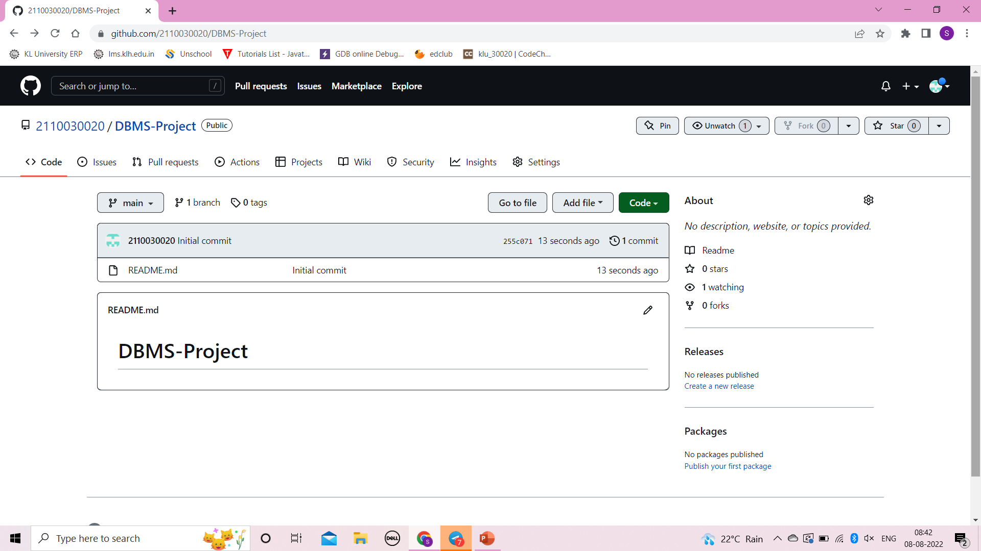
Github setup
2110030020-Ch.Sri Chandana

Slide 9
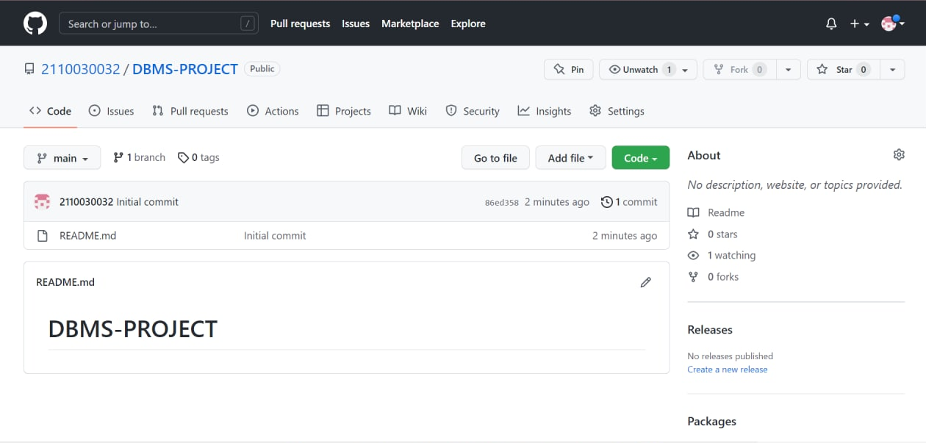
Github setup
2110030032-D.Neha

Slide 10
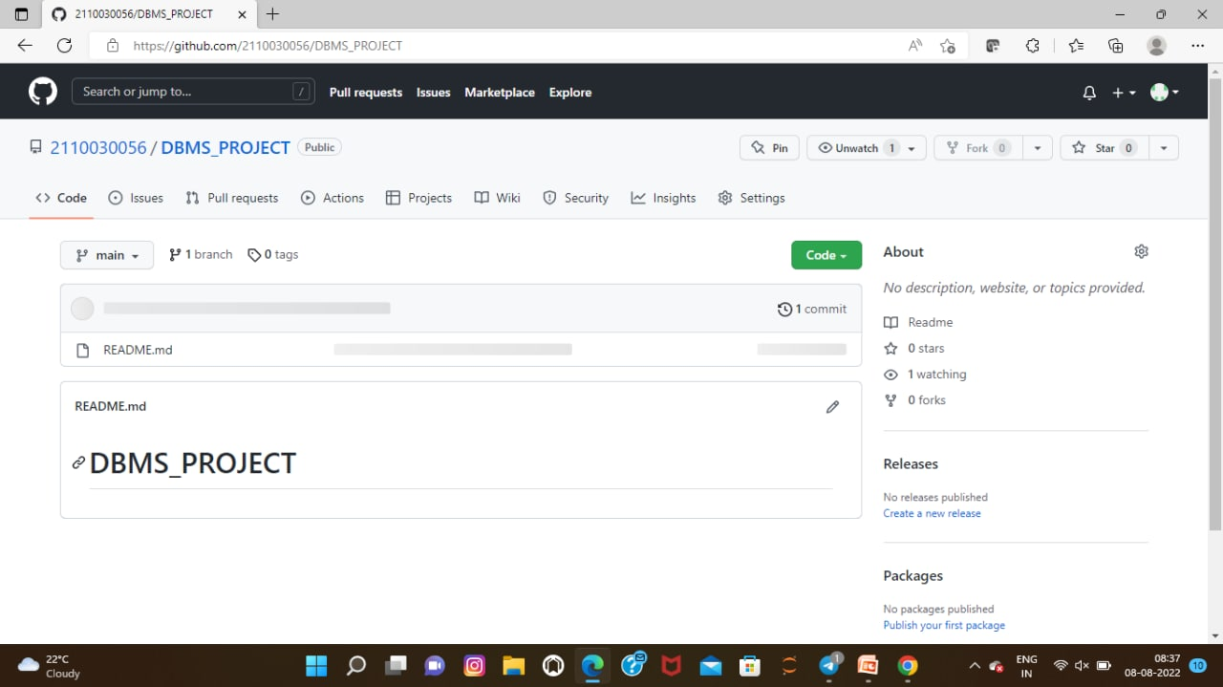
Github setup
2110030056-B.Akshita

Slide 11
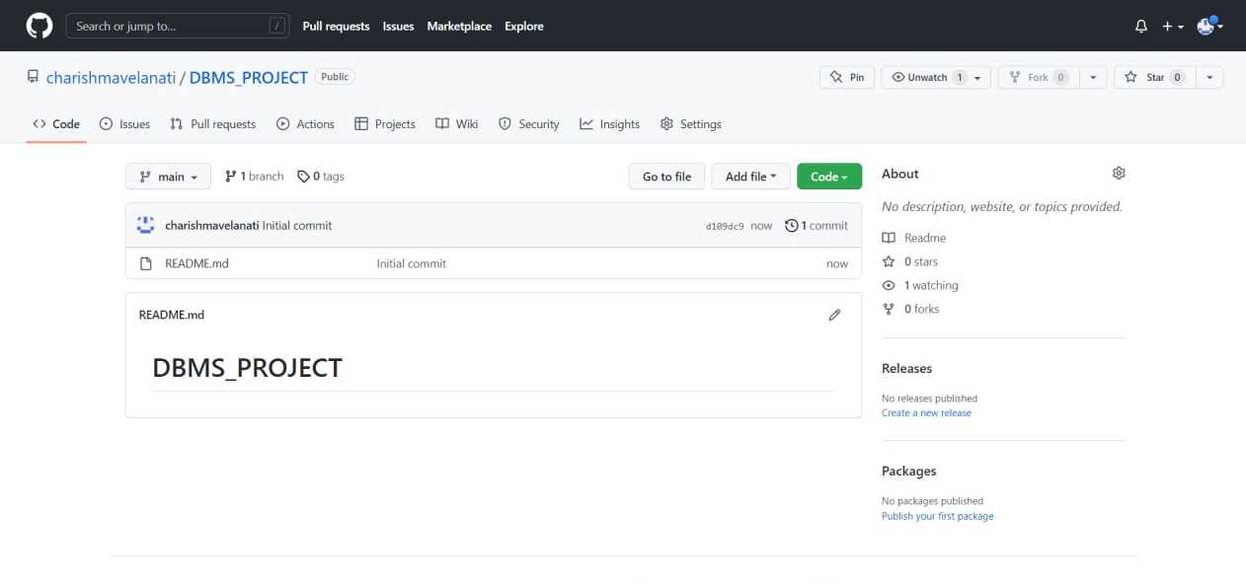
Github setup
2110030457-V.Charishma

Slide 12
Division of work among the group members
2110030020-Ch.Sri Chandana: PPT
2110030032-D.Neha: Information about project
2110030056-B.Akshita:PPT
2110030457:V.Charishma: Information about project

