Slide 1
FDA DBRepo
A database repository that supports the fair principles, data versioning and reproducible queries

Slide 2





Fair data austria
Lead: TU Graz
Timeline: January 2020 – December 2022
Förderung: Federal Ministry of Education, Science and Research (BMBWF)
Partner:
→ Fostering cooperation between Austrian universities in the development of coherent and robust research data management services
→ Creating the basis for the future of data-driven science together
+ 23 associated partners

Slide 3
Goals of fair data austria
Establishment and development of tools for the efficient creation of data management plans (DMPs and machine-actionable DMPs – maDMPs)
Conceptualization and development of next generation repositories for research data, code and databases
Professionalize data stewards by helping them acquire the skills and expertise needed for research data management
Development of training and support offers for efficient research data management
Founding of the FAIR Office Austria

Slide 4
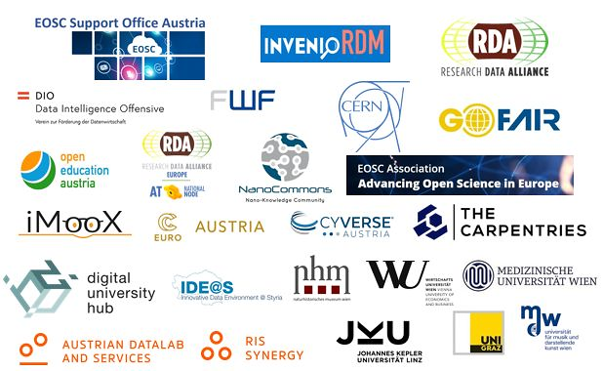





Cooperation partners

Slide 5
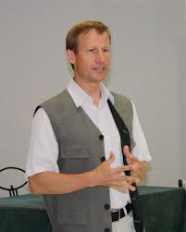
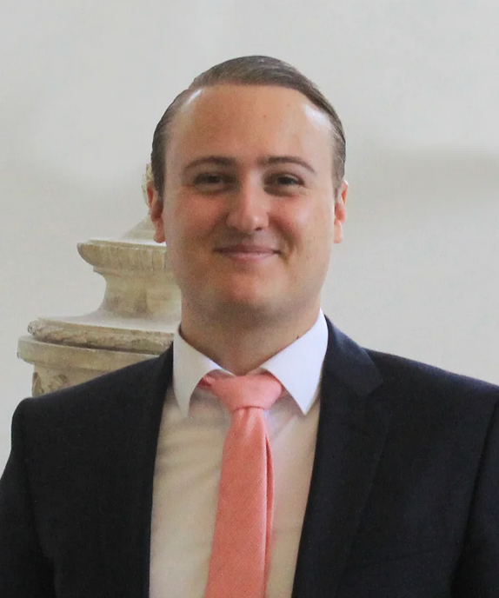
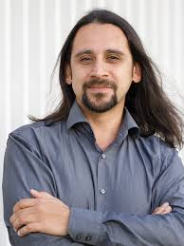

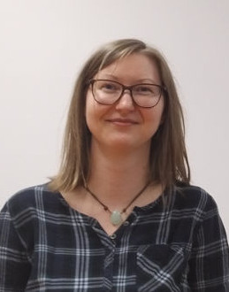

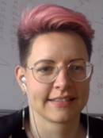
FDA DBREPO team
TU Wien
Universität Wien
Andreas Rauber
Martin Weise
Raman Ganguly
Kirill Stytsenko
Cornelia Michlits
Moritz Staudinger
Eva Gergely

Slide 6
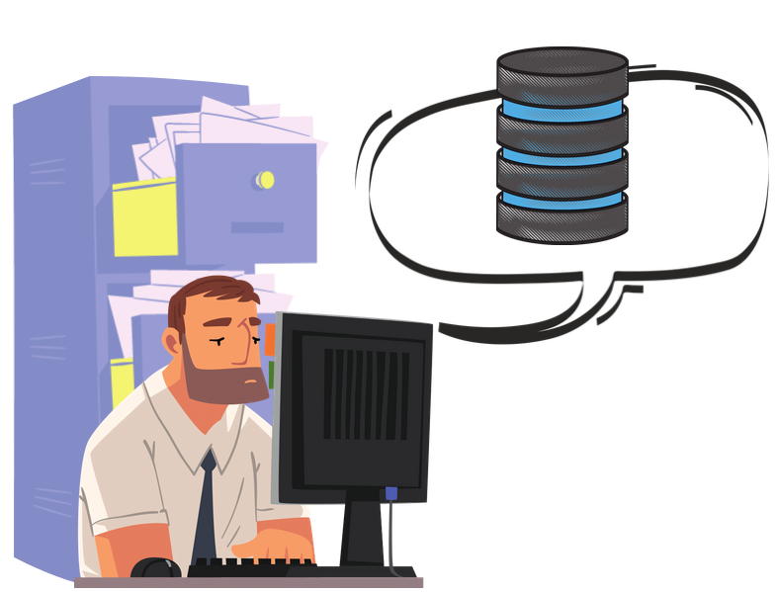
background FDA DBRepo
Frequent disadvantages of common databases in research:
Set up locally
Require administrative skills
No metadata or poor quality metadata
No data versioning
No support after the end of the project
No F.A.I.R.-NESS
Findable
Accessible
Interoperable
Re-usable

Slide 7
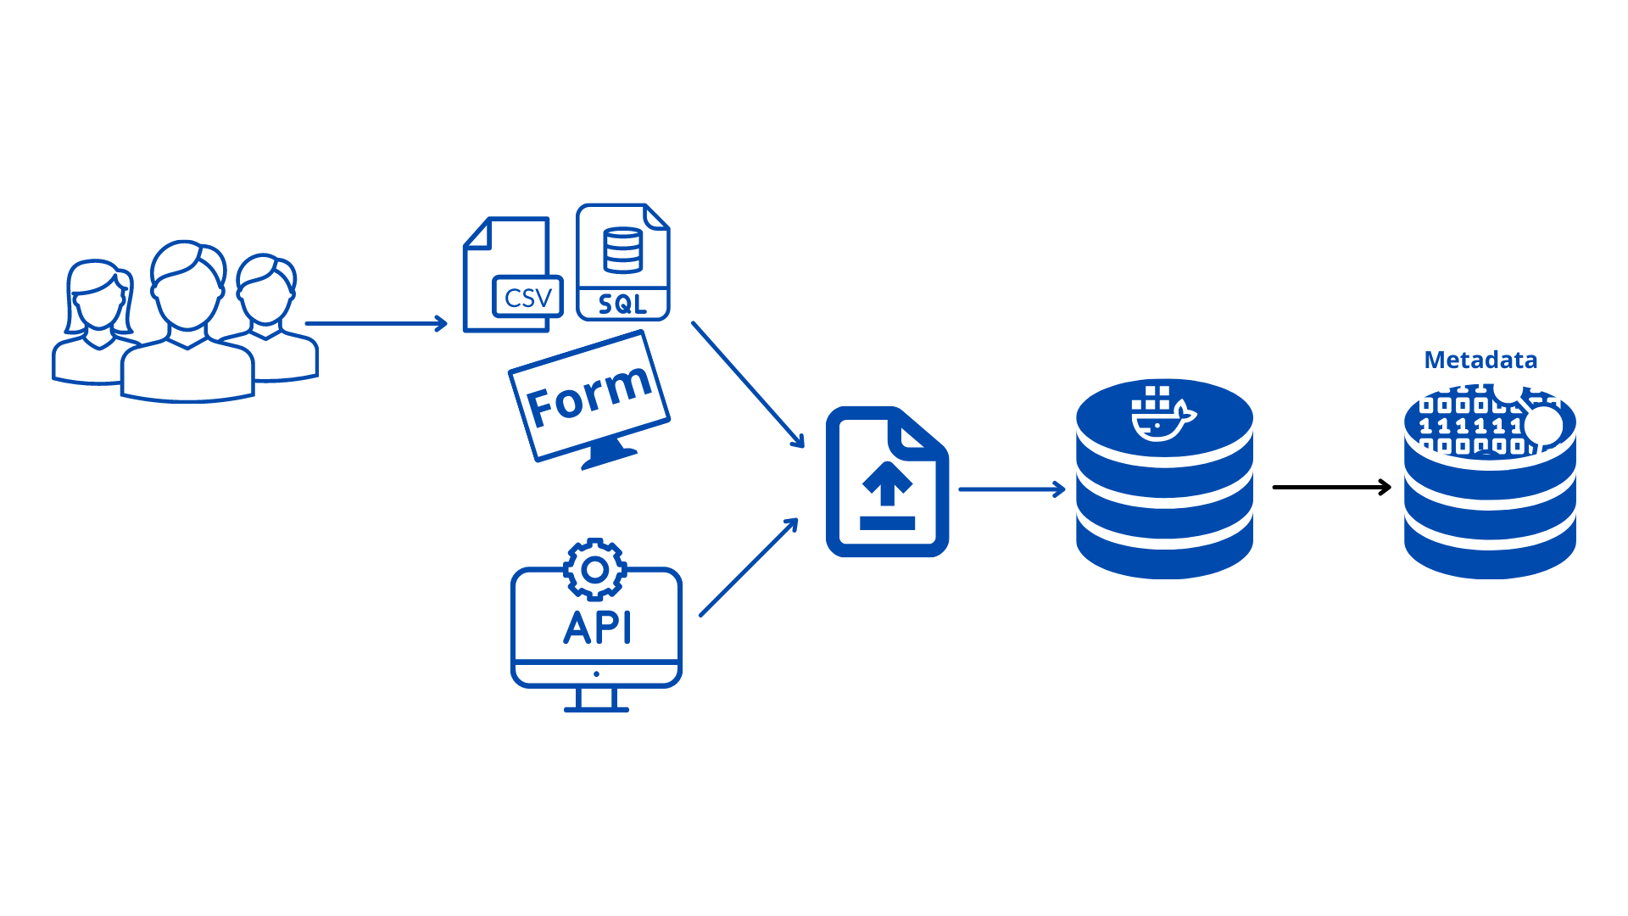
FDA DBRepo vision
Creation, population and use of databases directly in the repository framework
Database administration realized and supported by experts
(Partly) automatic generation of metadata
Reproducible and citable queries through data versioning
Support for different SQL expert levels

Slide 8

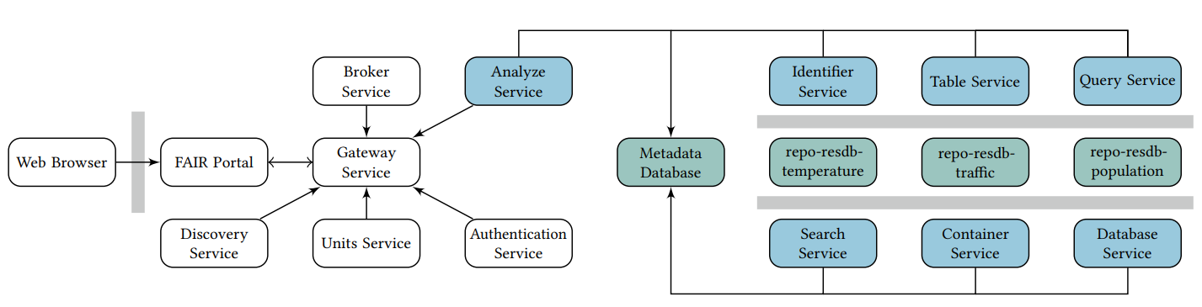

Architecture
Microservice architecture
Use of docker container
Meta information saved in a metadata database
REST API for sensory data

Slide 9



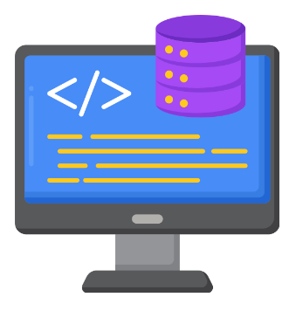
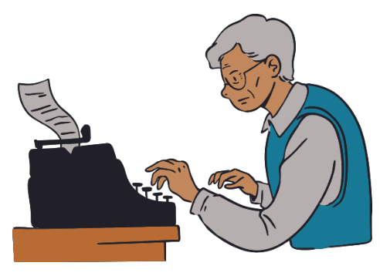

Social architecture
Researcher
→ Separation of concerns
Data Provider
Data Steward
FDA DBRepo (Frontend and Backend)
Database administrator
System administrator
Notes:
ERGÄNZEN

Slide 10
current state
https://dbrepo.ossdip.at/
The first prototype is online and has the following features:
Graphical User Interface (“FAIR Portal”)
Reference implementation for authentication
Creation, update and querying of databases via the FAIR Portal (currently supporting MariaDB databases)
A Query Builder (modular assembly of queries) and a Query Store (Saving and persisting of queries)
Data versioning (through the MariaDB Engine)
The source code is available on GitHub under an open source license

Slide 11
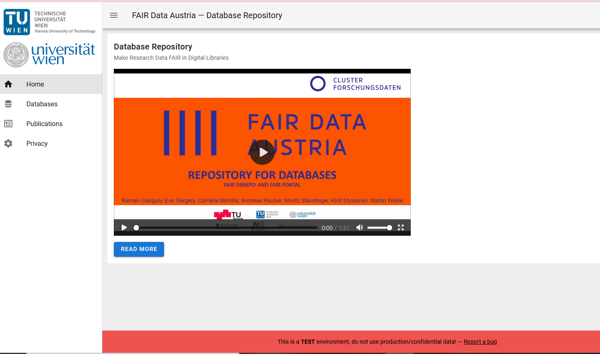
Fair portal landingpage

Slide 12
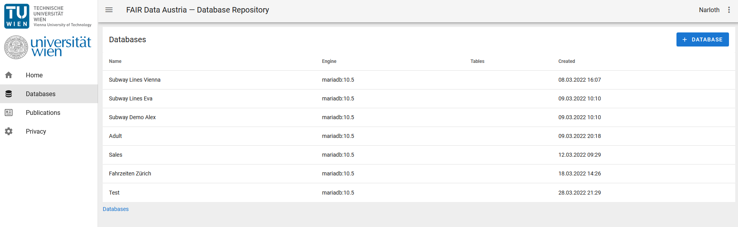
List of databases

Slide 13
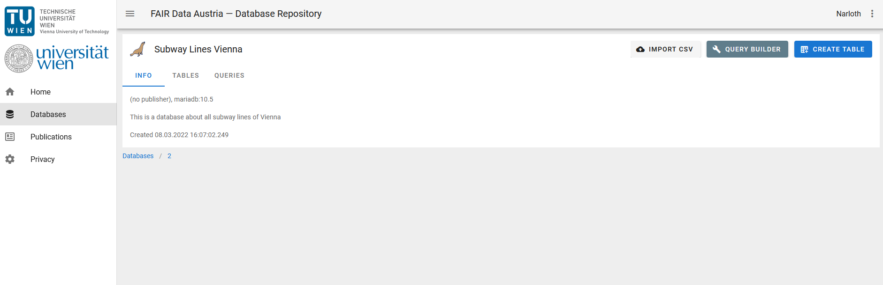
landingpage of a database

Slide 14
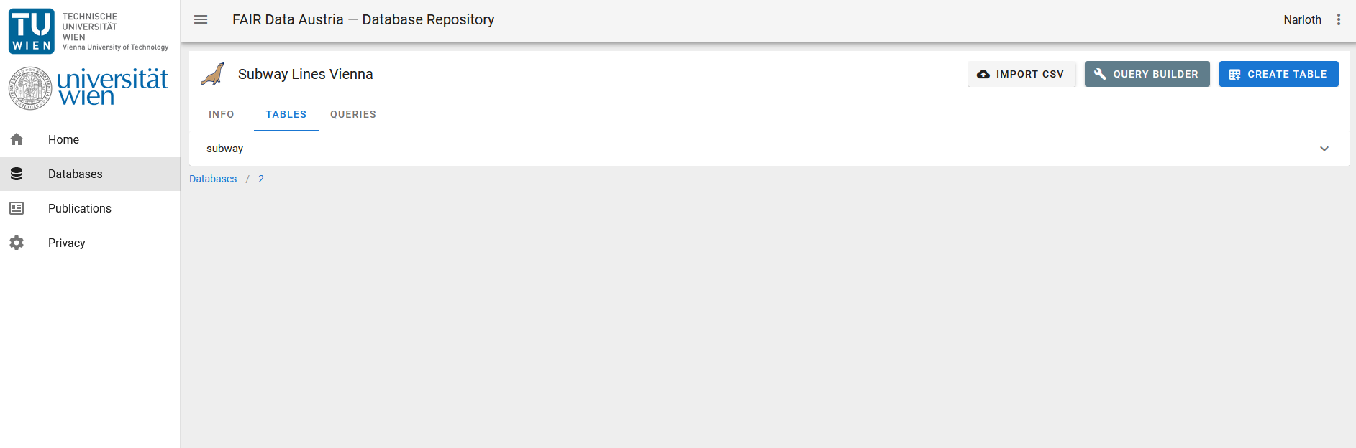
Tables in a database

Slide 15
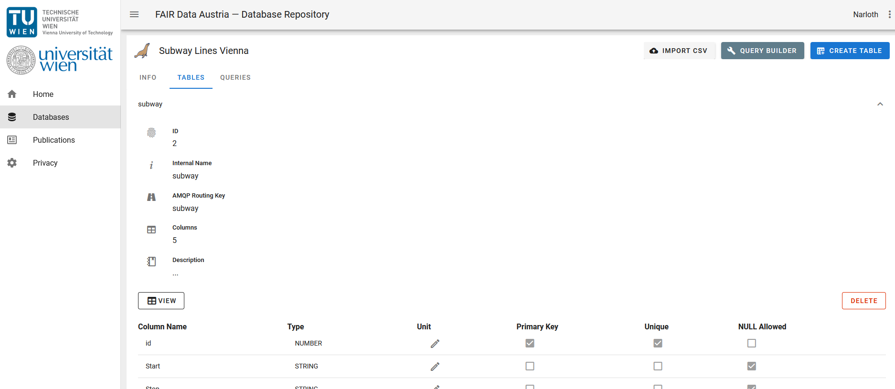
Landingpage of a table

Slide 16
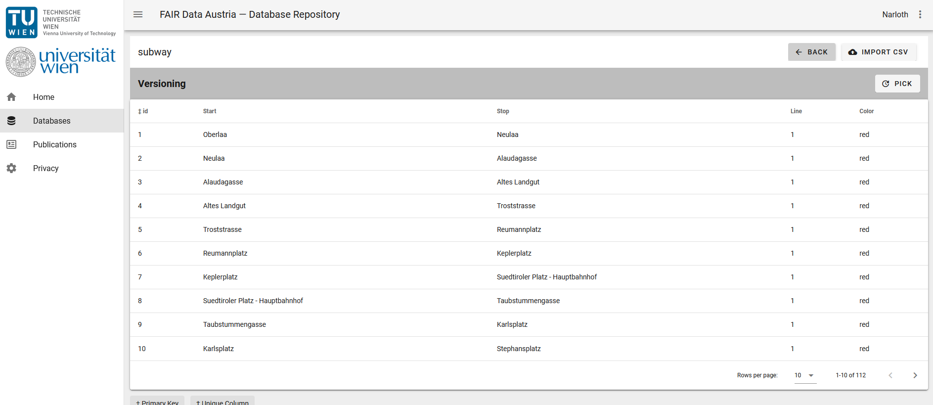
Data sets in a table

Slide 17
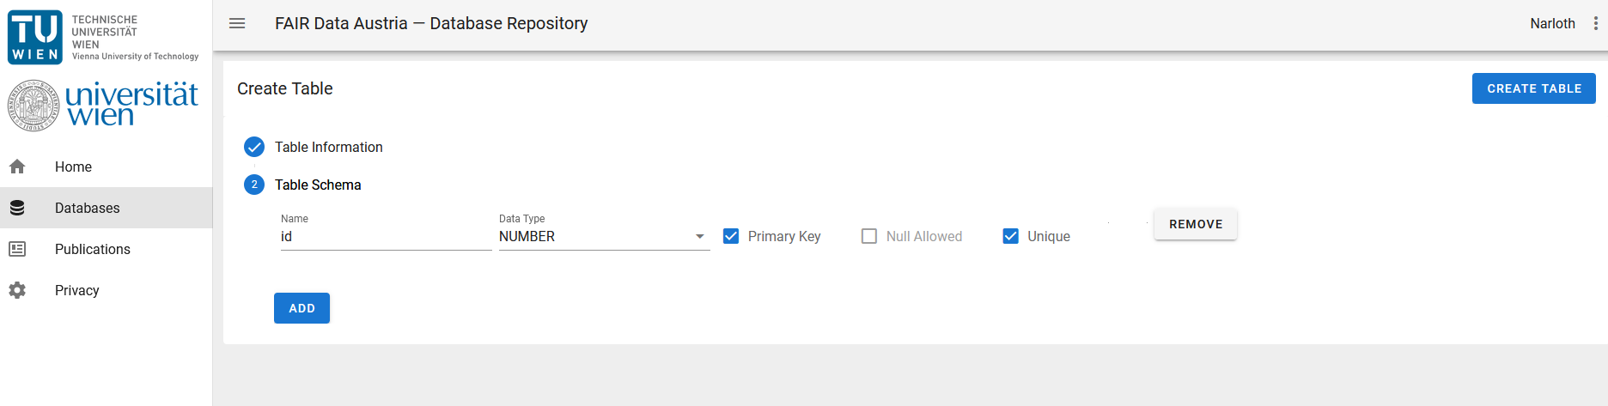
Manual creation of a table scheme

Slide 18
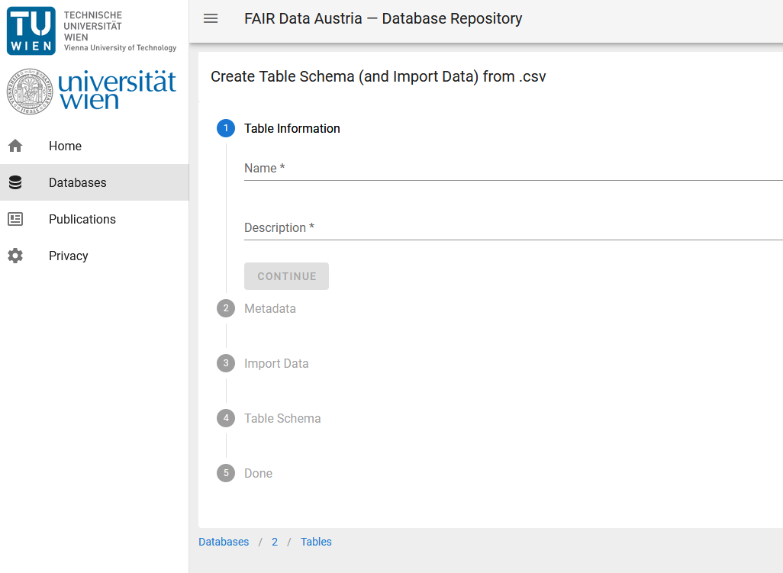
TablE import via csv

Slide 19
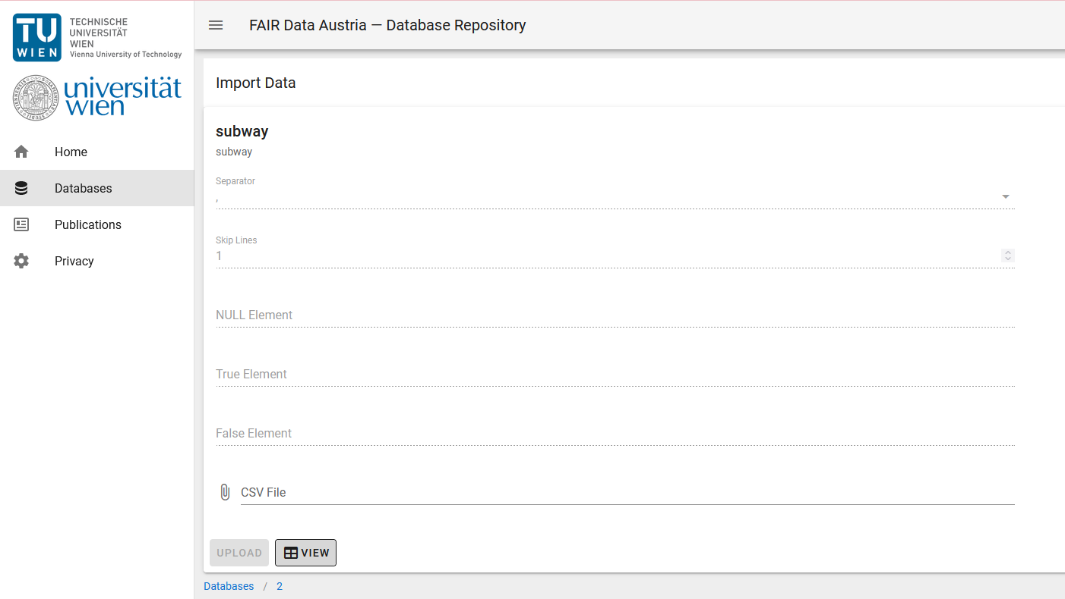
Importing new datasets to a table via csv

Slide 20
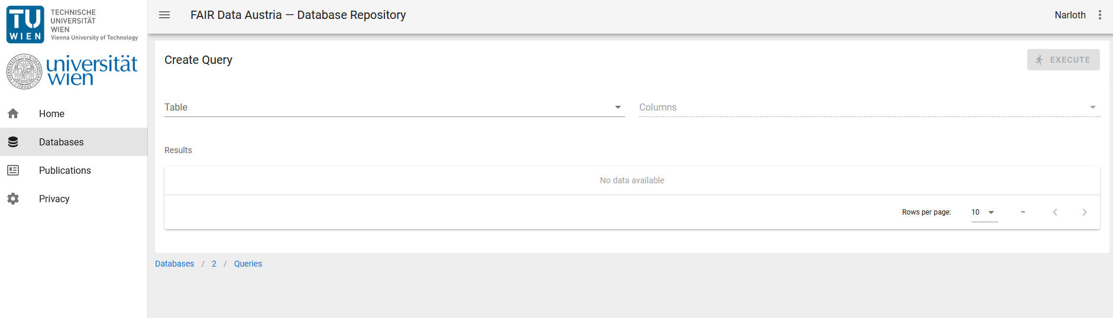
Modular creation of queries in the query builder

Slide 21
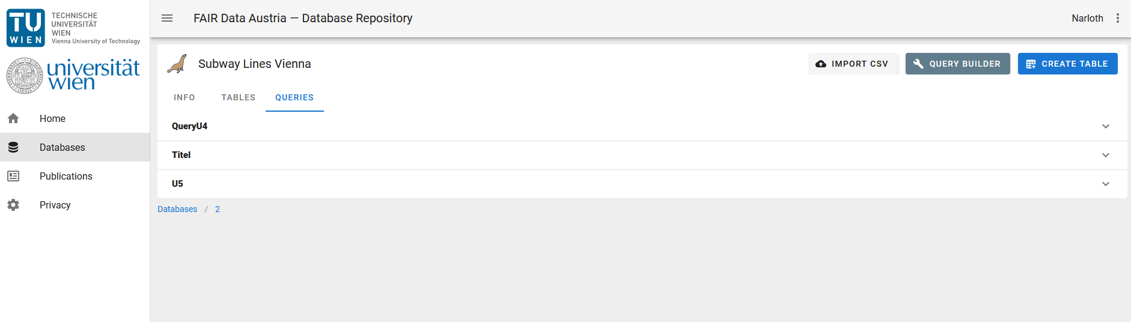
Persisted queries

Slide 22
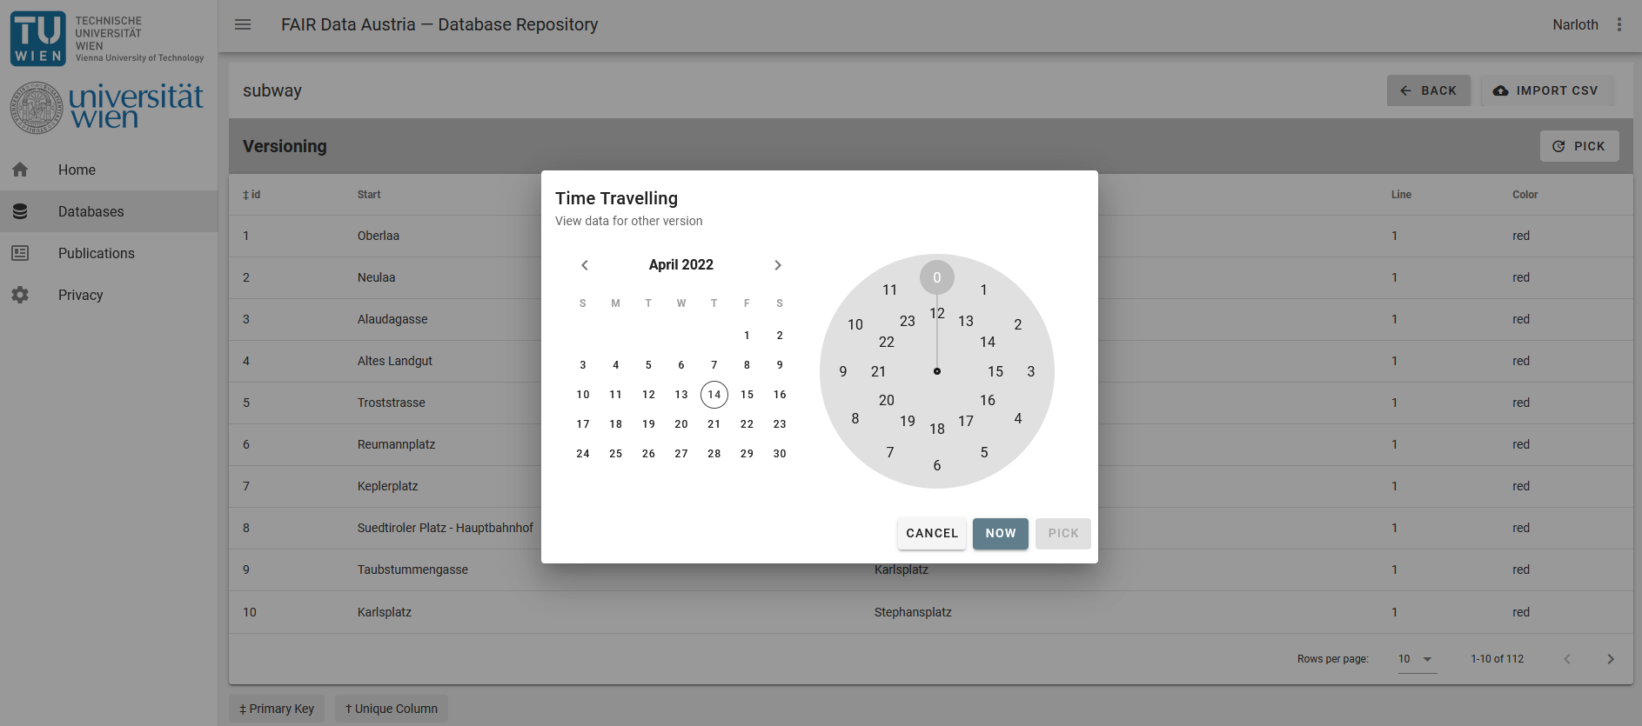
Versioning and date picker

Slide 23

Interested parties
Water Quality Economy Technical University of Vienna (Wassergütewirtschaft TUW=
Computer Center and Library University of Vienna (ZID und Bibliothek UW)
Historical and cultural science faculty University of Vienna (Historisch-Kulturwissenschaftliche Fakultät UW)
Philological and Cultural Studies University of Vienna (Philologisch-Kulturwissenschaftliche Fakultät UW)
International Interest:
Research Data Services and IT-Research and Development TU Darmstadt (DE)
Also interested?
Contact us under: eva.gergely@univie.ac.at and martin.weise@tuwien.ac.at

Slide 24
publication
Paper “FDA-DBrepo: A Data Preservation Repository Supporting FAIR Principles, Data Versioning and Reproducible Queries” DOI 10.17605/OSF.IO/B7NX5
M. Weise, C. Michlits, M. Staudinger, E. Gergely, K. Stytsenko, R. Ganguly, A. Rauber: “FDA-DBRepo: A Data Preservation Repository Supporting FAIR Principles, Data Versioning and Reproducible Queries”; Vortrag: iPRES 2021, Beijing, China; 19.10.2021 - 21.10.2021; in: “Proceedings of the 17th International Conference on Digital Preservation”, (2021), S. 34.
Next steps
Pilot phase with friendly user
Bugfixing and refinements
Set-up at the University of Vienna and other institutions

