Slide 1

A rails marketplace

Slide 2
What is prop swap?

Slide 3
What is prop swap?
A marketplace for plant owners to buy and sell plants, cuttings, props, etc

Slide 4
Why prop swap?

Slide 5
Why prop swap?
I live in a small apartment with someone who owns a large amount of succulents and cactuses.

Slide 6
Why prop swap?
I live in a small apartment with someone who owns a large amount of succulents and cactuses.
It would be awesome if she could sell some of them.

Slide 7
Why prop swap?
I live in a small apartment with someone who owns a large amount of succulents and cactuses.
It would be awesome if she could sell some of them.
I miss my balcony.

Slide 8
Other reasons why prop swap?
My wife spends an inordinate amount of time browsing and shopping for succulents and cactuses
Australia has strict biosecurity laws
Australia does not currently have a dedicated plant marketplace

Slide 9
Why the name prop swap?

Slide 10
Why the name prop swap?
The Prop Swap Shop - Too long

Slide 11
Why the name prop swap?
The Prop Swap Shop - Too long, dislike “the”
Propa swapa shoppa - Too Seuss

Slide 12
Why the name prop swap?
The Prop Swap Shop - Too long
Propa swapa shoppa - Too Seuss
Big Poppa’s Proppa Swappa Shoppa
Perfect! -- but the apostrophe poses a problem

Slide 13
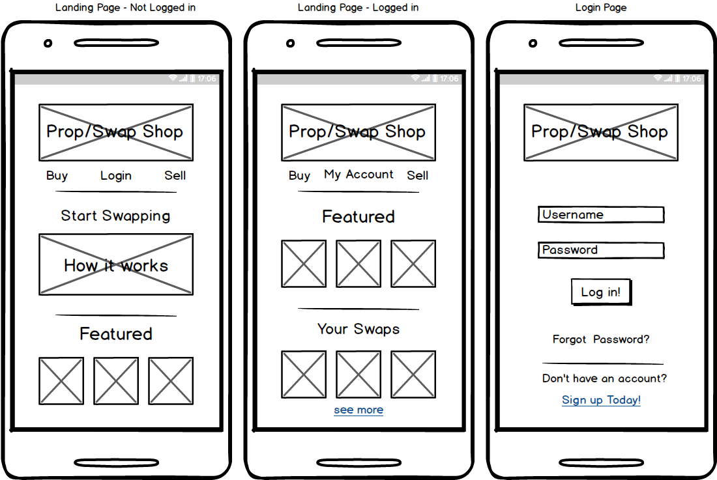
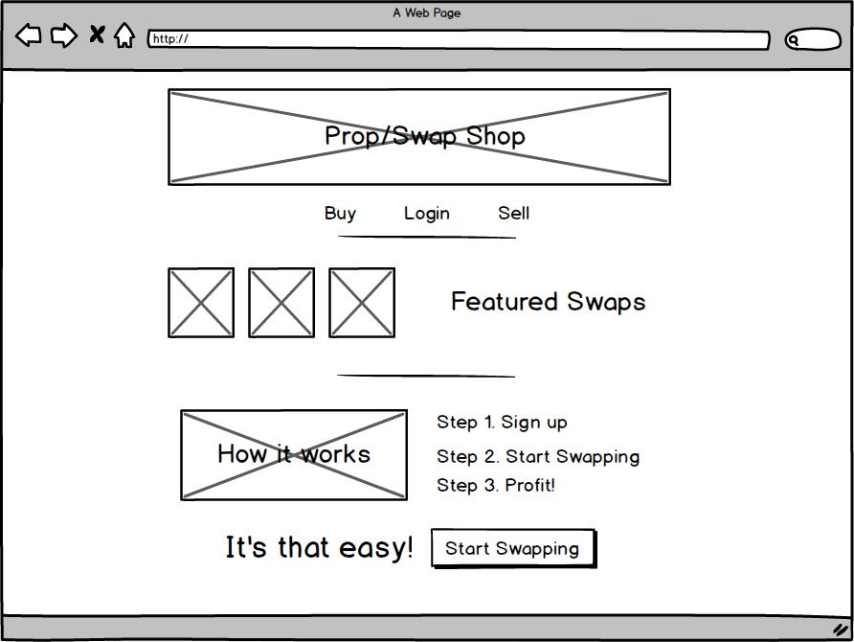
Let’s take a look!

