Slide 1
Building Restful API
In LARAVEL

Slide 2
Content
Basics
Restful API in LARAVEL
Model
Endpoint –URL/Route
Eloquent
Exception handling
API tools ---Postman

Slide 3
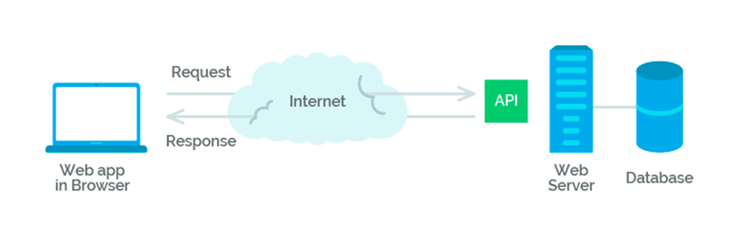
Introduction of RESTful API
API (application programming interface) is a set of rules and mechanisms by which one application or component interacts with the others.
API can return data that you need for your application in a convenient format (e.g. JSON or XML).
A REST Application Programming Interface (REST API) is a type of web server that enables a client, either user-operated or automated, to access resources that model a system’s data and functions.

Slide 4
REST. This abbreviation stands for representational state transfer.
The definition can be conveyed with simpler words: data presentation for a client in the format that is convenient for it.
There is one of the main points that you need to understand and remember: REST is not a standard or protocol, this is an approach to or architectural style for writing API.
REST is an architectural style, and RESTful is the interpretation of it.
That is, if your back-end server has REST API and you make client-side requests (from a website/application) to this API, then your client is RESTful.

Slide 5
How It Works
RESTful API best practices come down to four essential operations:
receiving data in a convenient format
creating new data
updating data
deleting data

Slide 6
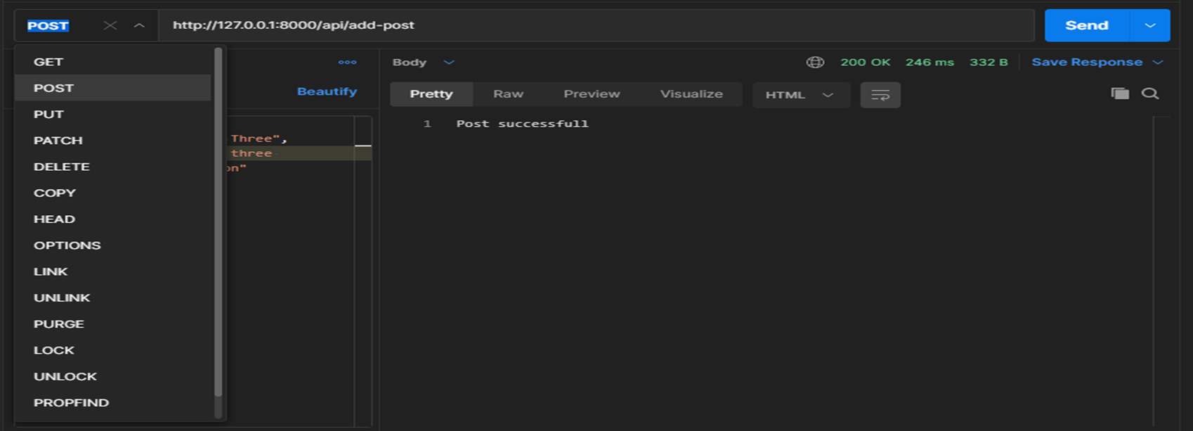
REST relies heavily on HTTP.
Each operation uses its own HTTP method:
GET - getting
POST - creation
PUT - update (modification)
DELETE – removal
The fact that REST contains a single common interface for requests and databases is its great advantage.

Slide 7
HTTP status codes
All requests you make have their HTTP status codes.
There are a lot of them and they are divided into 5 classes.
The first number indicates which of them a code belongs to:
1xx - informational
2xx - success
3xx - redirection
4xx - client error
5xx - server error

Slide 8
RESTful Architecture Design
All resources in REST are entities. They can be independent like:
GET /users ➔ get all users
GET /users/123 ➔get a particular user with id = 123
GET /posts ➔ get all posts
There are also dependent entities, that rely on their parent models:
GET /users/123/projects ➔get all the projects that a user with id = 123 has

Slide 9
Documentation(POSTMAN)
Postman is a scalable API testing tool that quickly integrates into CI/CD pipeline.
It started in 2012 as a side project by Abhinav Asthana to simplify API workflow in testing and development.
API stands for Application Programming Interface which allows software applications to communicate with each other via API calls.
For more https://www.guru99.com/postman-tutorial.html

Slide 10
Create project
PS C:\xampp\htdocs\REST-API-in-LARAVEL> composer create-project laravel/laravel RESTAPI

Slide 11
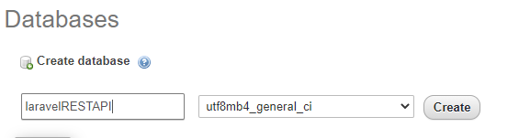
Database config (.env)
DB_CONNECTION=mysql
DB_HOST=127.0.0.1
DB_PORT=3306
DB_DATABASE=laravelRESTAPI
DB_USERNAME=root
DB_PASSWORD=

Slide 12
Add columns
PS C:\xampp\htdocs\REST-API-in-LARAVEL\RESTAPI> php artisan make:model Post –m
Schema::create('posts', function (Blueprint $table) {
$table->id();
$table->string('title');
$table->string('body');
$table->timestamps();
});

Slide 13
Create controller
PS C:\xampp\htdocs\REST-API-in-LARAVEL\RESTAPI> php artisan make:controller PostController
Controller created successfully.
PS C:\xampp\htdocs\REST-API-in-LARAVEL\RESTAPI>

Slide 14
Create post method
use App\Post;
class PostController extends Controller
{
function addPostAPI()
{ $post = new Post();
$post->title = $req->title;
$post->body = $req->body;
$post->save();//
return "Post successfull";
}
}

Slide 15
Route of add post and start app
use App\http\controllers\PostController;
Route::post('/add-post',[PostController::class,'addPostAPI']);
PS C:\xampp\htdocs\REST-API-in-LARAVEL\RESTAPI> php artisan serve
Laravel development server started: http://127.0.0.1:8000

Slide 16
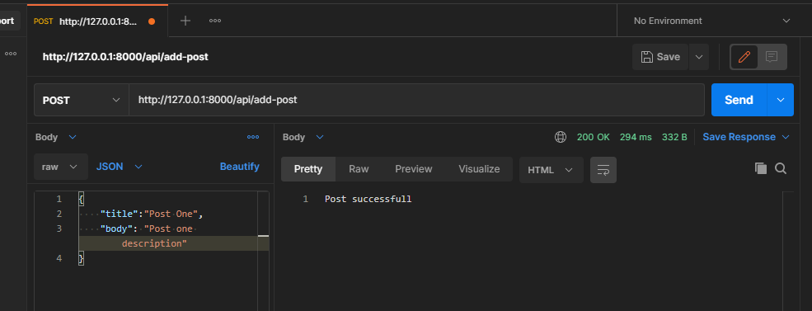
Create post using postman

Slide 17
Create Get posts method and route of it
function getPosts()
{
$posts = new Post();
return $posts->get();
}
Route::get('/posts',[PostController::class,'getPosts']);

Slide 18
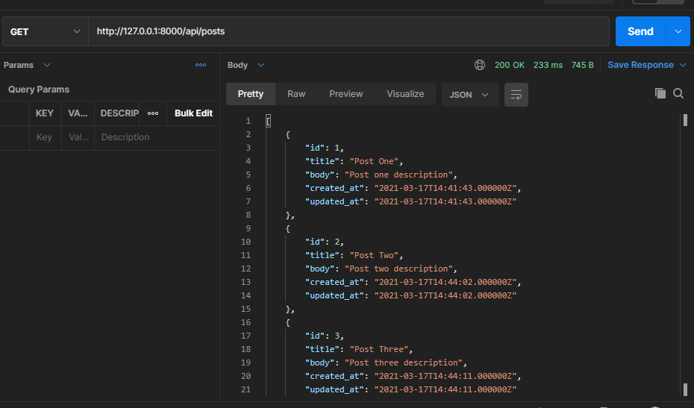
Get posts on postman

Slide 19
Create get a post by id and it route
function getPostById($id)
{
$post = Post:: where('id',$id)->first();
return $post;
}
Route::get('/post/{id}',[PostController::class,'getPostById']);

Slide 20
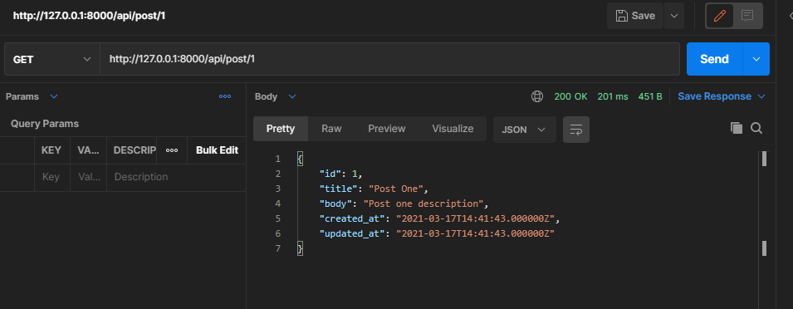
Test on postman

Slide 21
Create update post and its route
function updatePost(Request $request)
{
$post = Post:: find($request->id);
$post->title= $request->title;
$post->body = $request->body;
$post->save();
return "Post Updated successfully";
}
Route::put('/update-post/{id}',[PostController::class,'updatePost']);

Slide 22
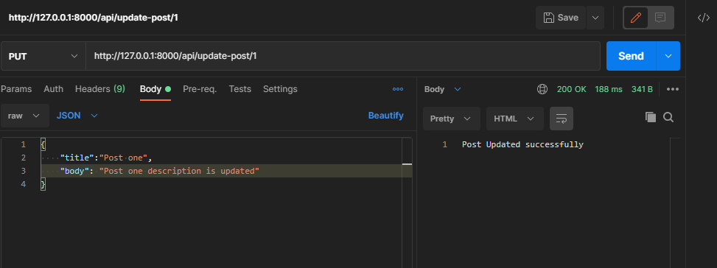
Test update API on postman

Slide 23
Create delete method and its route
function deletePost($id)
{
Post::where('id',$id)->delete();
return "Deleted";
}
Route::delete('/delete-post/{id}',[PostController::class,'deletePost']);

Slide 24
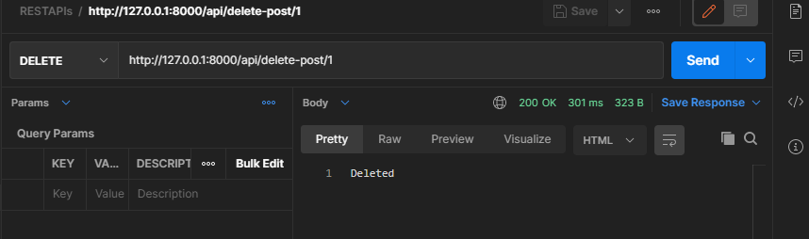
Test delete API on postman

Slide 25
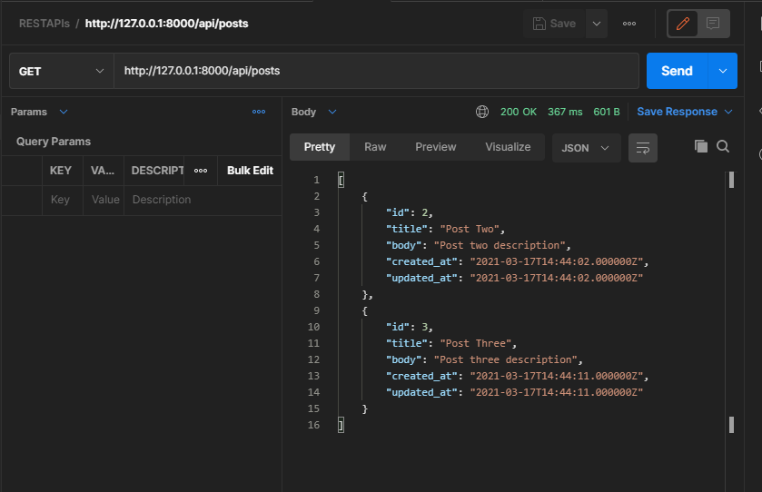
Check after delete

Slide 26
References and source code
https://www.twilio.com/blog/building-and-consuming-a-restful-api-in-laravel-php
https://coderaweso.me/laravel-rest-api-crud/
https://vinova.sg/2020/08/29/laravel-api-tutorial-building-testing-a-restful-api-toptal/
https://www.toptal.com/laravel/restful-laravel-api-tutorial
https://www.javatpoint.com/postman
https://github.com/DBUCS2013/REST-API-in-LARAVEL

