Slide 1
High Frequency Prediction Using Temporal Fusion Transformer (TFT), Xgboost and MLP
FE5225 Group project
—— A comparison
Group 10
Cheng Tuoyuan A0215646A
Wang Duyue A0215648Y
Wang Wenbo A0215659W
Zheng Zhongyi A0215673A

Slide 2
Content
Methods
Inplementation
Result

Slide 3
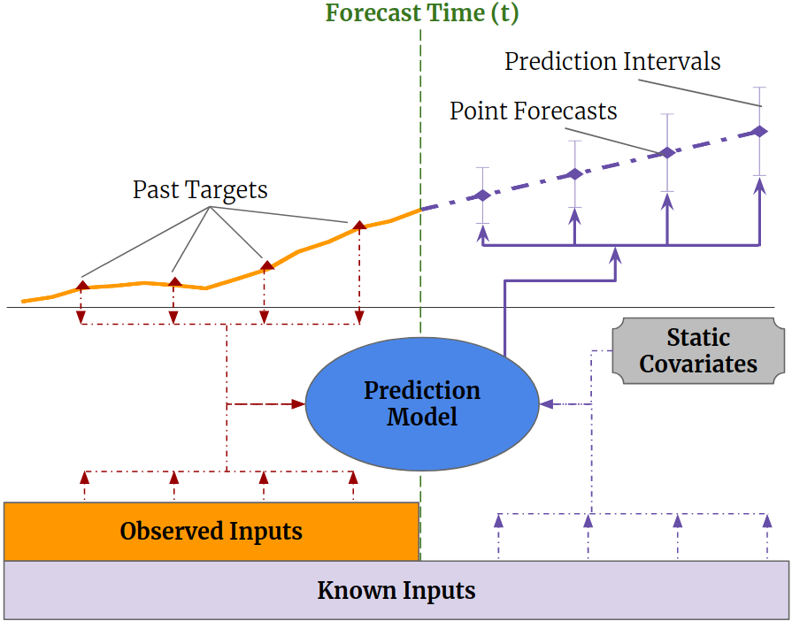
Temporal Fusion Transformers
Method
Multi-horizon forecasting often contains a complex mix of inputs – including, static (i.e. time-invariant) covariates, known future inputs, and other exogenous, time series that are only observed in the past – without any prior information on how they interact with the target.
Several deep learning methods have been proposed, but they are typically ‘black-box’ models which do not shed light on how they use the full range of inputs present in practical scenarios.
Illustration of multi-horizon forecasting with static covariates, past-observed andapriori-known future time-dependent inputs.

Slide 4
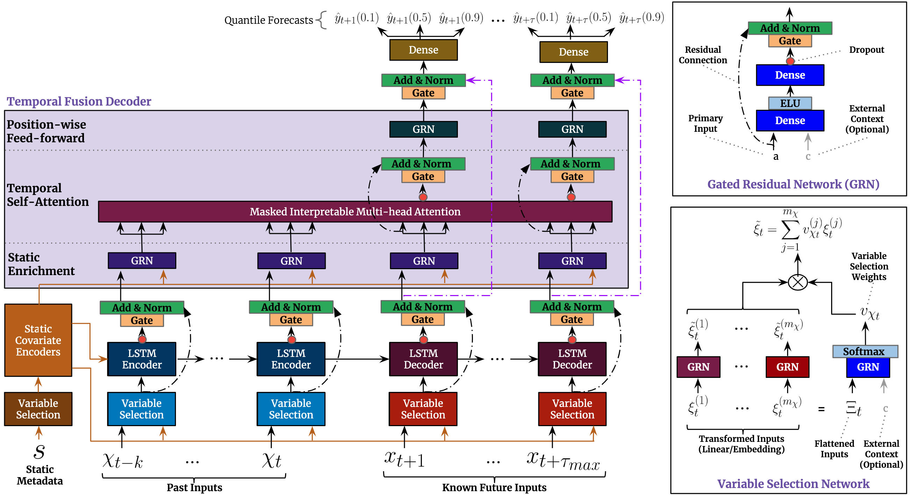
Temporal Fusion Transformers
Method
Temporal Fusion Transformer (TFT) is a novel attentionbased architecture which combines high-performance multi-horizon forecasting with interpretable insights into temporal dynamics.
To learn temporal relationships at different scales, TFT uses recurrent layers for local rocessing andinterpretable self-attention layers for long-term dependencies. TFT utilizes specialized components to select relevant features and a series of gating layers to suppress unnecessary components, enabling high performance in a wide range of scenarios.
TFT architecture. TFT inputs static metadata, time-varying past inputs and time_x0002_varying a priori known future inputs. Variable Selection is used for judicious selection of the most salient features based on the input. Gated Residual Network blocks enable efficient information flow with skip connections and gating layers. Time-dependent processing is based on LSTMs for local processing, and multi-head attention for integrating information from any time step.

Slide 5
Xgboost
Method
XGBoost is an optimized distributed gradient boosting library designed to be highly efficient, flexible and portable.
XGBoost can also be used for time series forecasting, although it requires that the time series dataset be transformed into a supervised learning problem first.
Neural Network-MLP
Multi-layer Perceptron (MLP) is a supervised learning algorithm that learns a function f(·): R^{m}→Rºby training on a dataset, where m is the number of dimensions for input and o is the number of dimensions for output. It can be applied to time series forecasting.

Slide 6
Data
Inplementation
The data we used is 500ms aggregate "high" frequency order book data of an index future contract.
(available from https://www.kaggle.com/c/caltech-cs155-2020)
train.csv - the data set
Data size 592380
Training size 473940
Validation size 118476
Time series train test split by 2:8

Slide 7
Data Fields
Inplementation
Feature name | Meaning
id | The timestep ID of the order book features.
last_price | the price at which the most recent order fill occurred.
mid | the "mid" price, which is the average of the best bid (bid1) and the best ask (ask1) prices.
opened_position_qty | In the past 500ms, how many buy orders were filled?
closed_position_qty | In the past 500ms, how many sell orders were filled?
transacted_qty | In the past 500ms, how many buy+sell orders were filled?
d_open_interest | In the past 500ms, what is (#buy orders filled)- (#sell orders fil
y | What is the change in the mid price from now to 2 timesteps (approx. 1 second) in the future? "1" means this change is strictly positive, and "0" means the change is 0 or negative.

Slide 8
Data Fields
Inplementation
Feature name | Meaning
bid1 | What is the 1st bid price?
bid[2,3,4,5] | What is the [2nd, 3rd, 4th, 5th] best/highest bid price?
ask1 | What is the 1st ask price?
ask[2,3,4,5] | What is the [2nd, 3rd, 4th, 5th] best/lowest/cheapest ask price?
bid1vol | What is the [2nd, 3rd, 4th, 5th] best/lowest/cheapest ask price?
bid[2,3,4,5]vol | What is the quantity of contracts in the order book at the [2,3,4,5]th bid price ?
ask1vol | What is the quantity of contracts in the order book at the 1st ask price ?
ask[2,3,4,5]vol | What is the quantity of contracts in the order book at the [2,3,4,5]th ask price?

Slide 9
Training process detail
Inplementation
The code is run on google’s colab and local IDE
Train on test dataset, prediction on the next 15 observation
Training time 1.5h
Manually tuning hyperparameters base on validation MSE loss

Slide 10
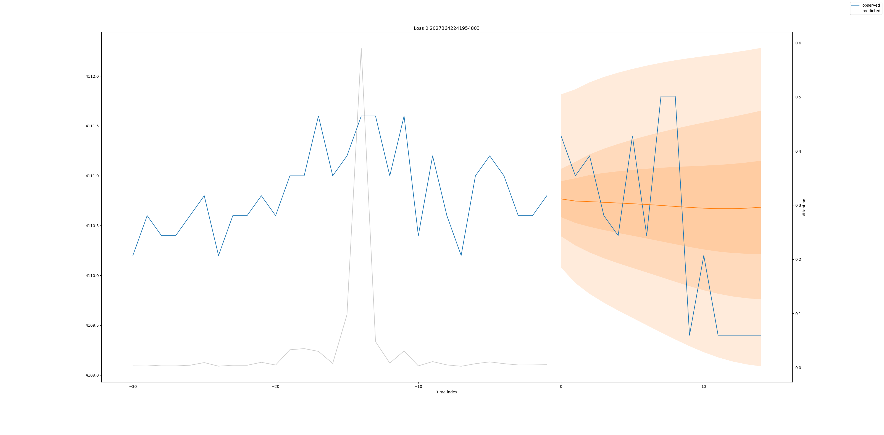
TFT Result
Result

Slide 11
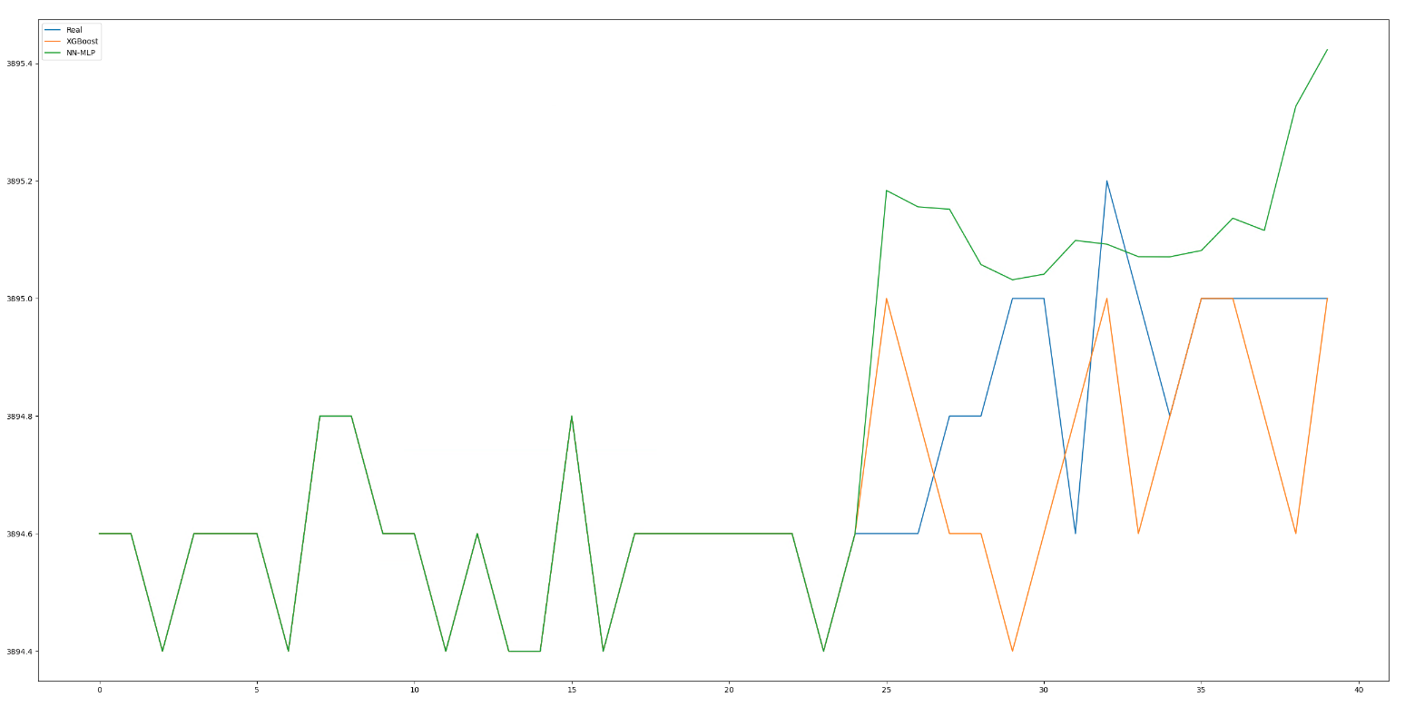
Xgboost and MLP Result
Result
MLP overfit and connot easily solved by tuning hyperparamaters base on Cross-validation.
Maybe should try LSTM, Bi-LSTM or GRU.
XGBoost caputure some pattern and show some generalization on out-of-sample prediction.

Slide 12
Comparison between methods
Result
For short term prediction based on high frequency data.
MLP too easily to overfit so may not be good option for this task
XGBoost still show that gradient boosting descision is still a very powerful model as it's show great genenization but not so stable.
Temporal Fusion Transformers show stable result and could realize shot term trend, but the problems is that it do not provide us with precised direction signal.

Slide 13
Thanks !

