Slide 1
AIS Vessel Effort Application
Created By:
Nicholas Buch, Danny Batterman, Tyler Soriano, Gavin Li

Slide 2
Project Goals
Query historical Automatic Identification Systems (AIS) vessel tracking data and determine if there are any trends.
Be able to select specific sections of the port and execute the query. Data pulled from SQL database into Python flask app, processed, and results sent to javascript front end.
Apply Linear Regression and LSTM models to the data to try multiple machine learning methods.

Slide 3
Database
Database consisted of more than 234,731,320 rows, containing columns for:
MMSI
BaseDateTime
Latitude
Longitude
VesselType
PostgreSQL database was used with AWS RDS cloud services.

Slide 4
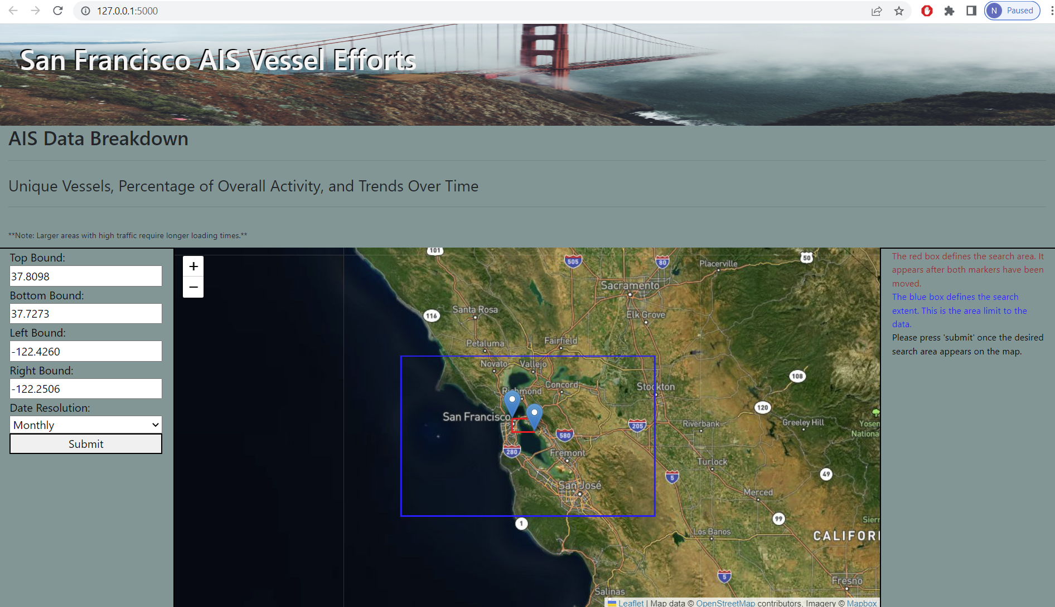
Front-End Search
Front-End was developed to take in search criteria based on location and “Date Resolution” as the interval of time being assessed. The criteria was passed to the flask app for the query and machine learning model processing. Once completed, the results were passed back to the javascript logic for display on the dashboard.

Slide 5
Back-End Processing
A flask app was created that looked for the html to “post” the selected data after clicking the ‘submit’ button. This was done using an AJAX method.
The search criteria was used in the SQL query, and the output of the models sent to the javascript as various routes within the app passing JSON objects.
A linear regression and LSTM model were used in the back-end, and the results called to the javascript for the dashboard.

Slide 6
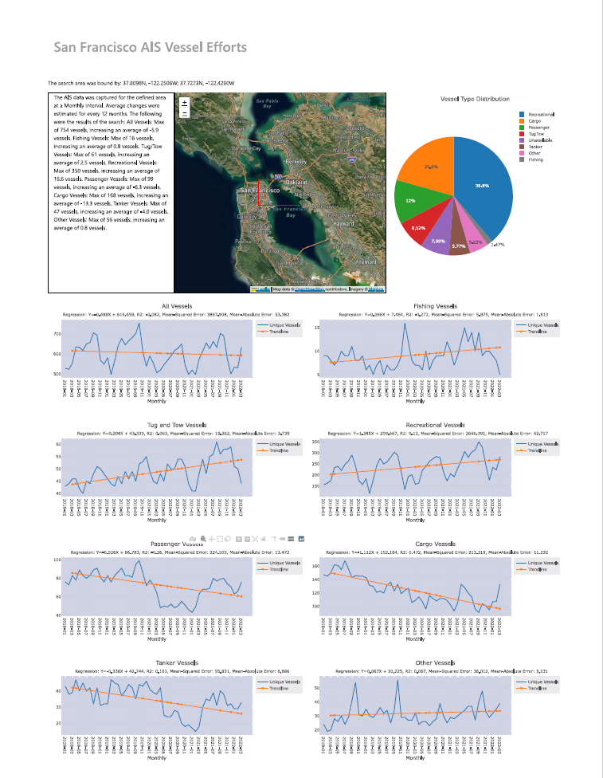
Dashboard
The results automatically redirect when the query completes. The dashboard was created using javascript plotly, HTML, and CSS scripts. A summary is provided for the search, as well as a map depicting the area selected and a pie chart breaking down the percentage of vessels by type.
A chart is plotted for each vessel type, with the queried data and the linear regression results.
An identical dashboard was used to display the LSTM results, which can be navigated to via the navigation bar at the top of the webpage.

Slide 7
Results
The application runs successfully, outputting the desired data and machine learning models.
The application takes roughly 3-10 minutes to execute, depending on the area selected and the date resolution.
Once executed, results can be switched between models, or a new query can be initiated.

Slide 8
Demonstration
The below is a video of the application running (with editing to limit load time):
*** put link to app demonstration here ***

