Slide 1
Gitflow
Code/Astro 2023

Slide 2
Why do we Need Gitflow?
When you’re working on big projects, many people are committing at once. Source control allows people to edit the same code base at the same time, using different branches.

Slide 3
Gitflow is a way of using Git and GitHub
Allows for multi-user development and testing
“Protects” the main code
Easy to go back to a stable point if something breaks
Work is performed in parallel on one or more feature branches.

Slide 4
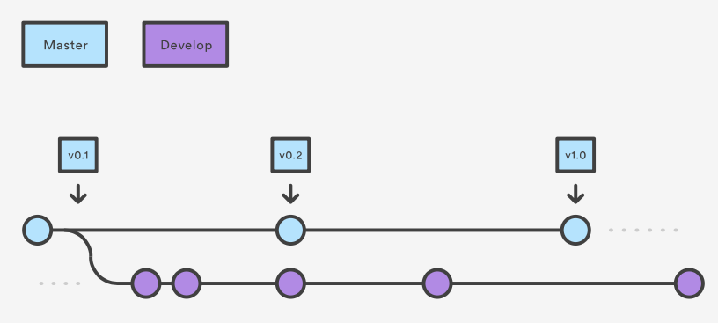
How It Works
1: Make a development branch off main
Main

Slide 5
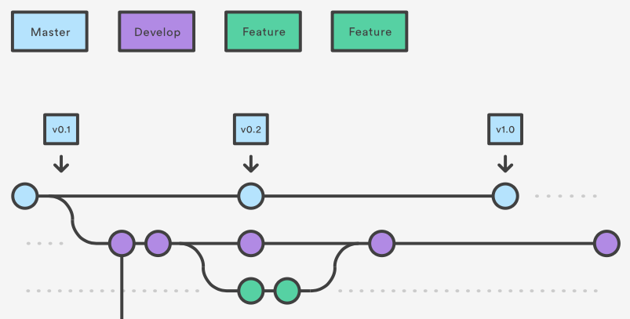
2. Create a feature branch from develop
Main

Slide 6
3. Merge into Develop
Main
Pull Request # 1

Slide 7
4. Merge into main
Main
Pull Request # 2
Pull Request # 1

Slide 8
4. Merge into main
Main
Pull Request # 2
Pull Request # 1

Slide 9
Demo: Gitflow
In this demo, you will learn how to:
Create and manipulate multiple branches within a git repo (main, develop, feature)
How to use these branches in a “standard” git workflow
Submit a pull request on Github to merge two branches
Try to type along with me as we walk through the demo. However, don’t worry if you get stuck!

Slide 10
Demo: Gitflow
In the demo, you will learn how to:
Try to type along with me as we walk through the demo. However, don’t worry if you get stuck! We’ll have time at the end to work on the demo in groups.

Slide 11
DEMO!

Slide 12
Summary of process to add a feature
Pull latest code from develop branch.
Create feature branch from develop branch.
Make your changes, stage, commit, then push to GitHub.
Submit pull request on GitHub & merge into develop.
Repeat until enough features have been merged into develop, then make a pull request from develop -> main.

Slide 13
Git Commands
> git checkout –b <new_branch> <orig_branch>
Make a new branch off of <orig_branch> (default: main)
> git checkout <branch>
Switch to desired branch
> git branch -a
List all the branches available on your local repo, highlighting the one you are currently on
git branch –d <branch_name>
Delete a branch from your local repo
There are a lot of “Git Cheatsheets” online if you want a summary of more commands!

Slide 14
Extra Slides

Slide 15
Class-sourced Vocabulary List
Git: version control system (mercurial)
GitHub: one choice for remote host for source-control projects (also see Gitlab/bitbucket
source control: act of keeping track of history of code
repo (short for “repository”): version-controlled project, keeps track of changes
pull request: way to notify developers of particular changes, and stages the changes in one branch to be pulled into another
commit: a change that adds a new “note” to current branch, like an object that holds iformatio about who made commit, changes involved
branch: way to add new feature to code, might have changes added relative to main/other branchs
clone: local repo copy linked to remote
Code/Astro vocab list: https://docs.google.com/document/d/1HuzcZbUOdDht9Q2Y5RB7d7THucwVZrZAPkskCw9u9XE/edit?usp=sharing
Notes:
on zoom: use stack.
IRL: raise hand.
Alternate btwn zoom & irl

Slide 16
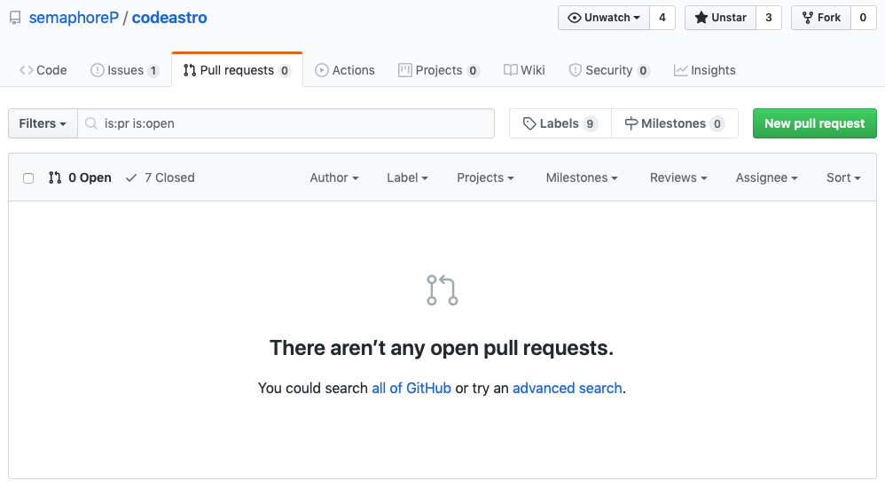
Feature done: Pull Request

Slide 17
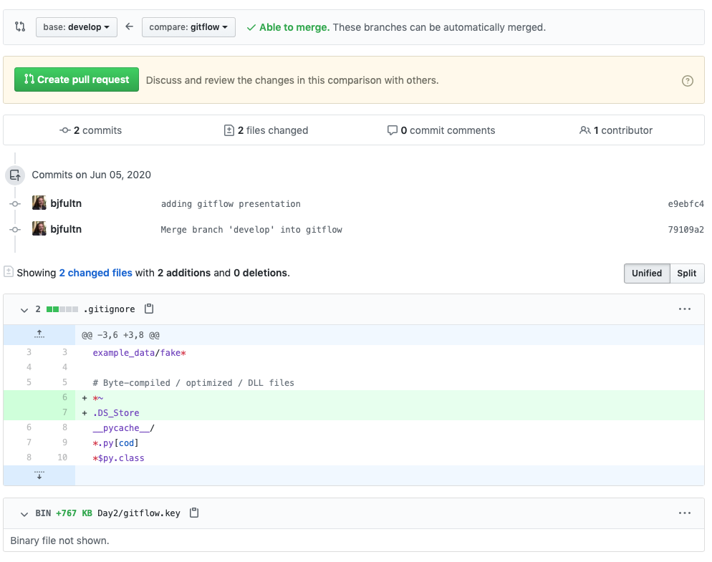
Feature done: Pull Request
Differences between your feature branch and develop will be highlighted
Be descriptive with your changes
Usually an admin or senior developer will review and merge into develop after approval
Automated checks may also run
Delete feature branch after merge

Slide 18
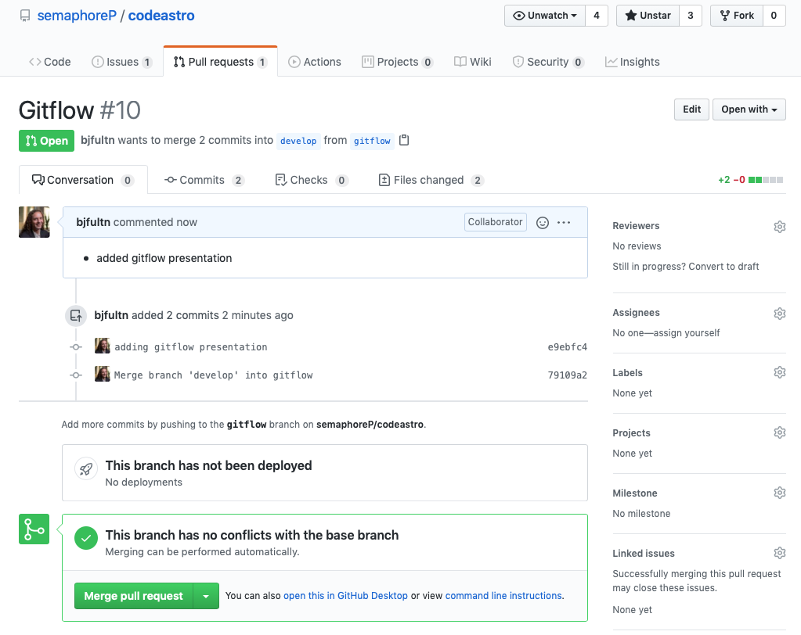
Feature done: Pull Request
Differences between your feature branch and develop will be highlighted
Be descriptive with your changes
Usually an admin or senior developer will review and merge into develop after approval
Automated checks may also run
Delete feature branch after merge

Slide 19
By the end of this lesson, you will be able to:
Create multiple branches within a git repository
Make a pull request from one branch into another
Describe the basic git workflow (”gitflow”)

