Slide 1
Gitflow

Slide 2
By the end of this lesson, you will be able to:
Create a git repository
Make a pull request consisting of multiple commits
Define gitflow & give examples of its advantages
commiting code | commit demo | gitflow conceptual walkthrough | gitflow demo

Slide 3
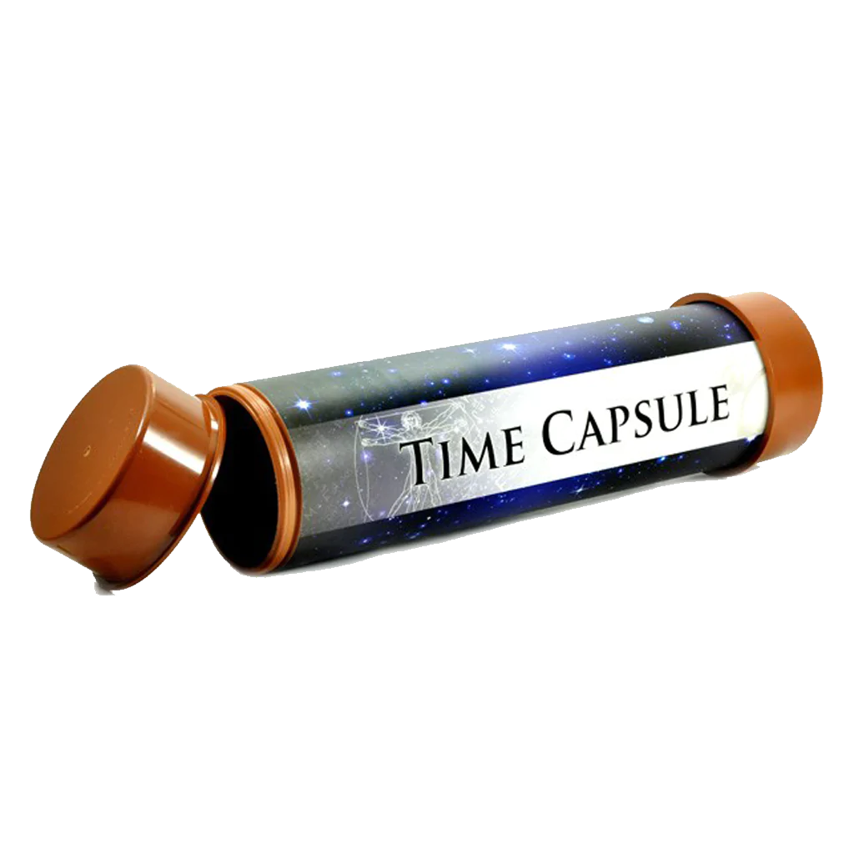

How Git Works (two analogies):
Analogy stolen from: https://www.freecodecamp.org/news/git-the-laymans-guide-to-understanding-the-core-concepts/
Commits are points in the code you can revisit. Commiting your code is like creating a time capsule.
The process of commiting your code is like the process of making a scrapbook.
Take pictures.
= Make changes to code.
2. Lay them out in a scrapbook.
= Stage the changes.
3. Glue them down.
= Commit the changes.
commiting code | commit demo | gitflow conceptual walkthrough | gitflow demo

Slide 4
Commiting Code Demo
commiting code | commit demo | gitflow conceptual walkthrough | gitflow demo
Notes:
commits are places in the code you can revisit.

Slide 5
We now know how to commit code, why do we need anything else?
When you’re working on big projects, many people are commiting at once. Source control allows people to edit the same code base at the same time, using different branches.

Slide 6
Gitflow is a way of using Git and GitHub
Allows for multi-user development and testing
“Protects” the main code
Easy to go back to a stable point if something breaks
Work is performed in parallel on one or more feature branches.
commiting code | commit demo | gitflow conceptual walkthrough | gitflow demo

Slide 7
Class-sourced Vocabulary List
Git: version control system (mercurial)
GitHub: one choice for remote host for source-control projects (also see Gitlab/bitbucket
source control: act of keeping track of history of code
repo (short for “repository”): version-controlled project, keeps track of changes
pull request: way to notify developers of particular changes, and stages the changes in one branch to be pulled into another
commit: a change that adds a new “note” to current branch, like an object that holds iformatio about who made commit, changes involved
branch: way to add new feature to code, might have changes added relative to main/other branchs
clone: local repo copy linked to remote
Code/Astro vocab list: https://docs.google.com/document/d/1HuzcZbUOdDht9Q2Y5RB7d7THucwVZrZAPkskCw9u9XE/edit?usp=sharing
commiting code | commit demo | gitflow conceptual walkthrough | gitflow demo
Notes:
on zoom: use stack.
IRL: raise hand.
Alternate btwn zoom & irl

Slide 8
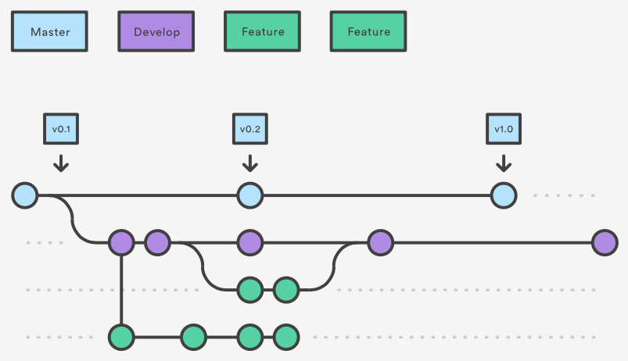
How it Works:
Main
Pull request ->
Pull request ->
Pull request ->
commiting code | commit demo | gitflow conceptual walkthrough | gitflow demo

Slide 9
Start on GitHub. Create a new repo.
Create a new repository on GitHub
Clone it to your local computer.
commiting code | commit demo | gitflow conceptual walkthrough | gitflow demo

Slide 10
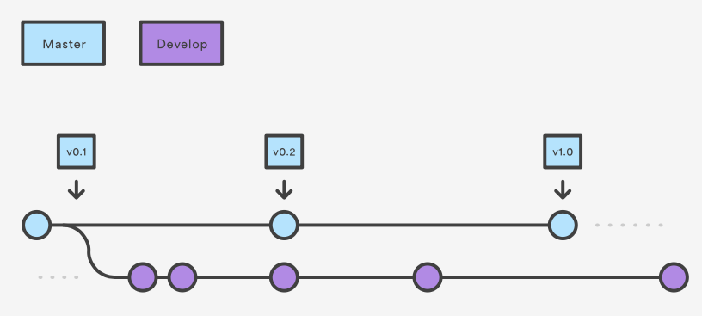
On your computer, create a develop branch.
Main
commiting code | commit demo | gitflow conceptual walkthrough | gitflow demo

Slide 11
Create a feature branch.
Main
commiting code | commit demo | gitflow conceptual walkthrough | gitflow demo

Slide 12
Commit some changes.
Main
commiting code | commit demo | gitflow conceptual walkthrough | gitflow demo

Slide 13
Create another feature branch from develop.
Main
Another developer might do the same on another feature branch
commiting code | commit demo | gitflow conceptual walkthrough | gitflow demo

Slide 14
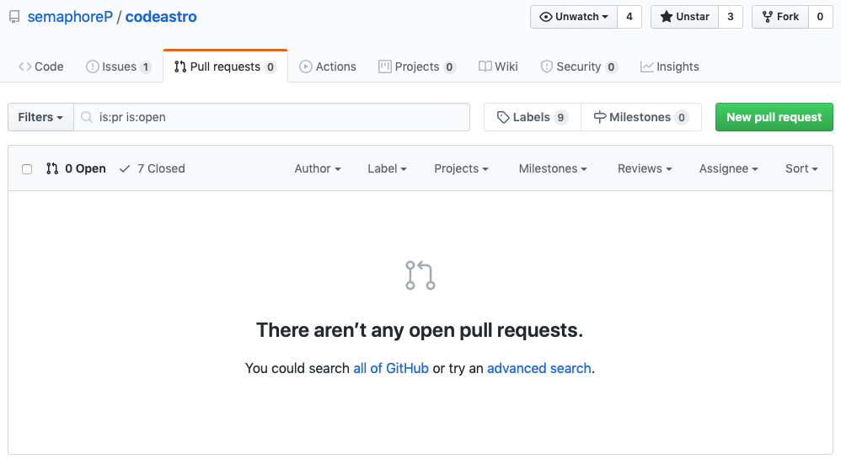
Feature done: Pull Request
commiting code | commit demo | gitflow conceptual walkthrough | gitflow demo

Slide 15
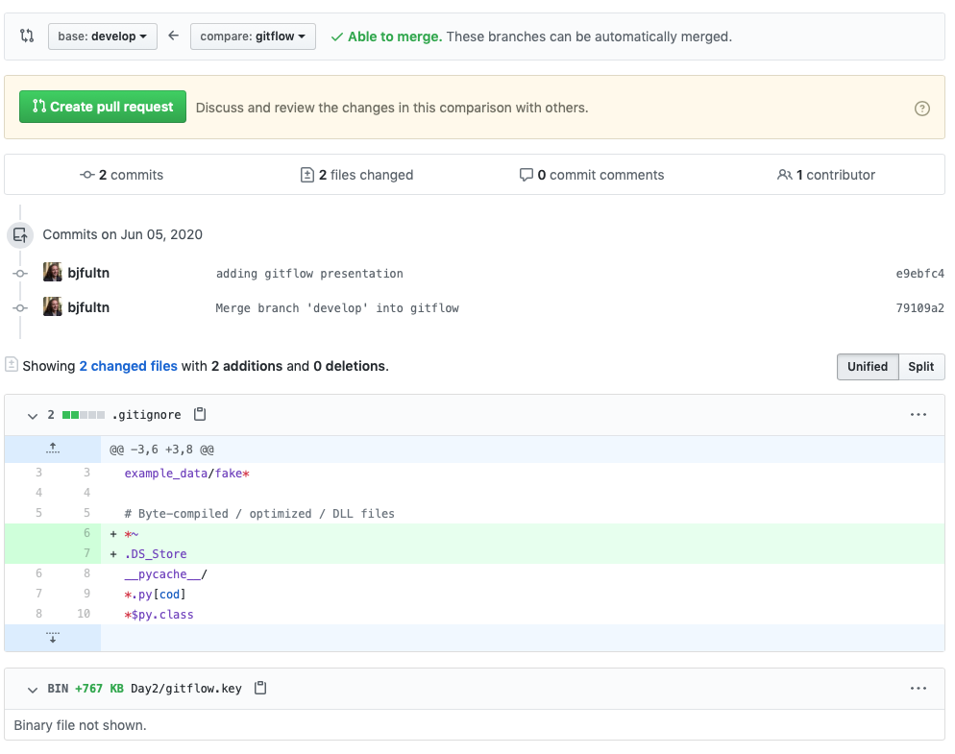
Feature done: Pull Request
Differences between your feature branch and develop will be highlighted
Be descriptive with your changes
Usually an admin or senior developer will review and merge into develop after approval
Automated checks may also run
Delete feature branch after merge
commiting code | commit demo | gitflow conceptual walkthrough | gitflow demo

Slide 16
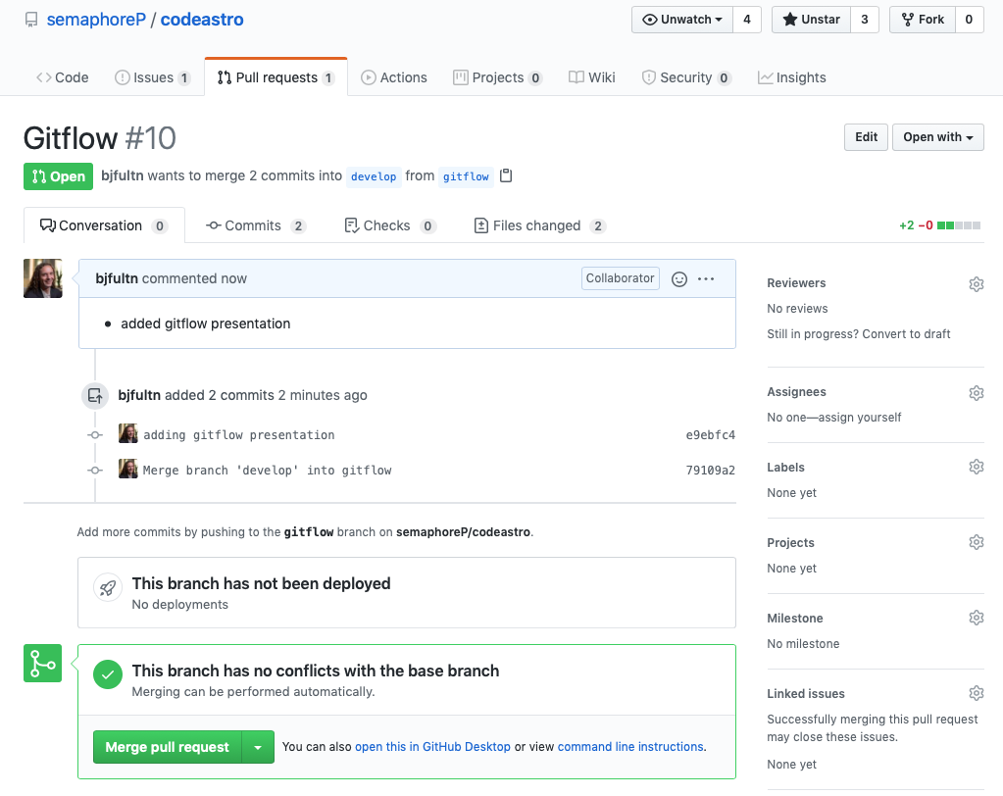
Feature done: Pull Request
Differences between your feature branch and develop will be highlighted
Be descriptive with your changes
Usually an admin or senior developer will review and merge into develop after approval
Automated checks may also run
Delete feature branch after merge
commiting code | commit demo | gitflow conceptual walkthrough | gitflow demo

Slide 17
Merge into main
Main
After enough features have merged into develop its time to merge into main
At that time we will usually make a new version release as well
commiting code | commit demo | gitflow conceptual walkthrough | gitflow demo

Slide 18
DEMO!
commiting code | commit demo | gitflow conceptual walkthrough | gitflow demo

Slide 19
Summary of process to add a feature
Pull latest code from develop branch.
Create feature branch from develop branch.
Make your changes, stage, commit, then push to GitHub.
Submit pull request on GitHub & merge into develop.
Repeat until enough features have been merged into develop, then make a pull request from develop -> main.

