Slide 1
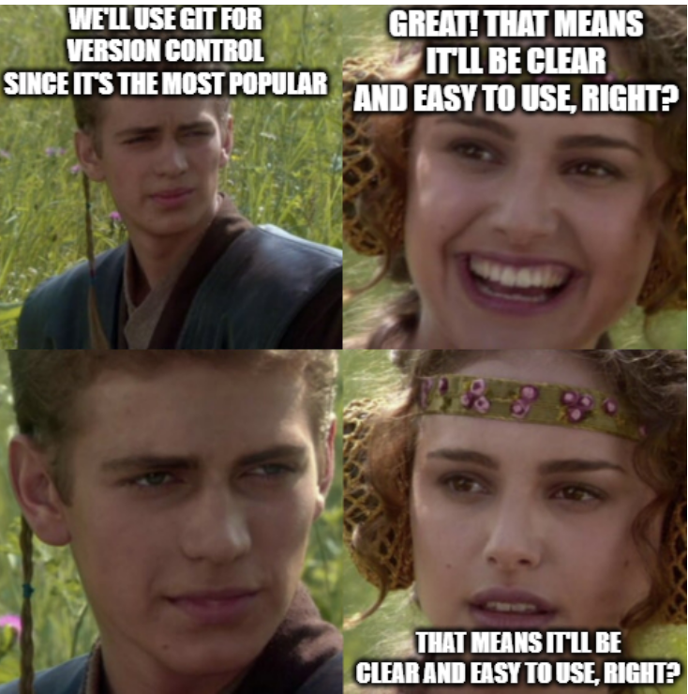
Git
ASTRON 441: 10/4/2022

Slide 2
Source Control
System for tracking manages in files
Why use source control?
Legacy versions of the code
Revert to old versions
Why was it working before?
Collaborative work
My recommendation: Use source control any time you are programming, even if it is just for yourself (and not just code!)

Slide 3
Source Control Flavors
Primitive source control: copy the entire folder and name it “OLD_v3”
File synchronization software: Dropbox, Google drive, other cloud storage, etc..
Good for tracking a mix of different file types
Specific for code development: git, svn, mercurial, team foundation
Git is the most popular in astronomy software development (and nearly everywhere)
https://doodle.com/meeting/participate/id/bD9nPVqd

Slide 4
Jason’s philosophy with Git
Git has a lot of features; I use a very small subset
I try to develop straightforward workflows as to minimize the amount of git I need to understand
I found it helpful to develop a mental model of git to reason through what I need git to do in various cases (later today)

Slide 5
The basics of git
Use git to keep track of changes
Sync changes to a remote repository
We’ll use git commands from the command line today because all git GUIs will just replicate a subset of these commands

Slide 6
Making a git repository
Git repo: any folder with a .git folder inside of it
git init
Turns the folder you are in into a git repo (by making the .git folder) with zero commits
git clone url
Downloads a repository from a url (e.g., the one from Github)
Generally, I do this: I make a new repo on Github and then download it
I recommend always to use the HTTPS url
git status
Gives you the state of your current repository
Demo: download ASTRON441 repo

Slide 7
Making a set of changes
A commit is a set of changes made to the repository
A history of changes is defined by the sequence of commits
How to make a commit
git add [file]
Adds any new changes from [file] to the next commit
Can be run multiple times (even on the same file)
git commit –m “[description]”
Makes a new commit that consists of all the added changes
Description should be a short phrase that summarizes the commits changes
Commits are free, so try to make commits small and modular
Demo: make change to ASTRON 441 repo

Slide 8
Synchronize Changes Online
Need a service like Github, Bitbucket, etc to store your Git repo (remote repo)
Goal: your laptop and remote repo are consistent with commits
Git has ways of resolving conflicts, but don’t make it hard on yourself
git push
Sends new commits you made to online repo
git pull
Grabs new commits from remote repo onto your machine (i.e. updates your download of the code)
Demo push, edit code on Github, and pull

Slide 9
Conflicts 🦇👻🕸️🎃🐈‍⬛
When two commits edit the same parts of the code
Git doesn’t know how to code, can only merge commits when non-overlapping
Git push will not work if it creates a conflict – you must pull and fix
Git pull will not work if you edited a file (but have not made a commit with those new changes) and try to pull commits that also edit the same file
General system to follow:
Make changes to your files
Make commits for those changes
git pull
Fix any conflicts if needed
git push
Demo: conflict in ASTRON 441 repo

Slide 10
What if I don’t want to save my changes?
git checkout filename
Reverts the file back to the version from the latest commit, removing any uncommited stages
Undo changes and then update your local repo
git checkout myfile.py
git pull
Demo: make change locally and undo it

Slide 11
But what if I like my changes but I don’t want to commit my changes just yet?
git stash
Saves all edits of a file, stashes them away elsewhere, and reverts files to version from last commit
git stash apply
Reapplies the most recently stashed changes to your current repo
[IMPORTANT]: If there are conflicts, will create merge conflicts
Preserve your uncommited changes but also updating your repo
git stash
git pull
git stash apply
Demo: stashing and unstashing changes

Slide 12
Git branches
If your git commits form a timeline, git branches are alternative timelines
However, we generally want have branches eventually converge with the main branch
git branch name
Makes a new branch with that name
git checkout name_of_branch
Switches to that branch
Very similar syntax to undoing changes on your current branch!!
Demo: make new branch and make a commit

Slide 13
Merging branches
git merge branch
Merges all changes from branch onto your current branch
Conflicts could arise!
I prefer merging branches using the Pull Request tool on Github/bitbucket/etc
Demo: Pull request merge branch

Slide 14
Mechanics of Git
ASTRON 441: 10/4/2022

Slide 15
The following oversimplifies the underlying git implementation but is a useful abstraction for thinking about what is happening under the hood.

Slide 16
Git commit
ID: 876ab12f0c8..
Parent ID: 10f3a8cb..
Changes = {
CREATE input.py:
add [TEXT] line 0
MODIFIED plot.py:
add [TEXT] line 12
delete [TEXT] line 36
...
}
Message: Made some changes to …
Author: Jason
Email: Jason@abc.com
Time: 1/1/2020, 4:30pm
Think of it as an object
Contains a list of changes compared to a previous git commit
This is the atomic unit of our model
A git repo will consist of chains of git commits.

Slide 17
Git commit tree
ID: 309f
Parent ID: None
Changes = {
CREATED color.py:
add [TEXT] line 0
}
Message: “Initial Commit”
...
309f
Let’s make a package that makes color images and plots them!
Initialize git for this folder
> git init
Create and add code to color.py to generate color images
> git add color.py
> git commit –m “initial commit”
[main 309f] initial commit
1 files changed
create color.py
>

Slide 18
Git commit tree
309f
Edit the code in color.py to fix a red color bug
> git add color.py
> git commit –m “Fix red color bug”
[main 8a6c] Fix red color bug
1 files changed
>
ID: 8a6c
Parent ID: 309f
Changes = {
MODIFIED color.py:
add [TEXT] line 12
delete [TEXT] line 36
...
}
Message: “Fix red color bug”
...
8a6c
Note: We will drop the arrow moving forwards, but keep in mind that each commit only know about its parent commit.

Slide 19
Git commit tree
309f
Wrote plot.py module that displays the color image
> git add plot.py
> git commit –m “added plotting”
[main 91e1] added plotting
1 files changed
create plot.py
>
8a6c
ID: 91e1
Parent ID: 8a6c
Changes = {
CREATE plot.py:
add [TEXT] line 0
}
Message: “Added plotting”
...
91e1

Slide 20
Git branches
Branches
main: 91e1
HEAD: (main) 91e1
309f
Branches allow working on separate features in parallel
Base branch is main or master
Git branches are essentially just pointers to the most recent commit
Pointers: doesn’t contain information, just points where the data is
Commits do not think about which branch they are part of
Follow the arrows back for the full branch history
HEAD points to where you currently are right now
8a6c
91e1
main (HEAD)

Slide 21
Git branches
309f
Branches
main: 91e1
plot_upgrade : 91e1
HEAD: (main) 91e1
I want to make the plotting interactive, so that we can adjust the coloring of the images by eye. Let’s make a new branch to work on this so we don’t break the current working code.
> git branch plot_upgrade
> git status
On branch main
>
8a6c
91e1
main (HEAD)
plot_upgrade

Slide 22
Git branches
309f
Branches
main: 91e1
plot_upgrade: 91e1
HEAD: (plot_upgrade) 91e1
New interactive plotting branch
> git branch plot_upgrade
> git status
On branch main
> git checkout plot_upgrade
> git status
On branch plot_upgrade
>
8a6c
91e1
main
plot_upgrade (HEAD)

Slide 23
Git branches
309f
Branches
main: 91e1
plot_upgrade: 353b
HEAD:(plot_upgrade) 353b
New interactive plotting branch
> git branch plot_upgrade
> git status
On branch main
> git checkout plot_upgrade
> git status
On branch plot_upgrade
Make edits to turn the plotting interactive
> git add color.py
> git add plot.py
> git commit –m “interactive!”
[plot_upgrade 353b] interactive!
2 files changed
>
8a6c
91e1
main
353b
plot_upgrade (HEAD)

Slide 24
Git branches
309f
Branches
main: a329
plot_upgrade: 353b
HEAD: (main) a329
Oops, we messed up colorings NaN pixels. We should fix that.
> git checkout main
> git status
On branch main
Make edits to color.py
> git add color.py
> git commit –m “fix nans”
[main a329] fix nans
1 files changed
>
8a6c
91e1
a329
353b
plot_upgrade
main (HEAD)

Slide 25
Git merge
Branches
main: 8443
plot_upgrade: 353b
HEAD: (main) 8443
Ok, we tested it and the interactive plotting works. Let’s merge in these change to main
> git checkout main
> git status
On branch main
> git merge plot_upgrade
If there are no conflicts, git will automatically make a merge commit.
>
91e1
a329
353b
plot_upgrade
ID: 8443
Merge From: 353b
Merge To: a329
Changes = {
MODIFIED color.py:
...
}
Message: “Merged branch plot_upgrade”
main (HEAD)
8443

Slide 26
Git merge
Branches
main: a329
plot_upgrade: 353b
HEAD: (main) a329
Merge plot_upgrade back into main
> git checkout main
> git status
On branch main
> git merge plot_upgrade
CONFLICT: Merge conflict in color.py
Our edits to color.py conflict. Manually fix conflicting changes, and then make the commit ourselves.
91e1
a329
353b
plot_upgrade
main (HEAD)

Slide 27
Merge conflict
main (HEAD)
plot_upgrade
color.py
…
99 def to_png(img, mask_nans=False):
…
color.py
…
99 def to_png(img, interactive=False):
…
git merge plot_upgrade
color.py
…
99 <<<<<<< HEAD
100 def to_png(img, mask_nans=False):
101 =======
102 def to_png(img, interactive=False):
103 >>>>>>> plot_upgrade
…
VS Code has cool syntax highlighting for git conflicts!

Slide 28
Merge conflict
main (HEAD)
plot_upgrade
color.py
…
99 def to_png(img, mask_nans=False):
…
color.py
…
99 def to_png(img, interactive=False):
…
git merge plot_upgrade
Manual code editing…
color.py
…
99 def to_png(img, mask_nans=False, interactive=False):
…

Slide 29
Git merge
Branches
main: 8443
plot_upgrade: 353b
HEAD: (main) 8443
Merge plot_upgrade back into main
> git checkout main
> git status
On branch main
> git merge plot_upgrade
CONFLICT: Merge conflict in color.py
Our edits to color.py conflict. Manually fix conflicting changes, and then make the commit ourselves.
> git add color.py
> git commit –m “Merged branch plot_upgrade”
[main 8443] Merged branch plot_upgrade
1 files changed
91e1
a329
353b
plot_upgrade
ID: 8443
Merge From: 353b
Merge To: a329
Changes = {
MODIFIED color.py: (including manual changes
...
}
Message: “Merged branch plot_upgrade”
8443
main (HEAD)

Slide 30
Activity 1
309f
Let’s say this is the current state of the branch on our computer (91e1 is the latest commit). We run git pull to pull updates from remote (e.g., Github). Draw out what happens to our local Git commit tree in each of the following scenarios:
Remote branch is ahead by an extra commit 832e.
The remote branch also has three commits, but the third commit is 832e instead of 91e1.
Hint: make a test repo and try these scenarios out if you get confused
8a6c
91e1
(HEAD)

Slide 31
Activity 2
309f
Oops, I just committed something, and it’s totally wrong in commit 91e1. Here are two ways to revert those changes.
git revert 91e1
git reset --hard 8a6c
Learn about these two commands online. Draw what happens to the git commit tree.
Assess when is the right time to use these commands
8a6c
91e1
(HEAD)

Slide 32
Last conceptual points
You should never be editing the underlying commit objects yourself
Ruins the point of source control
Can break the repo!
Git is meant to be distributed
You do not need a central repository
Can pass git repo between machines. Use it for version tracking code on your machine without ever pushing it anywhere.
In practice, we use services like Github to centralize the code to make is easy to collaborate and share code
Built on top of git are git workflows to standardize how we work together using git

