Slide 1
Formichines

Slide 2
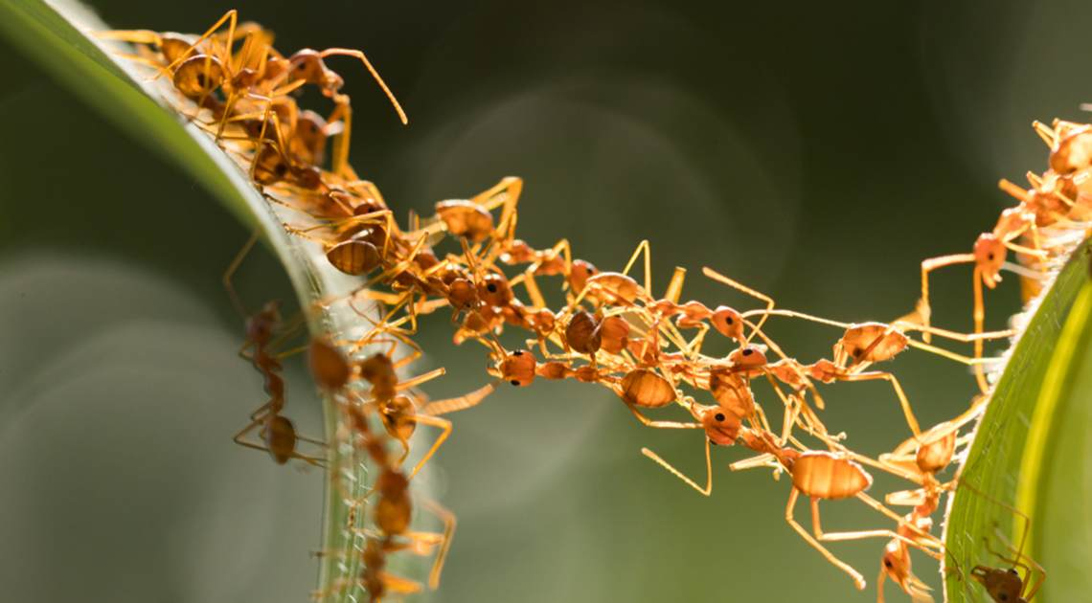
Ant Family Algorithms
- Inspiration from biology
- Accomplish difficult tasks exploiting collaboration
- Pheromone as a communication channel
- The more ants follow a specific path, the more likely it becomes to be followed.
- Shortest path problems.
Dorigo, Maniezzo, Colorni, Ant System: Optimization by a Colony of Cooperating Agents. In: IEEE Transactions on Systems, Man, and Cybernetics. Vol. 26, No. 1, 1996.

Slide 3
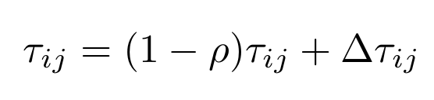
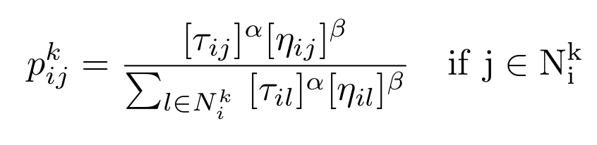
Ant Colony Optimization
- Multi-agent collaborative approach
- Pheromone evaporation and deposit
  - exploration vs exploitation tradeoff
-Artificial ants might have different aims
  - pheromone guided moves vs heuristically driven ones
Dorigo, Gambardella, Ant Colony System: A Cooperative Learning Approach to the Travelling Salesman Problem. In: IEEE Transactions on Evolutionary Computation, Vol.1 No.1, pp.53-66, April 1997.

Slide 4
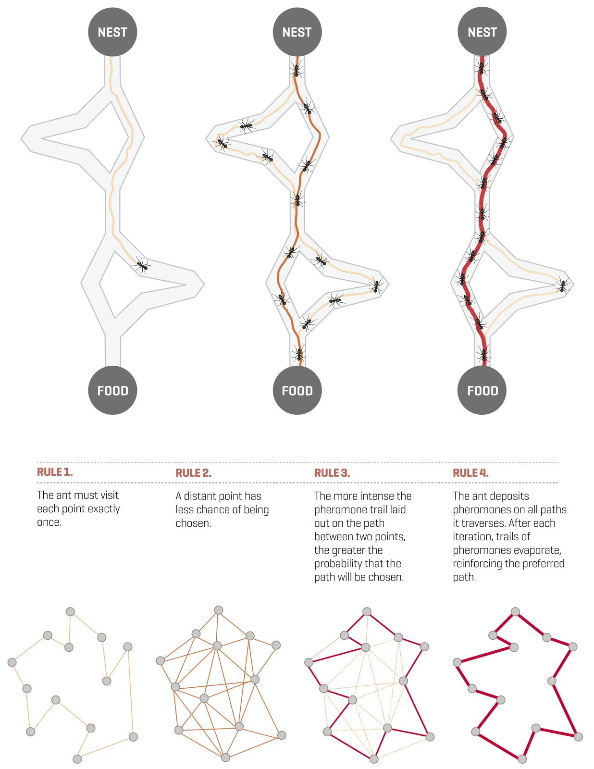

Slide 5

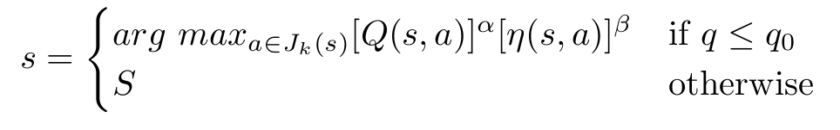
Ant-Q: a reinforment learning approach
The idea:
- integrate a Q-learning-like rule in the pheromone update procedure
- and in the single decision process
Gambardella,Dorigo, Ant-Q: A Reinforcement Learning Approach to the Traveling Salesman Problem. In: Proc. ML-95, 12th Int. Conf. Machine Learning. Palo Alto, CA: Morgan Kaufmann, pp. 252-260, 1995.

Slide 6
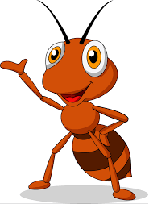
Parallel Implementation Hints
- ACO algorithm are quite memory expensive, but… naturally parallelizable!
- parallel systems (parent/children)
  - running on each core
- local pheromone matrices
- global updates every iteration (parent)
  - providing each child with an updated mean pheromone matrix
- technically:
  - Open MPI (https://www.open-mpi.org)
  - mpi4py (https://mpi4py.readthedocs.io/en/stable)
A great context review: M. Pedemonte, S. Nesmachnow, H. Cancela, A survey on parallel ant colony optimization, Applied Soft Computing,Volume 11, Issue 8, 2011, Pages 5181-5197,ISSN 1568-4946, https://doi.org/10.1016/j.asoc.2011.05.042.

