Slide 1
Airlines Application
Tony, Maria, Surekha

Slide 2
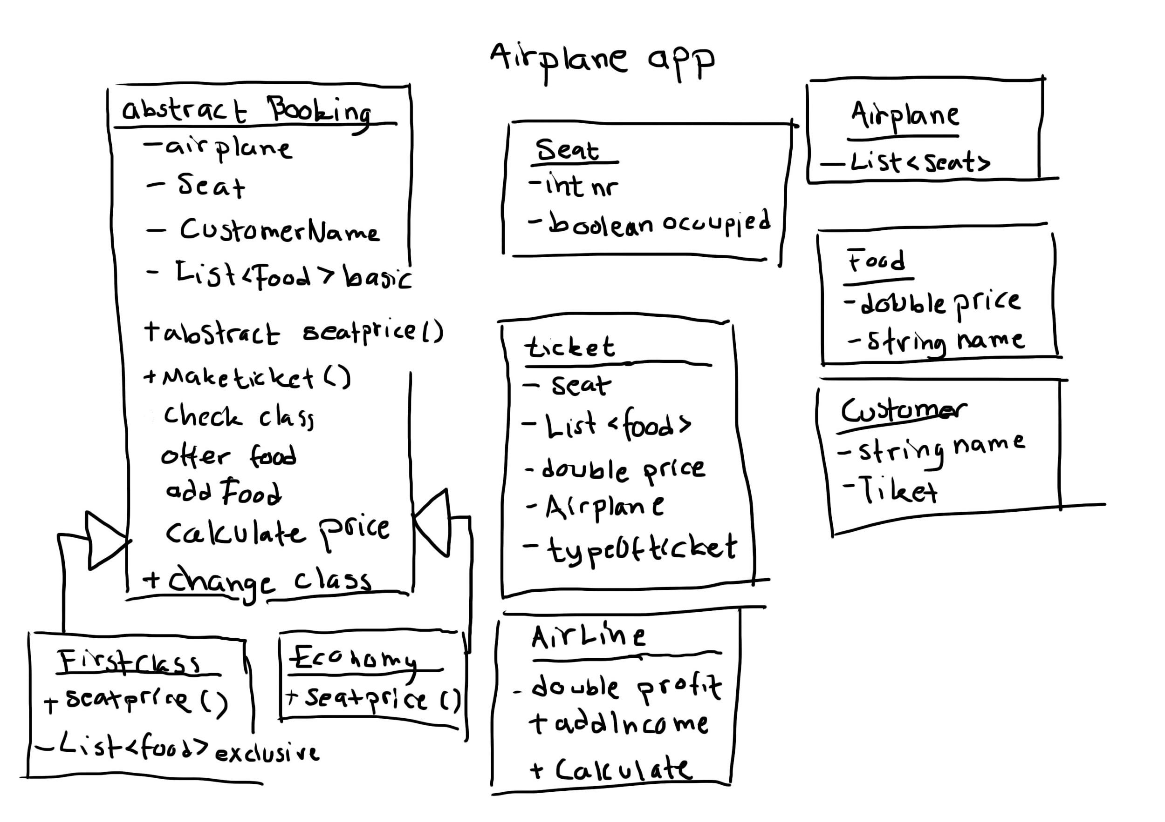

Slide 3
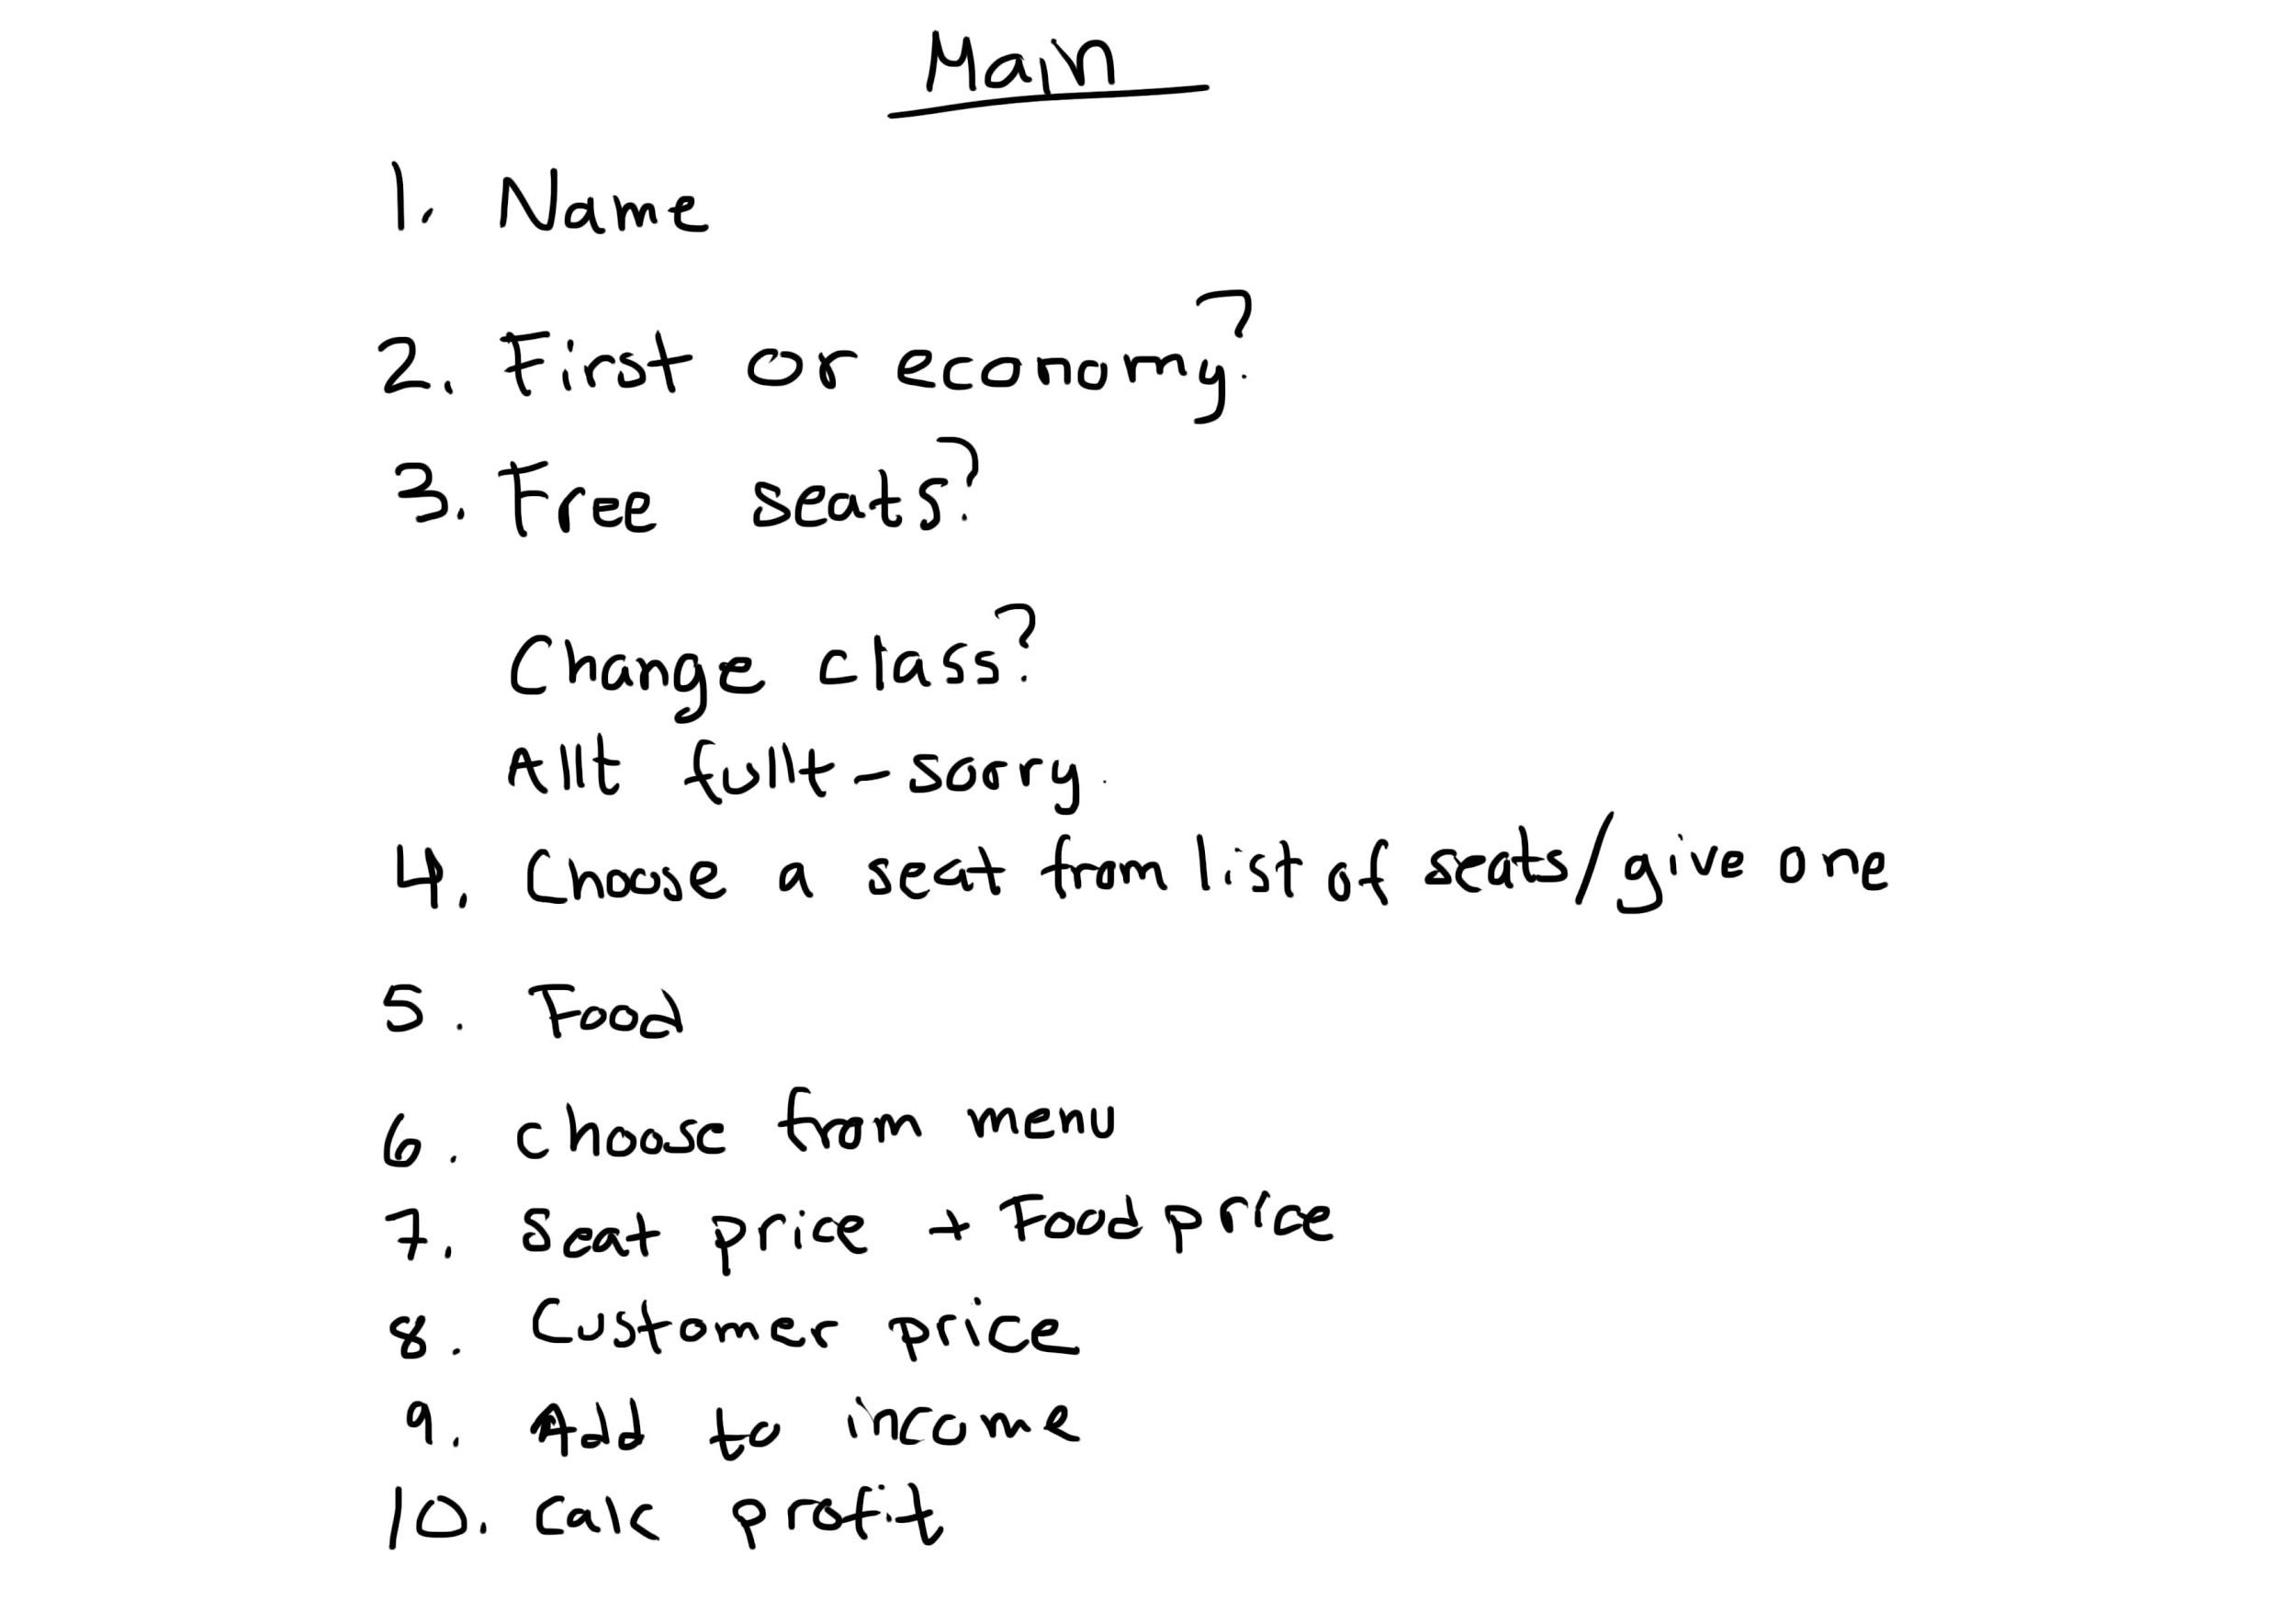

Slide 4
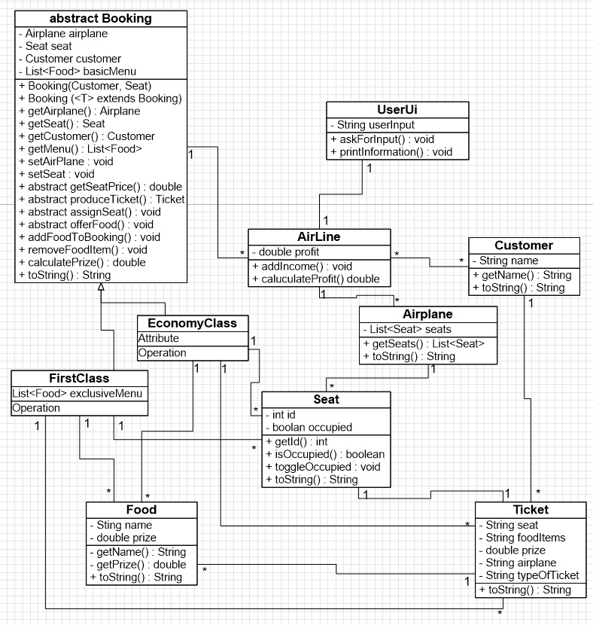
Starting design

Slide 5
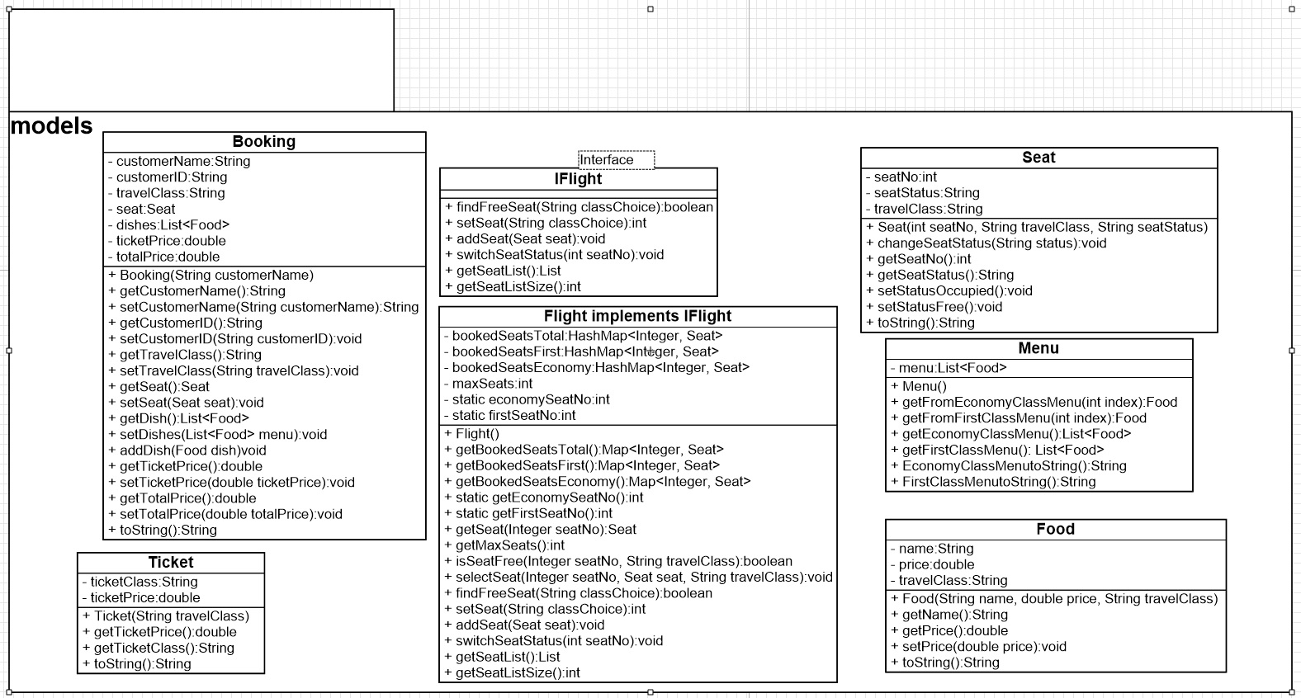
Finished Design

Slide 6
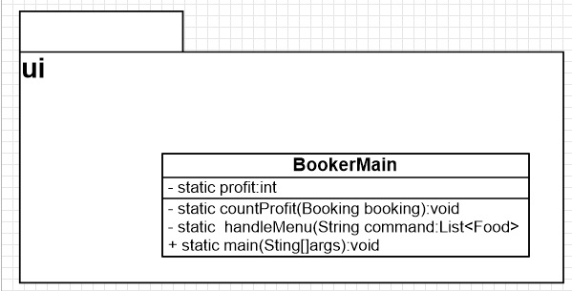
Finished Design

Slide 7
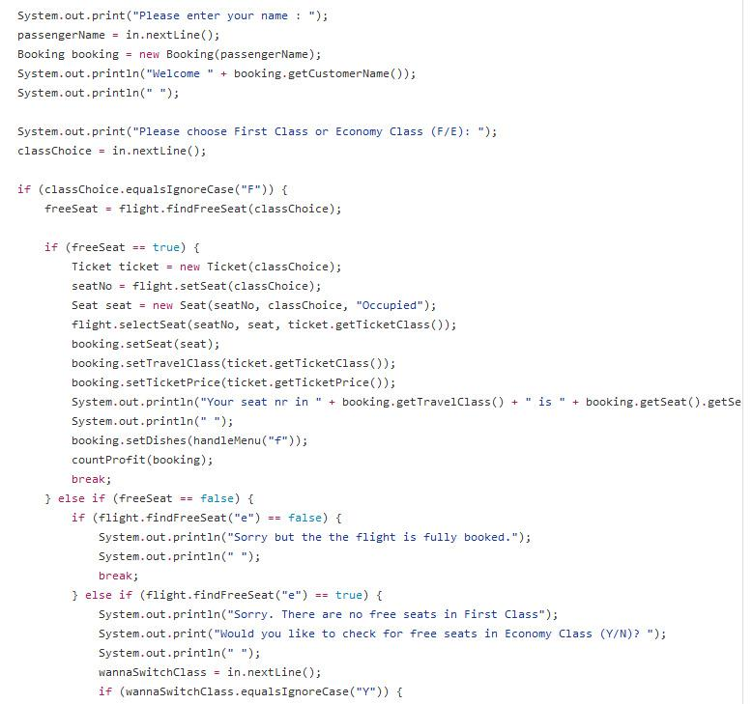
Main
User enters a name and then a empty booking is created ready to get filled up with information depending on user input. Example “f” and “e”.

Slide 8
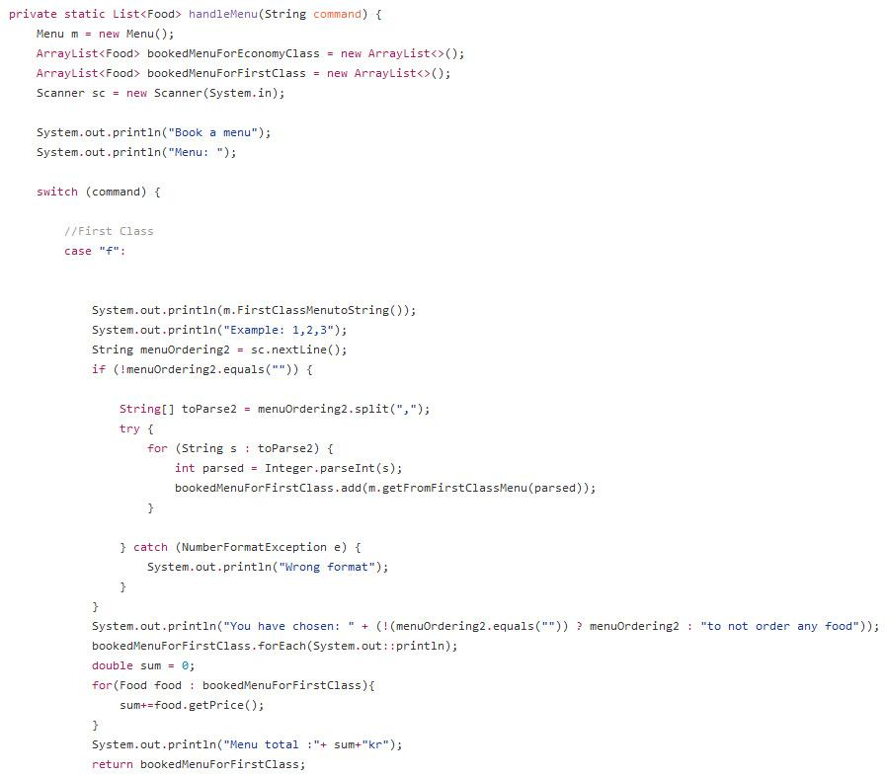
Main
Asking user to add food to their menu. Example input “1,2,3” will add the tree dishes to the menu. We parse the input to an array [1,2,3] using split(“,”).

Slide 9
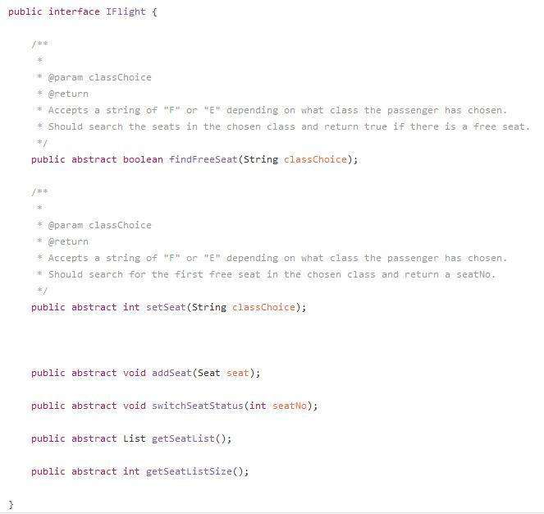
Interface
Cooperating with required methods and returns by using interface.

Slide 10
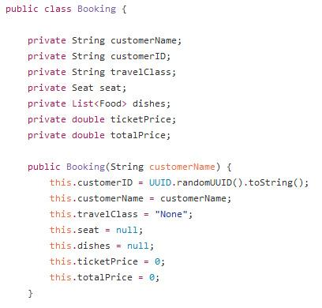
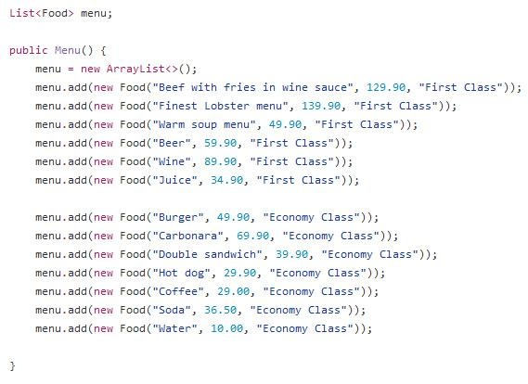
Constructors
Creating an empty Booking, ready for later input.
Adding the food directly in constructor.

Slide 11
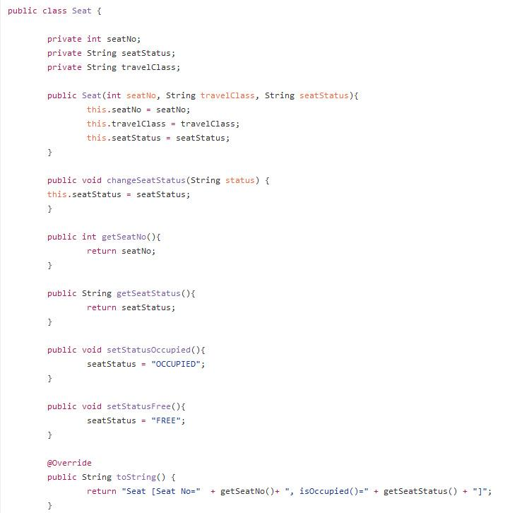
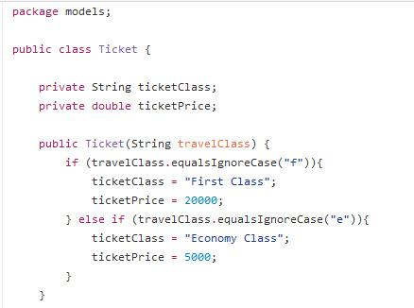
Strings
Using strings for if/else and occupying seats.

Slide 12
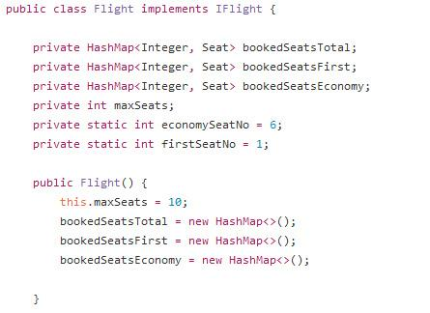
HashMaps
HashMaps representing the booked seats white static Integers keep track on the free seats.

Slide 13
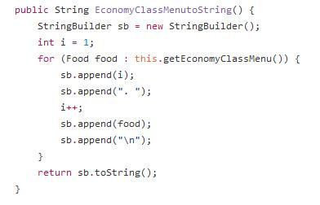
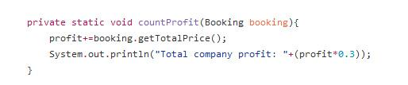
Methods
Special method to use for output String of the two Lists in Menu class, economy and first class.
A static countProfit() that adds a complete booking’s total cost and increment the profit every time it’s called.

