Slide 1

REACT NATIVE’S NEW ARCHITECTURE

Slide 2
What is React Native?
React Native’s current architecture
How JavaScript code is understand from the OS?
Main thread
JavaScript thread
Shadow thread
How UI is rendered?
Common issues.
React Native’s new architecture
JavaScript Interface (JSI)
Fabric
Turbo Modules
Codegen
What to look for

Slide 3
What is React Native

Slide 4

<View>
<ViewGroup>
<Text>
<TextView>
<Image>
<ImageView>
React Native Components
Native views
JavaScrpit is not compailed in to native platfrom languages?

Slide 5
How JavaScript code
is understand from the OS

Slide 6
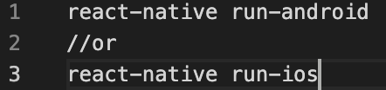

The building process
JS code
JS thread
Native / UI thread
Packager
Bridge
serialize json
Shadow thread

Slide 7
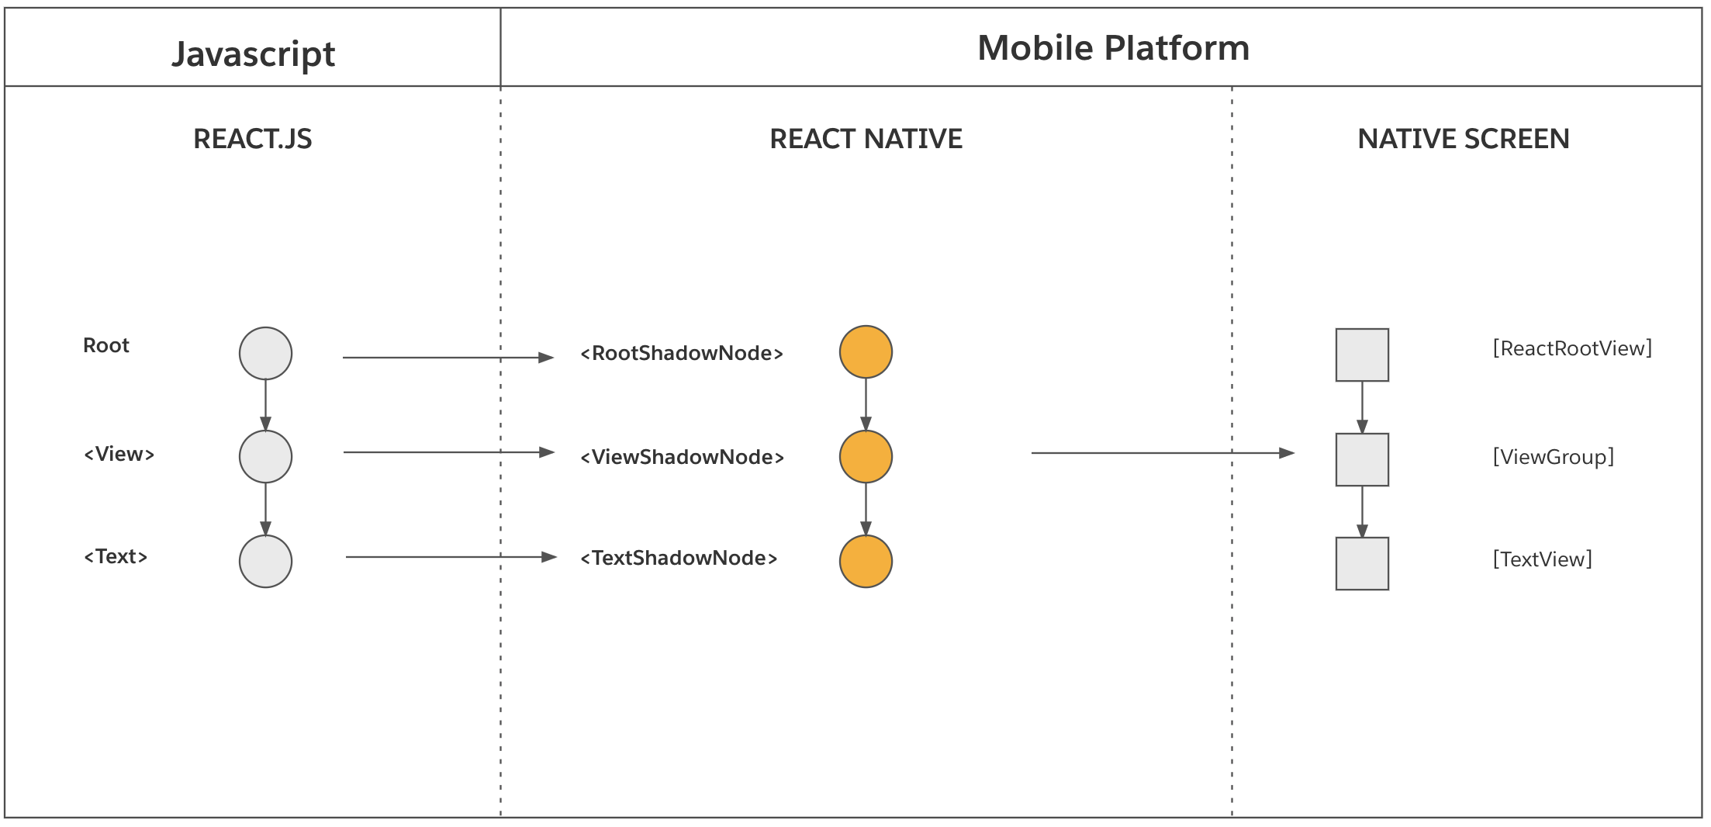
How the UI of React Native app is rendered?
ReactElementThree(JS) > ReactShadowThree(C++) > HostViewThree(Native)

Slide 8
React Native’s new architecture

Slide 9

Why?
Bridge is gone
Re-Rendering infrastructure is rewritten in more cross platform way
Type Saftly (Codegen)
React 18 is available only on the NEW ARCHITECTURE

Slide 10
JSI JavaScript Interface
JS thread
Native / UI thread
JSI
The New Architecture dropped the concept of The Bridge in favor of another communication mechanism: the JavaScript Interface (JSI).
The JSI is an interface that allows a JavaScript object to hold a reference to a C++ and vice-versa.
Once an object has a reference to the other one, it can directly invoke methods on it. So, for example, a C++ object can now ask a JavaScript object to execute a method in the JavaScript world and vice-versa.

Slide 11
JSI JavaScript Interface
Synchronous execution: it is now possible to execute synchronously those functions that should not have been asynchronous in the first place.
Concurrency: it is possible from JavaScript to invoke functions that are executed on different threads.
Lower overhead: the New Architecture doesn't have to serialize/deserialize the data anymore; therefore there are no serialization taxes to pay.
Code sharing: by introducing C++, it is now possible to abstract all the platform agnostic code and to share it with ease between the platforms.
Type safety: to make sure that JS can properly invoke methods on C++ objects and vice-versa, a layer of code automatically generated has been added. The code is generated starting from some JS specification that must be typed through Flow or TypeScript.

Slide 12
Pillars
Fabric (new render)
TurboModules (new native module system)
Codegen (tool that can be used to avoid writing a lot of repetitive)

Slide 13
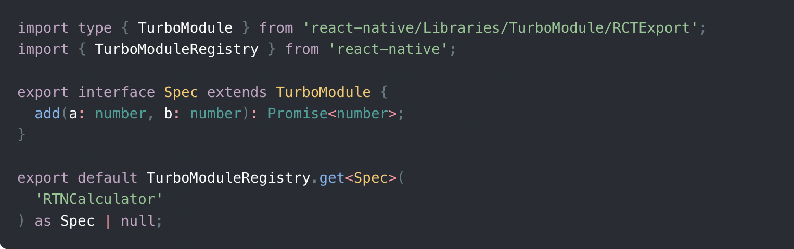
Codegen
Codegen will generate specific code for every platform: Android and iOS

Slide 14
Fabric
A Fabric Native Component is a Native Component rendered on the screen using the Fabric Render. Using Fabric Native Components instead of Legacy Native Components allows us to reap all the benefits of the New Architecture:
Strongly typed interfaces that are consistent across platforms.
The ability to write your code in C++, either exclusively or integrated with another native platform language, hence reducing the need to duplicate implementations across platforms.
The use of JSI, a JavaScript interface for native code, which allows for more efficient communication between native and JavaScript code than the bridge.

Slide 15
Turbo Modules
Turbo Native Modules are the next iteration on Native Modules that provide a few extra benefits:
Strongly typed interfaces that are consistent across platforms
The ability to write your code in C++, either exclusively or integrated with another native platform language, reducing the need to duplicate implementations across platforms
Lazy loading of modules, allowing for faster app start-up
The use of JSI, a JavaScript interface for native code, allows for more efficient communication between native and JavaScript code than the bridge

Slide 16
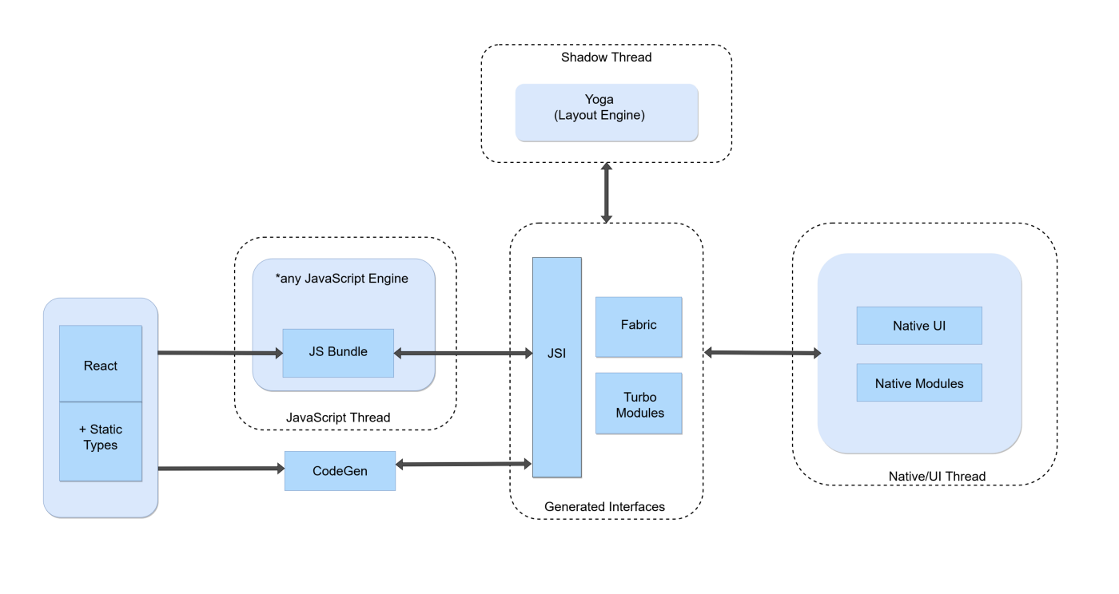

Slide 17
What to look for
Timeline:
68
69
70
New Architecure Support
React 17
React 18 Support
Bundled Hermes
CMake support
Unified Codegen Config
Fix all the transition from old to new architecture
in 68 and 69
Build tools: - React Native Gradele plugin will replace react.gradel
- Custom logic in Ruby for CocoaPods
Hermes will be recomendend JS engine
https://reactnative.dev/versions

Slide 18
Bonus
Maintain and improve high performance in react native app :
(profile the app, observe render patterns, apply memoization in the right places)
https://github.com/callstack/reassure
@rnx-kit/dep-check manages React Native dependencies for a package, based on its needs and requirements.
If you want to learn how dep-check is used at Microsoft,
and see a demo of how it works in a monorepo
"Improve all the repos – exploring Microsoft’s DevExp".

