Slide 1
this.greet(how: “Hello”, who: “Beer.JS”)

Slide 2
typeof NaN === “number”
parseInt(0.00000005) === 5
var self = this
Math.min() > Math.max()

Slide 3
/** Pit of Despair **/
typeof NaN === “number”
parseInt(0.00000005) === 5
Math.min() > Math.max()
var self = this

Slide 4
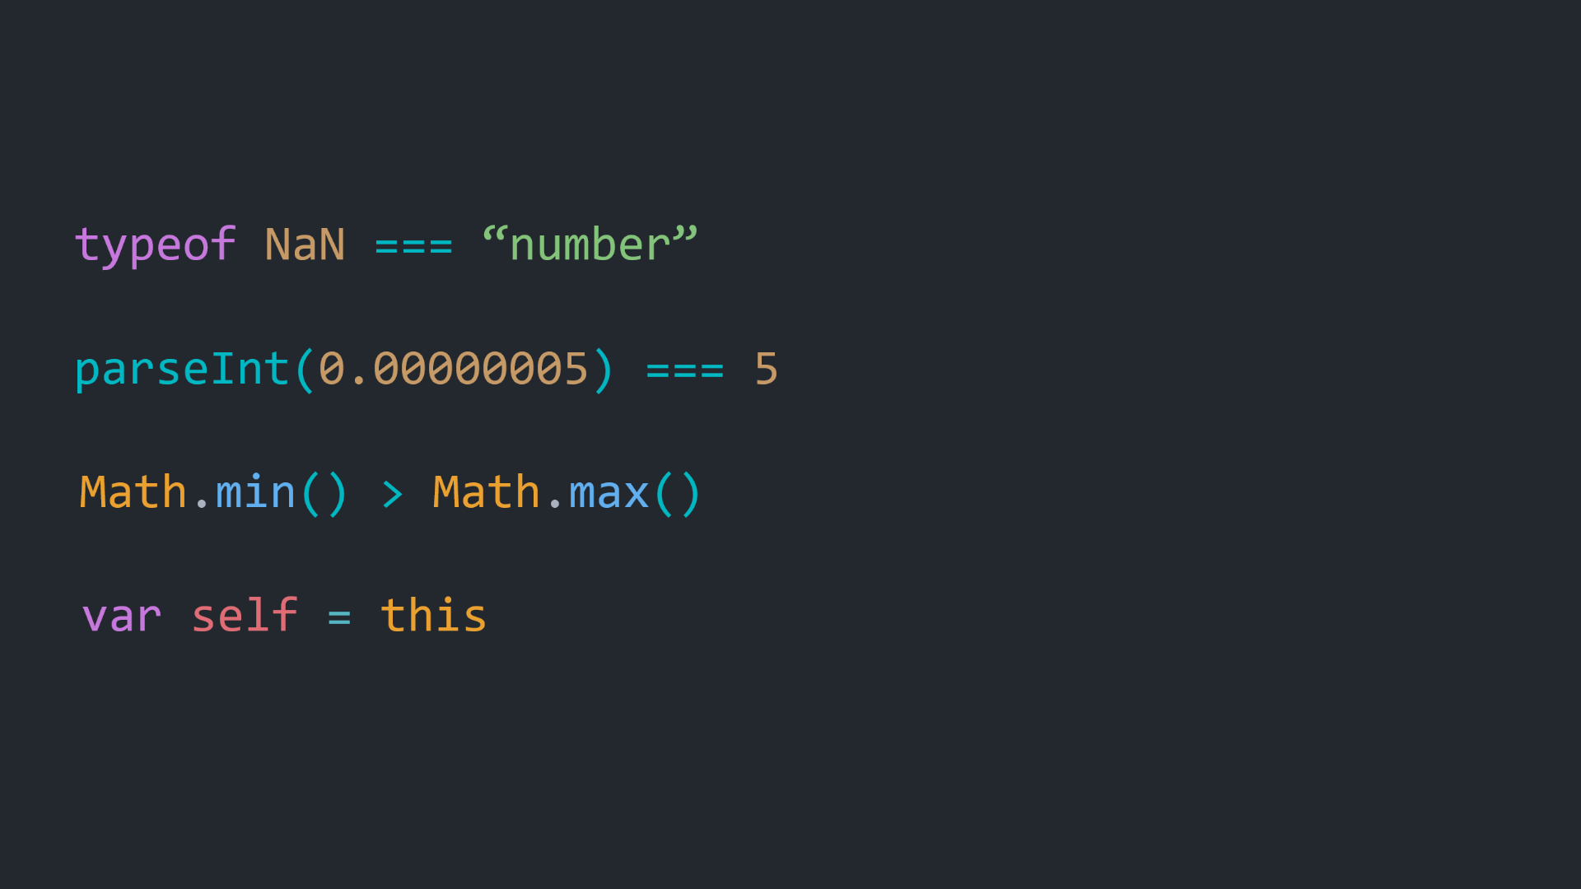
- IEEE 754
- Type Conversion
- Search Algo. Artifact
- GEC

Slide 5
Context Matters
The ABC’s of the GEC

Slide 6

noa@beerjs:$ whoami
Teodor Simonovski
Full Stack Developer and Tech-Lead @ Sourcico
99% of career spent working with JS
Like JS, Love TS

Slide 7
/*
* Any application that can be written in JavaScript,
* will eventually be written in JavaScript
*/
Jeff Atwood (2007)

Slide 8
var self = this

Slide 9
<script src=“./index.js”>

Slide 10
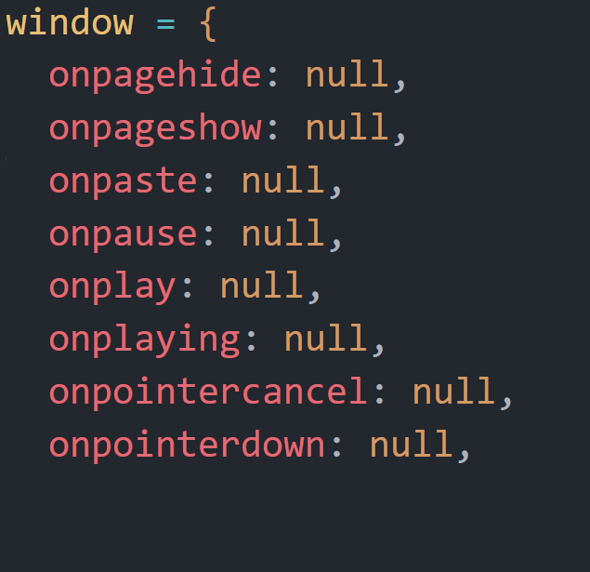
Global Execution Context
Create global object
window (browsers)
global (Node)
2. Create this keyword
this = window (browser)
3. Create scope chain
.
.
.
[GEC]

Slide 11
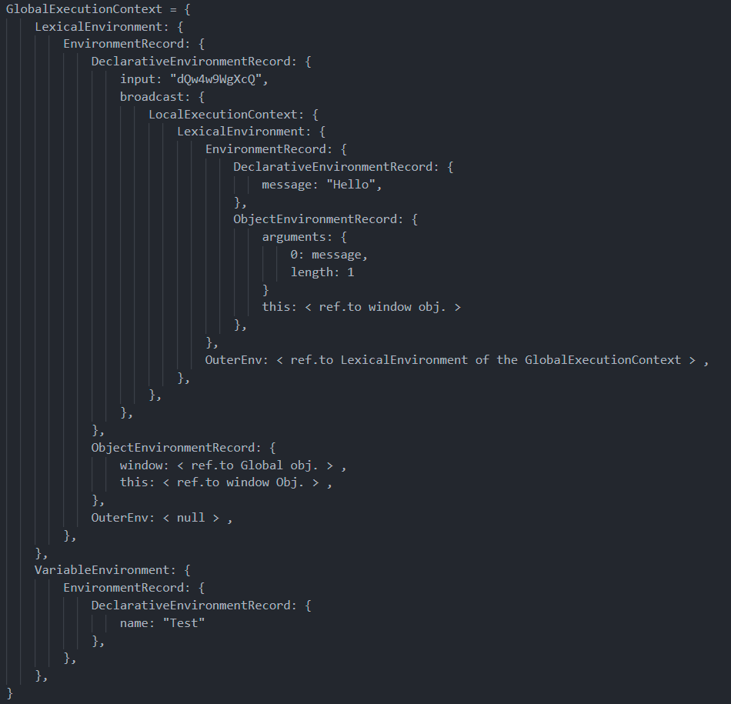

Slide 12
Creation Phase
window = {
…
}
var firstName = “Cave”
var lastName = “Johnson”
fullName(firstName, lastName)
function fullName(firstName, lastName) {
return `${firstName} ${lastName}`
}
fullName: function(…)
firstName: undefined
lastName: undefined

Slide 13
Execution Phase
window = {
…
}
var firstName = “Cave”
var lastName = “Johnson”
fullName(firstName, lastName)
function fullName(firstName, lastName) {
return `${firstName} ${lastName}`
}
fullName: function(…)
firstName: undefined
firstName: “Cave”
lastName: undefined
lastName: “Johnson”

Slide 14
Hoisting
var firstName = “Cave”
var lastName = “Johnson”
fullName(firstName, lastName)
function fullName(firstName, lastName) {
return makeUpperCase(`${firstName} ${lastName}`)
}
var makeUpperCase = function(string) {
return string.toUpperCase()
}

Slide 15
Execution Phase
window = {
…
}
var firstName = “Cave”
var lastName = “Johnson”
fullName(firstName, lastName)
function fullName(firstName, lastName) {
return `${firstName} ${lastName}`
}
fullName: function(…)
firstName: “Cave”
lastName: “Johnson”

Slide 16
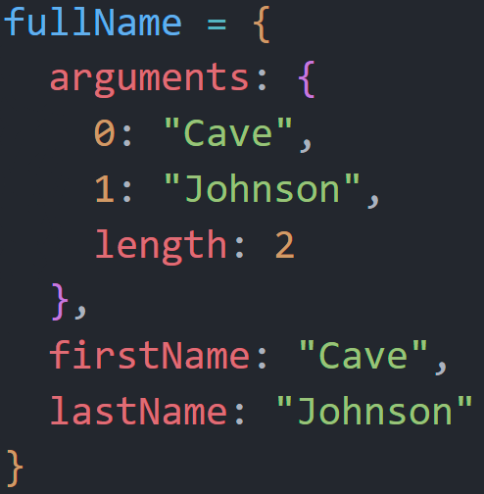
Functional Execution Context
Create arguments object
Zero-Indexed keys
length property
2. Create this keyword
this = ?
3. Create scope chain
[fullName, GEC]

Slide 17
What is this?
In a function call, the global object**
*in the browser, depends on strict mode
**in Node, depends on the type
In a method, the object
In an event, the element

Slide 18
Bind, Call, Apply
.bind(this)
Generates a new function with a new this
.call(this,…) / .apply(this,[,…])
Immediately calls the function, binding it with this from the argument
call accepts x amount of arguments,
apply accepts an array of arguments

Slide 19
let, const
=> Functions
{
Block Scoped,
const is…constant,
No more hoisting
{
Only as expressions
No this
No arguments object
}
ES6
}
Get hoisted,
But can’t access them

Slide 20
this.greet(how: “Bye”, who: “Beer.JS”)

