Slide 1
Recurrent Neural Network

Slide 2
Analyzing Text - Tokenization
Algorithm cannot deal with raw text and we have to convert text into numbers for machine learning methods.
This movie is great !
Great movie ? Are you kidding me ! Not worth the money.
Love it
…
Raw Text
[23, 55, 5, 78, 9]
[78, 55, 8, 17, 12, 234, 33, 9, 14, 78, 32, 77, 4]
[65, 36]
…
Tokenize
Suppose we only have 250 unique words in the entire dataset, and each unique word is replaced with an integer between 1 to 250, and 0 will be used for padding.
[23, 55, 5, 78, 9, 0, 0, 0, 0, 0]
[78, 55, 8, 17, 12, 234, 33, 9, 14, 78]
[65, 36, 0, 0, 0, 0, 0, 0, 0, 0]
…
Pad
& Truncate
Now we have a typical data frame, each row is an observation, and each column is a feature. Here we have 10 columns by designing after the padding and truncating stage. We have converted raw text into categorical integers.

Slide 3
Analyzing Text – Encoding/Embedding
Categorical integers can not be used directly to algorithm as there is no mathematical relationship among these categories. We have to use either Encoding or Embedding.
250 columns!
The OHE will explode the dimension if we have 10,000 unique words in vocabulary and a few hundreds words in the each review in the training dataset!
It is binary, sparse, without consider the relationship among words.
One Hot
Encoding
One_Column
One_Column_dummy
23
0, 0, 0, …, 1, 0, 0, …, 0, 0
Original data frame
OHE data frame
[23, 55, 5, 78, 9, 0, 0, 0, 0, 0]
[78, 55, 8, 17, 12, 234, 33, 9, 14, 78]
[65, 36, 0, 0, 0, 0, 0, 0, 0, 0]
…
[0, 0, 0, …, 1, 0, …, 0, 0, 0, 0, 0]
[0, 0, 0, …, 0, 0, …, 0, 0, 0, 0, 0]
[0, 0, 0, …, 0, 0, …, 0, 0, 0, 0, 0]
…
10 columns
250x10 columns!
Configurable (here use 4)
Dense embedding utilizes the inherit relationship of words and dramatically reduce the embedded dimension. The dimension is a vector space and can be configured such as 16 or 32.
It is low dimension, real number, can be learned or use pre-trained.
Dense
Embedding
One_Column
Embedding_Column
23
0.3, 0.9, 0.1, 0.2
Original data frame
OHE data frame
[23, 55, 5, 78, 9, 0, 0, 0, 0, 0]
[78, 55, 8, 17, 12, 234, 33, 9, 14, 78]
[65, 36, 0, 0, 0, 0, 0, 0, 0, 0]
…
[0.3, 0.9, 0.1, 0.2, …, 0.7, 0.8]
[0.2, 0.7, 0.3, 0.7, …, 0.4, 0.3]
[0.5, 0.8, 0.4, 0.6, …, 0.5, 0.9]
…
10 columns
10x4 columns!

Slide 4
Analyzing Text – Modeling
With Encoding or Embedding (preferred), we now have a typical data frame for model training: (1) FFNN where each column is an independent input, (2) RNN where the sequence of the word is considered (preferred)
Intermediate output
Can be used for next RNN layer
Final RNN output
To FFNN layer
RNN Output
[0.2,0.3,0.3,0.6]
[0.8,0.2,0.3,0.7]
[0.6,0.2,0.7,0.4]
[0.7,0.3,0.8,0.2]
[0.4,0.3,0.7,0.2]
RNN Layer
Embedding
[0.2,0.4,0.1,0.7]
[0.7,0.1,0.5,0.4]
[0.4,0.2,0.9,0.3]
[0.6,0.1,0.8,0.4]
[0.3,0.2,0.9,0.0]
Raw Text Input
This movie is great !
t=0
t=1
t=2
t=3
t=4
Output from embedding
& Input features to RNN
Time Stamp

Slide 5
IMDB dataset
Raw data: 50,000 movie review text (X) and it’s corresponding sentiment of positive (1, 50%) or negative (0, 50%) (Y).
Included in keras package, can be easily loaded and preprocessed
Preprocessing includes:
Set size of the vocabulary (i.e. N most frequently occurring words)
Set length of the review by padding using ‘0’ by default or truncating as we have to have same length for all reviews for modeling
Any words not in the chosen vocabulary replaced by ‘2’ by default
Words are indexed by overall frequency in the chosen vocabulary
Once the dataset is preprocessed, we can apply encoding or embedding and then feed the data to FFNN or RNN

Slide 6
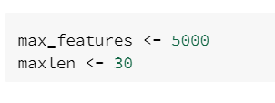

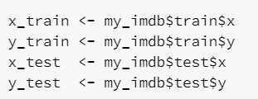
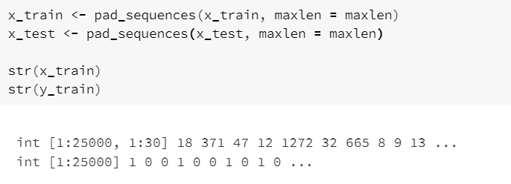
R Code – Data Preprocessing

Slide 7
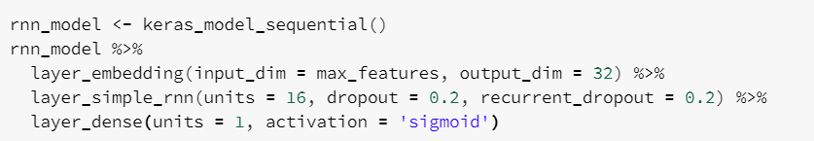
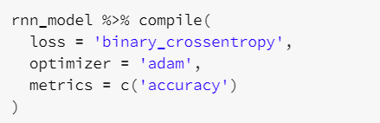
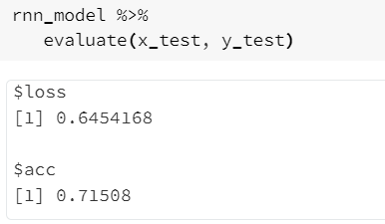
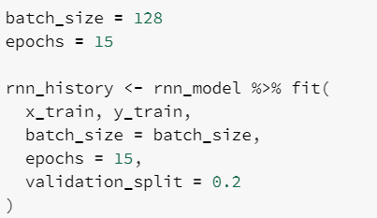
R Code – RNN Modeling

Slide 8

