Slide 1
Big Data
Data Science
Deep Learning
for Statisticians
Ming Li @ Amazon
mli@alumni.iastate.edu
Hui Lin @ Netlify
hui@linhui.org

Slide 2
Links to Notebooks, Books and URLs
Course homepage: https://course2019.netlify.com/
Databrick free community edition account open: link
Perceptron notebook: link
Adaline notebook: link
Feedforward neural network notebook: link
Convolutional neural network notebook: link
Recurrent neural network notebook: link
Big Data Platform notebook: link
Data preprocessing notebook: link
Data wrangling notebook: link
Industry recommendations for academic data science programs: link
Deep Learning Using R, François Chollet with J. J. Allaire, ISBN 9781617295546 (2018)
Python Machine Learning by Sebastian Raschka, ISBN-13: 978-1787125933 (2018)
https://keras.rstudio.com/
http://spark.rstudio.com/
https://databricks.com/spark/about
https://github.com/onnx/onnx

Slide 3
Deep Learning
The New Tool in Data Scientist’s Tool Box

Slide 4
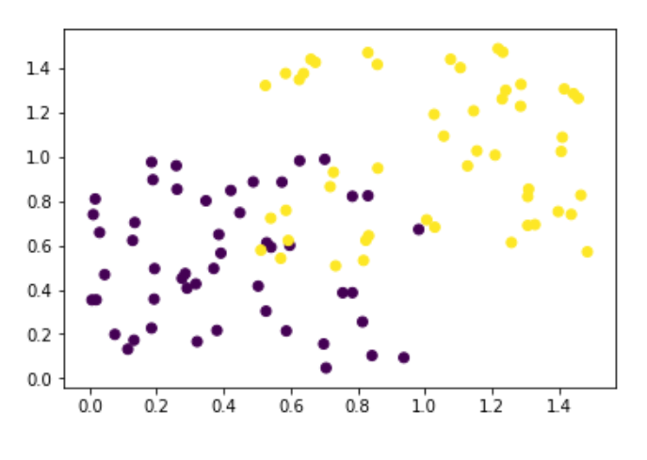
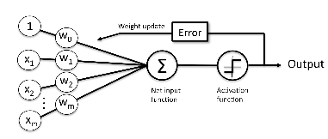
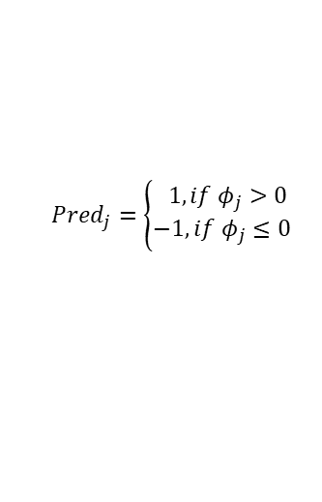

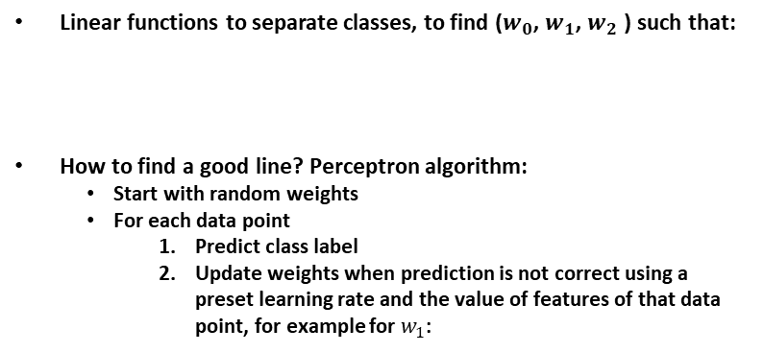

A Little Bit of History – Perceptron
Fun video: https://www.youtube.com/watch?v=cNxadbrN_aI
Classification of N points into 2 classes: -1 and +1 (i.e. two different colors in the picture below )
In this example below, only two features to use (X1 and X2)
Linear functions to separate classes, to find ($w_{0}$, $w_{1}$, $w_{2}$ ) such that:
How to find a good line? Perceptron algorithm:
Start with random weights
For each data point
Predict class label
Update weights when prediction is not correct using a preset learning rate and the value of features of that data point, for example for $w_{1}$:
$$φ_{j}=w_{0}+w_{1}x_{1,j}+w_{2}x_{2,j}$$
X2
$${Pred}_{j}=\left\{\begin{aligned} 1, if φ_{j}>0 \\ −1, if φ_{j}≤0\end{aligned}\right.$$
X1
$w_{1}=w_{1}$+$η\left({Actual}_{j}−{Pred}_{j}\right)x_{1,j}$
Perceptron algorithm is easy to be implemented in any modern program language.
It is a linear classification function and the weight is updated after each data points are feed to the algorithm (concept similar to stochastic gradient descent).
The algorithm continues to update when we feed the same dataset again and again (i.e. epochs)
It is not going to converge for none-linearly spreadable problems.
* From Sebastian Python Machine Learning

Slide 5


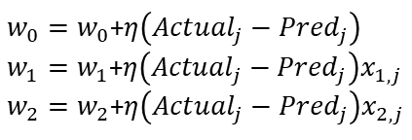
A Little Bit of History – Perceptron
For i in 1:M:
We set a maximum of epochs of M to run.
For j in 1:N:
For every data point, we update the weight based on the prediction correctness, learning rate and feature values.
$$φ_{j}=w_{0}+w_{1}x_{1,j}+w_{2}x_{2,j}$$
$${Pred}_{j}=\left\{\begin{aligned} 1, if φ_{j}>0 \\ −1, if φ_{j}≤0\end{aligned}\right.$$
$w_{0}=w_{0}$+$η\left({Actual}_{j}−{Pred}_{j}\right)$
$w_{1}=w_{1}$+$η\left({Actual}_{j}−{Pred}_{j}\right)x_{1,j}$
$w_{2}=w_{2}$+$η\left({Actual}_{j}−{Pred}_{j}\right)x_{2,j}$
For not linearly separable dataset, we need to use some accuracy threshold to stop the algorithm.
Calculate accuracy for the entire dataset to see whether the criteria has meet after each epoch.
Perceptron R notebook: link

Slide 6
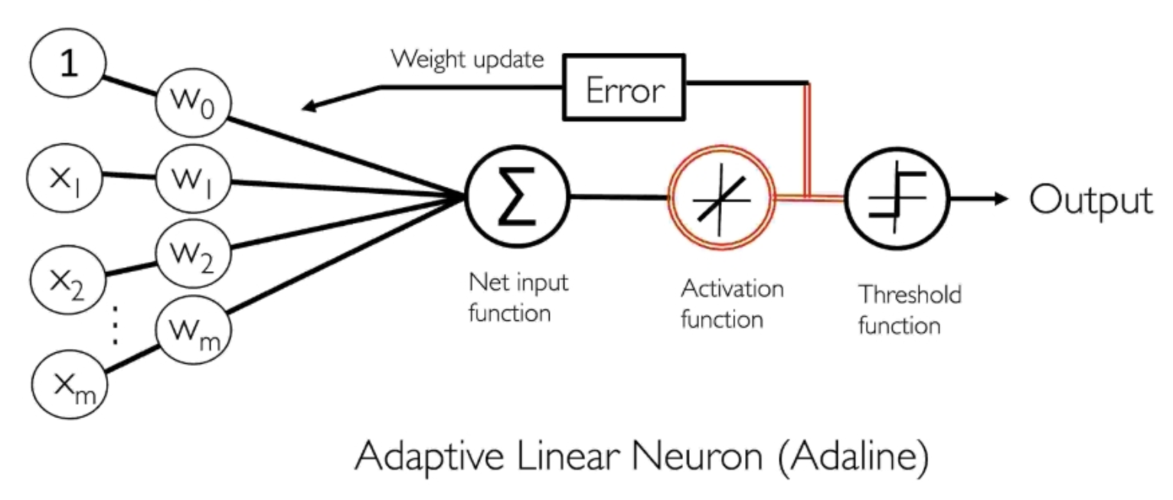
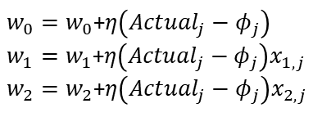
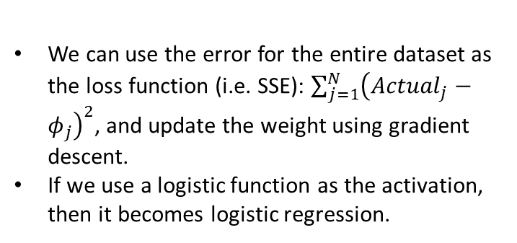
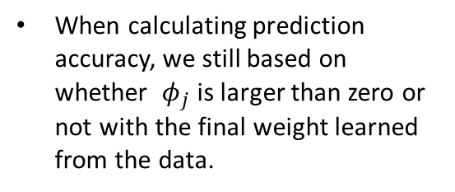
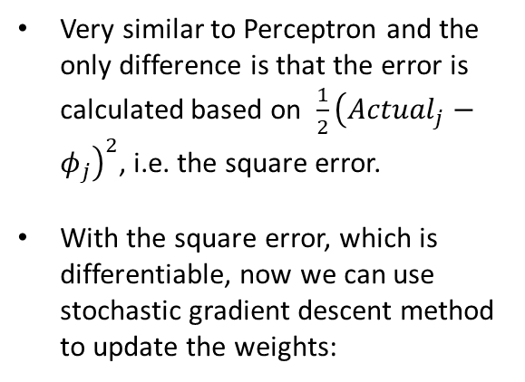
A Little Bit of History – Adaline
Very similar to Perceptron and the only difference is that the error is calculated based on ${\frac{1}{2}\left({Actual}_{j}−φ_{j}\right)}^{2}$, i.e. the square error.
With the square error, which is differentiable, now we can use stochastic gradient descent method to update the weights:
* From Sebastian Python Machine Learning
$w_{0}=w_{0}$+$η\left({Actual}_{j}−φ_{j}\right)$
$w_{1}=w_{1}$+$η\left({Actual}_{j}−φ_{j}\right)x_{1,j}$
$w_{2}=w_{2}$+$η\left({Actual}_{j}−φ_{j}\right)x_{2,j}$
Adaline R notebook: link
We can use the error for the entire dataset as the loss function (i.e. SSE): ${\sum_{j=1}^{N}{\left({Actual}_{j}−φ_{j}\right)}}^{2}$, and update the weight using gradient descent.
If we use a logistic function as the activation, then it becomes logistic regression.
When calculating prediction accuracy, we still based on whether $φ_{j}$ is larger than zero or not with the final weight learned from the data.

Slide 7
Feed Forward Neural Network

Slide 8
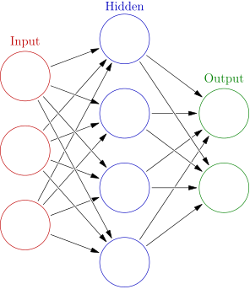

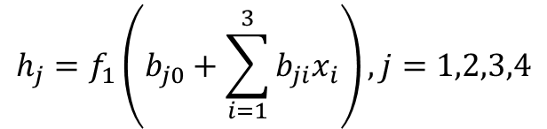











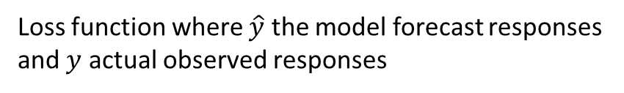


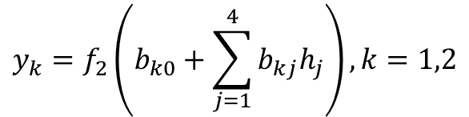
Simple Feed Forward Neural Network (FFNN)
Concepts stated as early as 1940s!
$$h_{1}$$
$$h_{j}=f_{1}\left(b_{j0}+\sum_{i=1}^{3}{b_{ji}x_{i}}\right), j=1,2,3,4$$
$$x_{1}$$
$$h_{2}$$
$$y_{1}$$
$$x_{2}$$
$$y_{k}=f_{2}\left(b_{k0}+\sum_{j=1}^{4}{b_{kj}h_{j}}\right), k=1,2$$
$$h_{3}$$
$$y_{2}$$
$$x_{3}$$
$$h_{4}$$
$$y=f_{2}\left(f_{1}\left(x,b_{1}\right),b_{2}\right)$$
Vector representation
$$\left[x_{1},x_{2},x_{3}\right]:$$
Input features vector for one observation
$$\left[y,y_{2} \right]:$$
Actual output outcome for one observation
$$f_{1}\left(∙\right),f_{2}\left(∙\right):$$
Activation functions, usually non-linear
$$L\left(y,\hat{y}\left(b,x\right) \right):$$
Loss function where $\hat{y}$ the model forecast responses
and $y$ actual observed responses
Total number of parameters (i.e. size of a NN): (3+1)*4 + (4+1)*2 = 26

Slide 9
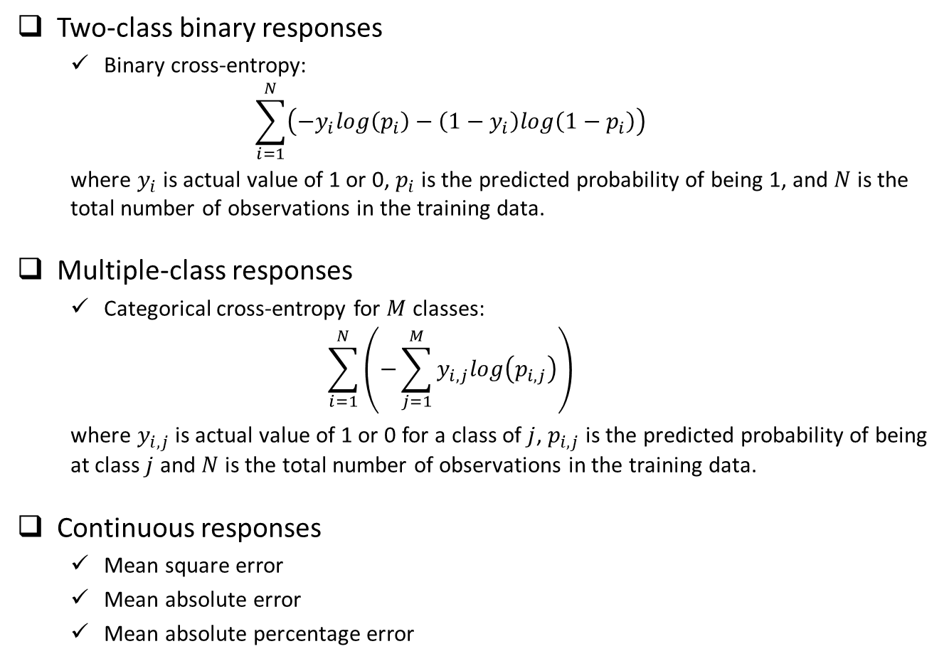
Typical Loss Functions
Two-class binary responses
Binary cross-entropy:
$$\sum_{i=1}^{N}{\left(−y_{i}log\left(p_{i}\right)−\left(1−y_{i}\right)log\left(1−p_{i}\right)\right)}$$
where $y_{i}$ is actual value of 1 or 0, $p_{i}$ is the predicted probability of being 1, and $N$ is the total number of observations in the training data.
Multiple-class responses
Categorical cross-entropy for $M$ classes:
$$\sum_{i=1}^{N}{\left(−\sum_{j=1}^{M}{y_{i,j}log\left(p_{i,j}\right)}\right)}$$
where $y_{i,j}$ is actual value of 1 or 0 for a class of $j$, $p_{i,j}$ is the predicted probability of being at class $j$ and $N$ is the total number of observations in the training data.
Continuous responses
Mean square error
Mean absolute error
Mean absolute percentage error

Slide 10
From Slow Progress to Wide Adoption
1940s – 1980s, very slow progress due to:
Computation hardware capacity limitation
Number of observations with labeled results in the dataset
Lack efficient algorithm to estimate the parameters in the model
1980s – 2010, a few applications in real word due to:
Moore’s Law + GPU
Internet generated large labeled dataset
Efficient algorithm for optimization (i.e. SGD + Backpropagation)
Better activation functions (i.e. Relu)
2010-Now, very broad application in various areas:
Near-human-level image classification
Near-human-level handwriting transcription
Much improved speech recognition
Much improved machine translation
Now we know working neural network models usually contains many layers (i.e. the depth of the network is deep), and to achieve near-human-level accuracy the deep neural network need huge training dataset (for example millions of labeled pictures for image classification problem).

Slide 11
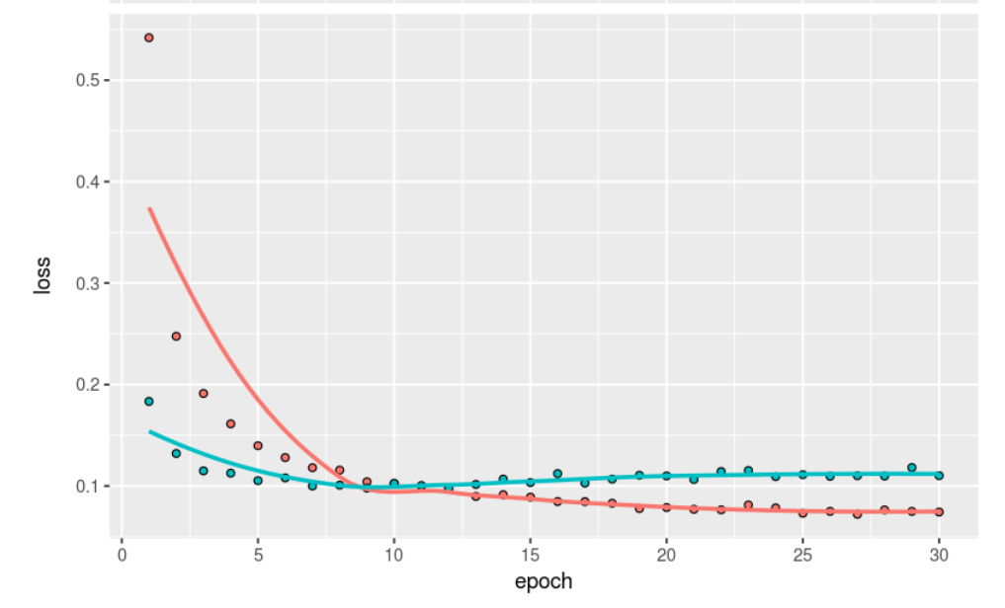
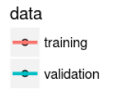
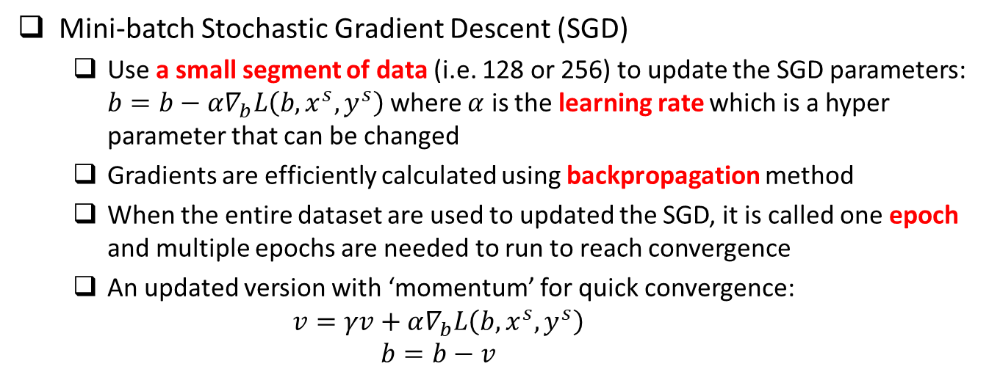
Optimization Methods
Mini-batch Stochastic Gradient Descent (SGD)
Use a small segment of data (i.e. 128 or 256) to update the SGD parameters: $b=b−α∇_{b}L\left(b,x^{s},y^{s}\right)$ where $α$ is the learning rate which is a hyper parameter that can be changed
Gradients are efficiently calculated using backpropagation method
When the entire dataset are used to updated the SGD, it is called one epoch and multiple epochs are needed to run to reach convergence
An updated version with ‘momentum’ for quick convergence:
$$v=γv+α∇_{b}L\left(b,x^{s},y^{s}\right)$$
$$b=b−v$$
The optimal number for epoch is determined by when the model is not overfitted (i.e. validation accuracy reaches the best performance).

Slide 12
More Optimization Methods
With Adaptive Learning Rates
Adagrad: Scale learning rate inversely proportional to the square root of the sum of all historical squared values of the gradient (stored for every weight)
RMSProp: Exponentially weighted moving average to accumulate gradients
AdaDelta: Uses sliding window to accumulate gradients
Adam (adaptive moments): momentum integrated, bias correction in decay
A good summary: http://ruder.io/optimizing-gradient-descent/

Slide 13


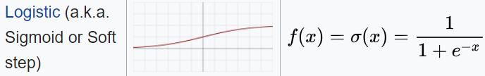
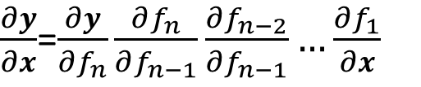
Activation Functions
$$y=f_{n}\left(f_{n−1}\left(f_{n−2}\left(…f_{1}\left(x,b_{1}\right)…,b_{n−2}\right),b_{n−1}\right),b_{n}\right)$$
Gradient:
$\frac{∂y}{∂x}$=$\frac{∂y}{∂f_{n}}\frac{∂f_{n}}{∂f_{n−1}}\frac{∂f_{n−2}}{∂f_{n−1}}…\frac{∂f_{1}}{∂x}$
Intermediate layers
Relu (i.e. rectified linear unit) is usually a good choice which has the following good properties: (1) fast computation; (2) non-linear; (3) reduced likelihood of the gradient to vanish; (4) Unconstrained response
Sigmoid, studied in the past, not as good as Relu in deep learning, due to the gradient vanishing problem when there are many layers
Last layer which connects to the output
Binary classification: sigmoid with binary cross entropy as loss function
Multiple class, single-label classification: softmax with categorical cross entropy for loss function
Continuous responses: identity function (i.e. y = x)

Slide 14
Deal With Overfitting
Huge number of parameters, even with large amount of training data, there is a potential of overfitting
Overfitting due to size of the NN (i.e. total number of parameters)
Overfitting due to using the training data for too many epochs
Solution for overfitting due to NN size
Dropout: randomly dropout some proportion (such as 0.3 or 0.5) of nodes at each layer, which is similar to random forest concept
Using L1 or L2 regularization in the activation function at each layer
Solution for overfitting due to using too many epochs
Run NN with large number of epochs to reach overfitting region through cross validation from training/validation vs. epoch curve
Choose the model with number of epochs that have the minimum validation accuracy as the final NN model

Slide 15
Recap of A Few Key Concepts
Data: Require large well-labeled dataset
Computation: intensive matrix-matrix operation
Structure of fully connected feedforward NN
Size of the NN: total number of parameters
Depth: total number of layers (this is where deep learning comes from)
Width of a particular layer: number of nodes (i.e. neurons) in that layer
Activation function
Intermediate layers
Last layer connecting to outputs
Loss function
Classification (i.e. categorical response)
Regression (i.e. continuous response)
Optimization methods (SGD)
Batch size
Learning rate
Epoch
Deal with overfitting
Dropout
Regularization (L1 or L2)

Slide 16
The MNIST Dataset

Slide 17
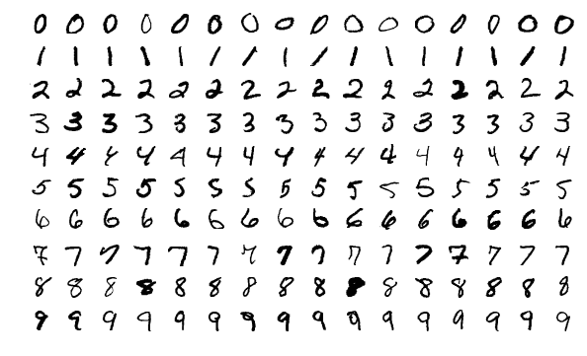
MNIST Dataset
Originally created by NIST, then modified for machine leaning training purpose
Contains 70000 handwritten digit images and the label of the digit in the image where 60000 images are the training dataset and the rest 10000 images are the testing dataset.
Census Bureau employees and American high school students wrote these digits
Each image is 28x28 pixel in greyscale
Yann LeCun used convolutional network LeNet to achieve < 1% error rate at 1990s

Slide 18
The IMDB Dataset

Slide 19
IMDB Dataset
Raw data: 50,000 movie review text (X) and it’s corresponding sentiment of positive (1, 50%) or negative (0, 50%) (Y).
Included in Keras package, can be easily loaded and preprocessed
Preprocessing includes:
Set size of the vocabulary (i.e. N most frequently occurring words)
Set length of the review by padding using ‘0’ by default or truncating as we have to have same length for all reviews for modeling
Any words not in the chosen vocabulary replaced by ‘2’ by default
Words are indexed by overall frequency in the chosen vocabulary
Once the dataset is preprocessed, we can apply encoding or embedding and then feed the data to FFNN or RNN

Slide 20
IMDB Dataset - Tokenization
Algorithm cannot deal with raw text and we have to convert text into numbers for machine learning methods.
This movie is great !
Great movie ? Are you kidding me ! Not worth the money.
Love it
…
Raw Text
[23, 55, 5, 78, 9]
[78, 55, 8, 17, 12, 234, 33, 9, 14, 78, 32, 77, 4]
[65, 36]
…
Tokenize
Suppose we cap unique words to be 250, and each one of these unique word is replaced with an integer. “2” will be used for any other words, and “0” will be used for padding.
[23, 55, 5, 78, 9, 0, 0, 0, 0, 0]
[78, 55, 8, 17, 12, 234, 33, 9, 14, 78]
[65, 36, 0, 0, 0, 0, 0, 0, 0, 0]
…
Pad
& Truncate
Now we have a typical data frame, each row is an observation, and each column is a feature. Here we have 10 columns by designing after the padding and truncating stage. We have converted raw text into categorical integers.

Slide 21
Using Keras R Package To Build Feed Forward Neural Network Model
FFNN Notebook: link

Slide 22
Procedures
Data preprocessing (from image to list of input features)
One image of 28x28 grey scale value matrix → 784 column of features
Scale the value to between 0 and 1, by divide each value by 255
Make response categorical (i.e. 10 columns with the corresponding digit column 1 and rest columns zero.
Load keras package and build a neural network with a few layers
Define a placeholder object for the NN structure
1st layer using 256 nodes, fully connected, using ‘relu’ activation function and connect from the input 784 features
2nd layer using 128 nodes, fully connected, using ‘relu’ activation function
3rd layer using 64 nodes, fully connected, using ‘relu’ activation function
4th layer using 10 nodes, fully connected, using ‘softmax’ activation function and connect to the output 10 columns
Add drop out to the first three layers to prevent overfitting
Compile the NN model, define loss function, optimizer, and metrics to follow
Fit the NN model using the training dataset, define epoch, mini batch size, and validation size used in the training where the metrics will be checked
Predict using the fitted NN model using the testing dataset

Slide 23
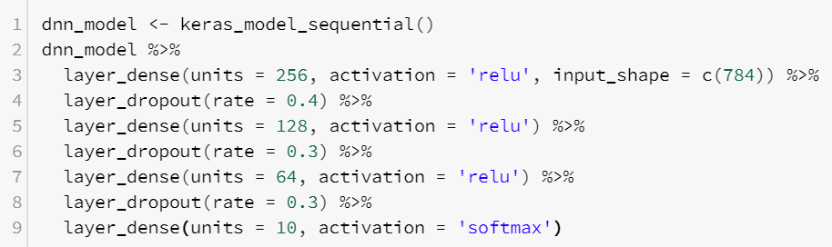
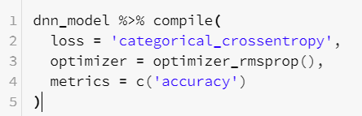
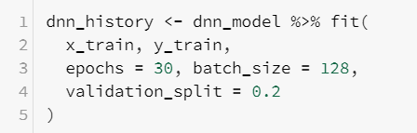

R Scripts
Define NN Structure
Compile and define loss function, optimizer and metrics to monitor during the training
Fit the model using training dataset and define epochs, batch size and validation data
Predict new outcomes using the trained model

Slide 24
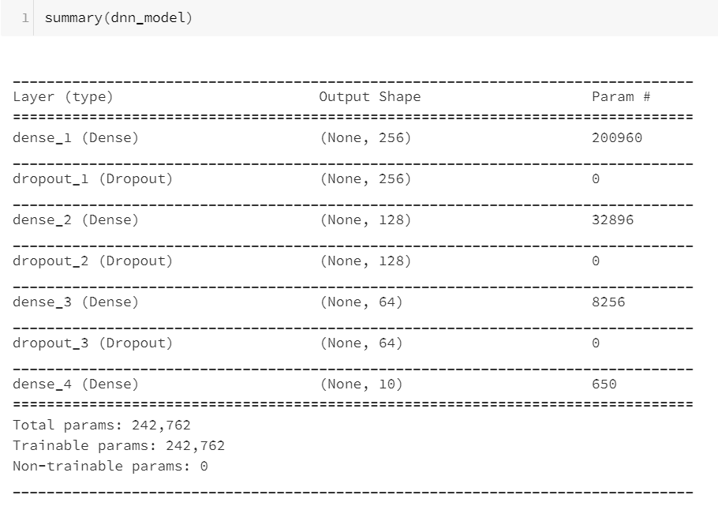
Size of the Model

Slide 25
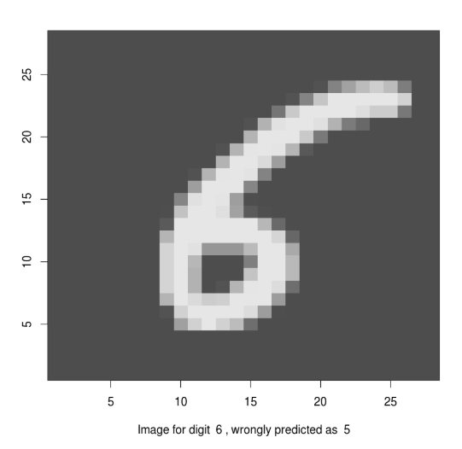
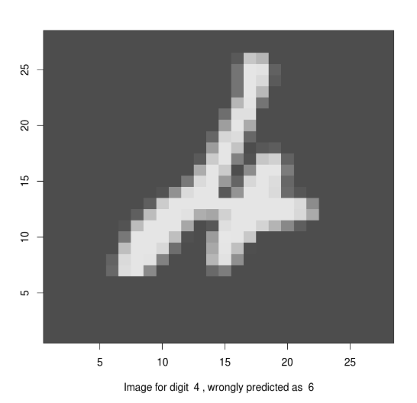
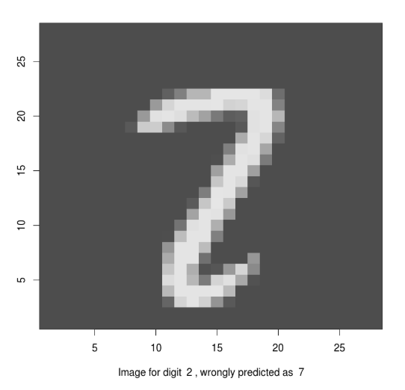
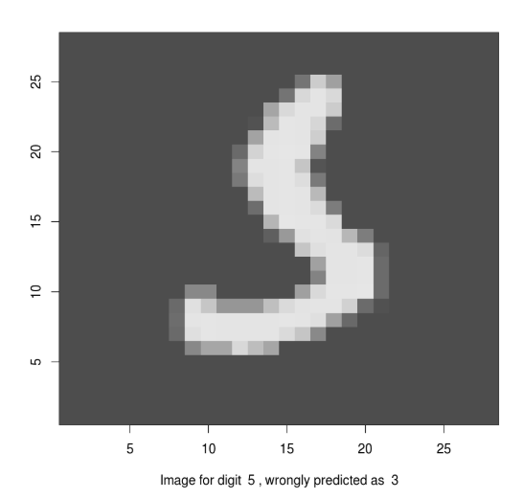
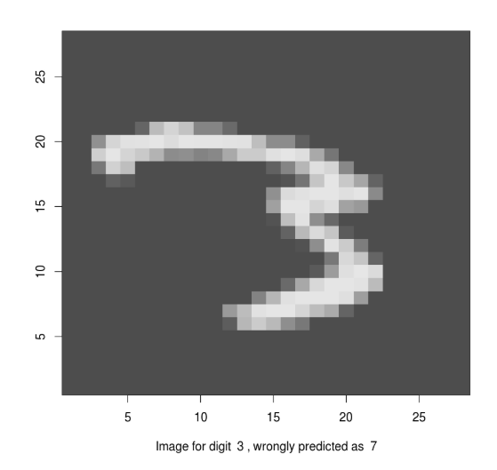
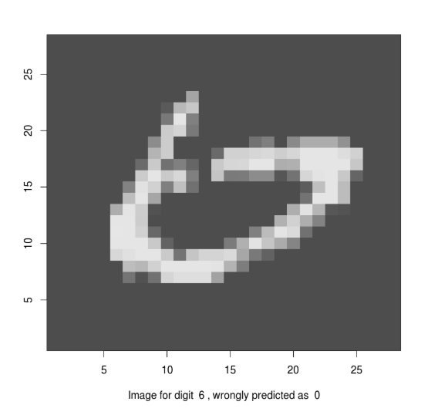
Performance
Accuracy: 97.99% without much fine tuning
A few misclassified images:

Slide 26
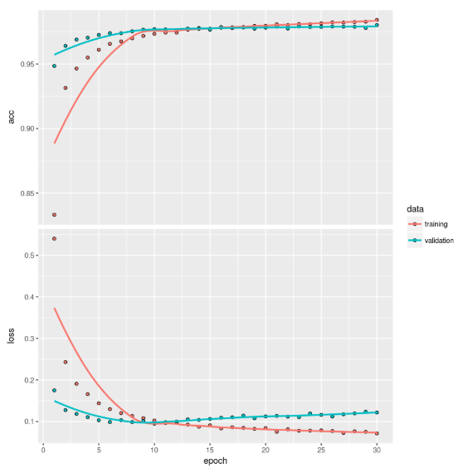
Cross-Validation Curve

Slide 27
Deep Learning Models Across Platforms

Slide 28
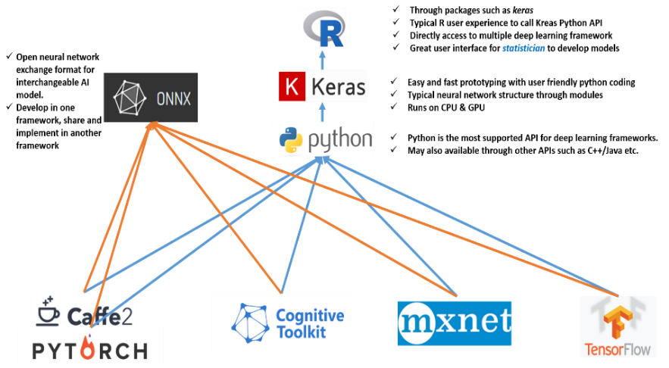
Open NN Exchange Format (ONNX)
https://github.com/onnx/onnx

Slide 29
Convolutional Neural Network
CNN Notebook: link

Slide 30
Recurrent Neural Network
RNN Notebook: link

Slide 31
Thank you!

