Slide 1
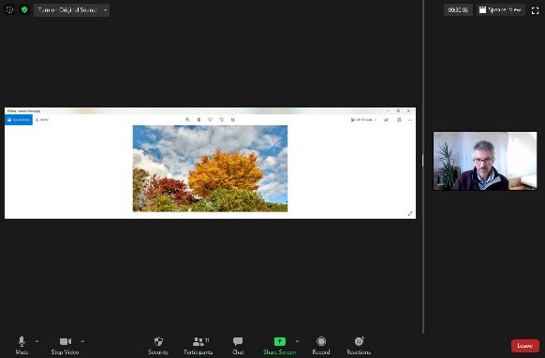
Presentation Requirements
Display your PowerPoint slides and show your face (remember to turn on the camera).

Slide 2
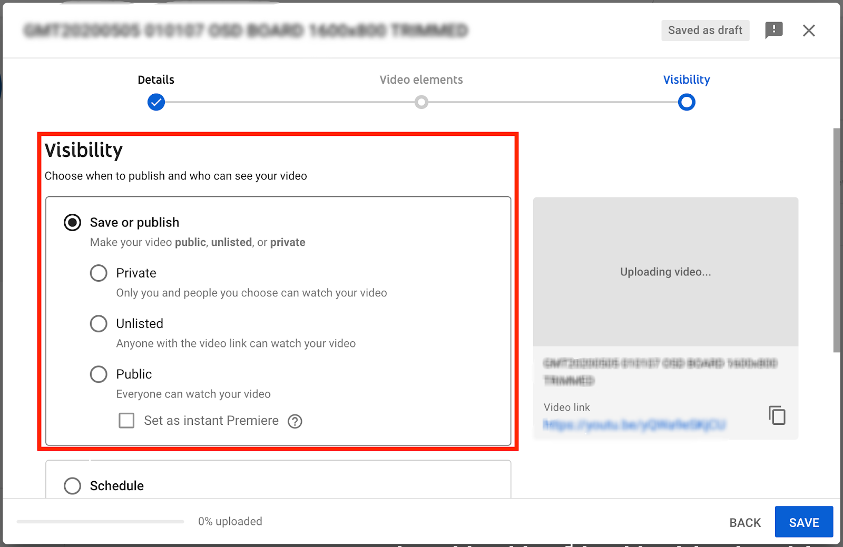
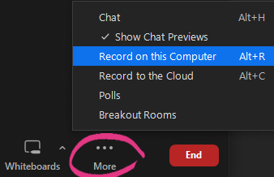
Submission
Record the audio and save it to your local laptop. Upload the recording to YouTube and set it as unlisted. Then, include the YouTube link in your submission.

