Slide 1
0a 13 08 96 01 12 05 41 6c 69 63 65 18 01 2a 0c 08 ac 02 12 07
PROTOBUF TRAFFIC + ProtoME
A field guide to Protocol Buffers on the wire
PROTOME
The 101 + Burp Suite extension demo
12 04 6d 61 69 6c 1a 06 73 65 63 75 72 65 22 02 ff 7f 28 2d 30

Slide 2
$ Whoami
Ron Twist · OSCP/CRTO ·
Role
Why I built it
Sole developer & maintainer of ProtoME — a Burp Suite extension for dynamic pentesting of protobuf HTTP(S) traffic.
Kept hitting protobuf payloads on engagements with no good editor in the loop. Manual varint surgery doesn't scale.
Talk plan
Where to find me
Part 1: Protobuf on the wire.
Part 2: ProtoME — how it closes the testing gap.
DC415
Linkedin.com/ron-twist/ github.com/twisted007/

Slide 3
user@proto:~$ cat agenda.txt
What we'll cover
Protocol Buffers — Google's binary serialization format — and ProtoME, the Burp extension that makes it testable. Here's the path.
01
02
03
04
History & origins
Where you'll see it
Protobuf vs JSON
Benefits & constraints
Where protobuf came from and why
gRPC, mobile, IoT, internal APIs
Binary schema vs self-describing text
What you gain, what you give up
05
06
07
08
Data types & .proto
On the wire
Security & pentest angle
ProtoME: the demo
The schema language and scalar types
Bytes, varints, tags, ZigZag, gRPC framing
Why opaque binary matters to us
Closing the tooling gap

Slide 4
user@proto:~$ git log --reverse
A short history
2001
2008
2015
2016
Now
Proto1 — internal
Open-sourced (Proto2)
gRPC arrives
Proto3
Editions
Born inside Google as an efficient way to serialize structured data across services.
Released publicly July 7, 2008 with C++, Java & Python. Introduced required / optional / repeated.
Google ships gRPC, an RPC framework built on protobuf — the main reason you see it on the wire.
Simplified syntax: dropped required, streamlined defaults and field presence for cross-language consistency.
Active dev (protoc v21+ versioning, 'editions' replacing the proto2/proto3 split). BSD-licensed.
No IETF RFC: protobuf is a Google-published spec (protobuf.dev), not a standards-track document. gRPC has formal specs; protobuf itself is a de-facto standard.

Slide 5
user@proto:~$ grep -r protobuf /
Where you'll see it in the wild
>_
gRPC APIs
>_
Mobile apps
>_
Google services
The big one. Microservice-to-microservice and increasingly public APIs ride gRPC over HTTP/2.
Android/iOS clients talk to backends in protobuf to save bandwidth and battery.
Maps, Photos, Play and most internal Google RPC traffic.
>_
IoT & embedded
>_
Data pipelines
>_
Crypto & fintech
Constrained devices favor the compact, low-overhead format.
Kafka, event streams and storage formats use protobuf schemas.
Trading APIs, wallets and exchanges for low-latency messaging.

Slide 6
user@proto:~$ diff json protobuf
Protobuf vs JSON
JSON
self-describing text
PROTOBUF
binary + external schema
{
"id": 1,
"name": "Alice",
"active": true
}
08 01 12 05 41 6c 69 63 65 18 01
field numbers replace key names; types live in a
shared .proto schema, not in the payload
≈ 42 bytes · keys travel with every message · human-readable
≈ 11 bytes · ~75% smaller · not human-readable
 | JSON | Protobuf
Encoding | UTF-8 text | Binary
Schema | Optional / implicit | Required (.proto)
Self-describing | Yes — keys in payload | No — needs the schema
Size & speed | Larger, slower parse | Compact, fast
Readability | Human-readable | Opaque bytes

Slide 7
user@proto:~$ weigh tradeoffs
Benefits & constraints
[+] BENEFITS
[!] CONSTRAINTS
Compact
Not human-readable
Binary encoding is typically 3–10x smaller than equivalent JSON.
You can't eyeball or grep the payload — bytes only.
Fast
Schema required
Less to parse and serialize; numbers stay numbers, no string parsing.
Without the .proto, fields are just numbered blobs.
Strongly typed
Tooling needed
The schema enforces structure across every language.
curl/Postman won't cut it; you need decoders & generators.
Schema evolution
Harder to debug
Add fields without breaking old clients; unknown fields are preserved.
Inspecting traffic requires extra steps (this is our hook).
Polyglot codegen
Field-number lock-in
One .proto compiles to Go, Java, Python, C++, and more.
Numbers can't be reused safely once assigned.

Slide 8
user@proto:~$ vim person.proto
The schema: .proto & scalar types
person.proto
Common scalar types
syntax = "proto3";
message Person {
int32 id = 1;
string name = 2;
bool active = 3;
repeated string roles = 4;
}
int32 / int64
Variable-length integers (varint)
uint32 / uint64
Unsigned varints
sint32 / sint64
Signed — ZigZag encoded (efficient for negatives)
fixed32 / fixed64
Fixed-width; faster for large values
float / double
32 / 64-bit IEEE 754
bool
Single varint (0 or 1)
field number (the = N) is what travels on the wire — not the field name. Numbers 1–15 cost one byte.
string / bytes
Length-delimited UTF-8 / raw binary
enum / message
Named constants / nested types

Slide 9
user@proto:~$ xxd message.bin
On the wire — anatomy of a field
Every field is a tag then a value. tag = (field_number << 3) | wire_type
Tag byte 0x08 = 0000 1000
Wire types
0
0
0
0
1
0
0
0
0
VARINT
int32/64, bool, enum
1
I64
fixed64, double
field_number = 1
wire_type = 0 (varint)
2
LEN
string, bytes, messages
upper 5 bits = field number · low 3 bits = wire type
5
I32
fixed32, float
Types 3 & 4 (groups) are deprecated / proto2 only.
Varints — small ints take few bytes. Each byte gives 7 bits of value; the high bit (MSB) is a 'more follows' continuation flag. Bytes are little-endian (low group first).
Encode 150 → bytes 96 01
0x96 = 10010110 → MSB=1, more follows
0x01 = 00000001 → MSB=0, last byte
concat low→high: 0000001 0010110 = 150
MSB stripped, groups reversed, then concatenated.
96
01

Slide 10
user@proto:~$ protoc --decode Person
Decoding a full message
Person { id: 1, name: "Alice", active: true } → 11 bytes:
08
01
12
05
41
6c
69
63
65
18
01
08
tag
field 1, varint (id)
Negatives & ZigZag
01
value
id = 1
int32 of -1 → 10 bytes (treated as huge unsigned).
sint32 uses ZigZag: maps -1→1, 1→2, -2→3… so small magnitudes stay 1 byte.
12
tag
field 2, LEN (name)
05
length
5 bytes follow
gRPC framing
41 6c 69 63 65
value
"Alice" in ASCII
1 byte compression flag + 4 bytes big-endian length, then the protobuf body.
18
tag
field 3, varint (active)
Strip these 5 bytes before decoding.
01
value
active = true
Field names (id, name, active) never appear on the wire — only their numbers. That's why you need the .proto to fully interpret a capture.

Slide 11
user@proto:~$ ./why_we_care.sh
Why this matters for security
Opaque to inspection
Tooling gap
Binary payloads dodge casual review — proxies, WAFs and analysts can't read them without a decoder.
Burp, ZAP and curl show raw bytes by default. Editing a single field by hand is painful and error-prone.
Attack surface still there
Schema = the keys
It's just a transport. IDOR, injection, auth flaws and broken access control live underneath the encoding.
With the .proto you can craft valid requests; without it you reverse-engineer field numbers and types.
Unknown-field leakage
Fuzzing & tampering
Servers preserve fields you didn't declare — capture diffs can reveal hidden / new API fields.
Well-formed mutation requires understanding wire types — malformed bytes just get rejected.

Slide 12
user@proto:~$ exec proto-me
The pentester dilemma
You've seen the format end-to-end. Here's the field reality:
Opaque in Burp
ENTER PART 2
You intercept a request. The body is opaque. Reading varints by hand is not the move.
A Burp Suite extension that closes the gap:
Schema or not
1
Load .proto
With the .proto, current tooling barely helps you edit. Without it, you infer structure tag-by-tag.
Point the extension at a spec file to craft new, valid requests.
Time pressure
2
Disassemble
Turn raw protobuf into a pseudo-JSON view you can actually read.
You have minutes — not hours — to decide if a field is interesting.
3
Edit
Bespoke harness
Tweak fields in JSON — no manual varint math, no hex surgery.
Every engagement, you're rebuilding the same one-off test harness.
4
Recompile & ship
Convert JSON back to protobuf bytes and send to the server.

Slide 13
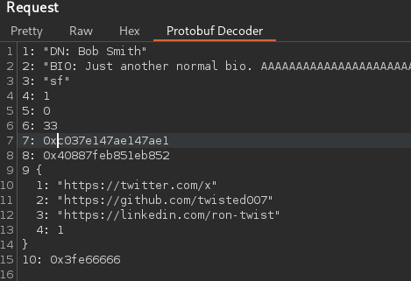
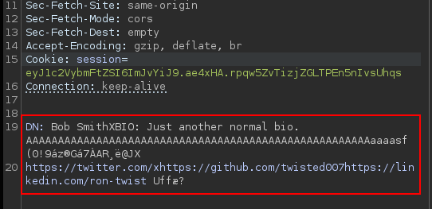
ProtoME: The Problem
A protobuf request in the wild
Intercepted request
Current tooling

Slide 14
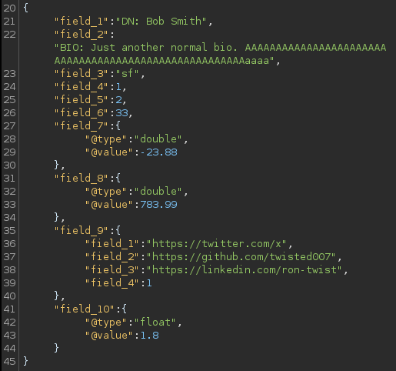
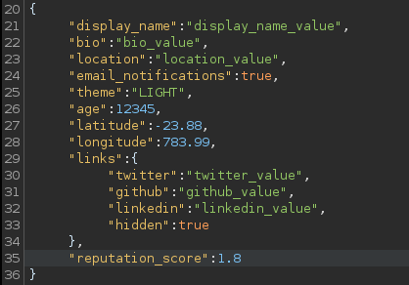
ProtoME: The Solution
Two modes for two realities
White-Box
Black-Box
You have the .proto. ProtoME compiles it, renders sample requests as pseudo-JSON, and serializes your edits back to wire-valid protobuf.
You don't have the .proto. ProtoME's byte-level parser infers field numbers and wire types, renders pseudo-JSON, recalculates lengths on send.

Slide 15
ProtoME: High-Level Architecture
How the extension is wired together
Burp / Montoya API
Schema engine
Extension hooks Repeater, Intruder, Proxy. Adds a ProtoME tab to each request view.
protoc-jar compiles loaded .proto files once. Descriptor set + HashMap maps field numbers ↔ names both ways.
Blackbox engine
JSON bridge
Standalone byte-level parser: walks tag → wire-type → length → payload. Recurses into nested LEN.
Google's JsonFormat (protobuf-java-util) serializes between JSON and protobuf. Custom wrappers for ambiguous wire types.
Concurrency
Java + Montoya thread model keeps the UI responsive while the parser/serializer runs per-request.

Slide 16
ProtoME: Schema-Based Workflow
When you have the .proto
1. Load .proto
2. Map fields
Extension calls protoc-jar once at load to build a descriptor set.
HashMap from compiled descriptor set — maps field numbers ↔ names both ways.
3. Generate sample
4. Edit as JSON
Walks the descriptor field list to produce a sample request populated with dummy data.
Tester edits values in the pseudo-JSON view. Field names, types, and nesting all visible.
5. Serialize
Net effect
JsonFormat (protobuf-java-util) bridges JSON → protobuf bytes. Request is sent with valid wire encoding.
No varint math. No length-prefix bookkeeping. No hex surgery. Edit-and-replay just works.

Slide 17
ProtoME: Blackbox Heuristics
When you don't have the .proto
Triggered by tester
Byte-level parser
Requests are decoded on-demand via right-click. No pre-load required.
BlackboxDecoder walks tags: extracts field number, wire type, and payload length per field.
Ambiguous wire types
Recursive parsing
Wire types 1 (I64) and 5 (I32) get type:value wrappers — tester picks float vs fixed.
LEN payloads that look like nested messages are decoded recursively.
Editable
Re-serialize
Tester edits the inferred JSON. Payload length is recalculated on serialization.
Output is a wire-valid protobuf byte stream — sent back through Burp like any other request.

Slide 18
ProtoME: Blackbox in Practice
A schemaless decode, walked through
Raw bytes
ProtoME output
08 01 12 05 41 6c 69 63 65 18 01 — the same 11 bytes from the 101. Opaque to a normal proxy.
{ "field_1 (varint)": 1, "field_2 (LEN, string)": "Alice", "field_3 (varint)": 1 }
Tag walking
String detection
Each byte stream tag → field number + wire type. No schema needed.
Length-prefixed bytes auto-decoded to string when ASCII-safe.
Wire-type wrappers
Ambiguous wire types (1, 5) wrapped with type:value so tester picks the interpretation.

Slide 19
ProtoME: Key Technical Decisions
Choices that shape the extension
Parallel code stacks
Fail-open requests
Whitebox and blackbox flows are independent — neither blocks the other if one fails.
If decoding fails, the original bytes still pass through. Dynamic testing keeps moving.
Optional gRPC framing
Structured errors
Toggle the 5-byte gRPC prefix on/off per request. Auto-detected when possible.
Decoder errors surface in the UI with field offsets, not silent failures.
Java + Montoya API
Type/value wrappers
Performance for byte-level parsing; clean concurrency for the Burp UI.
Disambiguates 1- and 5-wire-type payloads. Eases test-case generation.

Slide 20
ProtoME: Quality of Life
What makes it pleasant to use today
One-click .proto load
On-demand blackbox
Load any .proto file from the Burp UI. No restart, no config files.
Right-click any request to decode without schema. No pre-config required.
Request organization
Bug-bounty enablement
Track which endpoints you've tested across an engagement.
Lowers the bar for hunters to engage with protobuf-backed targets.
Byte-level mutation
Coverage tracking
Hand-craft payloads for parser-inconsistency or fuzzing scenarios.
Surface parser inconsistencies — same input, two implementations, different output.

Slide 21
ProtoME: Results & Impact
What the extension has unlocked
Junior consultant lift
No more obscurity
Staff junior consultants on engagements that previously required protocol-analysis skill.
Removes protobuf security-through-obscurity — pentesters can actually see what's on the wire.
No bespoke harness
Time to first mutation
Removes the need to build a one-off test harness for every protobuf endpoint.
Collapses first-request-to-first-mutation time from hours (manual varint work) to minutes.
Coverage win
Bug bounty enablement
Engagements that skipped protobuf endpoints under time pressure now get them tested.
Bug-bounty hunters can engage with protobuf targets that were previously out of reach.

Slide 22
References & next steps
Official docs
protobuf.dev
Language guides, encoding spec, history
Encoding deep-dive
protobuf.dev/programming-guides/encoding
Varints, wire types, ZigZag in detail
gRPC
grpc.io
The RPC framework that carries most protobuf
Source
github.com/protocolbuffers/protobuf
protoc compiler & runtimes (BSD)
ProtoME
github.com/twisted007/ProtoME
The Burp extension demoed today
Questions? ->

Slide 23
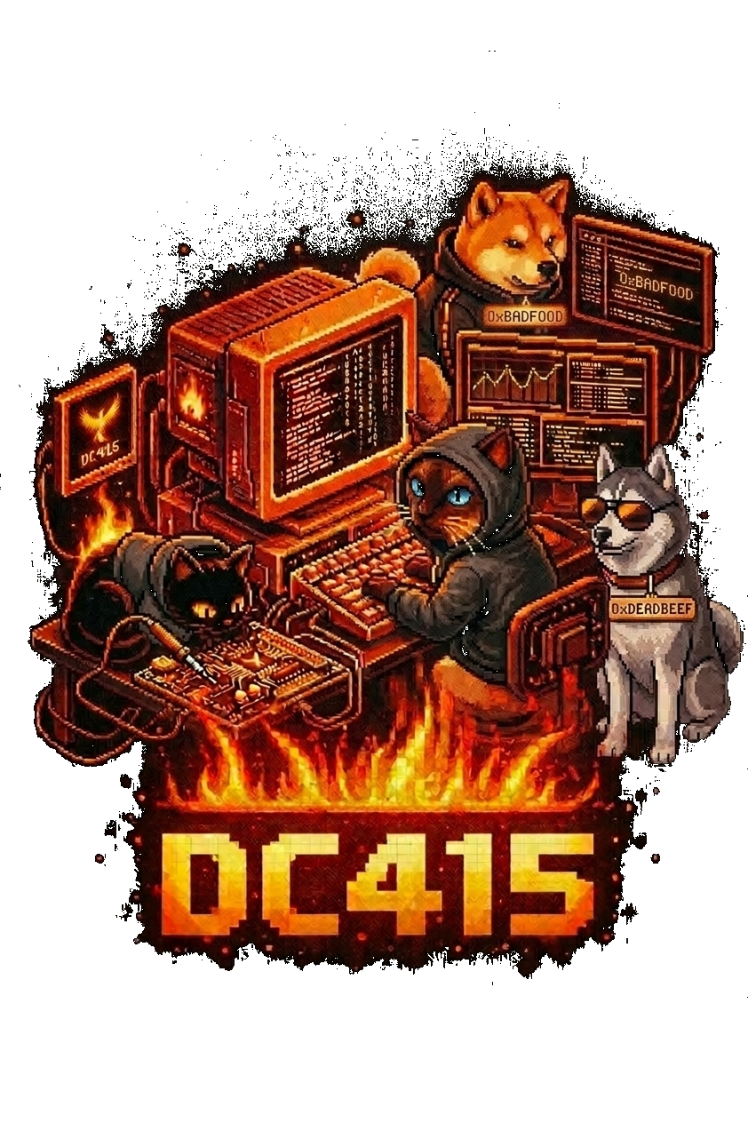
THANK YOU
Protobuf Traffic — a field guide to Protocol Buffers on the wire
@twisted007 · github.com/twisted007/ProtoME · DC415

