Slide 1

RetroPie & Emulation Station
7x7? HAH!

Slide 2
Hardware
Raspberry Pi – ($40) or a Cana Kit ($50)
8GB (min.) MicroSD card (and reader) (4GB*)
MicroUSB power supply (2.5A)
HDMI Cable (and HDMI TV/Monitor)
A Windows, Mac or Linux desktop/laptop
USB Controllers (optional)
USB Keyboard
USB wireless adapter if using wireless controller

Slide 3
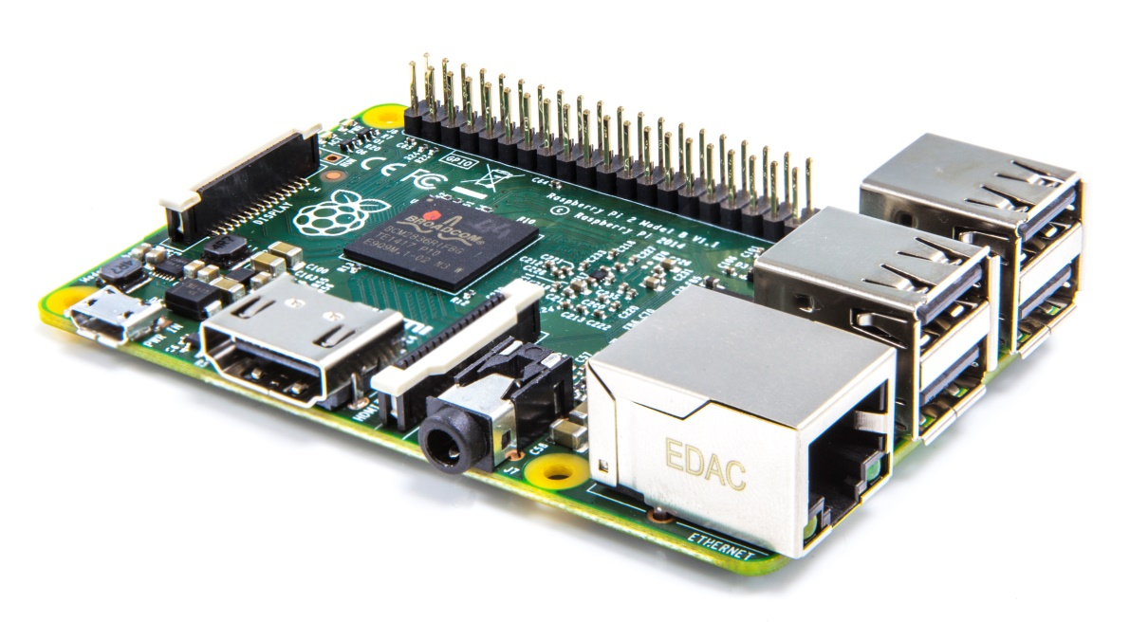
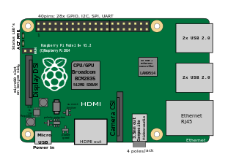
Raspberry Pi Board
Broadcom BCM2836 (900MHz) quad-core
4 USB 2.0 ports
1 RJ-45 port
40 GPIO Pins (get creative..)
1 micro SD card slot
4-pole 3.5mm A/V header
1 DSI Display connecter (LCD screens)
1 CSI Camera connector
Some have WiFi as well

Slide 4
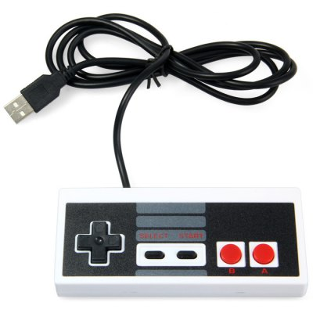



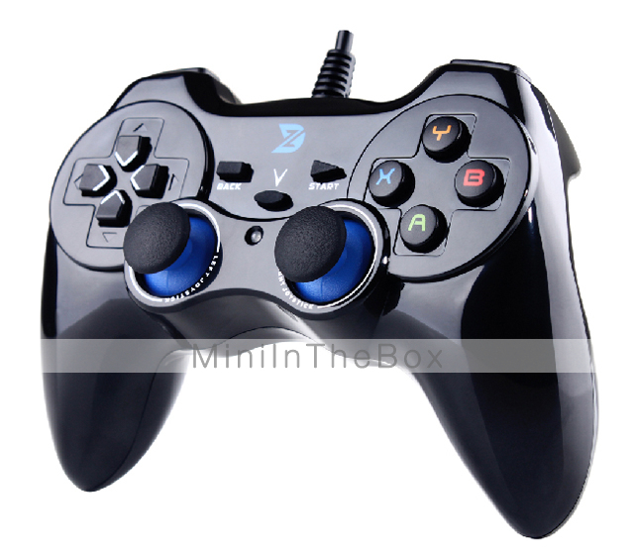
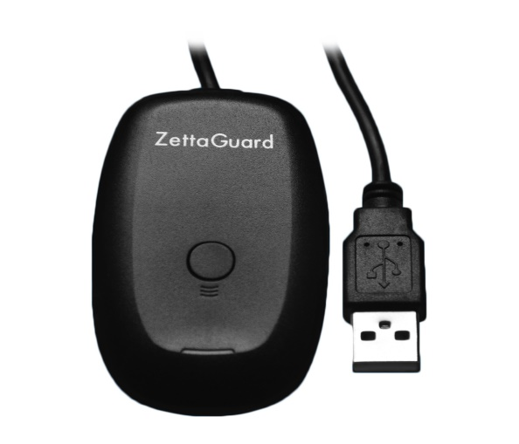
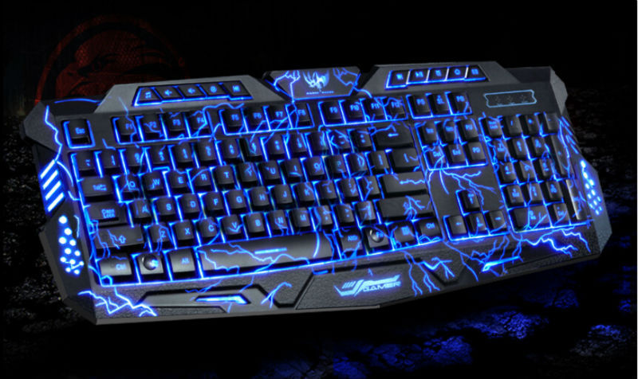
Controller Options

Slide 5
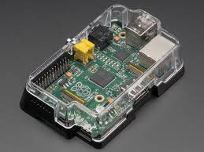
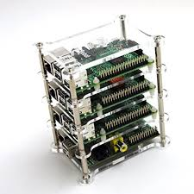
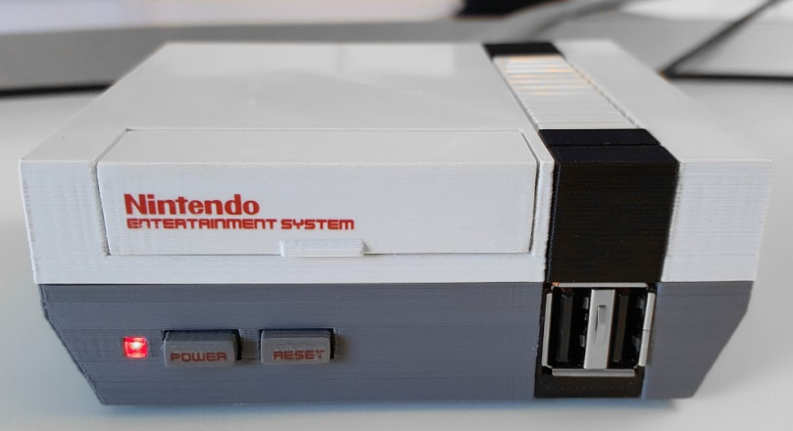
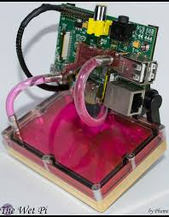
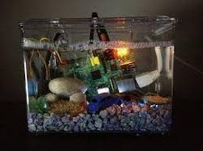


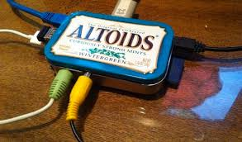
Case Options

Slide 6
Software
.zip extraction software – 7-zip, WinZip, etc.
SD Card formatting software (SDFormatter)
SD Card imaging software (Win32 Disk image)
BerryBoot doesn’t need to be written, other OSes will
PuTTy, WinSCP, or some SFTP application (optional)
BerryBoot, RetroPie, & ROMs

Slide 7
BerryBoot
BerryBoot is a boot manager – let’s you multi-boot
Comes with a handful of OSes and tools
Download berryboot .zip file
Extract the BerryBoot .zip file to the root of the SD card (ie. J:\) – not a sub directory
Insert SD card into the Raspberry Pi & power on
Choose your Welcome settings and click OK
Now click FORMAT for to install BerryBoot

Slide 8
ADD OS(es)
In the ADD OS screen/menu you have many to choose from including: Raspbian (Debian), Android, Ubuntu MATE, Ubuntu server (both 16.04), LTSP (Thinclient) – “Others” include Retropie, Kali Linux, Puppy, LightTPD (web server), or “Appliances” such as OpenMedia Vault (open NAS solution).
We will choose RetroPie for now
Highlight RetroPie and click next..
Wait for it to download & install (approx. 2-3 min.)
Click OK to reboot.

Slide 9
Controller configuration
Make sure your controller is plugged in on boot
Select RetroPie from the GUI boot menu
RetroPie is the OS, EmulationStation is the default front end that loads
Hold any button on your detected gamepad to configure it
Assign each button and wait a second or two before going to the next, it will go to the next by itself – Extremely easy to screw this part up.

Slide 10
Controller configuration continued
In the event it randomly skips, just proceed on until the end and we’ll come back to the “NOT ASSIGNED” buttons. (Typically the bumper & trigger buttons do this)
Once it’s on “OK” use the D-pad to go back up to the NOT ASSIGNED buttons, highlight the button and press “A” Now it will say “PRESS ANYTHING” – press the button you want assigned to it and move on.
Click OK on the bottom of the screen

Slide 11
System Configuration (Optional)
Select RetroPie in the EmulationStation menu
Your Overscan (display area) was setup during initial setup of BerryBoot, but if it’s off for any reason, go to ADVANCED options -> Overscan
In ADVANCED, set Memory Split to 128/128 to alter CPU/GPU memory allocation
After you are done, choose Finish and it’ll restart
OPTIONAL: RETROPIE -> RETROPIE SETUP
Update Scripts then use Binary-based updates to newest version of RetroPie (60~ min.)
WARNING: My installation broke after updating..

Slide 12
Adding games
Now, if your system didn’t die after updating, or you’ve reinstalled, let’s get some games!
Download ROMs
Open file manager (Explorer, Finder, etc.)
In Windows, type \\RETROPIE or \\ipaddress in the address bar
This will show folders: BIOS, CONFIG, ROMS, SPLASHSCREENS
Double click on ROMS, find the emulator folder, copy the ROMS to the correct emulator folder. (.RAR = OK)
Restart Emulation Station and play!

Slide 13
Using SFTP
If you can’t get it to work w/ file manager, use Putty or WinSCP, etc.
Get IP address from RetroPie menu
User: pi PW: raspberry
Protocol: SFTP
Accept cache key/certificate
Drag and drop ROM to correct emulator folder
Reboot Emulation Station and Play!

Slide 14
Worth Noting
XBOX Wireless controllers are a pain to setup, require extra hardware and results are iffy at best
To exit a game press START and SELECT at the same time
You can copy .RAR files directly to the emulator folder and it will read them.
Some systems (Dreamcast, PS1, NeoGeo,GameBoy Advance) require a special BIOS in the bios folders
Feel free to contact me with questions or help, but Google is probably quicker and more helpful
Don’t break your SD card. Remove it before installing the board into the case!

Slide 15
Links
Berry Boot – berryterminal.com/doku.php/berryboot
RetroPie – retropie.org/uk/download
ROMS:
Emuparadise.me, CoolROM.com, LoveROMs.com, FreeROMs.com, DopeROMs.com, RomHustler.com, CompleteROMs.com, Google.com
There are TONs of OS choices for the Raspberry Pi;
Anyone interested in a portable hacking setup? To be presented in 3-4 months?

