Slide 1
Resource Management
Doug Callaway
Sam Kapernick
Xiao Liu
Ruijin Liu

Slide 2
Agenda
Objective
Purpose
Audience
Features
Technologies
Responsibilities
Schedule

Slide 3
Purpose
Explain why this project idea is selected
State what are the importance/novelty of this project

Slide 4
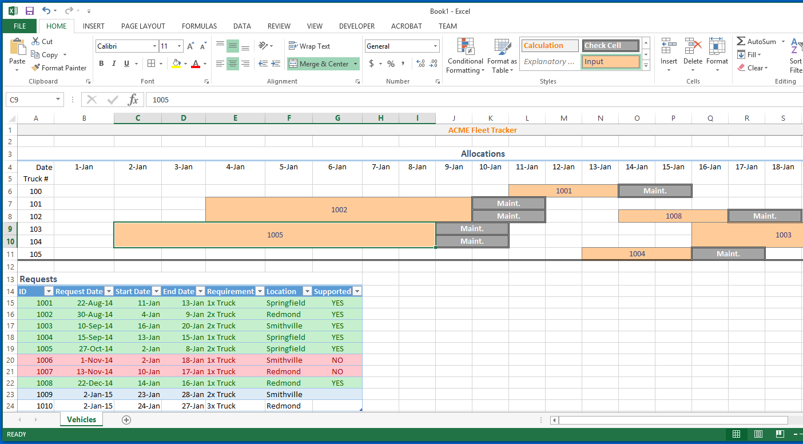

Slide 5
Audience
Identify the target users
Discuss the characteristics of the target users

Slide 6
features
Identify the basic features to be implemented
Identify and discuss features to enhance users experience

Slide 7
Sample User Interface

Slide 8




Technologies
M
E
A
N
express

Slide 9
Data Requirements (ERD)

Slide 10
Responsibilities
 | Doug | Sam | Xiao | Ruijin
Primary Roles | Backend Development Database Admin | Backend-Frontend API Management | Frontend Design Graphic Interface Design | Frontend Development User Interface
Strengths | NodeJS Database / Schema Design | JavaScript/HTML integration | CSS Graphics Creation
Weaknesses | Graphical Design CSS | Server-side development | Coding English

Slide 11
Schedule
Identify the major milestones of the project
Indicate when each milestone should be achieved
Gantt Chart

