Slide 1
Resource Management
Doug Callaway
Sam Kapernick
Xiao Liu

Slide 2
Agenda
Objective
Purpose
Audience
Features
Technologies
Responsibilities
Schedule

Slide 3
Purpose
Explain why this project idea is selected
State what are the importance/novelty of this project

Slide 4
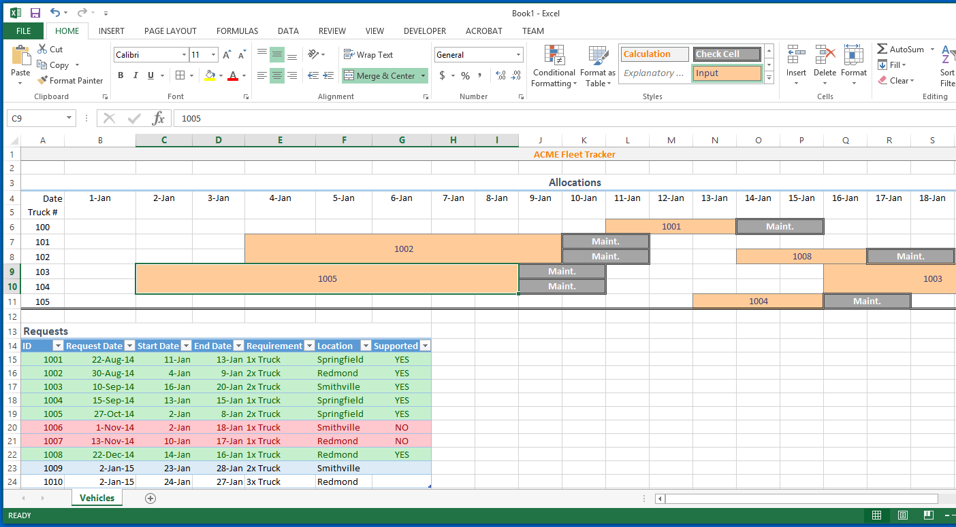

Slide 5
Audience
Identify the target users
Discuss the characteristics of the target users

Slide 6
features
Identify the basic features to be implemented
Identify and discuss features to enhance users experience

Slide 7
Sample User Interface

Slide 8
Technologies
Identify the functional & technologies requirements
Identify the data requirements

Slide 9
Responsibilities
Identify the strengths and weaknesses of each member
State and justify who in charge of what

Slide 10
Schedule
Identify the major milestones of the project
Indicate when each milestone should be achieved
Gantt Chart

