Slide 1
LINEAR MEASUREMENTS - SKELETAL
LR
+ | Right
- | Left
AP
+ | Anterior
- | Posterior
SI
+ | Superior
- | Inferior
3D
No sign

Slide 2
LINEAR MEASUREMENTS – TOOTH MOVEMENT
Upper right
Upper left
UR8 | UR7 | UR6 | UR5 | UR4 | UR3 | UR2 | UR1
UL1 | UL2 | UL3 | UL4 | UL5 | UL6 | UL7 | UL8
LR
+ | B
- | L
AP
+ | M
- | D
SI
+ | I
- | E
3D
No sign
LR
+ | D
- | M
AP
+ | B
- | L
SI
+ | I
- | E
3D
No sign
LR
+ | M
- | D
AP
+ | B
- | L
SI
+ | I
- | E
3D
No sign
LR
+ | L
- | B
AP
+ | M
- | D
SI
+ | I
- | E
3D
No sign
LR8 | LR7 | LR6 | LR5 | LR4 | LR3 | LR2 | LR1
LL1 | LL2 | LL3 | LL4 | LL5 | LL6 | LL7 | LL8
LR
+ | B
- | L
AP
+ | M
- | D
SI
+ | E
- | I
3D
No sign
LR
+ | D
- | M
AP
+ | B
- | L
SI
+ | E
- | I
3D
No sign
LR
+ | M
- | D
AP
+ | B
- | L
SI
+ | E
- | I
3D
No sign
LR
+ | L
- | B
AP
+ | M
- | D
SI
+ | E
- | I
3D
No sign
Directionality of Changes
B-Buccal
L- Lingual
E- Extrusion
I- Intrusion
M- Mesial
D- Distal
Lower right
Lower left

Slide 3
ANGULAR MEASUREMENTS – TEETH LONG AXIS
Upper right
Upper left
UR8 | UR7 | UR6 | UR5 | UR4 | UR3 | UR2 | UR1
UL1 | UL2 | UL3 | UL4 | UL5 | UL6 | UL7 | UL8
Pitch
+ | M
- | D
Roll
+ | B
- | L
Yaw
+ | MR
- | DR
Pitch
+ | B
- | L
Roll
+ | D
- | M
Yaw
+ | MR
- | DR
Pitch
+ | B
- | L
Roll
+ | M
- | D
Yaw
+ | DR
- | MR
Pitch
+ | M
- | D
Roll
+ | L
- | B
Yaw
+ | DR
- | MR
LR8 | LR7 | LR6 | LR5 | LR4 | LR3 | LR2 | LR1
LL1 | LL2 | LL3 | LL4 | LL5 | LL6 | LL7 | LL8
Pitch
+ | D
- | M
Roll
+ | L
- | B
Yaw
+ | MR
- | DR
Pitch
+ | L
- | B
Roll
+ | M
- | D
Yaw
+ | MR
- | DR
Pitch
+ | L
- | B
Roll
+ | D
- | M
Yaw
+ | DR
- | MR
Pitch
+ | D
- | M
Roll
+ | B
- | L
Yaw
+ | DR
- | MR
Lower right
Directionality of Changes
B-Buccal
L- Lingual
E- Extrusion
I- Intrusion
MR- Mesial Rotation
DR – Distal Rotation
Lower left

Slide 4
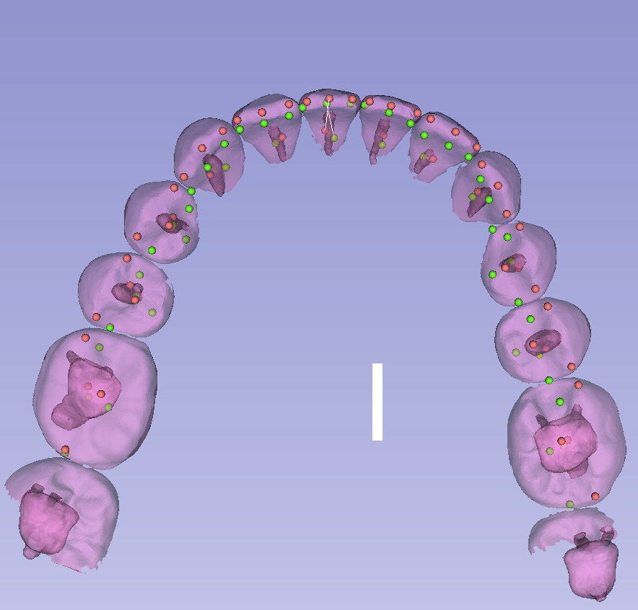
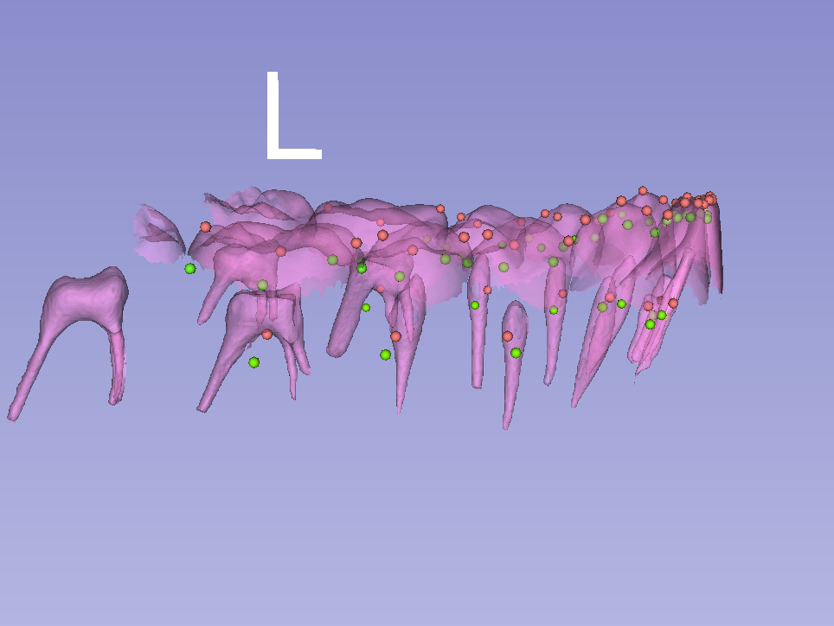
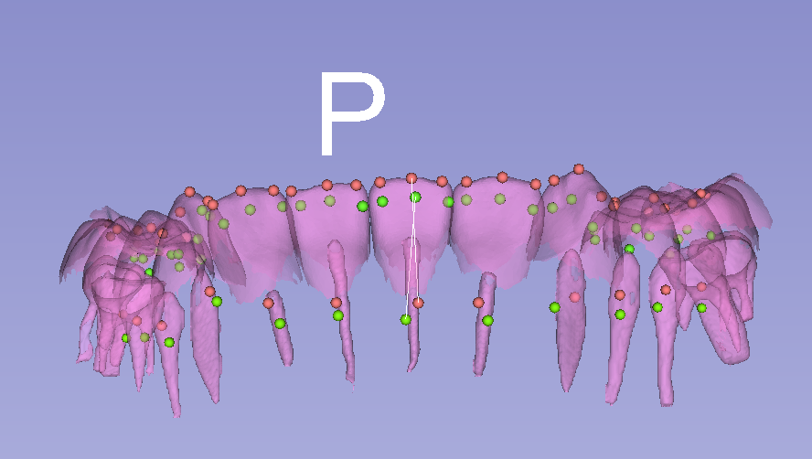
Roll
Yaw
Pitch

