Slide 1


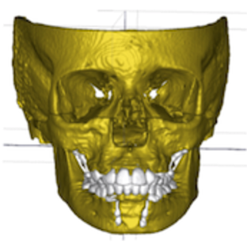
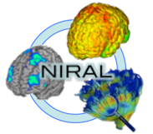







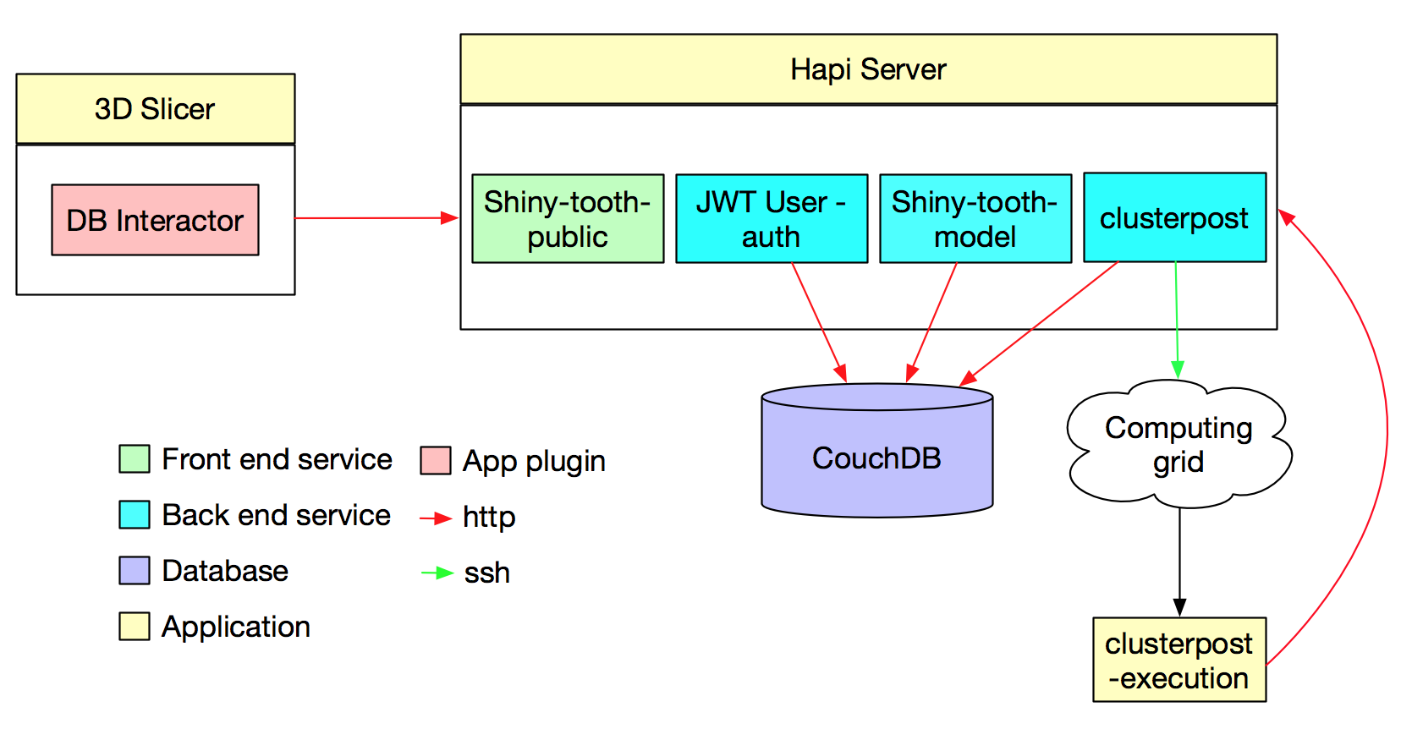
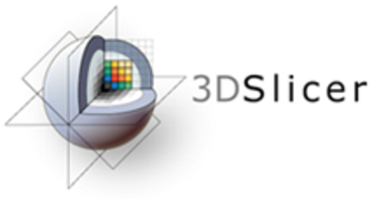
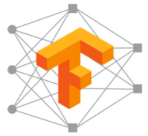

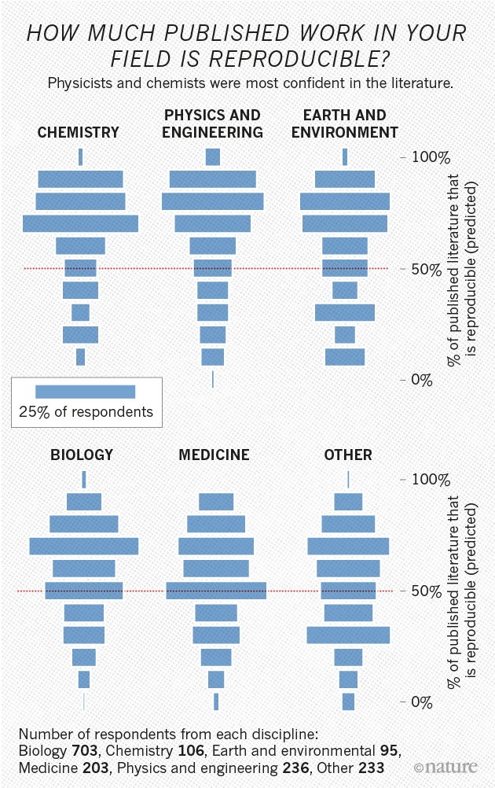
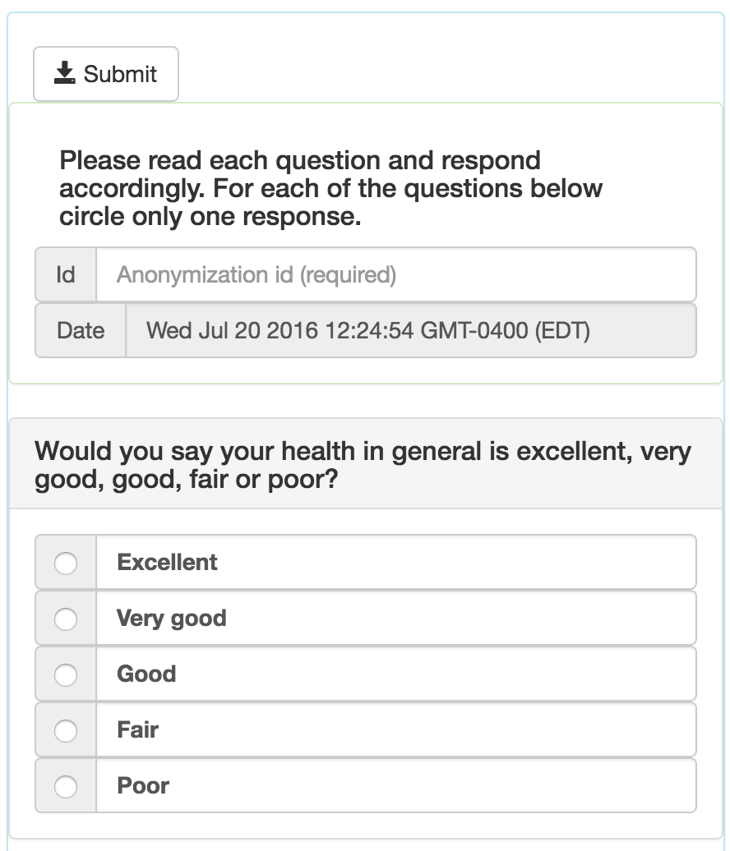
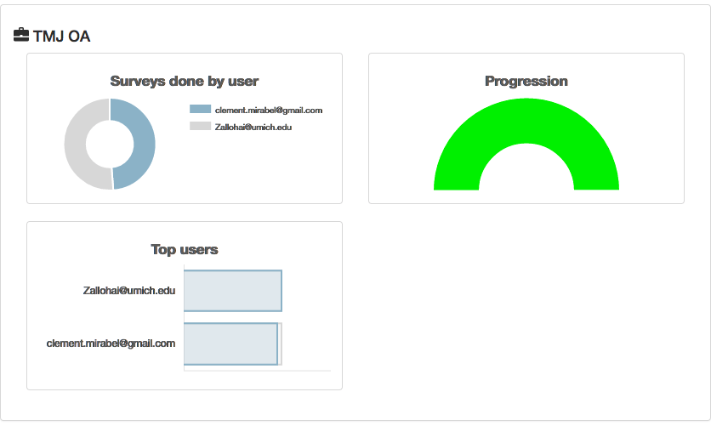
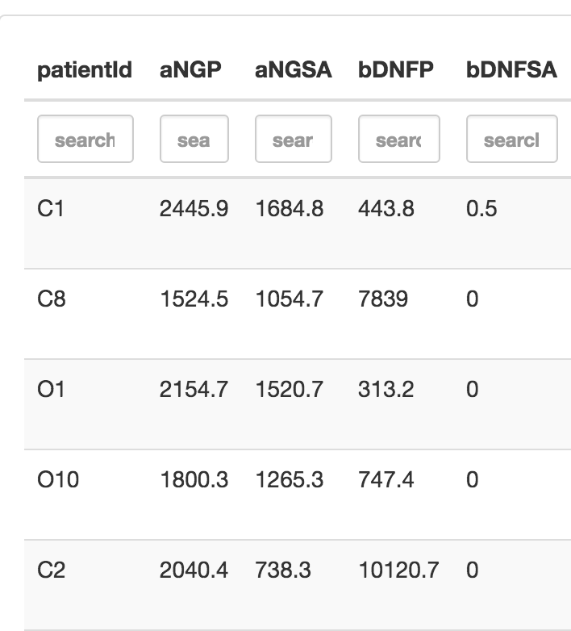
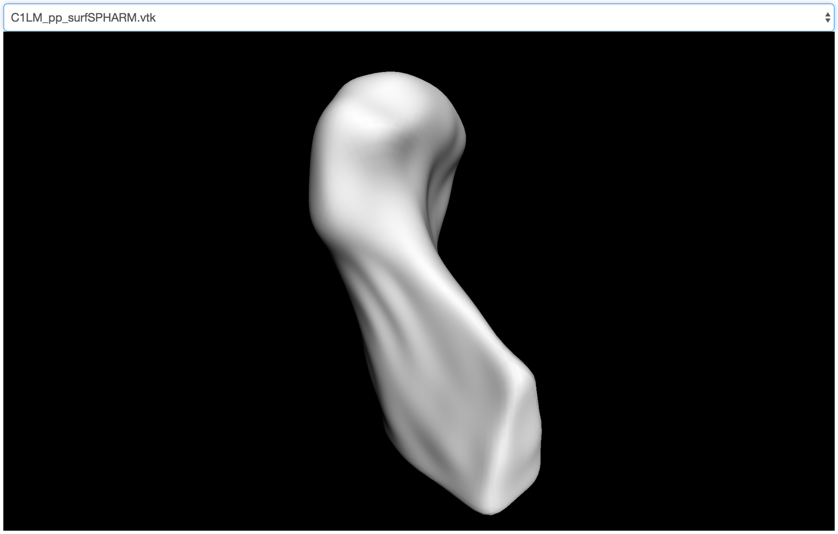
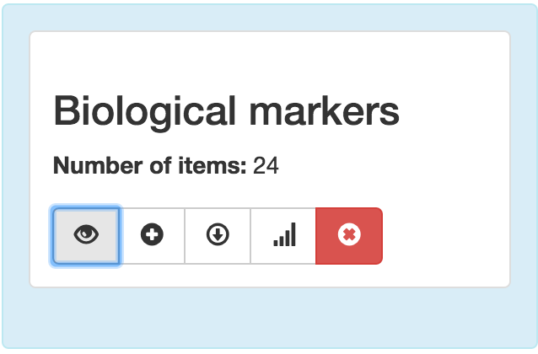
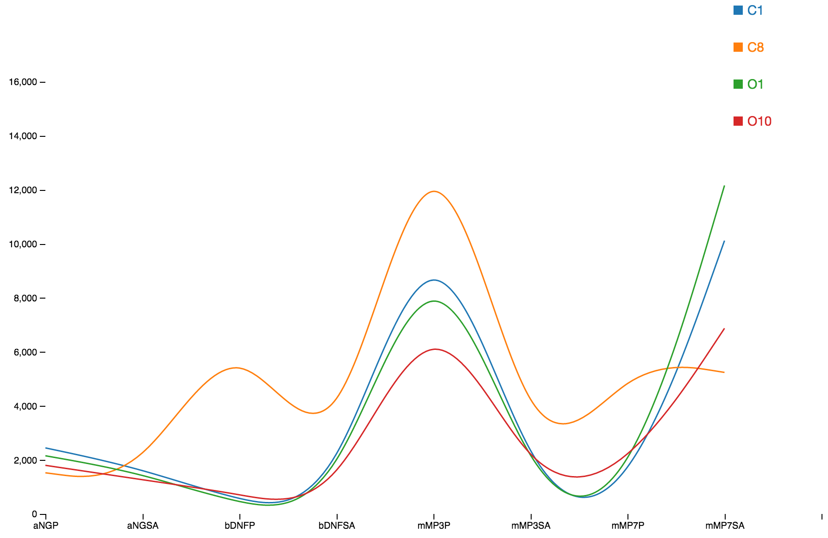
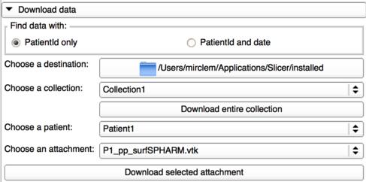

Facilitating Experiment Reproducibility Through Data Federation and Image Processing Tools Integration Juan C. Prieto, Clement Mirabel, Beatriz Paniagua, Marilia S. Yatabe, Antonio C.O Ruellas, Liana Fattori, Luciana Muniz, Martin Styner, and Lucia Cevidanes NIRAL, University of North Carolina, Chapel Hill
DCBIA, University of Michigan, Ann Arbor
INTRODUCTION
We present Shiny-tooth, a web based application created to facilitate:
Data federation of clinical and morphological data derived from medical images.
Web interactive data visualization.
Statistical analysis in remote computing grids using heterogeneous data sources.
Interaction with one of the most popular software for medical image analysis 3D Slicer.
Shape analysis using Deep Learning toolkits
METHODS
The primary motivation of this work is to improve the state of clinical research data organization in order to facilitate data sharing across institutions and collaborators and ultimately to facilitate the reproducibility of clinical trials.
Many scientific findings cannot be easily replicated by other groups. This situation has drawn the attention of the scientific community.
RESULTS
CONCLUSIONS
The application allows gathering clinical data and morphological data in a structured but flexible manner.
Several tools and plug-ins have been published and are available in the node package manager (npm) repository.
An extension is developed for one of the most popular software for medical image processing and three-dimensional visualization. The 3D-Slicer plug-in facilitates interaction with the data stored in the system.
With the tools presented here, we seek to provide new possibilities to record previous studies, facilitate data-sharing, improve experiment reproducibility and usage of deep learning toolkits.
REFERENCES
[1] Collaboration, O. S. et al., “Estimating the reproducibility of psychological science,” Science 349(6251), aac4716 (2015).
[2] DB, T., J, B., C, B., and et al, “Sharing clinical trial data: A proposal from the international committee of medical journal editors,” JAMA 315(5), 467–468 (2016).
[3] Krishnankutty, B., Bellary, S., Kumar, N. B., and Moodahadu, L. S., “Data management in clinical research: An overview,” Indian Journal of Pharmacology 44(2), 168–172 (2012).
[4] Cevidanes, L., Hajati, A.-K., Paniagua, B., Lim, P., Walker, D., Palconet, G., Nackley, A., Styner, M., Ludlow, J., Zhu, H., and Phillips, C., “Quantification of condylar resorption in temporomandibular joint osteoarthritis,” Oral Surgery, Oral Medicine, Oral Pathology, Oral Radiology, and Endodontology 110(1), 110 – 117 (2010).
[5] Paniagua, B., Cevidanes, L., Walker, D., Zhu, H., Guo, R., and Styner, M., “Clinical application of spharm- pdm to quantify temporomandibular joint osteoarthritis,” Computerized Medical Imaging and Graphics 35(5), 345 – 352 (2011).
[6] Danaele Puechmaille, M. S. and Prieto, J. C., “Civility: Cloud based interactive visualization of tractography brain connectome,” in [SPIE Medical Imaging], International Society for Optics and Photonics (2017).
[7] Styner, M., Oguz, I., Xu, S., Brechbuehler, C., Pantazis, D., Levitt, J., Shenton, M., and Gerig, G., “Frame- work for the statistical shape analysis of brain structures using spharm-pdm,” (07 2006).
http://www.nature.com/news/1-500-scientists-lift-the-lid-on-reproducibility-1.19970
2017 University of North Carolina, University of Michigan

