Slide 1
PPT Slide Template for DCC2GO Project
Draft template for common look of slides from EMPIR SCP project DCC2GO
Daniel Hutzschenreuter, Clifford Brown, PTB

Slide 2
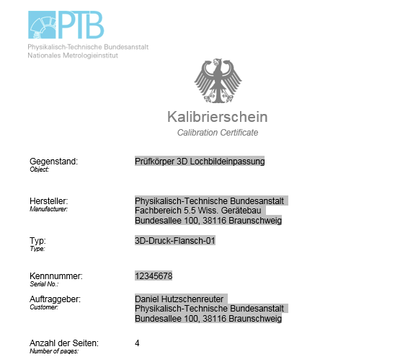
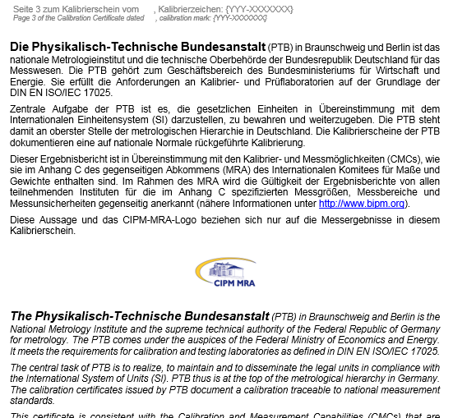
What is a Digital Calibration Certificate?
The handling of current calibration certificates requires manual work
Calibration certificates are commonly still paper documents or PDF files
These formats lack machine-readability
Transcribing data from a certificate needs to be done manually
Vulnerability to human errors that cause risks
Inefficiency in terms of time and costs

Slide 3
Why do we need DCCs?
Efficiency, in speed of transmission and readability into various digital systems
Avoids manual processing and the possibility of making transcription errors
Security - digital data files can be signed and securely transmitted
Company policy towards digital paper-less office
Digital measuring management systems need media break free (whole process is digital) collation of calibration data
The DCC can allow for significantly more information to be provided to customers …
.

Slide 4
How do I build a DCC?
Choose which type to use (XML or PDF Based)*
Look for Good Practice examples for the type of Calibration you are making. (Currently examples of Best Practice are available from the PTB website (link). DKD Mass Expert Report (link to find)
Find and use suitable tools to build the DCC (Gemimeg tool for XML, GitHUB repository for the PDF/A3 DCC). Other tools are available and will be described in more detail.
More technical details will be provided in the “DCC Starter Kit” and also via the DCC Summer School training material. (SEE shanna link to material see my email to Shanna)
*Please note Word files and plain pdf documents are not machine readable and so are not considered DCCs
Notes:
How do I build them? What are they based on? (D-SI, DCC)
Different DCC types (Introduce them only, more details later) (see 1.3 for list)
Creating DCCs (brief description, tools)

Slide 5
How do I build a DCC?
Compare the paper based workflow with the DCC workflow
Notes:
How do I build them? What are they based on? (D-SI, DCC)
Different DCC types (Introduce them only, more details later) (see 1.3 for list)
Creating DCCs (brief description, tools)

Slide 6
How can an organisation start with DCCs?
Training. Technical staff will need to be trained in the use of DCCs (See Starter Kit and Compendium (refer to webpage))
How will DCCs affect workflow? You will need to adapt your workflow (include something about automation, refer to starter kit)
How will DCCs affect my customers? They will also need to adapt their workflow
See document in task 2.1 for some more details for nearer term steps in subsection 3.
Notes:
What does an organisation have to do to start using DCCs? (Depends on what type of organisation you are)
Training. Technical staff will need to be trained in the use of DCCs (See Starter Kit and Compendium (refer to webpage))
How will DCCs affect workflow? You will need to adapt your workflow (include something about automation, refer to starter kit)
How will DCCs affect my customers? They will need to adapt their workflow

Slide 7

DCC Harmonisation
Consensus:
uniform structure/hierarchy
uniform exchange format (XML or PDF)
Technical solutions:
cryptographic signatures/seals
data security, encryption
authentication (identification of interaction) e.g. PKI
Legal requirements:
legal validity/ documentation of validity period
Withdrawal of calibration certificates
Fundamental NMI specification in SmartCom
Transfer of NMI specification to
end users & standardization
Digital Calibration Certificate (DCC) considering technical and legal requirements
Notes:
Harmonisation – being involved in the development of DCCs (List groups 1448, DCCUF, DKD/PTB (for measurands); DCC Core team)

Slide 8
Human Readability of DCCs
DCCs will retain a human Readable component for backwards compatibility (different ways of making it human readable)
The DCC can allow for significantly more information to be provided to customers …
The digital representation of calibration data allows for multiple ways of displaying it in a human readable form which may vary according to the role of the person viewing the information. Basically Accreditation people will want to see different information to a Customer of a calibration.
Notes:
DCCs will retain a human Readable component for backwards compatibility (different ways of making it human readable)

Slide 9
Security of DCCs
Notes:
Security and compatibility (across Euro boarders) of transmitting DCCs

Slide 10
Long Term Readability of DCCs
Notes:
Long Term Readability of XML and PDC/A3s

Slide 11
DCCs and Accreditation Authorities
Notes:
DCCs are accepted by accreditation authorities within Europe. (17025 does not say anything about format). But QM/accreditation authorities do require, as with current workflows for CCs, the workflow and persons responsible need to be fully documented.

Slide 12
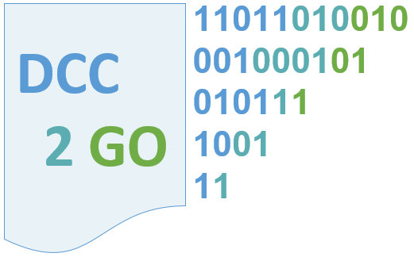
Draft Logo new
DCC
2 GO
11011010010
001000101
010111
1001
11
Image
PP Object

Slide 13
Remember to add credit for images used! See last slide in DCCBasics pptx

