Slide 1
DCC2GO Basic Knowledge on DCCs
Information for technical staff at NMIS and DIs
Author list

Slide 2
Today’s production life cycle
Life cycle of “calibration – use – recalibration” of measuring equipment
production
measure-
ment
1
7
QM
6
start of
calibration
2
Industry
5
Calibration
T
ransfer
time for re-
calibration
report
8
9
4
3
Optimi-
sation
data analysis
© figure: S. Hackel, et al, PTB, 2019

Slide 3
Today’s production life cycle
NMI & DI (calibration laboratory) start of working with DCCs
Importing (reading) data from DCC of (in-house) calibrated equipment to QM system
production
measure-
ment
1
7
QM
6
start of
calibration
2
Industry
5
Calibration
T
ransfer
time for re-
calibration
report
8
9
4
3
Optimi-
sation
data analysis
Manually creating first calibration reports in machine-readable DCC format
© figure: S. Hackel, et al, PTB, 2019

Slide 4

DCC examples
DCC by PDF document
DCC by XML document
<XML/>
DCC
PDF/A-3
DCC
PDF document providing human readable information and containing
Additional machine readable files with calibration result data
Fully XML structured file with all calibration information and data in machine-readable format
Optional human readable file (such as PDF) included as binary machine-readable data

Slide 5
Example: PDF A/3 Type DCC
Example from Task 2.1?

Slide 6
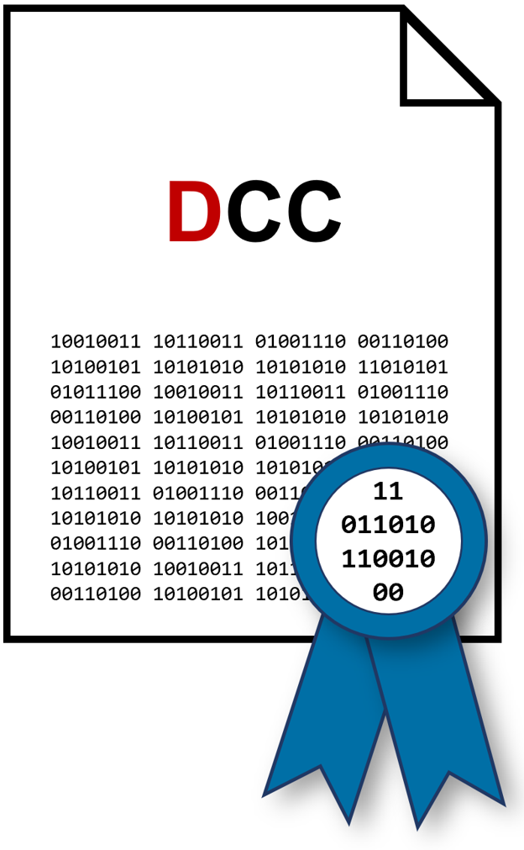
Example: XML Type DCC (1/3)
Fundamental DCC-layout
SI
17025
1. Administrative shell (mainly mandatory)
GUM
VIM
CODATA
…
2. Calibration results (partly regulated)
3. Individual information (not regulated)
4. Optional Attachment:
„Human readable document“ (e. g. PDF)
+ Framework conditions
+ legal requirements

Slide 7
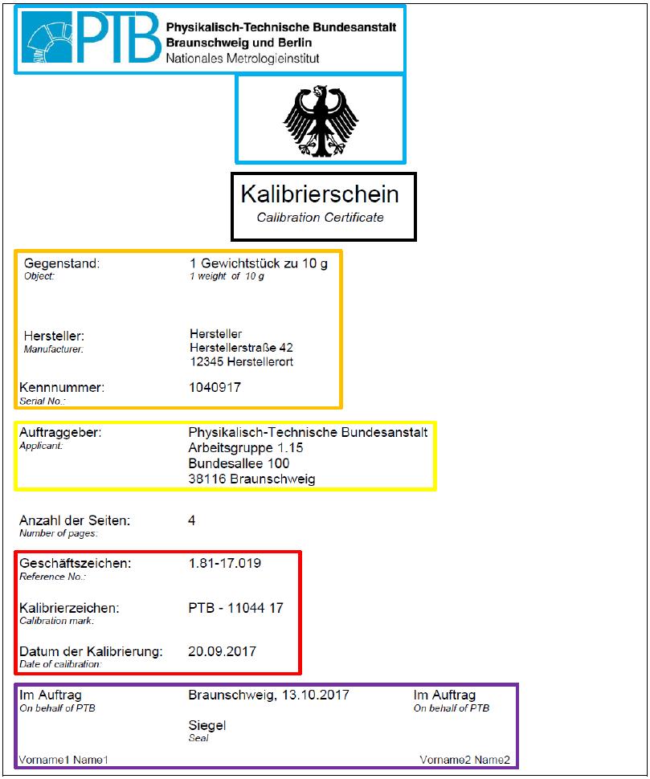
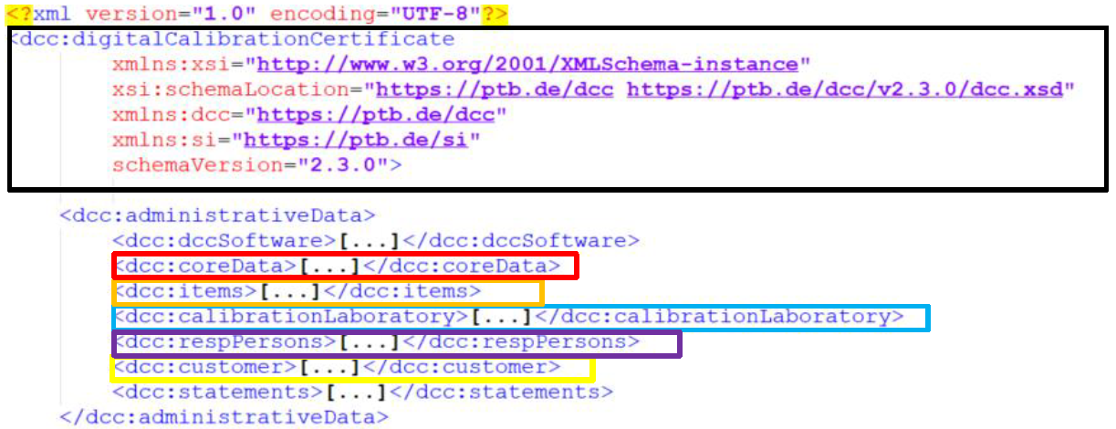
Example: XML Type DCC (2/3)
<XML/>
DCC
Human-readable
to
machine-readable
https://doi.org/10.5281/zenodo.3816696
PTB-Certificate-1.81-17.019.pdf
PTB-DCC-1.81-17.019.xml

Slide 8
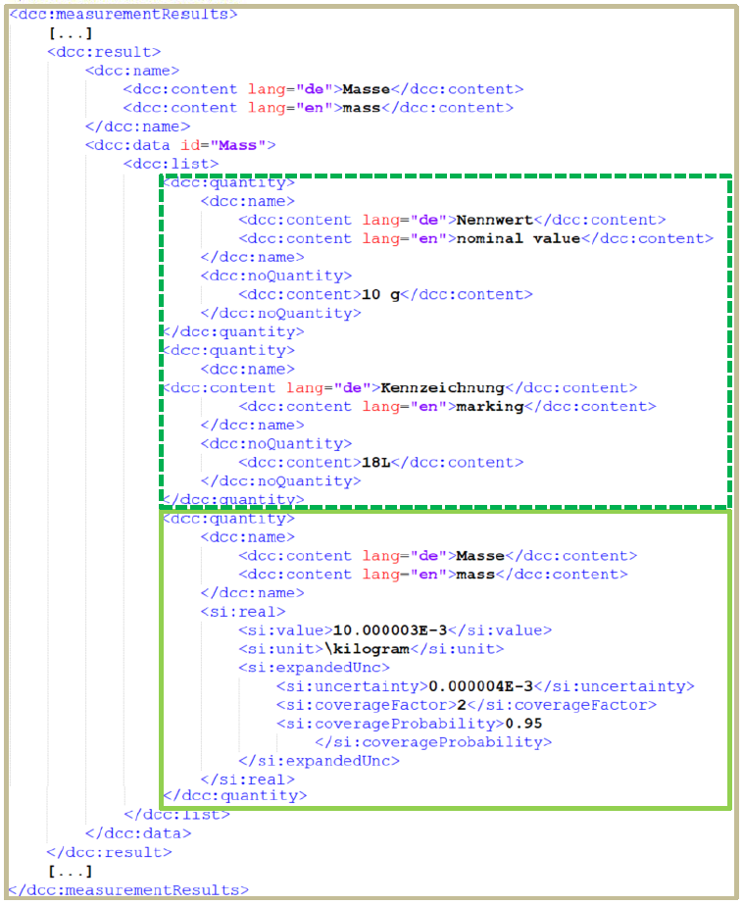
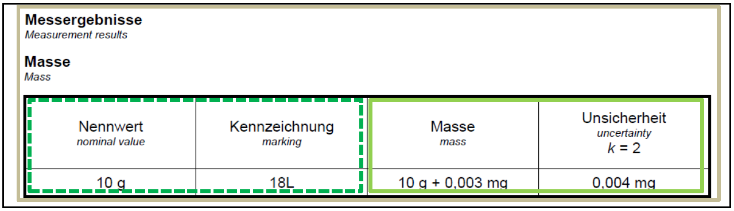
Example: XML Type DCC (3/3)
<XML/>
DCC
Human-readable
to
machine-readable
https://doi.org/10.5281/zenodo.3816696

Slide 9
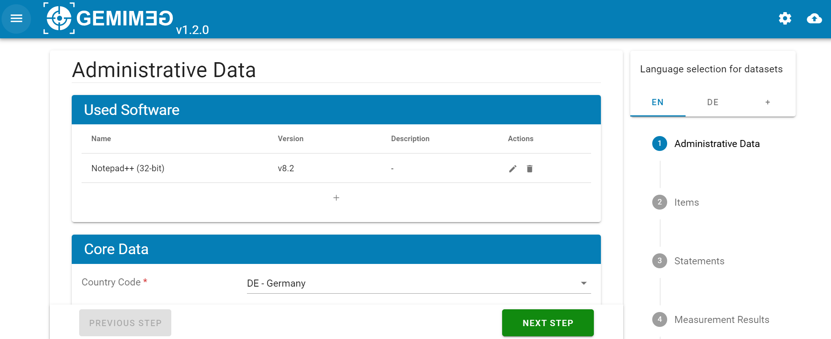
IT Requirements
Start working with XML type DCCs
An office computer is sufficient to start reading and writing XML DCCs
People experienced with XML may use standard text & code editors such as Notepad, Notepad++, Visual Studio
PTB offers the GEMIMEG TOOL which is a prototype web service for creating and reading DCCs with a user interface for people without experience in XML. The XML is created by the web service
https://www.gemimeg.ptb.de/gemimeg-tool/#/
Official documentation and resources:
https://www.ptb.de/dcc/
https://dccwiki.ptb.de/en/DCC_basic_ideas

Slide 10
Today’s production life cycle
NMI & DI (calibration laboratory) start of working with DCCs
production
measure-
ment
1
7
QM
6
start of
calibration
2
Industry
5
Calibration
T
ransfer
time for re-
calibration
report
8
9
4
3
Optimi-
sation
data analysis
First DCCs transferred to customers as appendix to existing analogue certificates
© figure: S. Hackel, et al, PTB, 2019

Slide 11
Today’s production life cycle
NMI & DI (calibration laboratory) advancing DCC transfer
production
measure-
ment
DCC with electronic or digital signature of person or seal of calibration lab (for trust)
1
7
QM
6
start of
calibration
2
Industry
5
Calibration
T
Calibration lab providing software (web) interface for DCC transmission / retrieval
ransfer
time for re-
calibration
report
Change of default format from analogue to DCC
8
9
4
3
Optimi-
sation
data analysis
© figure: S. Hackel, et al, PTB, 2019

Slide 12



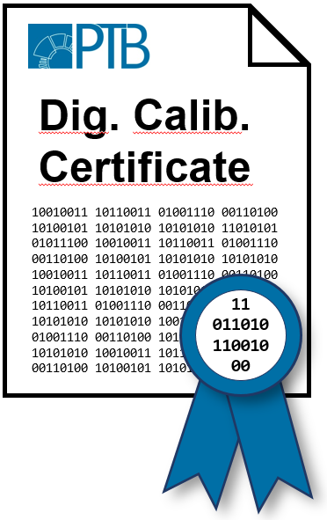





Role of digital signatures and seals
Calibration
Laboratory
E.g. Digital Signature
Calibration
Customer
DCC Exchange
Providing DCC Integrity
(no modifications)
Providing DCC Authenticity
(from our "lab")
Correct DCC from the Calibration Laboratory
Confidential transmission
(encryption)

Slide 13




IT Requirements
Start working with electronic and digital signatures
An office computer is sufficient to start working with electronic and digital signatures
Most PDF viewing and editing software allows to create simple electronic signatures that allow a low level protection of PDF documents against manipulation.
Qualified digital signatures for documents (XML, PDF, …) and document containers (folders) are more advanced and start working with this will need additional equipment:
Software to apply signature to files
Private (secret) digital key code for signing on a key card
Hardware device connected to computer via USB for reading the key card and authorising signature
Signer’s
Key Card
The European Commission has a list of providers of trusted and recognized signatures
https://digital-strategy.ec.europa.eu/en/policies/eu-trusted-lists

Slide 14
Today’s production life cycle
NMI & DI (calibration laboratory) advancing automation of DCC creation
Using software to automatically assemble administrative DCC data
production
measure-
ment
1
7
QM
6
start of
calibration
2
Industry
5
Calibration
Automated measurement processes and data collection in machine-readable formats
T
ransfer
time for re-
calibration
report
8
9
4
3
data analysis
Optimi-
sation
Automated evaluation of data for calibration report and assembly of DCC measurement results
© figure: S. Hackel, et al, PTB, 2019

Slide 15
Today’s production life cycle
NMI & DI (calibration laboratory) advancing automation of DCC usage
QM software automatically retrieving DCCs and importing data in company data bases
production
measure-
ment
Various processes where measure-ment data of equipment is automatically enhanced with metadata from DCC, e.g., measurement uncertainties, etc.
1
7
QM
6
start of
calibration
2
Industry
5
Calibration
T
ransfer
time for re-
calibration
report
8
9
4
3
Optimi-
sation
data analysis
© figure: S. Hackel, et al, PTB, 2019

Slide 16
IT Requirements
Some areas of a organization may already have laboratories where software and IT infrastructure has been established that allows an automatic processing of a calibration and the automatic creation of the Calibration Certificate (Word, PDF, or similar). Automatically creating a DCC would require only an additional output module for the software.
General requirements comprise for example
Databases for storing measurement data, calibration data, administrative data for customers, equipment data, etc.
Data exchange network allowing data exchange between digital outputs of measuring devices and software running the calibration (including instruments able to send and receive data)
Software automating the calibration process (controlling devices etc., collecting and evaluating data as well as creating output reports)
In case of the XML type DCC, first commercial tools are available
such as AnyDCC (© 2022 Stotz Software)

Slide 17
Today’s production life cycle
NMI & DI (calibration laboratory) advancing automation of services
production
measure-
ment
1
7
QM
6
start of
calibration
2
Industry
5
Calibration
T
ransfer
time for re-
calibration
report
8
9
4
3
Calibration laboratory offering portal where automatic processable requests for calibration services can be submitted
data analysis
Optimi-
sation
© figure: S. Hackel, et al, PTB, 2019

Slide 18
IT Requirements
Calibration laboratory and customer will need access to the world wide web to be able to exchange relevant information
The calibration laboratory needs to operate an access point for customers, e.g., an application running on a web server (hosted or rent by laboratory) or an service establish through a cloud environment.
The service of the calibration laboratory could provide a Web Page for humans to manually enter and submit data and in addition have a programming interface through which software of a customer could automatically submit data.
The customer may need to register an account at the service provided by the laboratory to be enabled to digitally submit requests for calibration.
The customer may operate an equipment management system that automatically schedules and requests re-calibration.

Slide 19
Machine-Interoperability
“Bad analogue data will create bad digital data”
Automation of processes and usage of data by machines will need machine-interoperable data ready for human-to-machine and machine-to-machine communication
Developments towards wider machine-interoperable DCCs include
Harmonization of formats like XML DCC
Harmonization of domain (measurand) specific calibration results & good practices
Harmonization of common identifiers (terms) for data and properties in DCCs
Where different DCC types are consumed, software for mapping between different data representations
Harmonization examples:
CIPM Digital-SI (format, SI identifiers) DKD committees (domain, good practice, identifiers)
XML DCC (format, identifiers) EURAMET TC-IM 1448 DCC (good practice, identifiers, mappings)

Slide 20
Final page with contact information

