Slide 1
Learning to Learn Words from Visual Scenes
Dídac Surís, Dave Epstein, Heng Ji, Shih-Fu Chang, Carl Vondrick
ECCV 2020

Slide 2
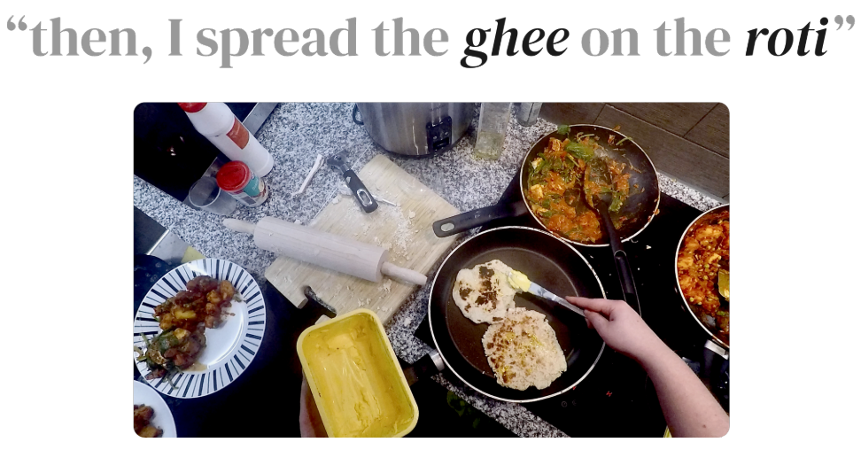
Language Acquisition
Language acquisition is the process of learning words from the surrounding environment.
Multi-modal Data
Single-modal Task
“ghee”: the butter on the knife
“roti”: the bread in the pan

Slide 3
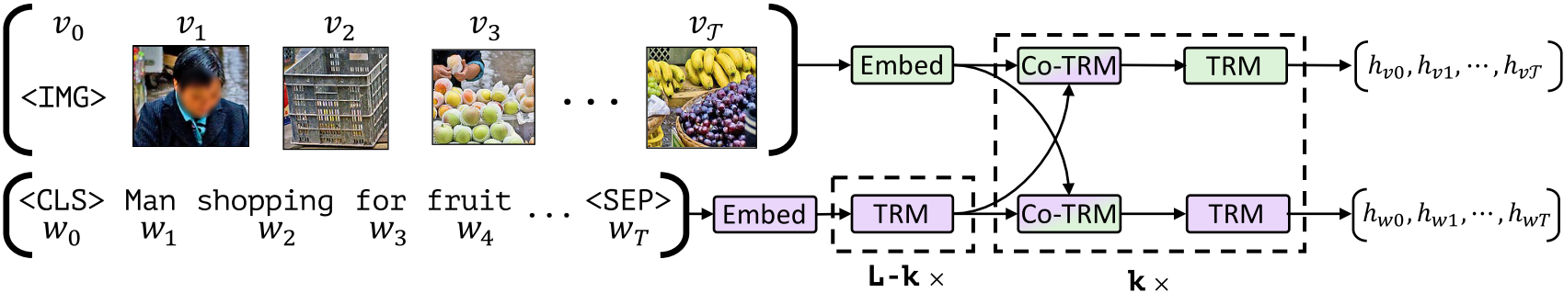
Visio-linguistic Embeddings
Try to learn a common & aligned embedding space for visual and textual feature
Typical architecture (ViLBERT*)
Transformer
Encoder
Aligned
Feature
Inputs from Both Modality

Slide 4
Drawbacks
Data inefficient
Require millions of examples to learn
Poor compositional generalization
E.g.: Green apple + Yellow banana → Green banana?
What about novel words?
Fixed embeddings are unable to adapt to novel words at inference time

Slide 5
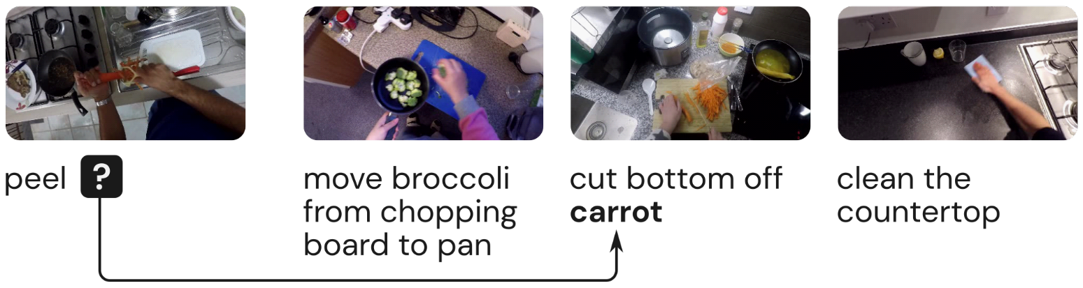
Motivation
Instead of learning the word embeddings, learn the process for acquiring word embeddings
As usual, train to perform a masked word task ...
But, do so by copying and pasting words

Slide 6
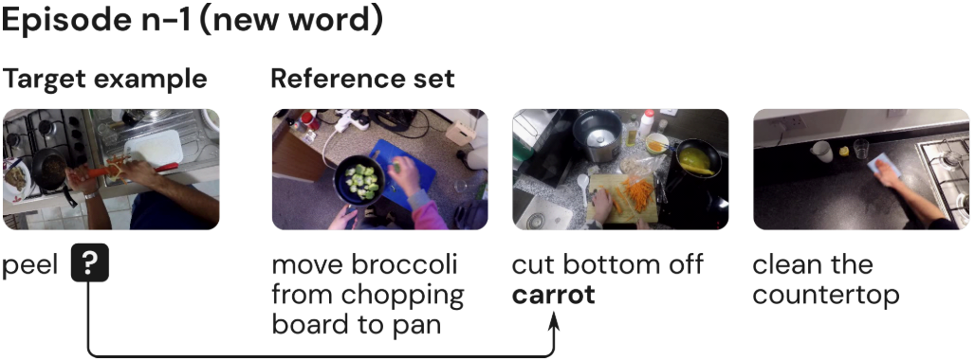
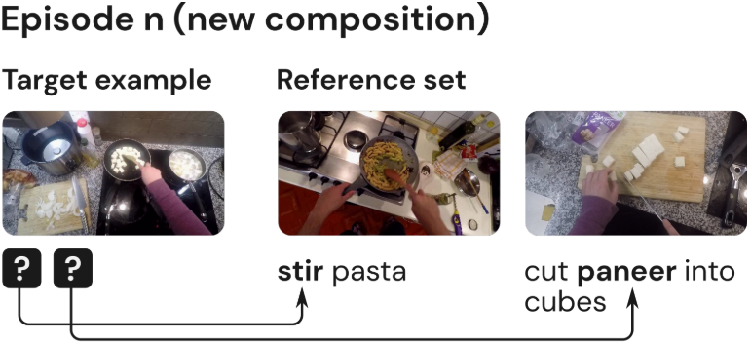
Build Training Episode
Novel
Compositional

Slide 7
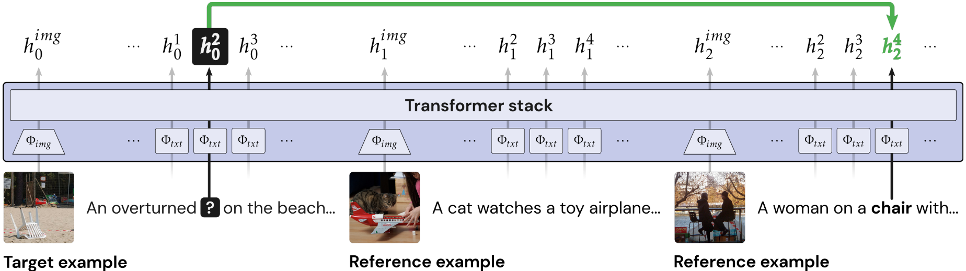
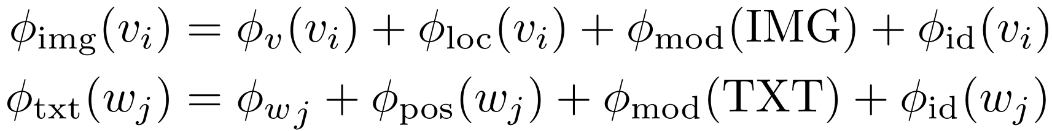
Model Architecture

Slide 8
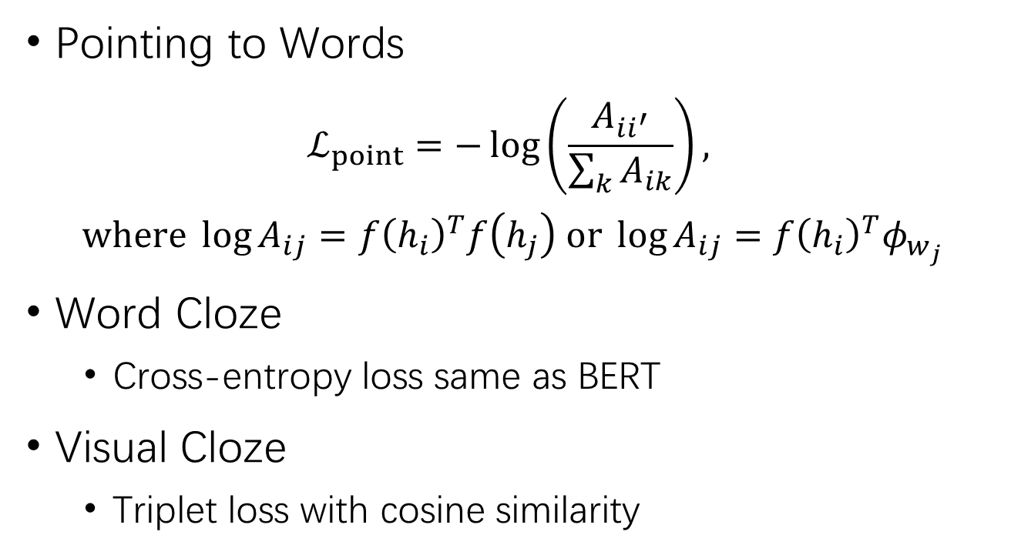
Learning Objectives
Pointing to Words
$$ℒ_{point}=−\log\left(\frac{A_{ii^{′}}}{\sum_{k}{A_{ik}}}\right),$$
$$where \log{A_{ij}}=f{\left(h_{i}\right)}^{T}f\left(h_{j}\right) or \log{A_{ij}}=f{\left(h_{i}\right)}^{T}φ_{w_{j}}$$
Word Cloze
Cross-entropy loss same as BERT
Visual Cloze
Triplet loss with cosine similarity

Slide 9
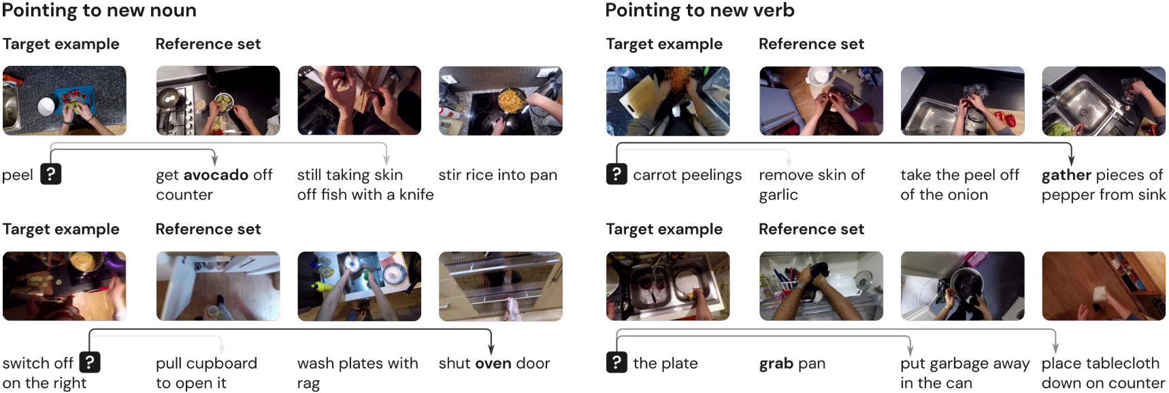
Non-parametric Inference
Input: an episode of vision and language pairs
Acquire words from reference set by pointing

Slide 10
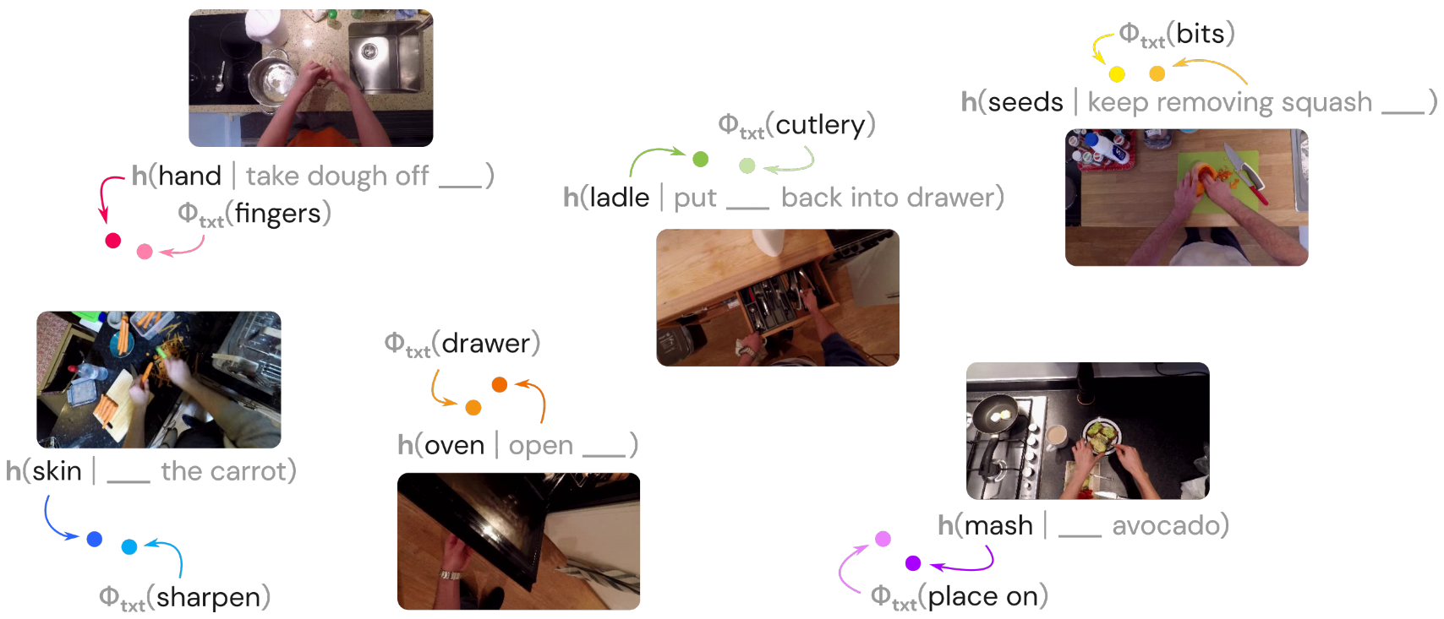
Embedding New Words

