Slide 1
Image Captioning
蒋志宏
2020.10.16

Slide 2
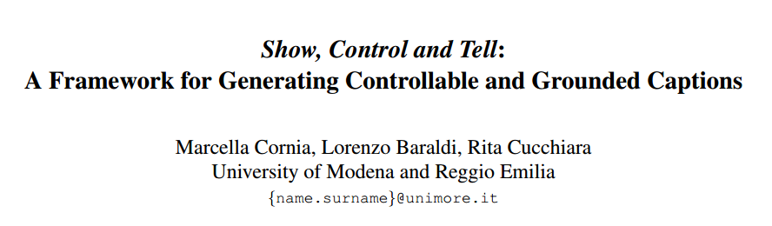
CVPR 2019

Slide 3
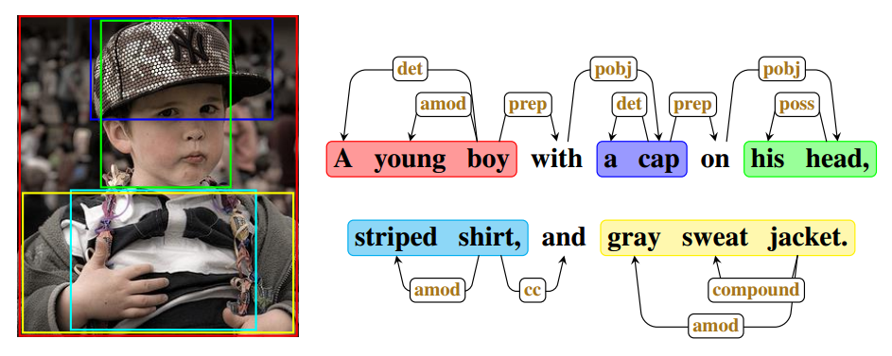
Controllable Image Captioning
a caption can be decomposed into a sequence of different noun chunks
As noun chunks can be visually grounded into image regions, a caption can also be mapped to a sequence of regions, each corresponding to a noun chunk.

Slide 4
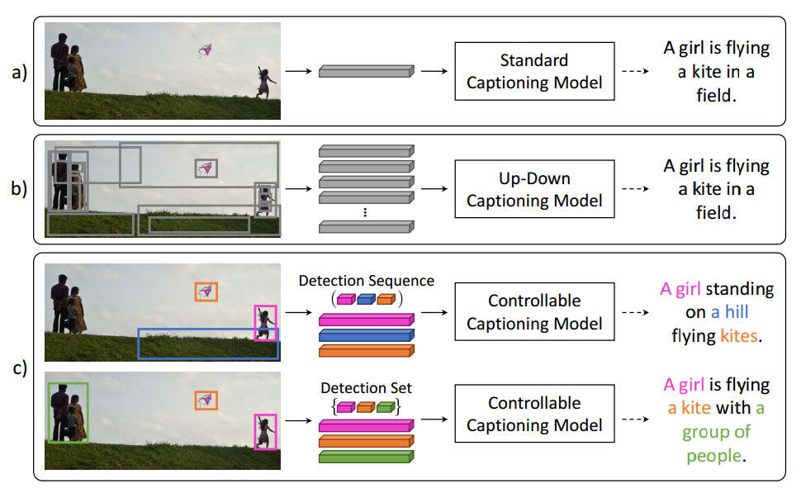
Controllable Image Captioning
Notes:
captioning models with global visual feature
attentive models with image regions
show, control and tell

Slide 5
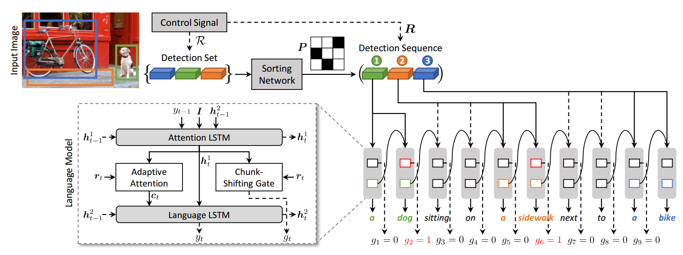
Model

Slide 6
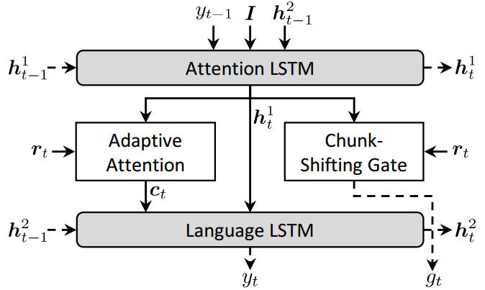
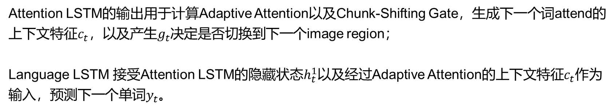
Language Model
Attention LSTM的输出用于计算Adaptive Attention以及Chunk-Shifting Gate，生成下一个词attend的上下文特征$c_{t}$，以及产生$g_{t}$决定是否切换到下一个image region；
Language LSTM 接受Attention LSTM的隐藏状态$h_{t}^{1}$以及经过Adaptive Attention的上下文特征$c_{t}$作为输入，预测下一个单词$y_{t}$。

Slide 7




Chunk Shifting Gate
在每个时间点，基于attention LSTM的状态设立一个chunk sentinel，记为 ，表示在每个chunk结尾处LSTM的状态。
用chunk sentinel的分数来决定，是否需要切换为下一个region。

Slide 8
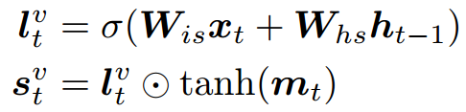
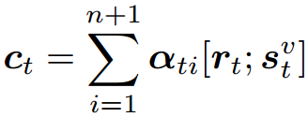

Adaptive Attention
设立一个visual sentinel：
计算$h_{t}对$[$r_{t}; s_{t}^{v}$] 的attention:

Slide 9
Sorting Network

Slide 10
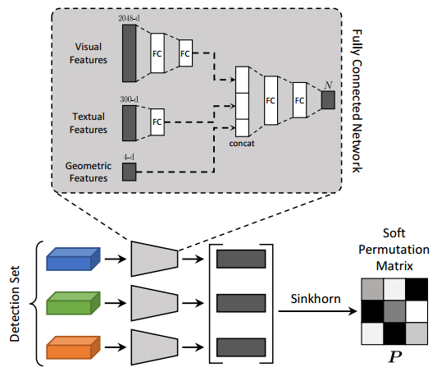
Sorting Network

Slide 11
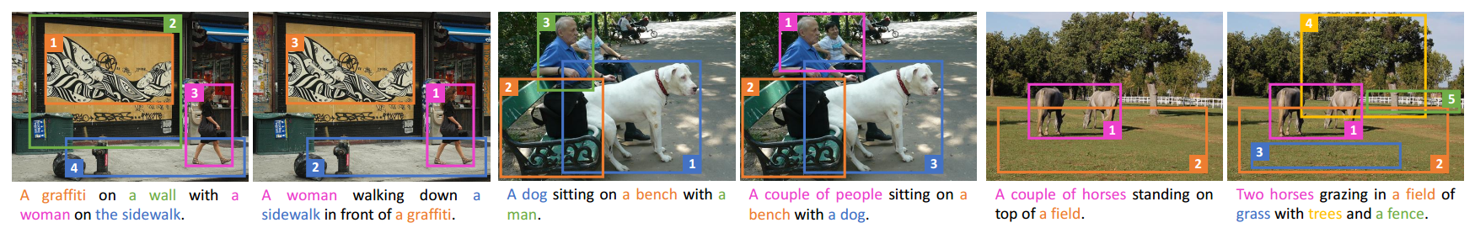
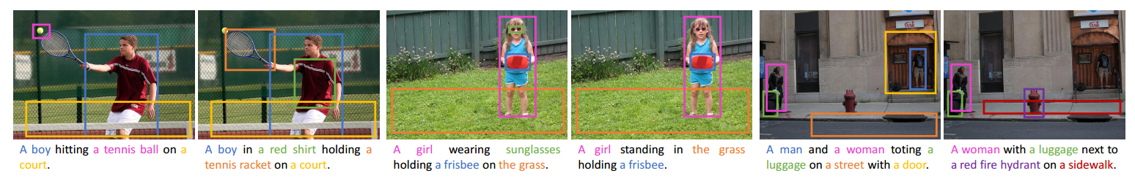
Results
Region Sequence
Region Set

Slide 12
Q & A

