Slide 1
Heritability Analysis of Complex Traits & Diseases:
Twin Study, Family Study, and GWAS
Jianxin Shi, PhD
Jianxin.Shi@nih.gov
Biostatistics Branch, Division of Cancer Epidemiology & Genetics

Slide 2
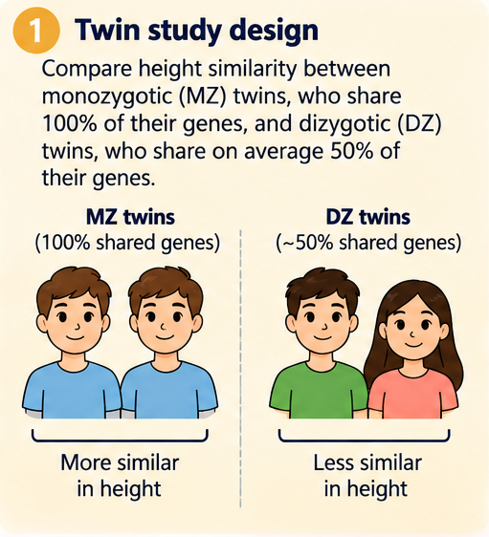
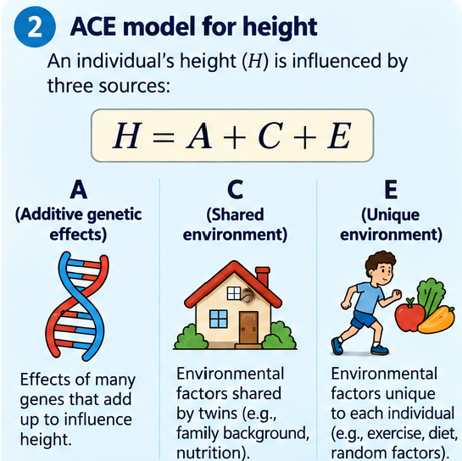
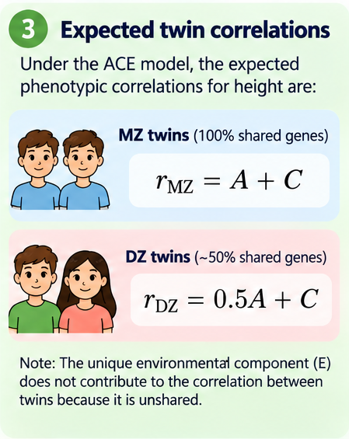
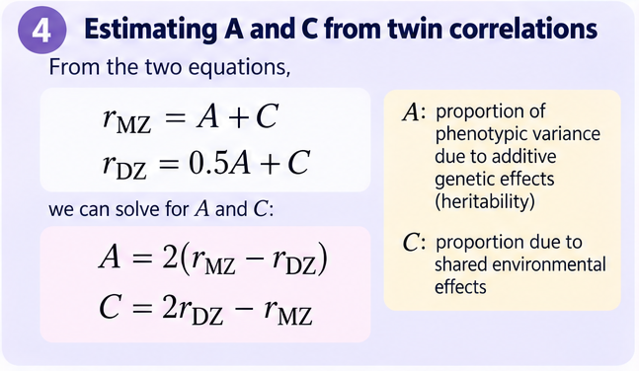
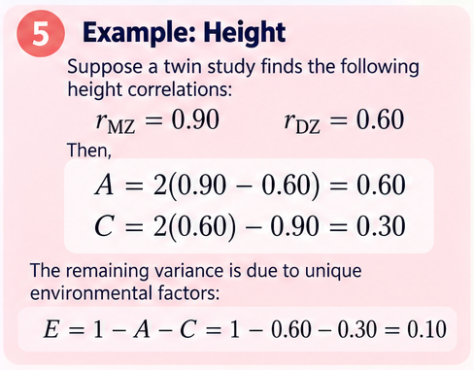
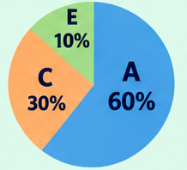
ACE Model: Estimating Heritability of Height Using Twin Data

Slide 3
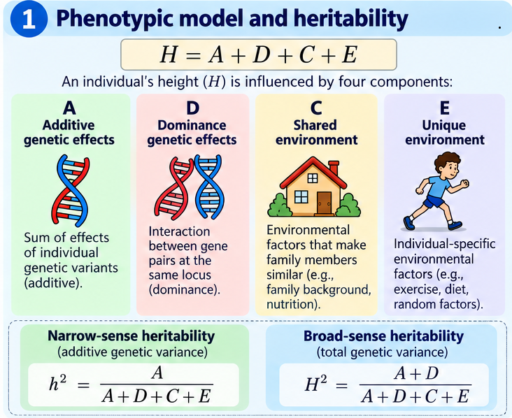
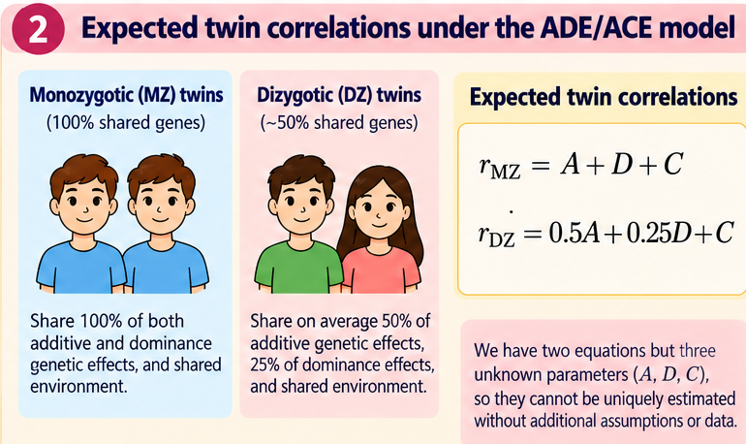
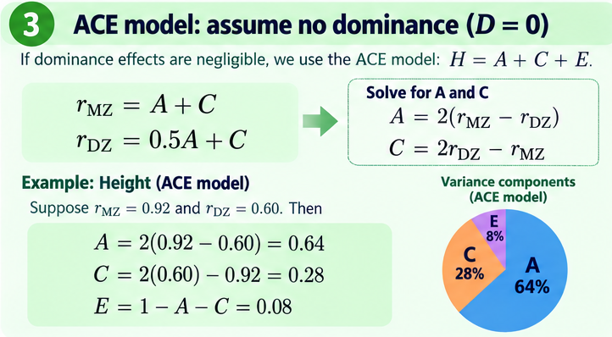
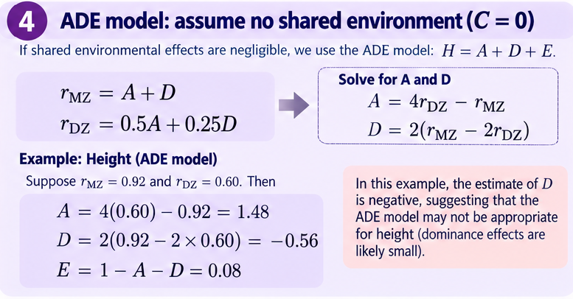
General Phenotypic Variance Partitioning

Slide 4
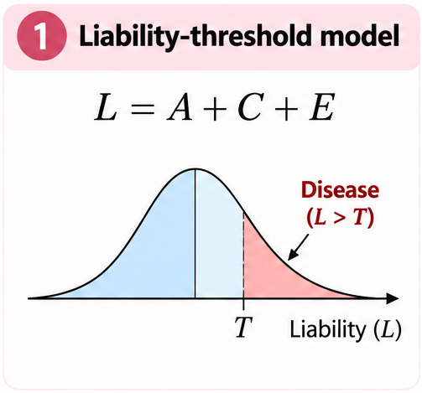
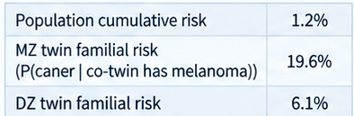
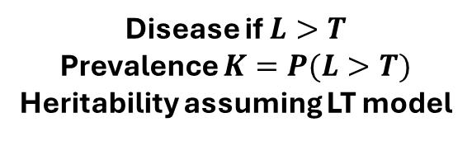

Estimate Cancer Heritability in Nordic Twin Study:
Liability Threshold mode + ACE
Diabetes: H1AC >6.5
For MZ twins, we have likelihood
Familial risk 0.196
Prevalence 1.2%
$→ρ_{MZ}=0.60$
Disease if $L>T$
Prevalence $K=P(L>T)$
Heritability assuming LT model
$$→ρ_{DZ}=0.30$$
ACE: $h^{2}=2\left(ρ_{MZ}−ρ_{DZ}\right)=2\left(0.6−0.3\right)=0.6$
Data for melanoma
Mucci et al., JAMA, 2016

Slide 5
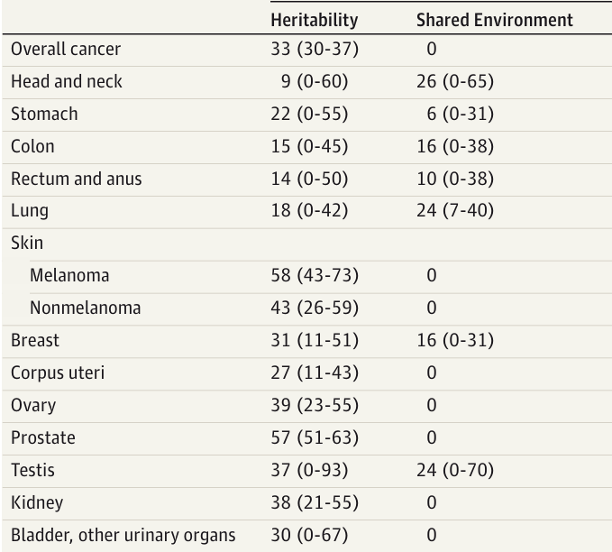
Mucci et al., JAMA, 2016

Slide 6
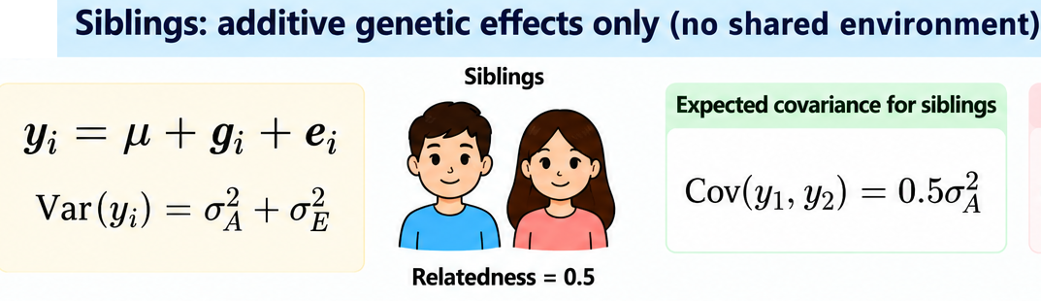
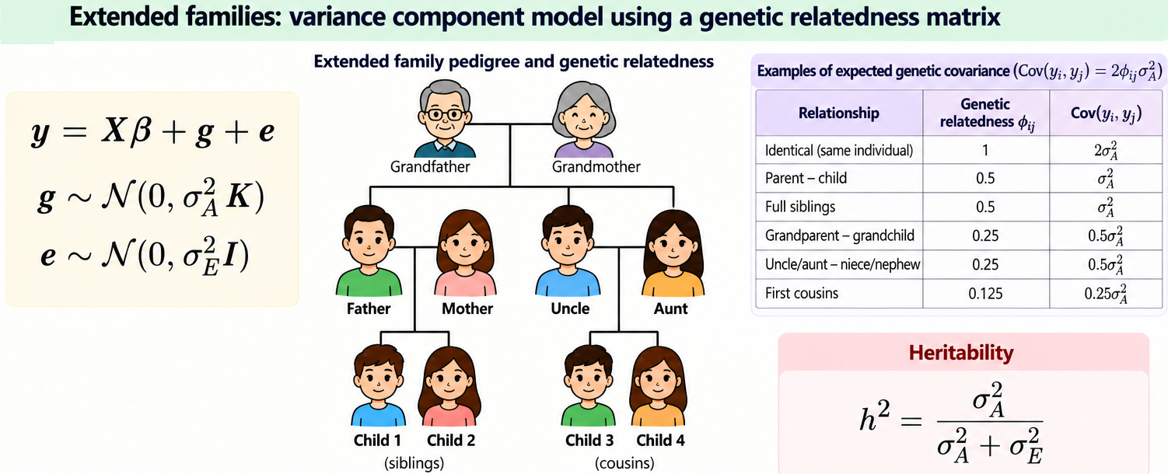
Variance Component Model for Heritability Estimate

Slide 7
Missing Heritability Problem in GWAS
High heritability from twins/families (80% height)
Small phenotypic variance explained by identified SNPs (2% in 2007)
Wrong estimate in twins/families or limited power of GWAS?

Slide 8
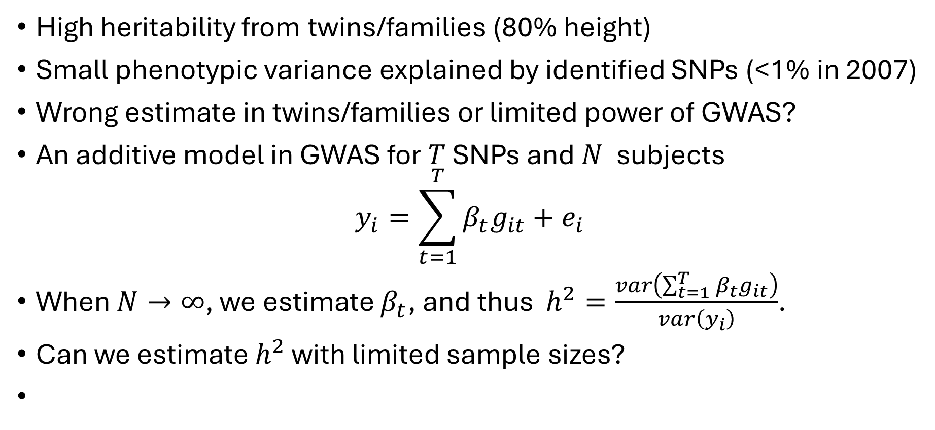
Missing Heritability Problem in GWAS
High heritability from twins/families (80% height)
Small phenotypic variance explained by identified SNPs (<1% in 2007)
Wrong estimate in twins/families or limited power of GWAS?
An additive model in GWAS for $T$ SNPs and $N$ subjects
$$y_{i}=\sum_{t=1}^{T}{β_{t}g_{it}+e_{i}}$$
When $N→∞$, we estimate $β_{t}$, and thus $h^{2}=\frac{var\left(\sum_{t=1}^{T}{β_{t}g_{it}}\right)}{var\left(y_{i}\right)}$.
Can we estimate $h^{2}$ with limited sample sizes?

Slide 9
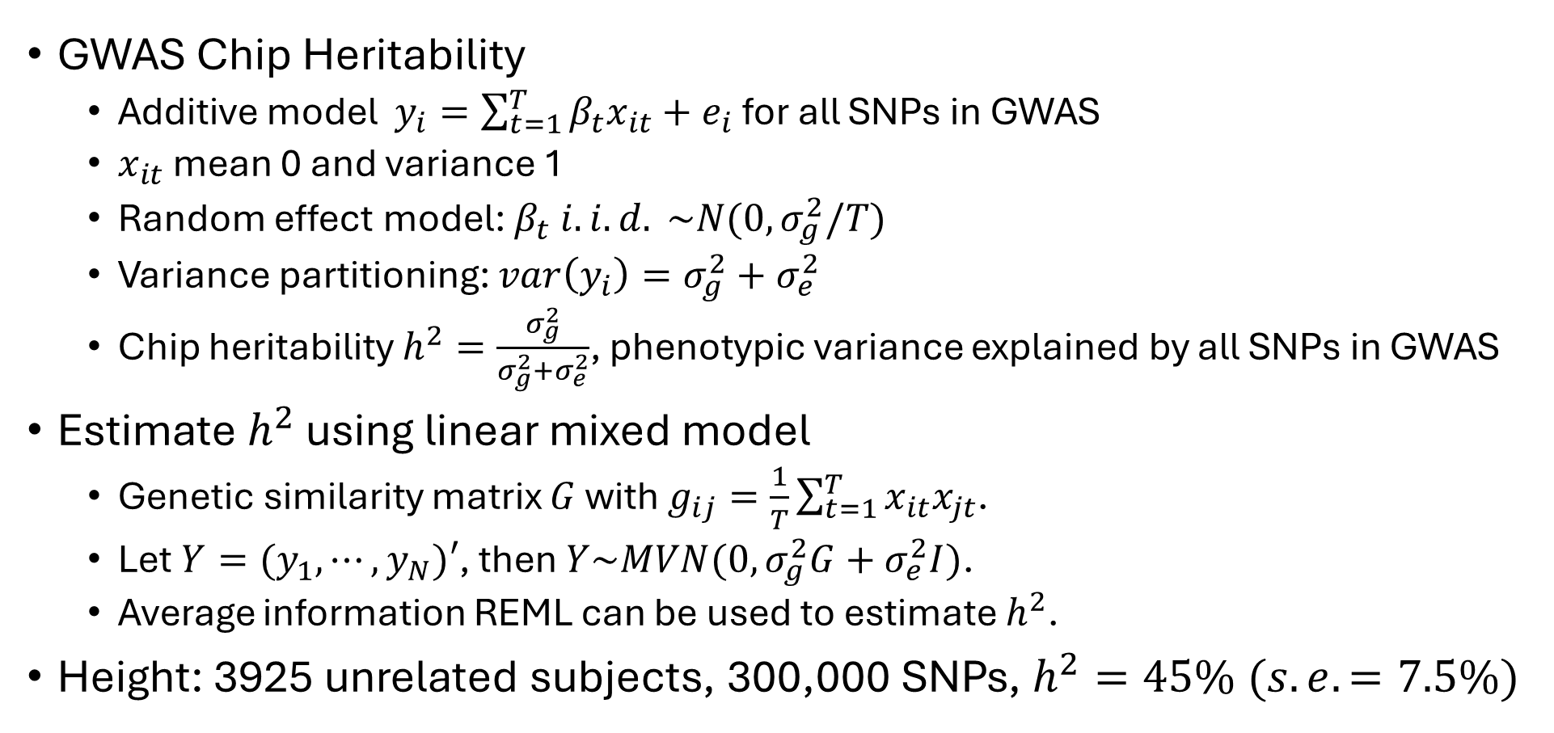
Estimate GWAS Chip Heritability
GWAS Chip Heritability
  Additive model $y_{i}=\sum_{t=1}^{T}{β_{t}x_{it}+e_{i}}$ for all SNPs in GWAS
  $x_{it}$ mean 0 and variance 1
  Random effect model: $β_{t} i.i.d. \sim N(0, σ_{g}^{2}/T)$
  Variance partitioning: $var\left(y_{i}\right)=σ_{g}^{2}+σ_{e}^{2}$
  Chip heritability $h^{2}=\frac{σ_{g}^{2}}{σ_{g}^{2}+σ_{e}^{2}}$, phenotypic variance explained by all SNPs in GWAS
Estimate $h^{2}$ using linear mixed model
  Genetic similarity matrix $G$ with $g_{ij}=\frac{1}{T}\sum_{t=1}^{T}{x_{it}x_{jt}}$.
  Let $Y=(y_{1},⋯,y_{N})′$, then $Y\sim MVN(0, σ_{g}^{2}G+σ_{e}^{2}I)$.
  Average information REML can be used to estimate $h^{2}$.
Height: 3925 unrelated subjects, 300,000 SNPs, $h^{2}=45\% (s.e. =7.5\%)$
Software: GCTA
Yang et al., Nat. Genet. , 2010

Slide 10
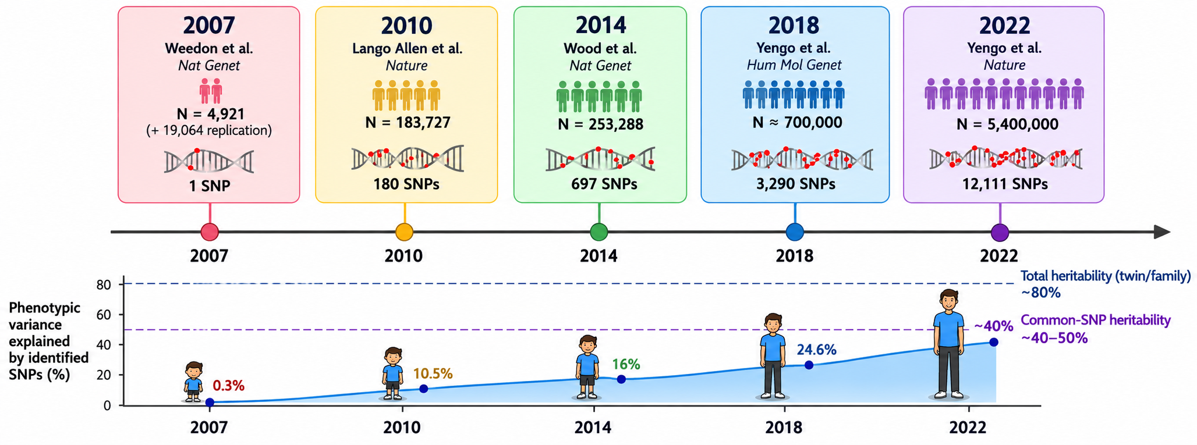
GWAS of Human Height: Progression and Future

Slide 11
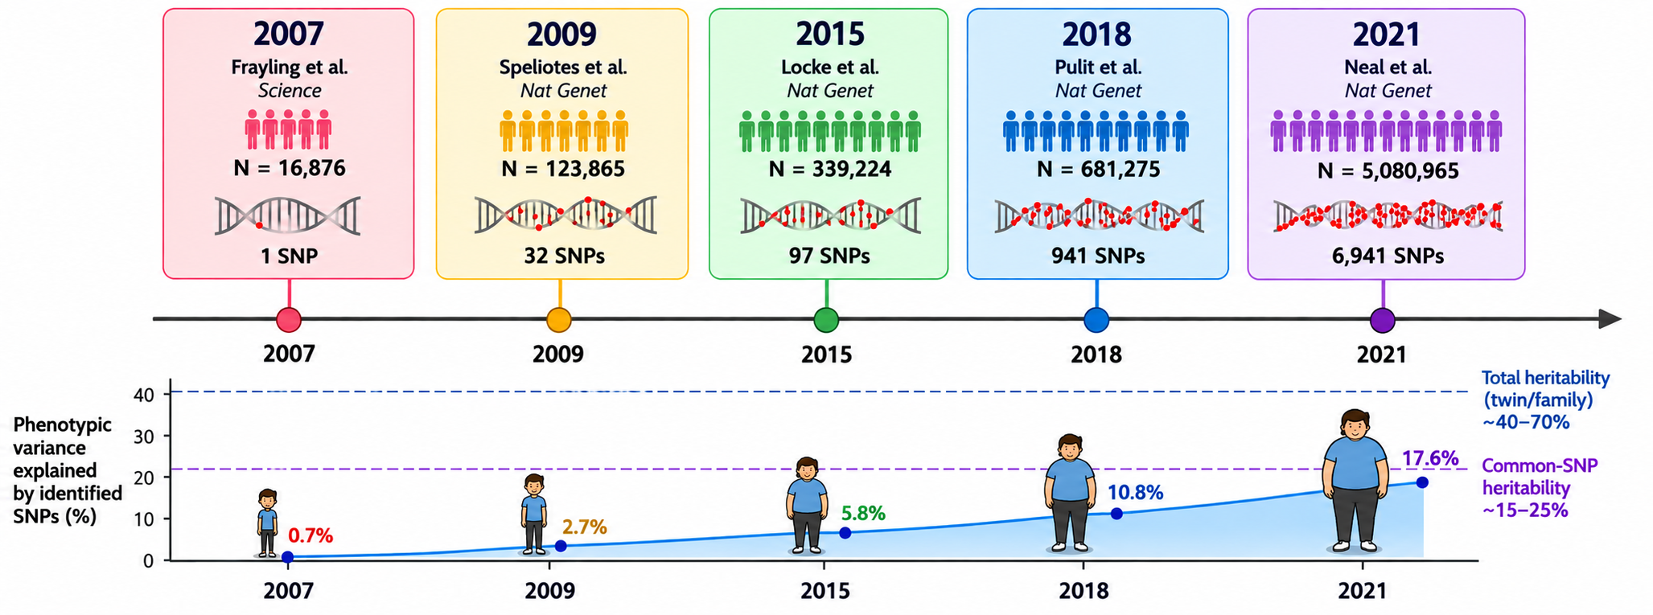
GWAS of Human BMI: Progression and Future

Slide 12
Additional Comments for Estimating Chip Heritability
Require individual genotype data to calculate GRM
At least 5000 subjects to have s.e. < 5%
More SNPs included (e.g., imputed), higher chip heritability
Refined models to allow effect size to depend on MAF
When sample size is very large (e.g., UK BioBank), rare variants can be included into the linear mixed model.
  N=350,000; MAF 0.01%-1%
  Whole genome sequencing: common + rare variants ~ 88% family heritability
  Wainschtein et al, Nature, 2026

Slide 13
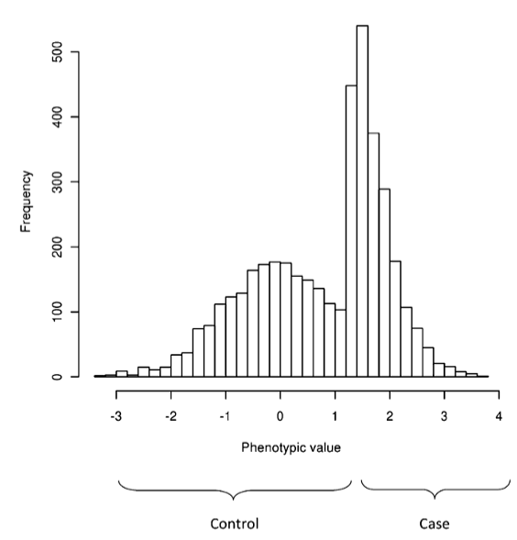
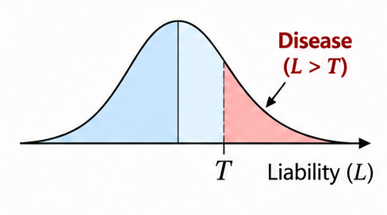
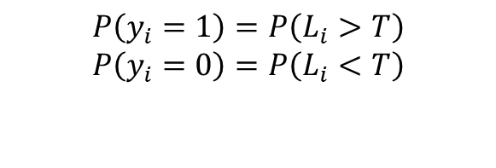
Estimate GWAS Chip Heritability for Binary Diseases:
Linear Mixed model + Liability Threshold model
$$P\left(y_{i}=1\right)=P\left(L_{i}>T\right)$$
$$P\left(y_{i}=0\right)=P\left(L_{i}<T\right)$$
Correction for oversampled cases
Software: GCTA
Yang et al., Nat. Genet. , 2010; Lett el at., AJHG, 2011, Yang et al., AJHG, 2011

Slide 14
Linear Mixed Model vs. LD Score Regression
GCTA based on mixed model requires individual level data
Modern GWAS are now typically based on meta-analysis, which collects summary statistics (beta/OR, s.e.) from studies.
Can we estimate heritability using GWAS summary statistics and what’s the price to pay?

Slide 15
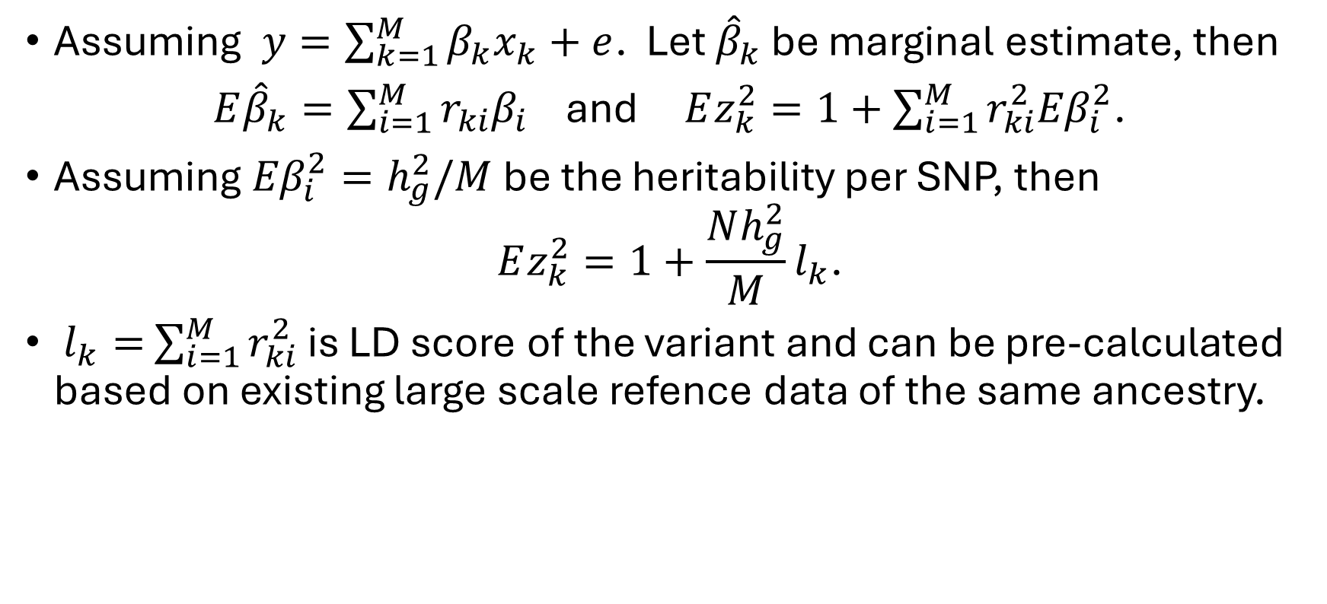
Statistical Framework of LDSC
Assuming $y=\sum_{k=1}^{M}{β_{k}x_{k}+e}$. Let ${\hat{β}}_{k}$ be marginal estimate, then
$E{\hat{β}}_{k}=\sum_{i=1}^{M}{r_{ki}β_{i}}$ and $Ez_{k}^{2}=1+$ $\sum_{i=1}^{M}{r_{ki}^{2}{Eβ}_{i}^{2}}$.
Assuming ${Eβ}_{i}^{2}=h_{g}^{2}/M$ be the heritability per SNP, then
$$Ez_{k}^{2}=1+\frac{Nh_{g}^{2}}{M}l_{k}\text{.}$$
$l_{k}=$ $\sum_{i=1}^{M}{r_{ki}^{2}}$ is LD score of the variant and can be pre-calculated based on existing large scale refence data of the same ancestry.

Slide 16
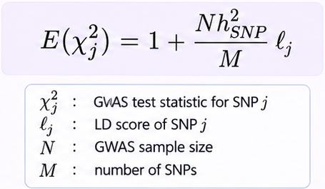
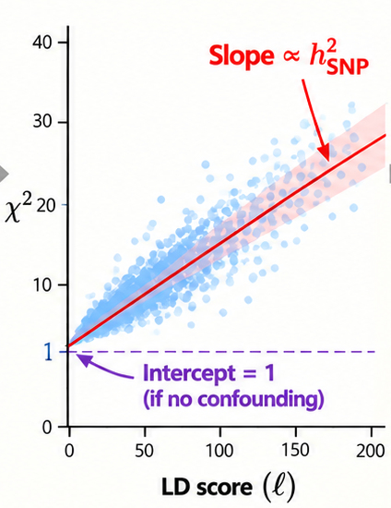
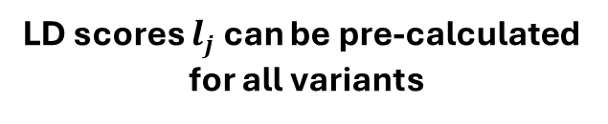
Statistical Framework of LDSC
LD scores $l_{j}$ can be pre-calculated
for all variants
Bulik-Sullivan et al., NG, 2014; Finucane et al, NG, 2015

Slide 17
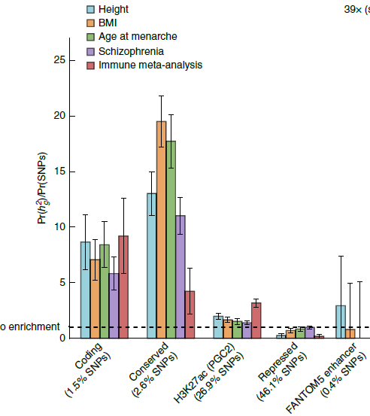
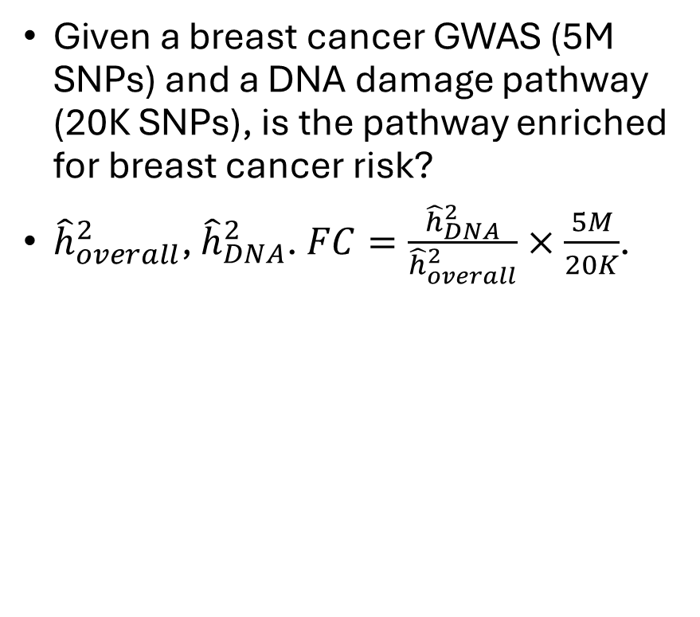
Heritability Enrichment Analysis Using LDSC
Given a breast cancer GWAS (5M SNPs) and a DNA damage pathway (20K SNPs), is the pathway enriched for breast cancer risk?
${\hat{h}}_{overall}^{2}$, ${\hat{h}}_{DNA}^{2}$. $FC=\frac{{\hat{h}}_{DNA}^{2}}{{\hat{h}}_{overall}^{2}}×\frac{5M}{20K}$.
Finucane et al, NG, 2015

Slide 18
Summary of Heritability Analysis
Family-based heritability analysis includes additive, dominant effects, but may be inflated by shared environment effects. Small sample size is needed.
GWAS chip heritability includes additive effects for common variants, may further include rare variants and dominant effects. Large sample size requires.
LDSC uses summary statistics but loses about 70% statistical efficiency compared to GCTA.
LDSC can infer population stratification!

