Slide 1
EDA in MVC using F#
Event Driven Architecture in MVC using F#
Notes:
Who is familiar with F#?

Slide 2
Agenda
EDA
Concept
Why & When
F#
Basic concepts
Benefits
Why & When
Project overview
Command Pattern
Events
Event Sourcing (may be)
Compare C# vs F# implementation
Pro and & Cons
Notes:
Event Sourcing (Capture all behaviors as a sequence of events)
Not in Agenda
Sagas (long running interactions)
Load Balancer
CQRS
Pipeline

Slide 3
Why Event Driven Architecture
EDA (Event Driven Architecture) is a methodology for building systems in which events flow between decoupled components and services
Detect and consumption of events
There is no concept of Request/Response
The event container is building up all the events for the consumer(s) which makes it easy to test (Dep. Inj. S in SOLID)
Easy to implement Event Sourcing
“Capture all changes to an application state as a sequence of events”
(Martin Fowler)
… “Capture all behaviors as a sequence of events”
Notes:
EDA is an architecture style promoting the production, detection, consumption of events
EDA provides a way of loose coupling.
Make it easy to TEST your code
EDA is an asynchronous publish-and-subscribe type of pattern
Great to implement Event Sourcing (Capture all behaviors as a sequence of events)
Event Store gives you a straightforward persistence engine for applications using event-sourcing, as well as being great for storing time-series data.

Slide 4
When Event Driven Architecture
EDA has Business value, you can easily extend the system with new things (events)
Great decoupling make it easy to scale
Component style Architecture
Promote Single Responsibility
Bring SOA to the next level
Easy to implement Event Sourcing
Used primarily to replay all past events to bring aggregate into current state
Notes:
Scalable systems (async)
Need of Audit LOG Event Sourcing
Extensible systems
Event Store gives you a straightforward persistence engine for applications using event-sourcing, as well as being great for storing time-series data.

Slide 5
Commands
Commands are directives to perform some action to the domain (Behaviors)
Commands can be rejected by the domain (validation)
Processing a Command will result in 0:n Events raised
Commands are imperative and are components of the Ubiquitous Language to describe the domain (PlaceOrderCommand)
Events
Events are the result of some action already happened
Events may never be rejected
Events are in past-tense and are components of the Ubiquitous Language to describe the domain (OrderPlacedEvent)
Notes:
Command changes the state of the object (DOMAIN)
Command Handler execute the Command
Domain validate the command and can reject him
The event is something that already happened
Event is usually the result of a command
The subscriber is handling the event
A Saga is a distribution of multiple workflows across multiple systems, each providing a path (fork) of compensating actions in the event that any of the steps in the workflow fails.
The term saga is commonly used in discussions of CQRS to refer to a piece of code that coordinates and routes messages between bounded contexts and aggregates
Saga is an alternative for distributed transaction

Slide 6
Commands & Events
Command
EventHandler
Dispatcher
Event
EventHandler
CommandHandler
EventHandler
Event
EventHandler

Slide 7


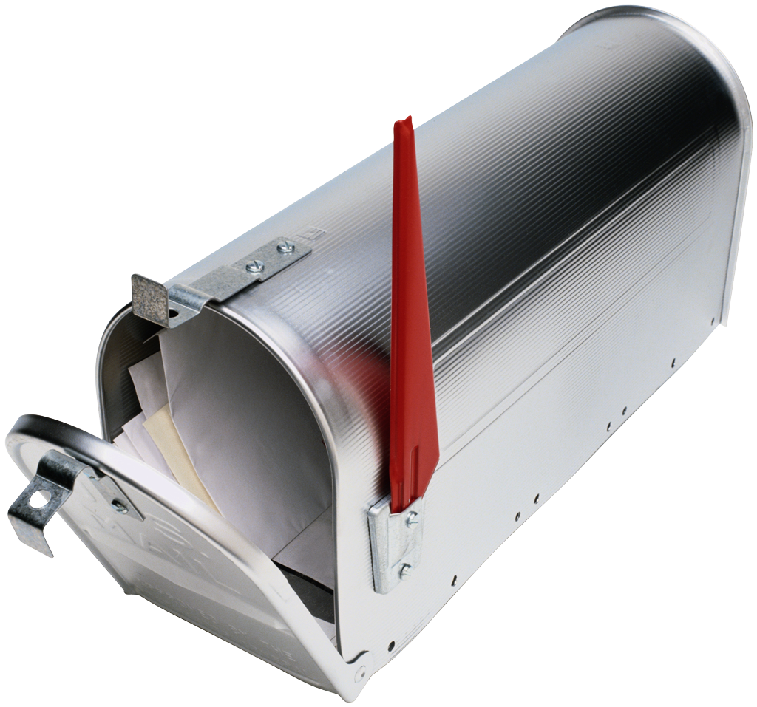
Project Overview Store Web Site
User Interface
Add/Remove Product
Create/Submit Order
Command captures the intent of the User
ES-DB
Commands
Log
Event Handlers
DB
The Command Handler publish the events Async to a queue
After database is updated publish the result to the View
Command Handler
Event Aggregator
Container for events that allow decoupling of pub and sub
Events

Slide 8
Why F#
Powerful type inference
Support REPL
Support for OOP
Higher Oder Function
Avoid nulls
Record Type
Immutable
No inheritance
Structural equality, comparison
Discrimination Union
Object Expression
Full .Net Library support and interoperability with other .Net languages
Active Patterns
Pattern Matching
Pipe operator |>
Type Providers
Support Actor model
Notes:
More important Avoid Nulls, Data Modeling (record, discrimination union)
Bug free!

Slide 9
When F#
Fast and easy prototyping
Fast and easy development
Data Modeling
Need concurrency (immutable as default)
Scalability (Async I/O)
Big Data
Notes:
Fast prototyping and data modeling

Slide 10
Summary
EDA allows to implement scalable, testable and extensible projects
F# is not a silver bullet, is great tool to know!
F# is a great for fast prototyping
F# vs C# -> 185 lines of code Vs +/-750
F# requires a learning curve but totally worth it
Notes:
Fast prototyping and data modeling

Slide 11

github.com/DCFsharp meetup.com/DC-fsharp/ @DCFsharp riccardo@teknology360.com

