Slide 1
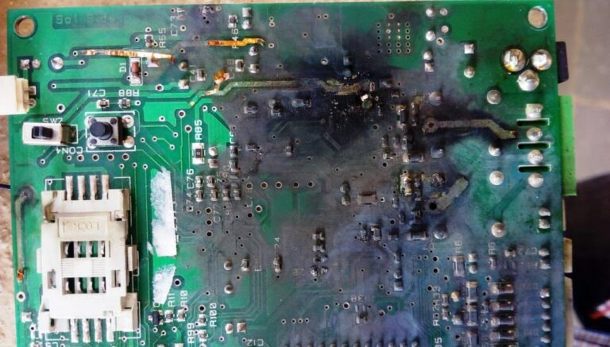
How to Think About Soldering
bran

Slide 2
ps u | awk '{print $1} END {print ":3"}'
Soldering as a hobby since 2017
Soldering at work on some expensive machines (but not any more)

Slide 3
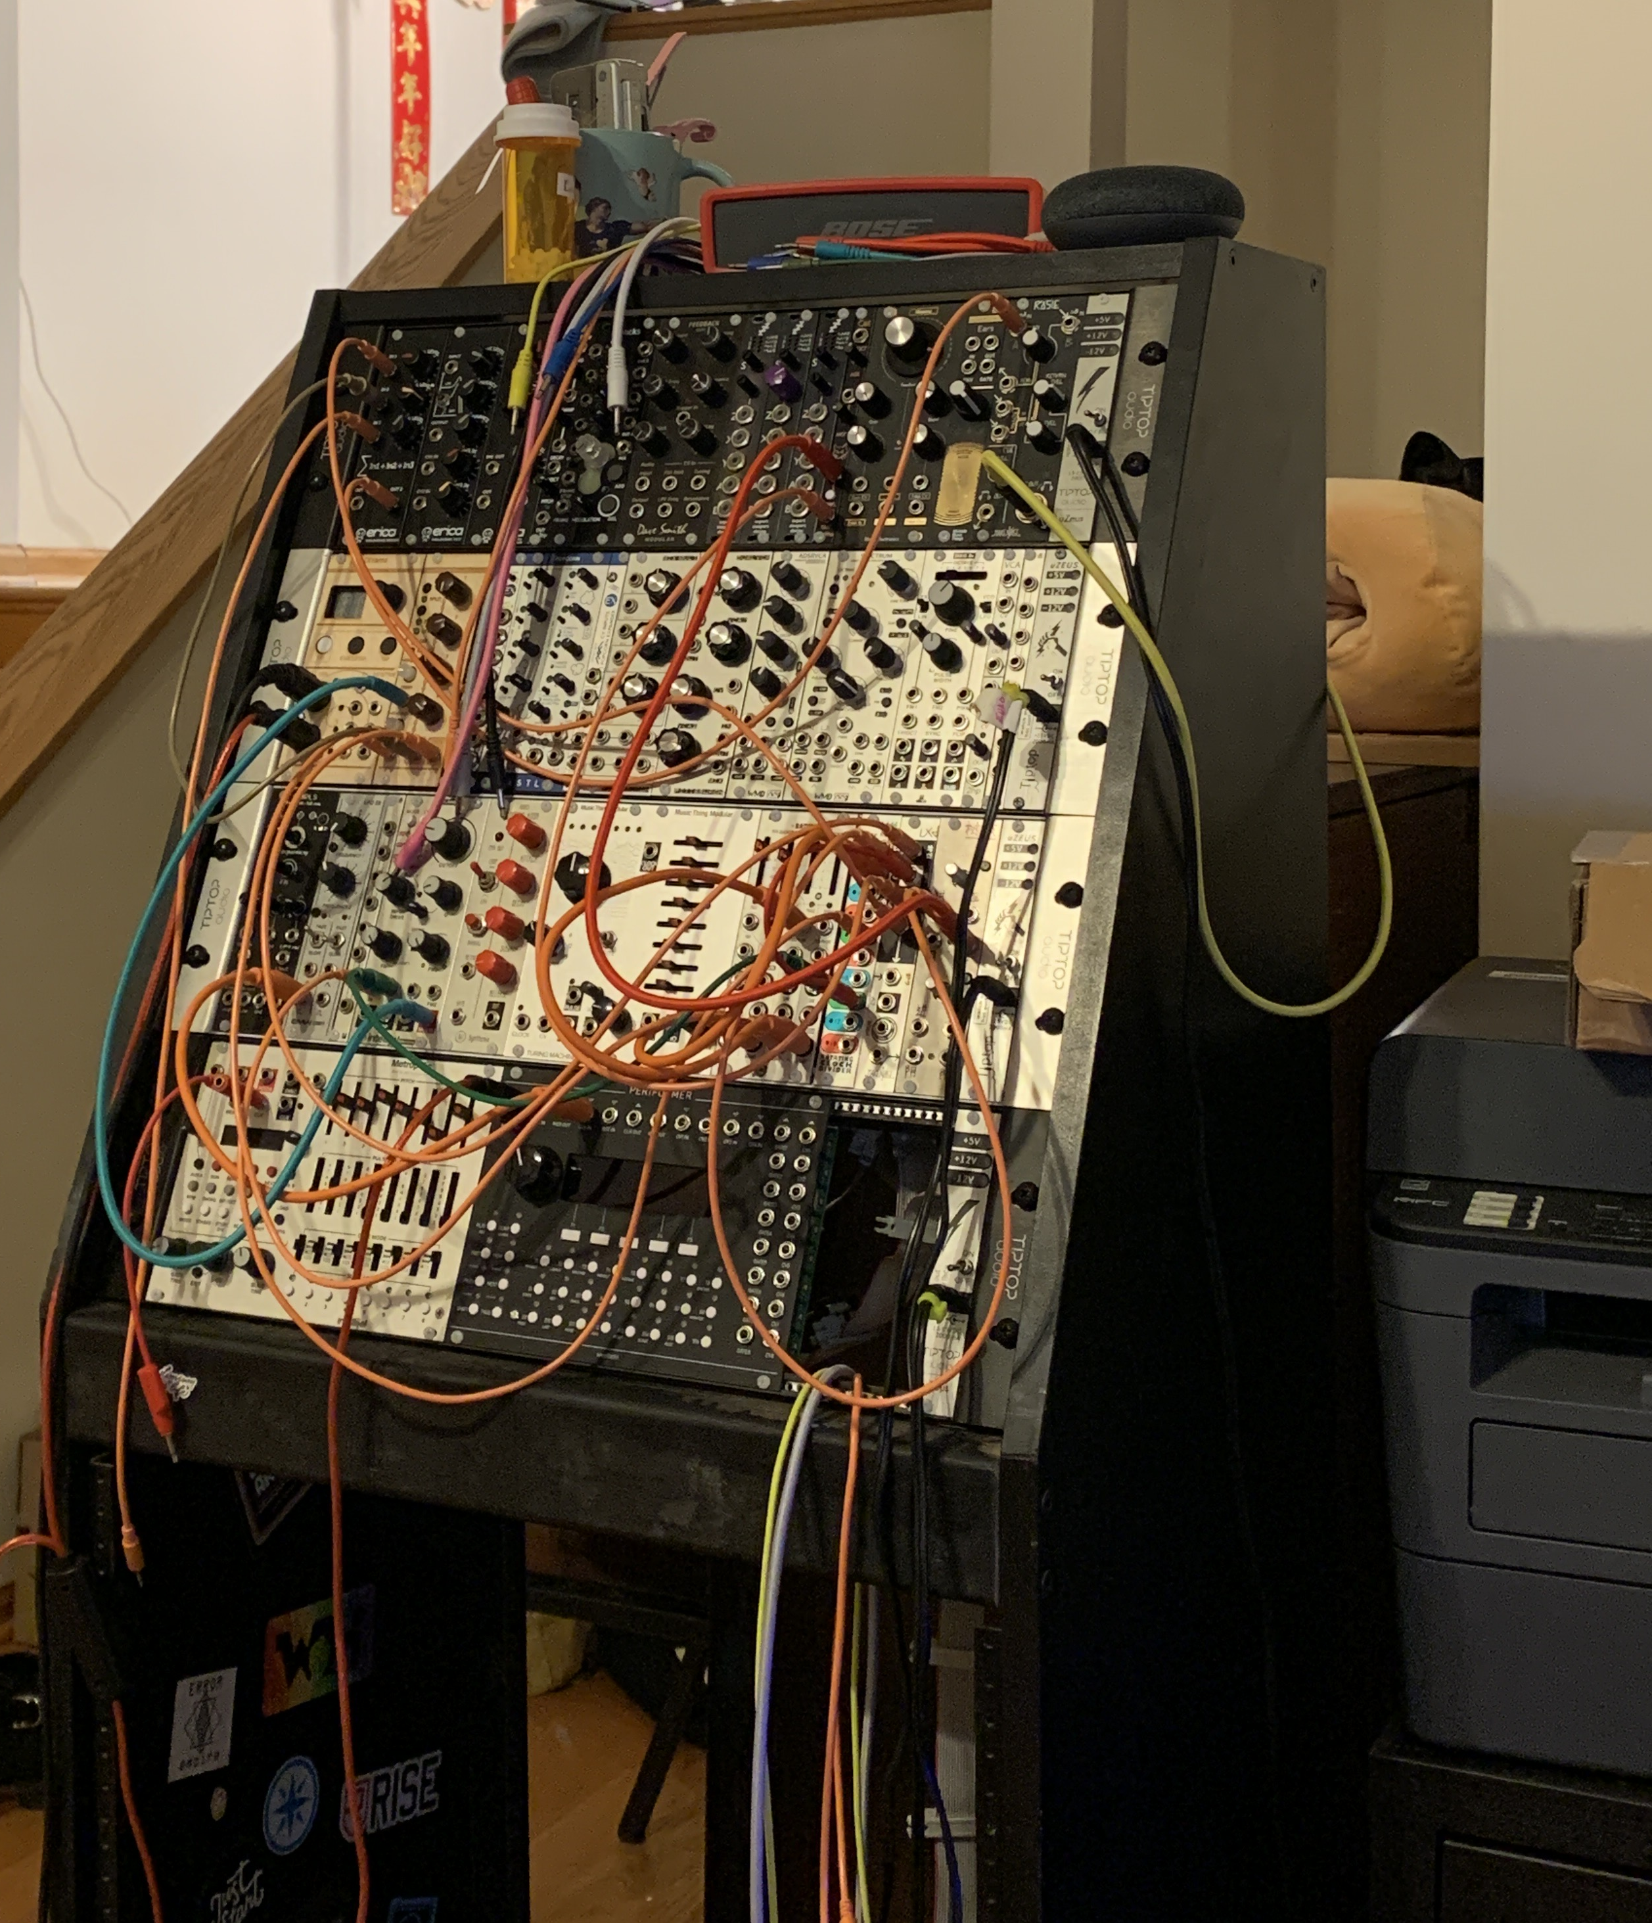
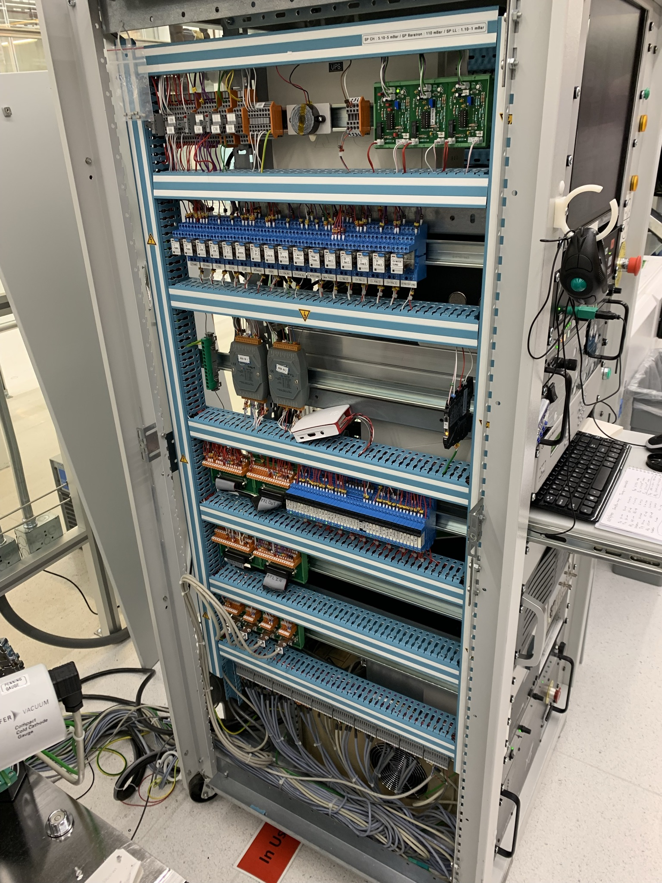
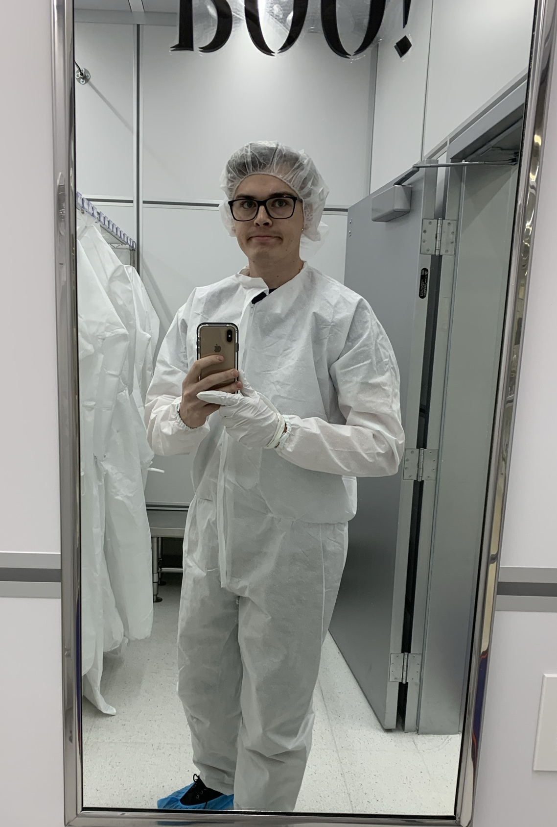
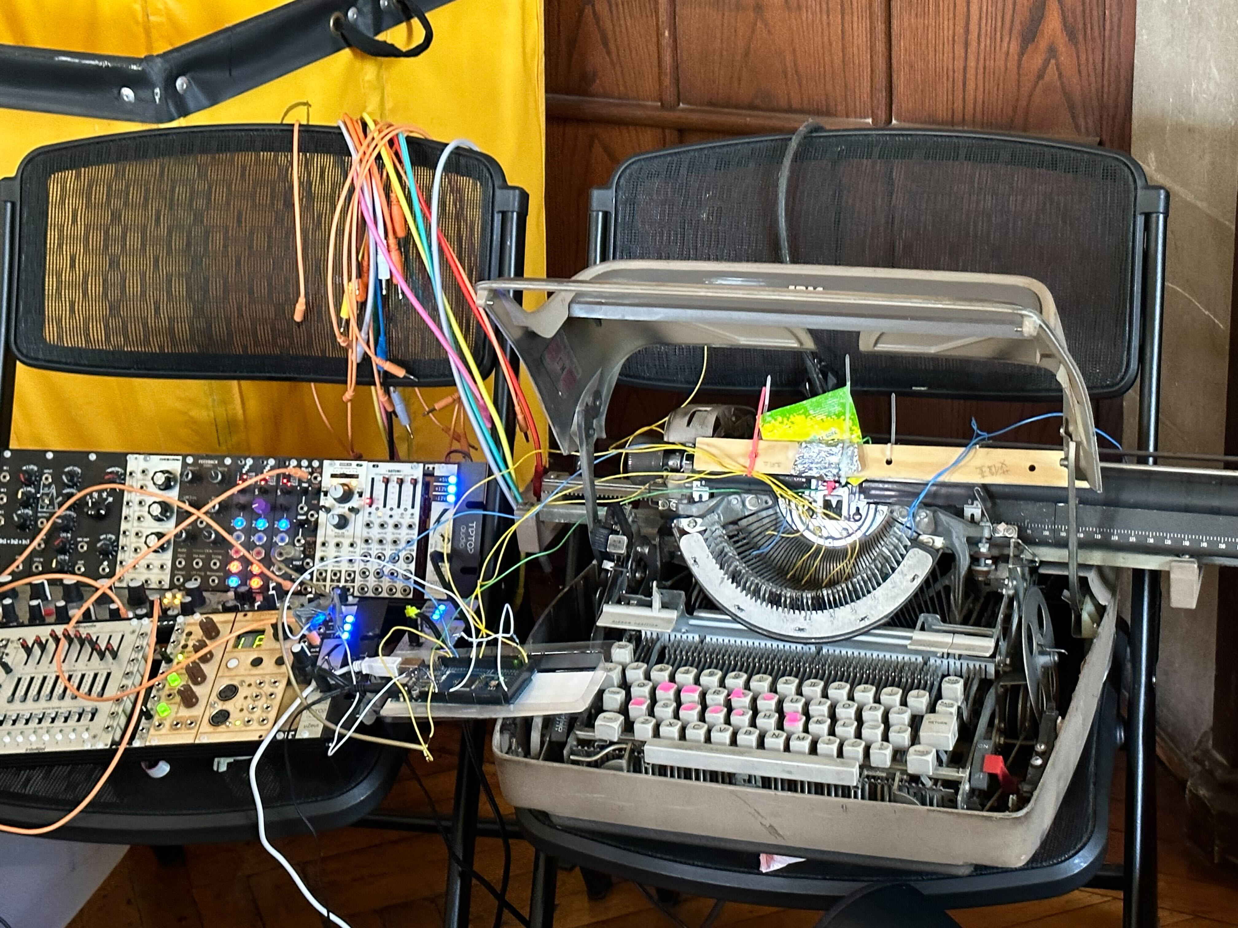

Slide 4
Soldering goals
Connect two pieces of metal to create a strong physical, electrical and emotional connection
Make/mod shit
Fix shit
Have fun
Learn electronics

Slide 5
Types of soldering
Wire to wire (20%)
Printed circuit boards (PCBs) (70%)
  Through-hole
  Surface mount
Other shit (10%)

Slide 6
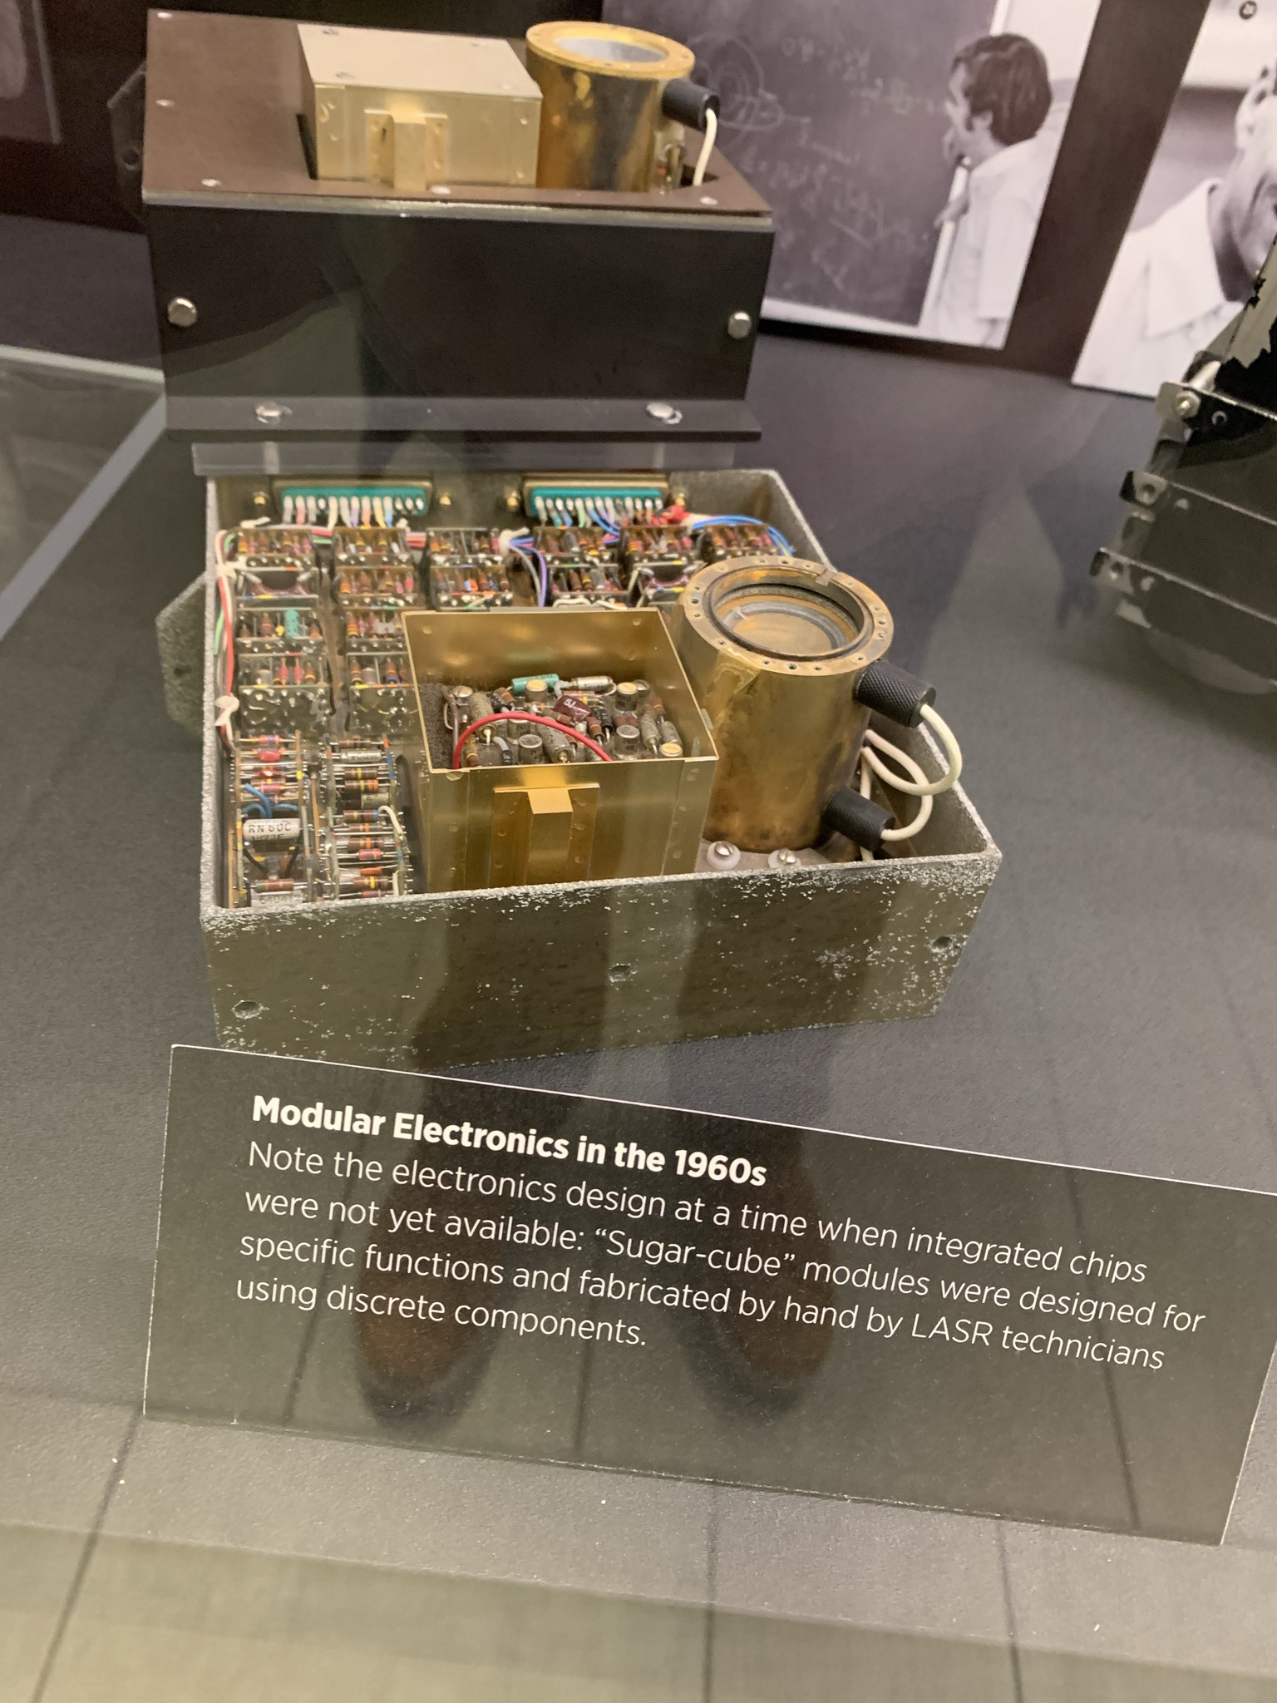
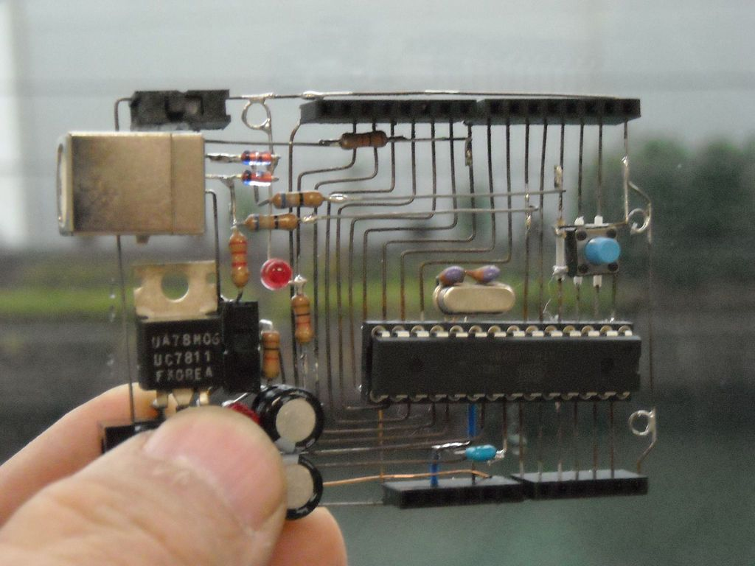
“Sugar cube” and “Dead bug” circuits

Slide 7
Fundamental forces
Heat – soldering iron
Oxidation - flux
  Surface tension/wetting
Metallurgy (alloying) - solder

Slide 8
NASA video since I can’t do it better
https://www.youtube.com/watch?v=_RXugDd0xik&list=PPSV
2:40 – 8:40, 13:10 – 14:36, 18:21 – 18:53
  Eutetic mixture
  Wetting
  Metal alloying / penetration
  Oxidation and heat
  Flux
  Core solder
  Good joints (shiny, smooth), vs “cold joint”

Slide 9
What they miss
Solder mask
Surface mount boards
Integrated circuits
  Ball Grid Array (BGA)

Slide 10
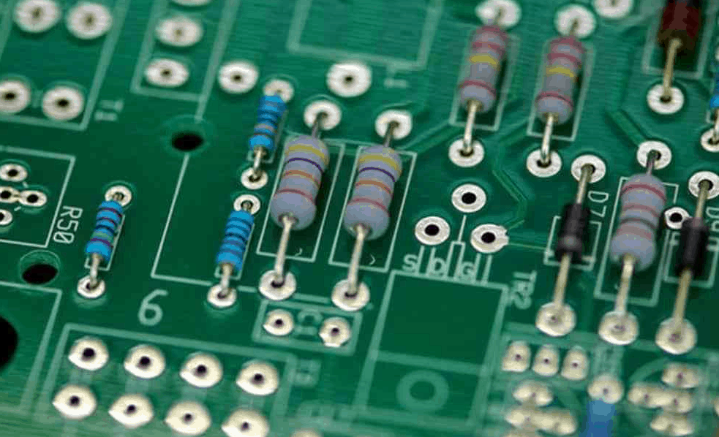
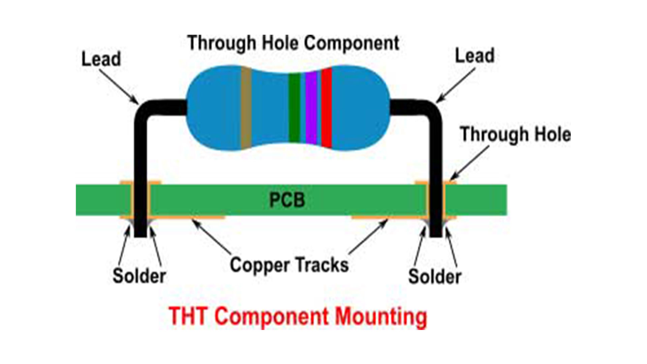
Through Hole PCB

Slide 11
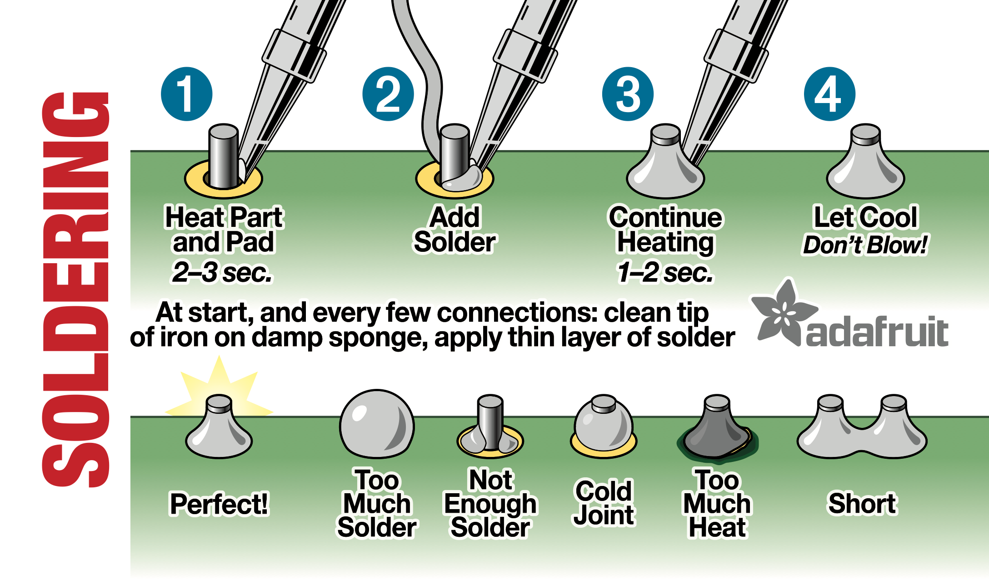

Slide 12
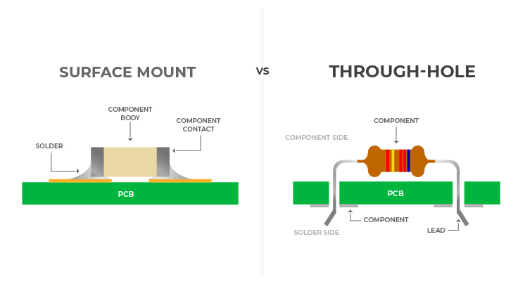
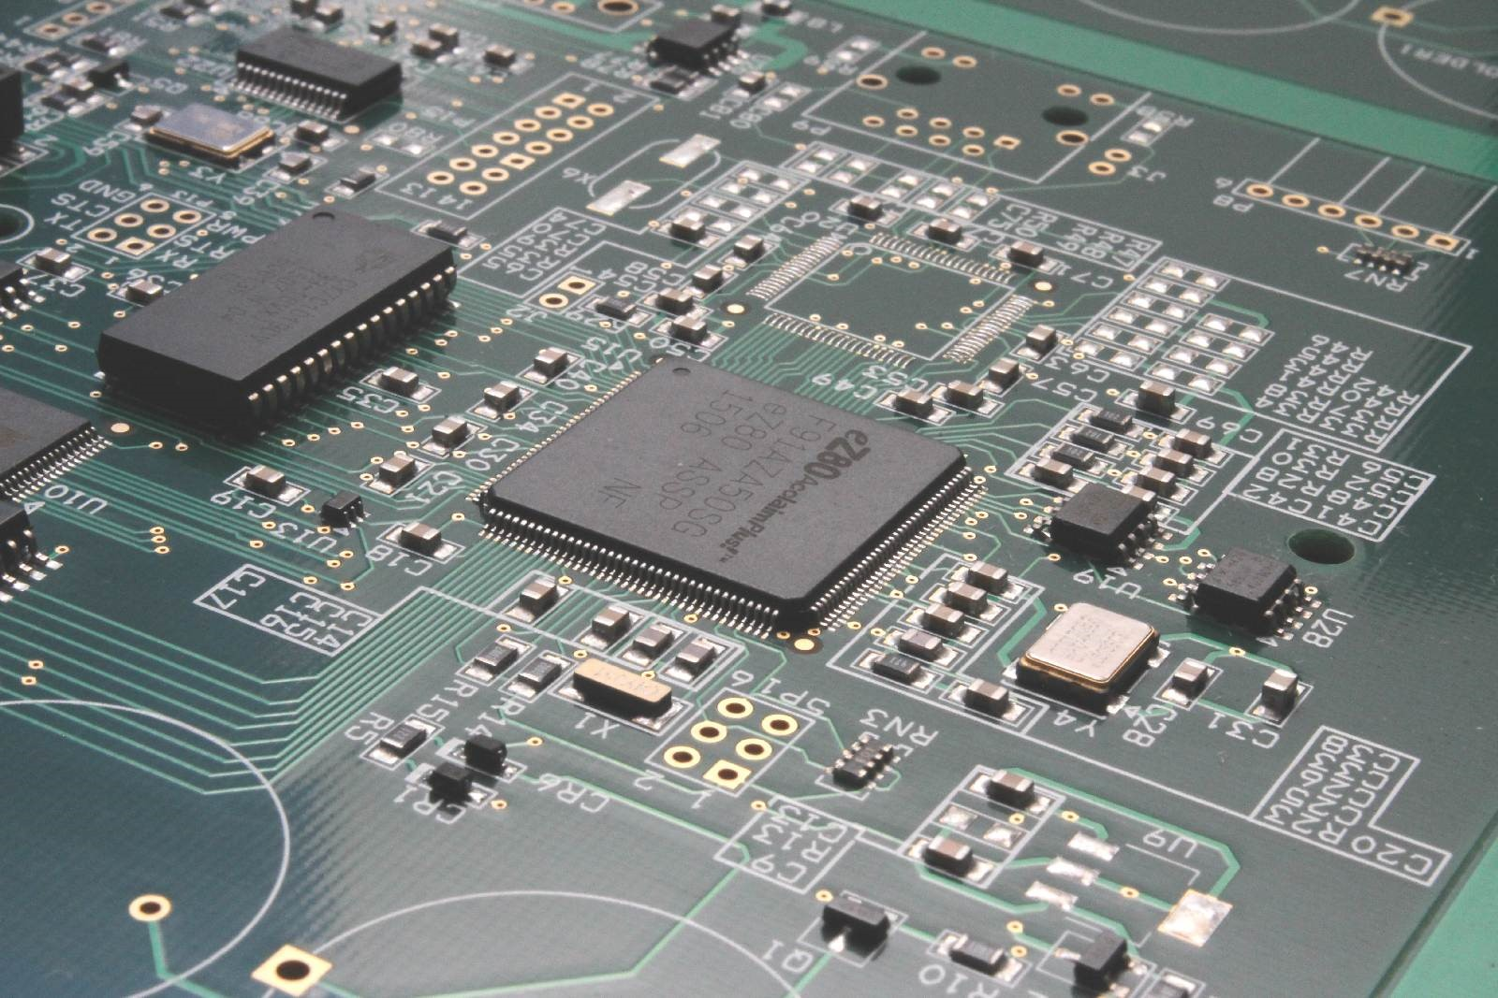
Surface Mount (SMT) PCB

Slide 13
Safety
Fire
  Do not get overconfident with an extinguisher, and only keep it on your escape route
Burns
  The first buy is lidocaine cream
Shock
  Turn that shit off
Inhalation
  Flux is not good for your lungs, don’t breathe that shit
Heavy metal exposure
  Wash your hands with soap and cold water, don’t eat + solder, keep a dedicated area

Slide 14
Soldering equipment
Iron (Hakko station, pinecil, Weller station)
Solder (LEAD)
Flux (Pen)
Ventilation (fan, fume extractor)
Safety glasses/goggles
Tip cleaning (sponge, brass sponge)
Work holding (PCB holder, helping hands)
Solder wick
Wire strippers
Side cutters
A dedicated area (ideally)

Slide 15

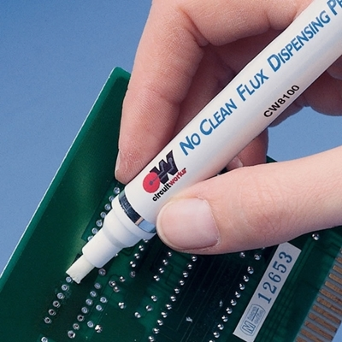
Flux

Slide 16
Tip Tinning and heating
https://www.youtube.com/watch?v=3jAw41LRBxU
3:15

Slide 17
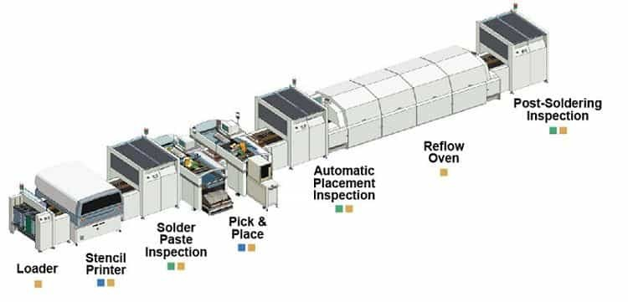
Automated MFG

Slide 18
Sick as fuck
Pick and place:
https://www.youtube.com/watch?v=S8qkaTsr2_o
Wave and reflow soldering:
https://www.youtube.com/watch?v=saOHrw4ezGw

Slide 19
Special Skills
De-soldering
Drag soldering
Solder paste, reflow soldering, ovens
Hot air rework

Slide 20
Questions?
Slides will be in the discord

