Slide 1
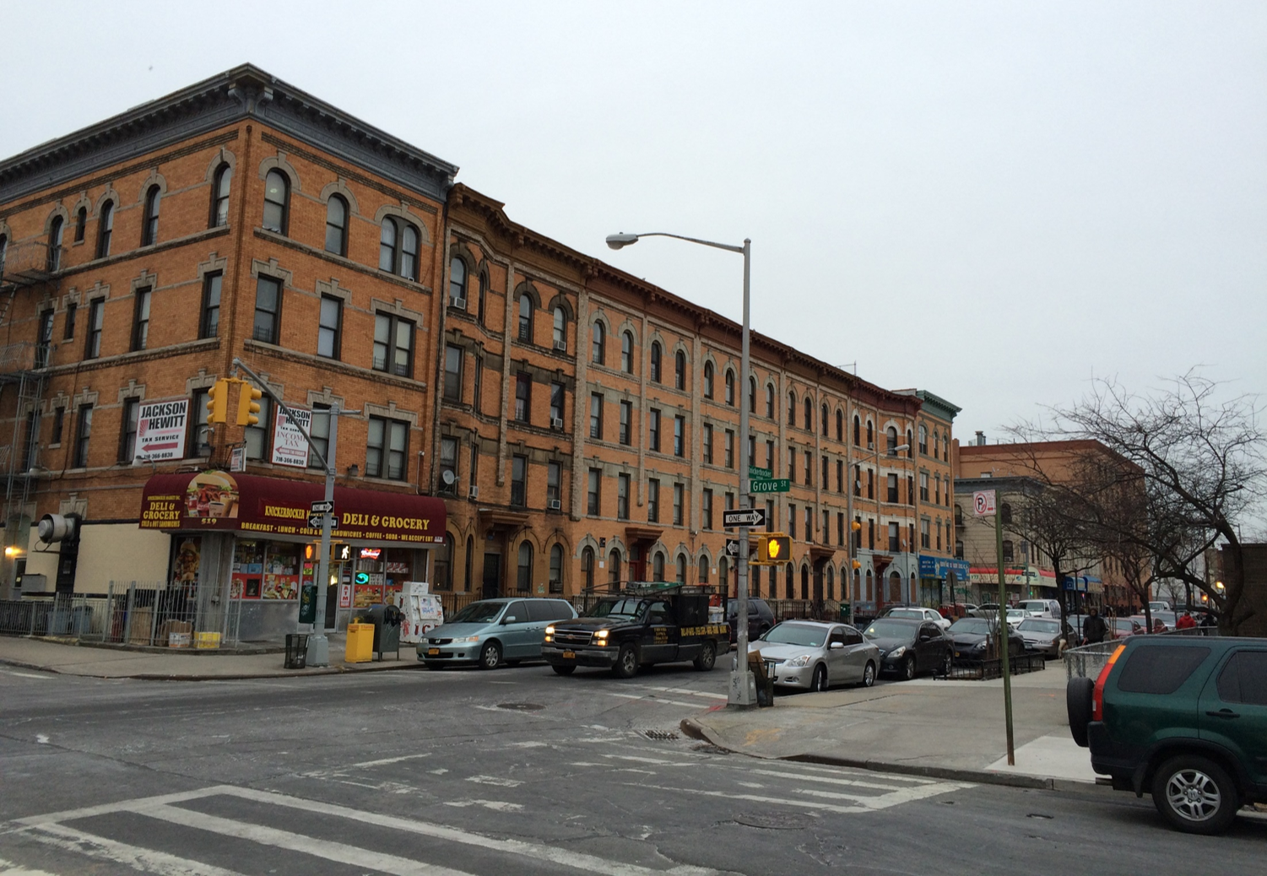
Neighborhood Demographics: Population and Age
Total Population
 | 2010 | 2016 | % Change
Total Population | 129,063 | 135,837 | 5.3%
Age Distribution
 | Study Area |  | Brooklyn |  | New York City
Median Age (years) | 30.6 |  | 34.5 |  | 35.9
Under 5 years | 8,561 | 6.30% | 193,851 | 7.40% | 555,383 | 6.60%
5 t0 19 years | 24,451 | 18.00% | 471,044 | 18.10% | 1,434,064 | 17.00%
20 to 39 years | 56,921 | 41.80% | 846,605 | 32.50% | 2,727,084 | 32.20%
40 to 64 years | 34,563 | 25.50% | 777,777 | 29.80% | 2,646,100 | 31.30%
65 years and over | 11,341 | 8.30% | 317,575 | 12.20% | 1,099,330 | 13.00%
Based on 2006 – 2010 and 2012 - 2016 ACS data for the Bushwick North (BK77) and Bushwick South (BK78) neighborhoods

Slide 2
Neighborhood Demographics: Housing and Households
Household Size and Housing Units
 | Study Area |  | Brooklyn |  | New York City
Average Household Size | 3.00 |  | 2.69 |  | 2.57
Occupied Housing Units | 42,511 |  | 916,856 |  | 3,109,784
Owner Occupied Units | 5,603 | 13.20% | 254,241 | 27.70% | 962,892 | 31.00%
Renter Occupied Units | 36,908 | 86.90% | 662,615 | 72.30% | 2,146,892 | 69.00%
Based on 2012 - 2016 ACS data for the Bushwick North (BK77) and Bushwick South (BK78) neighborhoods

Slide 3
Neighborhood Demographics: Languages Spoken at Home
Lan | Study Area
Population 5 years and over | 127,259 | 100.00%
Spanish or Spanish Creole | 69,582 | 54.70%
English only | 48,927 | 38.50%
Chinese | 2,161 | 1.70%
French Creole | 8759 | 0.80%
French (incl. Patois, Cajun) | 749 | 0.60%
All Other Languages | 4,869 | 3.83%
Based on 2011 - 2015 ACS data for the Bushwick North (BK77) and Bushwick South (BK78) neighborhoods

Slide 4
Neighborhood Demographics: Educational Attainment
 | Study Area |  | Brooklyn |  | New York City
Population 25 years and over | 87,885 |  | 1,753 |  | 5,851,772
Less than 9th grade | 16,479 | 18.80% | 173,424 | 9.90% | 579,784 | 9.90%
9th to 12th grade, no diploma | 14,040 | 16.00% | 177,622 | 10.10% | 544,697 | 9.30%
High school graduate (includes equivalency) | 20,068 | 22.80% | 452,449 | 25.80% | 1,402,714 | 24.00%
Some college, no degree | 12,174 | 13.90% | 243,487 | 13.90% | 829,201 | 14.20%
Associate's degree | 4,209 | 4.80% | 109,028 | 6.20% | 375,851 | 6.40%
Bachelor's degree | 15,744 | 17.90% | 362,659 | 20.70% | 1,246,538 | 21.30%
Graduate or professional degree | 5,171 | 5.90% | 235,026 | 13.40% | 872,987 | 14.90%
Based on 2012 - 2016 ACS data for the Bushwick North (BK77) and Bushwick South (BK78) neighborhoods

Slide 5
Neighborhood Demographics: Workers by Industry
 |  | Study Area
 | Civilian employed population 16 years and over | 66,122 | 100.00%
 | Educational services, and health care and social assistance | 13,750 | 20.80%
 | Arts, entertainment, and recreation, and accommodation, and food services | 10,127 | 15.30%
 | Retail trade | 8,322 | 12.60%
 | Professional, scientific, and management, and administrative and waste management services | 8,241 | 12.50%
 | Construction | 5,448 | 8.20%
 | Other services, except public administration | 3,928 | 5.90%
 | Transportation and warehousing, and utilities | 3,477 | 5.30%
 | Information | 3,356 | 5.10%
 | Manufacturing | 3,142 | 4.80%
 | Finance and insurance, and real estate and rental and leasing | 3,104 | 4.70%
 | Public administration | 1,607 | 2.40%
 | Wholesale trade | 1,404 | 2.10%
 | Agriculture, forestry, fishing and hunting, and mining | 216 | 0.30%
Based on 2012 - 2016 ACS data for the Bushwick North (BK77) and Bushwick South (BK78) neighborhoods

Slide 6
Neighborhood Demographics: Income
 |  | Study Area
 | Total households | 66,122
 | Household income of less than $10,000 | 6,457 | 14.20%
 | $10,000 to $14,999 | 3,543 | 7.80%
 | $15,000 to $24,999 | 5,627 | 12.40%
 | $25,000 to $34,999 | 3,986 | 8.80%
 | $35,000 to $49,999 | 5,817 | 12.80%
 | $50,000 to $74,999 | 7,489 | 16.50%
 | $75,000 to $99,999 | 4,571 | 10.10%
 | $100,000 to $149,999 | 5,273 | 11.60%
 | $150,000 to $199,999 | 1,590 | 3.50%
 | $200,000 or more | 1,110 | 2.40%
 | Median household income (dollars) | 42,607
Based on 2012 - 2016 ACS data for the Bushwick North (BK77) and Bushwick South (BK78) neighborhoods
Brooklyn
NYC

