Slide 1
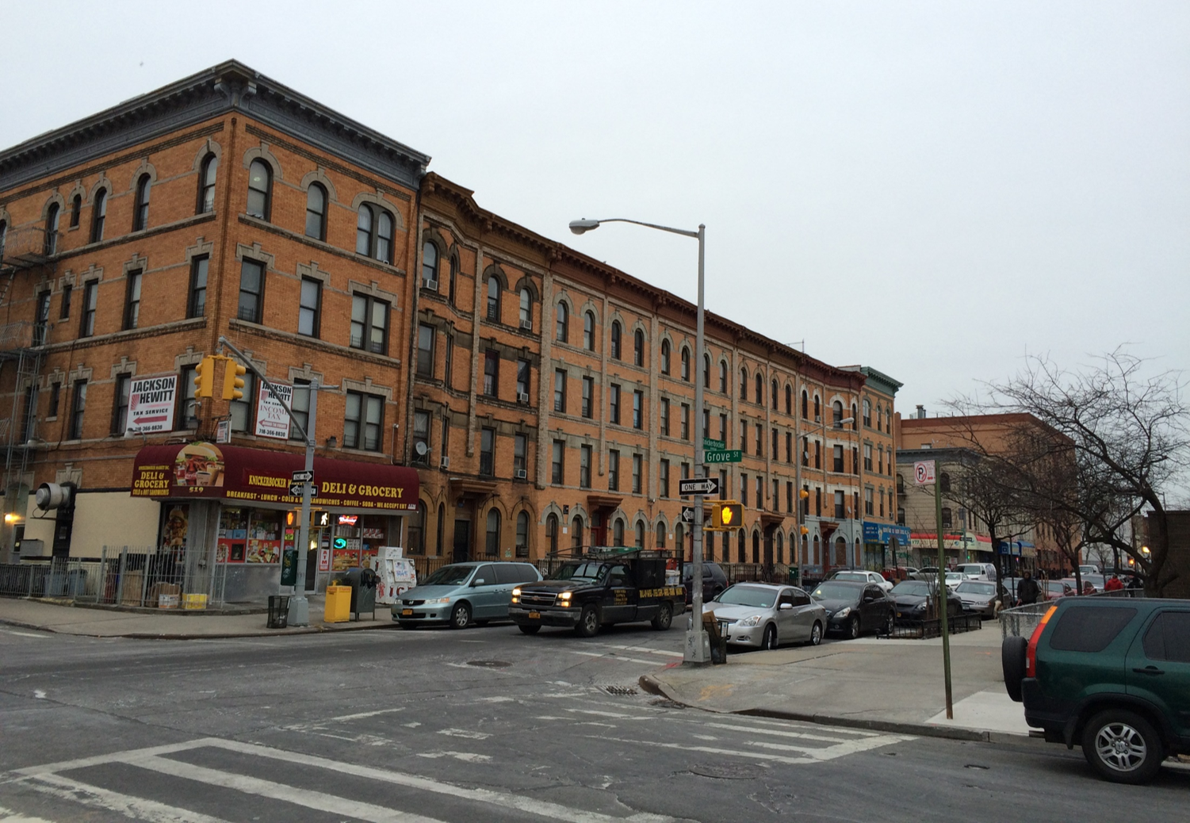
Neighborhood Demographics: Population and Age
Study Area | 2006-2010 | 2012-2016 | % Change
Total Population | 129,063 | 135,837 | significant increase
If CV of change is <20%, then can report percent change. If CV>=20%, but estimate of change is > MOE of change, then can label “significant increase” or “significant decrease”. If change is not statistically significant then dash out or mark “no significant change”
Study Area
Brooklyn
NYC
Age Distribution
Collapse categories or group into “other” if data are not reliable (CV >= 20%)
 | Study Area | Brooklyn | New York City
Median age (years) | 30.6 | 34.5 | 35.9
Under 5 years** | 6% | 7% | 7%
5 to 19 years* | 18% | 18% | 17%
20 to 39 years | 42% | 32% | 32%
40 to 64 years | 25% | 30% | 31%
65 years and over | 8% | 12% | 13%
Place an asterisk next to study area statistics that do not exhibit statistically significant differences with comparison areas and add notation, at bottom of page
*No statistically significant difference with Brooklyn
** No statistically significant difference with NYC
*** No statistically significant difference with Brooklyn or NYC
Study area: Bushwick North (BK77) and Bushwick South (BK78) neighborhoods
* No statistically significant difference with Brooklyn ** No statistically significant difference with NYC
Source: U.S. Census Bureau, 2006-2010 and 2012-2016 American Community Survey—Summary File

Slide 2
Neighborhood Demographics: Housing and Households
Study Area
Brooklyn
NYC
Household Size and Housing Units
 | Study Area |  | Brooklyn |  | New York City
Average Household Size | 2.94 |  | 2.73 |  | 2.65
Occupied Housing Units | 45,463 |  | 938,803 |  | 3,128,246
Owner Occupied Units | 6,108 | 13% | 276,447 | 29% | 1,000,242 | 32%
Renter Occupied Units | 39,355 | 87% | 662,356 | 71% | 2,128,004 | 68%
Place an asterisk next to study area statistics that do not exhibit statistically significant differences with comparison areas and add notation, at bottom of page
*No statistically significant difference with Brooklyn
** No statistically significant difference with NYC
*** No statistically significant difference with Brooklyn or NYC
Study area: Bushwick North (BK77) and Bushwick South (BK78) neighborhoods
Source: U.S. Census Bureau, 2012-2016 American Community Survey—Summary File

Slide 3
Neighborhood Demographics: Languages Spoken at Home
 | Study Area
Population 5 years and over | 127,259 | 100%
Spanish or Spanish Creole | 69,582 | 55%
English only | 48,927 | 39%
Chinese | 2,161 | 2%
All Other Languages | 6,589 | 5%
Group categories into “other” if data are not reliable (CV >= 20%)
Place an asterisk next to study area statistics that do not exhibit statistically significant differences with comparison areas and add notation, at bottom of page
*No statistically significant difference with Brooklyn
** No statistically significant difference with NYC
*** No statistically significant difference with Brooklyn or NYC
Study area: Bushwick North (BK77) and Bushwick South (BK78) neighborhoods
Source: U.S. Census Bureau, 2011-2015 American Community Survey—Summary File

Slide 4
Neighborhood Demographics: Educational Attainment
 | Study Area |  | Brooklyn |  | New York City
Population 25 years and over | 87,885 |  | 1,753,695 |  | 5,851,772
Less than 9th grade | 16,479 | 19% | 173,424 | 10% | 579,784 | 10%
9th to 12th grade, no diploma | 14,040 | 16% | 177,622 | 10% | 544,697 | 9%
High school graduate (includes equivalency) | 20,068 | 23% | 452,449 | 26% | 1,402,714 | 24%
Some college, no degree *** | 12,174 | 14% | 243,487 | 14% | 829,201 | 14%
Associate's degree | 4,209 | 5% | 109,028 | 6% | 375,851 | 6%
Bachelor's degree | 15,744 | 18% | 362,659 | 21% | 1,246,538 | 21%
Graduate or professional degree | 5,171 | 6% | 235,026 | 13% | 872,987 | 15%
Collapse categories or group into “other” if data are not reliable (CV >= 20%)
Place an asterisk next to study area statistics that do not exhibit statistically significant differences with comparison areas and add notation, at bottom of page
*No statistically significant difference with Brooklyn
** No statistically significant difference with NYC
*** No statistically significant difference with Brooklyn or NYC
Study Area
Brooklyn
NYC
Study area: Bushwick North (BK77) and Bushwick South (BK78) neighborhoods
*** No statistically significant difference with Brooklyn or NYC
Source: U.S. Census Bureau, 2012-2016 American Community Survey—Summary File

Slide 5
Neighborhood Demographics: Workers by Industry
Public administration
Other services, except public administration
Arts, entertainment, and recreation,
and accommodation, and food services
Educational services, and health care and social assistance
Professional, scientific, and management, and administrative and waste management services
Finance and insurance, and real estate and rental and leasing
Remove or group categories into “other” if data are not reliable (CV >= 20%)
Information
Transportation and warehousing, and utilities
Retail trade
To add MOE error bars to chart:
Chart– Design– Add chart element– more error bar options – error amount –custom specify value – select percent MOE column for both positive and negative values
Wholesale trade
Manufacturing
Construction
Study area: Bushwick North (BK77) and Bushwick South (BK78) neighborhoods
Agriculture, forestry, fishing and hunting, and mining was removed because estimates were not statistically reliable
Source: U.S. Census Bureau, 2012-2016 American Community Survey—Summary File

Slide 6
Neighborhood Demographics: Household Income
 | Study Area
Total households | 45,463
Median household income | $42,607
Less than $10,000
$10,000 to $14,999
Do not display median household income if data are not reliable (CV >= 20%)
$15,000 to $24,999
$25,000 to $34,999
Collapse categories or group into “other” if data are not reliable (CV >= 20%)
$35,000 to $49,999
$50,000 to $74,999
$75,000 to $99,999
To add MOE error bars to chart:
Chart– Design– Add chart element– more error bar options – error amount –custom specify value – select percent MOE column for both positive and negative values
$100,000 to $149,999
$150,000 to $199,999
$200,00 or more
Study area: Bushwick North (BK77) and Bushwick South (BK78) neighborhoods
Source: U.S. Census Bureau, 2012-2016 American Community Survey—Summary File

