Slide 1
FRC Control System

Slide 2
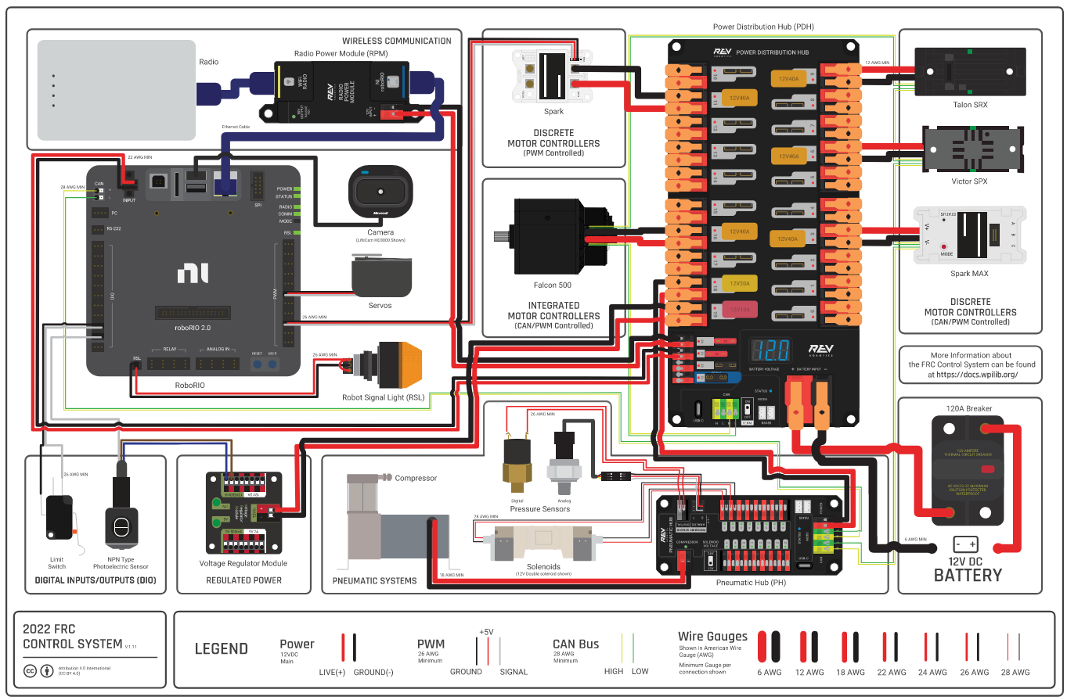
NEW
REV
Control
System

Slide 3
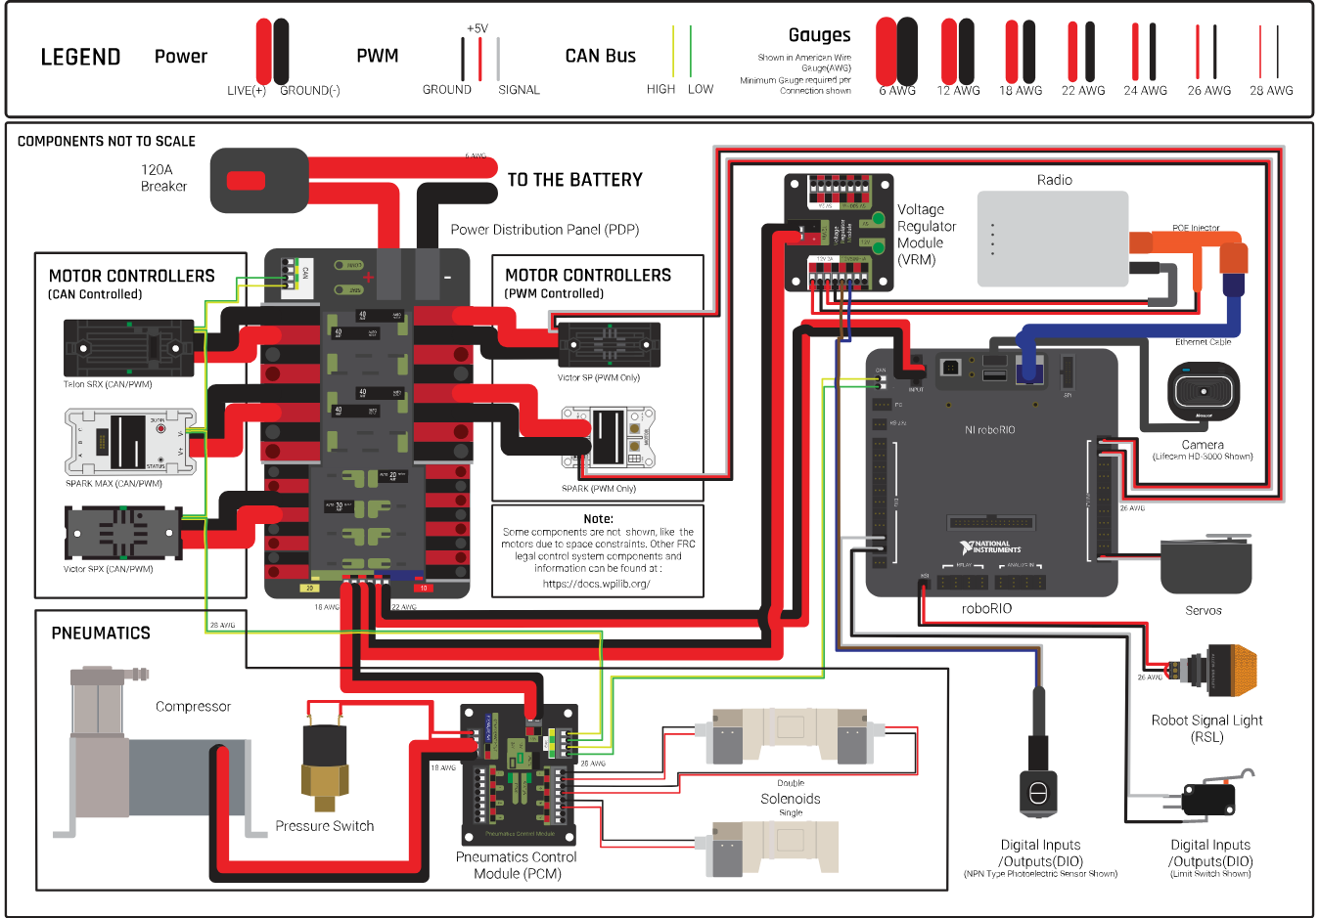
LEGACY
CTRE
Control
System

Slide 4
Notes
PoE & Direct Power Redundancy
CAN Start/Stop (Integrated 120 Ω)
Ethernet Switch
RPi, etc.
Ethernet Extension Through Switch
Better for Accessibility

Slide 5
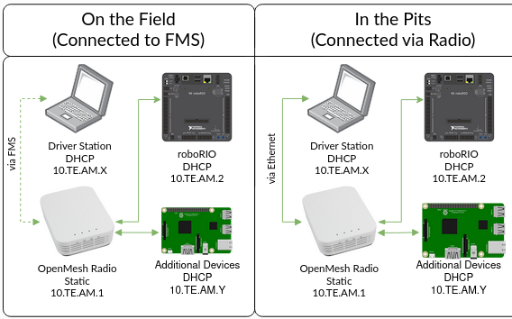
Networking
Make Your Life Easier:
Have a separate radio with the FMS image (for competition)
Statically Assign IP Addresses of Additional Components (Raspberry Pi, etc.)

